Slide 1
Economic Potential and Coal Mining Hazards in the Lakhra Area, Sindh, Pakistan.
*Seema Naz Siddiqui, Department of Geology, FUUAST, Karachi, Pakistan
Sohail Anjum, Department of Geology, FUUAST, Karachi, Pakistan
Viqar Husain, Department of Geology, University of Karachi, Pakistan
1

Slide 2
Contents
Aims and objective
Introduction
Stratigraphy of the area
Study area
Bara Formation
Tectonics and Structure
Coal Geology
Mining Hazard
Economic Potential
Thermal power generation
Recommendation
2

Slide 3
Aims and Objective
To discuss economic potential of Lakhra Coal Field
Utilization of coal in Thermal power generation
Indicate the mining hazards of the field
How to improve the mining conditions
How to get the attention for the investment of national and International firms
3

Slide 4
Introduction
The Lakhra coal field lies 141km from Karachi in the North West direction, 35km north west of Hyderabad and 15km west from Jamshoro (in between latitudes 25º30/ and 25º45 / N and longitudes 68º0 / 68º15 / E)
Coal field spreads over 1309 sq.km on both sides of Jamshoro-Dadu metalled road
Coal seams are at shallower depth (50 to 450 m) in the lower part of Ranikot group of Paleocene age
Coal rank is Lignite A to Bitiminuous C
Underground conventional mining technique is being used
4

Slide 5
Stratigraphy of the Area
Age | Group | Formartion Member | Thickness | Lithology | Lithological Description
Recent |  | Alluvium | Thin |  | Silt and sand
Pliocene |  | Manchar Fm. | 18.28 m |  | Ferruginous pebble Conglomerate, And poorly sorted Sandstone clay,
Early Eocene |  | Laki Lst Member | 20.7 m exposed in the area of 40C/2 330 feet thick resistant cliff In the Lakhra-Khanote Section |  | Limestone, cream Coloured, chalky, fossiliferous, hard resistant cliff
Early Eocene |  | Sonhari Member |  |  | Laterites
Late Paleocene | Ranikot Group | Lakhra Fm. | 137.16 Min the Lakhra-Khanote Section but243.8 M in Lakhra-Bholari Section |  | Fossiliferous, sandy limestone, sandstone, clay and shale.
Early Paleocene |  | Bara Fm. | 20.7 M exposed |  | Sandstone, Shale claystone, coal seams.
Coal seams
Unconfirmity
5

Slide 6
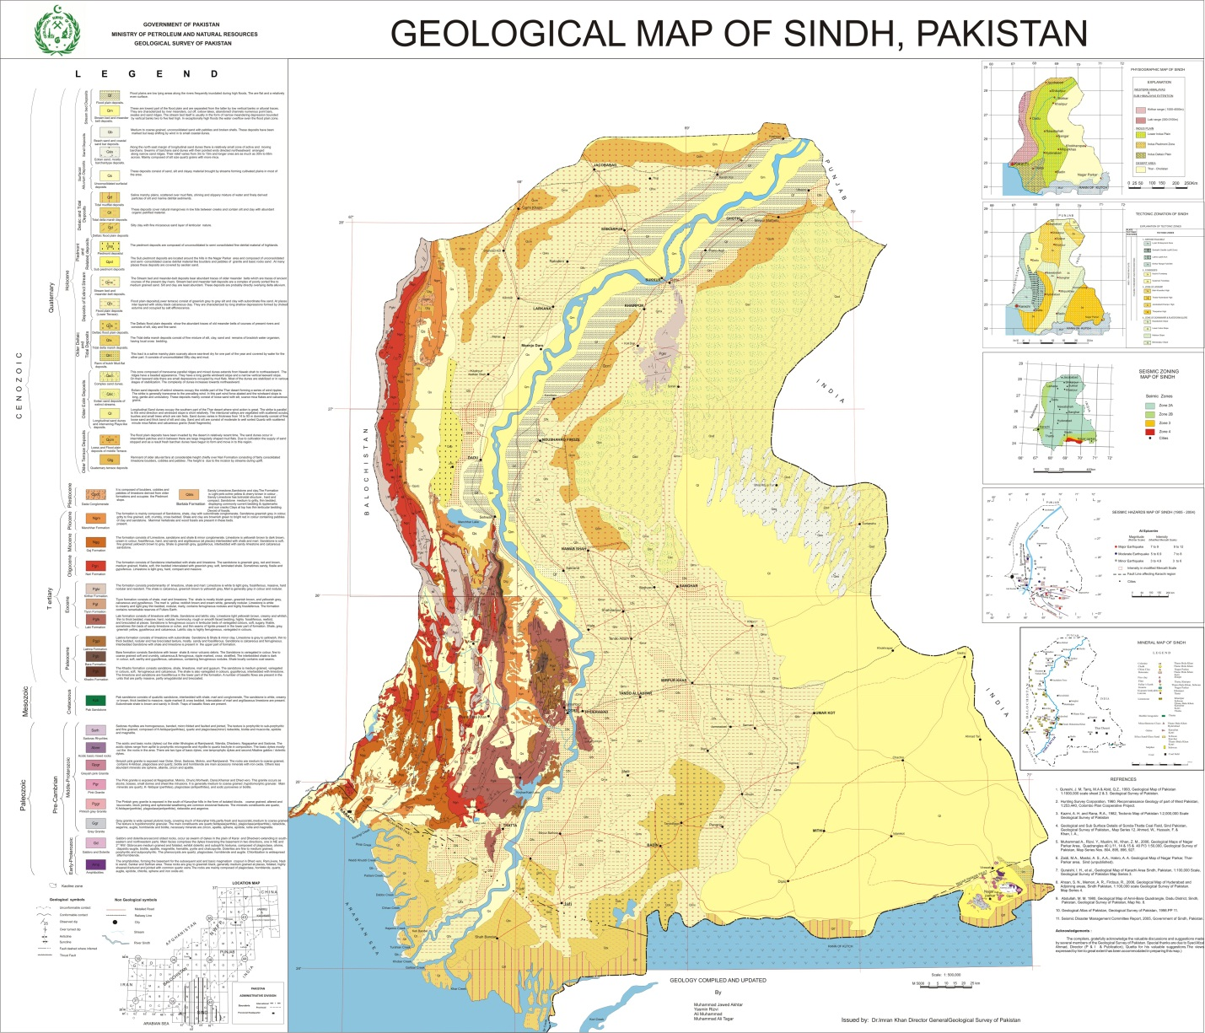
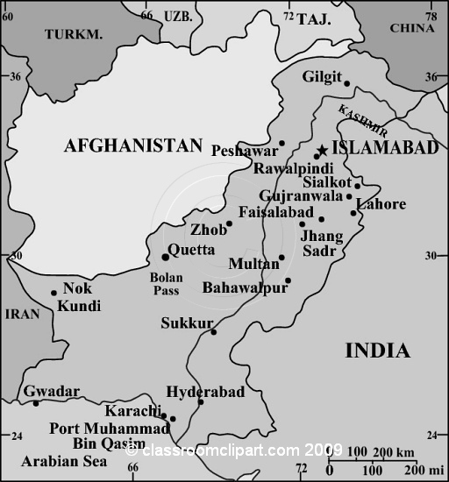
Study Area
Pakistan
Lakhra Field
6

Slide 7
Bara Formation
Lower part of Ranikot group (Bara Formation) was deposited under fluviatile conditions while the upper Ranikot (Lakhra Formation) is estuarine in origin
Bara Formation is composed predominantly of sandstone with subordinate claystone, shale, siltstone and coal seams of variable thickness
Claystone, shale and siltstone are light grey to grey, pyritic, coaly films irregularly distributed partly sandy
Coal is black to brownish black resinous, pyritic and crumbles to small chips on exposure to air and sun for few days and very combustive
Dhanwari, Lalian and Kath are the 3 main coal seams found along the crest of the anticline
Lalian Coal seam is easily mineable, present at the depth of 26 to 122m below the surface, underlain and overlain by the clay stone
7

Slide 8
Tectonics & Structure
The area contains a doubly plunging symmetrical anticline, known as the Lakhra anticline (Ghani et al, 1971)
Dips of the beds are gentle and vary from 1° to 6° approximately on both the flanks of anticline
Faults run nearly north to south at dips of 70° to 90°, towards east and west in the eastern and western flanks
8

Slide 9
Coal Geology
Lithology of the formations indicate that they have been deposited under shallow water to swampy conditions
Lower Ranikot Group (Bara Formation) was deposited under fluviatile conditions while the upper Ranikot (Lakhra Formation) is estuarine in origin
Coal is of brown lignite rank with low heating value and high moisture and sulphur content
9

Slide 10
Coal Grading of Lakhra Field
Average content:
Moisture = 28.9%
Volatile matter = 28.0%
Fixed Carbon = 25.2%
Ash = 18%
Sulphur = 4.7 to 7.0%
Calorification Value = 466 to 7552 btu / lb
Rank Lignite A to Bitimunous C
Depth = 50 to 450m
10

Slide 11
Mining Hazards (1/2)
Coal Field is neglected by the concerned authorities
650sq. Km area is allocated for power generation rest of the area is under sindh Government to provide mining lease
No proper rules and regulation are followed before and after providing the lease
Primitive mining methods are a great hazard
Lack of awareness of mechanized mining, skill labour and latest scientific knowledge are causing severe damage
Without any proper rules and regulation mine owners treat their staff as slaves
Basic infra stucture for living is insufficent for miners
11

Slide 12
Mining Hazards (2/2)
Environmental related awareness can not be seen in the area
Medical facilities are only on papers
Mine workers are constantly on life threat
Roof of mines, shaft rope, gas explosion and coal dust explosion like accidents may occur any time
Many workers are affected by respiratory and hearing loss problems
After completion of mine no precautionary measures are taken for rehablitation
Huge amount of mine waste is thrown in the area
Ground water may cause many types of hazards for the mine workers
12

Slide 13
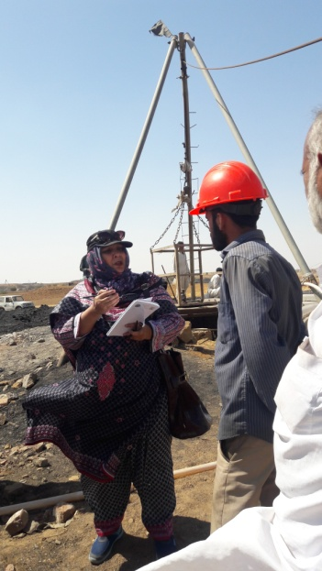
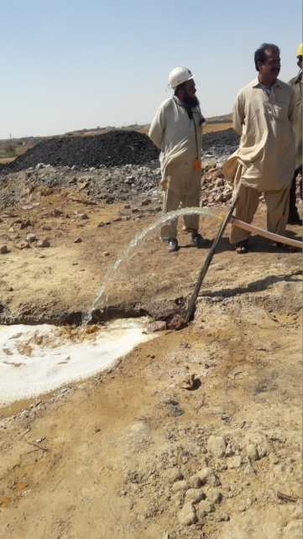
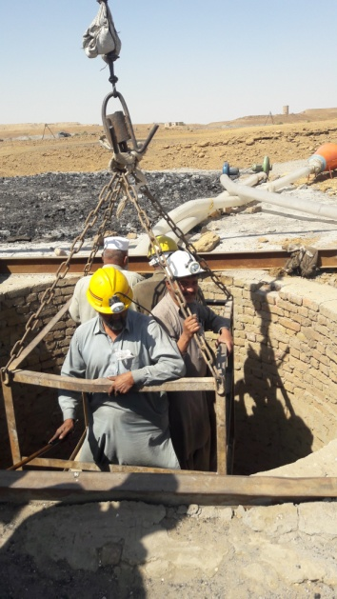
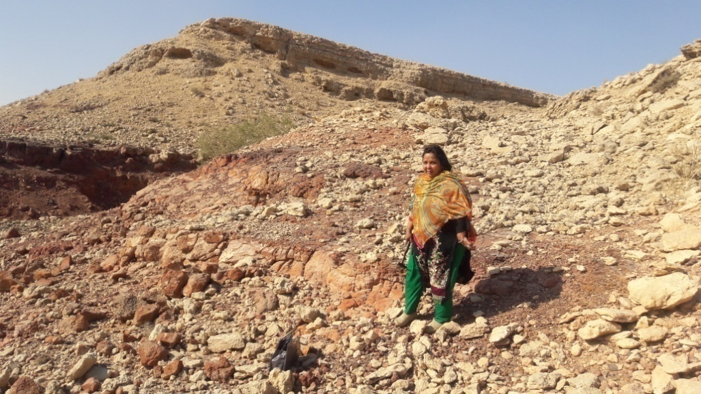
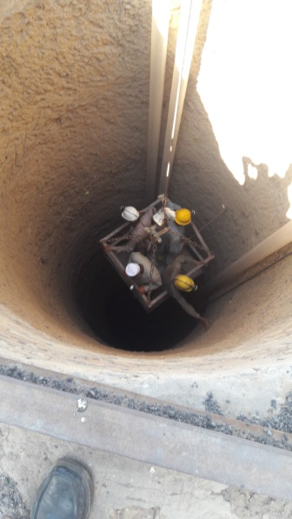
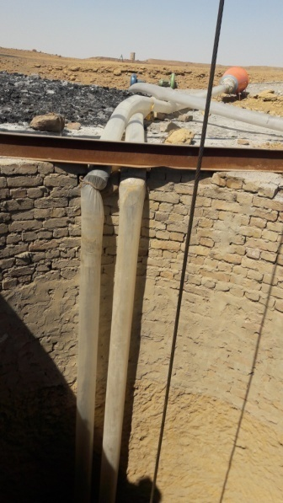
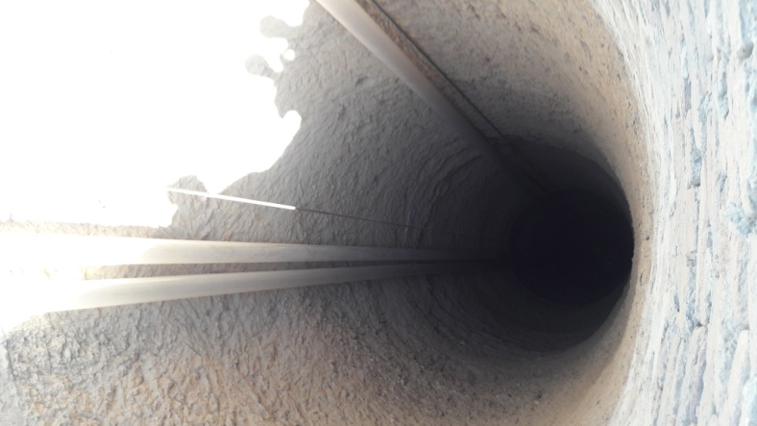
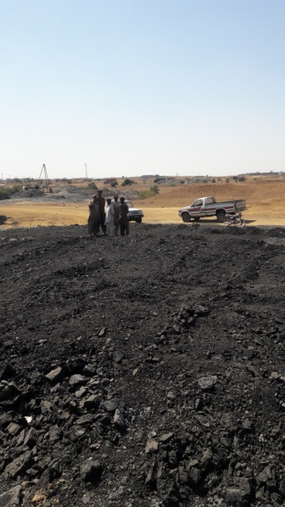
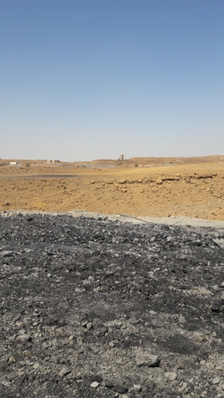
Glimpses of the Field (1/2)
Shaft
Shaft
Sonhari / Laki contact
Water
Miners
Coal
Coal
Air pipes
Shaft
Air pipes
13

Slide 14
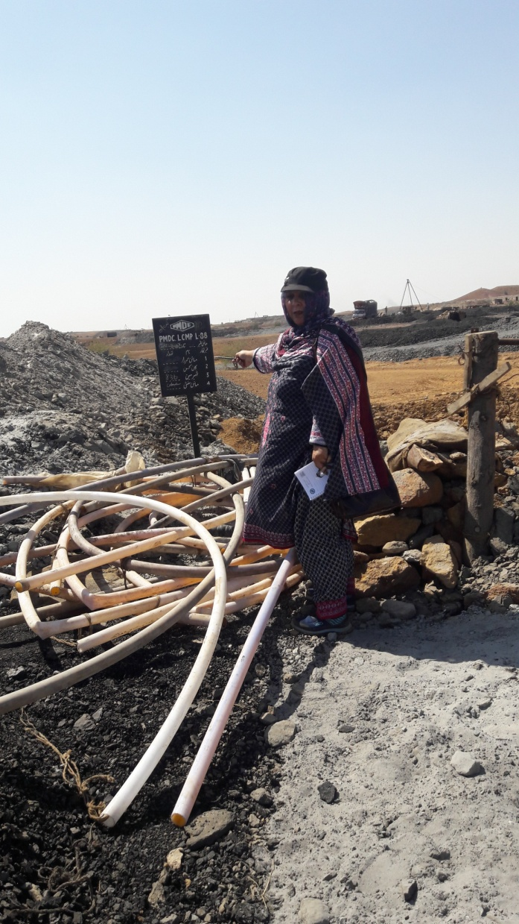
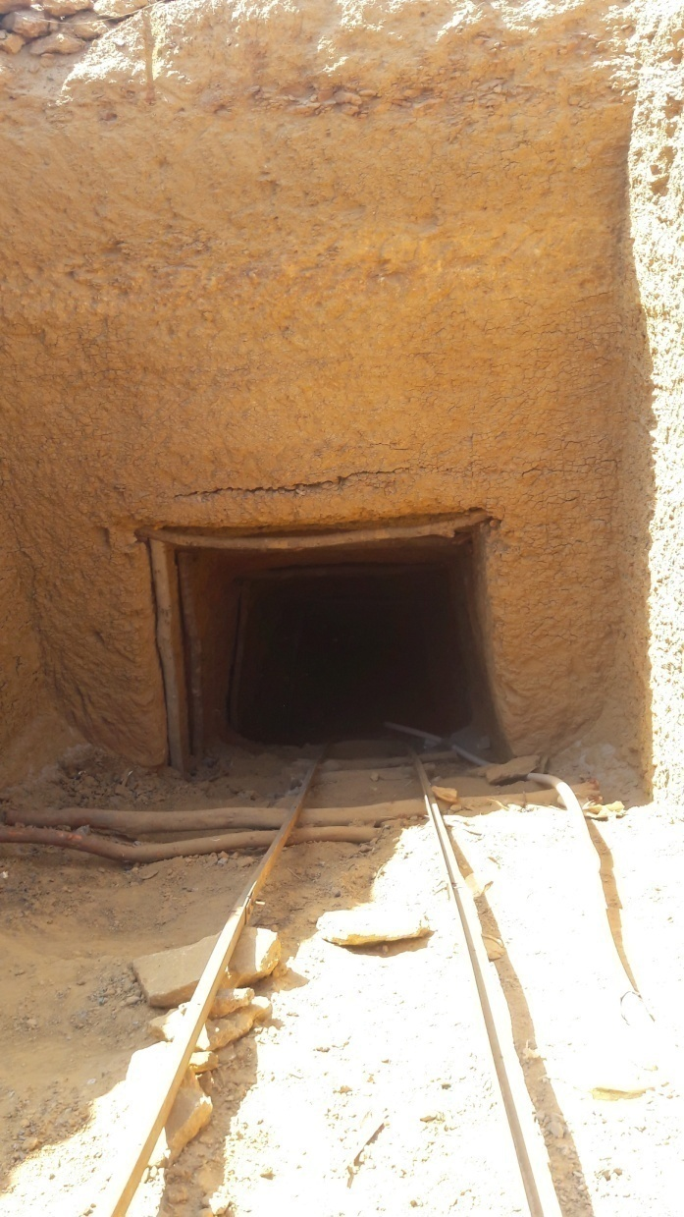
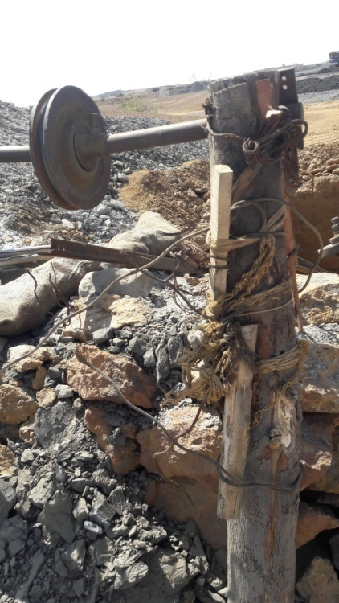
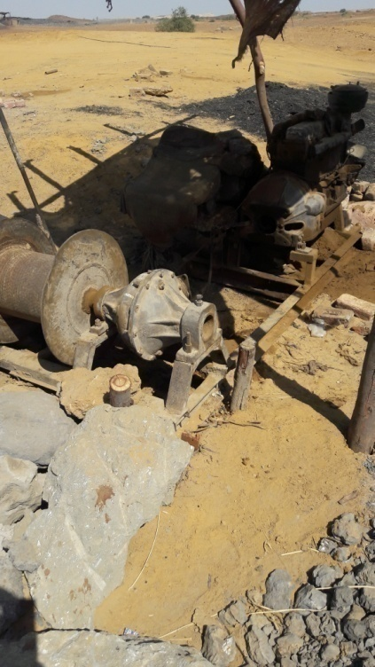
Glimpses of the Field (2/2)
Equipments laid Improperly on the ground
Mine Entrance
Unsafe Machinery
14

Slide 15
Economic Potential
One of the largest and ignored fields of Asia with easy accesibility
Reserves estimated near about 1328 million tonnes, only 244 million tonnes is measured and mined with the latest techniques
8000 tonnes of coal, per day, is mined from the field while annual coal extraction is about 3 million tonnes whereas the requirement of the country is 9 million tonnes
50 mining companies are engaged in the extraction of coal from the field
Some local brick klins and some cement factories are purchasing the coal at Rs 4000-5000 per tonne
15

Slide 16
Thermal Power Generation
Lignitic coal of the field is most appropriate for thermal power generation commercially
One power generation plant producing150MW was installed near the field in the 60’s
Plant currently operates to produce only 20MW due to lack of interest from the authorities as the plant top's the list for privitization
Many plans were not executed from 1990 to 2017 that were once under consideration for power generation from public and private sectors
Use of Lakhra coal for thermal power generation will be more value added and profit oriented for the mine owners and it will also save the huge transporation cost by trucks to different parts of the country
16

Slide 17
Recommendation
Government must take immediate action regarding exploitation of Lakhra coal reserves and computerize all the related data
Long terms policies and plans for the field should be executed by the governing authorities and experts
Implementation of Labour laws should be made mandatory
Attractions and relaxations will encourage the investors to install small power generation plants near the field that may help to overcome energy crisis in a limited manner
Mining related education should be made compulsory for the miners
17

