Slide 1
sxRNA: Using RNA-based, nano-switches to detect novel non-coding RNA expression
Scott A. Tenenbaum
SUNY- College of Nanoscale Science and Engineering, Nanobioscience

Slide 2
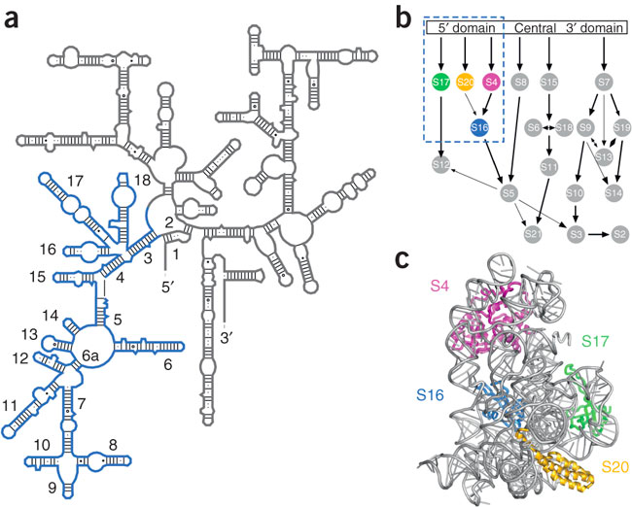

Slide 3
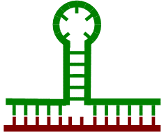

The Basic sxRNA Concept
Structural RNA
Formation
(sxRNA)
RNA-RNA
Interactions
Simple Duplex
Formation
+
OR
Structurally interacting RNA
  A 3-way junction structure created from trans-interaction
  An RNA sequence changes or “switches” the structure of the sxRNA in a designed manner
  This results in the formation of a new or strengthened stem-loop structure

Slide 4
Structurally Interacting RNA (sxRNA)

Slide 5
sxRNA Technology Platform Basics
sxRNA molecule has three components
  Stem loop – target of protein
  Flanks – complementary to trigger RNA
  Coding region – makes desired protein
sxRNAs are modular, i.e. change flanks for targets, change gene for use
Stem loop
5’
3’
Gene Coding Region
Flanks

Slide 6

sxRNA and SLBP Control
Histone stem loop binding protein
No stem loop
Stem loop
Gene
Gene
Translation
Translation
X
Protein
The presence of a stem-loop turns on protein production when the sxRNA complex attracts binding protein

Slide 7
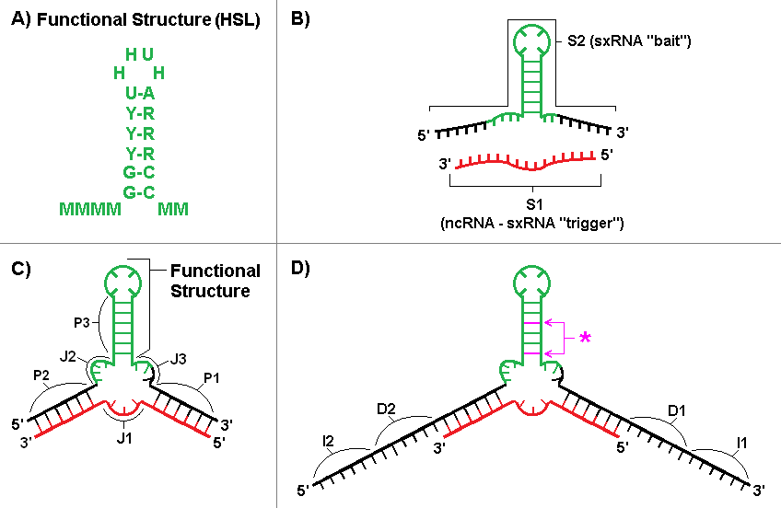

Slide 8
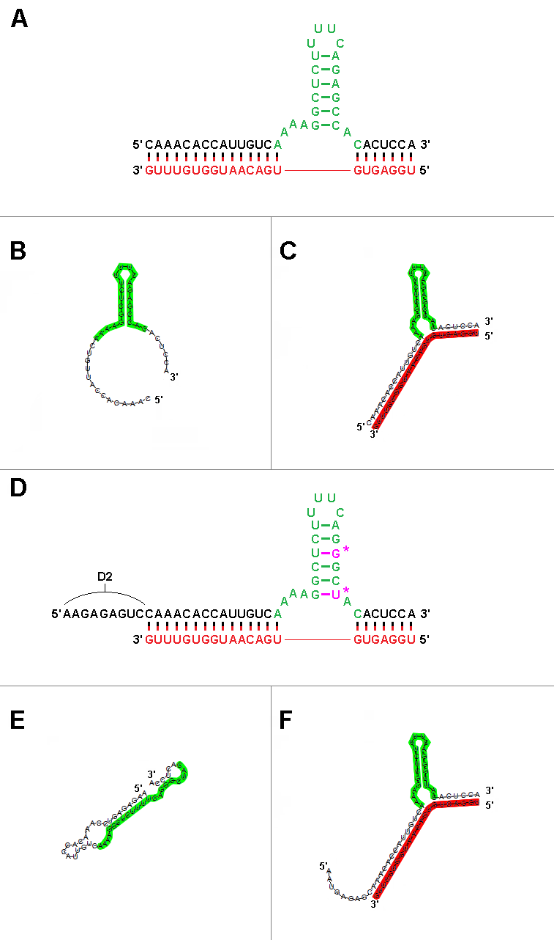

Slide 9
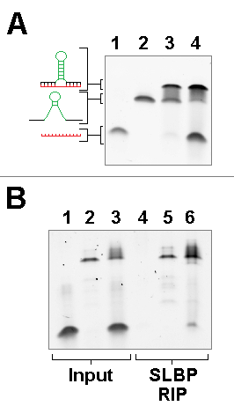

Slide 10
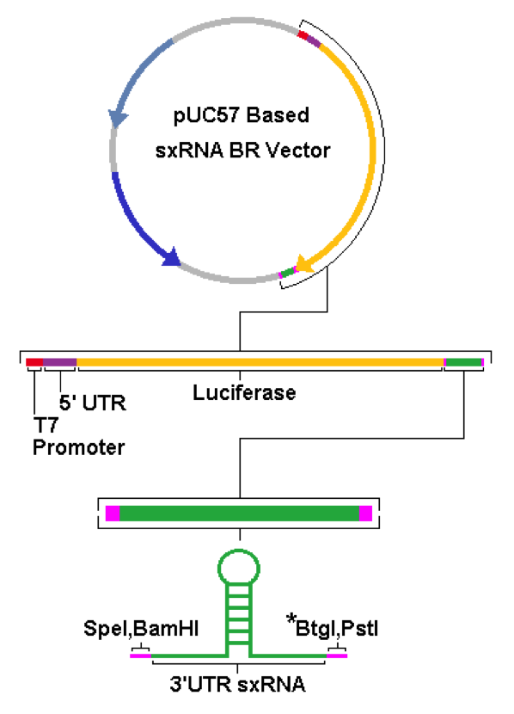
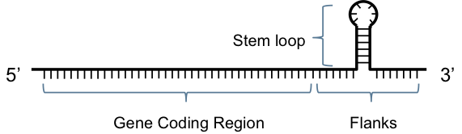
T7 -Transcription
sxRNA

Slide 11
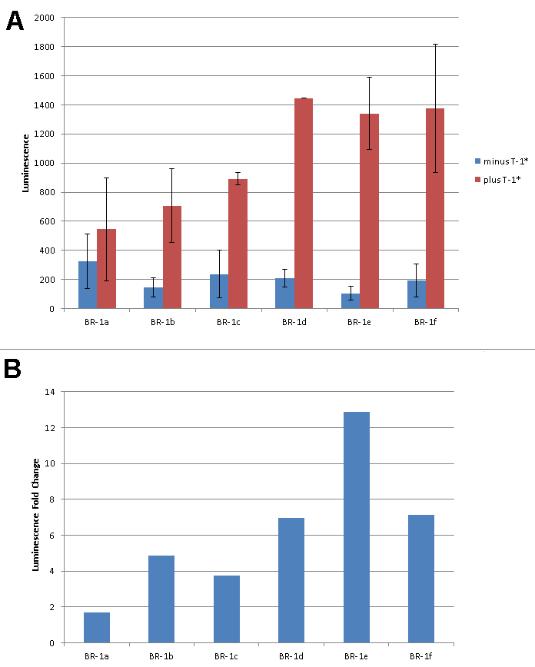

Slide 12
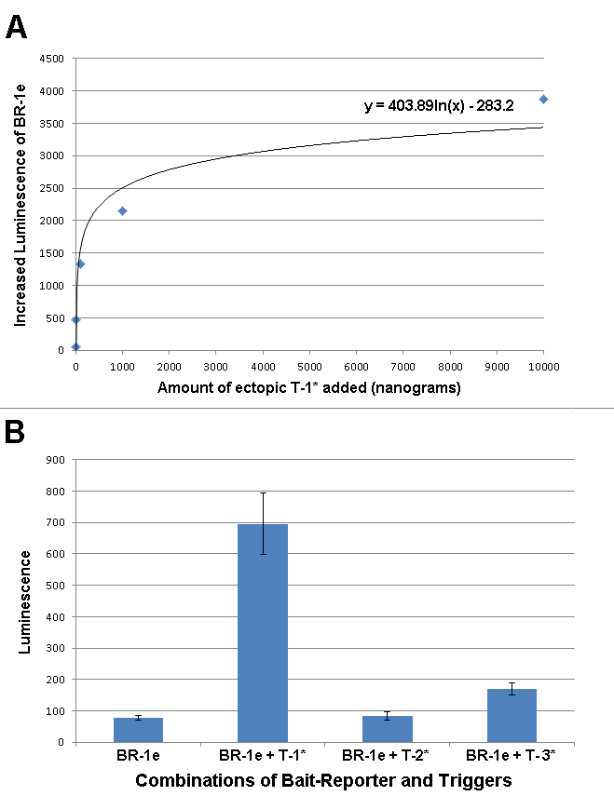

Slide 13
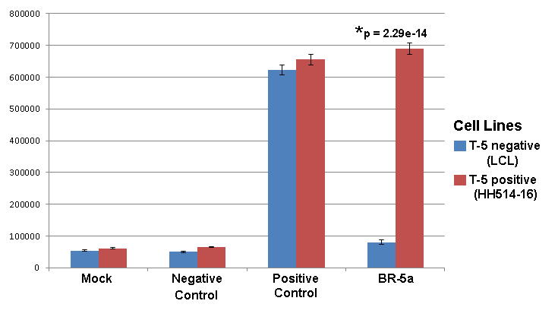

Slide 14
sxRNA Potential Applications
Molecular tool
  Stem cell quality control
  miRNA expression in cancer
Genetic disorders
  Cystic Fibrosis
  Duchenne muscular dystrophy
  Glycogen storage diseases
  Polycystic kidney disease
  Celiac disease
  Charcot-Marie-Tooth disease
  Hemophilia
  Sickle-cell disease
Tissue/Stem Cell Engineering
  Kidney repair
  Liver repair
  Heart
Cancer
  Breast
  Lung
  Colon
  Pancreatic
  Thyroid
  Bladder
Antiviral, Vaccine, Imaging

Slide 15
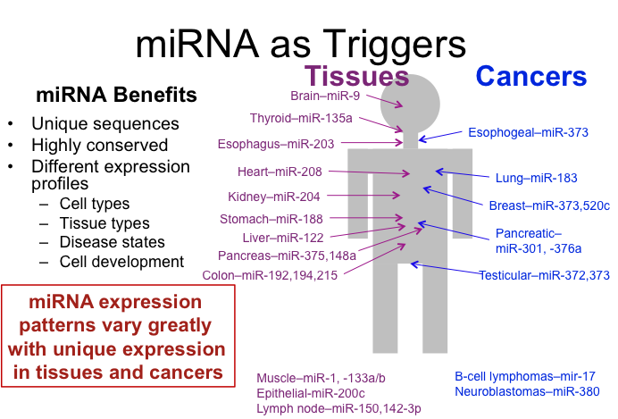

Slide 16







Funding

