Slide 1
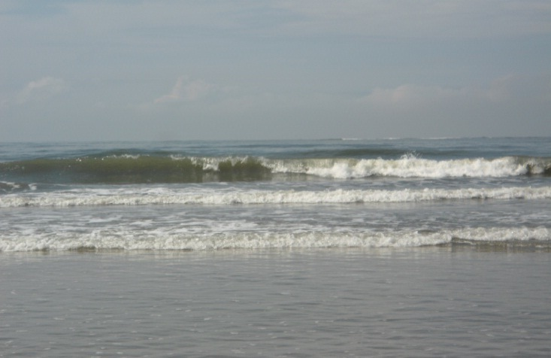
A PRESENTATION ON SEA-LEVEL RISE AND COASTAL SUBMERGENCE ALONG THE SOUTH –EAST COAST OF NIGERIA
BY SAVIOUR P. UDO-AKUAIBIT INSTITUTE OF NATURAL RESOURCES, ENVIRONMENT AND SUSTAINABLE DEVELOPMENT, UNIVERSITY OF PORT HARCOURT, RIVERS STATE, NIGERIA.
at the 2nd International Conference on Oceanography, Las Vegas, USA., July 21-23, 2014.

Slide 2
OUTLINE
INTRODUCTON
STUDY AREA&TECHNIQUES
RESULTS/DISCUSSION
SUMMARY
CONCLUSION

Slide 3
INTRODUCTION
Coastal submergence and shoreline retreat are global problems which can be attributed to sea- level rise and climate change. These constitute a serious threat to shoreline management in the Niger Delta.
This study is therefore aimed at analyzing shoreline recession as a result of sea level rise and also examines the impact on the strand coast, south eastern Nigeria.

Slide 4
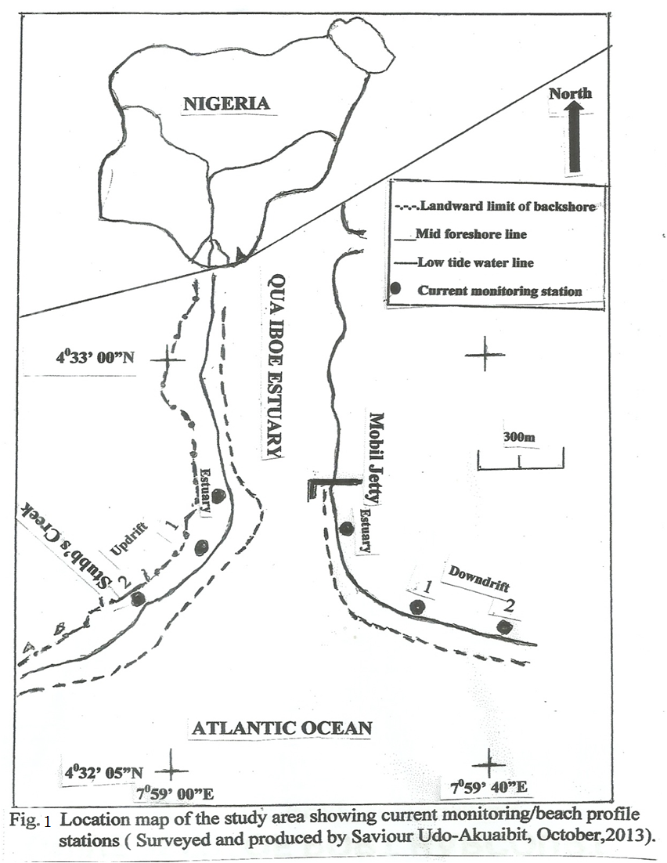
STUDY AREA &TECHNIQUES
Period Sept.28- October 6, 2013
Shoreline Mapping with GPS and camera.
Wave breaker parameters
Beach profile surveys

Slide 5
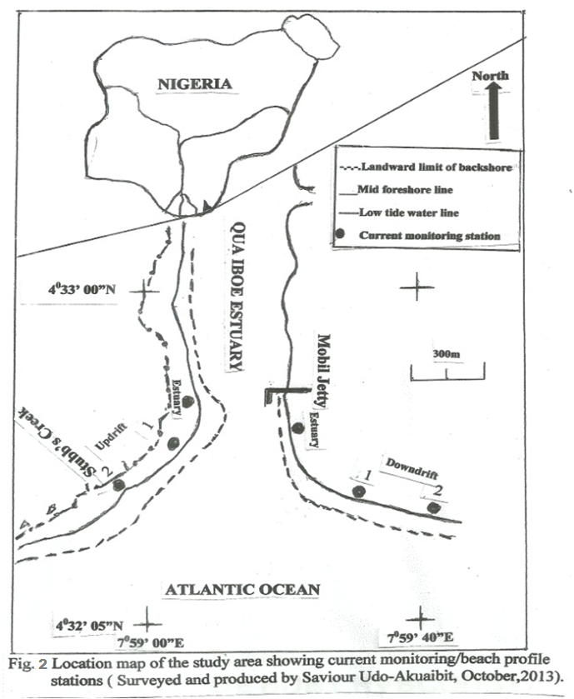
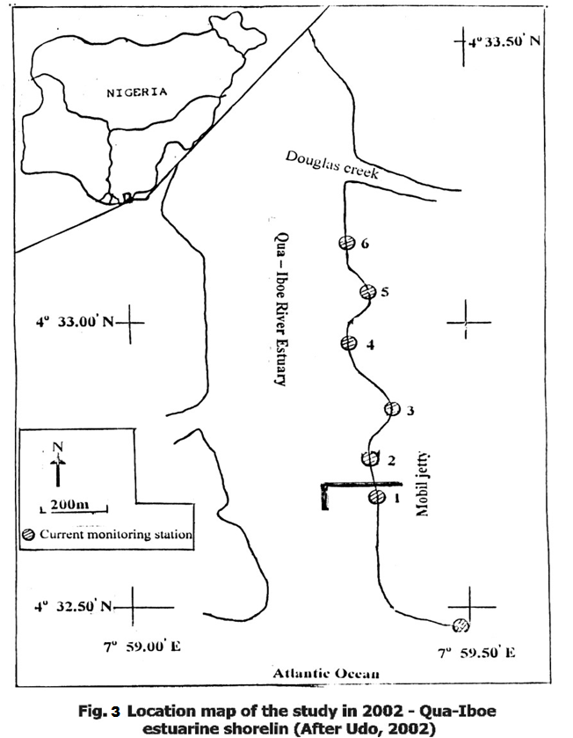
The 2002 And 2013 Editions Of The Shoreline Maps Of The Study Area
Notes:
2002 and 2013 editions of the shoreline maps of the study area

Slide 6
STUDY AREA
Plate 1: Aerial photo of Qua-Iboe Estuary in 2002
Notes:
Plate 1 Aerial photo of Qua-Iboe Estuary in 2002

Slide 7
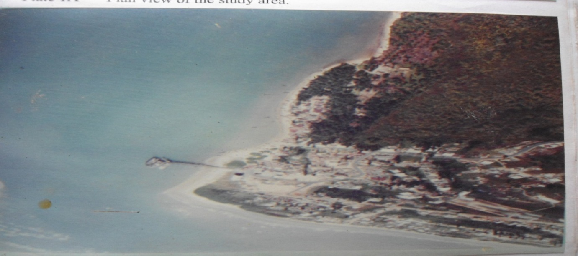
Plate 2: Aerial photo of Qua-Iboe estuary showing areas of severe erosion in 2002
Notes:
Plate 2: Aerial photo of Qua-Iboe estuary in 2002 showing areas of severe erosion

Slide 8
RESULT-ESTUARY: Current Velocities
Fig.4.Estuarine current velocity-Updrift
Fig.5.Estuarine current velocity:downdrift
Fig.6.Average Flow Velocity:Estuary updrift
Fig.7 Average Flow Velocity: Estuary Downdrift

Slide 9
RESULT-SURF ZONE: Longshore Current

Slide 10
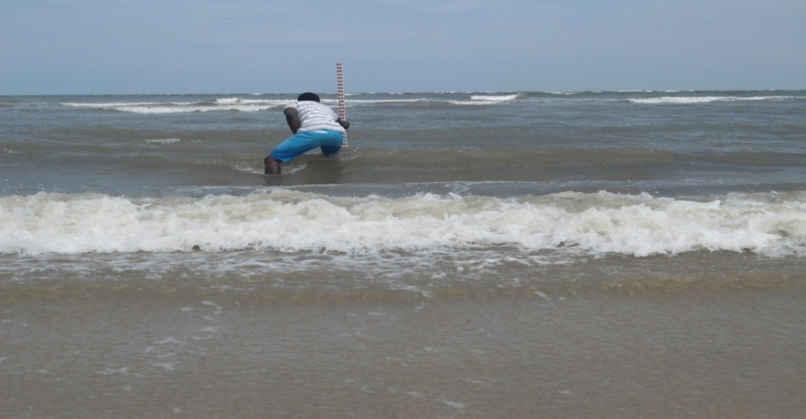
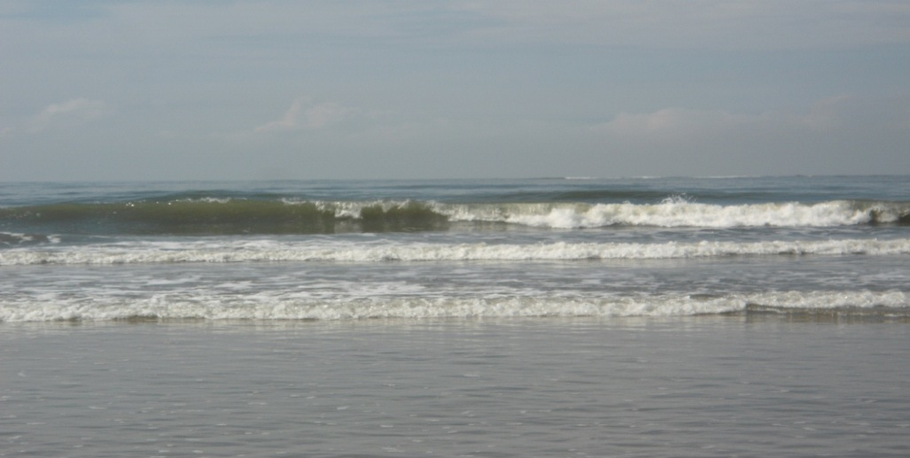
RESULT-SURF ZONE: UPDRIFT.ST.2 -WAVE PARAMETER
Plate 3.Wave breaker Height -Updrift
Plate 4: Wave breaker Height- Downdrift.

Slide 11
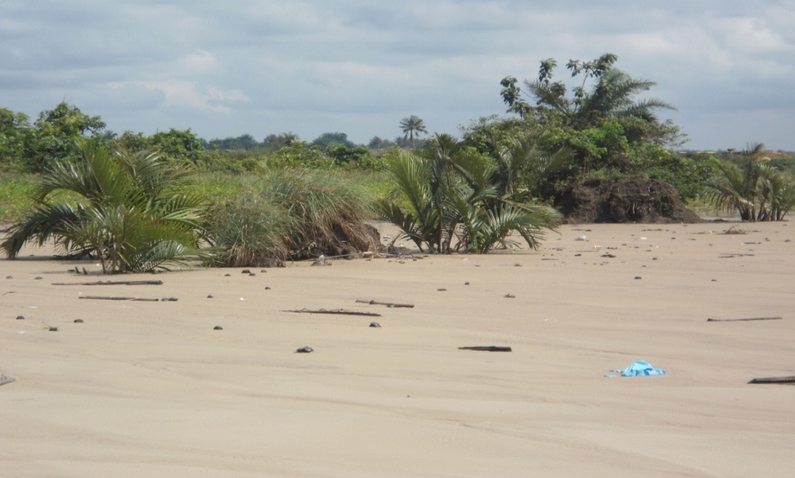
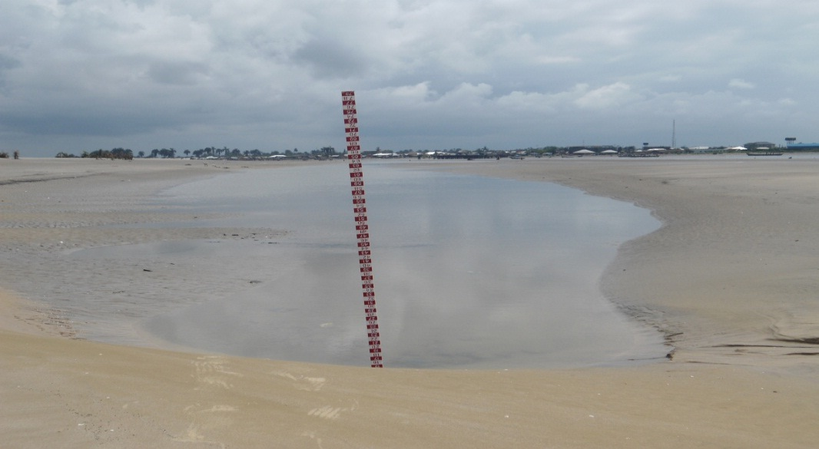
RESULT-UPDRIFT:BEACH PROFILE
Fig.14.Beach Profile: Updrift-Station 1
Fig.15. Beach Profile: Updrift Station 2
Plate 5:Backshore - Updrift Station 1
Plate6: Foreshore –Updrift Station 2

Slide 12
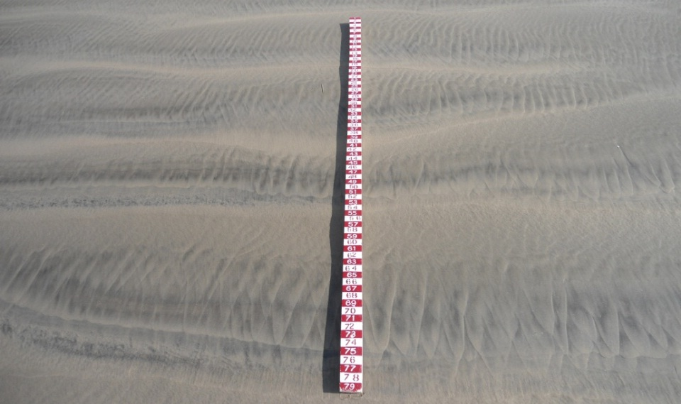
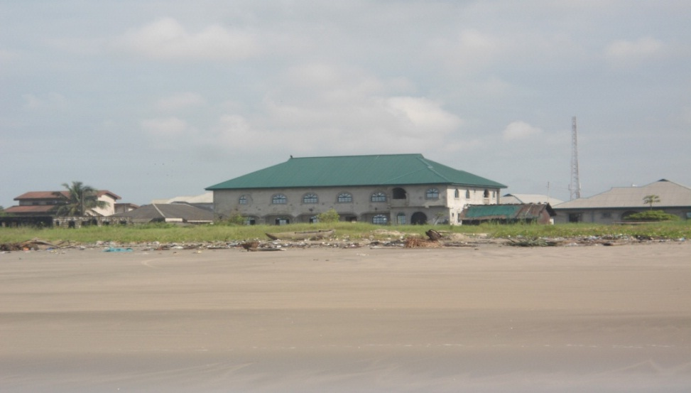
RESULT-DOWNDRIFT:BEACH PROFILE
Fig.16.Beach Profile: Downdrift Station1
Fig17.Beach Profile: Downdrift-Station 2
Plate 7: Foreshore- Downdrift Station 1
Plate 8: Foreshore- Downdrift Station 2

Slide 13
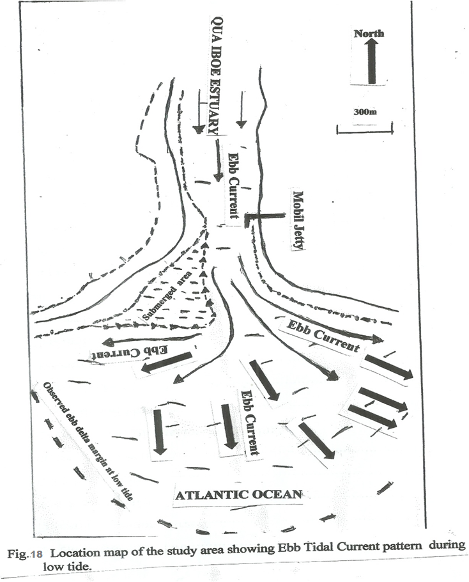
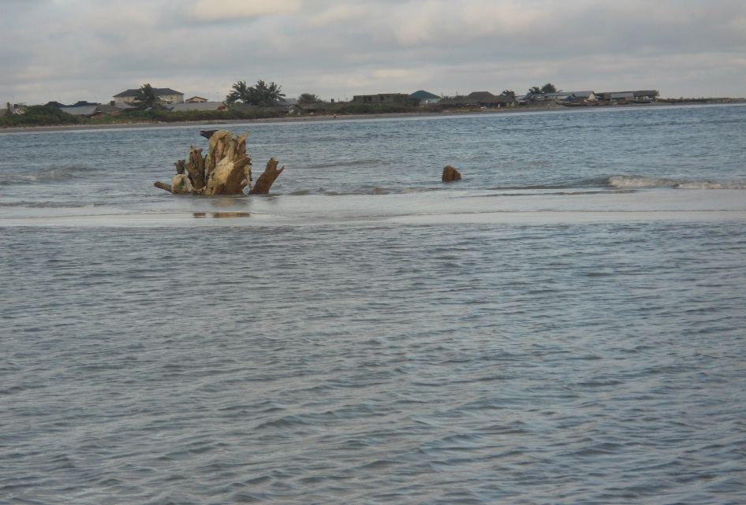
HYDRODYNAMICS-EBB PHASE
Plate 9. Offshore sand bar –Updrift.

Slide 14
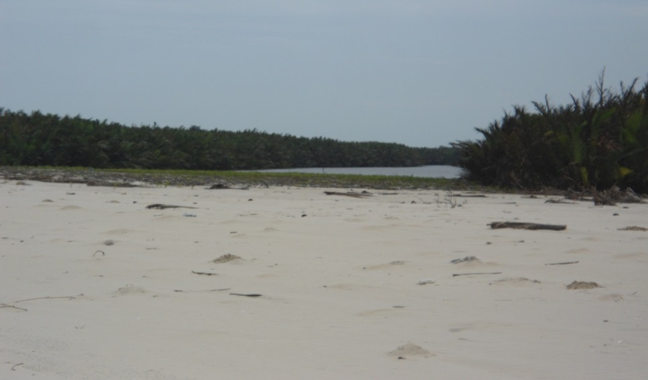
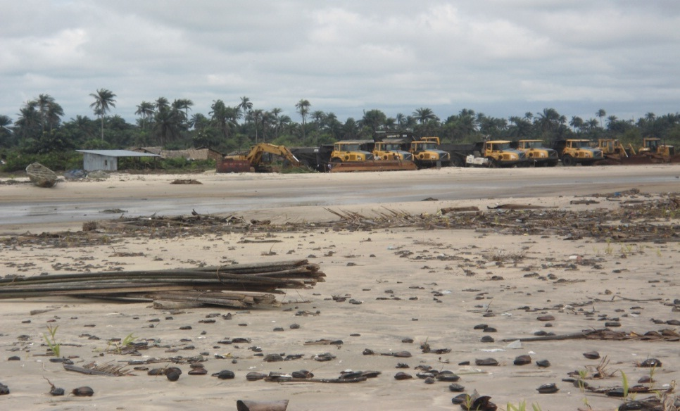
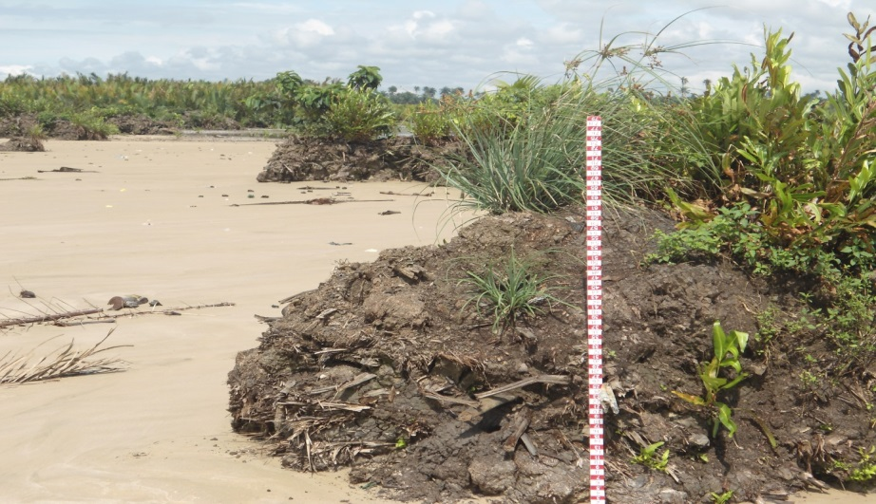
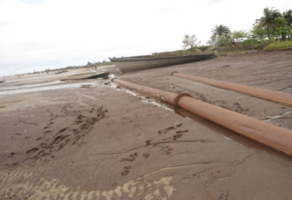
SHORELINE MANAGEMENT ISSUES
Plate 10 Stubb’s Creek sealed-up with sediment during storm surge in 2011
Plate 11: Foreshore trough at updrift beach
Plate 13: Beach Transportation-Updrift
Plate 13 shoreline retreat due to storm surge event at the updrift
Plate 12: Eroded backshore at updrift beach
Notes:
Plate 13 shoreline retreat due to storm surge event at the updrift

Slide 15
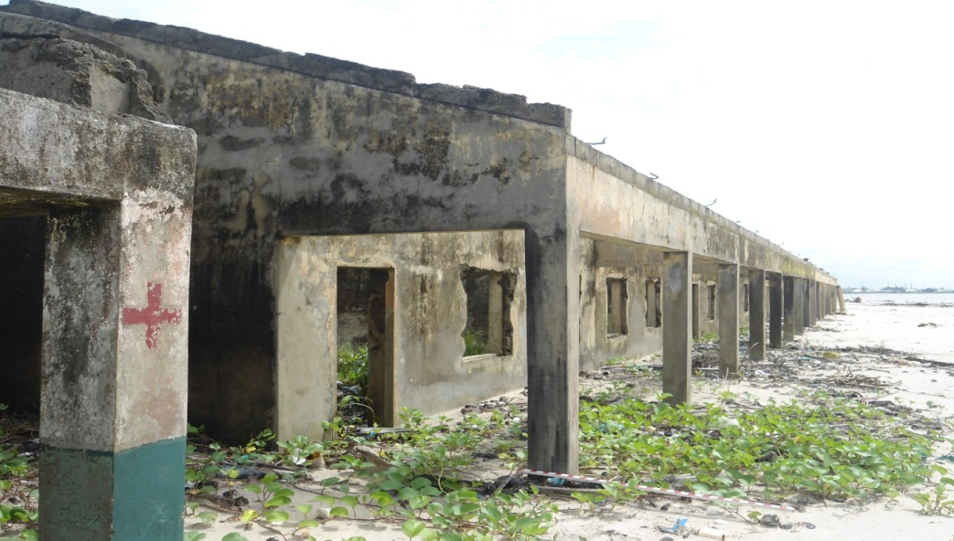
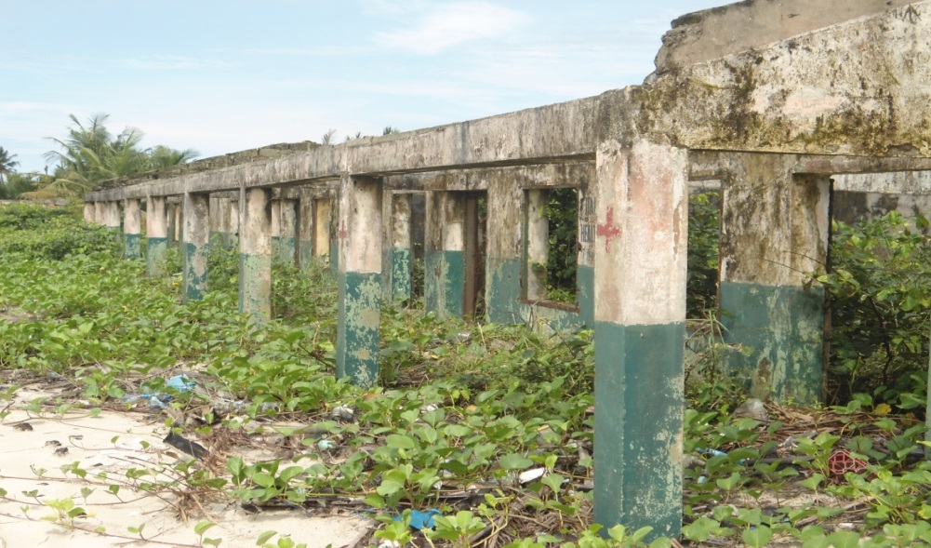
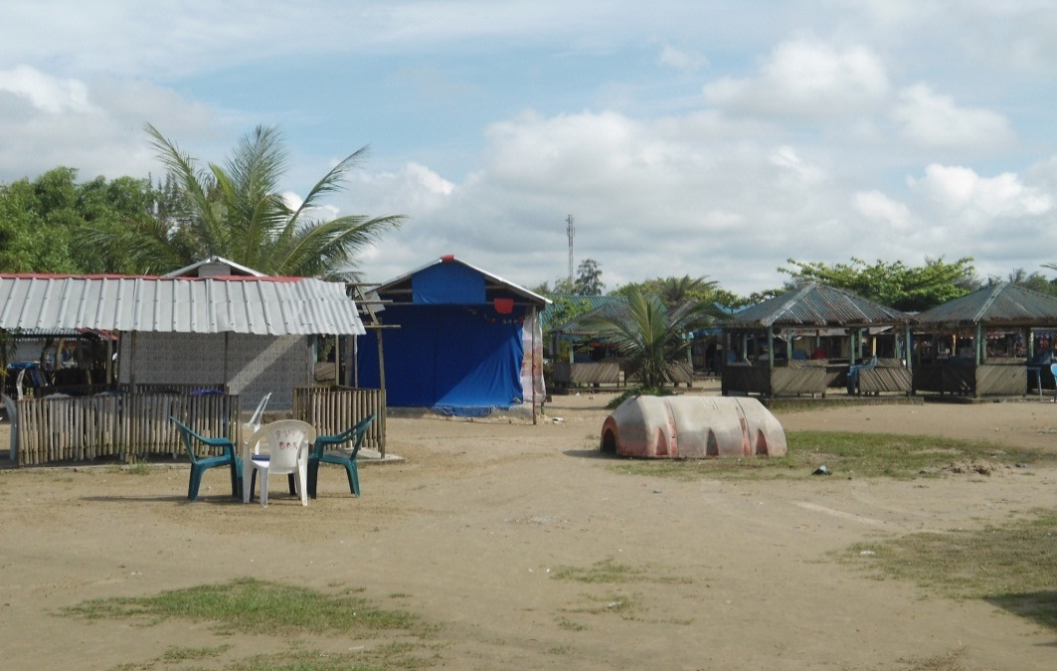
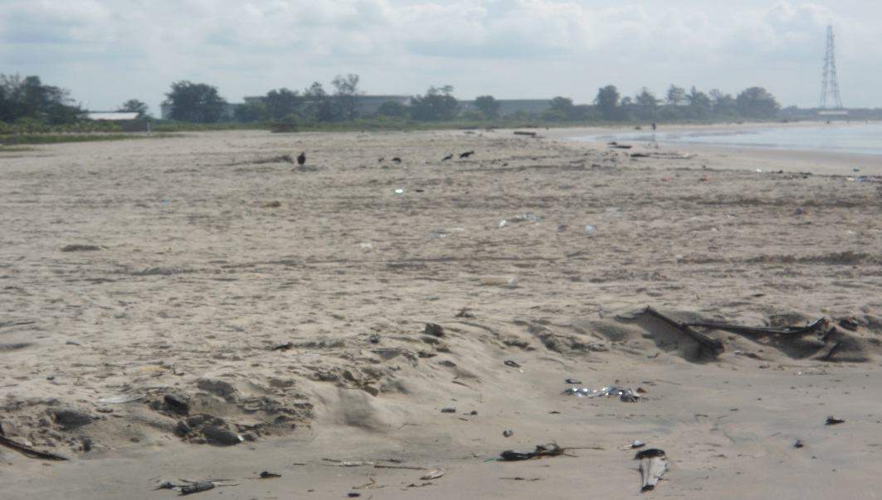
SHORELINE MANAGEMENT ISSUES
Plate 14:Former Itak Abasi primary School damaged by storm surge in 2011
Plate 15: Former Itak Abasi Health Centre damaged by storm surge in 2011
Plate 16: Ibeno beach resort
Plate17: sediment accretion at downdrift beach

Slide 16
SUMMARY
This presentation has :
Noted shoreline retreat and coastal submergence around Qua-Iboe Estuary as impact of sea-level rise and climate change in Nigeria.
Considered integrated coastal zone management approach as essential in managing the shoreline retreat through intervention projects by both public and private sectors.
Considered regular beach nourishment as a proactive measure to prevent shoreline retreat

Slide 17
CONCLUSION
In conclusion, the coastal submergence and shoreline retreat along the south east coast of Nigeria which is attributed to sea-level rise related storm surge can be considered as a signature of climate change in Nigeria. Therefore, more attentions should be given and concerted effort made by the government and private sectors to reduce any anthropogenic activity which accelerate climate change and sea-level rise.

Slide 18
CONTRIBUTION TO KNOWLEDGE
The production of a recent shoreline map of the study area as a basis for assessment of sea-level rise along the strand coast of Akwa Ibom State, South-eastern Nigeria.

Slide 19
THANK YOU FOR LISTENING

