Slide 1
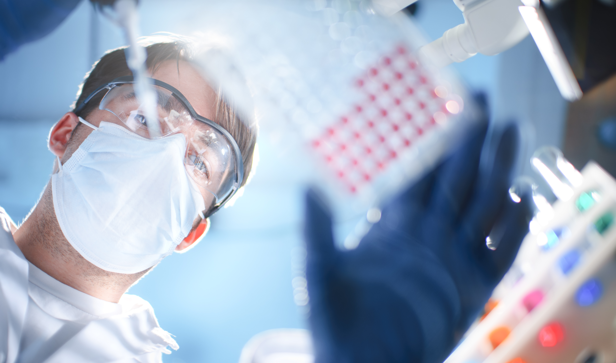
Shaping the Future of Personalised Healthcare
The Cell Cycle Cancer Test
^{www.fglabs.com}
¹
^{CONFIDENTIAL}

Slide 2
Shaping the Future of Personalised Healthcare
The DNA Replication Initiation Machinery
Cdc45
Cdc6
MCM
Replisome
ASK
Cyclin
M
Cdc7
CDK
P
P
G2
Cell Cycle
G1
ORC
S
License to Replicate
Geminin
Cdt1
^{www.fglabs.com}
²
^{CONFIDENTIAL}

Slide 3
Shaping the Future of Personalised Healthcare
Three Ways Out of Cycle
differentiation
Cdc6
quiescence
ORC
MCM
senescence
^{www.fglabs.com}
^{CONFIDENTIAL}

Slide 4
Shaping the Future of Personalised Healthcare
Introduction
DNA replication
initiation proteins in
tissue maintenance
and cancer
^{www.fglabs.com}
²
^{CONFIDENTIAL}

Slide 5
Shaping the Future of Personalised Healthcare
Introduction
DNA replication
initiation proteins in
tissue maintenance
and cancer
From bench
to bedside – new tests
for cancer detection
and prognosis
^{www.fglabs.com}
²
^{CONFIDENTIAL}

Slide 6
Shaping the Future of Personalised Healthcare
From bench
to bedside – new tests
for cancer detection
and prognosis
^{www.fglabs.com}
²
^{CONFIDENTIAL}

Slide 7
Shaping the Future of Personalised Healthcare
Requirement for Prognostic and
Predictive Markers in Breast cancer
50% of patients who
receive loco-regional treatment
will never relapse, whereas
the remainder will die of
metastatic disease
^{www.fglabs.com}
²
^{CONFIDENTIAL}

Slide 8
Shaping the Future of Personalised Healthcare
Requirement for Prognostic and
Predictive Markers in Breast cancer
50% of patients who
receive loco-regional treatment
will never relapse, whereas
the remainder will die of
metastatic disease
50%
^{www.fglabs.com}
²
^{CONFIDENTIAL}

Slide 9
Shaping the Future of Personalised Healthcare
Requirement for Prognostic and
Predictive Markers in Breast cancer
1/3 of patients who are node-negative will experience relapse
1/3
^{www.fglabs.com}
²
^{CONFIDENTIAL}

Slide 10
Shaping the Future of Personalised Healthcare
Requirement for Prognostic and
Predictive Markers in Breast cancer
1/3 of node-positive patients not receiving adjuvant therapy will be disease-free after 10 years
1/3
1/3
^{www.fglabs.com}
²
^{CONFIDENTIAL}

Slide 11
Shaping the Future of Personalised Healthcare
Cell Cycle Phase Progression
in Breast Cancer
H3
P
Aurora A
M
G2
MCM
G1
S
MCM2
Ki67
Geminin
Geminin
^{www.fglabs.com}
²
^{CONFIDENTIAL}

Slide 12
Shaping the Future of Personalised Healthcare
Tumour biopsy material
Multiparameter analysis:
Mcm2, geminin and H3S10ph
No
Mcm2 high (>30%)?
Geminin or
H3S10ph high?
No
Phenotype I
Good Prognosis
^{www.fglabs.com}
²
^{CONFIDENTIAL}

Slide 13
Shaping the Future of Personalised Healthcare
Tumour biopsy material
Multiparameter analysis:
Mcm2, geminin and H3S10ph
No
Mcm2 high (>30%)?
Yes
Geminin or
H3S10ph high?
Geminin or
H3S10ph high?
No
No
Phenotype I
Phenotype II
Good Prognosis
Good Prognosis
^{www.fglabs.com}
²
^{CONFIDENTIAL}

Slide 14
Shaping the Future of Personalised Healthcare
Tumour biopsy material
Multiparameter analysis:
Mcm2, geminin and H3S10ph
No
Mcm2 high (>30%)?
Yes
Geminin or
H3S10ph high?
Geminin or
H3S10ph high?
No
No
Yes
Phenotype I
Phenotype II
Phenotype III
Good Prognosis
Good Prognosis
Poor Prognosis
^{www.fglabs.com}
²
^{CONFIDENTIAL}

Slide 15
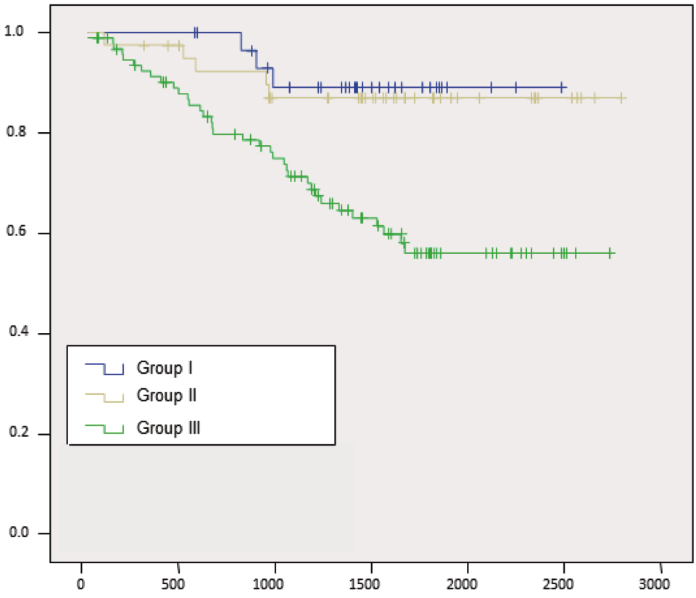
Shaping the Future of Personalised Healthcare
Cell Cycle State Predicts the Outcome
of Breast Cancer after Surgery
Proportion remaining free from recurrence
Days from diagnosis to death, recurrence or last follow up
^{www.fglabs.com}
²
^{CONFIDENTIAL}

Slide 16

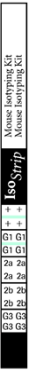
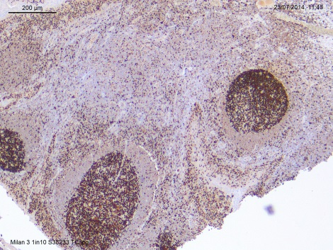
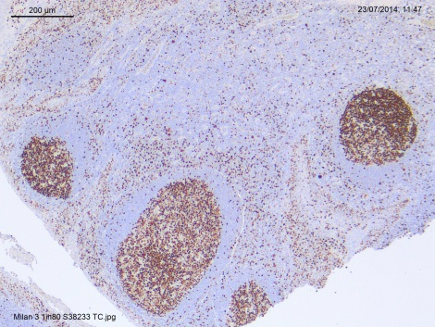
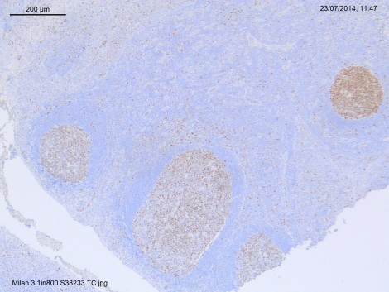
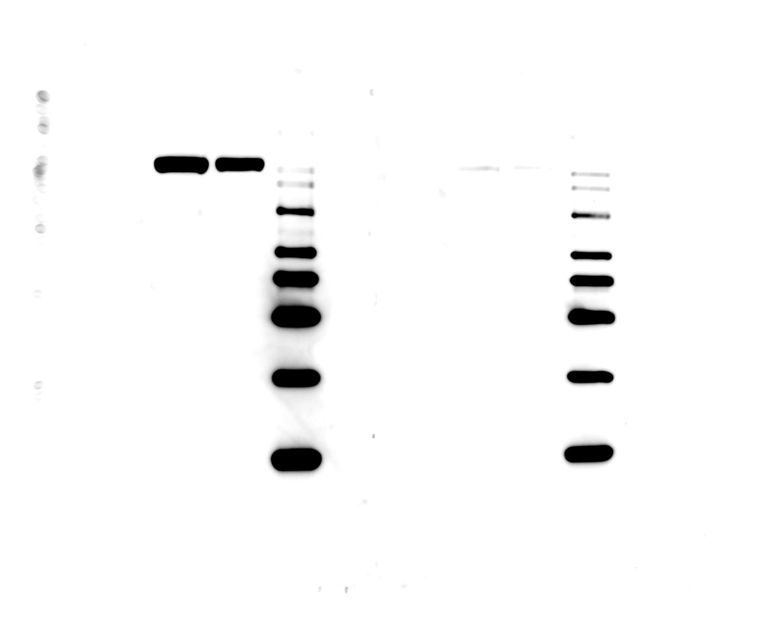
Shaping the Future of Personalised Healthcare
Immunisation
Clone generation
many
clones
Clone pre-selection (ELISA)
12
Clonal stability and Isotype homogeneity
11
IHC titration and reproducibility
7
Intensity scores of 37°C stability study
3
Accelerated antibody stability study
2.5
Negative
2
1 1/10
1.5
2 1/10
3 1/10
3
1
4 1/10
0.5
5 1/10
0
6 1/10
TP0
TP1
TP2
TP3
TP4
7 1/10
Development
^{www.fglabs.com}
^{www.fglabs.com}
^{CONFIDENTIAL}
^{CONFIDENTIAL}

Slide 17
Shaping the Future of Personalised Healthcare
IHC titration curve Mcm2 antibodies
Mcm2 BD Ab
^{www.fglabs.com}
^{CONFIDENTIAL}

Slide 18
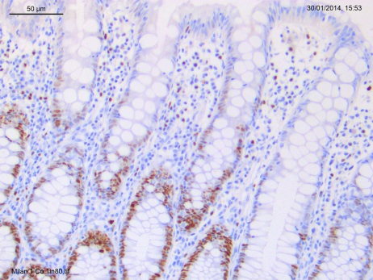
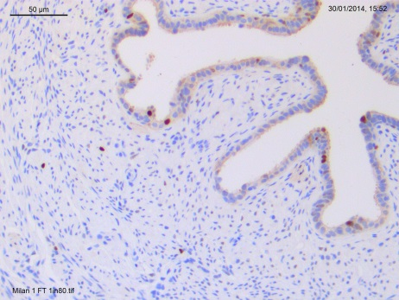
Shaping the Future of Personalised Healthcare
Validation in tissues with varying expression levels
High
Medium
Low
Placenta
Colon
Fallopian tube
^{www.fglabs.com}
^{CONFIDENTIAL}

Slide 19
Shaping the Future of Personalised Healthcare
Stability testing of Ab clones
37°C Stability
Study day 80
Select stable clones at a minimum of 18 months equivalent real time
^{www.fglabs.com}
^{CONFIDENTIAL}

Slide 20
Shaping the Future of Personalised Healthcare
Over and under treatment for patients
with breast cancer?
^{www.fglabs.com}
²
^{CONFIDENTIAL}

Slide 21
Shaping the Future of Personalised Healthcare
Over and undertreatment for patients
with breast cancer?
29%
(n=9)
Phenotype I
24% (18/76) of patients received adjuvant chemotherapy with minimal benefit
71%
(n=22)
Chemotherapy No Chemotherapy
^{www.fglabs.com}
²
^{CONFIDENTIAL}

Slide 22
Shaping the Future of Personalised Healthcare
Over and undertreatment for patients
with breast cancer?
20%
(n=9)
Phenotype II
24% (18/76) of patients received adjuvant chemotherapy with minimal benefit
80%
(n=36)
Chemotherapy No Chemotherapy
^{www.fglabs.com}
²
^{CONFIDENTIAL}

Slide 23
Shaping the Future of Personalised Healthcare
Over and under treatment for patients
with breast cancer?
Phenotype III
46% (49/106) of patients did not receive treatment with adjuvant chemotherapy
46%
(n=49)
54%
(n=57)
Chemotherapy No Chemotherapy
^{www.fglabs.com}
²
^{CONFIDENTIAL}

Slide 24
Shaping the Future of Personalised Healthcare
Failed trials? Let FGL find out why…
Growth Factor
Plasma Membrane
Receptor Protein
Signal
Transduction
Cascade
Cell Cycle
Out-of-cycle
Phenotype I
^{www.fglabs.com}
²
^{CONFIDENTIAL}

Slide 25
Shaping the Future of Personalised Healthcare
Failed trials? Let FGL find out why…
Growth Factor
Plasma Membrane
Receptor Protein
Signal
Transduction
Cascade
Cell Cycle
G1
Out-of-cycle
Phenotype I
G1 Arrest
Phenotype II
^{www.fglabs.com}
²
^{CONFIDENTIAL}

Slide 26
Shaping the Future of Personalised Healthcare
Failed Clinical trials? Let FGL find out why…
Growth Factor
Plasma Membrane
Receptor Protein
Signal
Transduction
Cascade
M
G2
Cell Cycle
G1
G1
S
Out-of-cycle
Phenotype I
G1 Arrest
Phenotype II
Actively Cycling
Phenotype III
^{www.fglabs.com}
²
^{CONFIDENTIAL}

Slide 27
Shaping the Future of Personalised Healthcare
Advantages
Can be used for all forms of breast cancer
Simple, inexpensive IHC based test
Identification of CT sensitive and insensitive tumours for breast cancers
Enables patient stratification for clinical oncology trials
Applicable to FFPE samples
^{www.fglabs.com}
^{CONFIDENTIAL}

Slide 28
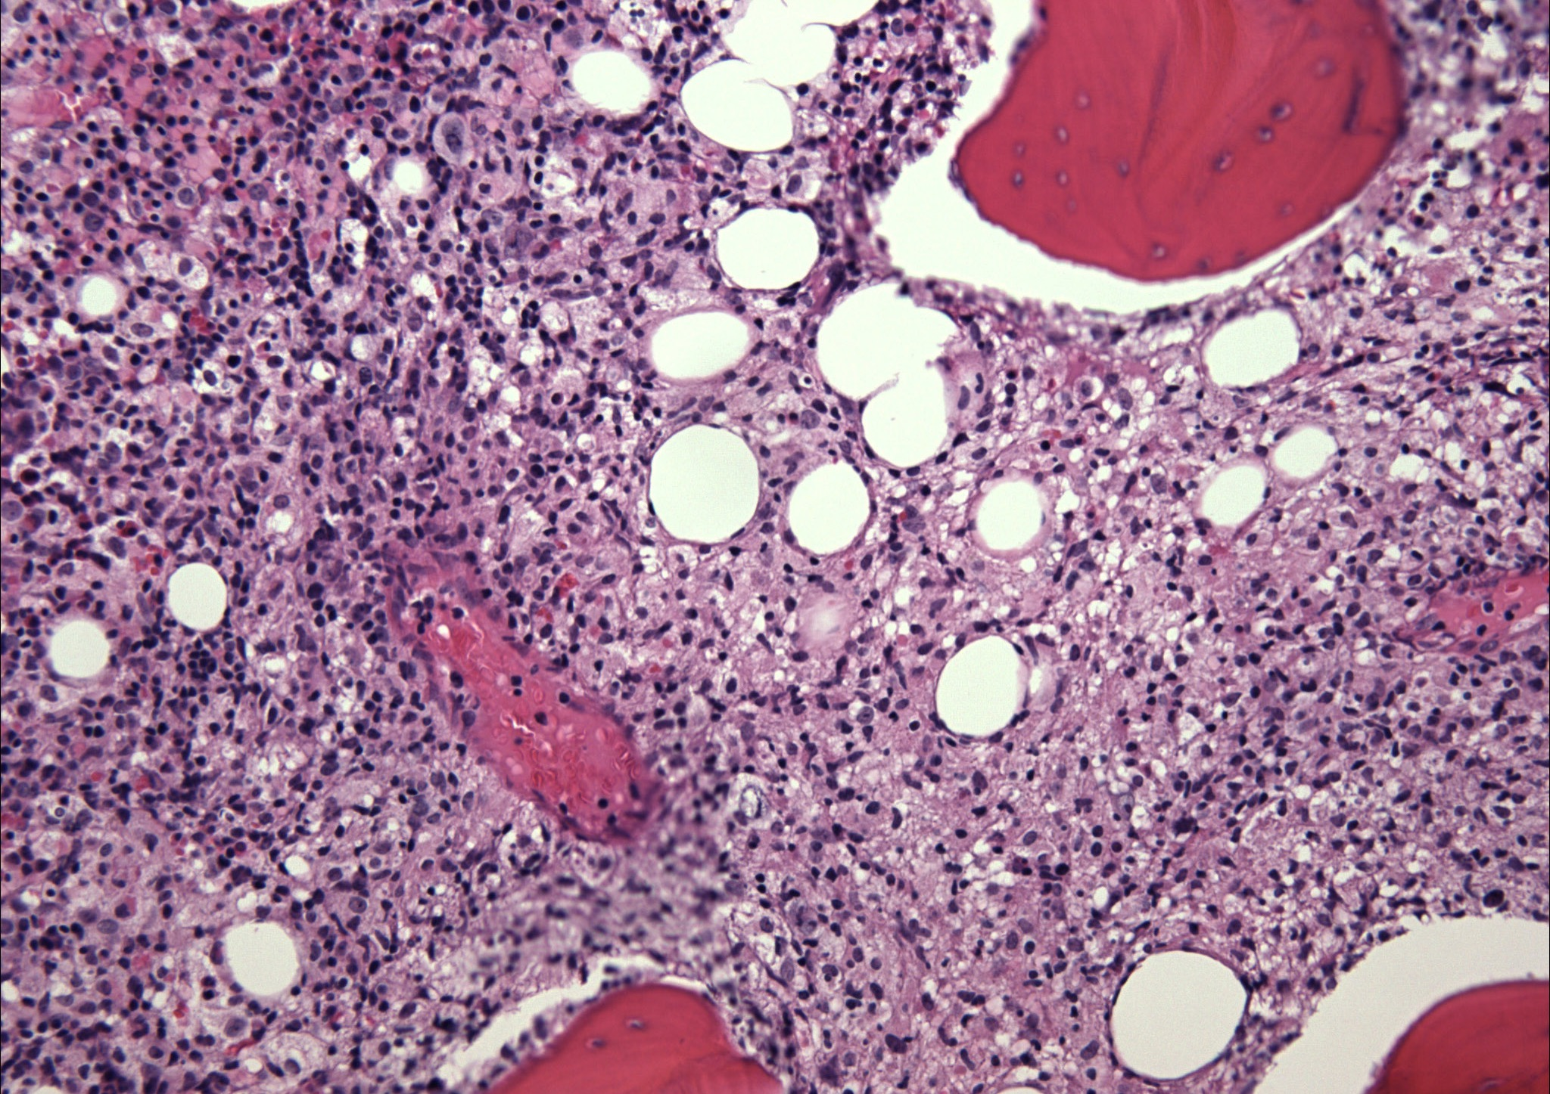
Thank You
www.fglabs.com

