Slide 1
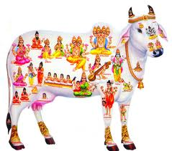
Surveillance of chloramphenicol residues in milk, eggs and chicken meat by LCMSMS
Dr. G. SARATH CHANDRA, Ph.D
Professor and Head
Pharmacovigilance Laboratory for Animal Feed and Food Safety
Directorate of Centre for Animal Health Studies
Tamil Nadu Veterinary and Animal Sciences University
Chennai – 600 051, INDIA

Slide 2
Residues are the metabolites of veterinary drugs, and their associated parent compounds, that remain in the animal or its produce (eggs, milk and honey) after treatment.
Their behaviour depends on the nature of the drug and its metabolites and on the pharmacokinetics of the drug in the animal concerned.
Those that are metabolised and excreted rapidly also rapidly deplete in the animal.
Those that are slowly metabolised may also deplete rapidly if their excretion is not dependent on metabolism.
Others may be subject to slow excretion, especially those that bind to macromolecules and are thus not available for metabolism and/or excretion.

Slide 3
Humans health and veterinary drugs:
Humans health and veterinary drugs Introduction A variety of animal species, including cattle,sheep, goats, pigs, horses, fish, birds and bees, are kept for the purpose of providing food for the human population. In order to maintain their wellbeing, it is sometimes necessary to treat these animals with pharmaceutical products and such treatments can result in residues of the active ingredients, or their metabolites, entering the human food chain. The European Union, for example, in 1999 banned all antibiotics used on humans from being used on animals as growth promotants (AGPs), and similarly the EU has banned the use of hormonal growth promotants (HGPs) on cattle. The USA, Canada and Australia allow such hormone use (subject to maximum residue levels)

Slide 4
The growing food safety concerns call for intensive surveillance of chloramphenicol in food products.
The objective of the study was to assess whether milk, eggs and chicken meat produced by the livestock farmers in TamilNadu state of India were contaminated with chloramphenicol residues

Slide 5
Chloramphenicol has been banned for use in all food-producing animals by the European Union (EU), and Most of the developed countries.. The EU recently set a minimum required performance limit (mrpl) for chloramphenicol determination at 0.3 μg/kg (ppb) in all foods of animal origin

Slide 6
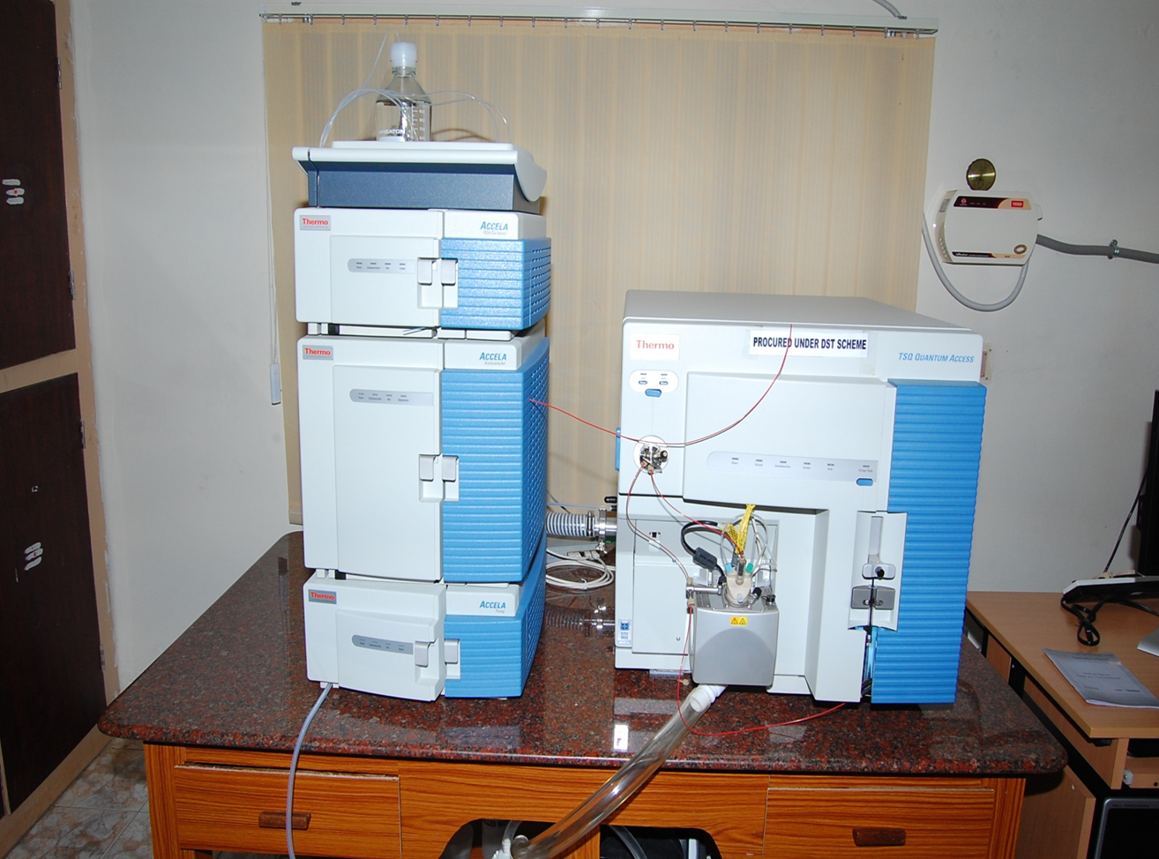
Liquid chromatography/mass spectrometry (LC/MSMS) method was employed for the determination of chloramphenicol (CAP) residues in milk, eggs, chicken muscle and liver, and kidney

Slide 7
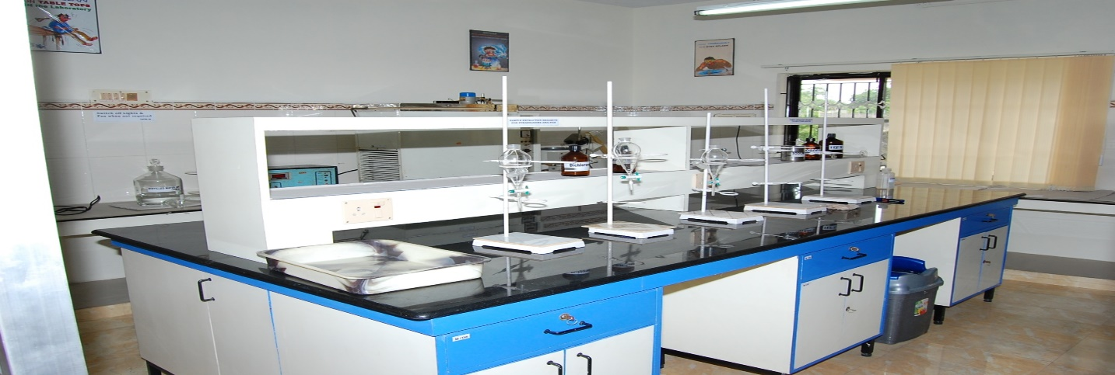
120 samples –milk,eggs,chiken meat, milkpowder and egg powder were analysed during 2011 to2012.
CAP was extracted from the samples with acetonitrile and defatted with hexane.
The acetonitrile extracts were then evaporated, and residues reconstituted in 10mM ammonium acetate--acetonitrile mobile phase and injected into the LC system, and detection was by a triple quadrupole mass spectrometer operated in selected reaction monitoring (SRM) mode

Slide 8
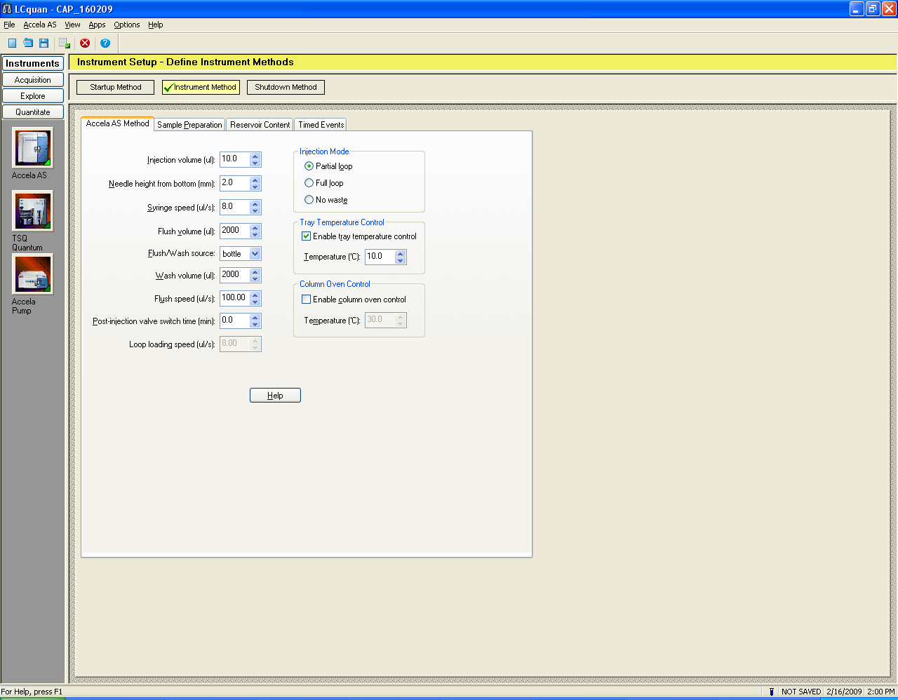

Slide 9
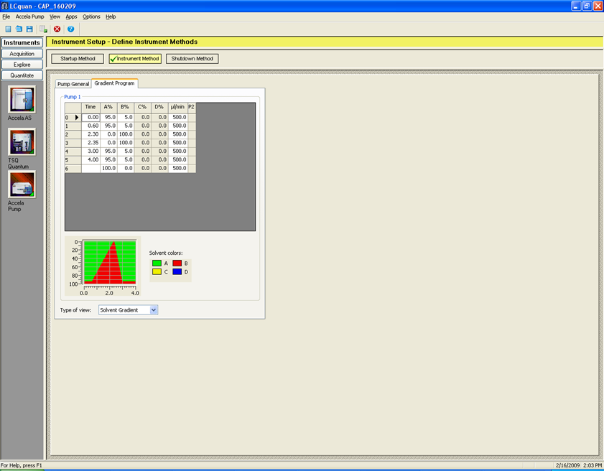

Slide 10
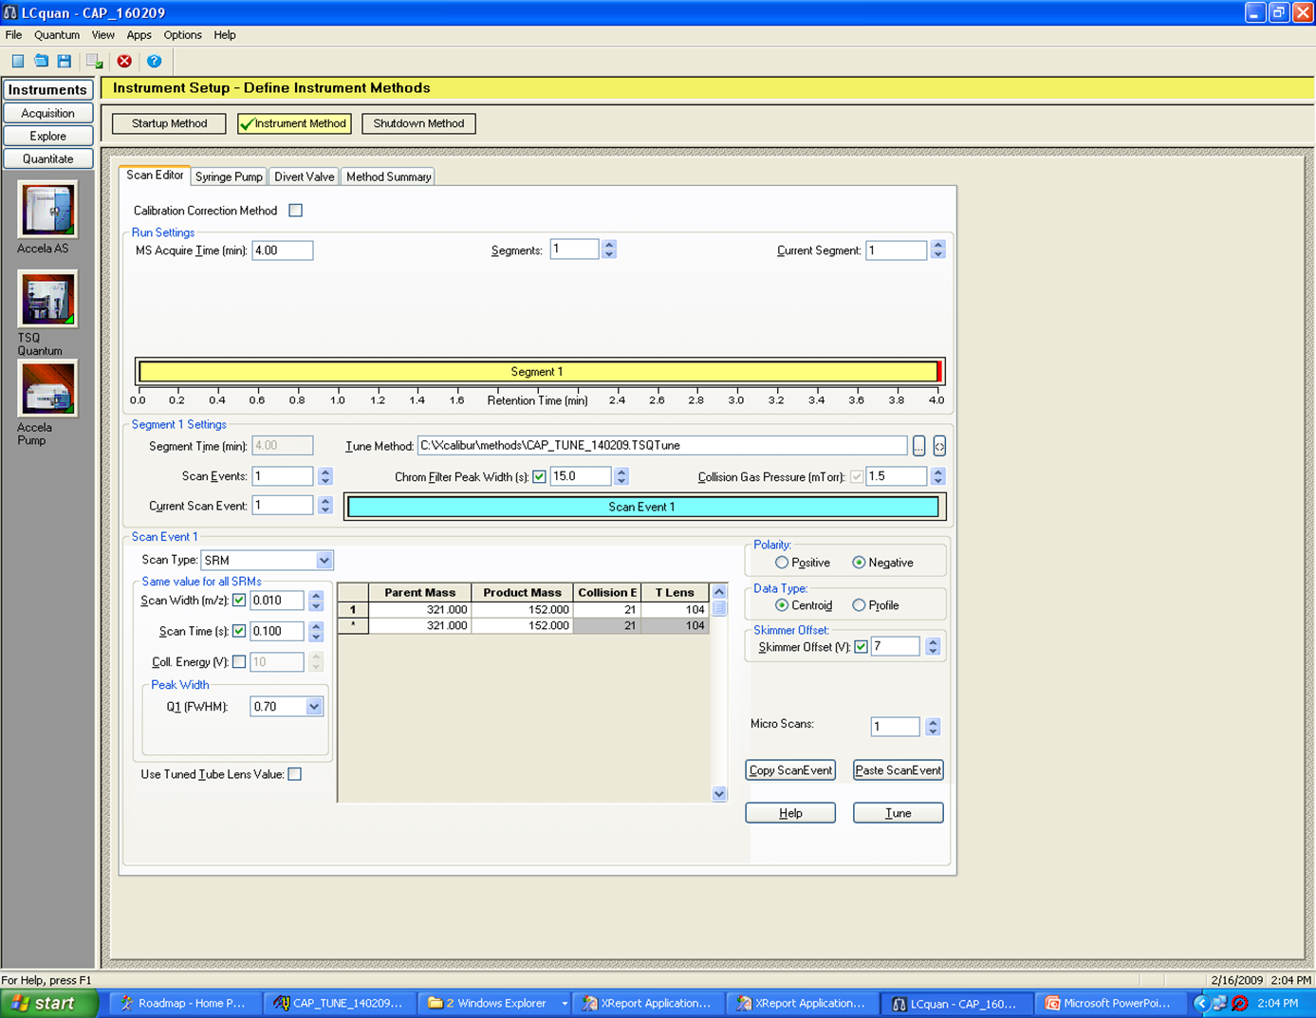

Slide 11
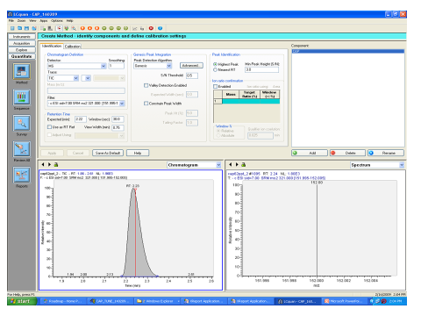

Slide 12
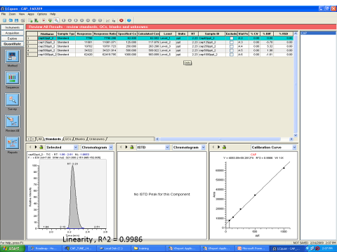

Slide 13
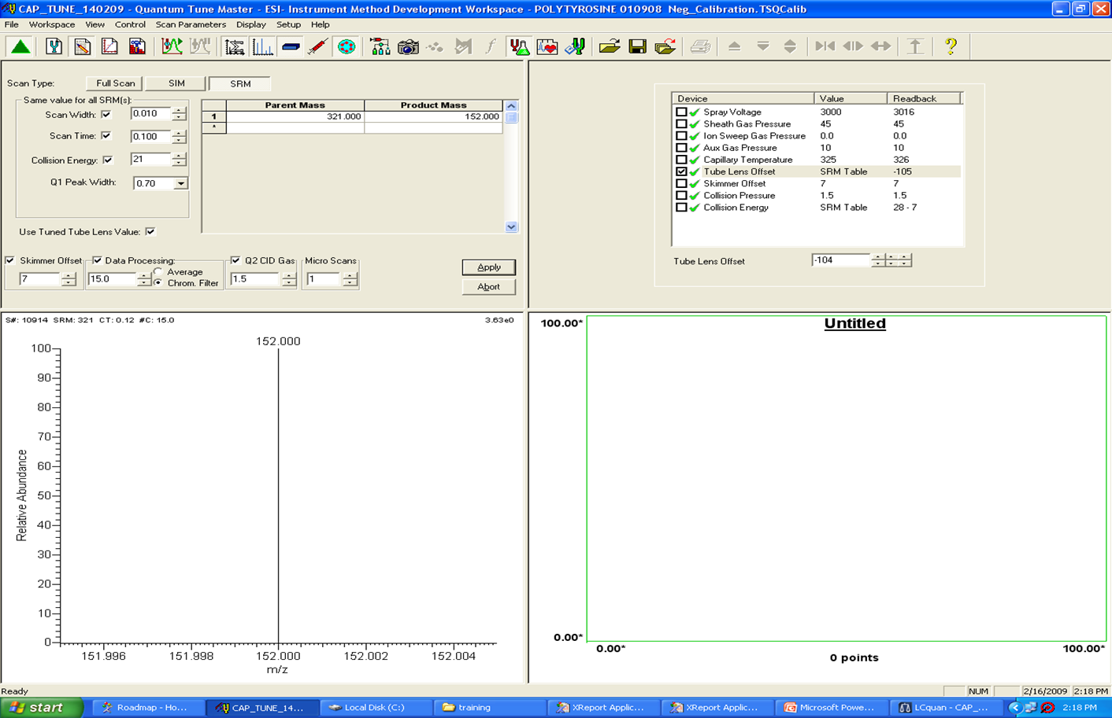

Slide 14
The method studied was sensitive enough to detect and quantify 0.050 ug/kg (ppb) chloramphenicol for screening purposes, much lower than the Minimum Required Performance Limit (MRPL) of 0.3 μg/kg imposed by European Commission's regulation.
The study revealed that most of the samples were in compliance with MRL and growing awareness amongst farmers to avoid banned antibiotic CAP.

Slide 15
Thank You

