Slide 1
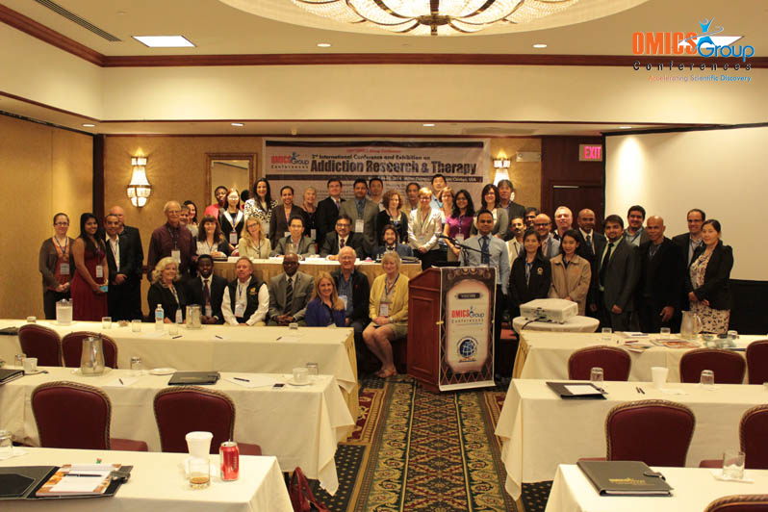
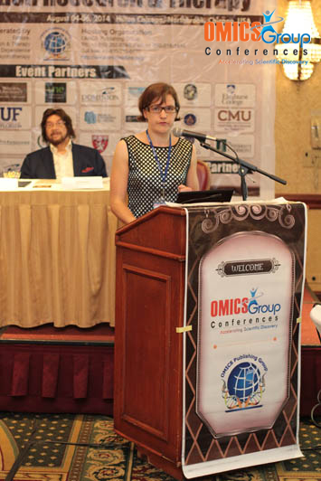
Addiction Therapy-2014 Chicago, USA August 4 - 6, 2014
Sarah Herremans

Slide 2
The effect of HF-rTMS in alcohol-dependent patients: Results from an fMRI study
Sarah Herremans, MD

Slide 3
Introduction
Study design & results
Conclusions

Slide 4
Key structures in addiction
DLPFC
Koob & Volkow, 2010
Notes:
OFC, VMPFC integerating sensory inputs and reward value to regulate motivated behavior
Affective part of ACC: Assessing salience of emotional and motivational information and regulation of emotional responses (bush, 2000)
Hippocampus: Processing of contextual information
Amygdala important in negative reinforcement
Amygdala and huppocampus: conditioned learning
Dorsal striatum: a region implicated in habit learning and action initiation, is involved in cue/context-dependent craving…as such, the DS may be a fundamental component of addiction.
Thalamus: important in the regulation of arousal and attentional modulation, planning action…thus, important in the addictive process
VS striatum receives information about motivational input from amygdala, ofc and other structures and plays a keyrole in the final action output from the basal ganglia
DLPFC: impulscontrol; incorporates intertemporal availability, so incorporates contextual information.
Ventral striatum with ncl accumbens: craving, incentive salience
dACC:signals stimulus value, rewarding actions and action costs (hayashi)
OFC: signals stimulus value(hayashi)
Insula:interoceptive cues
The acc plays a role in cognitive functions and is also activated by salient stimuli
The insula is engaged in interoception and cognitive functions

Slide 5
rTMS & alcohol craving in detoxified alcoholic patients
Mishra et al., 2010:
-> 10 daily sessions, HF-rTMS (10 Hz) right DLPFC, 1000 pulses per day, SHAM-controlled
=> ⬇ subjective craving, ⬇ relapse rate
Herremans et al., 2012:
-> 1 session, HF-rTMS (20 Hz) right DLPFC, 1560 pulses, sham (=PLACEBO)-controlled
No effect on subjective craving
Increase of attentional control during Go-NoGo task
Notes:
We measured subjective craving before and after one sham controlled HF-rtms session and after one such a session no significant changes in craving scores were found. One such a session is not enough to change subjective craving measurements

Slide 6
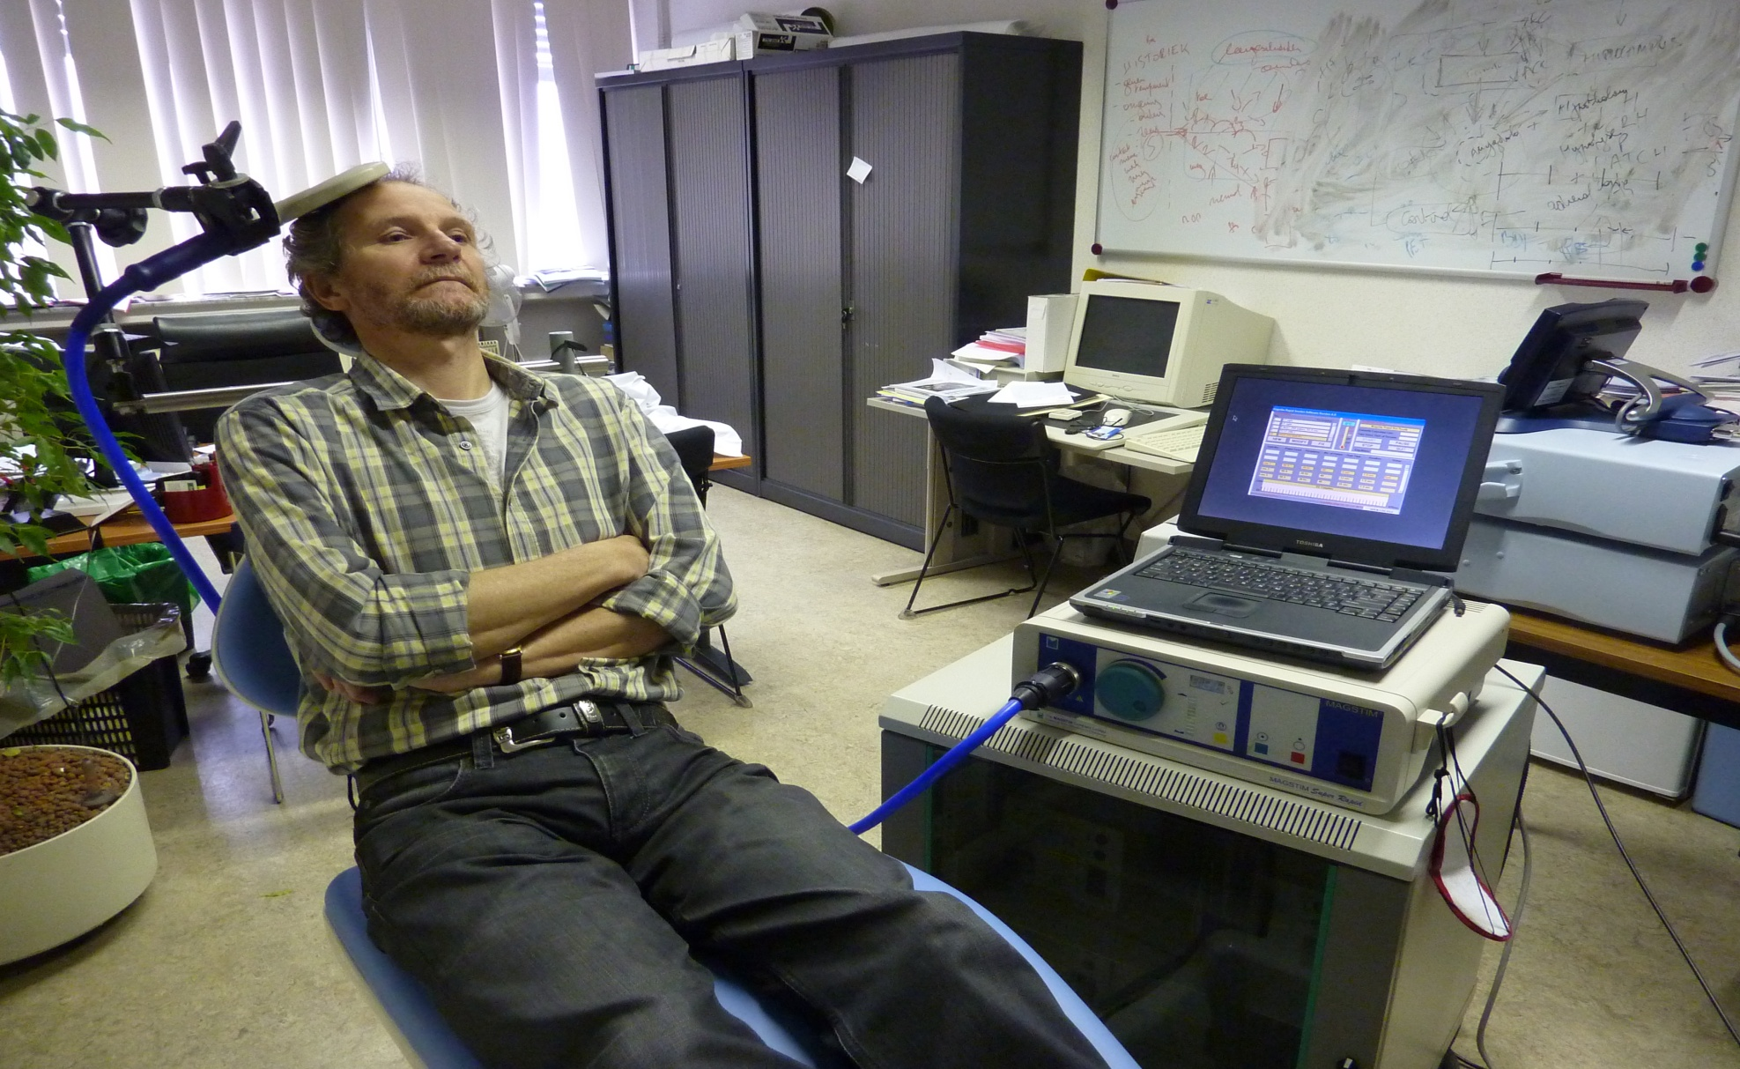
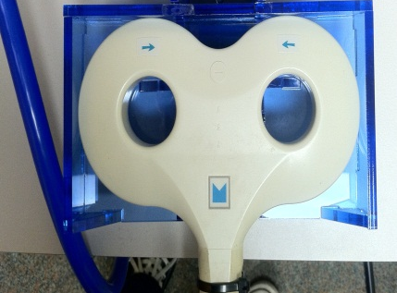
Repetitive transcranial magnetic stimulation (rTMS)
Notes:
Alternating current

Slide 7
transcranial magnetic stimulations (rTMS)
Notes:
High frequent vs low frequent: hz en acitverend.-/inhiberend
The magnetic field penetrates 2 cm underneath the coil, so it affects only cortical braintissue. In a second step deaper brain regions can be reached by synaptic connectivity

Slide 8
Can one and fifteen HF-rTMS sessions influence the craving neurocircuitry
in detoxified alcohol dependent patients during a cue-exposure?

Slide 9
Introduction
Study design & results
Conclusions

Slide 10
Demographic data
20 alcohol-dependent patients
Detoxified < CIWA-AR
11 males / 9 females
Age: 46,5 y (SD: 10,0)
Duration alcohol problem: 13.0 y (SD:9.9)

Slide 11
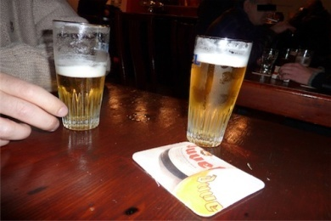
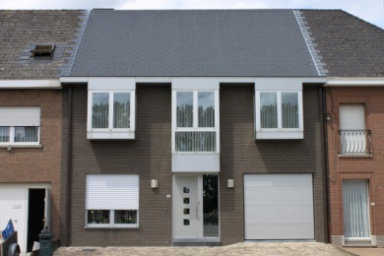
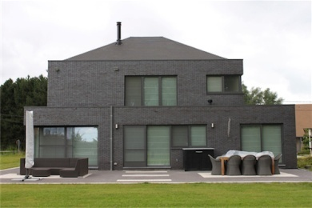
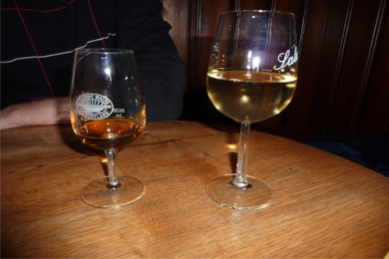
Study design – evaluation of 1 HF-rTMS session
fMRI Event Related design
VAS
X
X
…
VAS
“How much do you crave for an alcoholic beverage right now on a scale from 0 to 10?”
one sham – controlled HF-rTMS session
12 pts -> real stimulation
8 pts -> sham stimulation
HF-rTMS: 20Hz
1560 p/session
110% MT
Right DLPFC
fMRI Event Related design
…
VAS
X
X
VAS
Notes:
Hier ook iets zeggen over inclusiecriteria?

Slide 12
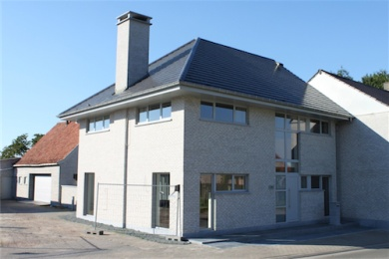
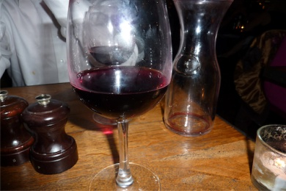
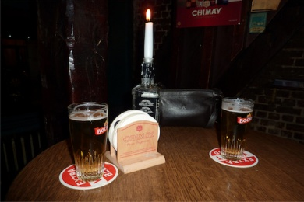
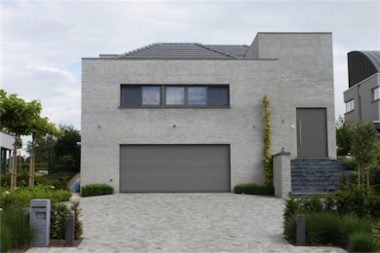
Study design – ACCELERATED evaluation of 15 HF-rTMS sessions
HF-rTMS: 20Hz
1560 p/session
110% MT
Right DLPFC
fMRI Event Related design
…
X
X
15 active HF-rTMS sessions
20 patients -> 2 drop-outs
fMRI Event Related design
…
X
X
Notes:
Hier ook iets zeggen over inclusiecriteria?

Slide 13
Results: Baseline

Slide 14
Baseline Alcohol cue > Neutral cue
P<0.001;
AlphaSim corrected voxel: 176
Inferior frontal gyrus (BA47) left
Inferior temporal gyrus (BA37) right
Medial Frontal gyrus (BA6) left
Superior parietal lobule (BA7) left/right
No increase in craving

Slide 15
Results: one sham-controlled
HF-rTMS session

Slide 16
Demographic data
 | Real stimulation (12) | Sham stimulation (8)
Age | M=48.0 SD=9.9 | M=44.4 SD=8.7
Gender (M/F) | 8/4 | 4/4
Benzodiazepine free days before stimulation | M=15.1 SD=5.2 | M=12.5 SD=2.7
% MT | M=57.6 SD=10.6 | M=64.1 SD=6.4
VAS before cue-exposure (0=>10) | M=2.3 SD=2.7 | M=2.6 SD=3.4
VAS after cue-exposure (0=>10) | M=2.5 SD=3.0 | M=2.8 SD=3.5

Slide 17
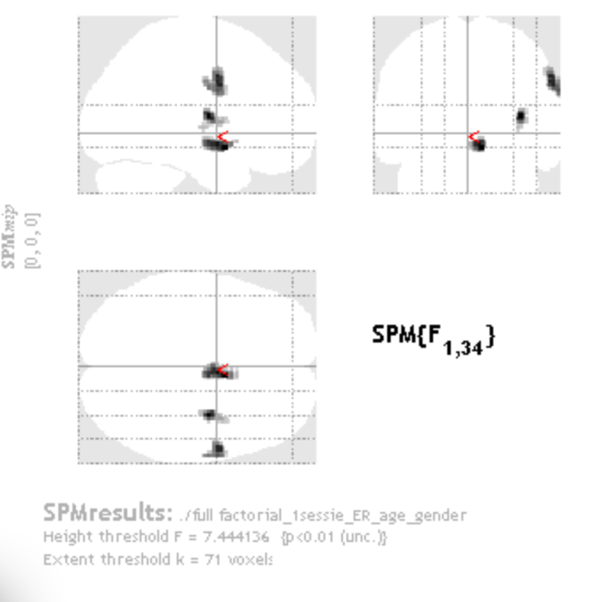
Results: 1 sham controlled session
INTERACTION:
Pre_Post x Sham_Real
F=7.4; p<0.01;
AlphaSim corrected voxel: 71
Nucleus Accumbens
Insula
BA6
Notes:
OK
Ook medial frontal gyrus

Slide 18
Results: 1 REAL stimulation
T=2.4;p<0.01
Nucleus Accumbens
Insula
Precentral gyrus (BA 6)
No effect of sham stimulation
No effect on VAS-craving (deltaVAS)
Notes:
The observed NcAc decrease after been exposed to the cue-exposure paradigm may discretely indicate craving attenuation in our subjects, although this was not substantiated by our VAS assessment. However, because we only assessed craving and not mood effects, we cannot rule out that performing the paradigm resulted in mood changes instead of craving (Berridge et al., 2013).
Indeed, we also observed increased activity in the right insula after one active HF-rTMS session during the alcohol-related cue-exposure. The insula has interoceptive functions and because of its reciprocal connections with ACC, ventromedial PFC, amygdala and ventral striatum it integrates autonomic and visceral information with emotion and motivation (Naqvi and Bechara, 2009). On the other hand, the involvement of the insula is often correlated with enhanced cue-induced conscious craving (Naqvi and Bechara, 2010). However, enhanced activity of the insula has not been consistently observed in alcohol-craving patients (Kuhn and Gallinat, 2011).
right BA 6 activity increases. This region consists of the premotor cortex and supplementary motor area (SMA) and is part of an extensive neurocircuit, that stores and processes action knowledge and tool use skills (Jasinska et al., 2014). As compared to neutral cues drug cues show increased activity in these regions (Grüsser et al., 2004, Schacht et al., 2012).
Terugkome op koob en volkow; acc wel betrokken en andere regio’s ba 6/ insula ook betrokken
Wordt vaak gevonden in andere cue-exposure experimenten
Rechter insula : vn betrokken bij stressmodulatie, zien v foto’s k t maken hebben met stresssysteem
OK
Niet vergeten dat sham niets gaf
BA:6: premotor cortex en supp motor area
Ofwel via marsbar: statistical table:
Pre>post:
8/4/-12: p=0.004256 BA25
Post>pre:
36/-8/10: p=0.000258: insula (BA13)
60/0/32: p=0.000433: BA6

Slide 19
Key structures in addiction
DLPFC
Koob & Volkow, 2010
Notes:
Ventral striatum with ncl accumbens: craving, incentive salience
Amygdala important in negative reinforcement
dACC:signals stimulus value, rewarding actions and action costs (hayashi)
OFC: signals stimulus value(hayashi)
Dorsal striatum: a region implicated in habit learning and action initiation, is involved in cue/context-dependent craving…as such, the DS may be a fundamental component of addiction.
Hippocampus: Processing of contextual information
Insula:interoceptive cues
Thalamus: important in the regulation of arousal and attentional modulation, planning action…thus, important in the addictive process
DLPFC: impulscontrol; incorporates intertemporal availability, so incorporates contextual information.
Amygdala and huppocampus: conditioned learning
OFC, VMPFC integerating sensory inputs and reward value to regulate motivated behavior
VS striatum receives information about motivational input from amygdala, ofc and other structures and plays a keyrole in the final action output from the basal ganglia
The acc plays a role in cognitive functions and is also activated by salient stimuli
The insula is engaged in interoception and cognitive functions
Affective part of ACC: Assessing salience of emotional and motivational information and regulation of emotional responses (bush, 2000)

Slide 20
Results: 15 active HF-rTMS sessions
in an accelerated paradigm

Slide 21
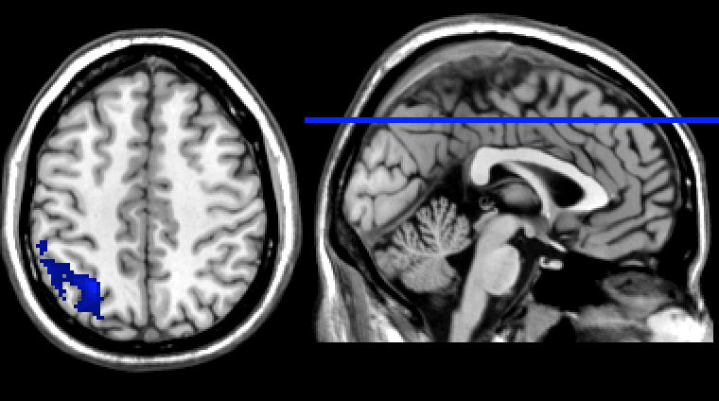
Treatment effect of 15 active rTMS sessions
2 drop-outs
T=2.6; p<0.01
alphaSim voxel corrected: 482
Superior Parietal lobule (BA7) deltaVAS during fMRI
craving (AUQ,OCDS): p<0.05
Notes:
sensory representation of drug cues and attentional processes, more specifically visuospatial attention and motor attention (Kastner and Ungerleider, 2000; Rushworth et al., 2003). Albeit not related to the craving neurocircuit - as proposed by Koob and Volkow (2010) - it has been hypothesized that increased cue-induced activation of brain areas involved in sensory processing could be an early manifestation of increased incentive salience (Jasinska et al., 2014). Therefore, in spite that subjective cue-induced craving was not changed in our patients, the observed decrease of activation of the superior parietal lobule suggests a decrease of incentive salience while viewing alcohol stimuli.

Slide 22
Key structures in addiction
DLPFC
Koob & Volkow, 2010
Notes:
Ventral striatum with ncl accumbens: craving, incentive salience
Amygdala important in negative reinforcement
dACC:signals stimulus value, rewarding actions and action costs (hayashi)
OFC: signals stimulus value(hayashi)
Dorsal striatum: a region implicated in habit learning and action initiation, is involved in cue/context-dependent craving…as such, the DS may be a fundamental component of addiction.
Hippocampus: Processing of contextual information
Insula:interoceptive cues
Thalamus: important in the regulation of arousal and attentional modulation, planning action…thus, important in the addictive process
DLPFC: impulscontrol; incorporates intertemporal availability, so incorporates contextual information.
Amygdala and huppocampus: conditioned learning
OFC, VMPFC integerating sensory inputs and reward value to regulate motivated behavior
VS striatum receives information about motivational input from amygdala, ofc and other structures and plays a keyrole in the final action output from the basal ganglia
The acc plays a role in cognitive functions and is also activated by salient stimuli
The insula is engaged in interoception and cognitive functions
Affective part of ACC: Assessing salience of emotional and motivational information and regulation of emotional responses (bush, 2000)

Slide 23
Introduction
Study design & results
Conclusions

Slide 24
1 active HF-rTMS session
Placebo - controlled design
No effect on cue-induced craving
⬇ Nucleus Accumbens
⬆ Insula
⬆ BA 6
No effect of sham stimulation
Notes:
1 sessie:in het systeem van koob en volkow zit, ba25 daalt en niet bij de sham, wat mogelijk t mken heeft met gedald visceromotorisch effect , maar geen daling craving
Multiple sessies: open studie, el effect op craving, maar geen effect op rewardsysteem, ondnks subj daling va ocds/auq, wel effect op aandachtsysteem
Limitatie open studie

Slide 25
15 active HF-rTMS sessions
Accelerated HF-rTMS protocol
Open study: ⬇ craving outside fMRI
No effect on cue-induced craving
⬇ superior parietal lobule
Notes:
In line met mishra
Ander mechanisme v rtms voor craving circuit aan te spreken dan via het cue-exposure ciruit
attention system gezien daling act left sup par lob

Slide 26
General conclusions
HF-rTMS => cue-induced craving
HF-rTMS => craving neurocircuit (Koob & Volkow,2010)
But:
HF-rTMS => salience and attention network
HF-rTMS => subjective craving
salience attribution to &
attention at alcoholic stimuli
Notes:
Werkingsmechanisme van rtms kan gaan via een ander mechanisme dan het craving circuit
En onze ptn hadden mss niet genoeg craving op baseline

Slide 27
Limitations
Relatively small sample
No control group for the treatment part
Hospitalized patients seldom report craving when confronted with alcoholic stimuli (Wilson et al., 2004)
Notes:
Relatively small sample size regarding the placebo controlled study
Geen controlegroep, but however a decrease of craving measured on validated craving questionnaires
So it is difficult to evaluate the effect on craving circuit

Slide 28
Thank you for your attention!
QUESTIONS?
Collaborators:
Chris Baeken, MD, PhD
Peter Van Schuerbeek, Msc
Marie-Anne Vanderhasselt, PhD
Frieda Matthys, MD
Rudi De Raedt, PhD

Slide 29
Meet the eminent gathering once again at Addiction Therapy-2015 Florida, USA August 3 - 5, 2015
Addiction Therapy – 2015 Website:
addictiontherapy.conferenceseries.com

