Slide 1
SARAH ABDULLAH BATWA
Consultant Obs& Gynae
MCHA . JEDDAH

Slide 2
Seroprevalence of Chlamydia trachomatis, cytomegalovirus, herpes simplex virus 1&2 in Saudi women with normal and abnormal early pregnancy: A pilot study
IRAQ
JORDAN
KUWAIT
QATAR
UAE
RED SEA
OMAN
YEMEN

Slide 3
Sexually transmitted diseases
Major health problem under diagnosed world wide
Incidence rise in females more than males, especially in reproductive age
Several organisms have been identified
WHO: 27 million infected in Middle East
WHO:Global incidence and prevalence of selected curable sexually transmitted infections – 2012
Major cause of complications
Maternal
Neonatal

Slide 4
Maternal Reproductive Complications of STIs
Pelvic inflammatory diseases (PID)
Chronic pelvic pain
Miscarriage
Ectopic pregnancy (EP)
Infertility

Slide 5
Untreated STIs in pregnant women
may result in
- Fetal wastage
Stillbirths
Low birth weight
Eye damage
- Lung damage
- Congenital abnormalities

Slide 6
Neonatal Complications of STIs
Chlamydia trachomatis
Pneumonitis
Conjunctivitis
Herpesviridae viruses
Serious Neurological manifestations

Slide 7
STIs are common, but difficult to track.
Many people with these infections do not have symptoms and remain undiagnosed.
Diseases diagnosed frequently but not reported and counted.
Most of the published data on prevalence and incidence of STIs come from developed countries.

Slide 8
Prevalence in KSA
Information about STIs in Islamic countries, where non-marital sex and homosexuality are prohibited by religion, is notably limited.
The appropriate preventive strategies adopted by SA. that conform to the Islamic rules and values were contributed in limit the spread of STIs
Incidence of STIs in SA is limited
Detailed information on human immunodeficiency virus (HIV) in Saudi Arabia (SA) was published for the first time in 2004.

Slide 9
Prevalence in KSA
Very limited number of studies
Majority by serology diagnosis
Majority in normally pregnant women
None on abnormal early pregnancy
Seroprevalence in normal pregnancy (IgG antibodies)
C. Trachomatis (4-21%) from different regions
CMV (about 90%)
HSV1 (80-90%)
HSV-2 (7-75%)

Slide 10
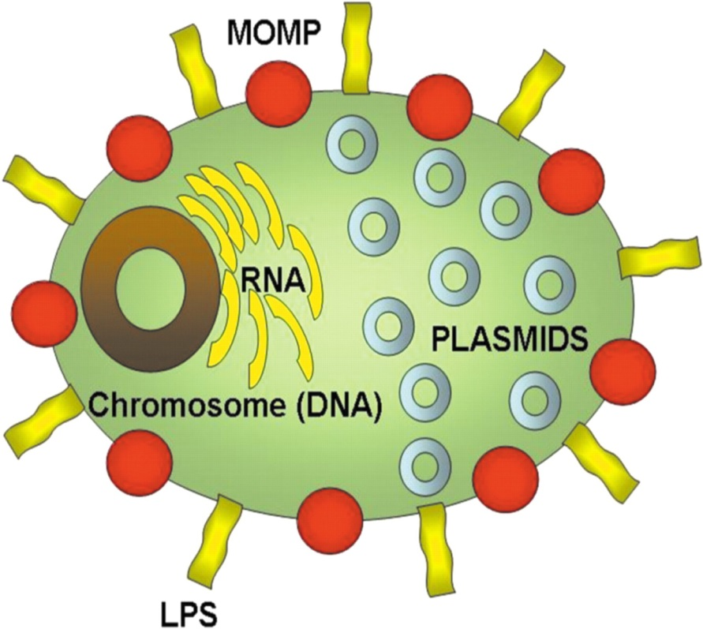
Chlamydia Trachomatis
Gram Negative bacteria
Obligatory intracellular
Most common STI
Majority patients are asymptomatic

Slide 11
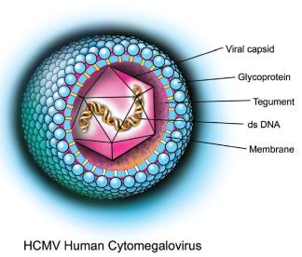
Cytomegalovirus
Herpes viridae family
Transmission through body fluids
Infection
Acute
Chronic
Reactivation
Several Maternal & Neonatal Complications

Slide 12
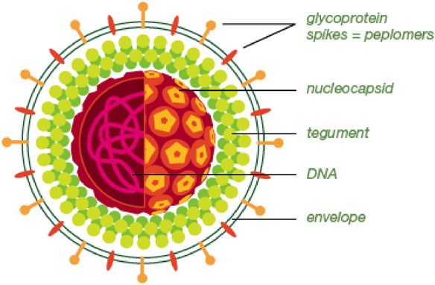
Herpes Simplex virus 1&2
Herpes viridae family
Latent infection
HSV-1
Mainly oro-labial (Cranial nerves)
HSV-2
Mainly genital (Dorsal spinal ganglia)
Abnormal site of infection
Mainly due to oral sex

Slide 13
Common Diagnostic Methods
Serology
C. Trachomatis (IgM, IgG & IgA)
IgG = Associated with reproductive complications
Herpes viridae viruses
IgM = Acute infection
IgG = Chronic/Non-active
IgM + IgG = Re-exposure/Re-activation
Nucleic Acid Amplification Tests (PCR)
All organisms (Current/Persistent infection)

Slide 14
Research Questions
Are C. trachomatis, CMV, HSV-1&2 associated with abnormal early pregnancy?
What is the seroprevalence in:
Miscarriage?
Ectopic pregnancy?
Normal pregnancy?

Slide 15
Seroprevalence of Chlamydia trachomatis, Cytomegalovirus, Herpes simplex virus 1&2 in Saudi women with normal and abnormal early pregnancy: A pilot study
Sarah Abdullah Batwa¹, Bassem Refaat² Ahmed Mohammed Ashshi² and Adel Galal El-Shemi²

Slide 16
Materials and methods

Slide 17
Study Design (Case-Control)
250 Participants
Control Group
100 Normal pregnancy
Case Group
150 abnormal early pregnancy
80 abortions
70 ectopic pregnancies
IgM
IgG

Slide 18
Inclusion & Exclusion Criteria
Inclusion Criteria | Exclusion Criteria
Saudi | Non-Saudi
Patient age ≥ 18 and < 40 years. | Patient age < 18 or > 40 years.
Spontaneous pregnancy | Pregnancy following assisted conception
Singleton pregnancy | Multiple/heterotopic pregnancy
Spontaneous abortion | Induced abortion

Slide 19
Methods
ELISA to measure serum IgM & IgG antibodies:
C. Trachomatis
CMV
HSV1
HSV2

Slide 21
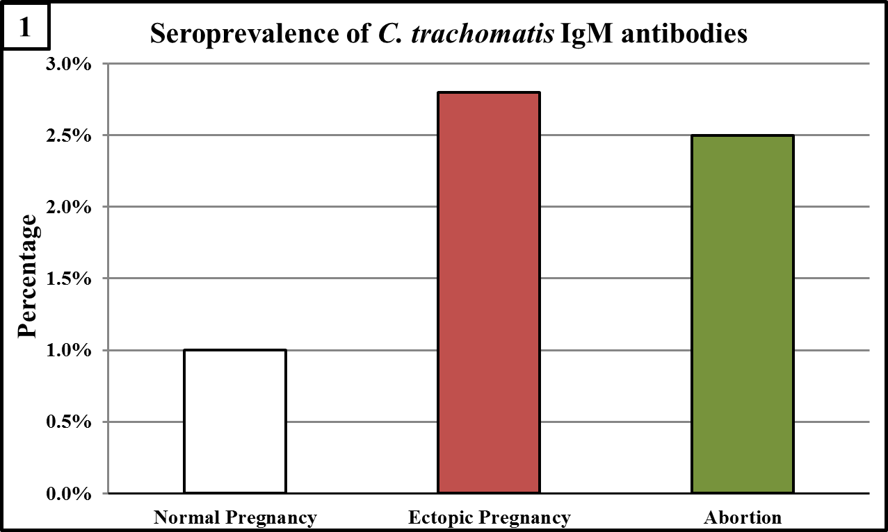
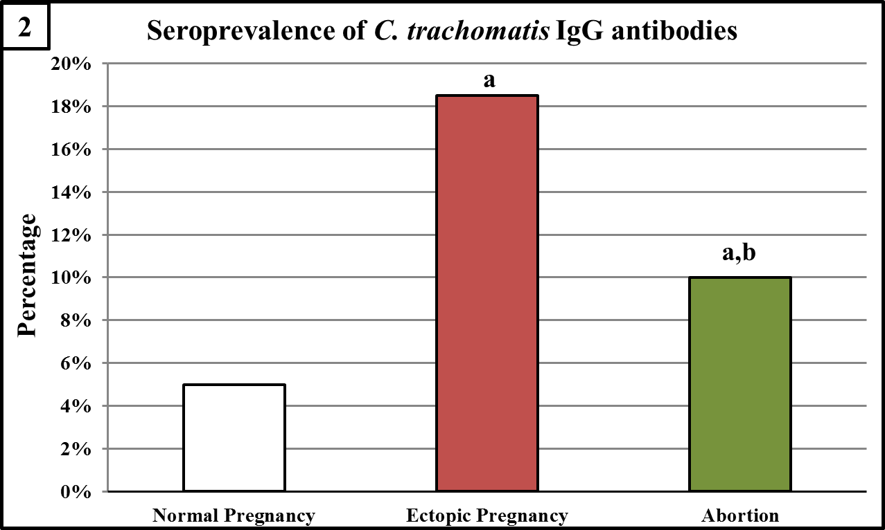
1- C. Trachomatis (a = p < 0.05 compared to normal pregnancy and b = p < 0.05 compared to EP groups).

Slide 22
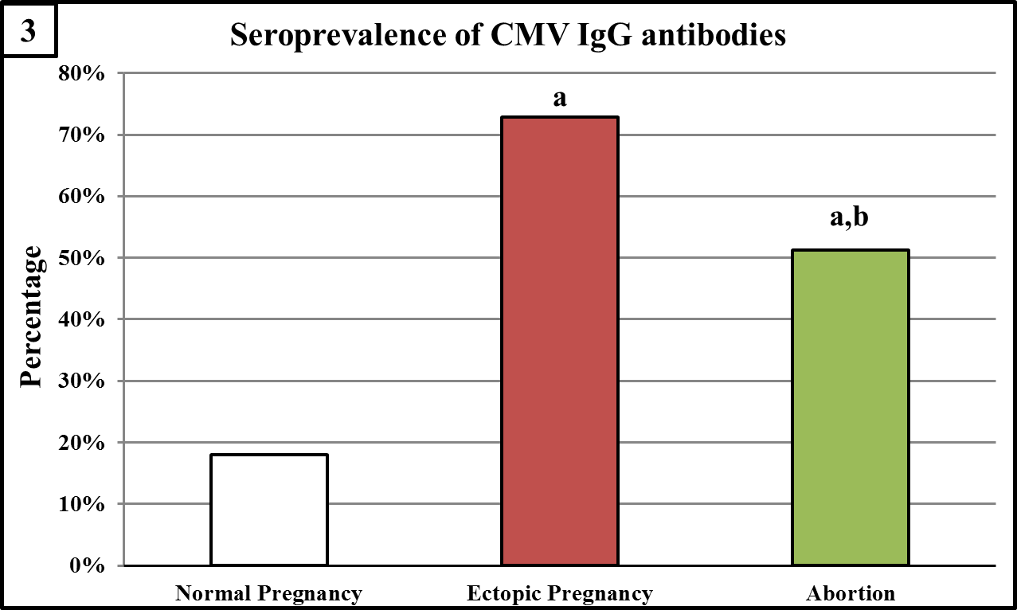
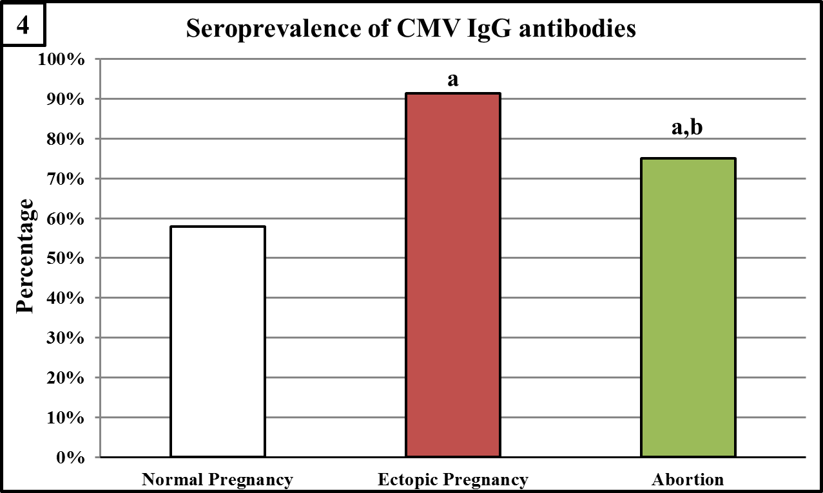
2- CMV (a = p < 0.05 compared to normal pregnancy and b = p < 0.05 compared to EP groups).
m

Slide 23
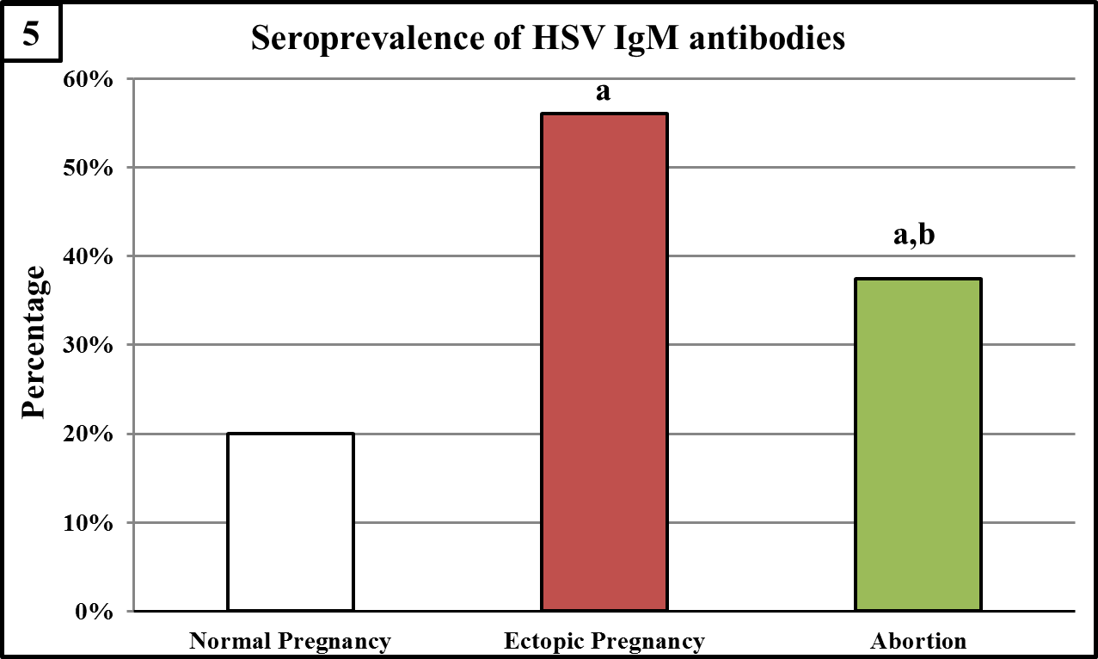
3- HSV IgM (a = p < 0.05 compared to normal pregnancy and b = p < 0.05 compared to EP groups).

Slide 24
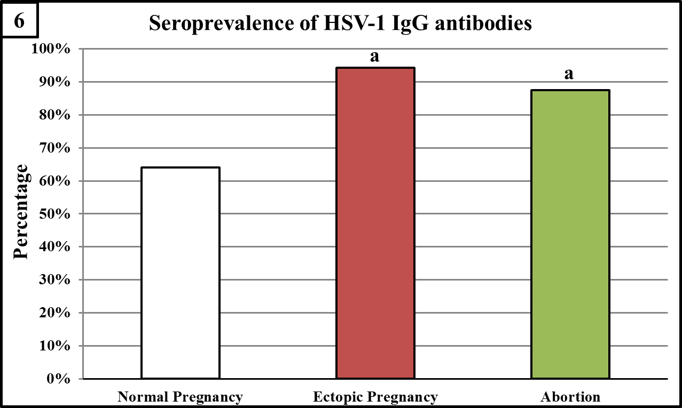
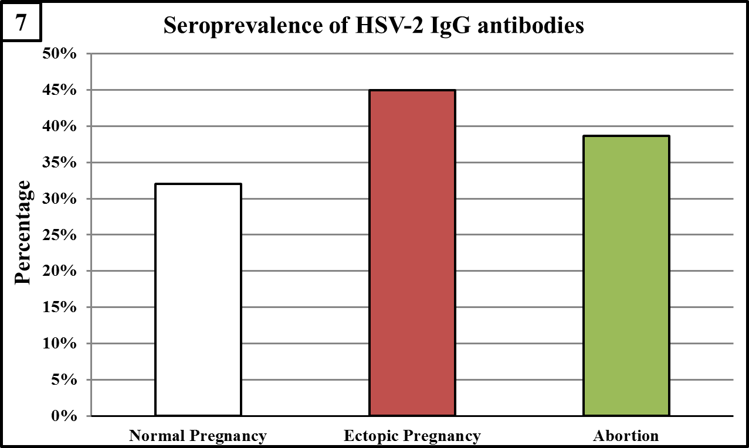
4- HSV IgG (a = p < 0.05 compared to normal pregnancy and b = p < 0.05 compared to EP groups).

Slide 25
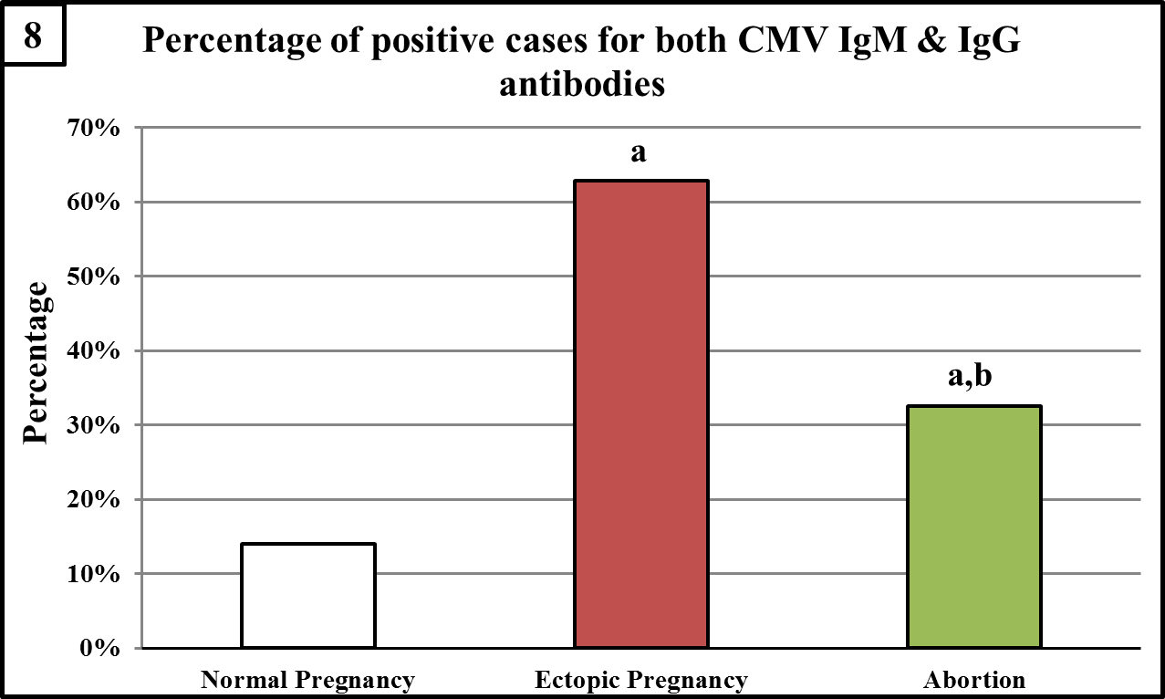
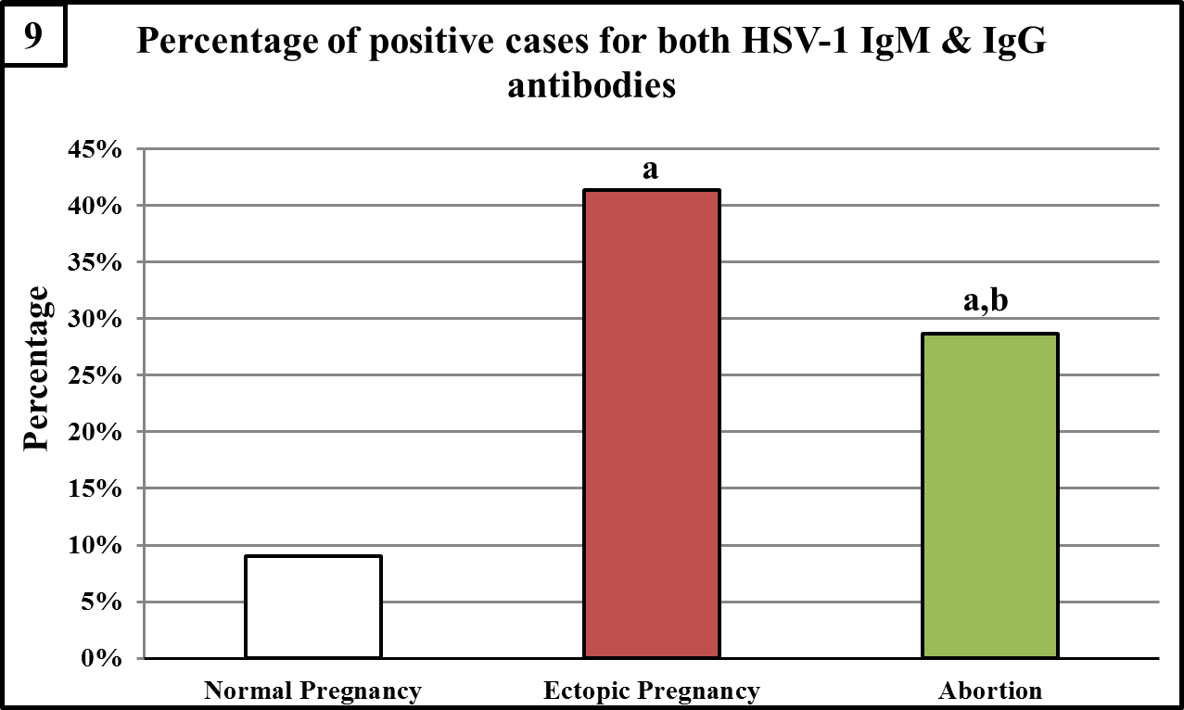
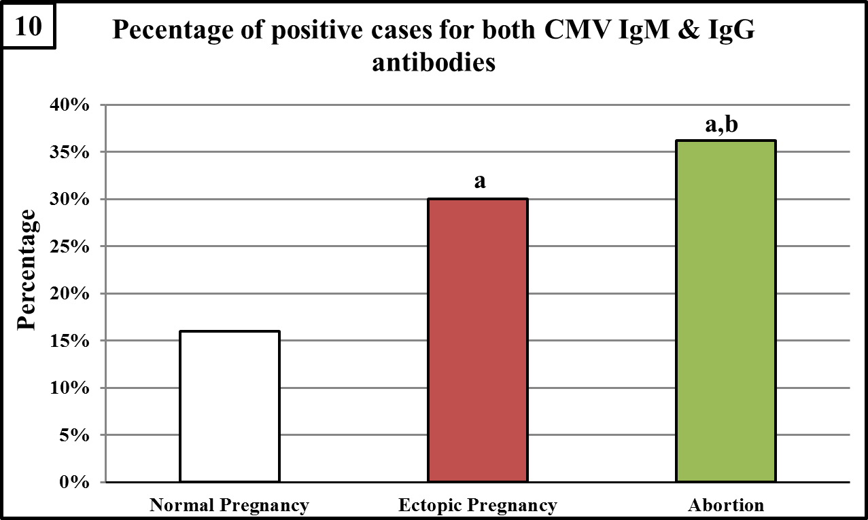
5- Percentage of positive cases for both IgM & IgG antibodies for Herpesviridae viruses

Slide 26
Conclusions
C. trachomatis, CMV, HSV could represent a major risk factor for adverse pregnancy outcome during the first trimester in Saudi females
The High number of positive cases for both IgM & IgG against CMV & HSV suggests that the development of abnormal early pregnancy could be associated with re-exposure/ reactivation of the viral infection.
The high prevalence of IgM antibodies against CMV & HSV in the normal pregnancy group suggests risk for vertical spread leading to neurological disabilities

Slide 27
Future Work
Confirmation of serological results by NAATs
Effect(s) of STIs on the expression of receptivity biomarkers Fallopian tube/endometrium tissues

Slide 28
THANKS FOR YOUR ATTENTION

