Slide 1
About OMICS Group
OMICS Group is an amalgamation of Open Access publications and worldwide international science conferences and events. Established in the year 2007 with the sole aim of making the information on Sciences and technology ‘Open Access’, OMICS Group publishes 500 online open access scholarly journals in all aspects of Science, Engineering, Management and Technology journals. OMICS Group has been instrumental in taking the knowledge on Science & technology to the doorsteps of ordinary men and women. Research Scholars, Students, Libraries, Educational Institutions, Research centers and the industry are main stakeholders that benefitted greatly from this knowledge dissemination. OMICS Group also organizes 500 International conferences annually across the globe, where knowledge transfer takes place through debates, round table discussions, poster presentations, workshops, symposia and exhibitions.

Slide 2
About OMICS International Conferences
OMICS International is a pioneer and leading science event organizer, which publishes around 500 open access journals and conducts over 500 Medical, Clinical, Engineering, Life Sciences, Pharma scientific conferences all over the globe annually with the support of more than 1000 scientific associations and 30,000 editorial board members and 3.5 million followers to its credit.
OMICS Group has organized 500 conferences, workshops and national symposiums across the major cities including San Francisco, Las Vegas, San Antonio, Omaha, Orlando, Raleigh, Santa Clara, Chicago, Philadelphia, Baltimore, United Kingdom, Valencia, Dubai, Beijing, Hyderabad, Bengaluru and Mumbai.
.

Slide 3
Genome-scale Promoter analysis using Exome Sequences (GPES)
San Ming Wang

Slide 4
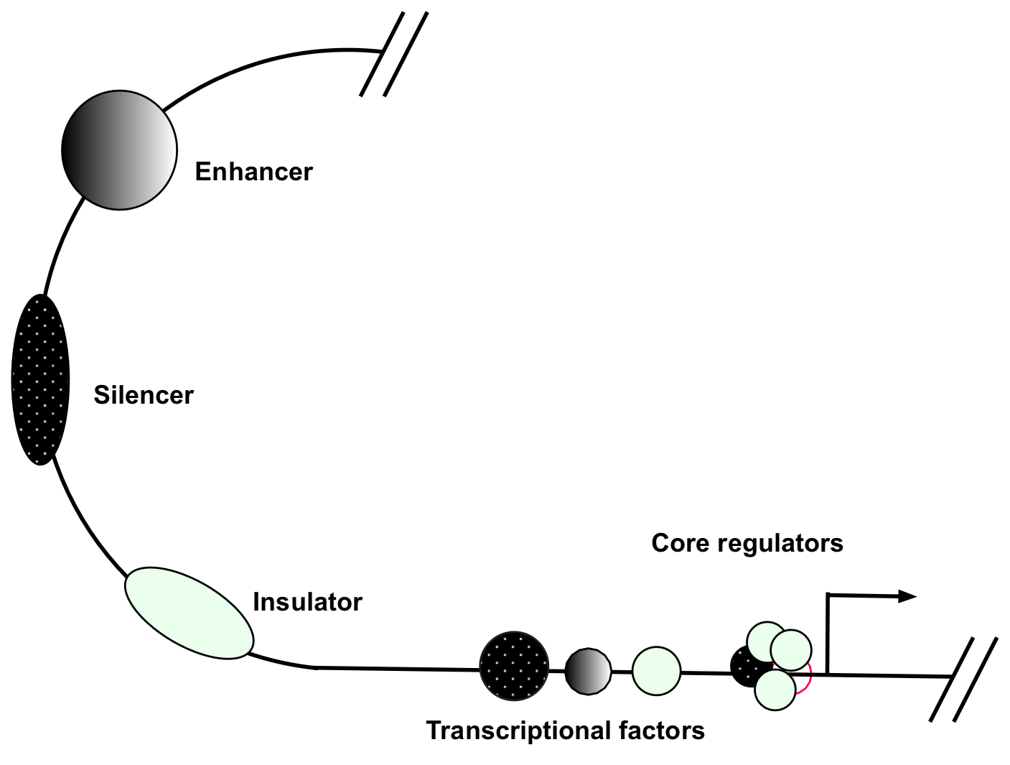
Regulation of gene expression
Distal elements
– enhancer, silencer, insulator
Promoter elements
– transcriptional factors, basal transcriptional machinery

Slide 5
Promoter structure

Slide 6
Promoter remains as a less-explored territory in disease study
Promoter directly controls gene expression
Mutation in promoter can have profound impact on biology and diseases
Lack of systematic tools for de novo promoter analysis
?

Slide 7
Existing method - Microarray
Promoter probes are based on human genome reference sequences
Human genome reference sequences were from “normal” individual genomes, not from disease genomes
Array is lack of the power for de novo promoter analysis

Slide 8
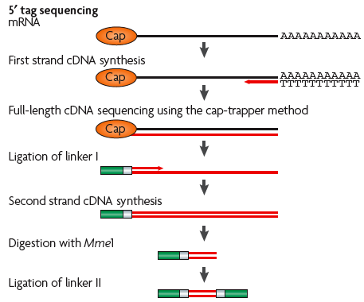
Existing method - Cap Analysis Gene Expression (CAGE)
Determine transcriptional start site
Do not analyze promoter
(Nature genetics 38, 626–35, 2006)

Slide 9
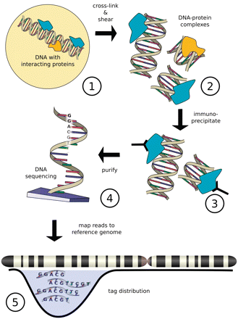
Existing method - ChIP-seq
Only analyze a given type of transcriptional factor-binding sites by immuno-precipitation
Brief Bioinform. 2011 Nov;12(6):626-33

Slide 10
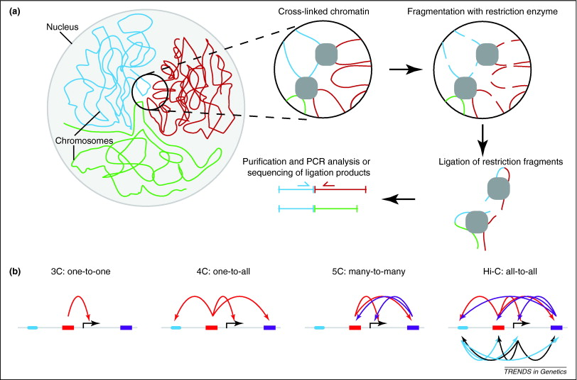
Existing method – Hi-C
Detect interaction between distal and promoter
Not focus on de novo promoter mapping
Trends Genet. 2011;27:63-71

Slide 11
Existing method – Whole-genome sequencing
It is not cost-effective to analyze promoters by sequencing the entire genome, as promoters account for only a small portion of the genome - using a canon to hit ants

Slide 12
Can exome sequences be used for genome-scale, de novo promoter analysis?

Slide 13
Distribution of actual exome sequences
(BMC Genomics. 13:194, 2012)

Slide 14
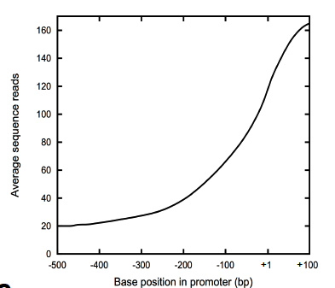
Distribution of exome data in promoter region (-500 to +100) from 50 exome data sets

Slide 15
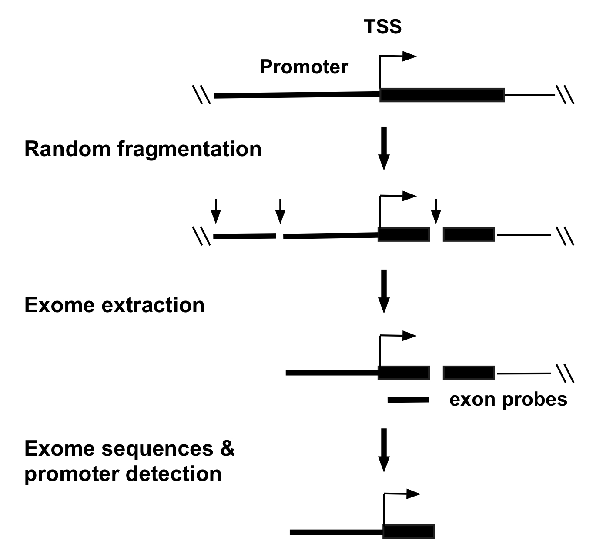
How does exome collect promoter sequences

Slide 16
50 exome data from breast cancer

Slide 17
Distribution of variants from the 50 exomes

Slide 18
Variants detected in promoters

Slide 19
Types of promoter variants identified
Class | Promoter | SNV | Indel | Total
Known motif | 601 | 521 | 57 | 578
TFBS motif | 238 | 251 | 37 | 288
TATA box | 179 | 195 | 30 | 225
Total | 1,018 | 967 | 124 | 1,091

Slide 20
Examples - variants in TATA-boxes

Slide 21
Examples - variants in TFBS motifs

Slide 22
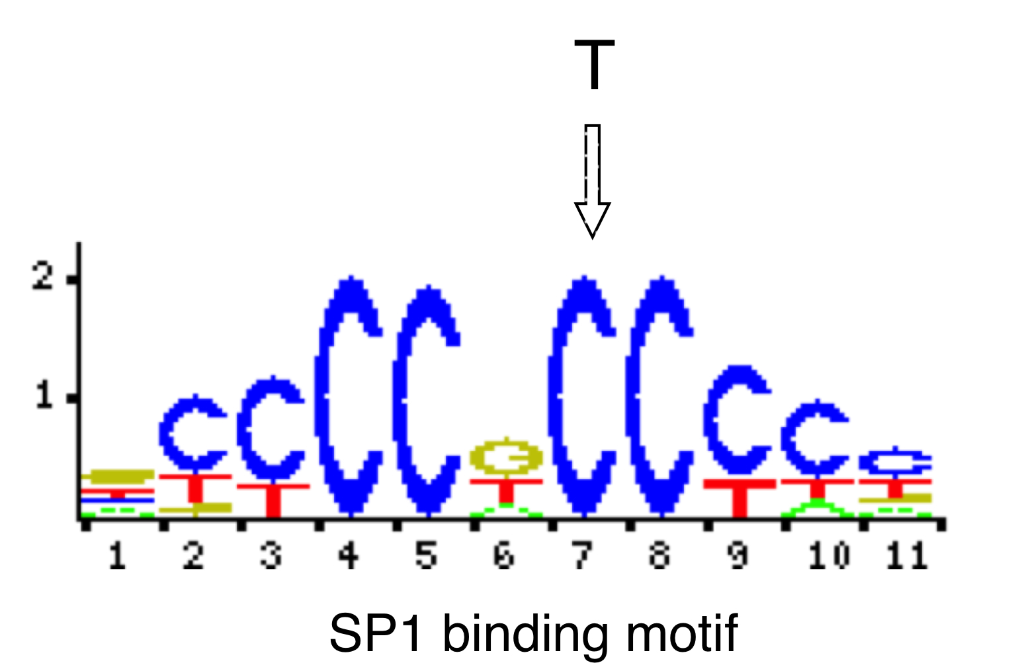
Example - a variant in Sp1 binding site

Slide 23
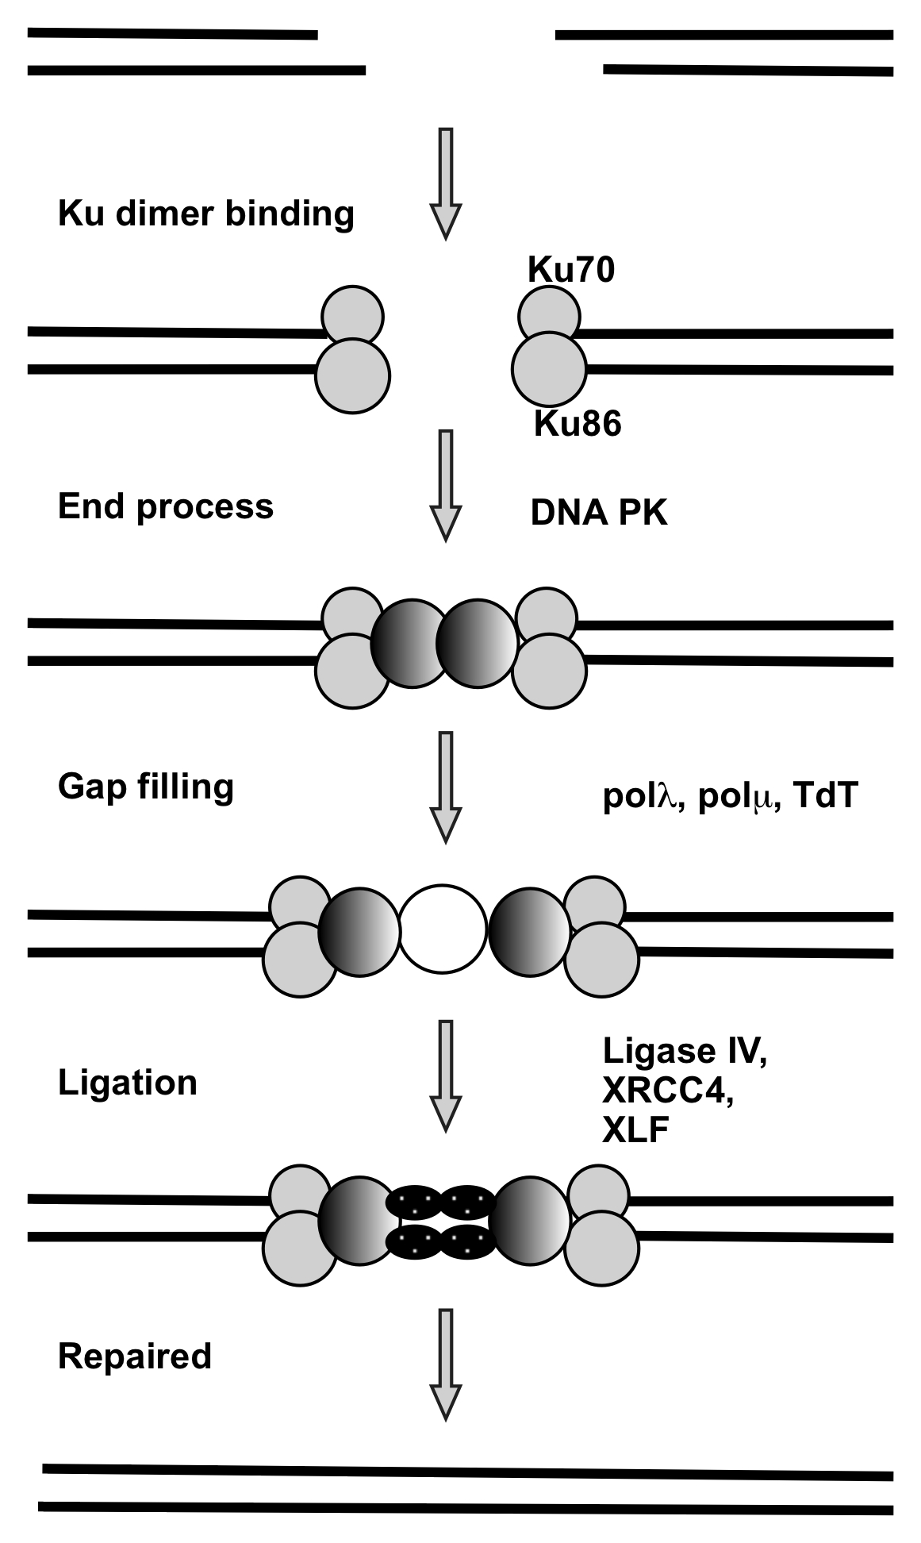
Example - Mapping variants in XRCC5 promoter
XRCC5:
Coding for Ku80
Involve in non-homologous, double-strand break repair (NHEJ) pathway

Slide 24
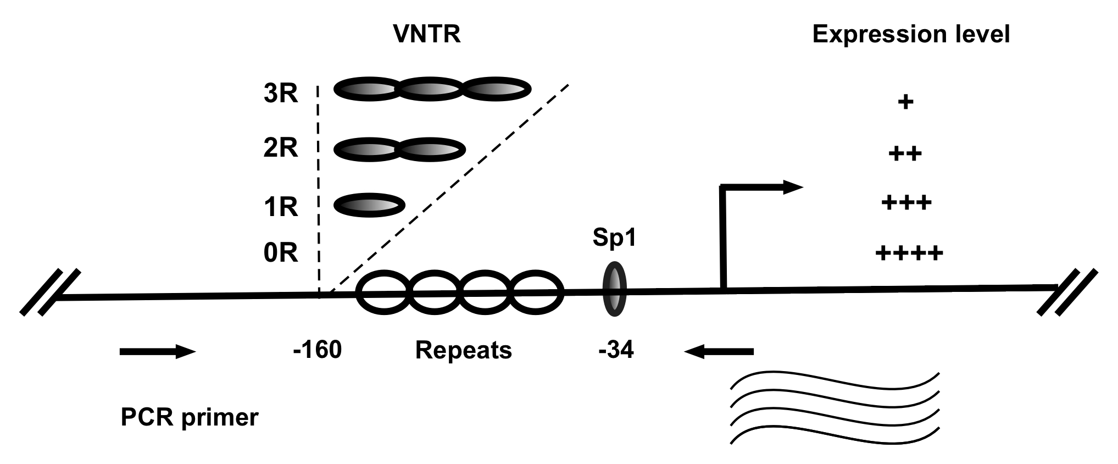
XRCC5 promoter structure, variable number tandem repeat (VNTR) polymorphism, and expression regulation.

Slide 25
XRCC5 promoter VNTR in breast cancer
Genotype | Case number (%)*
 | Normal | BRCA1+
2R/2R | 4 (7) | 12 (28)
1R/2R | 42 (72) | 25 (58)
1R/1R | 11 (19) | 5 (12)
0R/2R | 1 (2) | 1 (2)
0R/1R | 0 (0) | 0 (0)
Total | 58 (100) | 43 (100)
* Fisher test: p<0.03

Slide 26
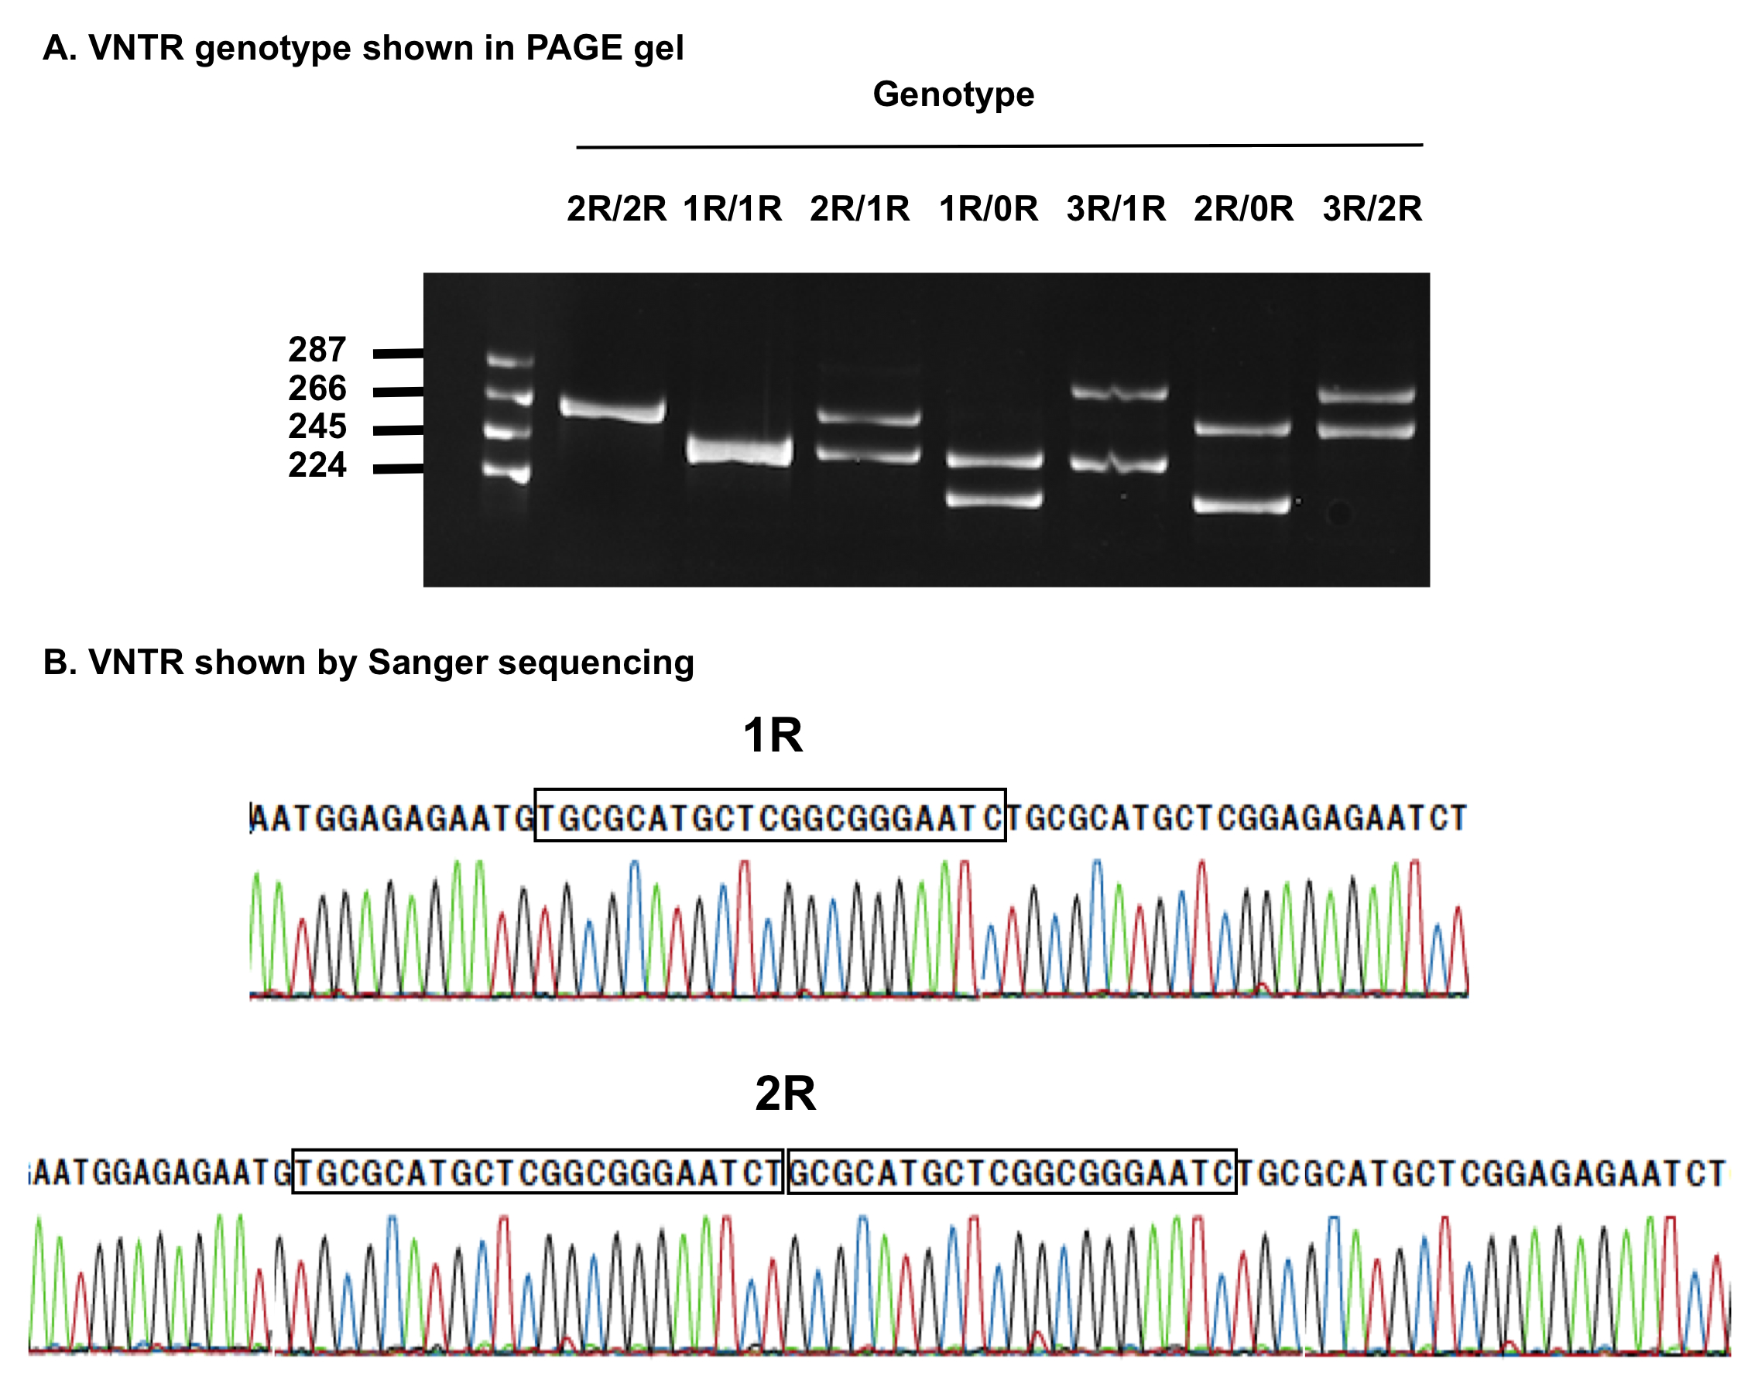

Slide 27
Abundant exome data publically available
Exome Aggregation Consortium (ExAC): 60,706
NHLBI GO Exome Sequencing Project (EVS6500): >6500
1000 genomes: 2,551
TCGA breast cancer: 1,081
GEO: 130
dbGaP: ?
…?
…?

Slide 28
Summary
GPES method provides a powerful tool for de novo promoter analysis, especially in the core-proximal region
Explore existing exome data using GPES should provide extensive knowledge for promoter architecture in biology and medicine
Genetic variation in promoter is likely far more complicated than currently consideration

Slide 29
Contribution
Yeong C. Kim
Bradley Downs
Hongxiu Wen
Fengxia Xiao
Peixian Chen
Jiangtao Luo
San Ming Wang

Slide 30
Let Us Meet Again
We welcome you all to our future conferences of OMICS International
Please Visit: http://transcriptomics.conferenceseries.com/
http://conferenceseries.com/
http://www.conferenceseries.com/genetics-and-molecular-biology-conferences.php

