Slide 1
WHY THE DRGs ARE NOT WELCOME IN COLOMBIA
Yuri Gorbanev; Ariel Cortés; Sandra Agudelo y Francisco J. Yepes
Pontificia Universidad Javeriana, Colombia.

Slide 2
Diagnosis-related group (DRG) is a system to classify hospital cases into groups.
Its intent was to identify the "products" that a hospital provides. One example of a "product" is an appendectomy.
The system was developed to replace "cost based" reimbursement that had been used up to that point in US health care system.
DRGs are assigned by a "grouper" program based on ICD (International Classification of Diseases) diagnoses, procedures, age, sex, discharge status, and the presence of complications or comorbidities.

Slide 3
INTRODUCTION
Innovation
Theory of diffusion of innovation (Rogers, 2003) suggests that successful adoption of an innovation depends on its attributes: relative advantage, compatibility, complexity, testing capacity and observability.
The organizational theories explain the adoption of innovation by the structure and culture of an organization.
The environmental theories explains the adoption of an innovation by the sociopolitical and economic context.

Slide 4
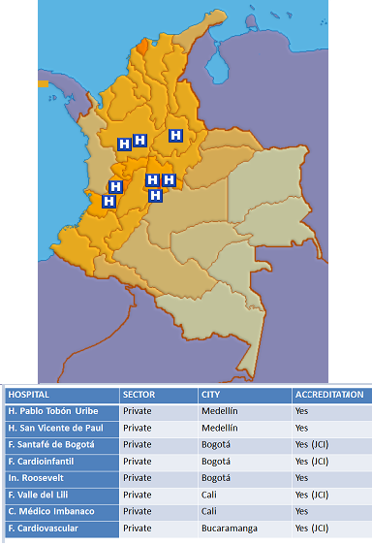
INTRODUCTION
Figure 1. High Complexity Hospital with DRGs in Colombia, 2014
Although DRGs are not an innovation in Europe or US, them actually do for Colombia
Only eight of 50 high complexity hospitals have it.

Slide 5
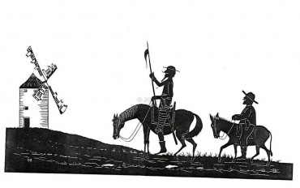
Our big challenge
Very low implementation proportion of DRGs* in colombian hospitals.
(Eight out of 50**)
*Diagnosis Related Groups
**High Complexity Hospitals
Notes:
http://www.unal.edu.co/contratacion/2008/ranking_hospitalario.pdf

Slide 6
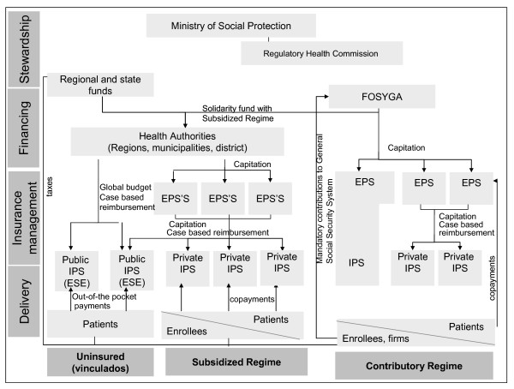
Figure 2. The model of managed competition in the Colombian healthcare system
Ministry of Health and social protection
Vargas et al. BMC Health Services Research 2010 10:297

Slide 7
INSTRUMENTS AND METHODS
It was an exploratory qualitative study that used a case method.
We made a pilot study to validate the interview guide.
We identified purposeful sample of key informants.
The positive and negative aspects with relation to innovation were identified as well as the cultural aspects and the relationship among them.

Slide 8
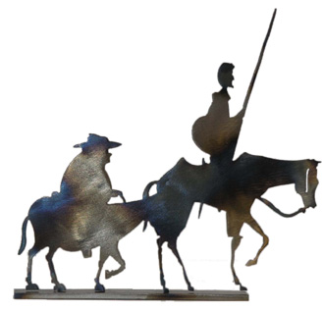
Informants
Table 1. Hospitals participanting in the study
HOSPITAL | WITH DRGs | WITHOUT DRGs | Total
Public | 0 | 1 | 6
Private | 2 | 3
We only could capture data from these 6 institutions, because DRG’s and HIS in Hospital Directors agenda were not a priority

Slide 9
Results
We found two types of constraints:
Institutional aspects: health care system
Organizational aspects: hospitals

Slide 10
Relative advantage
Directors know DRGs allow to combine clinical performance and cost considerations.
Improve clinical performance and quality of care, reduce the variability of medical practice, make staff performance transparent, helps to enforce the clinical practice guidelines and monitor the prescription of generic medicines rather than branded ones.
DRG can help to get accreditation.
Potentially, GRD can make negotiations between insurers and providers more transparent and evidence–based because allows to compare the performance of the hospital with national and international practice.

Slide 11
Cultural compatibility
DRGs are result oriented but, management indicators in Colombian hospitals and the health system in general are process oriented. (This occurs despite the evidence that good processes in health care do not ensure good results)
Directors thought DRGs threatens physician autonomy.

Slide 12
Complexity
There is a need of special training for doctors because they perceived DRGs as difficult to use.
Managers do not consider DRGs as an autonomous program but as a module of ERP used in their hospitals.
For Colombian medical doctors are essential to record the procedure because the procedure is billed.
The main difficulty lies in the requirement of a detailed and correct record of diagnosis according to ICD10.
Another obstacle to good reporting is the specific classification for procedures used in Colombia. (CUPs)

Slide 13
Testability
The acquisition process of DRGs also appears as a complex matter.
Managers consider DRGs as a system that cannot be tested before purchasing and implementation.
The interviewees seemed interested to do so but no provider offered such a possibility.

Slide 14
Observability
Managers agree that the observability of DRGs reports is not automatic.
DRGs allows keeping track of the performance to the level of an individual doctor, but the management chooses not to do so for fear of harming the organizational climate.

Slide 15
Figure 2. Institutional determinants of DRGs implementation process
Lack of competition on health market
DRGs help get accreditation
Relative advantage
Complexity
Compulsory reporting is based on process, not results
DRGs need helpful public policy
Compatibility
DRGs makes Insurer – Provider negotiation transparent, provides common language
DRGs need correct provider strategy
Testability
Observability
Positive Effect
Negative Effect

Slide 16
Figure 3. Organizational determinants of DRGs implementation process
DRGs need correct Coding
DRGs help to accreditation
Relative advantage
DRGs help to control costs
DRGs reduce VMP
Complexity
DRGs as a module of ERP
DRGs reduce physician autonomy
Compatibility
Physicians need training to work with DRGs
DRGs are result oriented
Testability
DRGs help to improve quality
Non conflict culture.
Observability
*VMP: Variability in Medical practice
*ERP: Enterprise Resource Planning
Positive Effect
Negative Effect

Slide 17
CONCLUSION
Interviewees have positive perception of DRGs.
DRGs allows to control for quality and costs simultaneously, they help to get accreditation, reduce VMP, potentially, may make negotiation between Insurers and Providers transparent.
… But the managers, who want to adopt DRGs, face organizational and institutional restrictions.
Among organizational restrictions are: the culture of physician autonomy, non conflict culture, sub record of diagnosis and emphasis on process instead of results.
Among the institutional restrictions are: lack of competition on the health care market, the negotiation between Insurers and Providers based on procedures not diagnosis and finally lack of public policy aimed at DRGs adoption.

Slide 18
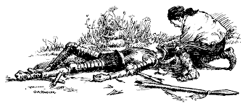
!Thank you!
Further information: sandra.agudelo@javeriana.edu.co
sandragesis@gmail.com

Slide 19
Bibliography
Ministerio de Protección Social; Universidad Nacional; FEDESALUD. Ranking de Instituciones Prestadoras de Servicios de Salud basado en el sistema únido de habilitación. Bogotá: Ministerio; 2006.
Greenhalgh T,GRFMPBOK. Diffusion of innovation in service organizations: Systematic review and recommendations. Milbank Quarterly, v. 82, No. 4 (Ebsco). 2004;: p. pp. 581–629.
Fleuren M, Wiefferink K, Paulussen T. Determinants of innovation within health care organizations. Literature review and Delphi study. International Journal for Quality in Health Care. 2004; 16(2): p. 107–123.
Rogers E. Diffusion of innovations New York: Free Press; 2003.
Greenhalgh T, Robert G, MacFarlane F, Bate P, Kyriakidou O. Diffusion of innovation in service organizations: Systematic review and recommendations. Milbank Quarterly. 2004; 82(4): p. 581–629.
Schein E. Organizational culture and leadership New York: Wiley; 2010.
Mathauer I, Wittenbecher F. Hospital payment systems based on diagnosis-related groups: experiences in low- and middle-income countries. Bulletin of the World Health Organization. 2013; 91(10): p. 746-756A.
Geissler A, Scheller-Kreinsen D, Quentin W. Do Diagnosis-Related Groups Appropriately Explain Variations in Costs and Length of Stay of Hip Replacement? A Comparative Assessment of DRG Systems across 10 European Countries. Health Economics. 2012; 21(Supplement 2): p. 103-15.
Thommen D, Weissenberger N, Schuetz P, Mueller B, Reemts C, Holler T, et al. Head-to-head comparison of length of stay, patients' outcome and satisfaction in Switzerland before and after SwissDRG-Implementation in 2012 in 2012: an observational study in two tertiary university centers. Swiss Medical Weekly. 2014; 144: p. 1-10.
Kroneman M, Nagy J. Introducing DRG-based financing in Hungary: a study into the relationship between supply of hospital beds and use of these beds under changing institutional circumstances. Health Policy. 2001; 55(1): p. 19-36.
Ridder H, Doege V, Martini S. Hospitals on the road to competitive advantage? The case of implementing DRG in German hospitals. Academy of Management Annual Meeting Proceedings. 2005;: p. B1-B6.
Ridder H, Doege V, Martini S. Differences in the Implementation of Diagnosis-Related Groups across Clinical Departments: A German Hospital Case Study. Health Services Research. 2007; 42(6): p. 2120-2139.
Gorbanev I, Cortés A, Agudelo S, Torres S, Yepes F. Percepciones del personal hospitalario sobre la preparación institucional para la implementación de innovaciones en el sector salud. Universitas Medica, V. 53, No. 4. 2012;: p. pp. 352 - 364.
Ridder H, Doege V, Martini S. Academy of Management Annual Meeting Proceedings. 2005;: p. B1-B6.

