Slide 1
Unknown genetic predisposition in familial breast cancer can lie deep in family tree
San Ming Wang
University of Nebraska Medical Center

Slide 2
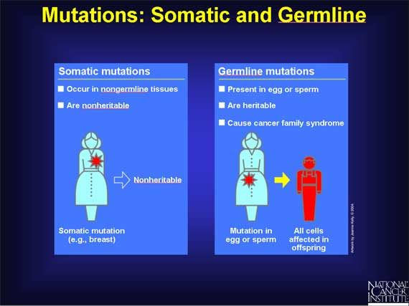
Genetically defined breast cancer
Sporadic Breast Cancer caused by somatic mutation
90% of breast cancer – “bad luck”
Familial Breast Cancer caused by germline mutation
10% of breast cancer - inherited
http://www.cancer.gov/types/breast

Slide 3
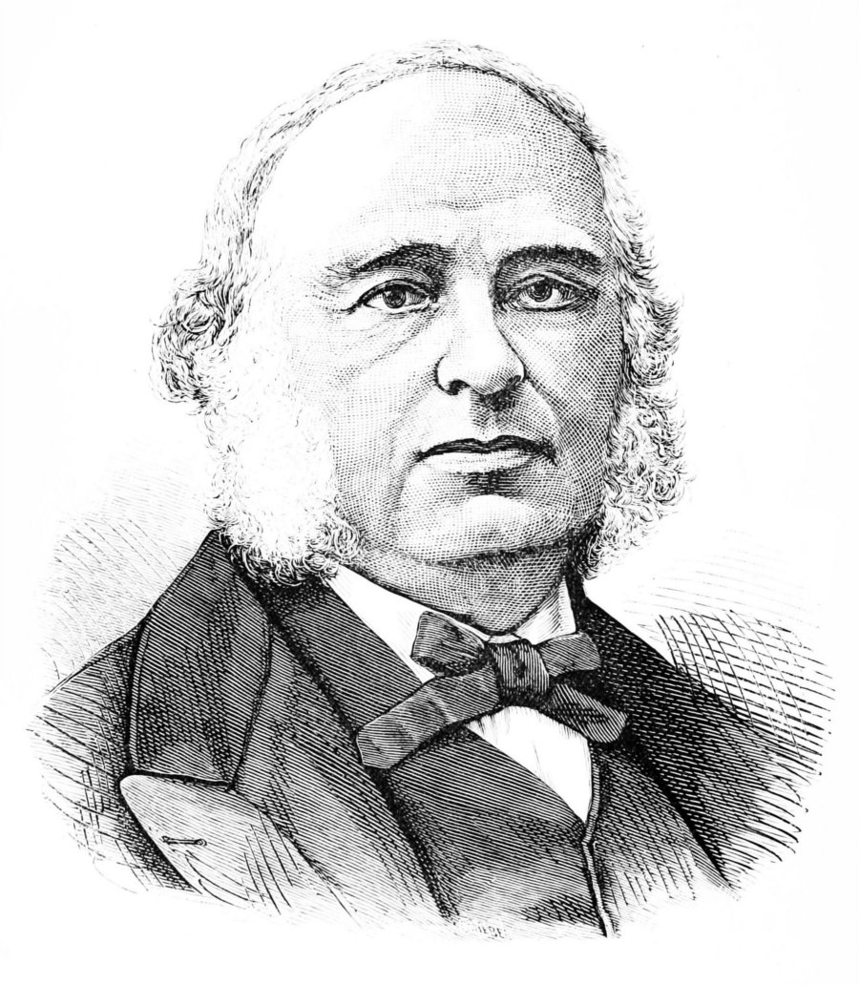
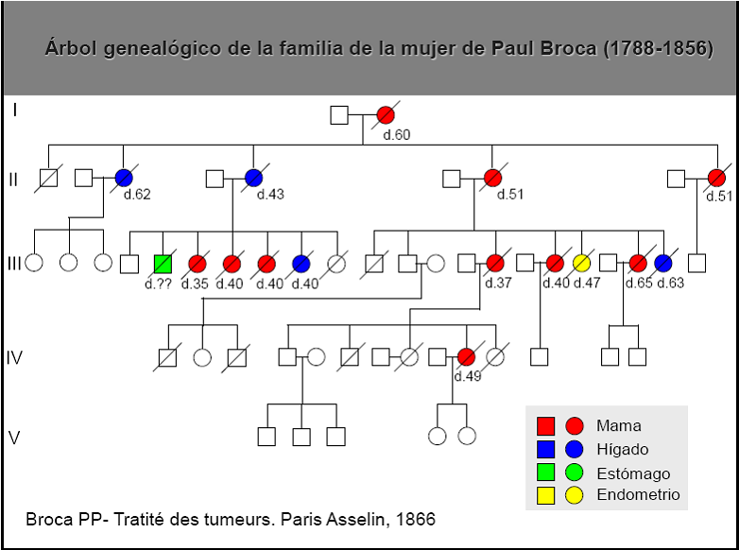
Familial Breast Cancer
In 1866, French physician Paul Broca reported 10 women over four generations in his wife’s family died from breast cancer

Slide 4
Genetic predisposition is the major factor for familial breast cancer
Factors contributing to cancer include environment, life style, nutrition, infection, genetics etc.
Genetic predisposition is considered as the major factor responsible for familial breast cancer
Familial breast cancer is a genetic disease

Slide 5
BRCAx familial breast cancer
Germline mutations in BRCA1 and BRCA 2 genes are known genetic predispositions for familial breast cancer
Germline mutations in BRCA1 and BRCA 2 genes are present in 10-20% of familial breast cancer
Predispositions for 40-50% of FBC are known
Predispositions for 50-60% of FBC remain unknown

Slide 6
Efforts made to identify the unknown predispositions
linkage analysis, positional cloning, genomic arrays, targeted sequencing, GWAS, exome sequencing have been applied
Large sample sizes of tenth of thousand cases per study are routinely used
Newly identified predispositions are very limited

Slide 7
Newly identified predisposition are all rare
Predisposition | BC cases | BC cases | References
 |  | with mutation
XRCC2 | 3,371 | 5 | Park et al, 2012
XRCC2 | 3,548 | 0 | Hilbers et al, 2012
FANCC | 1,435 | 1 | Tompson et al, 2012
BLM | 1,435 | 4 | Tompson et al, 2012
BRIP1/BACH1 | 357 | 2 | Cao et al. 2010
PPM1D | 6,634 | 21 | Ruark et al.
Total | 16,789 | 33 (0.5%)

Slide 8
The rarity makes it indistinguishable between disease and normal population
Identified rare germline mutations in XRCC2 in 5 out of 3,371 BRCA1/2-negative familial breast cancer cases. (Park, et al. Am J Hum Genet. (4):734-9, 2012)
The same mutation failed to be detected in another 3,548 BRCA1/2-negative familial breast cancer cases but in 1 of 1,435 normal control (Hilbers et al. J Med Genet. 49(10):618-20, 2012)

Slide 9
Current theory to explain germline predispositions in familial breast cancer
High-risk genes: rare mutations convey high-risk, such as BRCA1;
Intermediate-risk genes: rare mutations convey intermediate risk, such as CHEK2;
Modest risk genetic variants: common genetic variants such as the SNPs detected by GWAS population studies

Slide 10
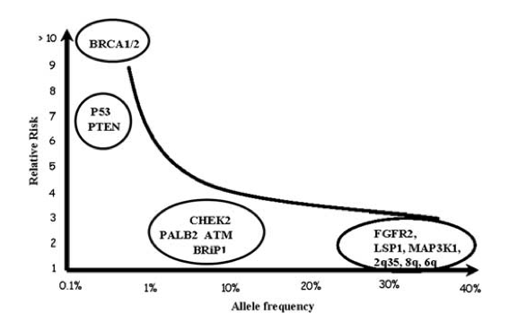
Distribution of known genetic predispositions
Fanale et al. Oncogene 31(17):2121-8, 2012

Slide 11
Question: frequency of unknown predispositions
Existing ?
40%
100%

Slide 12
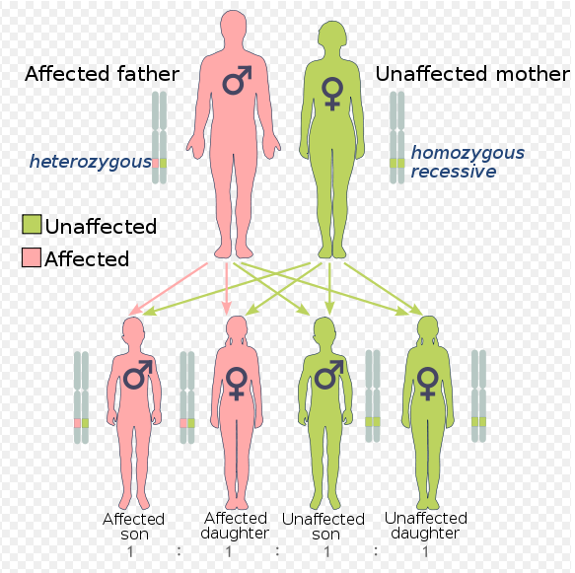
Hypothesis:
Unknown predisposition can be family-specific
FBC is an autosomal dominant disease
Each family is enriched with the predisposition
Focus on family may have higher chance to identify the unknown predisposition than population screening (diluted)

Slide 13
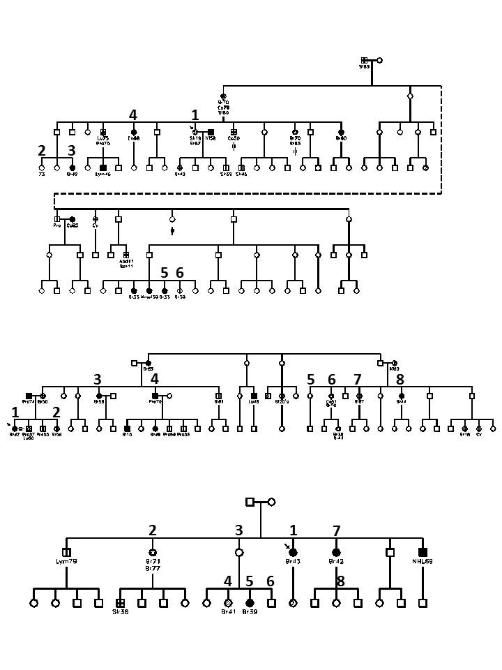
Studies in BRCAx families

Slide 14
Exome sequencing
Next-generation sequencing-based
>180,000 exons from around 20,000 genes in the human genome
1/100 genome DNA content
1/5 cost of sequencing whole genome ($1,000)
85% of known genetic diseases are caused by mutation in exon !
Genome
Exome
Sequencing
Next-generation DNA sequencing

Slide 15
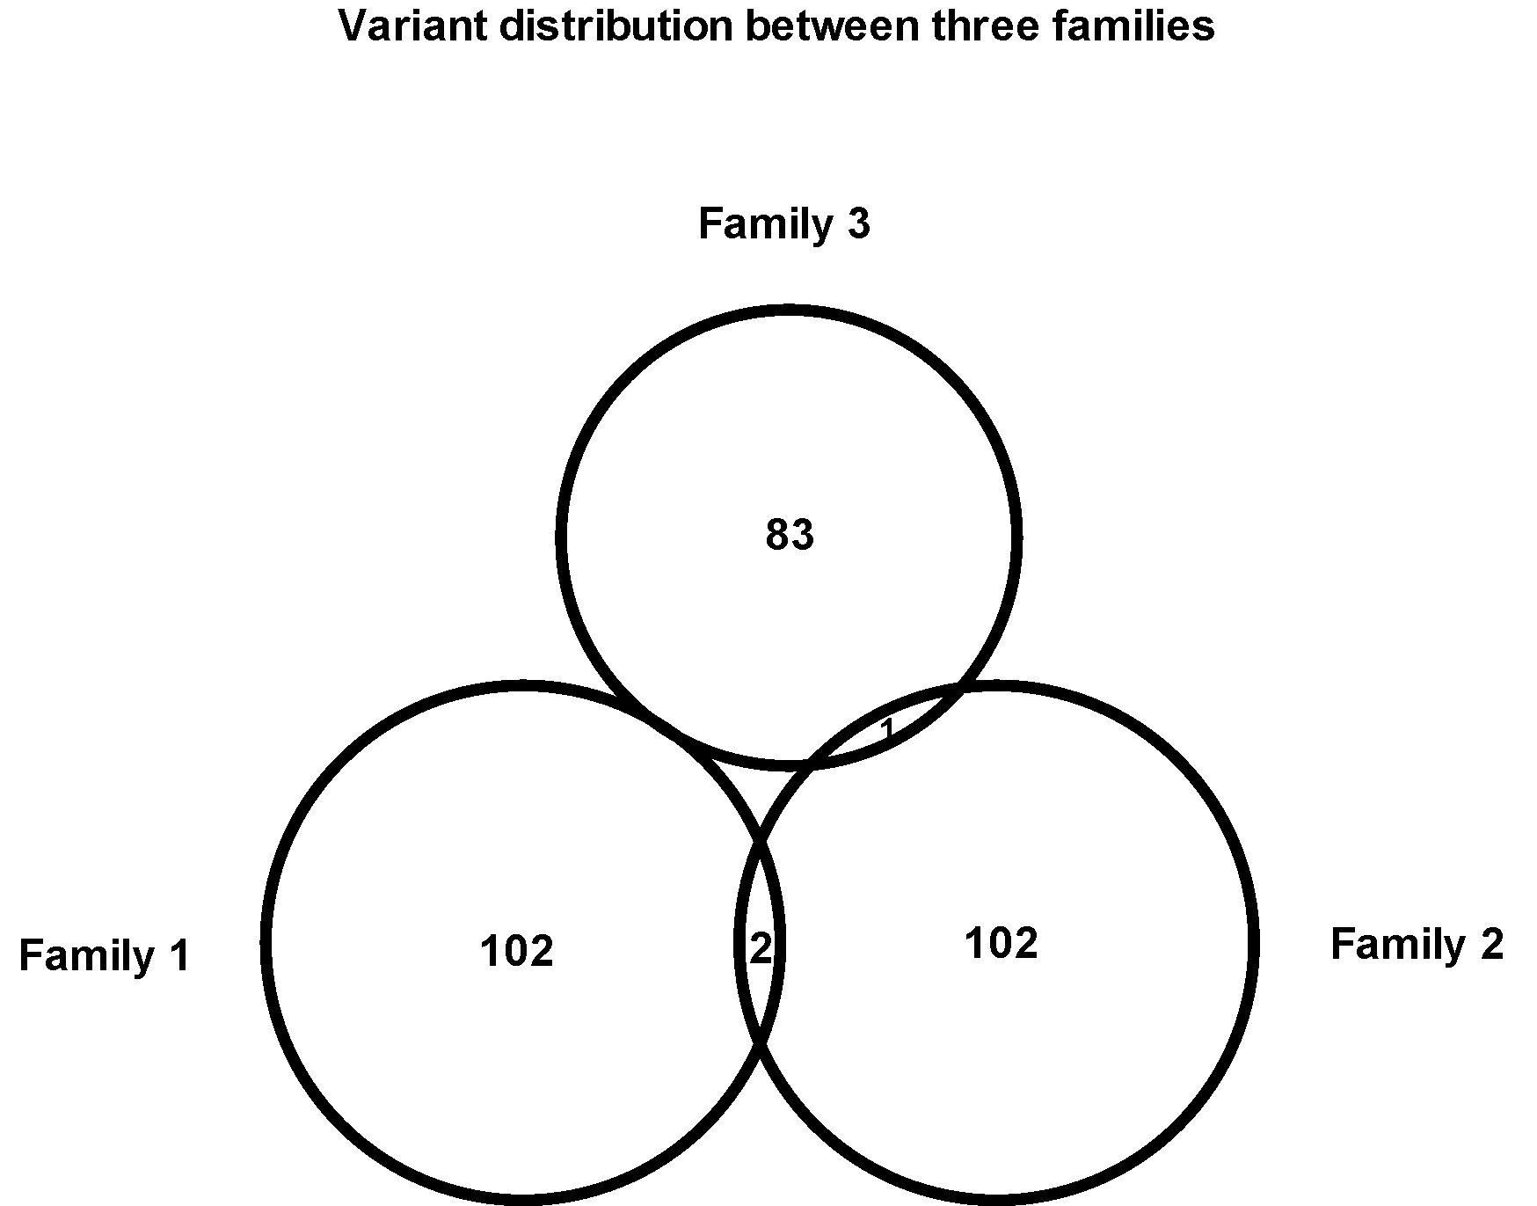
Germline mutations in three BRCAx families
are highly family-specific

Slide 16
Putative genetic predisposition in each BRCAx family
Gene | Position | Change | Distribution
Family 1
PINK1 | chr1:20972051 | -2A>G | - | + | + | - | - | -
USP28 | chr11:113683049 | A>G | - | + | + | - | - | -
TIGD2 | chr4:90034310 | C>T | - | - | - | - | + | +
Family 2
KAT6B | chr10:76789128 | G>T | + | + | + | + | + | +
KAT6B | chr10:76789311 | C>T | + | + | + | + | + | +
NOTCH2 | chr1:120459167 | C>T | + | - | - | - | - | +
Family 3
ADCY9 | chr16:4016224 | G>A | + | - | + | - | -
PHKB | chr16:47628126 | +1G>T | + | - | - | + | -
NANP | chr20:25596725 | A>G | - | + | + | - | -
PPP6R2 | chr22:50857867 | C>A | - | - | - | + | +

Slide 17
KAT6B

Slide 18
KAT6B
A histone acetyl-transferase
Its N-terminal is involved in transcriptional repression while its C-terminal is involved in transcriptional activation
Interacts with important transcriptional regulators RUNX1 and RUNX2.
A component of the MOZ/MORF complex involved in DNA replication, transcriptional regulation, and epigenetic modification of chromatin structure
Mutations cause several neural genetic disease
Not known involved in familial breast cancer

Slide 19
Are the same germline mutations in KAT6B also present in other BRCAX families?
42 additional cancers from 26 BRCAx families were tested
None of the mutations are present in these families
Sequencing entire KAT6B gene see no mutations

Slide 20
Distribution of germline mutations
in 26 BRCAx families

Slide 21
Each BRCAx breast cancer family may have its own genetic cause
Familial-specific predisposition
40%
100%

Slide 22
Genetic predispositions in familial breast cancer:
Same Disease, Different Causes
Common predispositions only exist in a portion of familial breast cancer
Family-specific predispositions are responsible for many familial breast cancer
Family-based approach can identify the unknown predispositions
Precision medicine, personalized medicine, familial medicine….
Wen et al. BMC Cancer. 2014 ;14:470

Slide 23
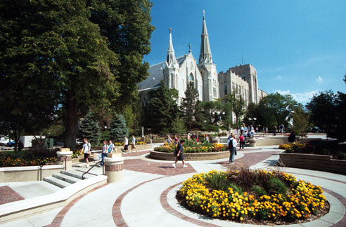
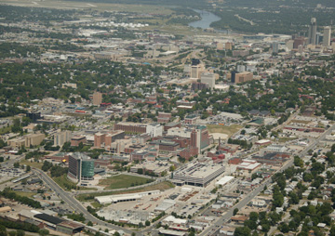
Contribution
University of Nebraska Med Center
Yeong C. Kim
Bradley Downs
Hongxiu Wen
Fengxia Xiao
Peixian Chen
Jiangtao Luo
San Ming Wang
Creighton University
Carrie Snyder
Mark Stacey
Dina Becirovic
Henry Lynch

