Slide 1
Investigating the Significance of Wild Aloe (Aloe ferox) Harvesting in the Livelihoods of the Rural Communities of the Eastern Cape, South Africa Mosweu S, Zhou L & Agdhassi F University of Fort Hare

Slide 2
Structure
Introduction
Methods
Results and Discussion
Conclusion and Recommendations
Future Research Activities

Slide 3
Introduction
The practice of Aloe ferox harvesting for various purposes started more than 300 years ago in South Africa (Newton and Vaughan,1996).
The communal areas of the Cape region are considered to have developed into hot spots for Aloe ferox harvesting in over the years.
In the recent years, limited livelihood options to rural communities and increased opportunities for commercial exploitation of Aloe ferox rendered its harvesting to be one of the alternative livelihood activities for the poor rural communities inhabiting communal areas of the Cape region (Shackleton et al, 2009).
However, there are few studies focusing on the significance of Aloe ferox harvesting in the livelihoods of the rural poor communities.

Slide 4
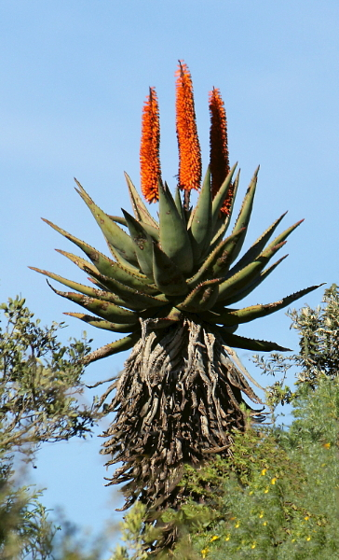
Introduction
Single stemmed, perennial shrub, height of 2-3 metres, succulent leaves.
Stems are characteristically clothed in a skirt of dry leaves.
Boat-like shaped leaves which curve upwards and bordered by sharp reddish spines.
Figure1. Aloe ferox plant

Slide 5
Introduction
The aim of this study was to investigate the significance of Aloe ferox harvesting in the livelihoods of the rural poor communities of three villages (Khayamnandi, Pumulani and Jani) in the Eastern Cape Province of South Africa.

Slide 6
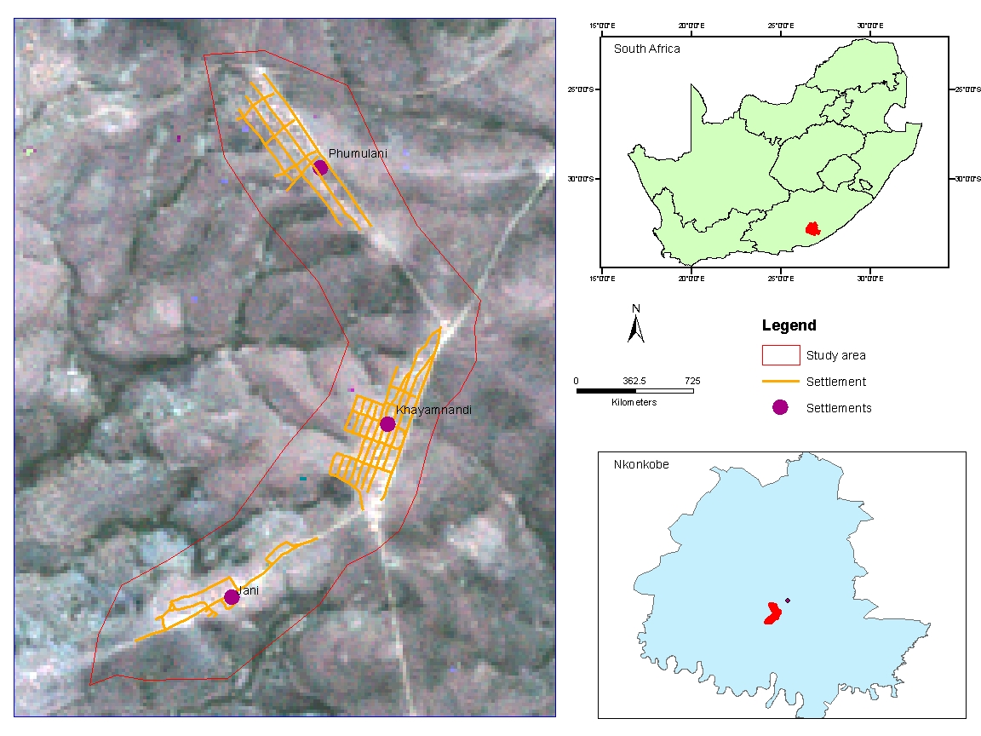
Figure 2. Location of the Study Area

Slide 7
Methods
Questionnaires were used to obtain data related to the perceptions of the communities about the significance of Aloe ferox harvesting in their livelihoods.
Questionnaires were administered through individual interviews .
A total of 38 individual (32 females & 6 males) were interviewed.
A focused group discussion (15 individuals) was conducted.
Field observations were undertaken.

Slide 8
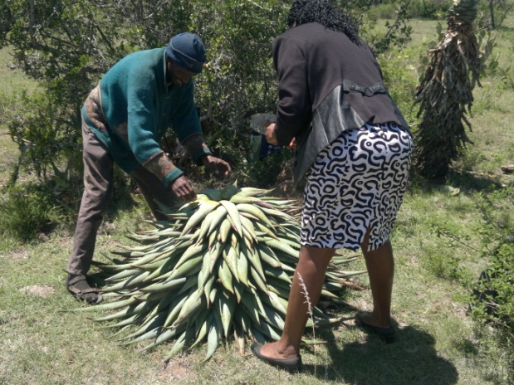
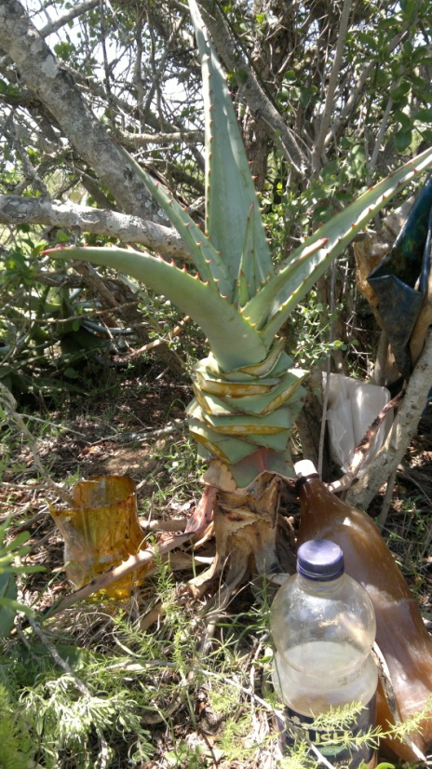
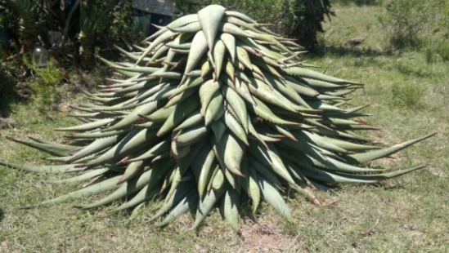
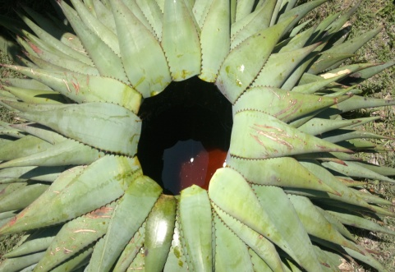
Results and Discussion
1-2L of exudates
Figure 3. Process of Aloe tapping
20L = R240.00 approximately 22 USD

Slide 9
Results and Discussion
All respondents found that Aloe tapping was already being practiced when they grew up.
They learnt how to do Aloe tapping through observing elders who were already acquainted with the activity.
The respondents were compelled to join Aloe harvesting group by lack of options for income generation.
They were not aware of policy
issues that affect their involvement
in this activity.

Slide 10
Results and Discussion
Harvesting was conducted any day except during rainy and windy days as these conditions negate productivity of the Aloe exudates.
7 respondents indicated that 2 members of their families were involved, while 1 mentioned that 3 family members were involved.
Since the Aloe harvesting is conducted some distance away from the settlements, the harvesters usually go out in groups for security purposes.
All harvesters did not have effective protective equipment, although some used conventional gloves, boots and coats.

Slide 11
Results and Discussion
Respondents indicated that some risks associated with Aloe harvesting include snake bites and injuries from the spines.
They also alluded to some illnesses that they believed were caused by inhaling gaseous products from Aloe exudates. This was however difficult to ascertain.
Figure 5. Aloe uses

Slide 12
Results and Discussion
Suggestions from the respondents
Government should
provide personal protective equipment,
set prices,
provide needed machinery,
train Aloe harvesters,
provide funds to start cooperatives/ groups.

Slide 13
Conclusion and Recommendations
This research established that Aloe ferox harvesting is a potential poverty alleviation communal activity which can be implemented in the rural areas of the Eastern Cape.
It is however not immune to challenges:
Lack of organization and coordination among the harvesters.
Lack of knowledge regarding the policies and regulations guiding the activity.
Lack of appropriate equipment.
Lack of monitoring and regulation of Aloe harvesting rates.
The communities may be assisted by governmental organization or non-governmental organizations to form community based natural resources management trust.

Slide 14
Future Research Activities
Determine ways of assisting the communities to establish a community based natural resource management trust.
Liaise with governmental and non-governmental organizations on issues of empowering the communities on Aloe harvesting related matters.
Continue this research by incorporating issues concerning sustainability

Slide 15
Thank You

