Slide 1


Effect of orientation, ventilation, floor space allowance and cooling arrangement of cattle shed on the microclimate of shed and milk yield of dairy cattle in Goa
S K Das, M Karunakaran and S B Barbuddhe
ICAR Research Complex for Goa
Ela – 403402, Goa, India

Slide 2
Introduction
Livestock is an integral part of agriculture in India more particularly in this state as most of the people due to multifarious reasons depend on the animal for their economic support.
As per basic animal husbandry statistics (2012) total cattle population in India is 199 million, total buffalo population is 105 million with total bovine population of 304 million.
Dairy housing systems have significant impact on the dairy production, overall health and longevity of dairy cattle. Housing systems have been transformed from pasture-based extensive system to indoor stall feeding system with limited outdoor access.
Housing management, in reality, is the manipulation of the animal environment to promote the most efficient production of milk, meat, and wool. A better understanding of micro climate of shed will greatly enhance managerial capabilities.

Slide 3

Housing provides the most potential control over micro climatological parameters; however, it comes at a relatively high initial investment cost per head.
In present time main focus is on cow comfort, which will increase milk production and eliminate many animal health problems. The most common measure taken by the Japanese farmers to reduce the temperature effect on dairy cattle was to improve the building construction (Nomiyama et al., 1981) since it is proved beyond doubt that high temperature and high humidity is deleterious to milk production (Lurdi, 1982).
Thiagarajan and Thomas (1990) also found that proper housing helped in reducing the extremes in maximum and minimum air temperatures.
Shades can improve animal comfort, productivity and should be designed properly to reduce heat stress. Good housing systems are those that are well designed for ease of management and maintenance at all times.
So, this study was taken with the object to develop suitable housing system to enhance comfort of animal and to increase the productivity of dairy cattle.

Slide 4
Materials and Methods
Sixty farmers spread over six talukas , namely Pernem, Bicholim and Ponda taluka of North Goa district; Salcete, Canacona and Sanguem talukas of South Goa district, were considered based on cattle population for this study.
Ten farmers consisting of large, medium, small and marginal from each taluka were considered .
Farmers were interviewed for collecting information on housing and dairy production system of Goa such as system of management, type of cattle shed, orientation of shed, ventilation of shed, roofing material, floor material, floor space provision, cooling system, breed of animal, feeding status and health status of animal etc.
Afterwards twenty four farmers were selected considering four from each taluka.

Slide 5
Digital hygrometer, dry bulb – wet bulb thermometer and maximum – minimum thermometer were installed in those cattle sheds and farmers were trained for recording data.
Data on microclimate was recorded regularly in the morning as per IMD (1994). THI was calculated as per West (1994).
Data on daily milk yield of cows were recorded twice daily as per standard procedure. Each farmer’s house was visited regularly for monitoring production, reproduction, health aspect of animal and data recording.
Afterwards data were analyzed statistically as per Snedecor and Cochran (1994) using SPSS package to find the effect of housing on microclimate of dairy shed and milk production of cow.

Slide 6
Results and Discussion
Effect of orientation of cattle shed
Data analysis revealed that orientation of cattle shed had significant ( P < 0.05) effect on average daily milk yield, average daily air temperature, average daily relative humidity and average daily temperature humidity index (Table -1).
Av daily milk yield was significantly higher in cattle shed having east – west orientation (9.720 ± 0.093 kg) than that in cattle shed with north south orientation (9.470 ± 0.085 kg). All the microclimates were significantly lower in shed with east – west orientation than that of shed having north - south orientation ( Figure-1).
This was due to the reason that this type of orientation reduces direct entry of solar radiation inside the cattle shed which ultimately helps to keep the house cool. Alignment of the long-axis in an east-west direction achieves the maximum amount of shade under the structure and is the preferred orientation for confined animals. So, it indicated that lesser heat stress and more milk yield were observed in cattle house having east – west orientation.

Slide 7
Table-1: Effect of orientation on microclimate and milk yield of cow
Particular | Av. daily milk yield (Kg) | Av. daily air temperature (⁰C ) | Av. daily relative humidity (%) | Av. daily temperature humidity index
East West Orientation | 9.720 ª ± 0.093 (3300) | 27.81 ^{b} ± 0.12 (3300) | 77.15 ^{b} ± 0.60 (3300) | 77.72 ^{b} ± 0.31 (3300)
North South Orientation | 9.470 ^{b} ± 0.085 (4620) | 28.05 ª ± 0.10 (4620) | 79.42 ª ± 0.36 (4620) | 79.02 ª ± 0.16 (4620)
F Value | 9.56 * | 7.12 * | 8.97* | 21.94*

Slide 8
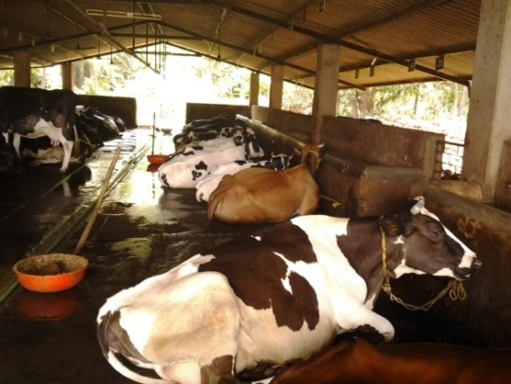
Buffington and Collier (1983) mentioned that the preferred orientation would be east-west for hot climates, i.e. the long axis of the building would run in an east-west direction and the shed height should be 3.65 m, and shading efficiency should not be lower than 85%.
In conformity to present findings Samer (2010) also advocated that shade structure should be oriented east-west where the largest area of the structure should receive the maximum wind to allow better aeration.

Slide 9
Effect of ventilation of shed
Ventilation of cattle shed had highly significant effect on average daily milk yield, while significant effect on all the microclimatological components
Significantly higher milk yield, lower air temperature, lower relative humidity and lower temperature humidity index were observed in cattle shed with good ventilation.
So, it indicated lesser heat stress and higher milk yield in cattle house having good ventilation ie proper height of roof and side wall and having cross ventilation in the shed.
Ventilation of Cattle shed | Av daily milk yield (kg) | Av daily air temp (⁰C) | Av daily relative humidity (%) | Av daily THI
Good | 9.896 ª ± 0.090 (4290) | 27.62 ^{b} ± 0.13 (4290) | 79.43 ^{b} ± 0.35 (4290) | 78.05 b ± 0.18 (4290)
Poor | 8.445 ^{b} ± 0.081 (3630) | 27.93 ª ± 0.09 (3630) | 80.70 ª ± 0.44 (3630) | 79.12 a ± 0.19 (3630)
F Value | 125.727 ** | 5.023* | 6.786 * | 4.251*

Slide 10
In conformity to present findings Meenakshisundaram et al (2009) reported that in poor type of house where ventilation was poor relative humidity was found to be significantly higher than that of good type of cattle house where ventilation was good.
Good ventilation causes minimal interference with convective and evaporative heat loss from the animals, ie allowing natural air movement to carry heat and moisture away from the surface of the animals.
Ventilation of shed depends on height, width and slope of the roof (Bianca, 1964).

Slide 11
Effect of floor space
Floor space provision inside cattle shed had highly significant effect on average daily milk yield all the microclimates.
Av daily milk yield was significantly higher while average daily relative humidity was significantly lower in cattle shed where standard floor space was maintained.
So, it indicated that standard floor space of 5 m²/ cattle should be maintained to get better milk yield .
Floor space provision | Av daily milk yield (kg) | Av daily air temp. (⁰C) | Av daily relative humidity (%) | Av daily THI
Standard Floor Space (5 m² / animal) | 9.736 ª ± 0.085 (4950) | 28.07 ª ± 0.12 (4950) | 79.88 ^{b} ± 0.37 (4950) | 79.49 ª ± 0.20 (4950)
Low Floor Space (< 5 m² / animal) | 8.184 ^{b} ± 0.090 (2970) | 27.23 ^{b} ± 0.11 ( (2970) | 81.09 ª ± 0.43 (2970) | 78.43 ^{b} ± 0.17 (2970)
F Value | 65.897 ** | 15.261 ** | 7.681 ** | 6.294 **

Slide 12
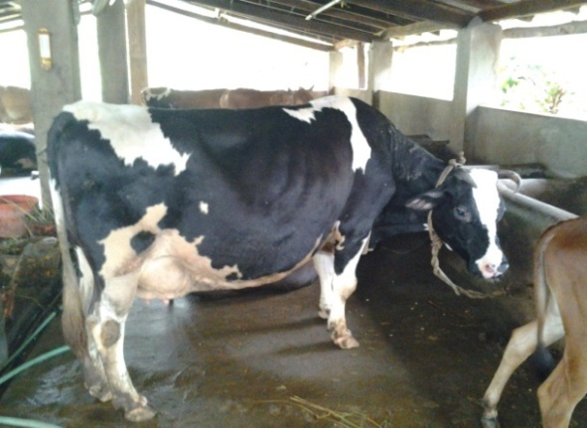
Meenakshisundaram et al (2009) reported that in poor type of cattle house where floor space provision was 2.61 m ² / cow, relative humidity was found to be significantly higher than that of good type of cattle house where floor space provision was 3.84 m ² / cow.
Stergarrdoe et al. (1986) stated that restriction of floor area adversely affected the behavior of cows.
In France, even under the temperate conditions, Brouillet and Raguet (1990) suggested a floor space allowance of 6 m² / cow.

Slide 13
Effect of cooling arrangement
Cooling arrangement in cattle house had highly significant (P < 0.01) effect on average daily milk yield and all the micro climatological parameters (Table - 4).
It was observed that average daily milk yield (10.692 ± 0.033 kg) was highest while average daily air temperature (26.61 ± 0.08 ⁰C) and average daily temperature humidity index (76.62 ± 0.14 ) were lowest in cattle shed where false ceiling was made by arecanut stem besides manual and mechanical cooling by electric fans (Fig. – 3).
However average daily relative humidity was lowest in shed where only manual cooling was arranged.

Slide 14

Table-4: Effect of cooling arrangement on milk yield of cow and microclimate of shed
Particular | Av. daily milk yield (Kg) | Av. daily air temperature (⁰C ) | Av. daily relative humidity (%) | Av. daily temperature humidity index
Manual cooling | 9.570 ^{b} ± 0.077 (3300) | 28.30 ª ± 0.11 (3300) | 78.65 ^{c} ± 0.42 (3300) | 79.90 ^{ab} ± 0.22 (3300)
Manual + Mechanical cooling | 9.070 ^{c} ± 0.132 (2310) | 27.35 ^{b} ± 0.12 (2310) | 79.50 ^{c} ± 0.52 (2310) | 78.53 ^{c} ± 0.24 (2310)
Manual cooling + False ceiling | 9.265 ^{bc} ± 0.069 (1320) | 28.26 ª ± 0.10 (1320) | 85.02 ^{b} ± 0.32 (1320) | 80.77 ª ± 0.16 (1320)
Manual cooling + Mechanical + False ceiling | 10.692 ª ± 0.033 (990) | 26.61 ^{c} ± 0.08 (990) | 90.43 ª ± 0.38 (990) | 76.62 ^{d} ± 0.14 (990)
F Value | 7.554 ** | 8.790 ** | 25.639 ** | 21.157 **

Slide 15
So, it was inferred that besides manual and mechanical cooling if false ceiling is made inside cattle house cow would feel more comfort with higher milk yield.
Suriyasathaporn et al (2006) reported that the use of electric fan in cattle shed operated during the day time increased milk production of cows during the first period of lactation.

Slide 16
Effect of housing on disease and reproductive disorders
It was observed that mastitis is the most common disease problem whereas repeat breeding is the most acute reproductive problem in farmer's field .
There was no association between housing and reproductive disorder.
However, mastitis was more prevalent in unhygienic shed and in dairy shed where more animals were accommodated ie below standard space was provided to each cow.
So more concern on space provision in the shed is needed to reduce disease problem.

Slide 17
Conclusion
So, it was revealed that orientation and ventilation of cattle shed, floor space provision and cooling arrangement in cattle house had significant (P < 0.05) effect on average daily milk yield and all the microclimates.
Semi open RCC house with east – west orientation and good ventilation was found to be suitable for high milk production and less heat stress on cattle.
Standard floor space of 5 m ² / cattle was found to be most suitable for higher milk yield and comfort of animal.
False ceiling inside cattle house besides manual and mechanical cooling would render cow more comfort with higher milk yield.

Slide 18
Acknowledgement
Authors acknowledge the contribution of Indian Council of Agricultural Research (ICAR), New Delhi for funding the institute project under which this experiment was carried out.
Authors acknowledge Director of the institute for providing necessary facilities to conduct this on farm experiment.
Authors also duly acknowledge Dr Anuradha Naik, Veterinary Officer, Mandrem, Dr Rajesh Kenny, Veterinary Officer, Bicholim; Dr Prabhu Gaokar, Veterinary Officer, Cuncolim, Dr Prashant Naik, Veterinary Officer, Sanguem, Mr Anand, VFA, Canacona for identifying farmer.
Authors thank all the sixty farmers who have provided necessary information for conducting the study.

Slide 19


Thank You

