Slide 1
About OMICS Group
OMICS Group is an amalgamation of Open Access publications and worldwide international science conferences and events. Established in the year 2007 with the sole aim of making the information on Sciences and technology ‘Open Access’, OMICS Group publishes 500 online open access scholarly journals in all aspects of Science, Engineering, Management and Technology journals. OMICS Group has been instrumental in taking the knowledge on Science & technology to the doorsteps of ordinary men and women. Research Scholars, Students, Libraries, Educational Institutions, Research centers and the industry are main stakeholders that benefitted greatly from this knowledge dissemination. OMICS Group also organizes 500 International conferences annually across the globe, where knowledge transfer takes place through debates, round table discussions, poster presentations, workshops, symposia and exhibitions.

Slide 2
About OMICS International Conferences
OMICS International is a pioneer and leading science event organizer, which publishes around 500 open access journals and conducts over 500 Medical, Clinical, Engineering, Life Sciences, Pharma scientific conferences all over the globe annually with the support of more than 1000 scientific associations and 30,000 editorial board members and 3.5 million followers to its credit.
OMICS Group has organized 500 conferences, workshops and national symposiums across the major cities including San Francisco, Las Vegas, San Antonio, Omaha, Orlando, Raleigh, Santa Clara, Chicago, Philadelphia, Baltimore, United Kingdom, Valencia, Dubai, Beijing, Hyderabad, Bengaluru and Mumbai.

Slide 3
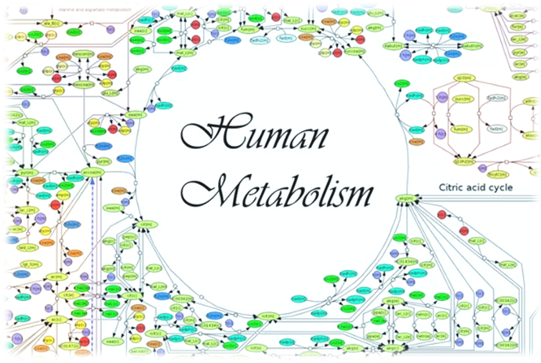
FEDERAL UNIVERSITY OF SANTA CATARINA - BRAZIL
Systems Biology of nanocellulose synthesis: new approach to build a core metabolic model
based on computational analysis
Samara Silva de Souza
2015
Notes:
GOOD AFTERNOON EVERYONE. MY NAME IS SAMARA SILVA DE SOUZA. I AM A PHD STUDENT IN CHEMICAL ENGINEERING AT FEDERAL UNIVERSITY OF SANTA CATARINA IN BRAZIL. TODAY WE’RE GOING TO BE TALKING ABOUT ….

Slide 4
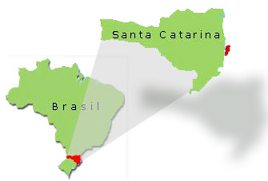
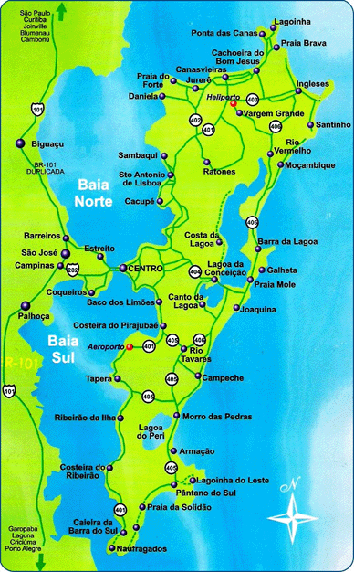
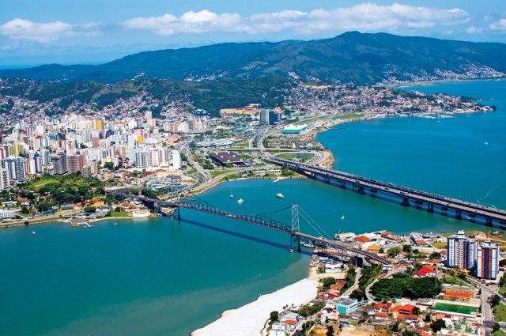
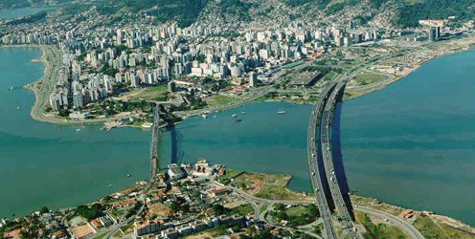
Notes:
FIRST, I CAME FROM SOUTH OF BRASIL, SANTA CATARINA STATE AND THE CAPITAL IS FLORIANOPOLIS. IT IS AN ISLAND AND IT IS CALLED MAGIC ISLAND, WELL YOU CAN IMAGINE WHY. THE ISLAND IS FULL OF BEACHES (42), MOUNTAINS, CULTURE AND LIGHTS.

Slide 5
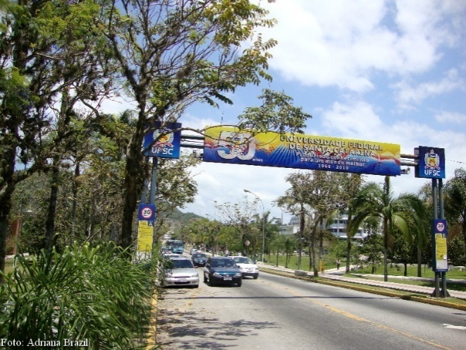
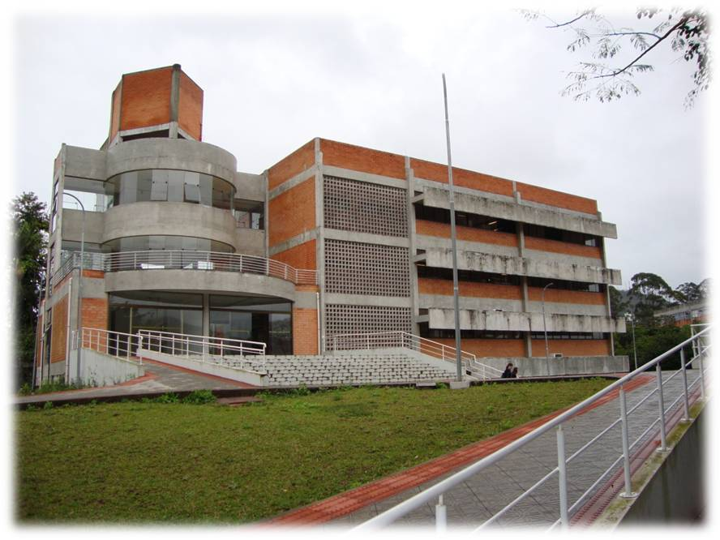
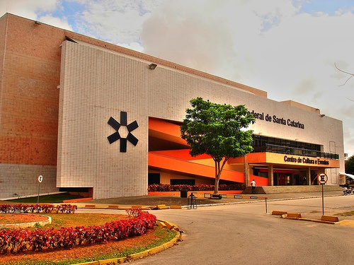
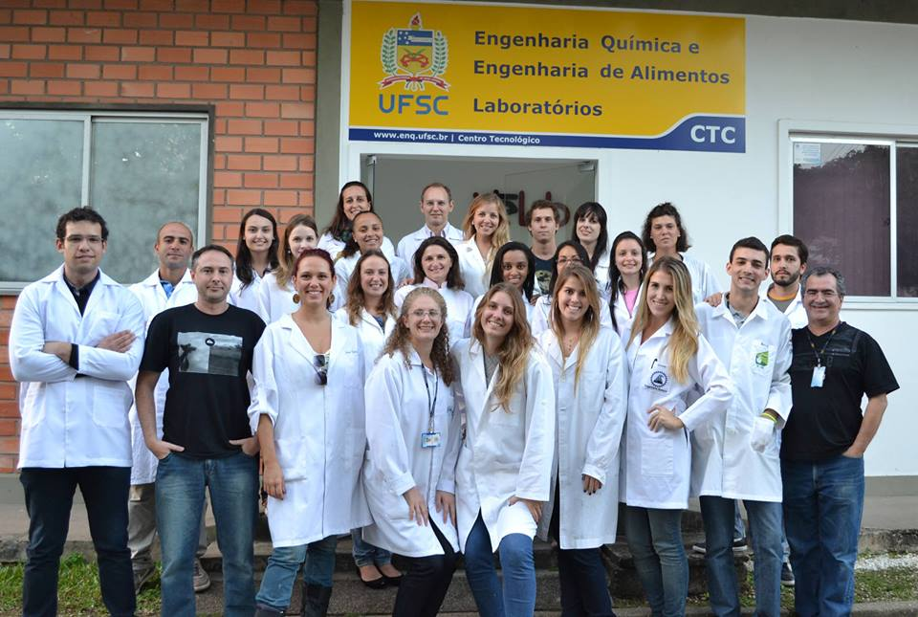
INTEGRATED TECHNOLOGIES
LABORATORY
Notes:
THE FEDERAL UNIVERSITY OF SANTA CATARINA IS A PUBLIC UNIVERSITY RANKED AS THE TENTH BEST UNIVERSITY IN BRAZIL. THERE ARE 55 YEARS OF HISTORY. THE CHEMICAL ENGINEERING COURSE HAS 30 YEARS OF EXISTENCE AND OUR LAB INTELAB INTEGRATE MULTIDISCIPLINARY RESEARCHES, AND WORKS IN THE FIELDS OF GENOME ENGINEERING, BIOINFORMATICS, METABOLIC ENGINEERING, AND TISSUE ENGINEERING.

Slide 6
“IN ORDER TO PUSH SCIENCE FORWARD AND DISCOVER ENDURING SOLUTIONS, WE MUST BE CREATIVE AND THINK OUTSIDE THE BOX. THE EASIEST WAY TO DO THAT IS TO DO WHAT WE ARE DOING HERE – TRANSFORMING OUR APPROACH BY BRINGING PEOPLE WITH DIFFERENT EXPERTISE TOGETHER TO WORK AS A TEAM.”
Neda Bagheri
Notes:
FISRT I’D LIKE TO READ THESE WORDS FROM NEDA BAGHERI, AN EXPERT IN COMPUTATIONAL BIOLOGY FROM NORTHWESTERN UNIVERSITY.
JUST TO THINK ABOUT IT. WE NEED THE INTEGRATION OF DIFFERENT FIELDS AND TO BUILD A NEW GENERATION OF SCIENTISTS.

Slide 7
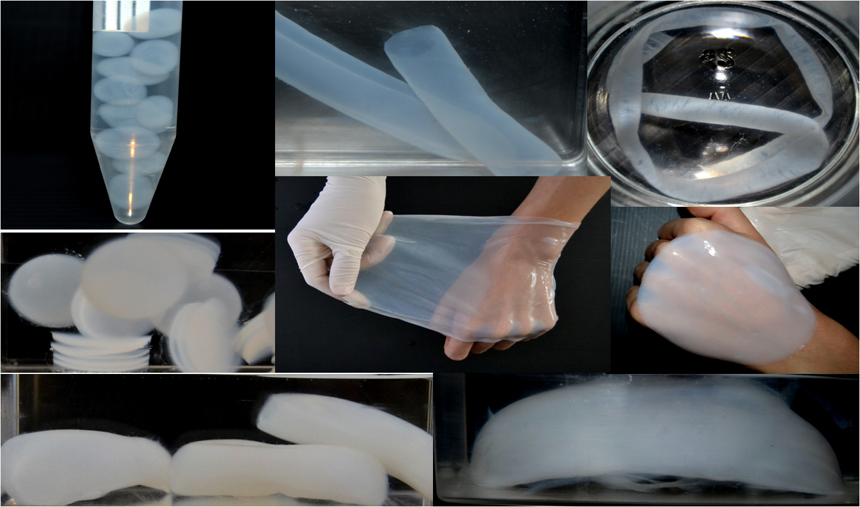
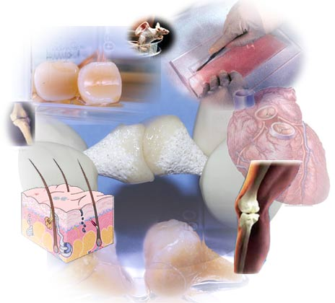
Gluconacetobacter hansenii
ATCC 23769
Komagataeibacter hansenii
ATCC 23769
NANOCELLULOSE
TISSUE
ENGINEERING
Notes:
SO OUR INTEREST IS BETTER UNDERSTANDING THE bacterial cellulose biosynthesis synthesized by Gluconacetobacter hansenii, NEWLY PROPOSED AS KOMAGATAEIBACTER hansenii. The G. hansenii IS A GRAM-NEGATIVE bacterium non-pathogenic, rod-shaped FORM. THERE ARE DIFFERENT PLATFORMS AND STRUCTURES THAT CAN BE OBTAINED FROM NANOCELULOSE, DEPENDING ON THE CULTURE CONDITIONS. WE HAVE VESSELS, MEMBRANES, SPHERES, COCCONS (A MACROSCOPIC STRUCTURE)
DESPITE THE IMPORTANCE OF NANOCELLULOSE BIOMATERIALS, PARTICULARLY FOR APPLICATIONS IN TISSUE ENGINEERING AND REGENERATIVE MEDICINE , THERE ARE A FEW WORKS IN OMICS SCIENCE WITH THIS BACTERIA.

Slide 8
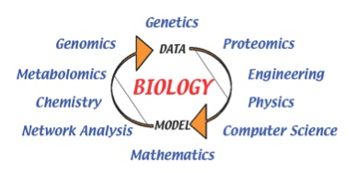
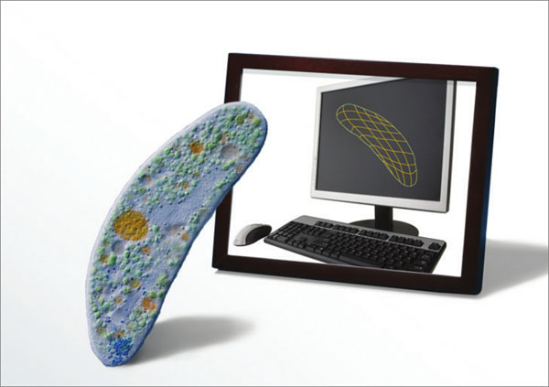
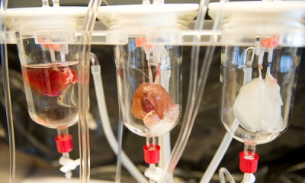
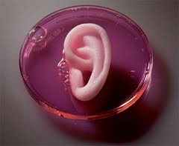
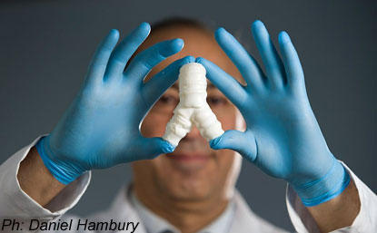
Systems Biology
Systems Biology will usher in the next big techonological wave, driving innovation and economic activity just as we saw at the dawn of the information age.
Notes:
SYSTEMS BIOLOGY AIMS TO UNDERSTAND THE BIOLOGICAL SYSTEMS IN AN INTEGRATED NETWORK, AND FOR THAT USES TOOLS AND CONCEPTS OF PHYSICS, ENGINEERING, COMPUTER SCIENCE, CHEMISTRY, MATH AND SO ON.

Slide 9
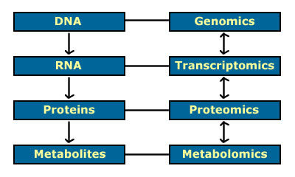
Metabolic Engineering: science which combining systematic analysis of metabolic pathways with other molecular biological techniques to improve cell properties (Stephanopoulos,1998).
One of the most important contribution is the emphasis of Metabolic Flux.
Study of the interactions between the components of biological systems, and how these interactions give rise to the function and behavior of that system.
Notes:
ONE OF THE MOST USED DEFINITIONS OF METABOLIC ENGINEERING IS FROM STEPHANOPOULOS WHICH SAYS
I START WORK WITH METABOLOMIC SCIENCES AND NOW MY BIG INTEREST IS TO INTEGRATE TRANSCRIPTOMIC ANALYSIS.
The main goal is to....

Slide 10
Omics sciences and generation of amounts of biological data - The integration of different areas of knowledge allowed advances in studies related to genomics, transcriptomics, metabolomics and proteomics.
Notes:
THE OMICS SCIENCES DEAL WITH THE GLOBAL ANALYSIS OF BIOLOGICAL SYSTEMS, INTEGRATING DIFFERENT FIELDS, SUCH AS BIOCHEMISTRY, GENETICS, PHYSIOLOGY AND COMPUTING, IN ORDER TO ISOLATE AND CHARACTERIZE GENES, PROTEINS AND METABOLITES, AND TO STUDY THE INTERACTIONS BETWEEN THEM, BASED ON EXPERIMENTAL TECHNIQUES, SOFTWARE AND DATABASES.

Slide 11
18/25
The extensive data available now opens the way to use existing computational approaches and to develop new ones to extract new biological insights about a fundamental physiological process.
Computational methods can then be used to model biological processes based on integrated data.
Notes:
THERE ARE SEVERAL TOOLS AND DATABASES AVAILABLE ONLINE, WHICH IF USED CORRECTLY CAN INTEGRATE MANY INFORMATION.

Slide 12
6/25
MOTIVATIONS
The bacterium G. hansenii produces a microstructure nanocellulose with high purity, a biomaterial of great interest for applications in tissue engineering and regenerative medicine.
We need professionals who know how to manipulate and analyze the extensive amount of data generated by sequencing technologies
Systems biology and omics techniques: Approaches in expansion that will open new opportunities of knowledge leading to new discoveries in several areas.
There are constantly new findings in computational tools and in omics techniques, promising major contributions to an understanding of overall cellular processes.
Notes:
SOME OF THE MOTIVATIONS DURING THE WORK

Slide 13
Notes:
THIS GRAPHIC DEMONSTRATES THE WIDENING GAP BETWEEN THE NUMBER OF GENOME SCALE METABOLIC RECONSTRUCTIONS AND PUBLICATIONS WITH BACTERIAL CELLULOSE OVER THE PAST SISTEEN YEARS EMPHASIZING THE NEED OF METABOLIC MODEL OF G. HANSENII DESCRIBING CELLULOSE BIOPRODUCTION..

Slide 14
The core metabolic model developed can provide strategies for developing these biomaterials through a better understanding of G. hansenii metabolic pathways.
We presented from an initial draft of genome-scale metabolic reconstruction and network analysis of G. hansenii, a core metabolism model that capture its capabilities and nanocellulose biosynthesis functions. The constraint-based reconstruction and flux analysis approach was used to analyze the core model and simulate different conditions to evaluate its consistency and representativity for cellulose biosynthesis.

Slide 15
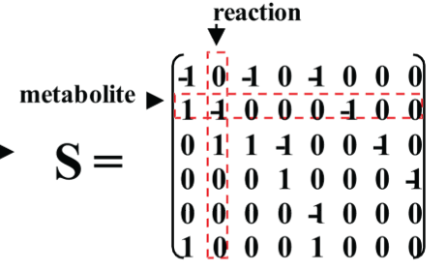
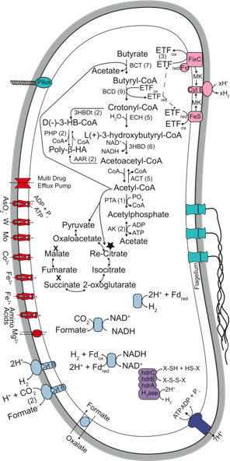
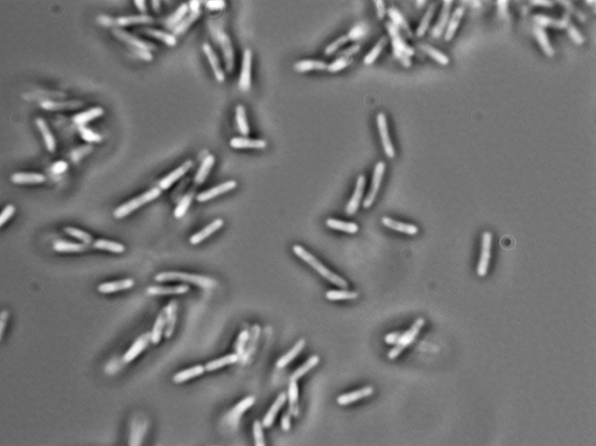
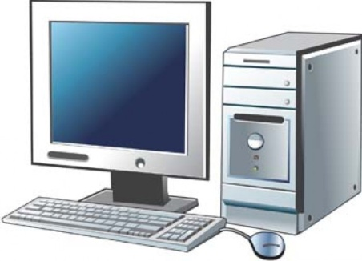
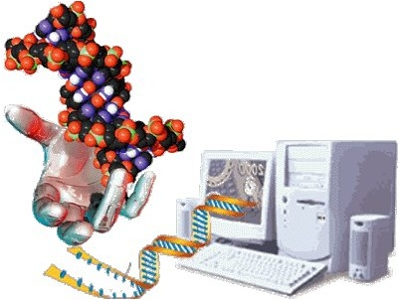
Bactéria
Gluconacetobacter hansenii
ATCC 23769
Generation of a mathematical model to investigate its metabolic behavior based on computational analysis.
Notes:
THE GOAL IS TO CHOOSE AN ORGANISM AND APPLY THE PRINCIPLES OF INFORMATION SCIENCES AND MATHEMATICAL AND COMPUTATIONAL APPROACHES TO ADDRESS BIOLOGICAL QUESTIONS.

Slide 16
A major objective is the determination of metabolic bottlenecks in cellulose biosynthesis, follow the step-strategy:
the establishment of the core model and manual curation,
the application of the model for metabolic flux analysis (MFA) only to evaluate the flux distribution.
the application of the model for flux balance analysis (FBA) by adding objective functions.

Slide 17
19/25
Notes:
THE FOUR STEPS USED IN THE PRESENT WORK ARE 1) CREATION OF A DRAFT MODEL USING AUTOMATED RESOURCES, 2) MANUAL CURATION TO CONSTRUCT THE CORE MODEL, 3) CONVERSION OF THE MODEL INTO A MATHEMATICAL FORMAT AND, 4) BIOLOGICAL AND BIOCHEMICAL ANALYSIS OF THE NETWORK.

Slide 18
An initial metabolic reconstruction for G. hansenii was performed in accordance with a previously described protocol*, but adapting some steps in order to construct a representative core model.
This protocol is properly structured for large-scale metabolic networks and well-studied organisms when several experimental evidences are available. However, for organisms with few reported information on their metabolic capabilities, such as G. hansenii, some adaptations in the protocol were necessary for the construction of a simplified and representative model.
*Thiele I, Palsson BO (2010) A protocol for generating a high-quality genome-scale metabolic reconstruction. Nat Protoc 5:93-121.

Slide 19
Glycolysis and gluconeogenesis
tricarboxylic acid cycle (TCA cycle)
pentose phosphate pathway (PPP); nitrogen metabolism,
ATP maintenance,
electron transport chain
oxidative phosphorylation
cellulose biosynthesis
biomass production
exchange reactions
Notes:
TO UNDERSTAND THE CELLULOSE BIOSYNTHESYS IT WAS BUILT THIS CORE MODEL WITH THE MAIN METABOLIC PATHWAYS.

Slide 20
Metabolic Flux Analysis (MFA). Combines a set of measured flows (uptake rates of the substrates) to calculate the flux distribution of all reactions during in silico calculations.
Notes:
The MFA plot shows the flux distribution under three different carbon sources with equivalent uptake rates in order to compare the results. Cellulose synthesis flux shows that about 19% of glucose, 45.6% of mannitol and 35.7% of glycerol were used for cellulose biosynthesis. There are several experimental studies that evaluate the best carbon source for the production of cellulose. The carbon source depends on the minimal growth medium chosen. Because the cellulose synthesis flux using glucose as a carbon source was lower as compared to other carbon sources, other fluxes were analyzed. The production is lower due to the deviation of the metabolic flux for the production of gluconic acid formed as a byproduct. When glucose enters the system, the flux of gluconic acid, was twice higher than other carbon sources. MFA could confirm that the bacterium directly oxidizes glucose in the form of gluconic acid, which accumulates in the system and decreases the pH of the media.

Slide 21
Metabolic fluxes resulted from Flux Balance Analysis (FBA)
to maximize cell growth during in silico calculations.
µ_{glc} =1.3303 h⁻¹
µ_{mann} =1.4209 h⁻¹
µ_{glyc} =1.5424 h⁻¹
* The flux distribution in these conditions describes that using glycerol as a carbon source, the pentose phosphate pathway was not favored theoretically. The fraction of carbon directed to the pentose phosphate pathway was growth-rate dependent.
Notes:
One of the FBA simulations used biomass reaction flux as objective function. By maximizing the biomass production the carbon flux is used for the bacterial growth, without any production of cellulose. This is another realistic scenario since there are strains that do not produce cellulose. As we check the specific growth rates per hour with 1.54 in glycerol. To evaluate the consistency of the model, the mass balance was checked and some simulations maximizing external metabolites and with nutrient limitations were carried out.

Slide 22
A description of minimal medium was essential to produce a metabolic model consistent with reality;
The determination of objective functions that were considered relevant was essential to analyze the metabolic network;
MFA analysis provided information about the contribution of each reaction to the metabolic processes and evaluated what had been evidenced experimentally in the literature.
By FBA analysis and simulations in different conditions showed that the core model was able to predict the phenotype cells will show in these conditions.
The core metabolic network was representative and consistent in all limits and defined boundary conditions.
Notes:
THIS WORK IS UNDER PUBLICATION. SOME CONCLUSIONS AFTER ALL WAS....

Slide 23
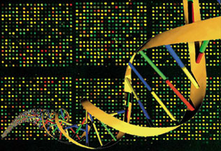
FUTURE PROSPECTS
TRANSCRIPTOMICS
Integrated transcriptomics and metabolomics analysis is a powerful tool to build the relationship between information elements (genes/transcripts) and functional elements (metabolites) in cells.
Notes:
SO THE FUTURE PROSPECTS IS TO INTEGRATE TRANSCRIPTOMIC ANALYSIS WHICH IS MY GOAL NOW DURING THE PHD. I REALLY WOULD LIKE TO WORK IS THIS ÁREA MORE SPECIFIC. SO TRY TO EXTRACT THE RNA AND ANALYSE DIFFERENTIAL GENE EXPRESSION USING ALL THESE BIOINFORMATIC TOOLS AVAILABLE.

Slide 24
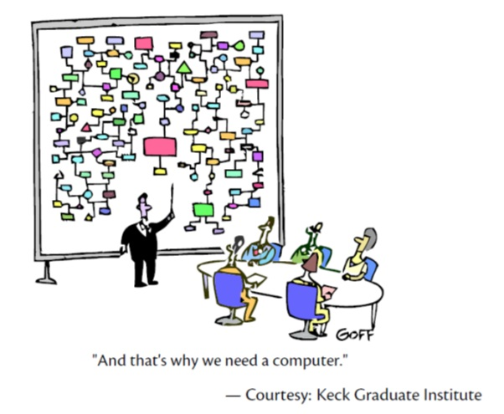
“May I end up by suggesting the following modeling strategy: always start by trying the simplest model and then only add complexity to the extent needed. This is the $10 approach, or as Einstein said, “Keep things as simple as possible, but not simpler”.”
Octave Levenspiel
Modeling Chemical Engineering, 2002
Notes:
AND I WOULD LIKE TO FINISH WITH THESE WORDS FROM OCTAVE LEVENSPIEL..

Slide 25
THANK YOU!!!
samara@intelab.ufsc.br
Notes:
I WOULD LIKE TO THANK YOU THE INVITATION AND THE CONFERENCE. IF YOU HAVE ANY QUESTION YOU CAN SEND ME AN EMAIL. I AM LOOKING FORWARD AN OPPORTUNITY TO DO PART OF MY PHD ABROAD. I AM OPEN MIND WITH DIFERENT PROJECTS.

Slide 26
Let Us Meet Again
We welcome you all to our future conferences of OMICS International
Please Visit: http://integrativebiology.conferenceseries.com/
http://conferenceseries.com/
http://www.conferenceseries.com/genetics-and-molecular-biology-conferences.php

