Slide 1
Anesthesia for Bariatric Surgery: What the occasional anesthesiologist should know
Prof Samar Jabbour-KHOURY, MD
Dayane DAOU, MD
American University of Beirut Medical Center
Beirut-Lebanon
2014

Slide 2
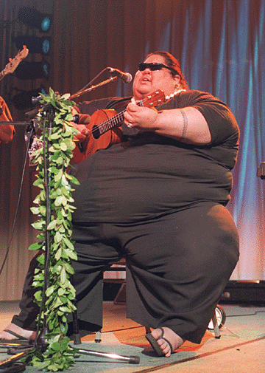
Who am I?

Slide 3
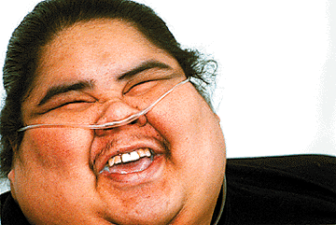
Unfortunately…
…he died at age 37 due to his obesity!
Notes:
IZ: israel kamakawiwo’Ole

Slide 4
Introduction

Slide 5
Bariatric ➔ GREEK word : baros = weight and iatrics = medical treatment
Greatest health challenge in western countries
UK: 23% men, 25 % women *
USA: 200 million people are overweight**
*Rennie KL, Jebb SA. Prevalence of obesity in Great Britain. Obes Rev 2005; 6: 11-2
** Baskin MI et al: Prevalence of obesity in the United States. Obes Rev 6:5-7, 2005

Slide 6
Definition
Excess of body fat
Intake > Expenditure
Genetic, behavioral, cultural and socioeconomic factors
Reduces quality of life and life expectancy
Increased healthcare services demands (> 100 billion dollars)
Notes:
Genetic: prader willi, lawrence moon biedl,leptin deficiency
Metabolic factors: hormones peptides…. Not well understood

Slide 7
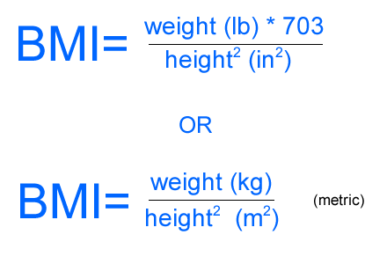
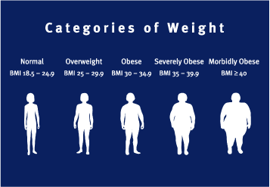

Slide 8
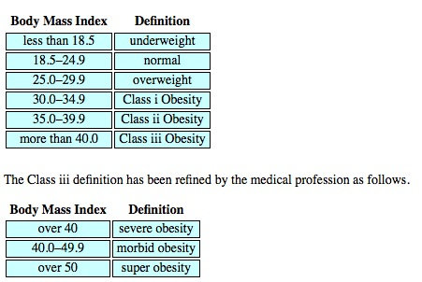

Slide 9
Limitations of BMI
Not a direct measure of adiposity
No account of fat distribution
No account of duration of obesity
Inaccurate at extremes of height
Inaccurate with extremes of lean body mass (athletes, elderly)

Slide 10
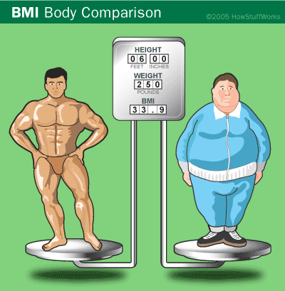

Slide 11
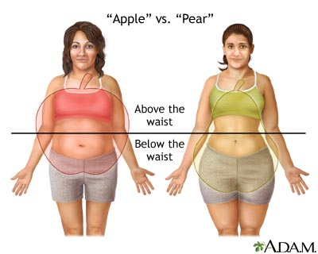
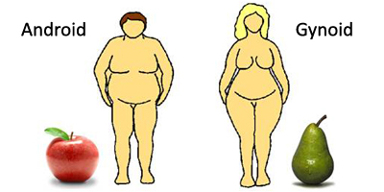

Slide 12
Some definitions…
IBW = Ideal Body Weight (kg) = height (cm) – X
Where X = 100 in males and 105 in females
PBW = predictive body weight (kg):
Males → PBW = 50 + 0.91(height in cm -152.4)
Females → PBW = 45.5 + 0.91(height – 152.4)
LBW = Lean Body Weight = TBW (Total Body Weight) – adipose tissue
Males = 80% of TBW
Females = 75% of TBW
Notes:
PBW is the same as ideal body weight
LBW is a combination of body cell mass, extracellular water, nonfat connective tissue

Slide 13
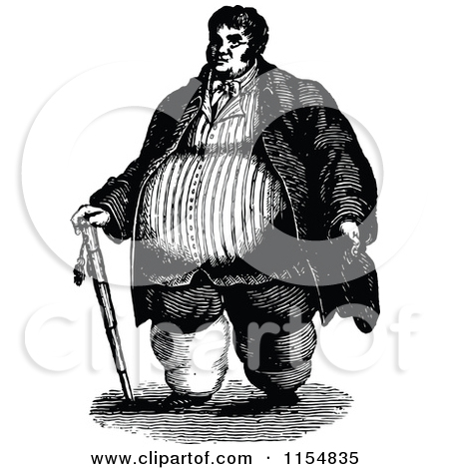
Associated co-morbidities

Slide 14
Hypertension
Coronary Artery Disease and Stroke
Sudden death (cardiac)
Restrictive lung disease
Obstructive Sleep Apnea, Hypoventilation
Diabetes Mellitus, Insulin Resistance
Cancer (breast, gynecological, gastrointestinal)
Osteoarthritis
Socioeconomical and psychosocial impairment
Notes:
Define metabolic syndrome: abdominal obesity, low HDL, high TG, glucose intolerance, HTN
70% of obese are prone to OSA

Slide 15
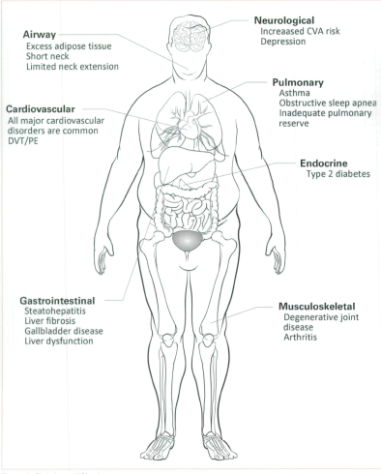

Slide 16
Studies : weight loss of 5-10% can improve glucose intolerance, DM2, HTN and DLP!!
Obesity is second only to smoking as a preventable cause of death!!

Slide 17
Treatment
MEDICAL SURGICAL
Sibutramine Restrictive Surgery
Orlistat Malabsorptive
Rimonabant Combined
Notes:
Sibutramine → mitral and aortic valve regurge
Orlistat → decreased ADEK → coagulation issues due to low vitamin K

Slide 18
There are many types of bariatric surgeries…

Slide 19
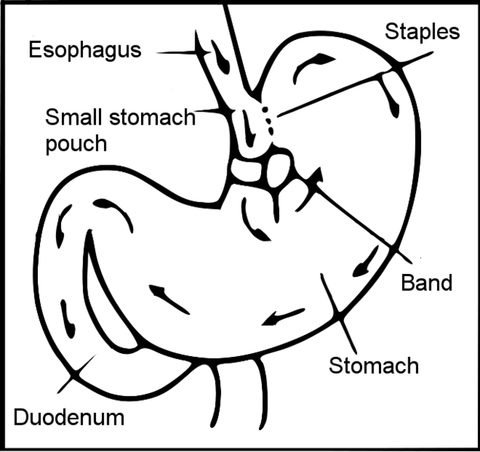
Vertical Banded Gastroplasty

Slide 20
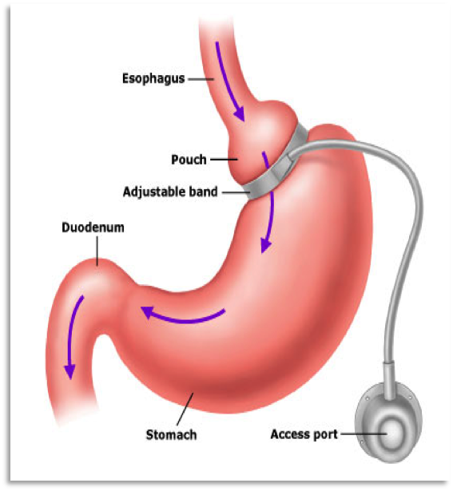
Adjustable Gastric Band

Slide 21
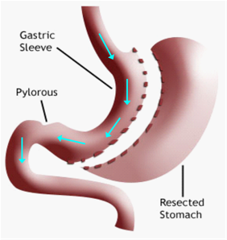
Sleeve Gastrectomy

Slide 22
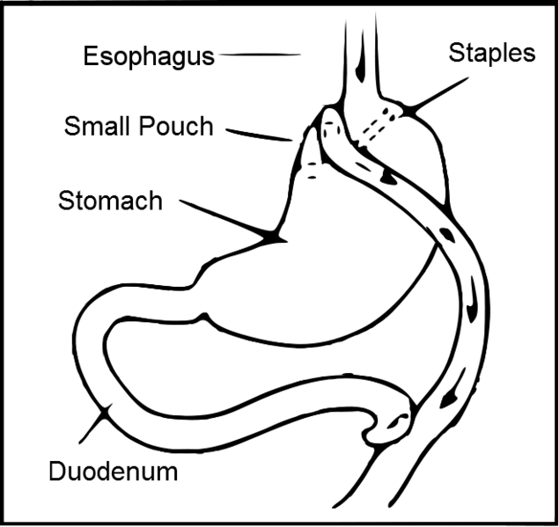
Roux-en-Y Gastric Bypass
Notes:
The most common

Slide 23
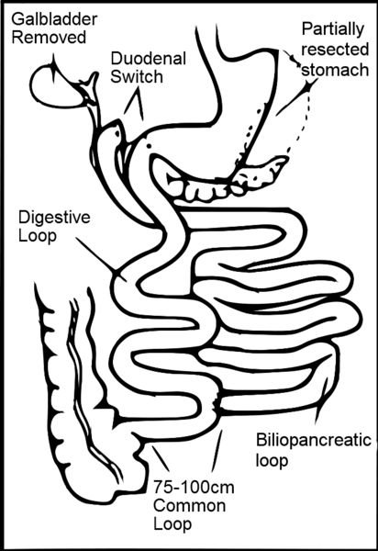
Sleeve Gastrectomy with duodenal switch
Notes:
For the super obese

Slide 24
Indications for Surgery
BMI > 40 or between 35 – 40 + comorbidities
Failed non-surgical treatment (6 months)
METABOLIC SYNDROME!
Needing intensive specialist management
Fit for anesthesia and surgery
Committed to the need of long term follow-up
Notes:
Talk about metabolic syndrome: wasit circumference (android obesity), HTN, insulin resistance, hyper LDL, hyper TG, Hypo LDL

Slide 25
Contraindications
Unstable CAD
Uncontrolled severe OSA
Uncontrolled psychiatric disorder
Mental retardation (IQ<60)
Inability to understand the surgery
Perceived inability to adhere to postoperative restrictions
Continued drug abuse
Malignancy with a poor 5-year prognosis

Slide 26
Health benefits of bariatric surgery
Improvement of Comorbidities
Notes:
Resolution of HTN, DM, DLP, OSA, improvement of respiratory function, of fatty liver, reversal of cardiomyopathy of obesity, decreased joint pain and improved mobility

Slide 27
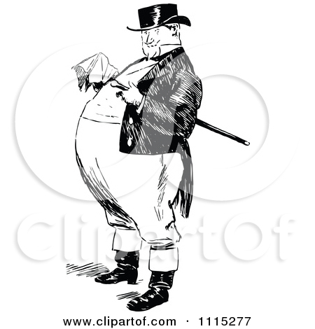
Anesthetic management for bariatric surgery

Slide 28
What the anesthesiologist should know preoperatively?

Slide 29
The pathophysiological changes associated with obesity

Slide 30
Respiratory system
Decreased chest wall compliance
Decreased lung compliance
Decreased FRC → decreased ERV → decreased safe apnea time → rapid desaturation
→ CC > FRC
Decreased VC
Notes:
V/Q mismatch in the dependent lower zones since they are underventilated and overperfused
ERV ost sensitive predictor of pulmonary function

Slide 31
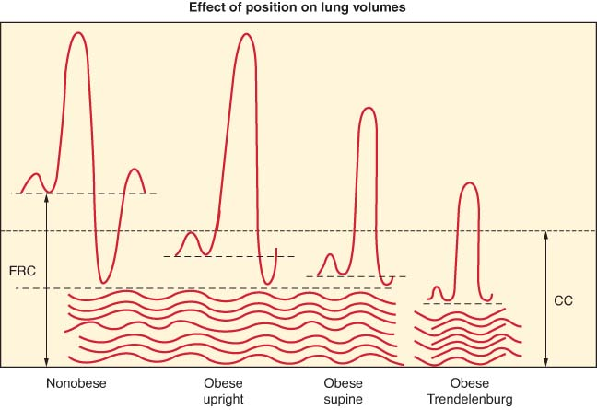

Slide 32
Respiratory system (cont’d)
Increased (A-a) O2 gradient
Increased O2 consumption and CO2 production → high energy turnover
Increased V/Q mismatch!!
OSA → do polysomnography preoperatively → need for CPAP?
Notes:
Talk orally about OSA and obesity hypoventilation syndromes
OSA: apneaic episodes secondary to pharyngeal collapse during sleep, airflow ceases, ongoing effort an closed airway, > 10s, > 5 / hour, > 30/ night with snoring, daytime somnolence and headaches, hypoxemia, polycythemia, systemic vasoconstriction, hypercarbia, pm HTN, core pulmonale
OHS: altered control of breathing, diurnal variation, PaCO2> 5.9 kPA with increased 1.3 kPA asleep, desat not explained by obstruction, decreased ventilatory response to CO2, coexists with OSA
Watch for semirecumbent position
Watch for respiratory depressants

Slide 33
Cardiovascular system
Increased blood volume → fat!
Atherosclerosis and hypercoagulability!
Increased Cardiac Output → 20-30 ml/kg
LV wall stress → dilatation and hypertrophy → obesity cardiomyopathy
Sympathetic activation → HTN
Arrythmias → fatty infiltration of conductive system
Notes:
Increased LV size by hypertrophy and dilation and increased risk of Afib
Sympathetic activation is due to OSA and increased RAAS from signals from fat
OSA → RVH and RV failure and core pulmonale
Biventricular failure insues!!!!!!

Slide 34
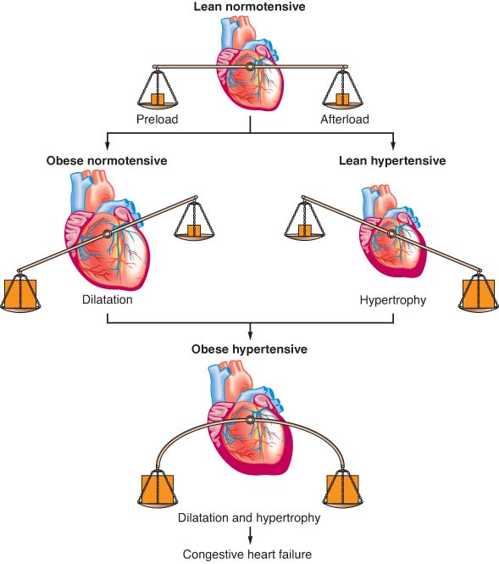

Slide 35
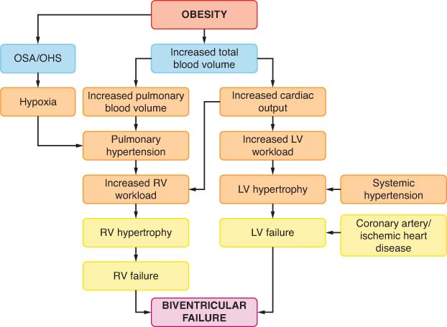

Slide 36
Gastrointestinal system
Increased gastric volume (> 25 mL)
Increased acidity (pH< 2.5)
Increased risk of regurgitation and aspiration!!
DM type 2
Metabolic syndrome
Fatty infiltration of liver
Hiatal hernia and GERD!
Notes:
PS (very imp to say): gastric emptying may be faster in the obese but bcz of their larger gastric volume (75% larger!!), the residual volume is larger
PS imp to say: the most commonly we have increased ALT!!!!!
Current fasting guidelines are accepted

Slide 37
Musculo-skeletal and other systems
Oestheoarthritis
Compression fractures
Urinary incontinence
Skin infections (candidiasis) → wound
Varicose veins
Lymphoedema
Hypothyroidism

Slide 38
Airway Changes
Limitation of movement of atlantoaxial joint and cervical spine → upper thoracic and low cervical fat pads
Excessive tissue folds in the mouth and pharynx
Suprasternal, presternal and posterior cervical fat
Short thick neck
Very thick submental fat pad
OSA → excessive tissue in lateral pharyngeal walls

Slide 39
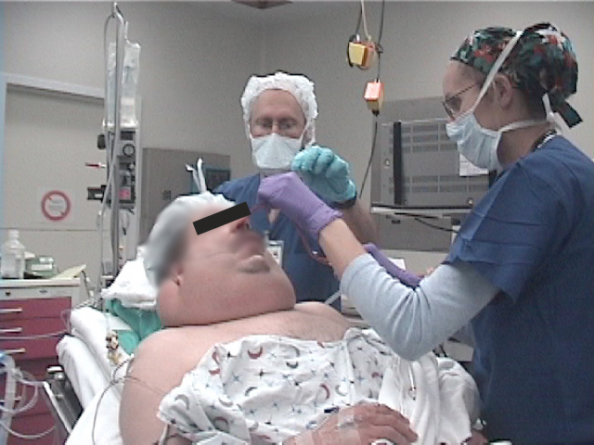
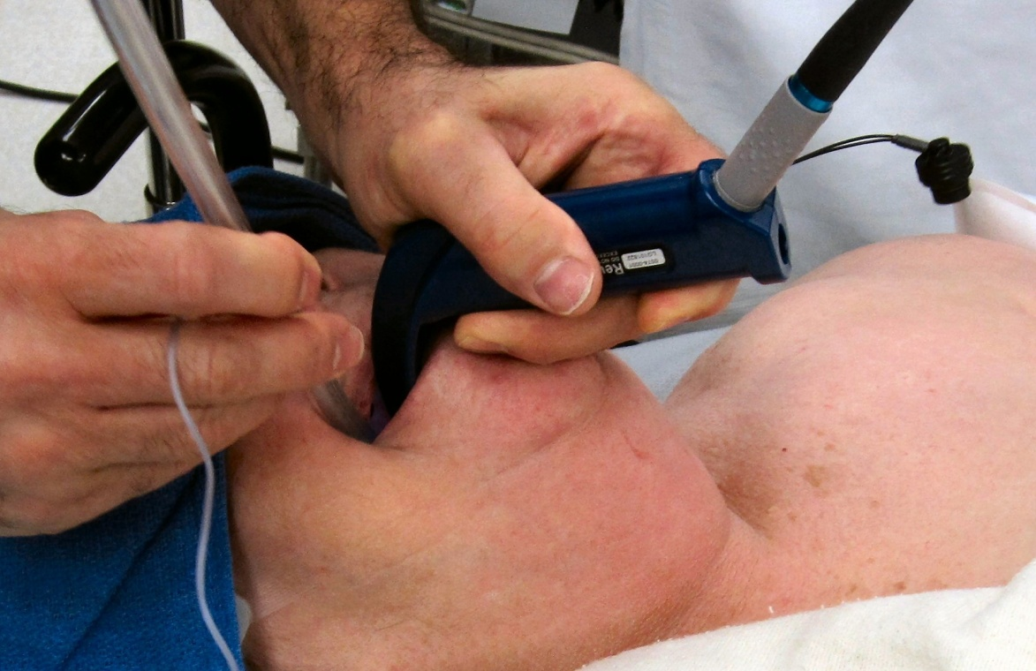

Slide 40
How does this affect drug dosing??

Slide 41
Effects on drug distribution
Reduced total body water
Increased total body fat
Increased lean body mass
Altered protein binding
Increased blood volume
Increased cardiac output

Slide 42
Loading Dose ➔ Volume of Distribution
Maintenance Dose ➔ Clearance
Increased redistribution → increased T1/2
Increased alpha-1-glycoprotein → decreased free drug concentration
Notes:
Very important to say: drug mainly distributed to lean tissues should have the loading dose calculated on the basis of LBW. If the drug is equally distributed btw adipose and lean then dosing should be based on TBW
For maintenance, a drug with similar clearance btw obese and nonobese should have maintenance calculated based on LBW. However, a drug whose clearance increases with obesity should have the maintenance calculated based on TBW.!!!!!!!!!!!

Slide 43
Effects on drug elimination
Hepatic clearance → only phase II affected
Renal clearance increased → increased RBF → increased GFR (ex: increased dosing of cimetidine and aminoglycosides antibiotics)
Notes:
Cimetidine and AG depend on renal excretion which is increased in obese hence increase dosing

Slide 44
Highly lipophilic (BZD, BrB) → increased VD → dosed on TBW
Less lipophilic (nondepolarizing muscle relaxants) → no change → dosed on LBW
Increased blood volume → increased plasma concentrations of rapidly injected IV drugs
Repeated injections → accumulation in fat → increased duration of action
➔ Exceptions: Digoxin, Procainamide and Remifentanil → highly lipophilic but dosed on LBW
Notes:
These exceptions have a context sensitive half time that is not affected but dosing
Important to say: adding 20% of estimated IBW dose of hydrophilic meds is sufficient in obese
Very imp: SUX based on actual body weight bcz of the increased activity of plasma pseudocholinesterases in obese patients

Slide 45
Preoperative assessment
What should we focus on??

Slide 46
Stabilizing comorbidities
Identifying OSA symptoms
Previous surgeries and previous anesthetics
Difficult airway anticipation
NECK CIRCUMFERENCE!!:*
40 cm → 5% risk
60 cm → 35% risk
➔ BMI per se is not a predictor of a difficult airway!
*Brodsky JB, Lemmens HJ, Brock-Utne JG, Vierra M, Saidman LJ. Morbid obesity and tracheal intubation. Anesth Analg 2002; 94:732-6
Notes:
70% of obese are prone to OSA
STOP-BANG questionnaire: Snoring, Tired, Observed, Pressure blood, BMI, Age, Neck circumference, Gender (male)
OHS triad: obesity, daytime somnolence, sleep-disordered breathing

Slide 47
Routine and specific lab tests
Glucose, lipid profile
Vitamin deficiencies
Liver function tests
ABG
Lung function tests
Polysomnography → initiate CPAP periop
Echocardiography
Notes:
Polysomnography: AHI > 30 is a warnign sign of rapid desat during induction
CPAP levels > 10 are a warning sign for difficult face mask ventilation

Slide 48
Preoperative preparation
Avoid Sedatives!
Aspiration prophylaxis → PPIs, H2 antagonists
Thromboembolism prophylaxis

Slide 49
Intraoperatively…

Slide 50
We need:
Special equipment
Trained personnel
Anesthetic expertise!!

Slide 51
Positioning

Slide 52
Special table with a bean bag
Cushion gel pads → pressure on gluteal muscles may lead to rhabdomyolysis!
Proper positioning:
Modified Lloyd – Davis position = steep trendelenburg with legs spread apart and both arms out on arm boards
Notes:
Stacking = tip of the chin is at a higher level than the chest
BP cuff = 75 % of arm circumference
Position :
Supine = vena cava nad aortic compression
Tren = worsens FRC
Reverse trend = increased lung compliance
Prone = detrimental effects of lungs ventilation and airway oxygenation
Carpal tunnel is the most common neuropathy following bariatric surgery

Slide 53
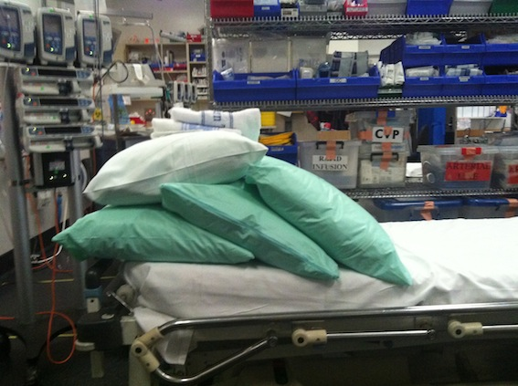
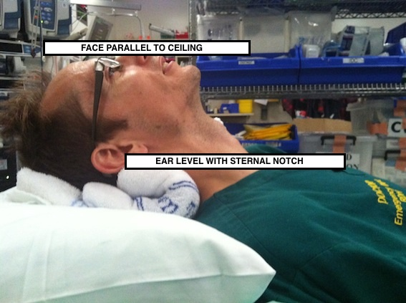
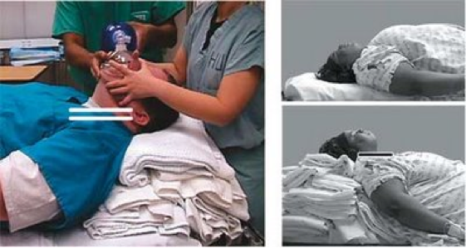
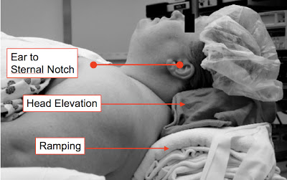

Slide 54
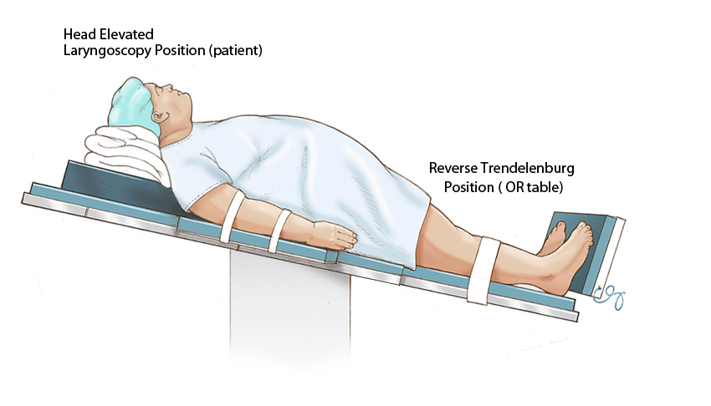

Slide 55
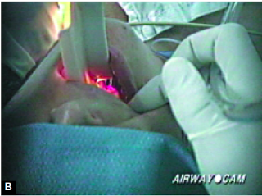
ALWAYS CHECK FOR THE CRITERIA OF A DIFFICULT AIRWAY MANAGEMENT
Notes:
Retrognathia, large neck, protuberant teeth, limited neck mobility,

Slide 56
Induction
Head-up position (HELP)
Stacking
Good preoxygenation
Tidal volumes < 13 ml/kg
PEEP and recruitment maneuvers
AIRWAY
Notes:
PEEP is the only ventilatory parameter that has been proven to improve ventilatory function
HELP: head elevated laryngoscopy position

Slide 57
Induction Issues
Regurgitation*
Aspiration
Hypoxemia
* Koolwig J, et al. BMJ Case Rep 2013. doi:10. 1136/bcr-2013-201009
Notes:
Obesity by itself is not a risk factor for aspiration
Regurgitation occurs after LABG (add article reference)

Slide 58
Maintenance
Sevoflurane and Desflurane → lower lipid solubility than Isoflurane
AVOID N₂O
Fluids well balanced → avoid ATN and volume overload
Short- acting agents preferred
Consider Dexmedetomidine*
* Bakhamees HS, El-Halafawy YM, Ek-Kerdawy HM, Gouda NM, Altemyatt S. Effects of dexmedetomidine in morbidly obese patients undergoing laparoscopic gastric bypass. Middle East J Anesthesiol 2007; 19:537-51
Notes:
Add articles about DEX

Slide 59
Profound muscle relaxation needed → Vecuronium, Rocuronium and Cisatracurium
Pneumoperitoneum < 15 mmHg
Cephalad displacement of diaphragm → displace ETT to mainstem bronchus!
Help with intragastric baloon placement and leak tests!
Notes:
If pneumoperitoneum > 20 mmHg → vena cava compressiona and decreased cardiac output

Slide 60
Emergence
Semirecumbent and FULLY awake
Prompt but SAFE
Observe in OR before transfer

Slide 61
Recovery Room
SKILLED personnel
Watch ventilation
Initiate CPAP or BiPAP if needed
Use multimodal analgesia
Notes:
Analgesia: opiods, acetaminophen, tramadol, NSAIDs…weigh the risks and benifits

Slide 62
Postoperatively…
Initiate thrombophylaxis
Continue analgesics
Continue CPAP if initiated
Antibioprophylaxis
PPIs and gastric protection
Fluid management
Notes:
Thrombophylaxis: SCD stockings and heparine unfractionned or LMWH

Slide 63
Complications of bariatric surgery

Slide 64
Risk factors for complications
Male
Age > 65
Open surgery
Long operative time
Cardiac and respiratory comorbidities
Diabetes
Low case load

Slide 65
General complications
Infection
Hemorrhage
Incisionnal hernia
Bowel obstruction
Deep Venous Thrombosis

Slide 66
Specific complications
Anastomotic leak
Anastomotic stricture
Dumping syndrome
Nutritional deficiencies:
Vitamin B12
Thiamine
Protein
Vitamin A

Slide 67
 | All Surgeries | Gastric Banding | Roux-en-Y
Early | Bleeding Infection Dehydration Peritonitis Bowel obstruction Perforation Pneumonia DVT/PE Death | Band slippage Band malfunction Infection at band site | Leak from anastomotic site
Late | Cholelithiasis Cholecystitis Pouch dilation GERD/dysphagia Herniation at the surgical site Nutrionnal issues Fat-soluble vitamin deficiencies (vit B12) | Anorexia Band slippage Band malfunction Infection at band site | Small bowel obstruction Marginal ulcers Pancreatitis Stricture
Notes:
From Miller’s

Slide 68
In conclusion…

Slide 69
Health benefits
Sustained loss of 65-80% of excess body weight
Resolution of:
Diabetes
Hypertension
Dyslipidemias
OSA
GERD
Low back pain and joint pain

Slide 70
Obesity and Heart-Rate Variability
What’s HRV?
Variation in intervals between heartbeats
Reflects cardiac autonomic modulation
Influenced in a favorable way by increased parasympathetic activity
Thayer JF et al. The relationship of autonomic imbalance, heart rate variability and cardiovascular disease risk factors. International journal of Cardiology 141 (2010) 122-131

Slide 71
Obesity → autonomic imbalance → increased sympathetic and decreased parasympathetic activities → increased workload and stress on the heart → decreased HRV → risk factor for heart diseases (MI, sudden death…)
Weight loss → restored autonomic balance → increase HRV → correlates with decreased heart diseases!!!
Nault I. et al. Impact of bariatric surgery-induced weight loss on heart rate variability. Metabolism Clinical and Experimental 56 (2007) 1425-1430

Slide 72
Increased self-esteem and participation in social activities!!

Slide 73
To Conclude…

Slide 74
Obesity…
Is a major healthcare problem
Increases co-morbidities and decreases the quality of life
Is a daily challenge for the anesthesiologists
Needs extra care during the perioperative period
➔Advancement in the anesthesia technology has made a dramatic improvement

Slide 75
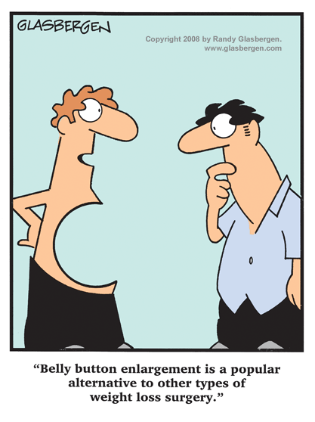
Bariatric surgery is a beneficial and cost-effective healthcare intervention!

Slide 76
References
Bucklin B, Anesthesia and Obesity, Chap 44 in Clinical Anesthesia, 7th edition, LWW 2013 (Ed: Barash, PG)
Sinha AC and David ME, Anesthesia for Bariatric surgery, Miller’s Anesthesia 7th edition, p.2089-2103
Raveendran et al., Perioperative management of the morbidly obese, IARS 2013 Review Course Lectures
Perioperative management of the morbidly obese patient, published by The Association of Anaesthetists of Great Britain and Ireland, 21 Portland Place, London W1B 1PY
Sabharwal A et al, Anesthesia for bariatric surgery, Continuing Education in Anesthesia, Critical Care & Pain, Vol 10 Numb 4. 2010
Nishiyama T et al. Anesthesia for Bariatric Surgery, OBES SURG (2012) 22:2013-219

Slide 77
References (cont’d)
Brodsky JB, Lemmens HJ. Brock-Utne JG, Vierra M, Saidman LJ. Morbid Obesity and tracheal intubation. Anesth Analg 2002; 94:732-6
Karason K, Molgaart H, Wikstrand J, Sjostrom L. Heart rate variability in obesity and the effect of weight loss. American Journal of Cardiology 1999; 83:1242-7
Nault I. et al. Impact of bariatric surgery-induced weight loss on heart rate variability. Metabolism Clinical and Experimental 56 (2007) 1425-1430
Trimer R. et al. Heart rate variability and Cardio-respiratory coupling during sleep in patients prior to Bariatric surgery. OBES SURG (2014) 23:471-477
Mehta RK. Impacts of obesity and stress on neuromuscular fatigue development and associated heart rate variability. International Journal of Obesity (2014), 1-6
Thayer JF et al. The relationship of autonomic imbalance, heart rate variability and cardiovascular disease risk factors. International journal of Cardiology 141 (2010) 122-131

Slide 78
Thank you!

