Slide 1
Inguinal hernia: Always a benign condition?
Low, SBL; Boctor, DSZM; Suliman, IGI
Notes:
Inguinal hernia is a common surgical disease in the elderly. However, are they always benign? Is there any association with malignancy? In the literature, there is a rare but real association with malignancy. As such, we aim to use a case to focus on a particular type of hernia and discuss how best to manage it, keeping in mind the association with malignancy.

Slide 2
Mr JH
74 ♂ → ED c/o pleuritic chest pain and hip pain
CTPA = bilateral consolidations
Hip XR = residual contrast in the bladder which had herniated into his right scrotum
Notes:
74 year old man presented to the Emergency Department with pleuritic chest pain and hip pain.
Computed tomography pulmonary angiogram (CTPA) revealed bilateral consolidations. Following that, a pelvic radiograph revealed residual contrast in the bladder which had herniated into his right inguinoscrotal region.

Slide 4
Mr JH
2 yr hx of intermittent groin swelling, LUTS and compressing his scrotum for complete bladder emptying
CT = bladder hernia, sclerotic bony metastases and a caecal tumour
Treatment = right hemicolectomy + hormonal therapy
Notes:
On retrospective questioning, he gave a two year history of intermittent groin swelling, lower urinary tract symptoms and having to manually compress his scrotum for complete bladder emptying (2-stage).
CT revealed a bladder hernia, sclerotic bony metastases and a caecal tumour. Subsequently, he underwent hormonal therapy for metastatic prostate cancer and a right hemicolectomy.

Slide 6
Introduction
Herniation: Protrusion of part of bladder through abdominal wall or pelvic floor
Important to diagnose as:
Increase risk of intra- and post-operative complications (if diagnosis not made pre-operatively)
Association with underlying malignancy
Notes:
Risk of bladder injury during hernia repair – 12% - Catalano et al, 1999
Less than 7% of bladder hernias are diagnosed before surgery; 16% are diagnosed post-operatively owing to complications; rest are diagnosed pre-operatively – Oruc et al, 2004.
In the literature review paper by Oruc et al, 13 of 116 cases (11.2%) was associated with malignancy – 9 bladder ca, 3 prostate ca, 1 ca

Slide 7
Epidemiology
Prevalence 0.3 – 3%; 1 – 4% of inguinal hernia cases
50 – 70 years old ♂
Right-sided
Inguinal canal (70%); Femoral canal (27%); Obturator foramen; Ischiorectal fossa; Abdo wall
Varying sizes but usually small ‘knuckle’ of herniated bladder
Notes:
Herniation of the bladder is noted in neonates and infants with a patent PV but this prevalence decreases with age.
They appear in 75% of the cases at the inguinal level (6). The right side is most often implied and bilateral instances have been described (4). Second in frequency (23%), come crural vesical herniations occurring mainly in female patients (6). Exceptional localizations make up the last percents: obturator foramen, linea alba, ischiorectal fossa, incisional site or post-traumatic tear area (1, 7).

Slide 8
Aetiology
Abdominal/ pelvic wall weakness
Abnormal width of the inguinal canal
Abnormal bladder wall 2° bladder outlet obstruction
Peritoneal fibrosis/ adhesions
Obesity
Notes:
Peritoneal fibrosis/ adhesions – caused by trauma or previous surgery in the region that exert fixation and tract forces on the hernia border and sac – Pereira et al, 1998; Soloway et al, 1960; Epner et al, 1993; Escudero et al, 2007.
Older men have a predilection due to bladder outlet obstruction secondary to an enlarged prostate, pericystitis and adhesion of the bladder wall to pre-vesical fat which allows the fat to drag the bladder wall into the hernial sac and generalised weakness of the abdominal wall.
Associated abnormalities: Herniation of bowel loops and fat tissue

Slide 9
Classification I
Paraperitoneal (most common)
Portion of parietal peritoneum herniates along with bladder
Extraperitoneal
Peritoneum is intact and in place
Intraperitoneal
Herniated part is surrounded completely by peritoneum
Notes:
Classification is divided according to the relationship of the herniated bladder to the parietal peritoneum.
Paraperitoneal – most common, 60% and often large in which the peritoneum hernia sac covers the external aspect of the herniated bladder which can be direct or indirect, inguinal or femoral, lies medial to the hernial sac;
Extraperitoneal – 30%, anterior or lateral surface of the bladder protrudes as a direct hernia with an absence of peritoneal evagination
Intraperitoneal – 10%, upper and posterior part of bladder entering the hernial sac completely covered by peritoneum (indirect), peritoneum covers the entire portion of the herniated bladder.
If digestive inguinal hernias are most often indirect and extend into the inguinal canal following its oblique course, IBHs are generally direct and break a weak suprapubic parietal zone medial to the epigastric vessels (2 ).
IBHs have been classified in three subgroups according to their relationship with the peritoneum (4, 8): 30% of all are extraperitoneal. Very rarely they are
totally encased in peritoneal sheets (intraperitoneal type). Most cases (60%) are paraperitoneal with the herniated bladder only partly accompanied by peritoneum. The relationships between the bladder and the peritoneum are very important as the presence of peritoneal tissue can hide a subjacent vesical wall and bring about unintentional injury to the bladder during operative repair (2, 6, 9).

Slide 10
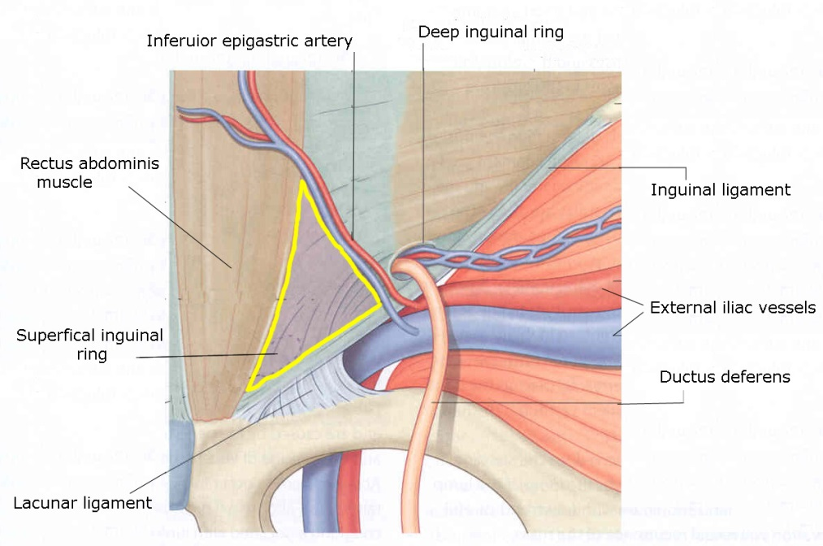
Classification II
Indirect (via patent processus vaginalis)
Protrude lateral to inferior epigastric vessels
Direct (through Hesselbach triangle)
Protrude medial to inferior epigastric vessels

Slide 11
Clinical features
Most asymptomatic
LUTS
Dysuria, ↑ frequency, urgency, difficulty in voiding, nocturia, hematuria
Severe
2-stage micturition (Mery’s sign)
Notes:
Mery’s sign: after a normal spontaneous urination the patient voids his bladder by compressing the swollen hemiscrotum upward

Slide 12
Associated pathologies

Slide 13
Diagnostic Imaging
CT Best diagnostic clue
Demonstration of protrusion through hernia
Cystography (IVU/IVP) is traditional
Voiding in an upright position
US
Other causes of groin swelling
Presence of hydronephrosis
Notes:
Neither intravenous urography nor cystography prove the best choice in examining IBHs and this is due to their low level of sensitivity. In supine decubitus positioning indeed the density of the contrast medium causes it to remain at the declive part of the bladder and prevents it flowing into the hernia (1).
Indirect signs have been described that help detect hernial abnormalities (ipsilateral ureteral displacement, small volume of the bladder, incomplete visualization of the bladder base = Reardon and Lowman triad) (6, 7, 11) but they remain too inconspicuous. That is why most agree to say that an upright positioning of the patient together with a voiding test are the only means to demonstrate the presence of a hernia by forcing the contrast medium to flow into it as a result of higher intravesical pressure (3, 7, 11).
US demonstrates accurately, among other potential causes of groin swelling, a vesical hernia (soft anechoic mass with its own wall of a thickness of a few millimeters and connected to the bladder). A Valsalva maneuver or an upright positioning clearly increase the volume of the fluid-filled mass whereas voiding the bladder, possibly in two stages, will obviously result in emptying the cystocele. US moreover distinguishes a direct herniation from an indirect one by Doppler location of the lateral or medial position, respectively, of the inferior epigastric vessels (14, 15). At last, US allows stadifying a possible hydronephrosis and can suspect an possible subvesical obstruction.
CT scans demonstrate vesical hernias as well as US mainly after the bladder has been injected with contrast medium (1) or even better insufflated with gas (10). Just like US, it helps study a subvesical problem and quantifies hydronephrosis
PET/CT – 1) Bladder hernias and bladder diverticula have been misinterpreted as FDG-avid tumors, 2) May persist as "hot spots" even after bladder has been emptied

Slide 14
Take Home Messages

Slide 15
Take Home Message 1
Enquire about LUTS in patients with hernia

Slide 16
Take Home Message 2
If POSITIVE LUTS:
Further imaging needed

Slide 17
Take Home Message 3
If POSITIVE imaging,
?Investigate for malignancy?

Slide 18
Thank you
Any questions?

