Slide 1
Carbonic Anhydrase: A New Therapeutic Target for Managing Diabetes
Salihu Ibrahim Ismail
College of Medicine and Allied Health Professions
Federal University, Dutse.
Nigeria.

Slide 2
Introduction
The manifestations of diabetes cause considerable human suffering and enormous economic costs.
Diabetes caused at least USD 612 billion dollars in health expenditure in 2014, with an estimated 4.9 million deaths in 2014.¹
Every seven seconds a person dies from diabetes. ¹
1. IDF DIABETES ATLAS SIXTH EDITION POSTER UPDATE 2014

Slide 3
387 million people presently have diabetes; by 2035 this will rise to 592 million. ¹
77% of people with diabetes live in low- and middle-income countries. ¹
More than 22 million people in the Africa Region have Diabetes; by 2035 this figure will almost double. ¹
1. IDF DIABETES ATLAS SIXTH EDITION POSTER UPDATE 2014

Slide 4
There were 3.747 million cases of diabetes in Nigeria in 2014.¹
Prevalence of diabetes in adults in Nigeria is 4.6%. ¹
Number of death in adults due to diabetes is 105,091.¹
Cost per person with diabetes in Nigeria is USD 178.4.¹
1. IDF DIABETES ATLAS SIXTH EDITION POSTER UPDATE 2014

Slide 5
The development of long-term complications in diabetes is influenced by hyperglycemia.
Poor control of hyperglycemia accelerates its progression.
The resulting chronic hyperglycemic condition in diabetes is associated with long term damage, dysfunction, and failure of various organs, such as eyes, kidneys, nerves, heart, and blood vessels.²
To prevent complications, Good management of diabetes should be to monitor the development of such complications and to provide timely intervention.
2. American Diabetes Association. Diagnosis and classification of diabetes mellitus. Diabetes Care, 30(Suppl. 1), S42–S47. (2007).

Slide 6
Therapeutic Target
Inhibition of gluconeogenesis, lipolysis, and fatty acid oxidation, as well as stimulation of β3-adrenergic receptors.³
Diabetes is being combated through aggressive treatment directed at lowering circulating blood glucose and inhibiting postprandial hyperglycemic rise.
Current treatment, although provide a good glycemic control but do little in preventing complications.⁴
3. Moneva, M.H. and Dagogo-Jack, S. Multiple Drug Targets in the Management of Type 2 Diabetes. Current Drug Targets, 3: pp. 203-221(2002).
4. Vats, V., Yadav, S.P. and Grover, J.K. Ethanolic extreact of Oscimum sanctum leaves partially attenuates streptozotocin-induced alterations in glycogen content and carbohydrate metabolism in rats. Journal of Ethnopharmacology, 91: 109-113. (2004).

Slide 7
Current Strategies for The Treatment of Diabetes
Reducing insulin resistance using glitazones.
Supplementing insulin supplies with exogenous insulin.
Increasing endogenous insulin production with sulfonylureas and meglitinides.
Stimulating insulin secretion with Gliptins.
Reducing hepatic glucose production through biguanides.
And limiting postprandial glucose absorption with alpha-glucosidase inhibitors.

Slide 8
Emerging Therapeutic Targets
Insulin sensitizers including protein tyrosine phosphatase-1B (PTP-1B) and glycogen synthase kinase 3 (GSK3).⁵
Inhibitors of gluconeogenesis like pyruvate dehydrogenase kinase (PDH) inhibitors. ⁵
Lipolysis inhibitors. ⁵
Fat oxidation including carnitine palmitoyltransferase (CPT) I and II inhibitors, ⁵ and.
Energy expenditure by means of beta 3-adrenoceptor agonists. ⁵
5. Wagman A.S., Nuss J.M., Current therapies and emerging targets for the treatment of diabetes. Curr. Pharm. Des. 7(6):417-50. (2001)

Slide 9
It is well established that the risk of microvascular and macrovascular complications is related to glycemia, as measured by HbA1c; this remains a major focus of therapy.
Our study aimed at assessing whether carbonic anhydrase is associated with short and long term implication in diabetes mellitus. The study aimed to provide therapeutic target at the same time a new marker to assist in identifying diabetic individuals at a high risk of developing diabetic complications.

Slide 10
Carbonic Anhydrase
Carbonic anhydrase is a globular zinc metalloenzyme of molecular weight 30 KD.
The enzyme was discovered in 1933 and has been the subject of intense scientific investigation.
Carbonic anhydrase is one of the fastest enzymes known.
The catalytic rate of carbonic anhydrase is approximately 1×10⁶ s⁻¹ (i.e each enzyme molecule can hydrate 10⁶ molecules of CO₂ per second)⁶.
6. Radzicka, A. and Wofenden, R. Science 267: 90-93 (1995)

Slide 11
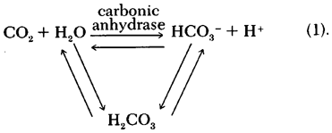
General Carbonic Anhydrase Reaction

Slide 12
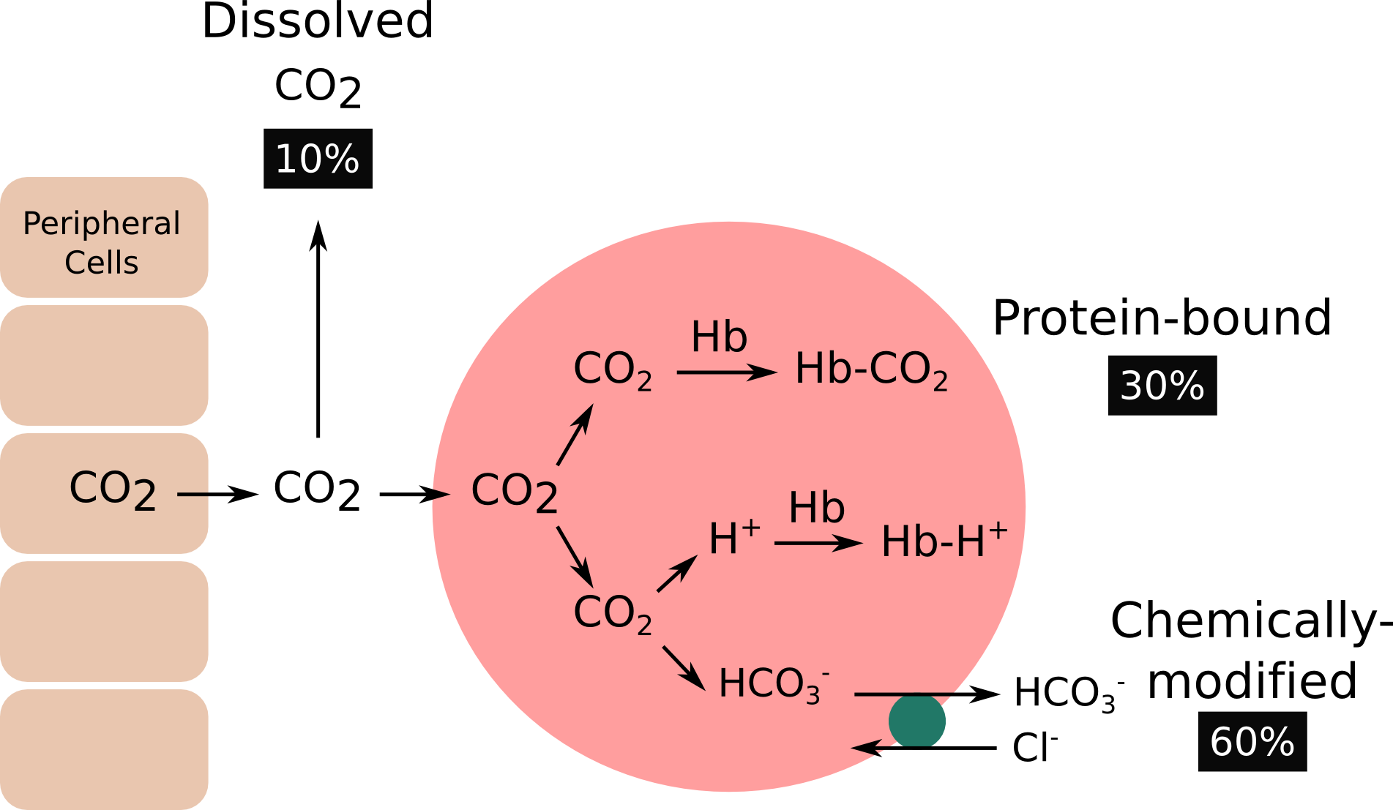
Carbonic Anhydrase Reaction in RBC
Na⁺
CA
NaHCO₃ = 20
H₂CO₃ 1

Slide 13
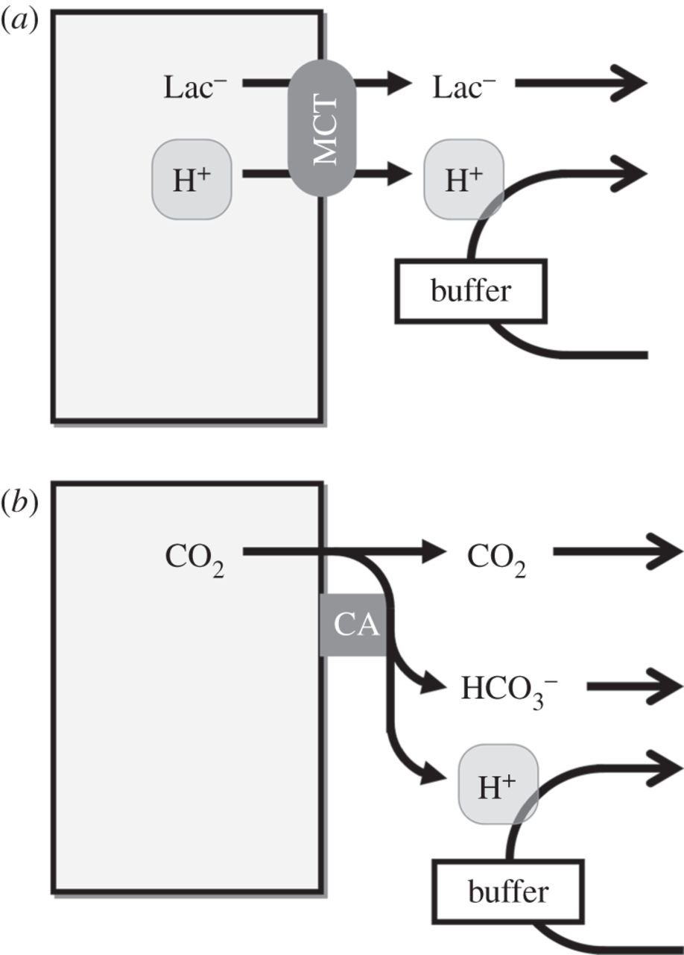
Role of CA in Lactate and CO₂ Transport
CA

Slide 14
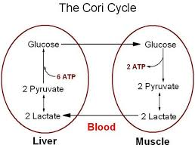
pH = 7.4
H⁺ H⁺ H⁺ H⁺ H⁺ H⁺
H⁺ H⁺ H⁺ H⁺
H⁺ H⁺
H⁺

Slide 15
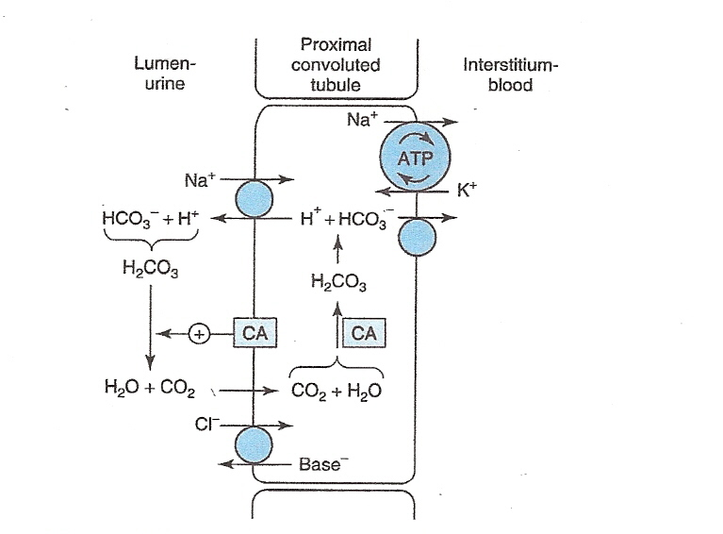
Metabolic Acidosis in Diabetes
Metabolic acidosis is the most common serious acid-base disorder complicating diabetes mellitus.
Carbonic anhydrase inhibitors produce metabolic acidosis by their action on carbonic anhydrase in the proximal and distal renal tubules. This blocks excretion of hydrogen ions, producing an alkali urine.
X
X

Slide 16
INHIBITION OF CARBONIC ANHYDRASE
CA inhibition is associated with undesired side effects; such as:⁷
Numbness and tingling of extremities;
Metallic taste;
Depression;
Fatigue;
Malaise;
Weight loss;
Decreased libido;
Gastrointestinal irritation;
Metabolic acidosis;
Renal calculi and
Transient myopia
7. Supuran, C. T. Carbonic anhydrases: Novel Therapeutic applications for inhibitors and activators. Drug discovery 7: 168-181 (2008)

Slide 17
RESEARCH DESIGN
IN VIVO STUDIES
INVESTIGATION OF CHANGES IN ERYTHROCYTE CARBONIC ANHYDRASE ACTIVITY IN NORMAL RATS
NORMAL
RANDOM
NORMAL
FASTING
14 DAY(S) INVESTIGATION OF ERYTHROCYTE CARBONIC ANHYDRASE IN STZ INDUCED DIABETIC RATS (60mg/kg)
28 DAY(S) INVESTIGATION OF INHIBITED ERYTHROCYTE CARBONIC ANHYDRASE IN STZ INDUCED DIABETIC RATS (60mg/kg)
28 DAY(S) INVESTIGATION OF ERYTHROCYTE CARBONIC ANHYDRASE IN STZ INDUCED DIABETIC RATS (60mg/kg) TREATED WITH ACETAZOLAMIDE 250mg/kg, METFORMIN 1000mg/kg AND METHANOL LEAF EXTRACT OF CADABA FARINOSA 1000mg/kg

Slide 18
IN VITRO STUDIES
n-HEXANE, ETHYL ACETATE AND METHANOL CRUDE EXTRACT WAS OBTAINED BY SUCCESSIVE EXTRACTION USING SOXHLET APPARATUS
BASED ON THE IN-VITRO STUDIES, MOST ACTIVE LEAF EXTRACT WAS SELECTED FOR FURTHER STUDIES
BASED ON STUDIES ABOVE, THE ACTIVE COMPONENTS FROM THE MOST ACTIVE LEAF EXTRACT WAS ANALYZED.
INVITRO INHIBITORY STUDY OF ACETAZOLAMIDE(15μg/100μL) , METFORMIN(15μg/100μL) AND CRUDE EXTRACT(S) OF CADABA FARINOSA(15μg/100μL) ON CARBONIC ANHYDRASE(10μg/100μL) ACTIVITY
FT-IR
GC-MS

Slide 19
MATERIALS AND METHODS
Preparation of extract of cadaba farinosa leaves
he leaves of Cadaba farinosa were, washed, air-dried at room temperature, grinded to powder. The crude extract was obtained through successive soxhlet extraction by dissolving 800g of powdered plant leaves in 2.5L of n-Hexane followed by ethyl acetate and finally methanol for 48 hours each in a soxhlet apparatus. The crude fractions were concentrated using rotary evaporator and stored in a dessicator until use.
Study animals
Male wister albino rats of 180–220 grams weight were used for this study.
Induction of diabetes
Diabetes was induced in all the rats except in the normal controls, by Streptozotocin (STZ) 60 mg per kg body weight, dissolved in ice cold citrate buffer (0.1 M, pH 4.5), through intraperitoneal route. Fasting hyperglycemia was confirmed by the elevated glucose level > 200 mg/dl in plasma, determined at 72 h after injection. Hyperglycemic rats were included for the study along with the normal control animals.

Slide 20
Biochemical Analysis
Metabolic parameters:
Blood glucose, lactate, cholesterol and triglycerides triglycerides were measured using (Accutrend GCT Meter, Roche, Germany with Cobas® test strips).
Glycosylated haemoglobin determination:
HbA1c was measured according to the manufacturers instruction, using standard reagent kits (Spectrum-diagnostics, Egypt).

Slide 21
ASSAY OF CARBONIC ANHYDRASE ACTIVITY
Carbonic anhydrase activity was determined as described by vapoorte et al.⁸, with the modification described by Parui et al.⁹, using spectrophotometer at 348 nm.
One unit of enzyme activity was expressed as μmol of p-nitrophenol released/min/μ L from hemolysate at room temperature (25ºC).^{9,10}
8.Verpoorte JA, Mehta S, Edsall JT. Esterase activities of human carbonic anhydrase. J. Biol. Chem., 242: 18: 4221-4229, 1967.
9. Parui R, Gambir KK, Mehrotra PP. Changes in carbonic anhydrase may be the initial step of altered metabolism in hypertension. Biochem Int 1991; 23: 779–89.
10. Gambhir, K. K., Oates, P., Verma, M., Temam, S. and Cheatham, W. High fructose feeding enhances erythrocyte carbonic anhydrase 1 mRNA levels in rat. Ann. N. Y. Acad. Sci. 827, 163–169 (1997).

Slide 22
STATISTICAL ANALYSIS
Results were presented as mean ± standard Deviation (SD). Within and between groups, comparisons were performed by the analysis of variance (ANOVA) (using SPSS 20.0 for windows Computer Software Package). Significant differences were compared by Duncan‟s new Multiple Range test; a probability level of less than 5% (P< 0.05) was considered significant.¹⁰
10. Duncan, D.B. (1955). Multiple range and multiple F-test. Biometrics, 11, 1–42.

Slide 23
CHANGES IN ERYTHROCYTE CARBONIC ANHYDRASE ACTIVITY IN UNTREATED DIABETIC RATS

Slide 24
Carbonic anhydrase activity (μmol/min/ μL)
Glucose concentration (mMol/L)
Figure 1A: Changes in erythrocyte carbonic anhydrase activity in Normal Random/Fasting and STZ induced diabetic rats (60mg/kg). for 14days.
*P < 0.05 vs Normal control (n=5).
Figure 1B: Changes in blood glucose concentration in Normal Random/Fasting and STZ induced diabetic rats (60mg/kg). for 14days.
*P < 0.05 vs Normal control (n=5).
Lactate concentration (mMol/L)
Figure 1C: Changes in blood lactate concentration in Normal Random/Fasting and STZ induced diabetic rats (60mg/kg). for 14days.
*P < 0.05 vs Normal control (n=5).

Slide 25
Cholesterol concentration (mMol/L)
Normal Random Normal Fasting Diabetic Fasting
Figure 1D: Changes in blood Cholesterol concentration in Normal Random/Fasting and STZ induced diabetic rats (60mg/kg). for 14days.
*P < 0.05 vs Normal control (n=5).
Triglyceride concentration (mMol/L)
Normal Random Normal Fasting Diabetic Fasting
Figure 1E: Changes in blood Triglyceride concentration in Normal Random/Fasting and STZ induced diabetic rats (60mg/kg). for 14days.
*P < 0.05 vs Normal control (n=5).

Slide 26
28 DAYS CHANGES IN ERYTHROCYTE CARBONIC ANHYDRASE ACTIVITY IN DIABETIC RATS TREATED WITH ACETAZOLAMIDE

Slide 27
Carbonic anhydrase activity (μmol/min/ μL)
Glucose concentration (mMol/L)
Figure 2A: Inhibition of erythrocyte carbonic anhydrase activity by Acetazolamide (250mg/kg/day) in STZ induced diabetic rats (60mg/kg), for 28 days.
*P < 0.05 vs Normal control; “P < 0.05 vs Diabetic control (n=5).
Figure 2B: : Glucose concentration in STZ induced diabetic rats (60mg/kg) treated with Acetazolamide (250mg/kg/day) for 28 days.
*P < 0.05 vs Normal control; “P < 0.05 vs Diabetic control (n=5).
Lactate concentration (mMol/L)
Figure 2C: Lactate concentration in STZ induced diabetic rats (60mg/kg) treated with Acetazolamide (250mg/kg/day) for 28 days.
*P < 0.05 vs Normal control; “P < 0.05 vs Diabetic control (n=5).

Slide 28
Cholesterol concentration (mMol/L)
Figure 2D: Cholesterol concentration in STZ induced diabetic rats (60mg/kg) treated with Acetazolamide (250mg/kg/day) for 28 days.
*P < 0.05 vs Normal control (n=5).
Triglyceride concentration (mMol/L)
Figure 2E: Triglyceride concentration in STZ induced diabetic rats (60mg/kg) treated with Acetazolamide (250mg/kg/day) for 28 days.
*P < 0.05 vs Normal control (n=5).

Slide 29
28 DAYS CHANGES IN ERYTHROCYTE CARBONIC ANHYDRASE ACTIVITY IN DIABETIC RATS TREATED WITH ACETAZOLAMIDE, METFORMIN AND METHANOL LEAF EXTRACT OF CADABA FARINOSA

Slide 30
Carbonic anhydrase activity (μmol/min/ μL)
HbA1C concentration (mMol/L)
Figure 3A: The effect of Acetazolamide, Metformin and Methanol extract of Cadaba farinosa on erythrocyte carbonic anhydrase activity levels in STZ induced diabetic rats treated at 250mg/kg/day, 500mg/kg/day and 1000mg /kg/day doses for 28 days. *P < 0.05 vs Normal control; “P < 0.05 vs Diabetic control (n=5).
Figure 3B: The effect of Acetazolamide, Metformin and Methanol extract of Cadaba farinosa on HBA_{1C} levels in STZ induced diabetic rats treated at 250mg/kg/day, 500mg/kg/day and 1000mg /kg/day doses for 28 days. *P < 0.05 vs Normal control; “P < 0.05 vs Diabetic control (n=5).
Glucose concentration (mMol/L)
Lactate concentration (mMol/L)
Figure 3C: The effect of Acetazolamide, Metformin and Methanol extract of Cadaba farinosa on glucose concentration in STZ induced diabetic rats treated at 250mg/kg/day, 500mg/kg/day and 1000mg /kg/day doses for 28 days. *P < 0.05 vs Normal control; “P < 0.05 vs Diabetic control (n=5).
Figure 3D: The effect of Acetazolamide, Metformin and Methanol extract of Cadaba farinosa on lactate concentration in STZ induced diabetic rats treated at 250mg/kg/day, 500mg/kg/day and 1000mg /kg/day doses for 28 days. *P < 0.05 vs Normal control; “P < 0.05 vs Diabetic control (n=5).

Slide 31
Cholesterol concentration (mMol/L)
Figure 3D: The effect of Acetazolamide, Metformin and Methanol extract of Cadaba farinosa on Cholesterol concentration in STZ induced diabetic rats treated at 250mg/kg/day, 500mg/kg/day and 1000mg /kg/day doses for 28 days. *P < 0.05 vs Normal control; “P < 0.05 vs Diabetic control (n=5).
Triglyceride concentration (mMol/L)
Figure 3D: The effect of Acetazolamide, Metformin and Methanol extract of Cadaba farinosa on Triglyceride concentration in STZ induced diabetic rats treated at 250mg/kg/day, 500mg/kg/day and 1000mg /kg/day doses for 28 days. *P < 0.05 vs Normal control; “P < 0.05 vs Diabetic control (n=5).

Slide 32
INVITRO INHIBITORY STUDY OF CRUDE EXTRACT OF CADABA FARINOSA ON CARBONIC ANHYDRASE ACTIVITY

Slide 33
Carbonic anhydrase activity (μmol/min/ μL)
Figure 4A: In-Vitro inhibitory effect of Acetazolamide, Metformin and Crude extract of Cadaba farinosa on Bovine erythrocyte carbonic anhydrase activity treated at 15μg/10μg enzyme concentration each.
% INHIBITION
Figure 4B: Percentage inhibition

Slide 34
INVITRO INHIBITORY STUDY OF PURIFIED FRACTIONS OF METHANOL LEAF EXTRACT OF CADABA FARINOSA ON CARBONIC ANHYDRASE ACTIVITY

Slide 35
Carbonic anhydrase activity (μmol/min/ μL)
Figure 5A: In-Vitro inhibitory effect of Acetazolamide, Metformin and purified fractions of methanol leaf extract of Cadaba farinosa on Bovine erythrocyte carbonic anhydrase activity treated at 15μg/10μg enzyme concentration each.
% INHIBITION
Figure 5B: Percentage Inhibition

Slide 36
Weight of Different Crude Extract of Cadaba farinosa obtained from soxhlet extraction
EXTRACT | WEIGHT OBTAINED (g) | %YIELD
Methanol | 23.18/800g | 2.9
Ethyl Acetate | 15.2/800g | 1.9
n-Hexane | 100.6/800g | 12.6

Slide 37
Proposed Mechanism of lactate-induced cell acidification (LIA) by Carbonic Anhydrase Inhibition in Diabetes Mellitus

Slide 38
PROPOSED MECHANISM OF “Lactate Induced Acidemia” CYCLE IN DIABETES
H⁺
H⁺
H⁺
H⁺
RBC
MUSCLE
H⁺
H⁺
H⁺
H⁺
H⁺
H⁺
H⁺
H⁺
H⁺
MCT
MCT
CA
CA
H⁺
Lactate
Lactate
H⁺
H⁺
H⁺
H⁺
H⁺
H⁺
H⁺
H⁺
H⁺
H⁺
H⁺
H⁺
H⁺
H⁺
H⁺
LIVER
H⁺
H⁺
CA
H⁺
H⁺
MCT
Glucose
H⁺
Glucose

Slide 39
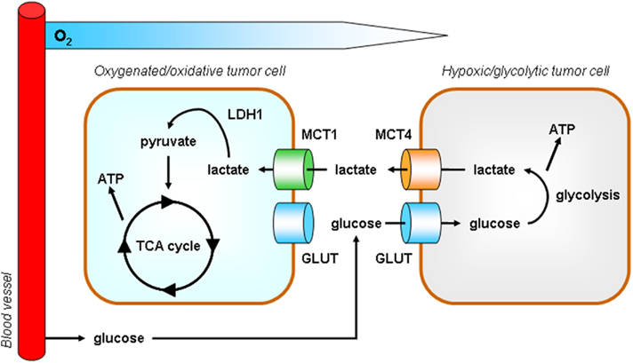
Proposed Mechanism of Carbonic Anhydrase Inhibition Induced Lactic Acidosis (CAIILA) in Diabetes Mellitus
f
Liver
Erythrocyte/Muscle
X
CA
CO₂ ₊ H₂O HCO₃⁻ + H⁺
CO₂
CO₂
CO₂
CO₂
H⁺ H⁺ H⁺ H⁺ H⁺H⁺
H⁺ H⁺ H⁺ H⁺
H⁺ H⁺ H⁺
H⁺ H⁺ H⁺ H⁺
H⁺ H⁺ H⁺ H⁺ H⁺ H⁺
H⁺ H⁺ H⁺ H⁺ H⁺ H⁺ H⁺ H⁺ H⁺
H⁺ H⁺ H⁺
H⁺ H⁺ H⁺
H⁺ H⁺ H⁺ H⁺ H⁺
H⁺ H⁺ H⁺
H⁺ H⁺ H⁺ H⁺ H⁺ H⁺
H⁺ H⁺ H⁺
H⁺ H⁺ H⁺ H⁺ H⁺
H⁺ H⁺
H⁺
H⁺ H⁺ H⁺ H H⁺
CO₂
CO₂
CO₂
X
CO₂
CO₂
CO₂
CO₂
CO₂
CO₂
CO₂
CO₂
CO₂
CO₂
CO₂
CO₂
CA
X
CO₂
CO₂
CO₂ + H₂O
HCO₃⁻ + H⁺
CO₂
BLOOD

Slide 40
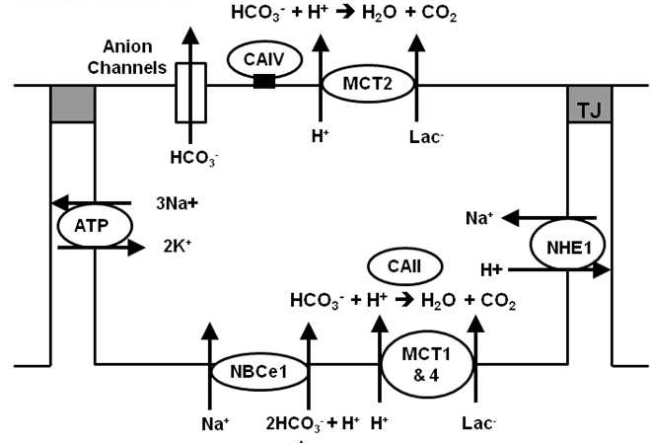
Carbonic Anhydrase Inhibition in Diabetes Mellitus
X
X
Nguyen T.T, and Bonano JA, Lactate-H+ Transport Is a Significant Component of the In Vivo Corneal Endothelial Pump. (Invest Ophthalmol Vis Sci. 2012;53:2020–2029.

Slide 41
Summary
According to the results obtained a remarkable increase in carbonic anhydrase activity was observed in the early stage of the disease. Untreated diabetes and its treatment with Metformin over a long period, results in decreased carbonic anhydrase activity.
Inhibition of carbonic anhydrase in diabetic rats leads to increased level of both lactate and HbA1C.

Slide 42
Conclusion
Carbonic anhydrase inhibition may be the key factor enhancing HbA1c formation, which may be associated with increased lactic acid level. Disrupting the carbonic anhydrase buffering system in vivo may lead to lactate induced acidosis.
These data may provide a new evidence that uncontrolled diabetes for a long period of time and pharmacological agents that can inhibit carbonic anhydrase, may prove harmful in protecting diabetic patients, from developing vascular complications.

Slide 43
THANK YOU
FOR LISTENING!!!

