Slide 1
Growth and seed yield of fenugreek (Trigonella foenum-graecum L.) as influenced by plant growth regulators and bio-fertilizers
Dr. S.S. Meena
ICAR-National Research Centre on Seed Spices,
Tabiji, Ajmer (Rajasthan)-305206,India

Slide 2
Introduction
Fenugreek (Trigonella foenum-graecum L.)
It also known as Methi in Hindi.
Belongs to family Fabaceae
Native of Mediterranean region
It is an annual herbaceous multipurpose crop grown during winter season.
Seed is mainly used as condiment and also in the pharmaceutical industry
Seed contain 28.4% protein, 5. 8% fat and 47.4% carbohydrates.
It’s leaves are also a good source of protein, minerals and vitamin A & C

Slide 3
Medicinal properties
Seed has many medicinal properties like diuretic, carminative and aphrodisiac.
Some special dishes prepared from it and are very beneficial in increasing appetite, regulating digestive system and giving relief from joint pain particularly common in old people.
Seed are useful in diabetes and also in fever.
Its seeds are substitute to cod liver oil.
In leucorrhoea, 3-6 g of fenugreek powder and 6-12 g of sugar candy with 50-100 ml of fresh cow milk should be taken twice daily.

Slide 4
Medicinal properties
Fenugreek seeds ground into paste and one tea spoon of the same in lukewarm water taken internally at early morning is helpful in Vata diseases, especially in joint pain, back pain etc.
Fenugreek is traditionally used to stimulate the metabolism and to help control blood sugar level in cases of type 2 diabetes.
To treat asthma, boil the seeds and then crush them to make paste, mix honey and take twice a day for month.

Slide 5
Distribution and production
Major producing countries are India, Argentina, Egypt, France, Spain, Turkey, Morocco and China.
In India an estimated area of fenugreek 9.3 thousand ha with production of 1.13 lakh tones (Spice Board, 2012-13).
Fenugreek seeds of worth Rs. 133.78 corers was exported from India during (Spice Board, 2013-14).
Major producing states are Rajasthan, M.P., Maharashtra, Haryana, Punjab, Gujarat, U.P. and Bihar.

Slide 6
Scope
Current productivity of fenugreek is 1220 kg/ha.
Cultivated mainly on marginal lands with poor fertility
Farmers do not adopt improved package of practices specially biofertilizers

Slide 7
Objectives of present study
To study the effect of biofertilizers on growth and yield.
To assess the effect of different concentrations of plant growth regulators on growth and yield.
To examine the interaction effect of biofertilizers and plant growth regulators, if any.

Slide 8
Experimental details
Treatments Symbol
A. Biofertilizers:
No inoculants : B₀
Rhizobium : B₁
PSB : B₂
Rhizobium+PSB : B₃
B. Plant growth regulators:
Control (water spray) : P₀
GA₃ 50 ppm : P₁
GA₃ 100ppm : P₂
NAA 10ppm : P₃
NAA 20ppm : P₄
Design : RBD
Replication : 4

Slide 9
Observations recorded
1 | Plant height (cm)
2 | Dry matter accumulation
3 | Number of primary branches per plant
4 | Number and dry weight of nodules per plant
5 | Numbers of pods per plant
6 | Pod lenght (cm)
7 | Pod weight (gm)
8 | Number of seeds per pod
9 | Seed Yield (q/ha.)
10 | Straw yield (q/ha.)

Slide 10
Table 1.Effect of bio-fertilizers and plant growth
regulators on growth attributes of fenugreek
Treatment | Plant height at harvest (cm.) | Dry matter accumulation/ plant at harvest (mg.) | No. of primary branches/ plant | No. of nodules /plant | Dry weight of nodules/plant(g)
Bio-fertilizers
Control | 85.75 | 296.40 | 6.60 | 17.07 | 0.07
Rhizobium | 86.45 | 331.27 | 6.67 | 21.13 | 0.12
PSB | 85.79 | 333.41 | 6.61 | 20.20 | 0.11
Rhizobium + PSB | 89.91 | 337.35 | 6.68 | 24.35 | 0.16
CD (P = 0.05) | 0.33 | 30.96 | 0.44 | 1.31 | 0.01
Plant growth regulators
Water spray | 82.01 | 311.44 | 6.32 | 18.33 | 0.12
GA₃ 50 ppm | 89.27 | 326.15 | 6.75 | 20.33 | 0.14
GA₃ 100 ppm | 90.98 | 327.52 | 6.80 | 20.94 | 0.12
NAA 10 ppm | 89.85 | 328.40 | 6.65 | 21.08 | 0.12
NAA 20 ppm | 82.77 | 329.54 | 6.66 | 22.08 | 0.08
CD (P = 0.05) | 0.30 | 27.69 | 0.39 | 1.18 | 0.01

Slide 11
Table 2- Effect of bio-fertilizers and plant growth regulators on growth attributes of fenugreek
Treatment | Number of pods/ plant | Pod length (cm.) | Pod weight (mg.) | Number of seeds/ pod | Seed yield q ha⁻¹ | Straw yield q ha⁻¹
Bio-fertilizers
Control | 76.55 | 11.40 | 4.53 | 16.99 | 13.89 | 42.62
Rhizobium | 85.24 | 11.87 | 4.68 | 17.68 | 16.07 | 44.54
PSB | 85.23 | 11.85 | 4.63 | 17.60 | 16.31 | 55.27
Rhizobium + PSB | 89.62 | 12.05 | 4.72 | 17.81 | 17.43 | 46.68
CD (P = 0.05) | 5.28 | 0.80 | 0.31 | 1.09 | 0.75 | 2.70
Plant growth regulators
Water spray | 80.03 | 11.58 | 4.29 | 17.06 | 13.36 | 39.31
GA₃ 50 ppm | 84.56 | 11.80 | 4.66 | 17.41 | 16.29 | 45.63
GA₃ 100 ppm | 84.89 | 11.62 | 4.68 | 17.45 | 16.59 | 46.45
NAA 10 ppm | 84.97 | 11.86 | 4.71 | 17.68 | 17.65 | 46.78
NAA 20 ppm | 86.37 | 12.12 | 4.85 | 18.00 | 17.99 | 47.48
CD (P = 0.05) | 4.72 | 0.71 | 0.28 | 0.98 | 0.85 | 3.09

Slide 12
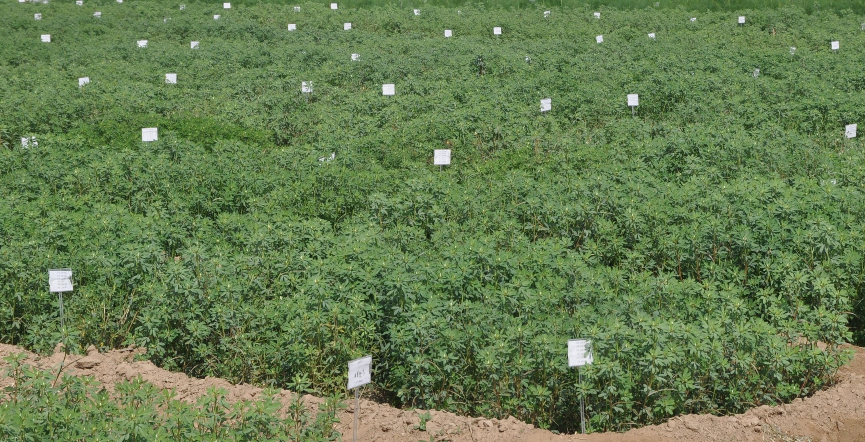
Experimental view

Slide 13
Results
Bio-fertilizers
Bio-fertilizer significantly influenced the plant height, dry matter accumulation, number of primary branches per plant, number of nodules per plant, dry weight of nodules per plant, number of pods per plant, pod length, pod weight, number of seeds per pod and seed yield kg ha⁻¹.
Seed inoculation with Rhizobium + PSB recorded the maximum plant height (89.91 cm), dry matter accumulation (337.35) at harvest, number of primary branches per plant (6.68), number of nodules per plant (24.35), dry weight of nodules per plant (0.16), number of pods per plant (89.62), pod length (12.05cm), pod weight (4.72g), number of seeds per pod(17.81), seed yield ha⁻¹ (17.43)and straw yield ha⁻¹ respectively as compared to control.

Slide 14
Results
Plant growth regulators
Plant growth regulators significantly improved the growth attributes.
Foliar spray of plant growth regulators significantly increased the number of pods/plant, pod length, pod weight, number of seeds/pod, seed yield and straw yield q/ ha in comparison to control.
Foliar application of 20 ppm NAA recorded the maximum number of pods/plant (86.37), pod length (12.12 cm) highest pod weight (i.e.,4.85mg), number of seeds/pod (18.0), seed yield (17.99q ha-1) and straw yield (47.48q ha-1 which was closely followed by 10 ppm NAA.

Slide 15
Conclusion
Thus foliar spray of NAA 20 ppm is the best treatment for realized highest yield attributes and seed yield of fenugreek in comparison to rest treatment.

Slide 16
Thanks

