Slide 1



Potential valorizations of artificial gypsum generated in the manufacture of titanium dioxide pigments
World Congress and Expo on Recycling
July 20-22, 2015 Barcelona
S.M. Pérez-Moreno, M.J. Gázquez, J.P. Bolívar
Group of Radiations Physics and Environment, University of Huelva, Huelva, Spain.
E-mail address: silviamaria.perez@alu.uhu.es
Notes:
Good afternoon, the title of my work is…

Slide 2
Content
INTRODUCTION
OBJECTIVES
MATERIALS AND METHODS
RESULTS AND DISCUSSION
  WASTE CHARACTERIZATION
  APPLICATIONS 1
  APPLICATIONS 2
FINAL REMARKS
Notes:
I will begin with a brief introduction of the problem treated in this work and the main objectives set out. After, I will show the materials studied and methods used, following by the applications selected and finally, the most relevant conclusions.

Slide 3
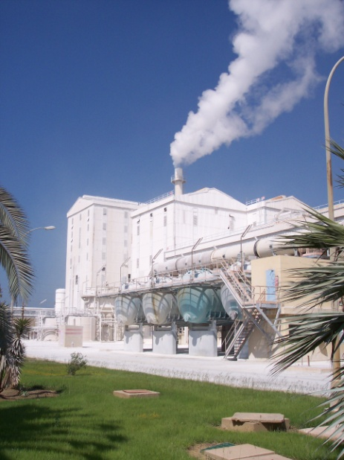
INTRODUCTION
Globally huge amounts of inorganic industrial wastes are generated and their management represents a high cost and an environmental problem.
The development of technologies and new applications to valorize these wastes is of increasing importance.
The factory of Tioxide-Huelva is the only one in Spain devoted to the TiO₂ production.
Two residues, red gypsum (RG) and un-attacked ilmenite mud (MUD) have been studied.
Notes:
Punto 1:Leer
Punto 2:Leer
Punto 3: In the southwest of Spain, is located an industry engaged in the production of titanium dioxide, a pigment that delivers whiteness to a vast range of products from coatings and polymers to cosmetics and food.
Punto 4: The industry generates two residues, red gypsum and un-attacked mud that have been studied in this work.

Slide 4
INDUSTRIAL PROCESS
ILMENITE (FeTiO₃)
PRECIPITATION
FILTER AND WASH
DIGESTION
CLARIFICATION
CALCINATION
H₂SO₄
Weak acid stream
MUD
TiO₂
NEUTRALIZATION
30.000 tons per year
RED GYPSUM
(CaSO₄·2H₂O)
70.000 tons per year
Currently these wastes have no commercial value and are disposed of in an authorized and controlled repository area
Notes:
In this slide is shown the main steps of the production of titanium dioxide.
The raw material of the process is the ilmenite which is digested with sulfuric acid. After clarification step, it is generated the MUD, it is the solid fraction un-attacked. The titanium dioxide (TiO2) is produced after precipitation and calcination steps.
During wash step, it is generated a weak acid stream, that after neutralization with Ca(OH) calcium hydroxide, it is generated the red gypsum.
Large amount of mud and red gypsum is produced, about 30.000 and 70.000 tons per year, respectively. And “leer”
In the same way, it is released large amount of carbon dioxide into the atmosphere, approximately 200.000 tons per year.

Slide 5
OBJECTIVES
  Use of RG and MUD as building materials for fire-resistant panels.
  Use of RG as a calcium source for carbon dioxide sequestration.
Notes:
Idea 1: The objectives set out in this work have been to study the …”leer”

Slide 6
CHARACTERIZATION METHODS
X-Ray fluorescence (XRF)
X-Ray difraction (XRD)
Inductively coupled plasma-mass spectrometry (ICP-MS)
Granulometry analysis
Thermogravimetric analysis (TGA)
Scanning electron microscopy (SEM-EDS)
Notes:
The analysis techniques used for characterization of waste and new products have been…”Leer”

Slide 7
MATERIALS
MUD and RG samples were collected every 5 days for 1 month, in order to evaluate the possible temporal variability of the characteristics of these material
In order to carry out the applications studied in this work, several materials as Pladur, vermiculite and NaOH were used.

Slide 8
Results and discussion
  WASTE CHARACTERIZATION
  APPLICATIONS 1
  APPLICATIONS 2
Notes:
In next slide, I will present the result of this work.
Firstly, I will show the physicochemical characterization of mud and red gypsum that have been used as raw material in the different applications, in order to understand the applications selected. And After, I will explain the experimental procedure of each applications and I will show the most relevant results.

Slide 9
  MUD AND RED GYPSUM
Waste characterization

Slide 10
MUD
Granulometry ~ 40 µm
SiO₂ | 18±1
Al₂O₃ | 2.5±0.2
FeO_{(T)} | 11±1
MnO | 0.36±0.01
MgO | 0.38±0.02
CaO | 0.75±0.01
SO₃ | 6.1±0.7
TiO₂ | 53±1
ZrO₂ | 4.2±0.1
Concentration (%) of major elements
by XRF
SEM analysis of MUD and their X-ray spectra
Mineralogical composition by XRD: ilmenite (FeTiO₃), rutile (TiO₂),
Zircon (ZrSiO₄), Quartz (SiO₂)
Mineral phases are highly refractory
Notes:
Idea 1: Mud, the insoluble solid fraction in sulphuric acid, contain mainly Titanium (Ti), silica (Si) and iron (Fe). According to mineralogy results, mud is composed of ilmenite, rutile, zircon and quartz. These mineral phases are highly refractory.
In the image it can be seen the different phases. The particle number 1 is zircon. 2 and 3 are quartz particles, and number 4 is a ilmenite particle.

Slide 11
red gypsum
Granulometry ~ 60 µm
SiO₂ | 1.2±0.2
Al₂O₃ | 1.4±0.2
FeO_{(T)} | 14±2
MnO | 0.35±0.04
MgO | 1.4±0.2
CaO | 33±2
SO₃ | 27±1
TiO₂ | 7.6±1.2
SEM analysis of RG and their X-ray spectra
Concentration (%) of major elements by XRF
Mineralogical composition by DRX: Gypsum (CaSO₄·2H₂O) and iron and titanium oxides
Notes:
Idea 1: Red gypsum, generated in the neutralization step, contain mainly calcium (Ca), sulfur (S) and iron (Fe). According to mineralogy results is composed of gypsum, and iron and titanium oxides.
In the image, it can be seen the characteristic morphology of gypsum (number 1) and number 3, it can be seen the amorphous phase, which contain iron and titanium.

Slide 12
  RG and MUD as building materials for fire-resistant panels
APPLICATION 1
Notes:
The first application has been to use ….”leer”

Slide 13
Code | RG | MUD | Vermiculite
Plate 1 | 100 % | - | -
Plate 2 | 75 % | 25% | -
Plate 3 | 80% | 15% | 5%
Vermiculite was used to increase the insulating capacity of plates.
Pladur ^{(R)} was used as typical building material.
Plates were made using a low cost manufacturing method:
The components were mixed with water, in different percentages.
The pastes obtained were poured into a 25 x 25 cm by 2.8 cm thick molds and were dried for 25 days at ambient temperature.
Notes:
Idea 1: In this applications three plates were manufactured with different composition. Plate 1, only with red gypsum. Plate 2, with 75% (seventy five percent ) of red gypsum and 25% (percent) of mud. And Plate 3, (80%) red gypsum, (15%) mud and (5%) vermiculite. “leer..”
And Also,..Pladur..”leer”
“Leer”

Slide 14
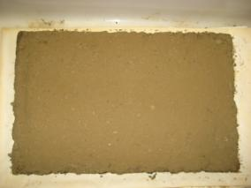
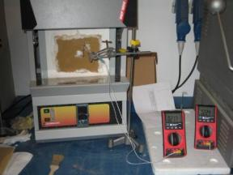
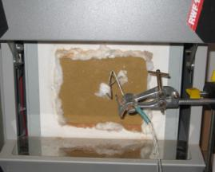
fire-resistance tests
The fire-resistance capacity was evaluated in agreement to EN-1363-1 standard, which established a temperature (T) versus the time (t) inside an oven by the equation: T = 20+345· log10(8t+1), where T is the internal temperature (°C), and t is the time (minutes) from the beginning of the test.
The experiment is finished when:
The temperature of one of the thermocouples on the non-exposed surface of the material is above 180 ºC.
The average temperature of all the thermocouples on the non-exposed surface is above 140 ºC + Tenv (environmental temperature).
Notes:
Leer…

Slide 15
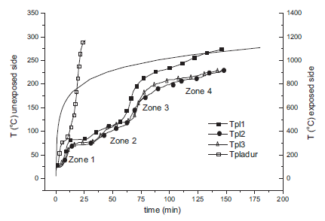
exposed surface
Plates 1–3: similar insulating behavior, much better than Pladur®.
The addition of mud improves thermal insulation significantly, mainly due to its highly refractory mineral phases. (Plate 2 and 3 better than 1)
The influence of vermiculite on the material is negligible.
Notes:
The results are shown in this figure. It is represented in the right axis the temperature of exposed side and in the left axis the temperature of non-exposed side versus time.
This line belong to pladur, typical material used in building construction. It can be seen that the pladur reaches high temperature in short time, whereas the plates need more time to reach the same temperature. So..”leer punto 1”.
However, the plate 2 and 3 are slightly better than plate 1. It is because ..Leer”Punto 2”.
In the figure, it can be seen that for two hours, plates 2 and 3 reach less than 200 ºC.
Leer…

Slide 16
Concentration values (µg/L) of leachability of trace elements from the plates and limits values of TCLP test .
 | As | Cd | Co | Se | Cr | Cu | Ni | Pb | Sr | V | Zn
Plate 2 | <1 | <1 | 5.2±0.4 | <1 | 1.7±0.2 | 25.7±1.8 | 42±5 | <1 | 336±11 | <1 | 39±3
Plate 3 | <1 | 1.9±0.1 | 8.5±0.5 | <1 | 2.1±0.2 | 47.2±2.2 | 68±3 | <1 | 330±10 | <1 | 71±4
U.S. EPA | 5000 | 1000 | - | 1000 | 5000 | - | - | 5000 | - | - | -
The leaching test shows a metals concentration lower than regulatory limits by EPA for TCLP test.
Notes:
In order to evaluate the mobility of pollutants into the environment, it has been done the TCLP test to different plates. In this table, it is represented the results, which show that values are much lower than regulatory limits.

Slide 17
  RG as a calcium source for carbon dioxide sequestration.
APPLICATION 2
Notes:
The second application has been to use ….”leer”

Slide 18
CARBONATION PROCESS
(RG)
CaSO₄·2H₂O _{(s)}
Carbonation
Separation of phases
Extraction of Ca
Tº = 75ºC, P= atm
Na₂SO_{4 (aq)}+ H₂O
NaOH + H₂O
CO₂
CaCO_{3 (s)}
Theoretical Global Reaction:
CaSO₄·2H₂O _{(s)} + 2 NaOH_{(aq)} + CO_{2 (g)} → CaCO₃ _{(s)} + Na₂SO_{4 (aq)} +H₂O
Notes:
The carbonation process involves the extraction of calcium, using a solution of sodium hydroxide, followed by the reaction with carbon dioxide in aqueous phase. And finally the products are separated by filtration.
During the process, it takes place this reaction, where it is generated a calcium carbonate in solid phase and sodium sulphate in solution.

Slide 19
Concentration (%) of major elements and the transfer factor (%) in the brackets
 | RG | Carbonated fraction | Sulphate fraction
SiO₂ | 0.74±0.05 | 1.2±0.1 (103±11) | 0.35±0.03 (38±4)
Al₂O₃ | 0.75±0.02 | 1.0±0.1 (84±8) | 0.04±0.01 (4.4±1.1)
Fe₂O₃ | 7.3±2.0 | 9.0±2.5 (79±30) | 0.03±0.01 (0.34±0.15)
MnO | 0.25±0.07 | 0.30±0.08 (76±29) | 0.01±0.01 (3.3±3.4)
MgO | 0.77±0.05 | 0.30±0.02 (25±2) | 0.95±0. 06 (101±9)
CaO | 28±2 | 47±3 (106±10) | 1.8±0.1 (5.3±0.5)
Na₂O | 0.18±0.01 | 0.50±0.03 (0.84±0.07) | 37±3 (80±8)
K₂O | 0.03±0.01 | 0.04±0.01 (84±35) | 0.01±0.0 1 (27±20)
TiO₂ | 3.8±0.1 | 4.7±0.1 (79±3) | 0.02±0.010 (0.43±0.21)
P₂O₅ | 0.05±0.01 | 0.05±0.01 (64±18) | 0.01±0.01 (17±17)
SO₃ | 34±1 | 2.1±0.1 (4.0±1.0) | 35±1 (85±4)
Notes:
Both products of carbonation process have been studied. In this table is represented the concentration in percent of major elements and the transfer factor. The results show that almost all of components of red gypsum remain in the carbonated fraction. However, the sulfur contained in red gypsum and sodium are transferred to the solution or sulphate fraction, as it is expected.

Slide 20
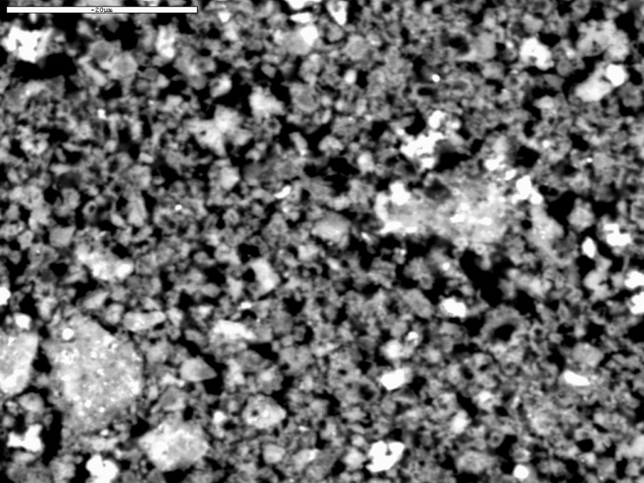

Mineralogical composition by XRD: Calcite (CaCO₃) and rutile (TiO₂).
SEM analysis and their corresponding X-ray spectra
2
1
Thermogravimetric analysis results
3
₂
₁
₃
Carbonated sample (C1)
Particles present a poorly developed rectangular shape which is characteristic of calcite (CaCO₃)
Notes:
Others techniques have been used to the characterization of carbonated fraction. The result confirm that Calcium contained in the red gypsum has been dissolved in the process and it is in form of calcite.
In the image, number 1. It can be seen that …”Leer”,
However, the iron and titanium remain in the carbonation sample undisturbed.

Slide 21

Co₂ SEQUESTRATION EFFICIENCY (C_{E})
Where:
X exp ~ calcium in form of carbonate generated in the process
X theo ~ total calcium in the red gypsum
C_{E} = 92 ± 6 %
Notes:
In order to evaluate the degree of carbonation of red gypsum, it has been calculated the carbon dioxide sequestration efficiency, which is defined as the ratio between …”leer”
The results show a high degree of carbonation, more than 90% of efficiency and their uncertainty is low. So, the process is quite reproducible.

Slide 22
CONCLUSIONS
Notes:
In next slides, I will show the most relevant conclusions of two applications studied and the final remarks.

Slide 23
Application 1: use of RG as building materials for fire-resistant panels
Fire-resistance Test demonstrate that the plates perform better than some materials used in construction such as Pladur®. The tested material also possesses acceptable mechanical properties that showed no noticeable distortion or breakage during the test. Although, the mechanical properties of plates must be study.
Also, it was conducted leaching tests using the TCLP procedure and results showed a negligible environmental impact.

Slide 24
application 2: use of RG a calcium source for carbon dioxide sequestration
The products of RG carbonation, using NaOH as extracting agents, are: CaCO₃ and Na₂SO₄.
The pollutants remain almost completely into the carbonation fraction, whereas the sulphate fraction is very clean. The environmental implications of both of them are negligible for future applications.
The carbonation efficiency obtained is very high under experimental conditions.

Slide 25
Final remarks
This study was carried out to evaluate the use of RG as building materials for fire-resistant panels and a calcium source for carbon dioxide sequestration, owing to its high content of Ca.
Previously, it was necessary an exhaustive characterization of raw materials and later, a study of new materials obtained or products was made.
Preliminary results show that these residues are viable in the studied applications.
And the environmental implications are considered as negligible.

Slide 26
thank you for your attention
World Congress and Expo on Recycling
July 20-22, 2015 Barcelona
Group of Radiations Physics and Environment, University of Huelva, Huelva, Spain.
E-mail address: silviamaria.perez@alu.uhu.es

