Slide 1
IMMUNOTOXICITY OF INDUSTRIAL EFFLUENTS IN FIN FISH: AN ALTERNATIVE ANIMAL MODEL FOR IMMUNOTOXICOLOGICAL STUDIES
Dr. Catherine P.Alexander
Associate Professor
Research Centre of Zoology,
Jayaraj Annapackiam College for Women Periyakulam, Theni Dist- 625 601,
Tamil Nadu, India

Slide 2
Immunotoxicity
Interaction of the Xenobiotics on immune system (Xenobiotic - A chemical that is foreign to the biosphere i.e. is not produced by a natural biological or abiotic source)
Inhibit or depress immune function
Immunosuppression - Susceptibility to bacterial, viral and parasitic infection
Damage to primary and secondary lymphoid organs
Elicitation of an immune response –
Hypersensitivity & Autoimmune disease.

Slide 3
The immune system represents the interface between an individual’s health and the pathogens present in its environment.
The immune system is exquisitely sensitive for assessing the toxic effects of chemicals of environmental concern.

Slide 4
Xenobiotics that elicit Immune Reactions
Polyisocyanates - Toluene diisocyanate
Acid Anhydrides - Trimellitic anhydride
Metals & Metal Salts - Pt, Co, Ni, Cr
Drugs – Penicillin
Pesticides – Carbamates
Polycyclic aromatic hydrocarbons & halogenated aromatic hydrocarbons – PCBs & PBBs
Benzene
Dibenzodioxin (TCDD – dioxin)
Organophosphorous compounds, ozone, metals, organotin, cyclophosphamide
(Zeeman and Brindley, 1981; Dunier and Siwicki, 1993; Anderson and Zeeman, 1995;
Luebke et al., 1997; Zelikoff et al., 2000; Bols et al., 2001; Rice, 2001; Burnett, 2005;
Carlson and Zelikoff, 2008)

Slide 5
AQUATIC TOXICOLOGY
Dissolved metals – minute amounts in the aquatic environment
Through industry may be transported, concentrated, changed into other forms and are reintroduced into the aquatic system as contaminations.
Fish are a fairly inexpensive protein-rich food that constitutes the sole protein source for many people. Unfortunately they are frequently exposed to many pollutants in the aquatic environment.
Fish and their immune system may also represent an important scientific tool in the monitoring of environmental quality, particularly immunotoxic environmental pollution

Slide 6
FISH IMMUNE SYSTEM
Fish are the first group of vertebrate animals with both innate and adaptive immune responses.
The immune system of fishes can be subdivided into broadly three categories which differ in the speed and specificity of response
First line of defence is external barriers separating the fish from its environment, i.e., the epithelia of skin, gills and alimentary canal
Inside the fish, the second immune category is formed by the innate immune system which enables a rapid response to invading pathogens.
The third line of immune defense is the adaptive or acquired immune system, a set of humoral and cellular components that enable a pathogen-specific response. Adaptive immune system of fish usually shows a rather slow response to infective pathogens, taking weeks instead of days as in mammals.

Slide 7
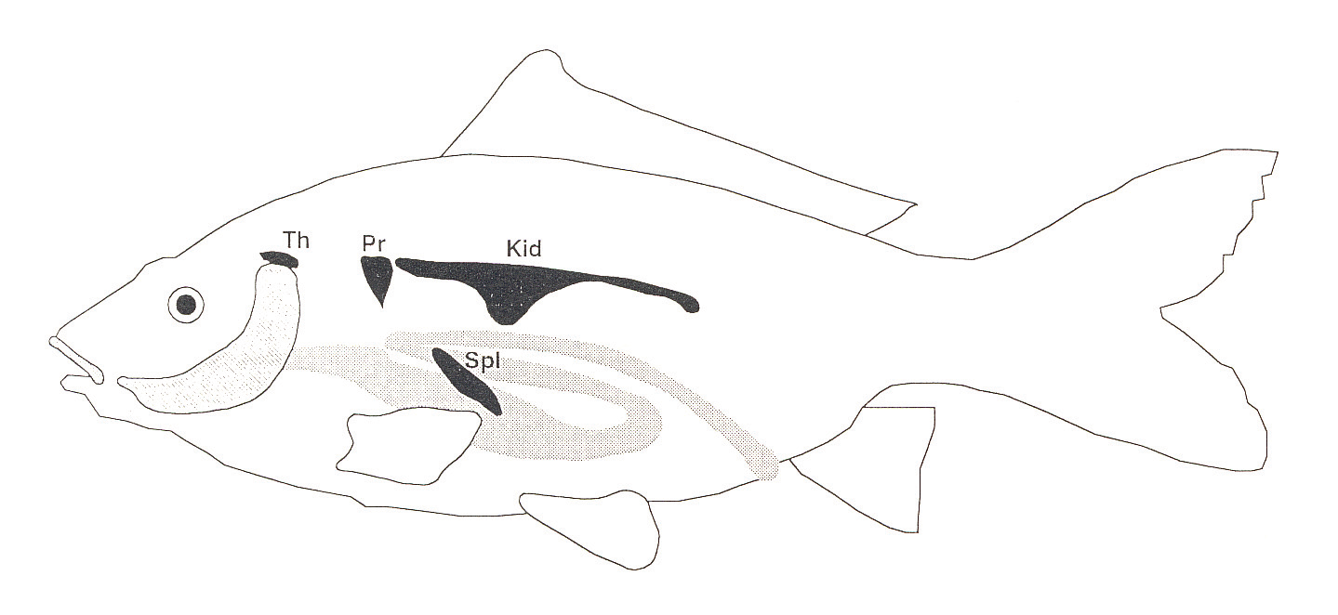
The immune system of teleost fishes

Slide 8
The immune system of teleost fishes…
The immune tissues are quite different since fish lack the bone marrow and lymphatic nodules.
Pronephros (anterior/head-kidney) is the main lympho-haematopoietic tissue
Thymus is the main tissue for T cells development and maturation.
Spleen is the main secondary lymphoid tissue
Other important site for the immune response is the mucosal associated-lymphoid tissue (MALT) – skin, gills and gut.
The non-specific immune parameters are useful to determine the health status of fish and to evaluate the immunomodulatory substances for fish farming as markers for pollution and diseases resistances.

Slide 9
The immune system of teleost fishes…
The humoral immune response is a compilation of proteins and glycoproteins
The complement system, in plasma and mucus, shows classical, alternative and lectin activation pathways
An important bacteriolytic enzyme is the lysozyme, mainly found in eggs, mucus, plasma and leucocytes
There are also other innate immune factors such as acute phase proteins (C-reactive protein CRP), antimicrobial peptides, interferon (IFN), lectins, proteases, protease inhibitors or eicosanoids
Ig are the major component of the adaptive humoral immune response.
Fish have only one immunoglobulin isoform, the IgM - tetrameric instead of pentameric as it occurs in mammals.
WBCs are functional equivalent to lymphocytes, granulocytes, macrophages and NK cells.
Fish macrophages secrete a wide range of biologically active molecules including reactive oxygen species (ROS) including superoxide anion (O_{2–}), hydrogen peroxide (H₂O₂) and hypochlorous acid (HOCl) etc., which are involved in the bactericidal activity, during a phenomenon termed the respiratory burst (Secombes 1990).

Slide 10
QUESTIONS?
How to assess immunotoxic effects?,
What are the mechanisms leading to immunotoxicity?,
What are the implications of the effects on immunocompetence and organism fitness?
As the piscine immune cells and organs are closely associated with the blood system, and partly act as filtering system for the circulatory system, they are highly accessible to toxicants.
Additionally, the immune system may be indirectly affected by toxicants via the neuro-endocrine system

Slide 11
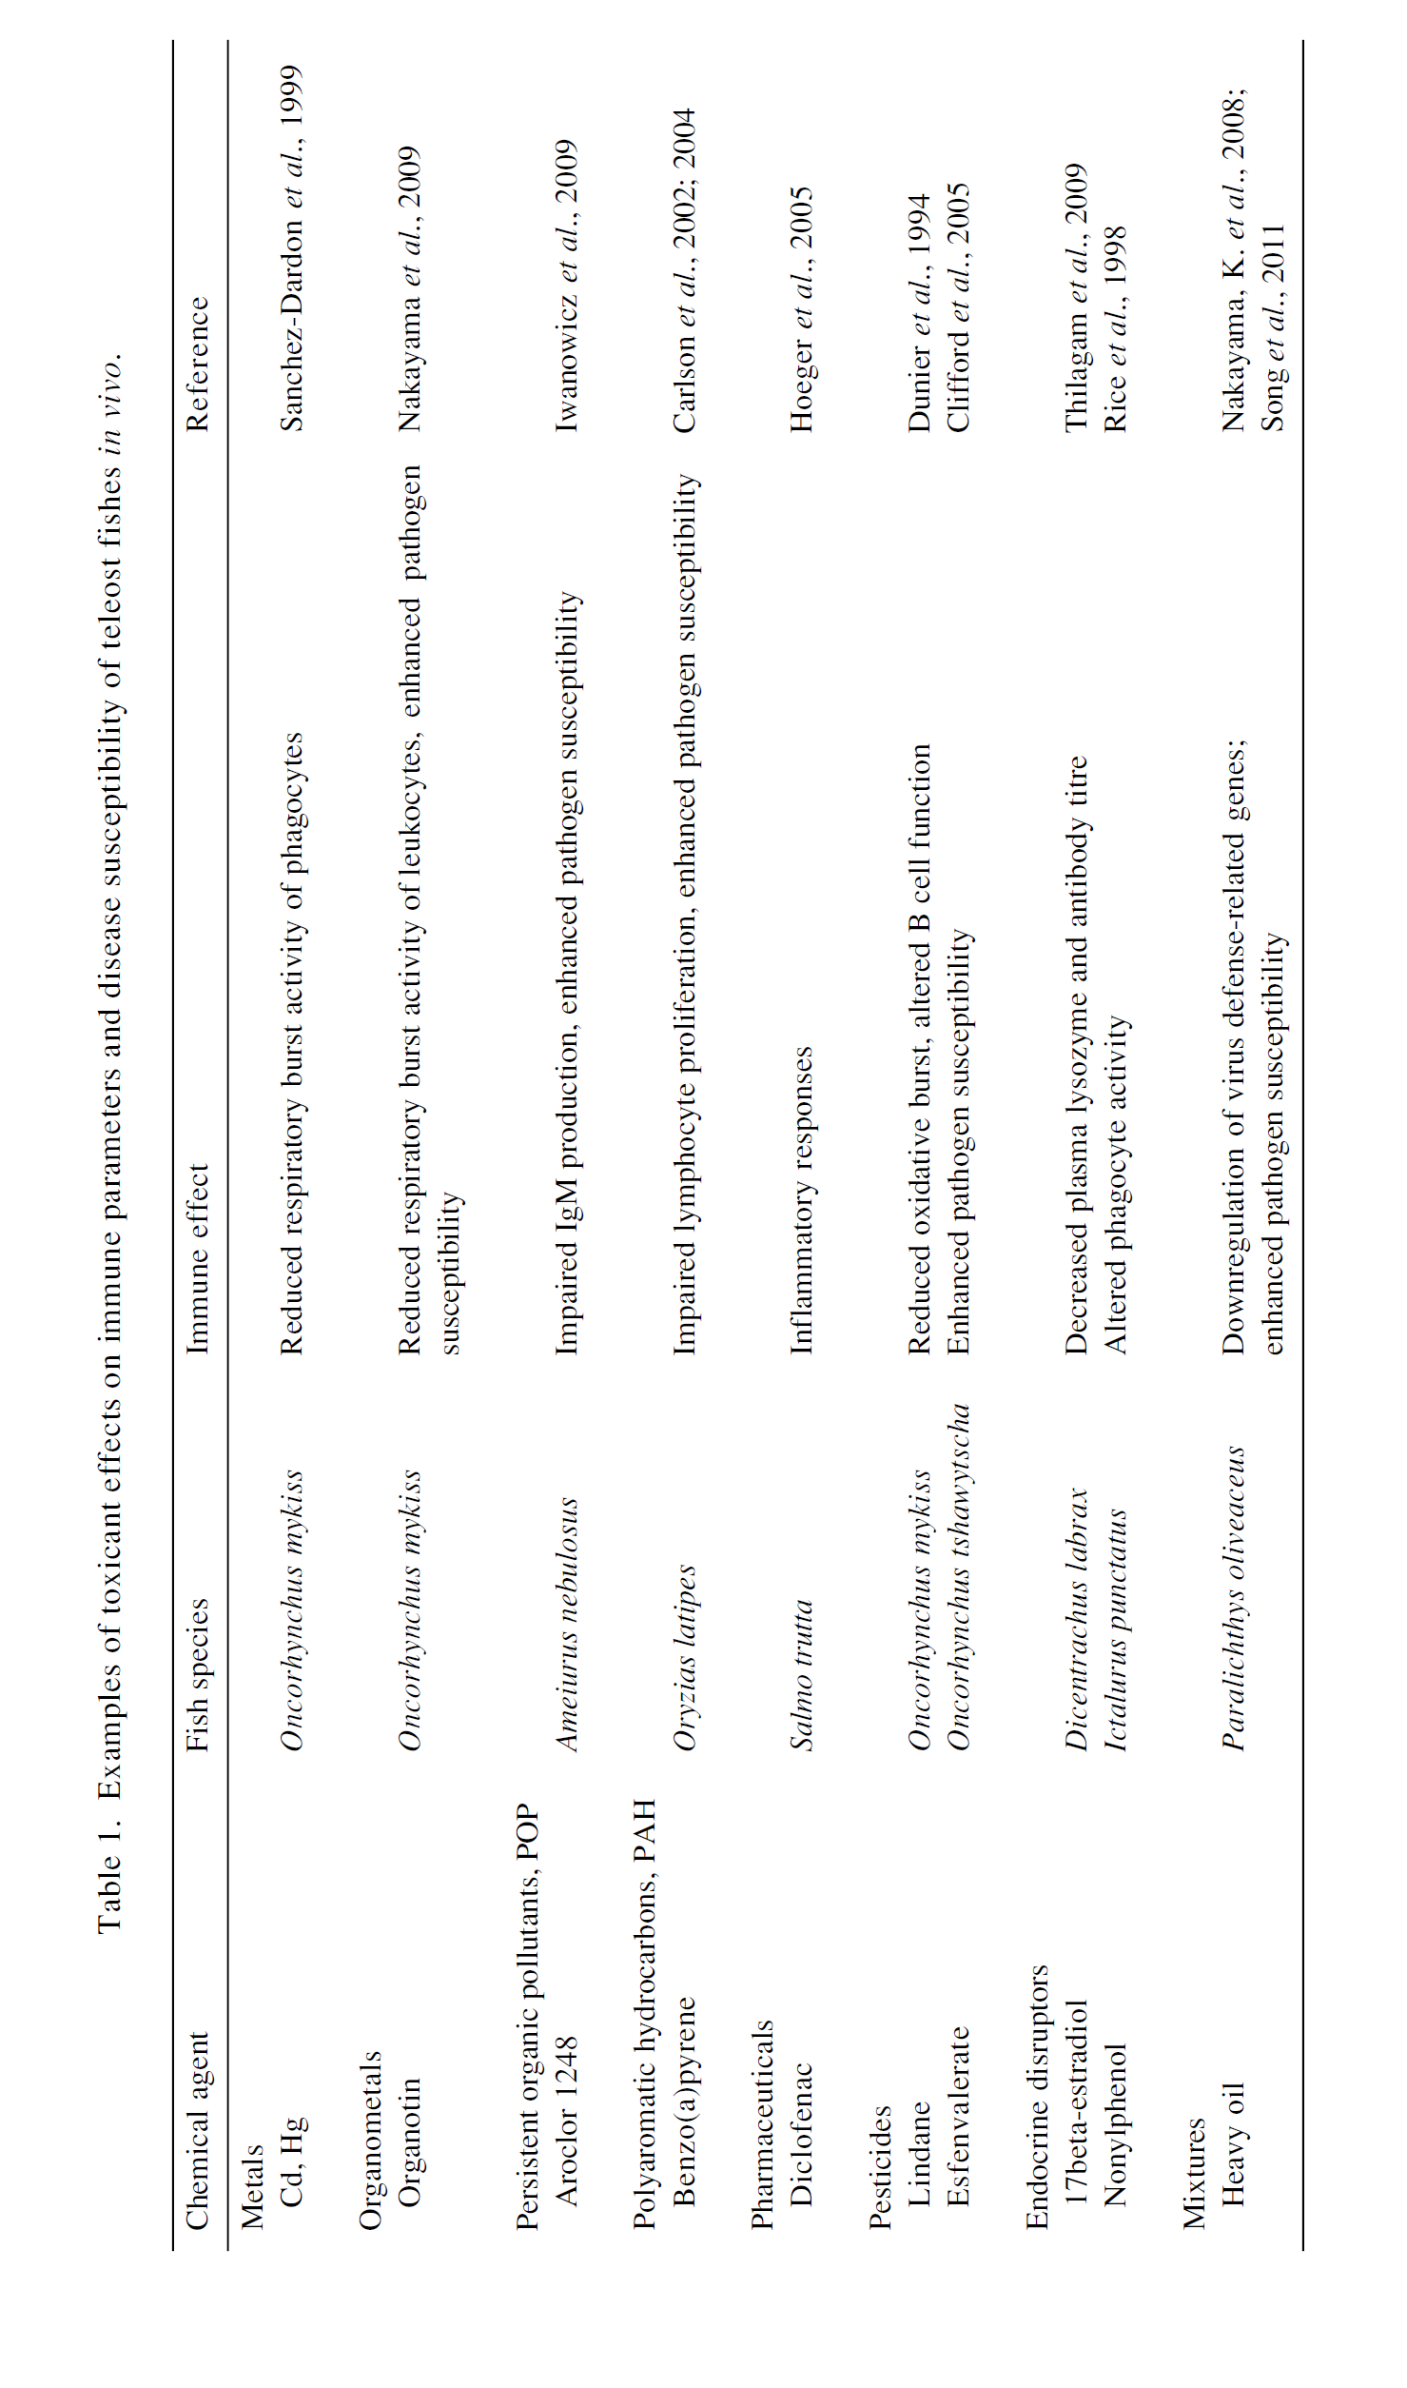

Slide 12
OBJECTIVE
To investigate the effect of sub lethal concentrations of industrial effluents on the immunity of Cyprinus carpio in terms of
- nonspecific
- specific
Tannery industry
Coffee industry and
Electroplating industry

Slide 13
Effluent exposure
96 h LC₅₀ -static bioassay method (Doudoroff et al., 1951)
Probit analysis (Finney, 1964).
The 96 h LC₅₀ of TE for C.carpio - 4.5% of TE.
0.0045%, 0.045% and 0.45%
The 96 h LC₅₀ of coffee mill effluent for C.carpio - 3% of effluent.
0.003%, 0.03% and 0.3%
96 h LC₅₀ of electroplating industrial effluent for C.carpio - 0.128% of effluent.
0.004%, 0.007%, 0.03%, 0.010and 0.013%

Slide 14
Experimental Setup
Two sets with four groups (6 fish/ Group) each
SET I - non specific immune parameters - exposed to test concentrations for specified days
SET II - specific immunity - exposed to test concentrations - immunized intraperitoneally with heat killed Aeromonas hydrophila.

Slide 15
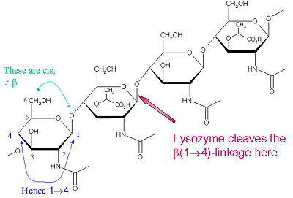
SERUM LYSOZYME ACTIVITY
Cleaves β (1-4) between n-acetyl muramic acid and n-acetyl glucosamine present in the peptidoglycan cell wall of Gram (+) bacteria
Serum lysozyme level was measured by a turbidimetric assay. The serum was incubated with Micrococcus lysodeikticus (substrate for lysozyme) and the reduction in absorbance at 490nm was calculated.
REF:
Parry, R.M., Chandan, R.C., Shahani, K.M. (1965). A rapid and sensitive assay of muramidase. Proc. Soc. Exp. Biol. 119, 384–386.
Hutchinson, T.H., Manning, M.J. (1996). Seasonal trends in serum lysozyme activity and total protein concentration in dap (Limanda limanda L.) sampled from Lyme Bay, UK Fish. Shellfish. Immunol. 6, 473–482.

Slide 16
Effect of chronic exposure to industrial effluent on the serum lysozyme activity in Cyprinus carpio

Slide 17
SERUM MYELOPEROXIDASE
MPO catalyses the oxidation of halide ions by H₂O₂ to form hypohalites, chloramines and singlet oxygen which are detrimental to pathogens

Slide 18
SERUM MYELOPEROXIDASE ACTIVITY
10µl of fish serum was added to 90 μl of HBSS (pH 7.3, without Ca²⁺ and Mg²⁺)
35µl of TMB was added and incubated for 2 minutes
35 μl of 2M H₂SO₄ was added to stop the reaction
OD at 450 nm
REF:
Quade, M.J.and Roth, J.A. (1997). A rapid, direct assay to measure degranulation of bovine neutrophil primary granules. Veterinary Immunology and Immunopathology 58, 239–248
Sahoo, P.K., Kumari J.and Misra, B.K. (2005).Nonspecific immune responses in juveniles of Indian major carps. Journal of Applied Ichthyology 21:151-155

Slide 19
Effect of chronic exposure to industrial effluent on the serum myeloperoxidase activity in Cyprinus carpio

Slide 20
SERUM ANTIPROTEASE ASSAY
Inhibition of trypsin is one way to measure antiprotease activity. Chromogenic substrate BAPNA is hydrolysed by trypsin amidase yielding yellow dye paranitroaniline which is measured photometrically
10μl of test sera was mixed with 20μl of Trypsin(1 mg/ml)
in 0.01M Tris HCl. pH 8.2
Incubated for 5 min.
Add 500μl of 2 mM BAPNA and made up the volume to
1 ml with 0.1M Tris HCl
Incubated for 25 min at room temperature
Added 150μl of 30% Acetic acid.
OD at 410nm.
The results are expressed in percent trypsin inhibition.
%Trypsin Inhibition = (A1 –A2 /A1) x 100
A1 = Control (Without serum); A2 = Sample
REF:
Bowden, T.J., Butler, I.R., Bricknell, I.R.and Ellis, A.E. (1997). Serum trypsin inhibitory activity in five species of farmed fish. Fish and Shellfish Immunology 7, 377-385

Slide 21
Effect of chronic exposure to industrial effluent on the serum anti-protease activity in Cyprinus carpio

Slide 22
ANTIBODY RESPONSE - BACTERIAL AGGLUTINATION ASSAY
25ml of antiserum was added to the first well of 96 well ‘V’ bottom microtitre plates
Two fold serial dilutions were made using PBS
25μl of heat- killed A.hydrophila cell suspension (1x10⁹ cells/ml) pre-stained with crystal violet was added
Shake well and incubate at 37ºC overnight
The highest dilution of serum sample that showed detectable macroscopic agglutination was recorded and expressed as log₂ antibody titre of the serum.
REF:
Karunasagar, I., Ali, A., Otta, S.K., Karunasagar, I. (1997). Immunisation with bacterial antigens: Infections with motile Aeromonads. Dev. Biol. Stand. 90, 135–141.

Slide 23
Effect of chronic exposure to industrial effluent on the antibody response to heat-killed Aeromonas hydrophila assayed by bacterial agglutination tested in Cyprinus carpio

Slide 24
Implications
Assessment of the hazard of immunotoxic chemicals not only focus on the relationship between chemical exposure and the immune system, but it needs to take into consideration the complex functional properties and the ecological context of the immune system.
The results of this study would emphasize the importance of integration of immunological assays into environmental monitoring with reference to industrial effluents.
The immunotoxicity of industrial effluents may influence the ability of fish to defend against infectious diseases.

Slide 25
Thank You

