Slide 1
Wind Stress over Water Surfaces:
Comparisons of Various Estimation Methods
Professor S. A. Hsu
Coastal Studies Institute,
Louisiana State University
Email: sahsu@lsu.edu

Slide 2
Wind stress τ = ϱ U*² = ϱ C_{d} U₁₀²
Where ϱ is the density of air,
U* is the friction velocity,
C_{d} is the drag coefficient, and
U₁₀ is the wind speed at 10m above the water surface.

Slide 3
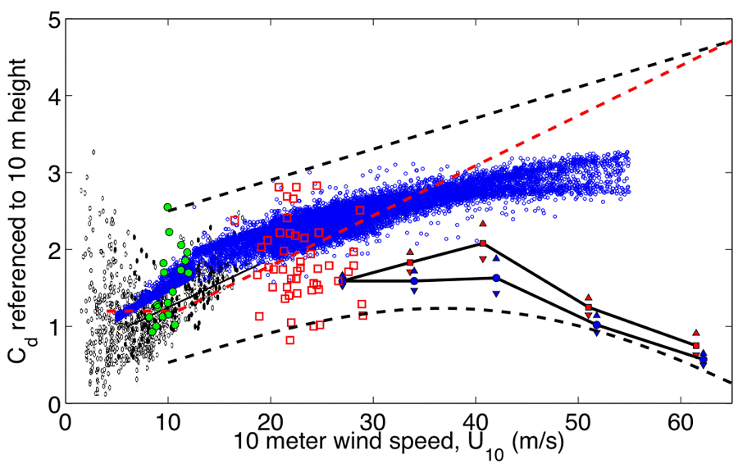
www.gfdl.noaa.gov/

Slide 4
1. Wind-wave Interaction Method
When U₁₀ is less than 7.5 m/s, surface tension and thermal effects dominate the air-water interaction;
When U₁₀ > 7.5 m/s, mechanical turbulence takes over, so that the logarithmic wind profile prevails,
U₁₀ = (U*/k) Ln (10/Z_{o}) (1)
Where k (=0.4) is the von Karman constant,
Z_{o} is the aerodynamic roughness length.

Slide 5
According to Taylor and Yelland (2001, JPO),
Z_{o} / H_{s} = 1200 (H_{s}/L_{p}) ^{4.5} (2)
L_{p} = g T_{p} ² / (2π) = 1.56 T_{p}² (3)
Where H_{s} is significant wave height,
L_{p} is peak wave length, g is gravitational
acceleration, and T_{p} is dominant wave period.

Slide 6
2. Wave Method
According to Csanady (2001) and JONSWAP
Wave Spectra (Carter, 1982), for U₁₀ > 20m/s after wave breaker saturation (Amorocho and DeVries,1980; and Geernaert et al.,1987),
g Hs/U*² = 0.053 (g T_{p} /U*) ^{3/2} (4)
Therefore,
U* = 36 H_{s}²/ T_{p} ³ (5)

Slide 7
3. Turbulence Intensity or Gust Factor Method
According to Hsu (1988, Coastal Meteorology)
And Hsu (2003, Journal of waterway, Port,
Coastal, and Ocean Engineering),
U* = k p U₁₀ (6)
G = 1 + 2P (7)
U₂ / U₁ = (Z₂ / Z₁) ^{p} (8)
P = σu / U₁₀ (9)
G = U_{gust} / U_{sustained} (10)

Slide 8
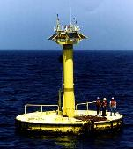

Slide 9
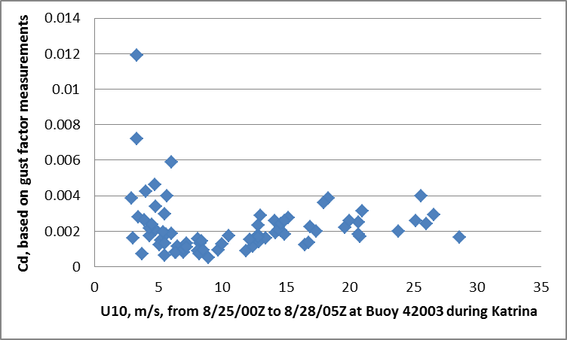

Slide 10
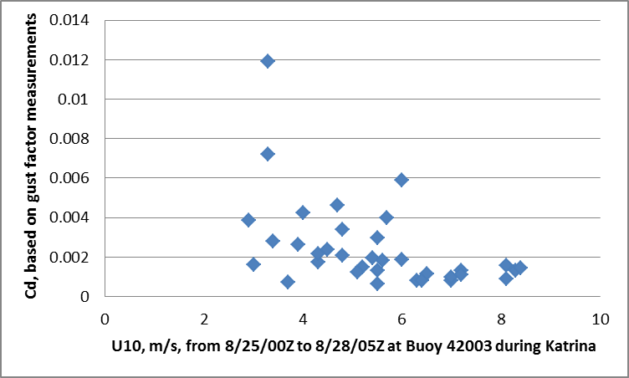

Slide 11
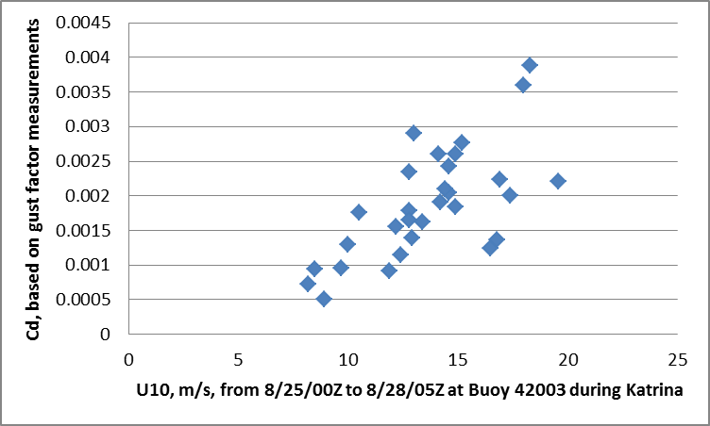

Slide 12
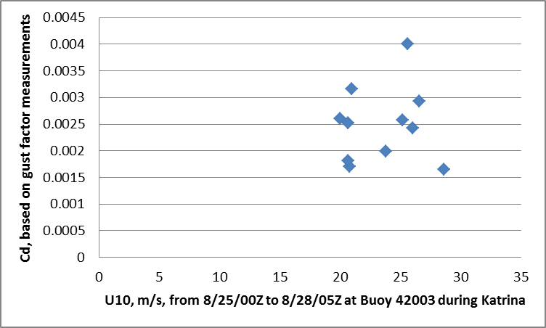

Slide 13
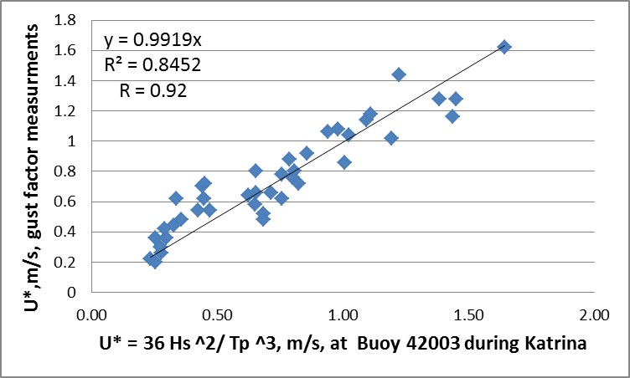

Slide 14
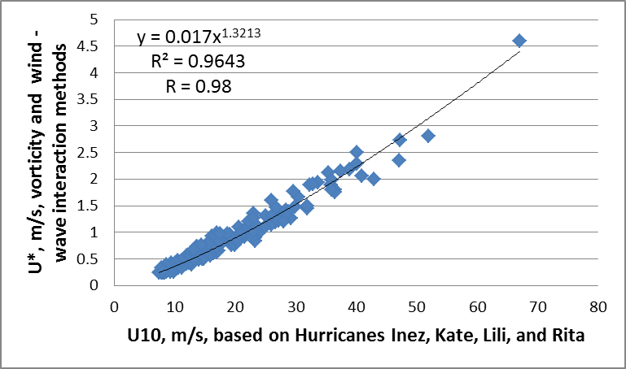

Slide 15
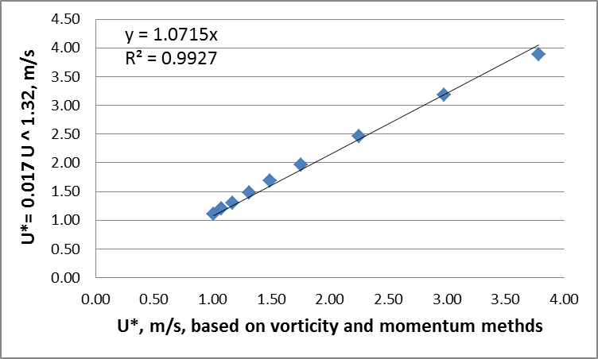

Slide 16
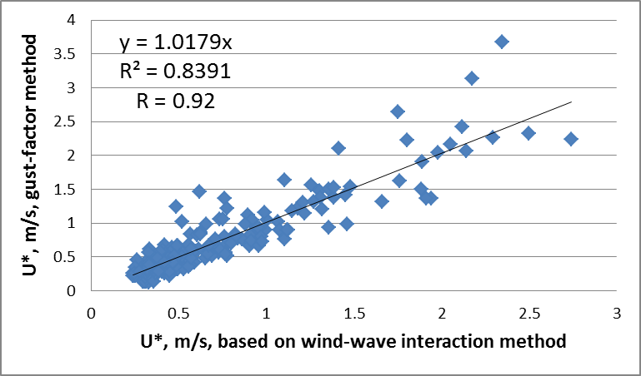

Slide 17
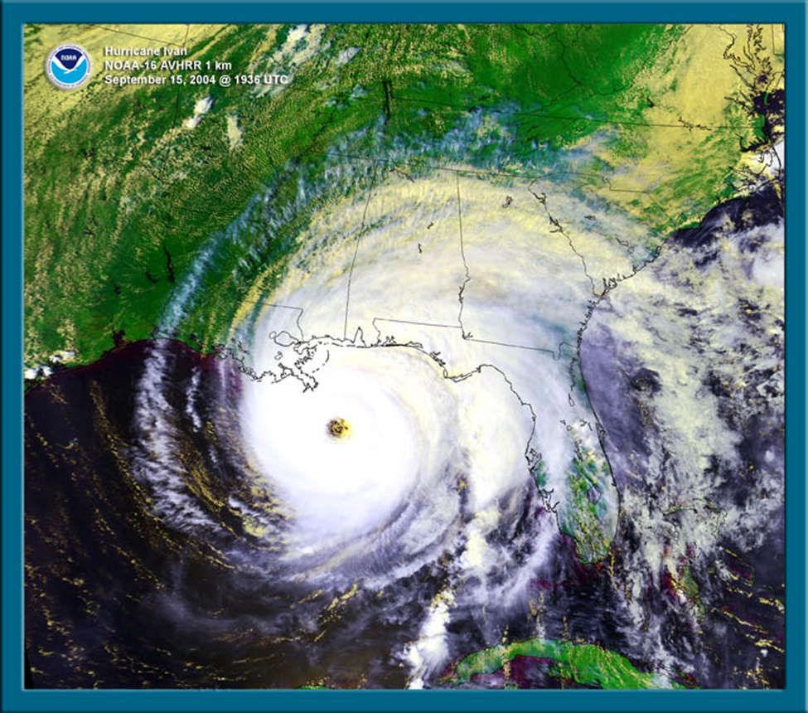

Slide 18
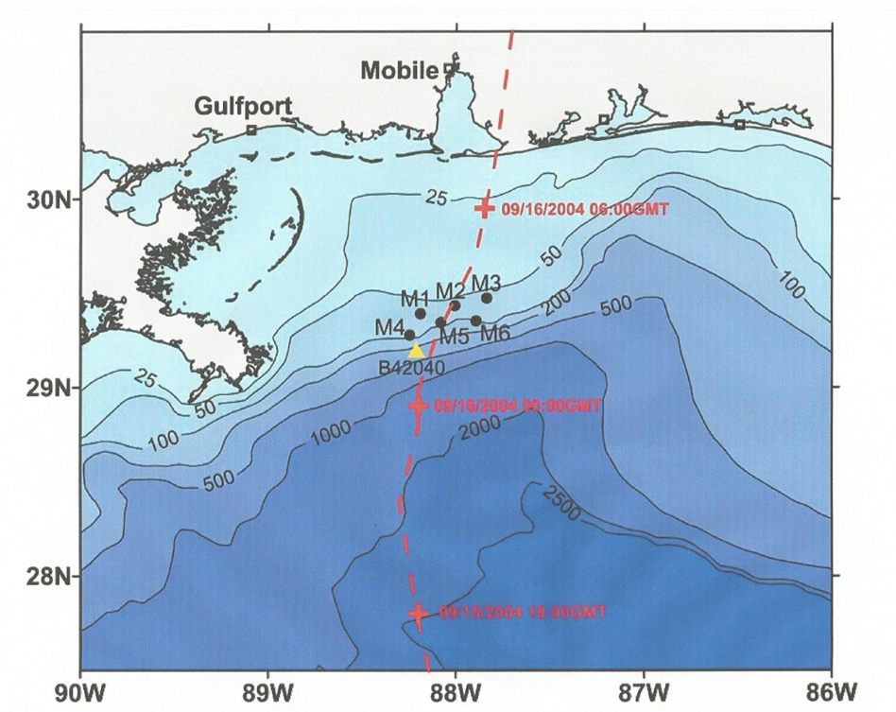

Slide 19
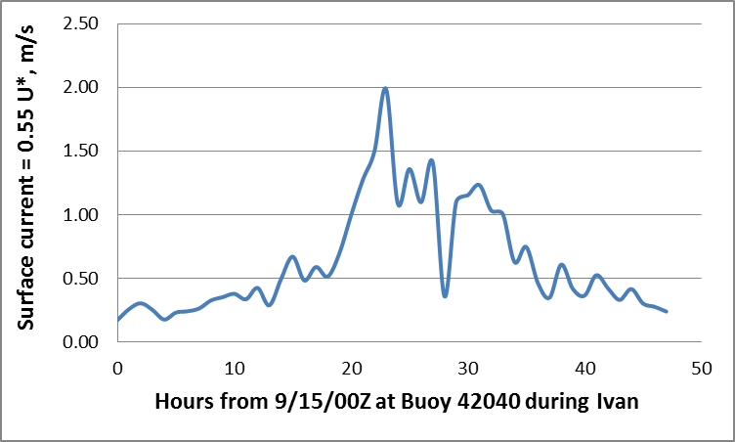

Slide 20
