Slide 1


Which role for Probiotics in Celiac Disease
Ruggiero Francavilla, MD PhD
Consultant in Pediatric Gastroenterology & Hepatology
Senior Lecturer in Pediatrics
Dpt Biomedicina Età Bioevolutiva
University of Bari - Italy

Slide 2
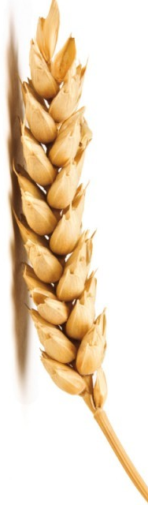
Celiac Disease
Celiac disease (CD) is an immune-mediated systemic disorder elicited by gluten and related prolamines in genetically susceptible individuals and characterised by the presence of a variable combination of gluten-dependent clinical manifestations, CD-specific antibodies, (HLA-DQ2 or HLA-DQ8 haplotypes) and enteropathy.
Fasano A, Catassi C. NEJM 2012;367:2419

Slide 3
Celiac Disease
At this time, the only treatment for CD is lifelong adherence to a gluten-free diet, which involves the elimination of grains containing gluten, wheat, rye, and barley in addition to food, products and additives derived from them.
Green PH. Lancet. 2003;362:383

Slide 4
Celiac Disease
Adherence to GFD to improve symptoms, reduce the risk of complications, and confer health benefits (i.e. improvement in bone mineral density).
However, studies have shown that dietary transgressions in patients with CD are common and can occur anywhere from 32% to 55%
Silvester JA. Can J Gastroenterol.2007;21:557
Högberg L. Scand. J. Gastroenterol.2003;38:75

Slide 5
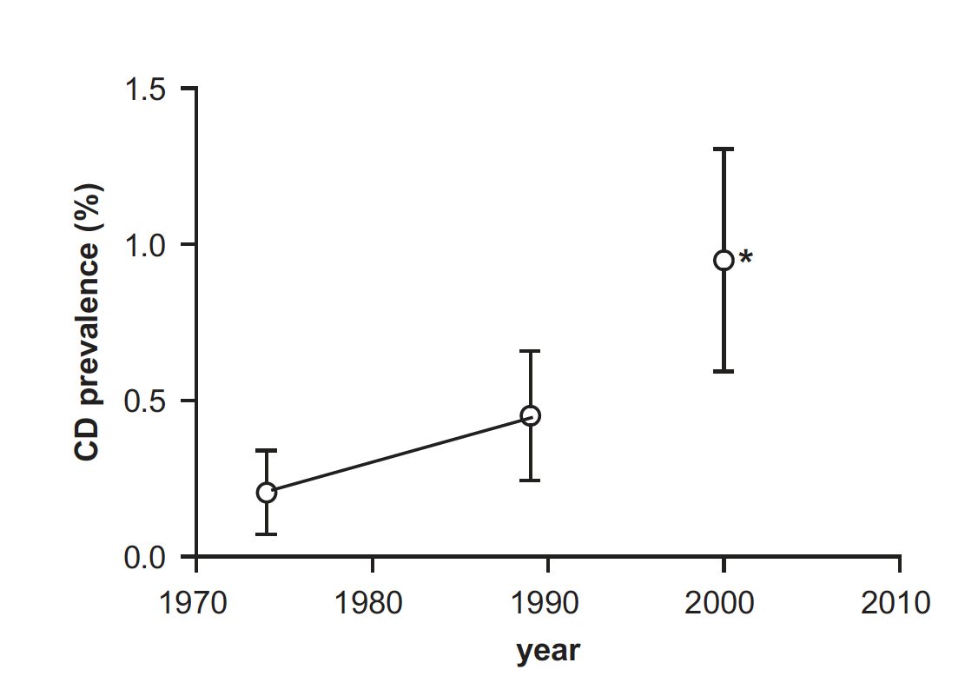
Increase of Prevalence
A recent US study showed that CD prevalence was only 0.2% in the year 1975, and increased 5-fold during the following 25 years
Catassi C. Ann Med. 2010;42:530

Slide 6

Increase of Prevalence: role of Environment
infant feeding patterns
changes in the quantity and quality of ingested gluten
the spectrum of intestinal infections
gut microbiota colonization

Slide 7
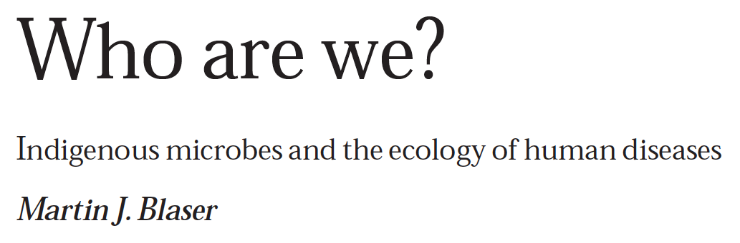
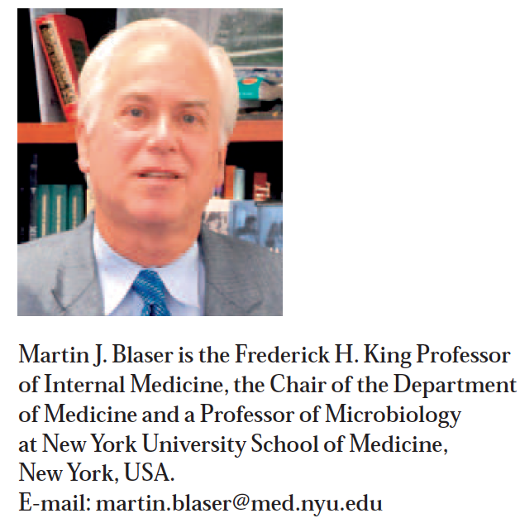
Who are we?
Blaser MJ. EMBO Rep. 2006;7:956

Slide 8
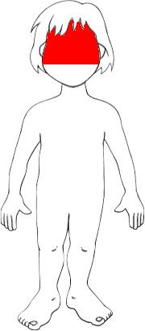
Who are we?
10¹³
Massive assemblages of competing and cooperating microbes are known collectively as microbiota
10⁶ per cm²
10¹⁴
1,000 specie in nicchie differenti
5*10¹² per ml
Blaser MJ. EMBO Rep. 2006;7:956

Slide 9
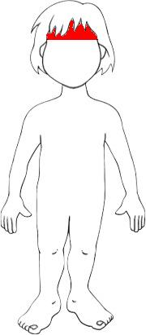
Who are we?
25,000
The entire set of genes that is known as the microbiome.
3,000,000
Blaser MJ. EMBO Rep. 2006;7:956

Slide 10

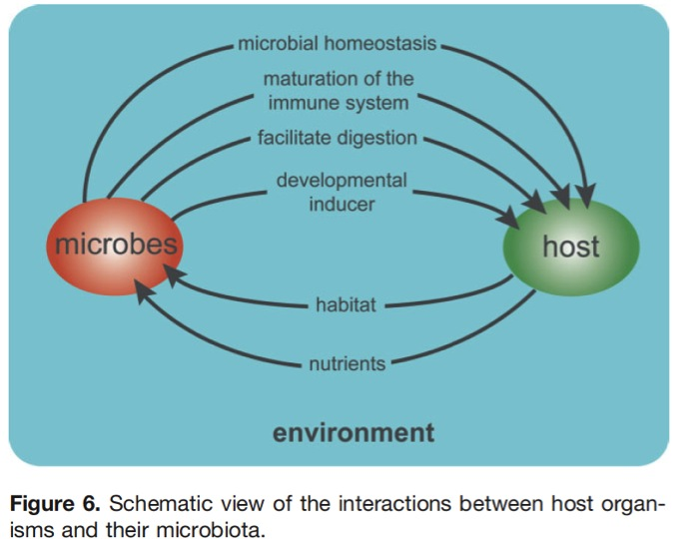
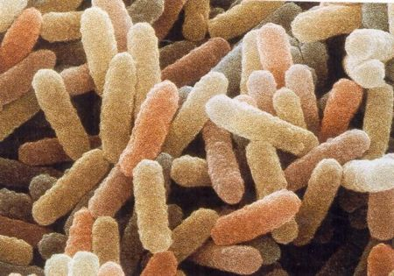
Coevolution
Stable envrovment
Habitat
Food
Immune-modulation
Metabolic activities
Ann Rev Gen 2008;42:165

Slide 11
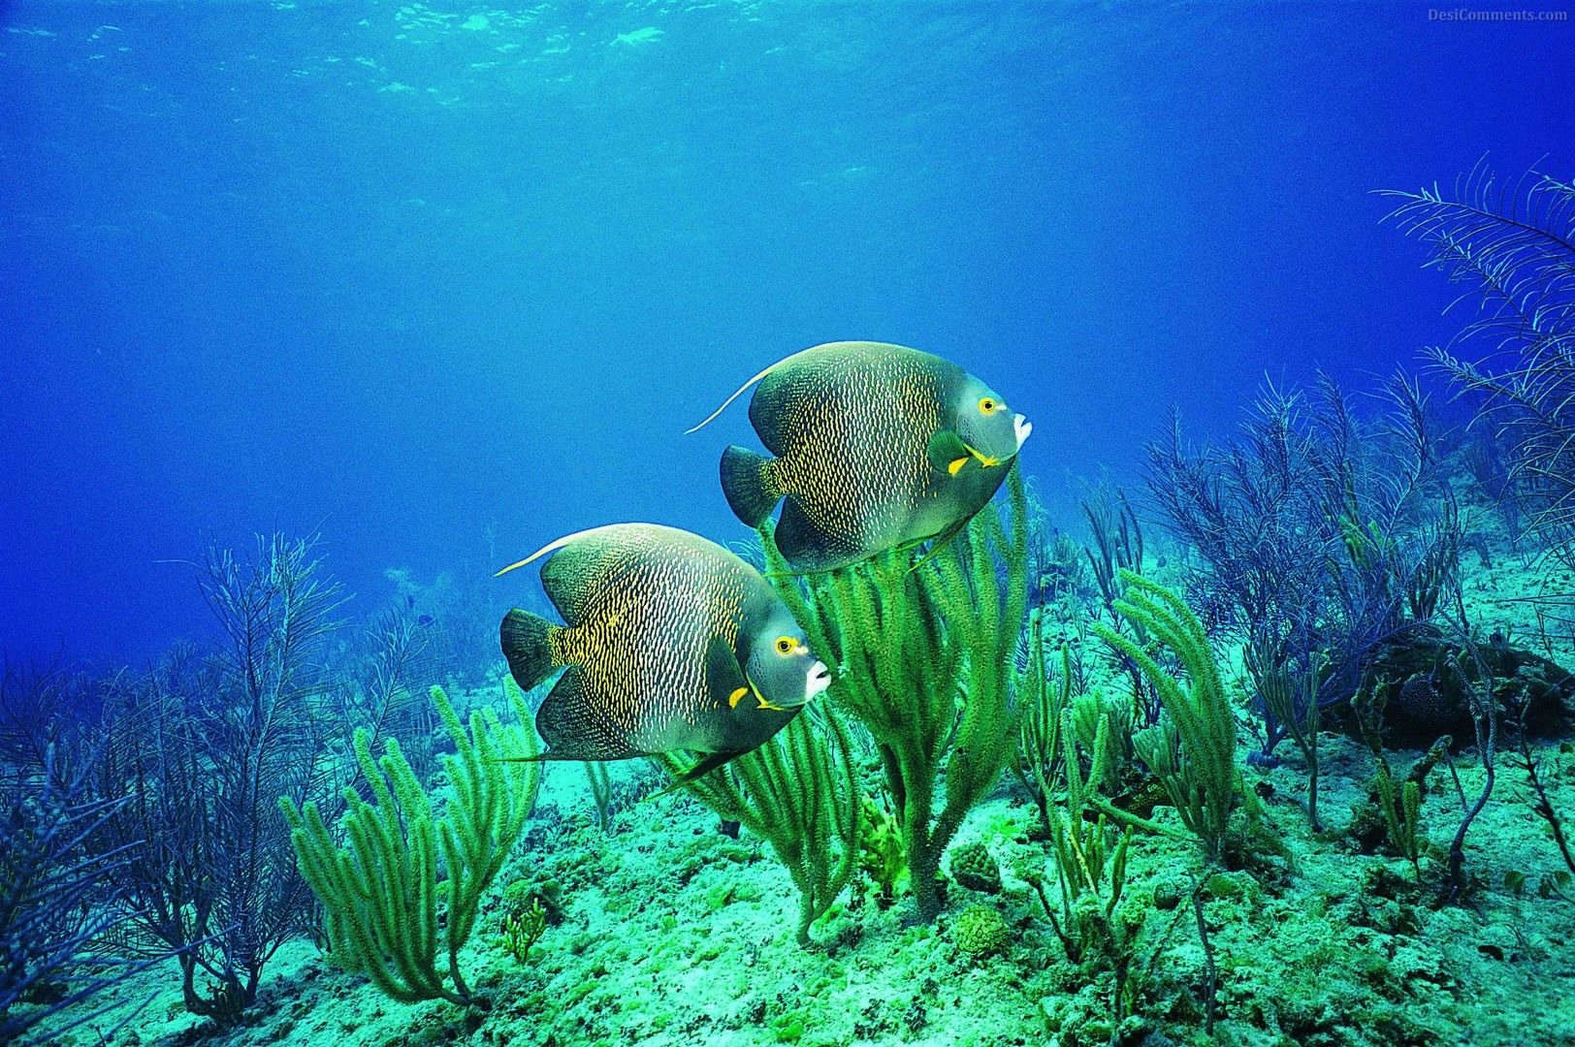
…biome
In ecology, biome refers to the sets of plants and animals in a community (such as a jungle, forest, or coral reef) in which an enormous diversity of species, large and small, interact to form complex webs of mutual support.
When a keystone species disappears or goes extinct the ecology suffers. It can even collapse

Slide 12
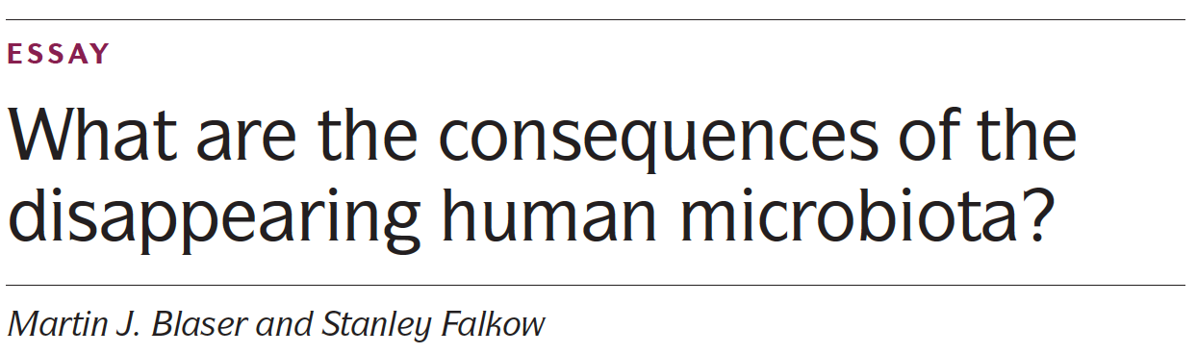
Disappearing Microbiota Hypothesis
“For a number of reasons, we are losing our ancient microbe”
The loss of microbial diversity on and within our bodies is exacting a terrible price.
obesity, childhood diabetes, asthma, hay fever, food allergies, esophageal reflux and cancer, celiac disease, Crohn’s disease, ulcerative colitis, autism, eczema

Slide 13
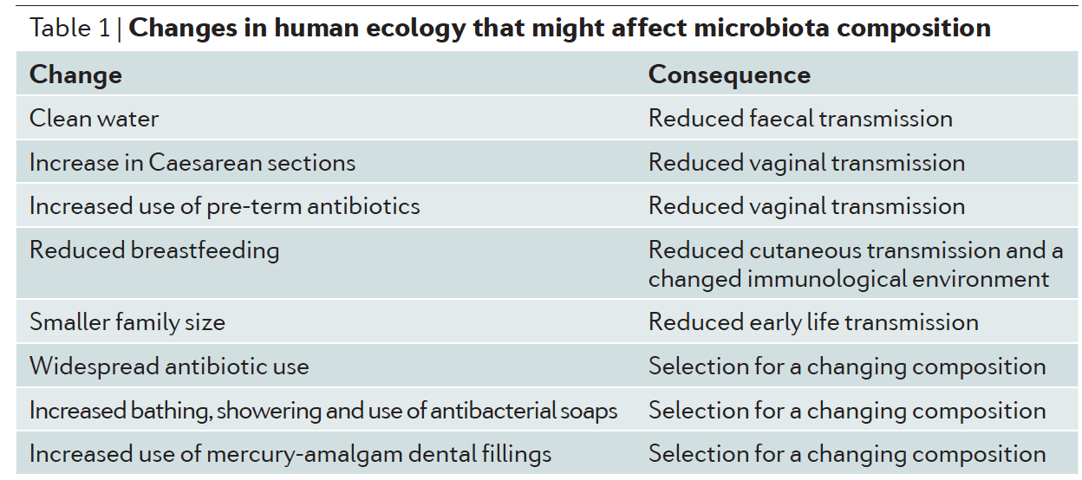
Disappearing Microbiota Hypothesis
obesity, childhood diabetes, asthma, hay fever, food allergies, esophageal reflux and cancer, celiac disease, Crohn’s disease, ulcerative colitis, autism, eczema

Slide 14
Dysbiosis
Health
Diet
Disease
Hygene
Antibiotics
Life style
Pathogenic community
no single microbe is pathogenic alone. Instead, the community assemblage is an environmental risk factor that contributes to a disease state
Eubiosis
Dysbiosis
Ley R. Cell. 2006;124:837

Slide 15


Is this true for Celiac Disease?
Harmless bacteria
Lactobacillus, bifidobacteria
Potentially harmful bacteria
Bacteroides, Prevotella, E. Coli
regardless of whether CD was active or inactive (GFD)
Sanz Y. New York: Nova Science;2009.
Nadal I. J Med Microbiol.2007;56:1669.
Collado MC. BMC Microbiol.2008;22:232.
Collado MC. J Clin Pathol.2009;62:264.
De Palma G. BMC Microbiol.2010;10:63.
Di Cagno R. Appl Environ Microbiol. 2009;75:3963

Slide 16

CD dysbiosis and GFD
Some of these alterations (e.g., increased numbers of enterobacteria or staphylococci) are restored after adherence to a gluten-free diet, suggesting they are secondary consequences of the disease
Others (increased Bacteroides, virulent-E. coli and decreased Bifidobacteria and Lactobacilli) are associated with CD and, therefore, could play a more prominent role in this disorder
Sanz Y. New York: Nova Science;2009.
Nadal I. J Med Microbiol.2007;56:1669.
Collado MC. BMC Microbiol.2008;22:232.
Collado MC. J Clin Pathol.2009;62:264.
De Palma G. BMC Microbiol.2010;10:63.
Di Cagno R. Appl Environ Microbiol. 2009;75:3963

Slide 17
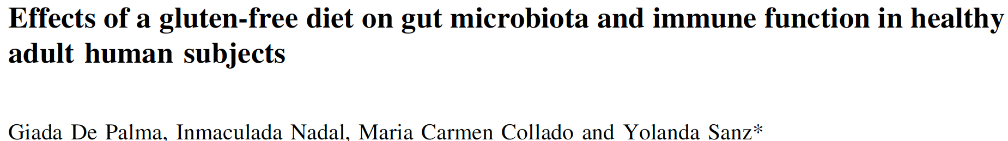
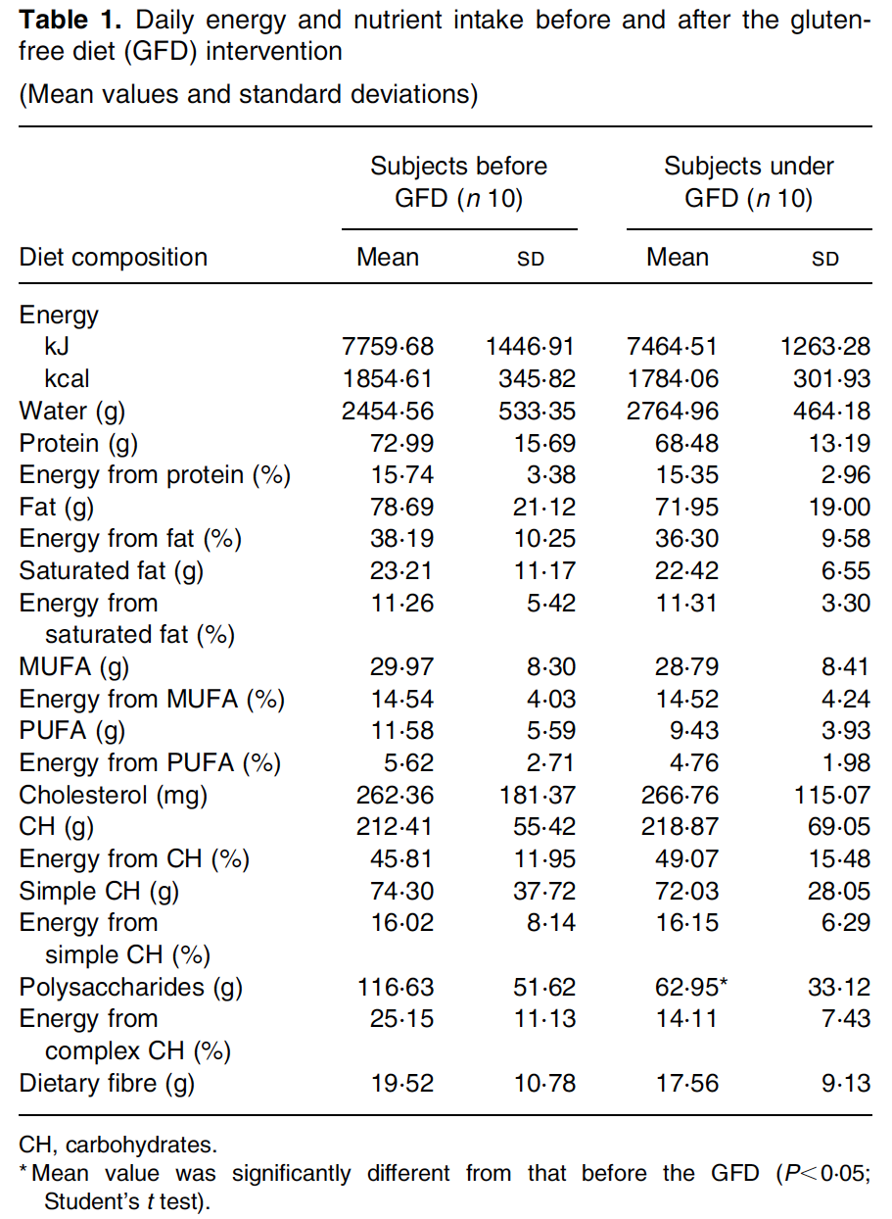
Dysbiosis and GFD
This may contribute to the disruption of the delicate balance between the host and its intestinal microbiota which might favor the overgrowth of opportunistic pathogens and weaken the host defenses and not favor completely the normalization of gut ecosystem in treated CD patients.
De Palma G. Br. J. Nutr. . 2009;102:1159

Slide 18
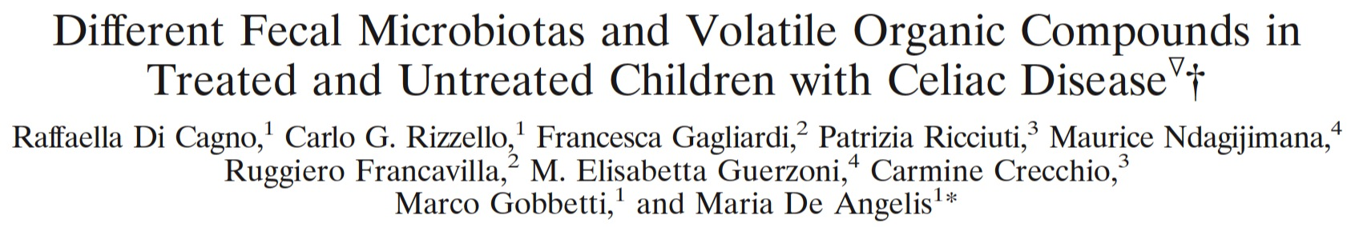
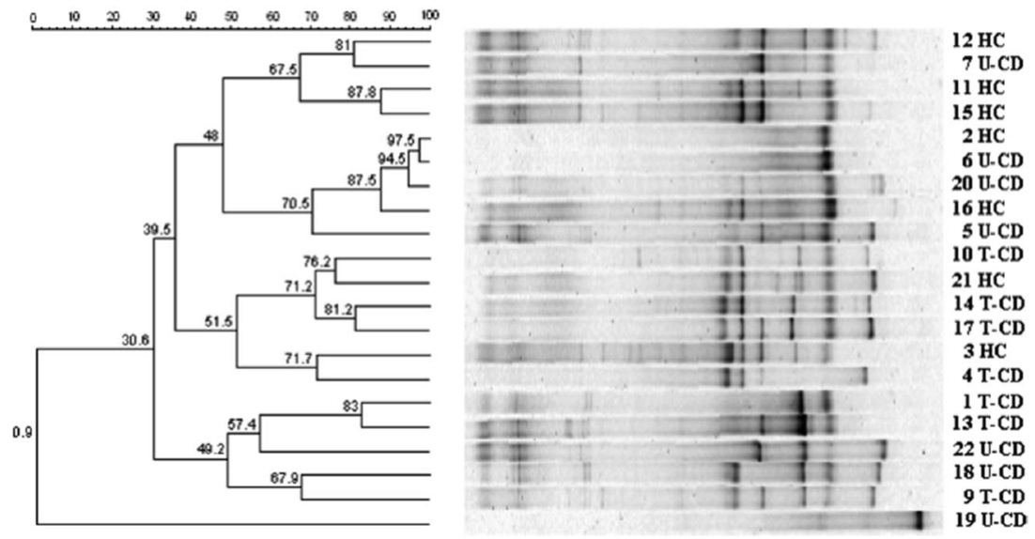
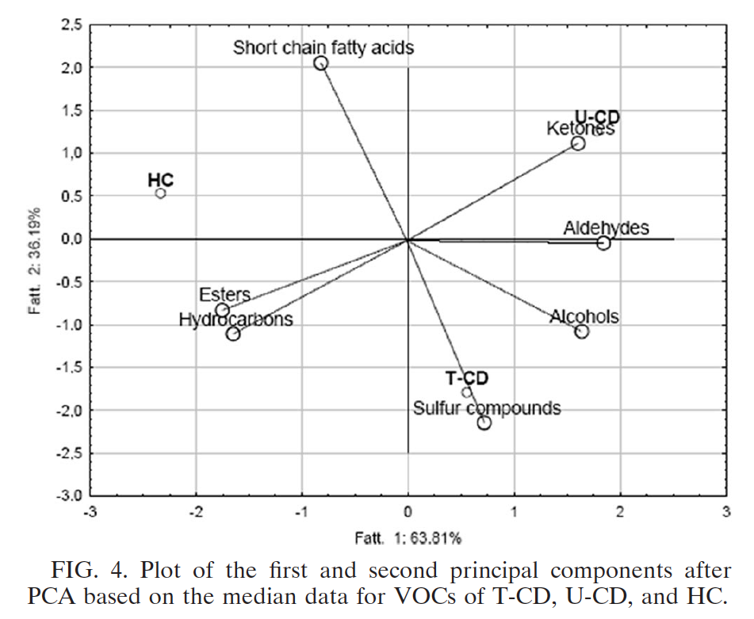
CD dysbiosis and GFD
The percentages of Lactobacillus and Bifidobacterium species were lower in CD as compared to HC and remained lower after years of GFD. The median concentrations of volatile organic compounds varied markedly for HC, T-CD, and U-CD
Di Cagno R. Appl Environ Microbiol. 2009;75:3963

Slide 19
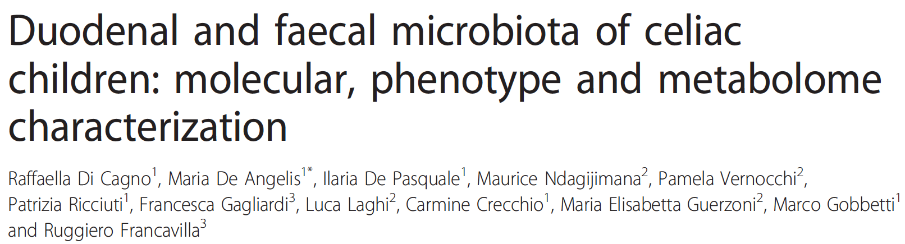
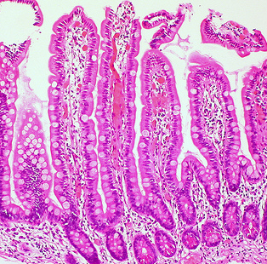
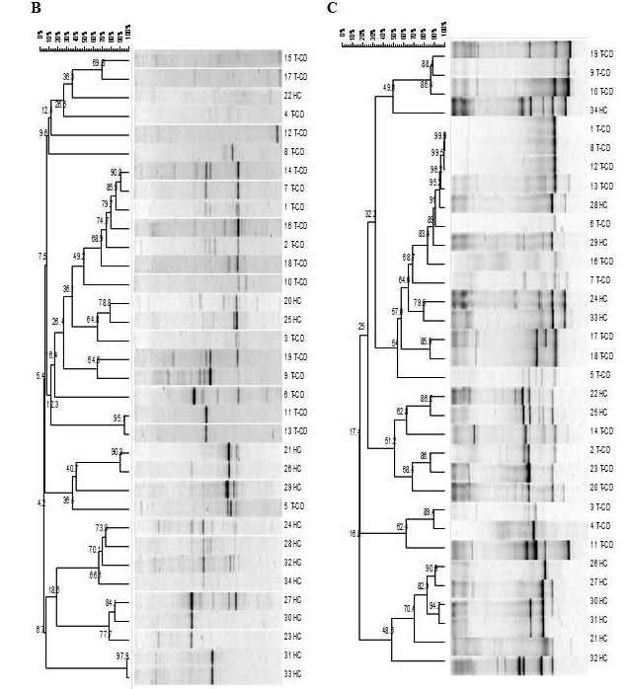
CD dysbiosis and GFD
We did not find bifidobacteria in biopsy specimens of CD subjects although present in fecal samples.
In addition, we showed a low level of microbiota diversity in biopsy specimens
Di Cagno R. BMC Microbiol. 2011;11:219

Slide 20
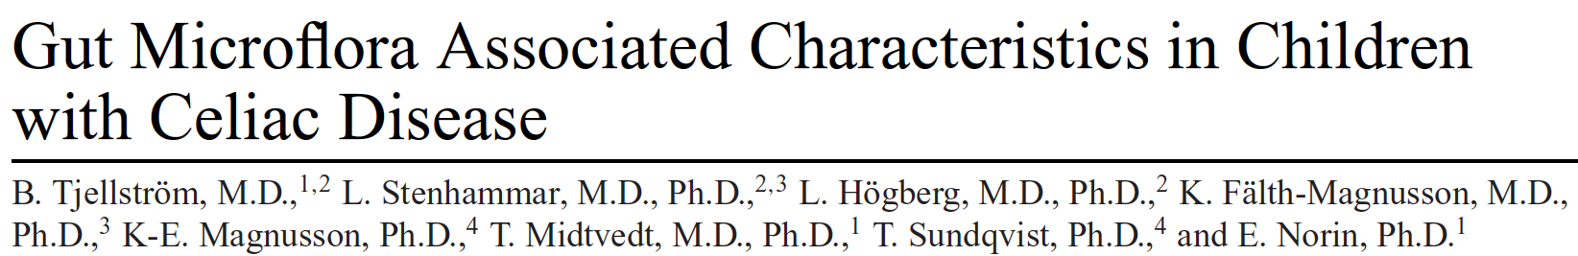
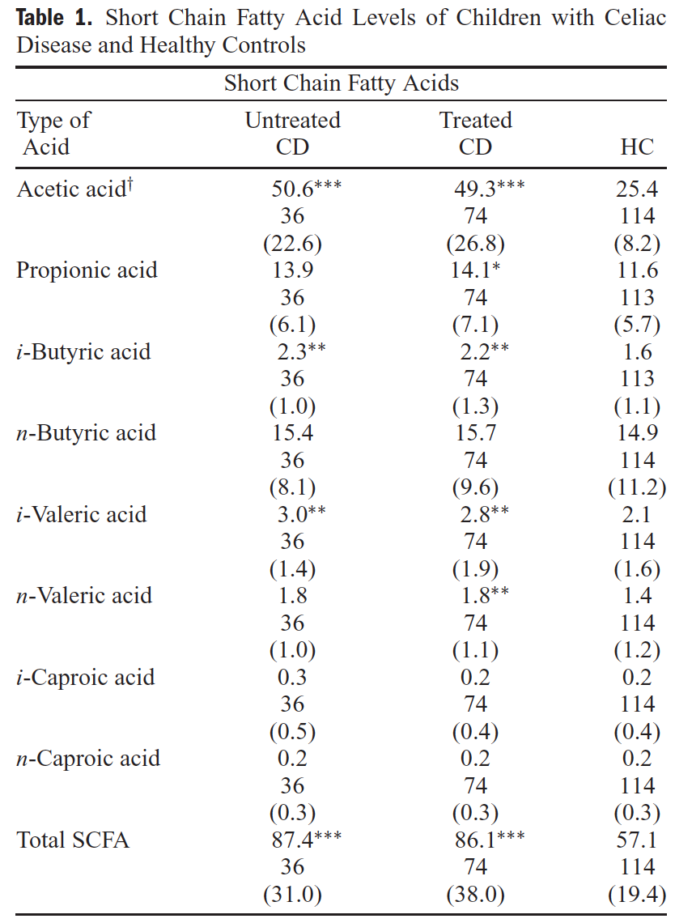
Increase of Prevalence: role of Environment
study of the SCFA pattern in fecal samples from children with CD: the results indicate that there is a difference in the metabolic activity of intestinal microbial flora in children with CD compared to that in HC.
Tjellström B. Am J Gastroenterol. 2005;100:2784.

Slide 21
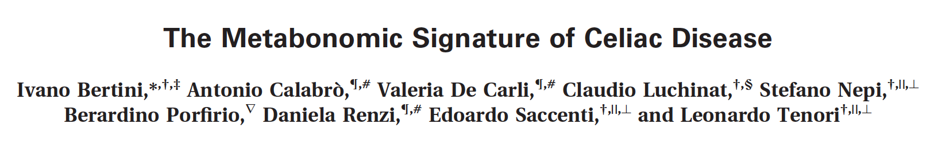
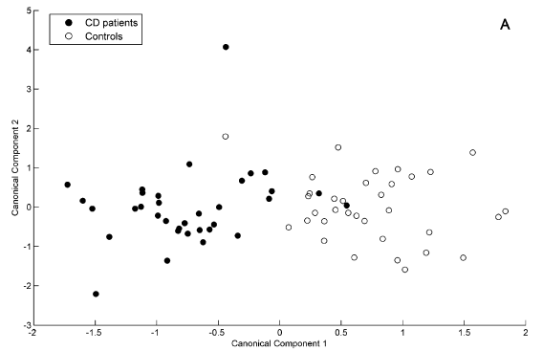
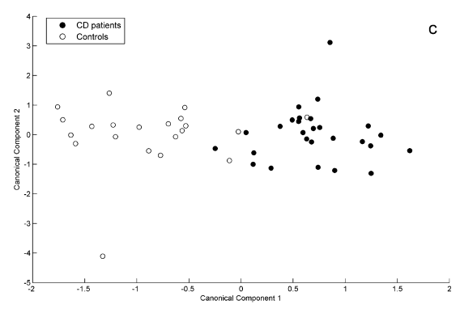
Metabonomic Signature of CD
blood
Urine
NMR thus reveals a characteristic metabolic signature of celiac disease. Altered serum levels of glucose and ketonic bodies suggest alterations of energy metabolism, while the urine data point to alterations of gut microbiota
Bertini I. J Proteome Res. 2009;8:170

Slide 22
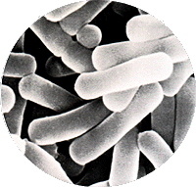
Probiotic in dysbiosis
Health
Disease
Eubiosis
Dysbiosis
Ley R. Cell. 2006;124:837

Slide 23
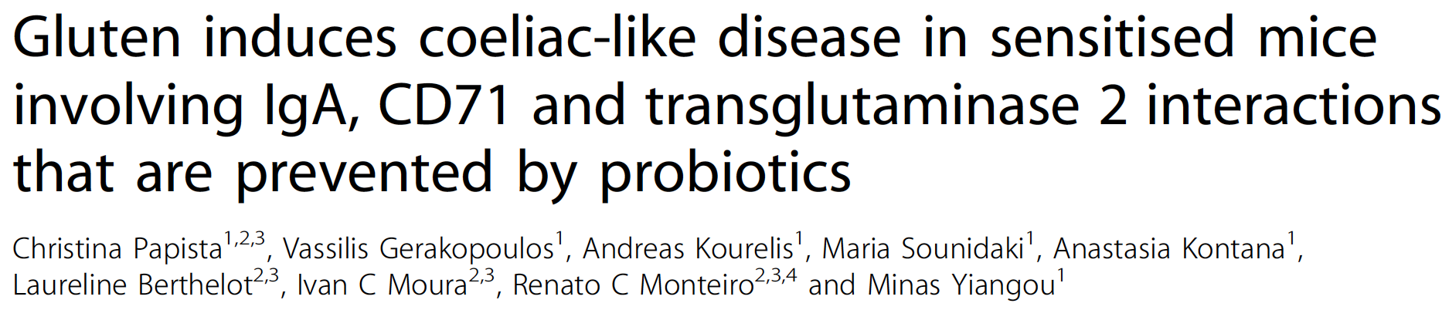
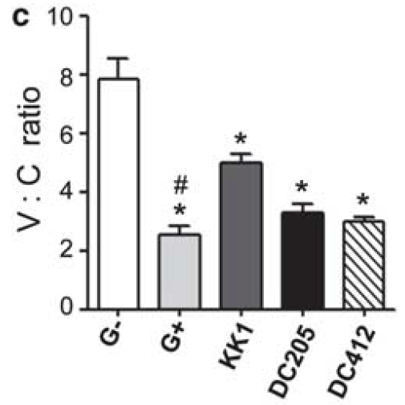
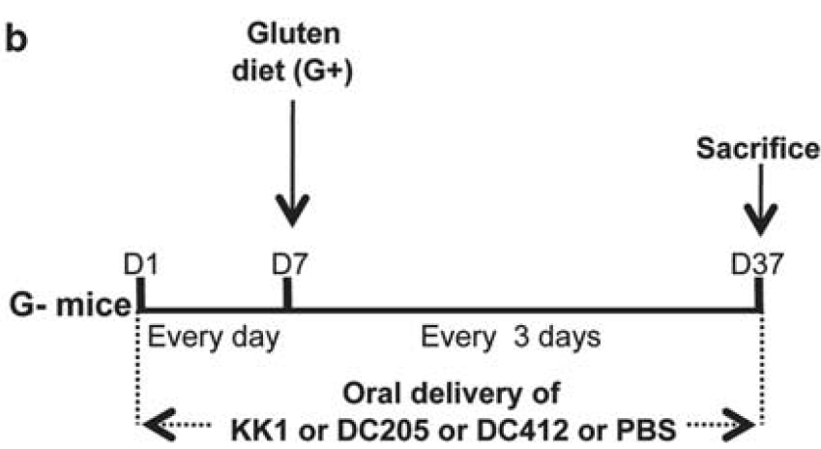
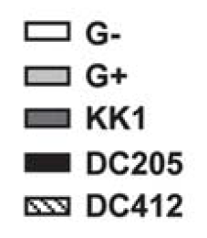
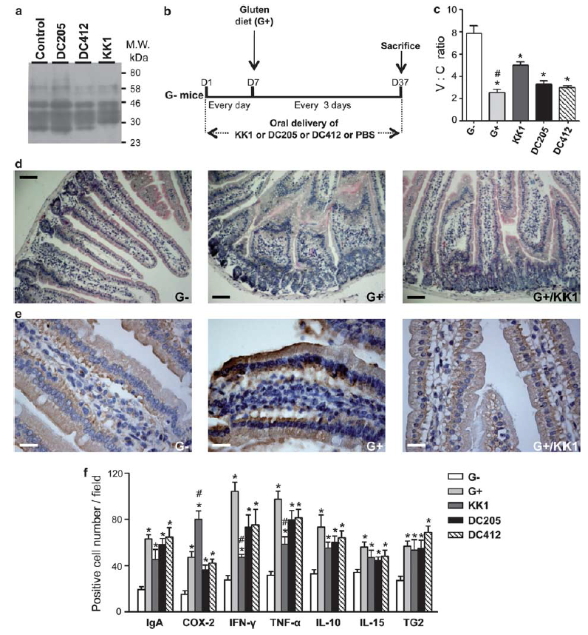
Probiotic in CD – prof of concept
Papista C. Lab. Invest. 2012;92:625

Slide 24
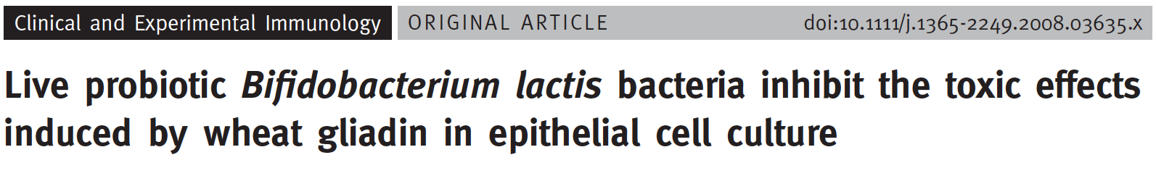
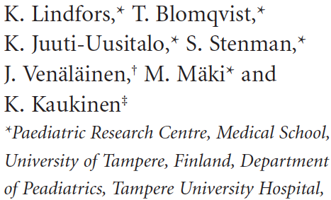
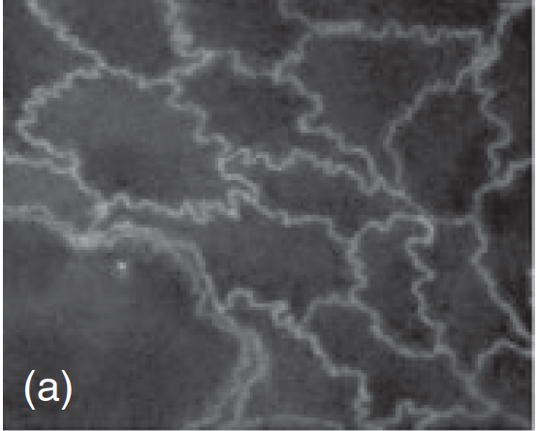
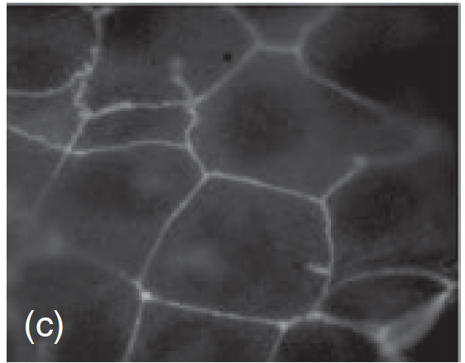
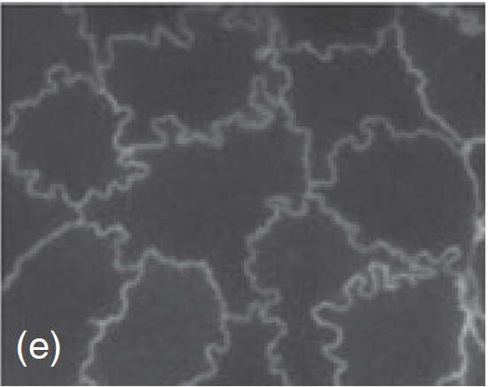
Probiotic in CD – prof of concept
The ability of live probiotics to inhibit gliadin-induced damage to human colon cells Caco-2
Normal tight junctions
Tight junctions after gliadin administration
Tight junctions after
gliadin and probiotic administration
Lindfors K. Clinical and Experimental Immunology. 2008;152:552

Slide 25
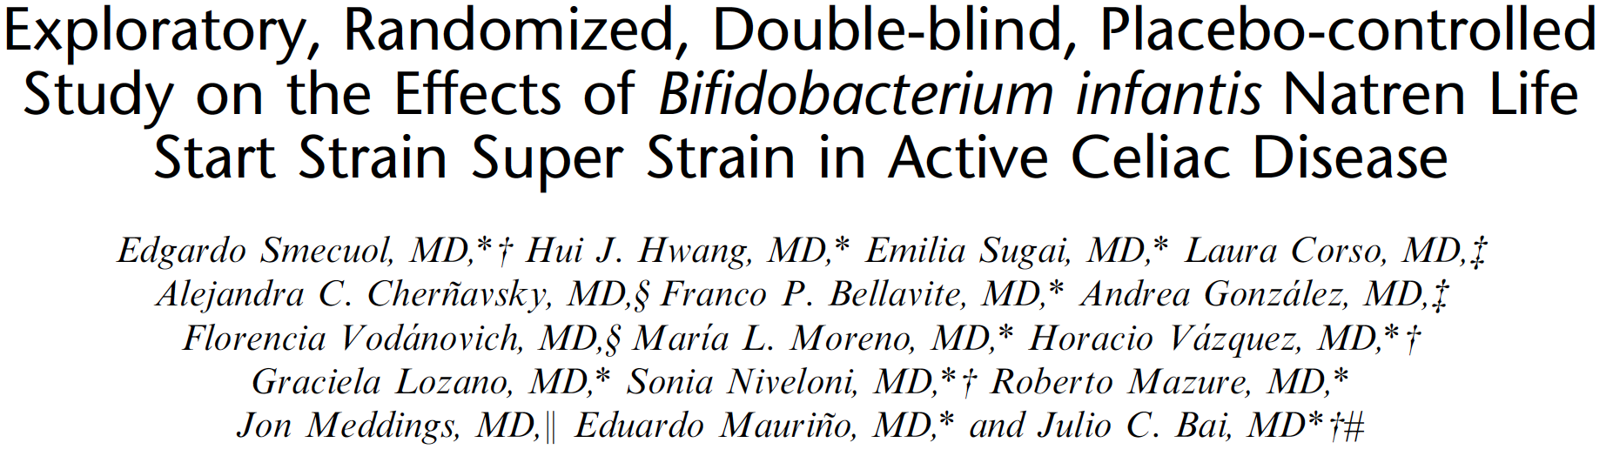
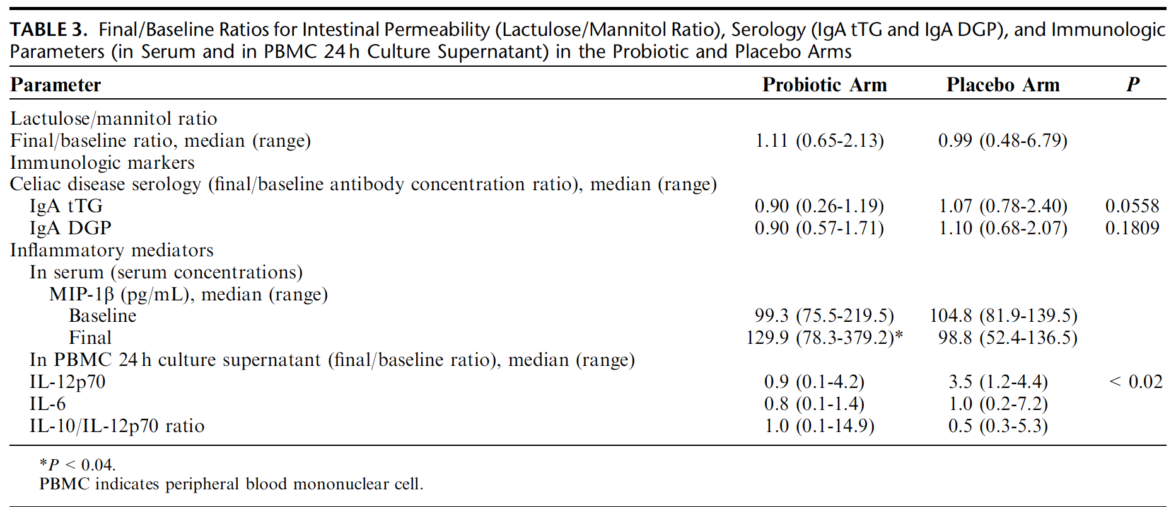
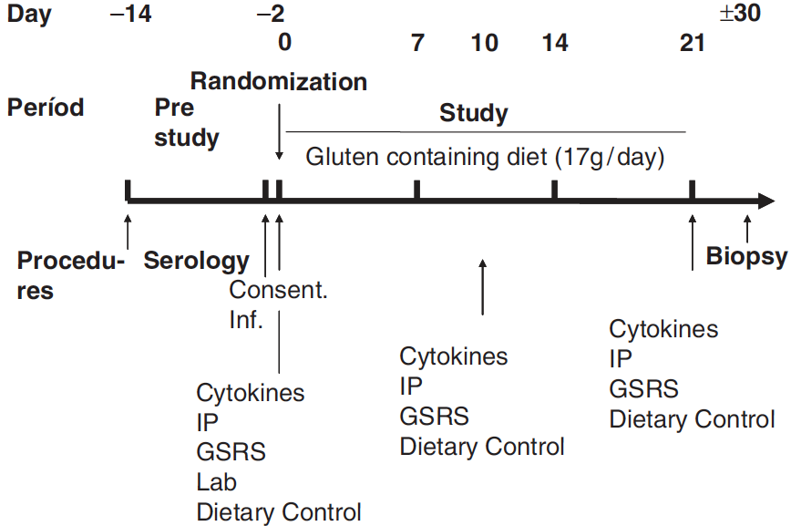
Probiotic in CD at diagnosis
Study plan
Smecoul E. J Clin Gastroenterol 2013;47:139

Slide 26
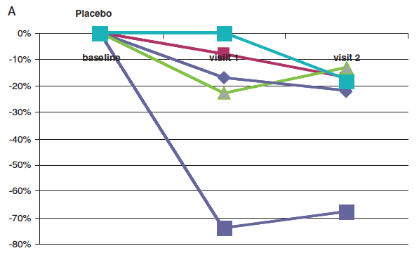
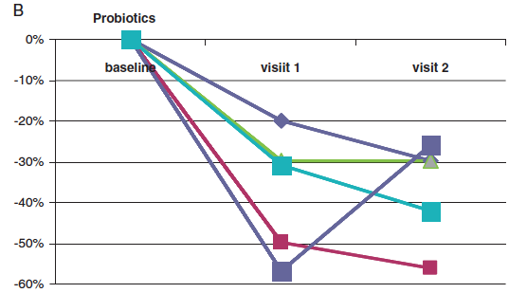
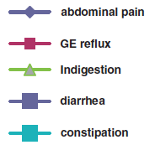
Probiotic in CD at diagnosis
Placebo
Probiotic
More than 70% of patients reported that these symptoms had improved with probiotics, whereas improvement occurred in 30% of patients with placebo. Once again, diarrhea was perceived as improved at the end of the trial by 80% of patients in both treatment arms.
Smecoul E. J Clin Gastroenterol 2013;47:139

Slide 27
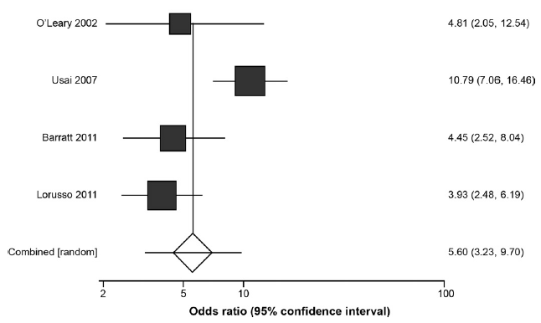
Increase of Prevalence of IBS in CD
The pooled OR for IBS-type symptoms was significantly higher in those with CD compared with controls. The odds of IBS-type symptoms were more than 5-fold higher (5.60; 95% CI, 3.23–9.70) among all patients with CD, regardless of adherence with a GFD, compared with controls without CD.
Sainsbury A. Clin Gastroenterol Hepatol. 2013;11:359

Slide 28

Increase of Prevalence of IBS in CD
854 CD patients: 353 adults e 401 children
1237 control: 484 adults e 389 children
40
30
% of IBS patients
17
22
celiaci
controlli
celiaci
controlli
Cristofori F. SIGENP. 2014

Slide 29
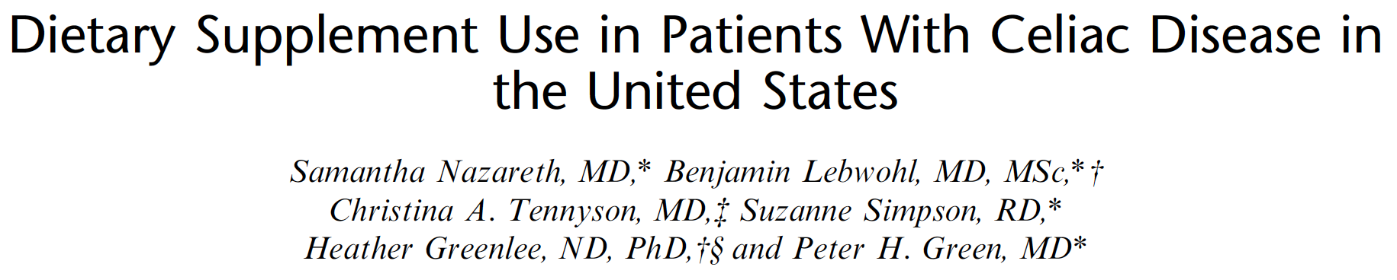
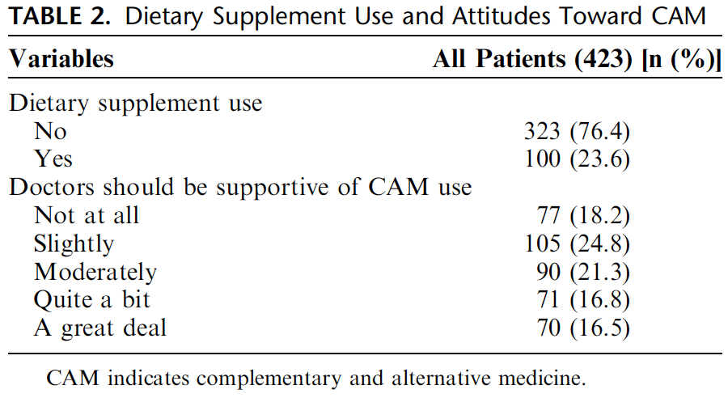
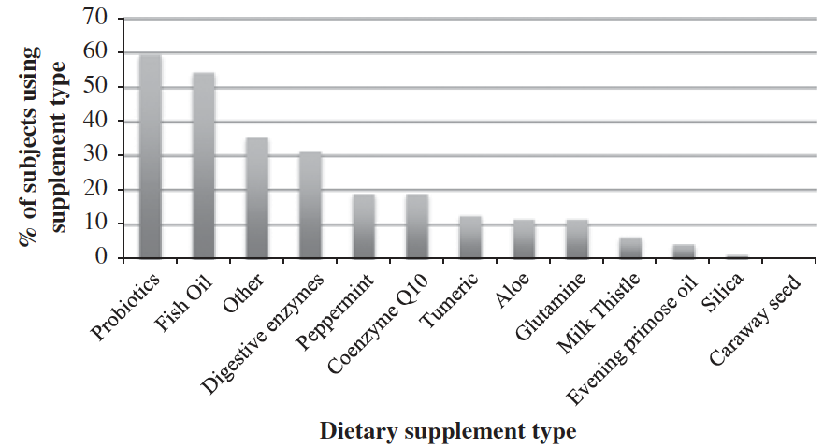
Increase of Prevalence of IBS in CD
CD patients completed a questionnaire on demographics, types of dietary supplement use, attitudes toward CAM
Nazareth S. J Clin Gastroenterol 2014; in press

Slide 30
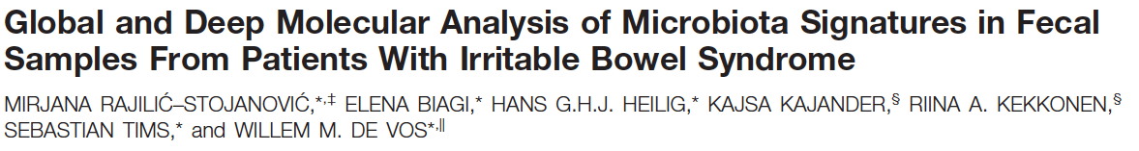
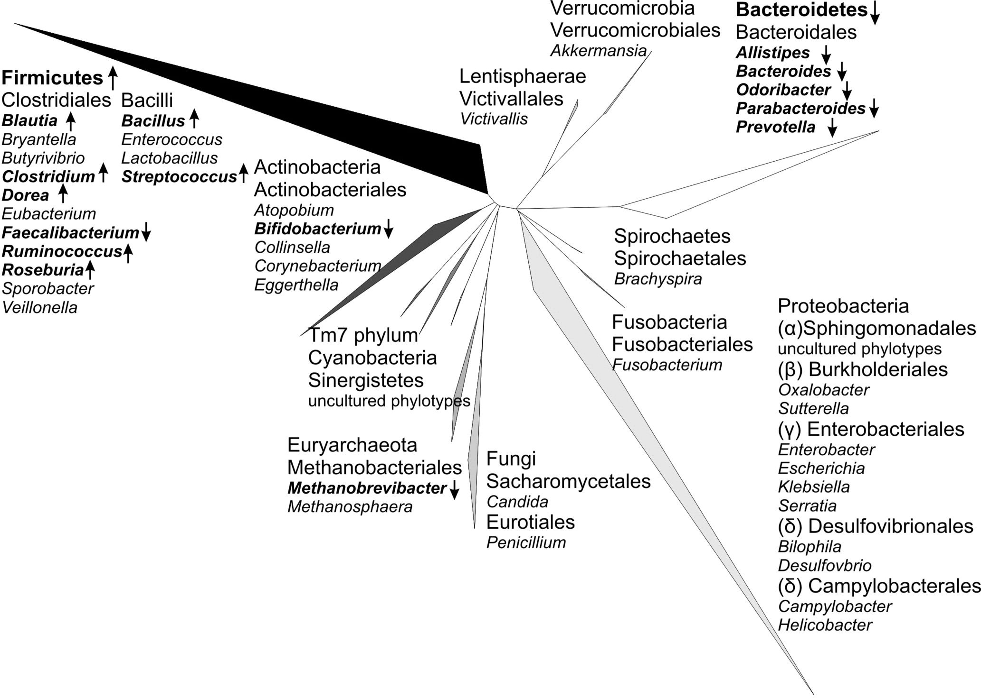
Microbiota in IBS
2x
Global and deep molecular analysis of fecal samples indicates that patients with IBS have a different composition of microbiota
Rajilic´-Stojanovic. Gastroenterology 2011;141:1792

Slide 31
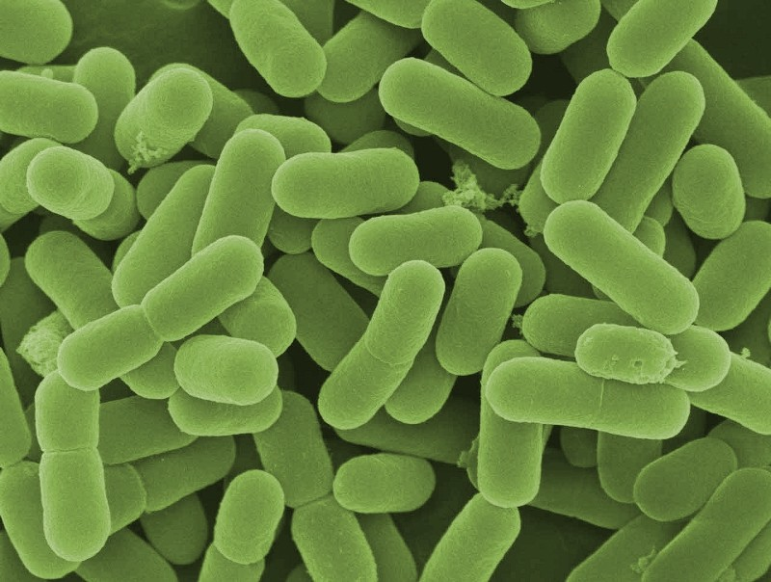
Probiotic combination for CD&IBS patients
Lactobacillus plantarum CECT 4528
Lactobacillus casei 101/37 LMG P-17504
Bifidobacterium breve Bbr8 LMG P-17501
Bifidobacterium breve Bl10 LMG P-17500
Bifidobacterium animalis (Subsp. lactis) LMG P-17502

Slide 32
PROCEDO study
116 patients enrolled
Probiotic (58 pts)
CD-IBS
R
Follow-up
RUNNING-IN
Still symptomatic
2 weeks
Placebo (58 pts)
6 weeks
6 weeks
E
W₂
W₂
W₄
W₆
W₈
W₈
W₁₀
W₁₂
W₁₄
IBS-SS
IBS-SS
*
°
*
*
°
*
* IBS severity score (IBS-SS) assessed by VAS
* Gastrointestinal Symptom Rating Scale (GSRS)
* Bristol Stool Chart (BSC)
* IBS Quality of Life (I-QOL)
* Symptom Check List (SL-90)
* Hospital Anxiety & Depression Scale (HADS)
° Urine - stools
ClinicalTrials.gov Identifier: NCT01699191

Slide 33
PROCEDO study: GSRS
87 patients analysed (75%); end of study November 2014.
Combination
Placebo
35
30
25
20
p=0,05
p<0,05
Gastrointestinal symptom rating score (GSRS)
15
10
5
0
E
W₂
W₄
W₆
W₈
W₁₀
W₁₂
W₁₄
Running-in
Intervention
Follow-up

Slide 34
PROCEDO study: IBS-SS by VAS
87 patients analysed (75%); end of study November 2014.
Combination
Placebo
10
8
p<0,04
p<0,05
6
Intensity of episodes of pain (VAS)
4
2
0
E
W₂
W₄
W₆
W₈
W₁₀
W₁₂
W₁₄
Running-in
Intervention
Follow-up

Slide 35
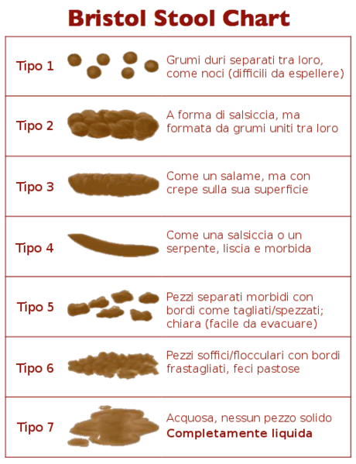
PROCEDO study: BSC
87 patients analysed (75%); end of study November 2014.
Improvement of defecation
p<0,04
Combination
Placebo

Slide 36
Probiotic combination for CD&IBS patients
A 6-wk treatment with a probiotic mixture of 2 Lactobacilli and 3 Bifiodobacteria provided effective symptom relief in celiac patients suffering of symptoms suggestive for IBS
Improve GI symptoms during and after the administration;
Reduce the severity of abdominal pain during the period of administration;
Improve the quality of defecation;
Effect tend to disappear after the discontinuation of the administration;
Effect on QOL still to be analyzed.
L. plantarum CECT 4528
L. casei 101/37 LMG P-17504
B. breve Bbr8 LMG P-17501
B. breve Bl10 LMG P-17500
B. animalis (Subsp. lactis) LMG P-17502

Slide 37
Probiotic combination for CD&IBS patients
A 6-wk treatment with a probiotic mixture of 2 Lactobacilli and 3 Bifiodobacteria provided effective symptom relief in celiac patients suffering of symptoms suggestive for IBS
L. plantarum CECT 4528
L. casei 101/37 LMG P-17504
B. breve Bbr8 LMG P-17501
B. breve Bl10 LMG P-17500
B. animalis (Subsp. lactis) LMG P-17502

Slide 38
PROCEDO: effect on gliadin peptides
The probiotic combination has the ability to hydrolyze toxic gliadin polypeptides
L-Q-L-Q-P-F-P-Q-P-Q-L-P-Y-P-Q-P-Q-L-P-Y-P-Q-P-Q-L-P-Y-P-Q-P-Q-P-F
PepN
PepO
PEP
L-Q-L-Q-P-F-P-Q-P-Q-L-P-Y-P-Q-P-Q-L-P-Y-P-Q-P-Q-L-P-Y-P-Q-P-Q-P-F
PepN/PepO/PEP
L-Q-P F-P-Q-P-Q L-P-Y-P-Q-P-Q L-P-Y-P-Q-P-Q L-P-Y-P-Q-P-Q-P-F
PepN/PepX
Q-P F-P Q-P-Q L-P Y-P Q-P-Q L-P Y-P Q-P-Q L-P Y-P Q-P Q-P-F
PepQ/PepX
Q-P Q-P Q-P Q-P
PepQ

Slide 39
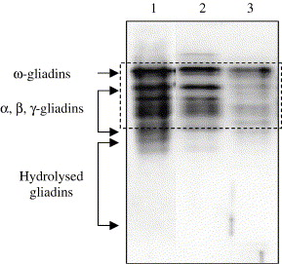
PROCEDO: effect on gliadin peptides
The probiotic combination has the ability to hydrolyze toxic gliadin polypeptides
ω-gliadin
α,β,γ-gliadin
Hydrolized gliadins
Western blot/R5 analysis of:
European gliadin reference
Dough (control)
Dough incubated for 24 h at 37 °C with the probiotic combination.

Slide 40

PROCEDO: effect on gliadin peptides
The probiotic combination has the ability to hydrolyze toxic gliadin polypeptides
(1)
(2)
MALDI-TOF mass spectra of aqueous ethanol extract of wheat gliadin:
European gliadin reference
Dough (control)
Dough incubated for 24 h at 37 °C with the probiotic combination.
(3)

Slide 41

Summary
CD is characterized by a state of dysbiosis that do not completely reverse by GFD levels;
Bifidobacteria and lactobacilli are reduced in CD patients, and these bacteria can be considered a promising target for probiotic therapy at least to reduce GI symptoms that are common in this condition.
The identification of strains capable of producing enzymes that degrade gliadin peptides and induce anti-inflammatory effects needs to be studied.
Finally, studies including a larger sample size and involving international health and research centers would contribute to the design of common directions and guidelines for the use of probiotic and advance the knowledge regarding the importance of microbiota in CD.

