Slide 1
A case report
progressive form of biliary and hepatic paracoccidioidomycosis, simulating cholangiocarcinoma.

Slide 2
Clinical History
IDentification: E.Z.D, 53 years old, female, olive skin, married, housewife, Rio de Janeiro native – RJ, resident in Sapucaia, RJ.
Main Complaint: “Dark urine and itch”

Slide 3
Clinical History
History of the current illness: Patient reports that there was some evidence of coluria condition in October 2013, associated with fecal acolia, pruritus and jaundice (4 +/4 +). The patient sought care in the Basic Health Unit in Sapucaia in December, when a total abdominal USG showed bile duct obstruction. The patient then sought for treatment in the private service, when a percutaneous transhepatic cholangiography and the contrast injection showed an extra hepatic bile duct obstruction. It was then decided to keep the biliary drainage. The patient was sent to the Bonsucesso Federal Hospital with a probable diagnosis of cholangiocarcinoma for staging and conduct.

Slide 4
Clinical History
Early pathological history: denies hypertension , diabetes mellitus and other comorbidities. Denies drug allergy . History of mumps and measles in childhood . Denies previous admissions .
Physiological Archives History : The patient was born by vaginal delivery aseptic , adequate psychomotor development, pubarche at age 9 , thelarche at age 10 , menarche at age 11 with regular cycles , first intercourse at age 18 without using condoms . Contraceptive use since 17 years . Menopause after 51 years without hormone replacement . Makes regular gynecological screening . GII TO PII . Performed prenatal, uneventful pregnancies .
Family history : Father died with esophageal CA , deceased mother with a history of Chron disease , alive and healthy brother . Denies hypertension and DM family .
Social History : Lives with her husband in brick house with seven rooms . water coming from the CEDAE . Do not have a pet. Qualitatively and quantitatively adequate food . Denies recent travel . Vaccination card day.

Slide 5
USG
Intrahepatic bile duct dilatation, and absence of cholelithiasis and coledocolitiasis.

Slide 6
ERCP
Intrahepatic bile duct dilatation . Probable obstruction confluence of right and left hepatic duct .

Slide 7
Physical Examination
Patient was admitted for emergency HGB , awake , lucid and oriented . Cooperative, attentive to the environment, eucardica, eupnea, pale (1+/ 4+), hypohydrated (2+ / 4+), jaundiced (2+ / 4+), acyanotic, afebrile. Drainage output reduction (50ml in the past 6 days), dark urine, acholic stools.
Head and neck : atypical faces, no palpable lymph nodes, unchanged oropharyngeal.
AR : MVUA no adventitious sounds. Preserved elasticity and scalability .
LCA : RCR 2T , no murmurs or extra-systole .
Abdomen: distended without signs of peritoneal irritation, painful to deep palpation , presence of biliary drain , showing no visceromegalies or masses , bowel sounds present.
MMs: pulse present, free of edema.

Slide 8
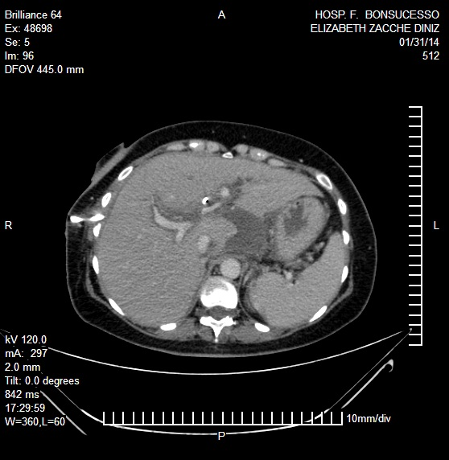
CT
Dilatation of intra-hepatic bile ducts, with mild aerobilia.
Presence of biliary drainage with proximal convergence of the bile ducts.

Slide 9
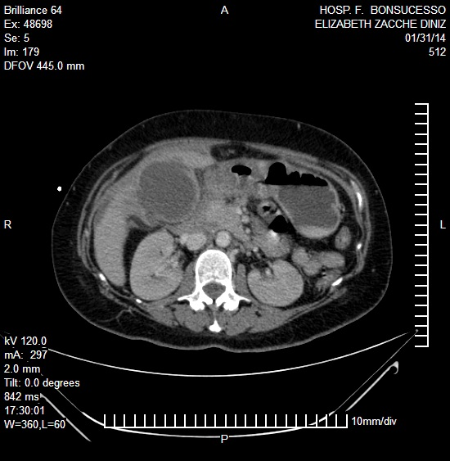
CT
Most of the abdominal lymphadenopathy showed calcifications in the celiac trunk topography, hepatic hilum, para-aortic and mesenteric.
Hypodense formations on the left, rounded lobe with cystic densities

Slide 10
Laboratory
 | ADMISSION | REFERENCE
BT | 9.5 mg/dL | 0.3 a 1.2 mg/dL
BD | 8.0 mg/dL | <0.2 mg/dL
AST | 61 U/L | <34 U/L
ALT | 34 U/L | 10 a 49 U/L
FA | 238 U/L | 45 a 129 U/L
GAMA-GT | 396 U/L | <38 U/L
HB | 7.2 g/dL | 11.6 a 15.4 g/dL
HT | 22.0% | 40 a 54%
LEUCOCITOS | 15.1mil/mm3 | 4 a 11mil/mm3
LINFOCITOS | 10.9% | 20 a 35%
EOSINOFILOS | 1.6% | 1 a 6 %
UREIA | 23mg/dL | 19.2 a 49.2mg/dL
CREATININA | 0.4mg/dL | 0.6 a 1.1 mg/dL

Slide 11
Surgical Treatment
The patient was subjected to exploratory laparotomy. The abdominal cavity presented extensive inflammatory process and areas of adhesion in the stomach, duodenum and bile duct. The dissection process showed and extensive bile duct-duodenal gastric fistula with cholecystitis and the presence of pus inside the vesicle. A Cholecystectomy and partial gastrectomy with Billroth II reconstruction was performed. Since the bile duct could not be individualized, nor the Kehr’s drain be implemented, it was decided to maintain the percutaneous drainage.

Slide 12
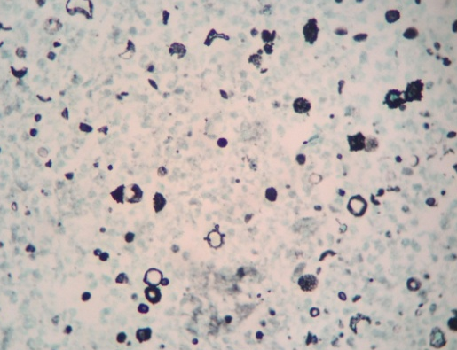
Histopathological
Granulomas composed of epithelioid cells with central necrosis (A). Fungal round structures in their majority, of varying sizes and buds in various directions are seen in staining by hematoxylin and eosin (B), PAS (C) and silver impregnation technique (D).
There was Mother cell presenting two buds, Mickey Mouse head-like appearance.

Slide 13
Clinical Treatment
30-day antifungal therapy with Amphotericin B (IV).
Following therapy may be carried out with Itraconazole until a year after serology has become negative .
Within a three-month treatment there was a reduction of bile drainage and cholangiography revealed passage of bile through the bile duct to the duodenum.

Slide 14
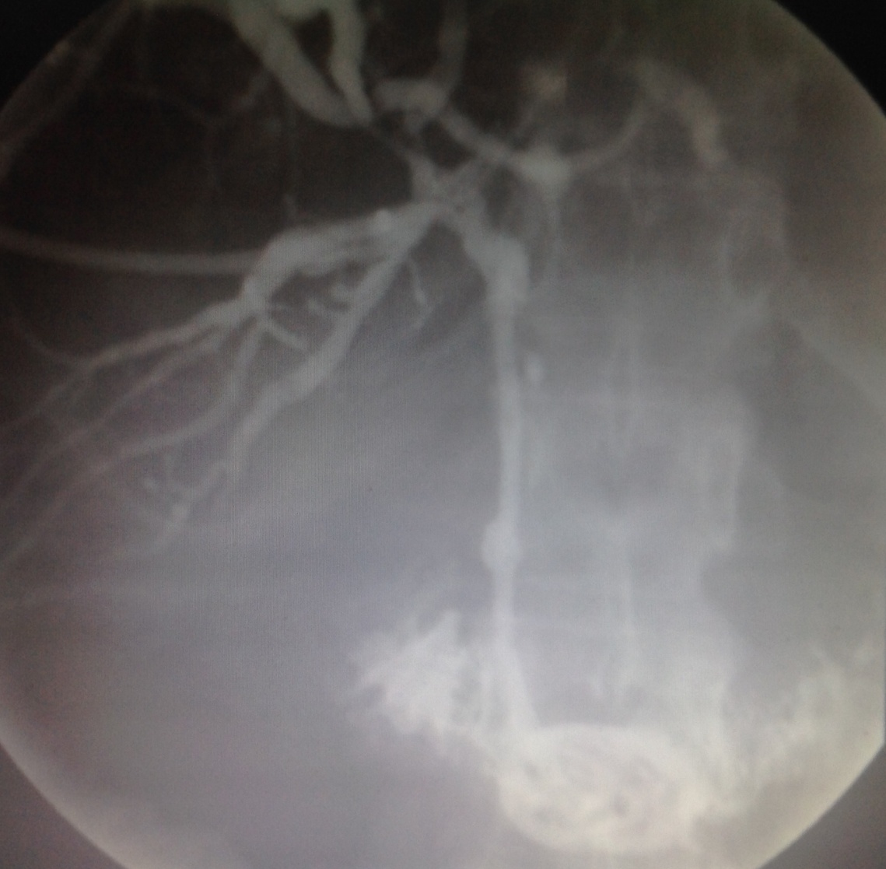
PTC
Percutaneous transhepatic cholangiography after antifungal therapy.

Slide 15
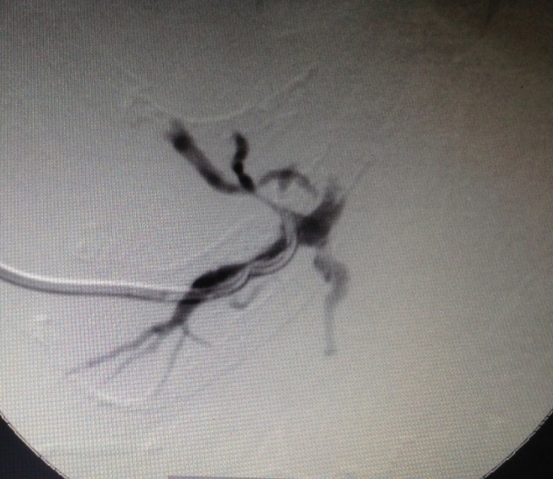
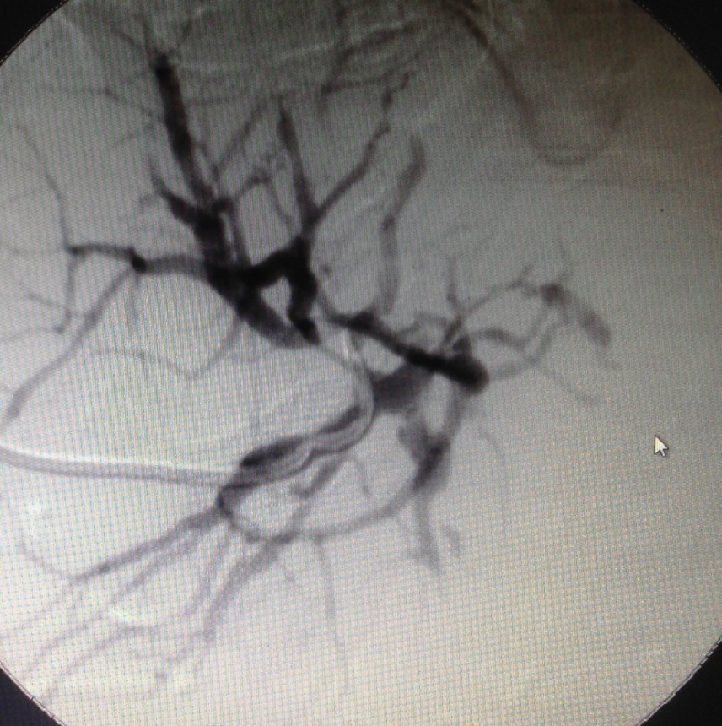
Radiology procedure
Pigtail external drain (8F) for an external-internal one (10.2F).
The external drainage remains closed, and the drain will be exchanged every three months for a drain of bigger caliber, so that the route can be recovered and the drain removed.

Slide 16
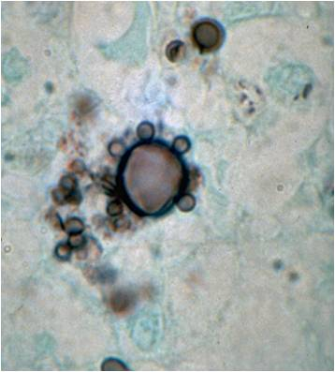
Paracococcidioidomycosis
The paracococcidioidomycosis is a systemic granulomatous disease.
Evolution predominantly chronic and may also be present in acute and subacute form ( juvenile type ).
Frequently, it involves the lungs , phagocyte system , mucous membranes , skin and adrenals .
Etiologic agent: the dimorphic fungus Paracoccidioides brasiliensis (Pb)

Slide 17
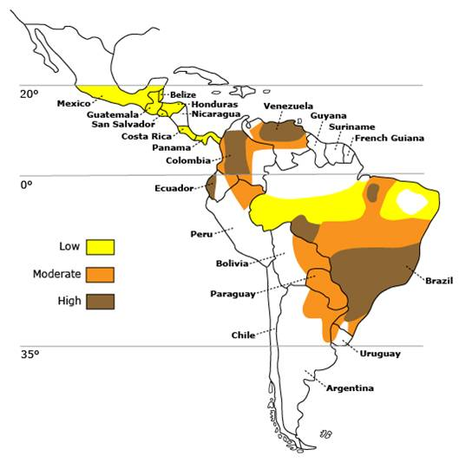
Epidemiology
Endemic disease in Latin America .
80 % of cases documented in Brazil .
No mandatory reporting.
Wetlands with soil often acid.
Rural workers .
Equally distributed among the sexes
before puberty .
10 times more prevalent in men in adulthood.
It can infect wild and domestic animals.

Slide 18
Pathogenesis
Transmission is through the upper airways, by inhalation of fungus.
The Th1 response is described as a response to protection and Th2 as disease susceptibility.
It is a systemic mycosis, with lymphatic or hematogenic spread,
Granulomatous formation in primary outbreak of infection.

Slide 19
Classification of Cnical forms

Slide 20
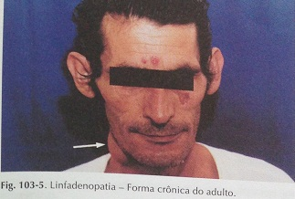
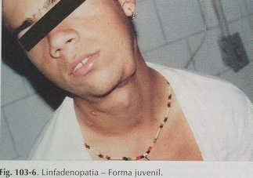
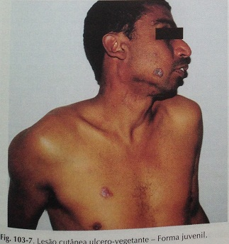
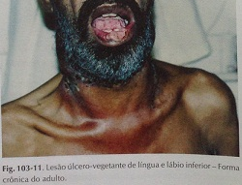

Slide 21
Clinical Picture
Systemic mycosis with tendency to spread to any organ or system.
Lungs , lymph nodes , aerodigestive tract mucosa, skin, adrenals, digestive system, bones and joints, bone marrow, central nervous system CNS, urogenital system, thyroid , eyes and surroundings.
Non-specific clinical picture: malaise, anorexia and weight loss. Occasional fever should be considered a sign of seriousness.

Slide 22
Clinical Manifestations
Asymptomatic infection
Chronic x Acute pneumonia (90%)
Extrapulmonary disease (hematogeneous spread)
Most affected organs Lung<skin<Bone and UGT
2-3 of the patients had multisystem disease and 90% progressed to death without treatment.

Slide 23
Manifestações Clínicas
In a study with 326 patients:
91% lung involvement
18% dermatological and upper airways mucosa involvement.
4% bone involvement
2% UGT involvement
3% of other organs involvement (larynx, soft tissues, LN, esophagus, trachea and joints.)
Common symptoms of chronic pulmonary form :
Cough - 73 %
Fever - 54 %
Purulent sputum - 50 %
Chest pain - 41 %
Dyspnea - 38 %
Weight loss of at least 5% - 37%
Night sweats - 37 %
Chills - 28 %
Hemoptysis - 23 %

Slide 24
Differential Diagnosis
Viral and bacterial pneumonia
Tuberculosis
Histoplasmosis
Malignancy
Sarcoidosis
Idiopathic pulmonary fibrosis
Carcinoma
Leishmaniasis.

Slide 25
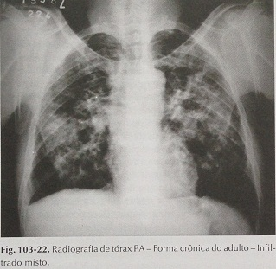
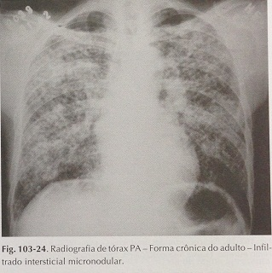
Chest x - ray
There were no symptoms or alterations on the physical examination of the respiratory system.
The chest x-ray showed lesions in the left hemithorax atelectasis band in the right lung.
The radiological pattern of disease is alveolar and perihilar interstitial infiltrates, bilateral and symmetrical, allowing differential diagnosis ofhistoplasmosis (most prominent perihilar adenopathy) TB or lung tumors.

Slide 26
TC de tórax
Chest tomography revealed a discreet bilateral pleural apical thickening.
Atelectasis bands localized in the medium, lingula and lower lobes.
Tiny calcified lymph node in the aortopulmonary window.
No sing of pleural effusion
Trachea and bronchial source unchanged

Slide 27
CONCLUSION
The most affected age group is between 30 and 50 years of age and over 90 % of cases are male.
In adults, the predominant clinical presentation is chronic, with pulmonary involvement, but when it affects children or adolescents, it is presented in the acute or sub-acute form.
When not diagnosed and treated in time, it can lead to severe and lethal disseminated forms, with fast and progressive involvement of the lung, integument, lymph nodes, spleen, liver and lymphoid organs of the digestive tract.
However, the involvement of the gastrointestinal tract is isolated and infrequent. For this reason, we report a case with unusual clinical presentation in which we can observe the involvement paracoccidioidomycotic exclusively in the bile and hepatic duct.

Slide 28
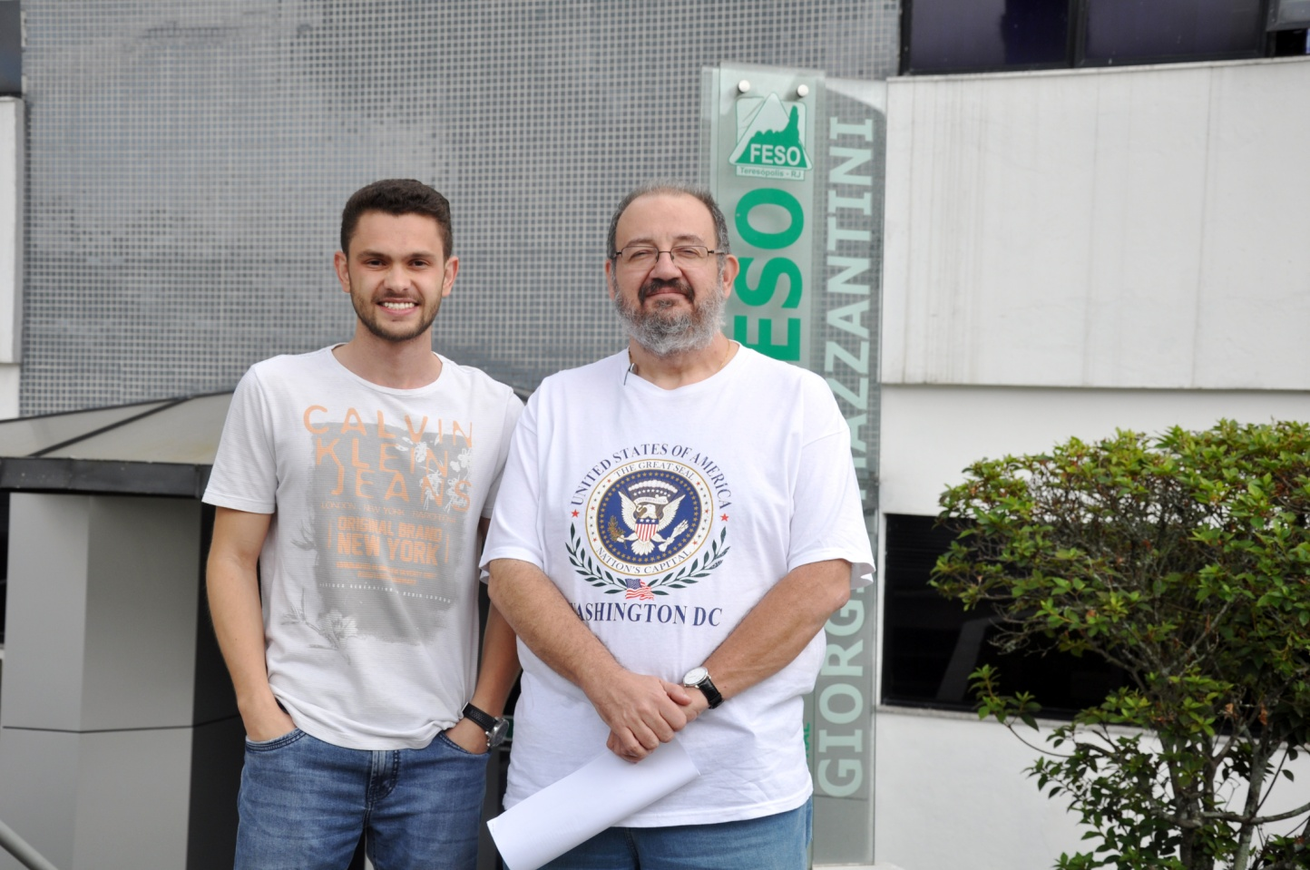
Thank you!

