Slide 1


Improvements in bêche-de-mer fishery through sustainable harvesting in Fiji Islands: An overview
Roveena Vandana Chand^{1,} Ravinesh Ram² and Paul C. Southgate²
School of Biological and Chemical Sciences, Faculty of Science Technology and Environment, University of the South Pacific, Suva, Fiji Islands
School of Marine and Tropical Biology, Faculty of Science and Engineering, James Cook University, Townsville, Australia

Slide 2
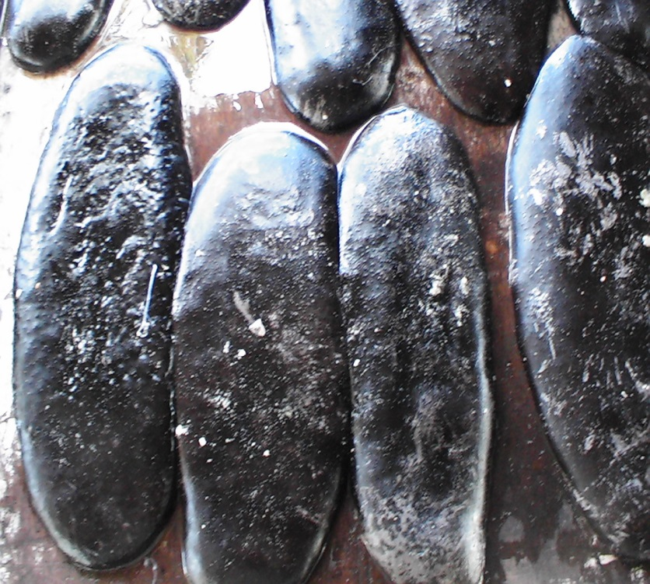
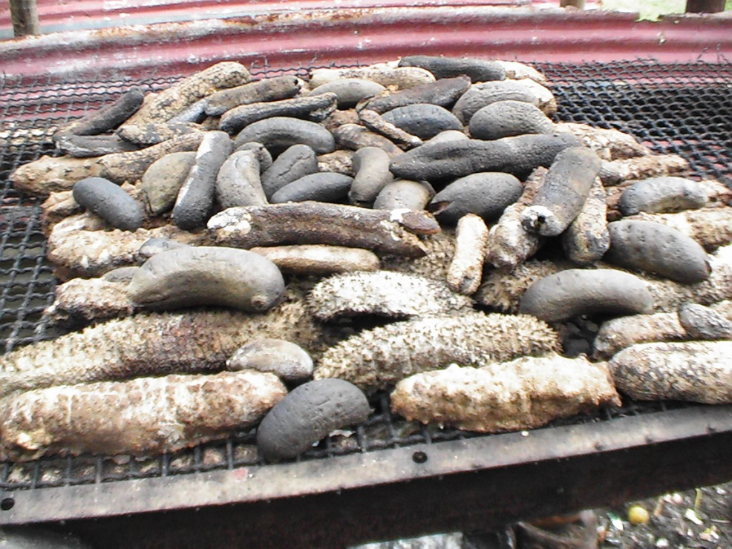
Bêche-de-mer

Slide 3
Presentation Overview
Introduction
Study site
Study design
Current status of Fiji sea cucumber fishery
Resolving current problems
Future problems
List of IUCN sea cucumber redlist species
Conclusion

Slide 4
Introduction/Background
Sea cucumbers have been a major source of income for Fijian communities.
Processing methods used by the people is 2 centuries old
Fiji’s management act on sea cucumbers is old and has not been amended since 1980’s
A number of research has been conducted for improving the income, quality and sea cucumber management in the Pacific Islands (Carleton, 2013; Friedman, 2010)
Main aim of this research is to report on the improvements of bêche-de-mer fishery in Fiji through proper management and sustainable harvesting

Slide 5
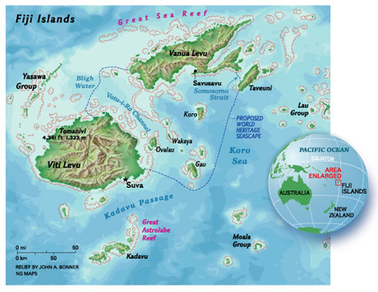
Location of Fiji Islands
Source: http://ngm.nationalgeographic.com/ngm/0411/feature3/images/mp_full.3.jpg

Slide 6

Study Design
Data collected through online databases and through personal observations
A number of people in the BDM trade were interviewed (fishers, exporters and Marine agents)

Slide 7
Current Status
    Fijis exports 27 commercial species from Genera:
      Holothuria sp
      Actinopyga sp
      Stichopus sp
      Thelenota sp
      Bohadschia sp
      Pearsonothuria sp

Slide 8
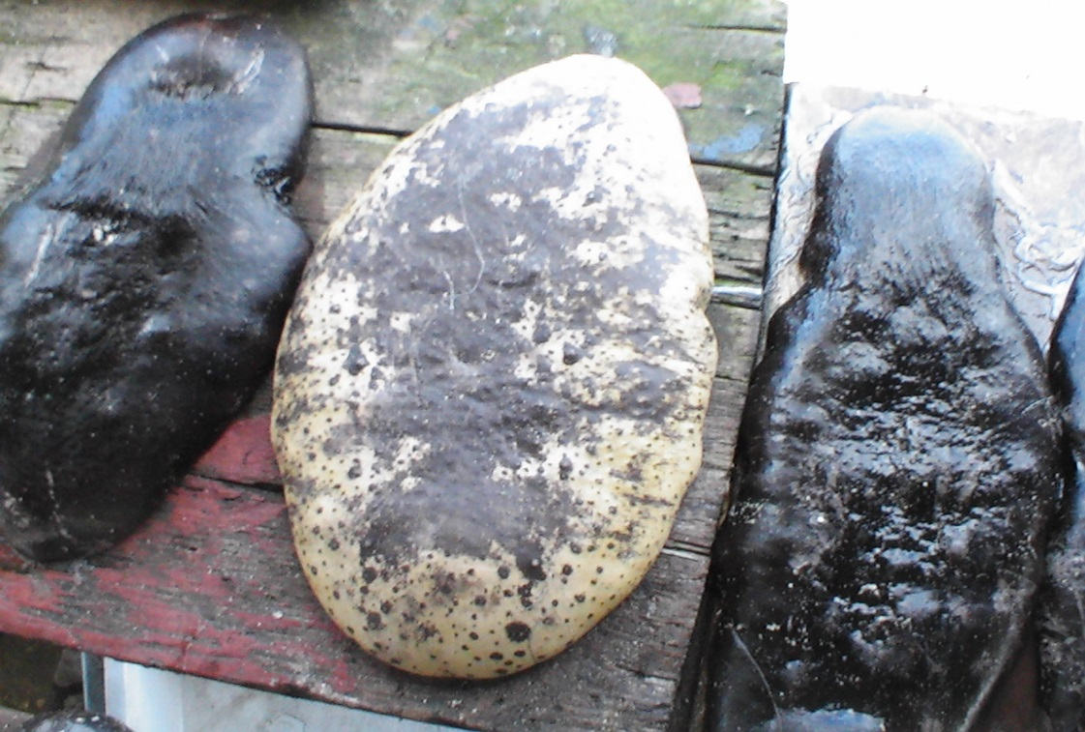
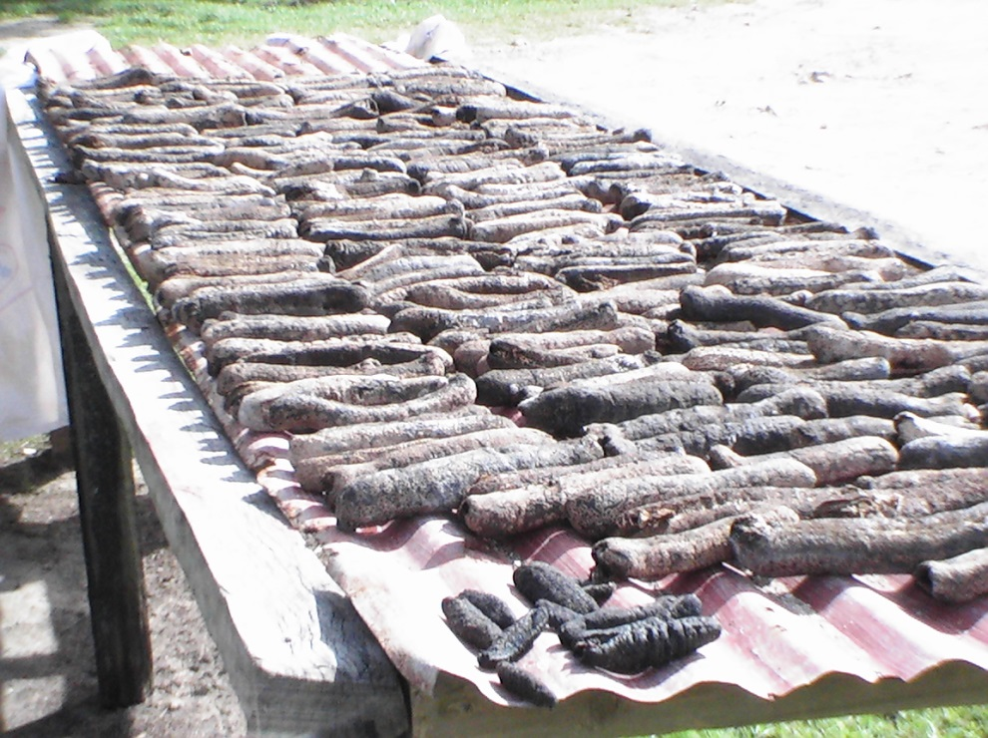
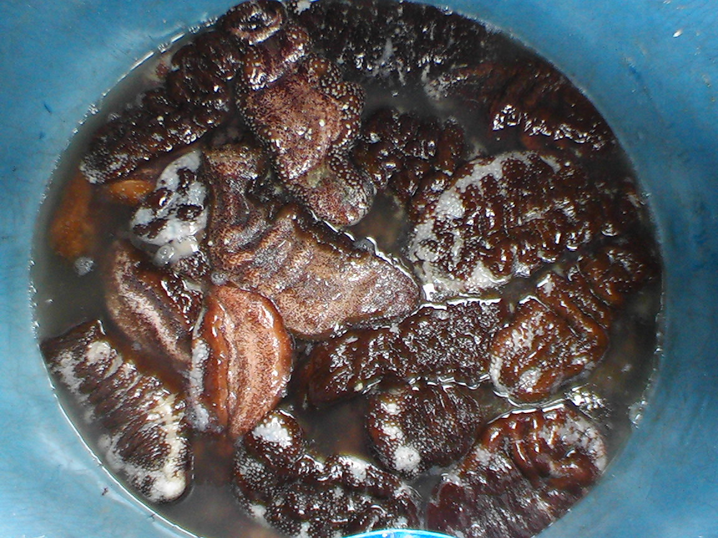
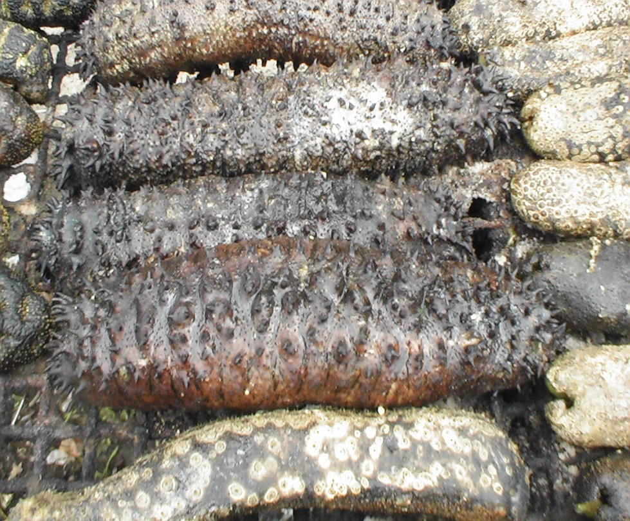

Slide 9
The main target species
    Target species
      Holothuria scabra (Sandfish) (US$ 16-45/kg dry/ Fiji $US 90/kg) VH
      Holothuria fuscogilva (White teatfish) ($US 45-85/kg dry) VH
      Holothuria lessoni (Golden Sandfish) (US$ 16-45/kg dry/ Fiji $US 60/kg) H
      Holothuria whitmaei (Black teatfish) ($US 25-65/kg dry) H
      Thelenota ananas (Prickly redfish) ($US 25-65/kg dry) H
      Stichopus chloronotos (Greenfish) ($US 25-65/kg dry) H
      Actinopyga echnites (Deep water redfish) ($US 25-65/kg dry) H
      Actinopyga mauritiana (Surf redfish) ($US 25-40/ kg dry) H
      VH – very high value H – High value M- medium value (10 species) L-Low value (4 species)

Slide 10
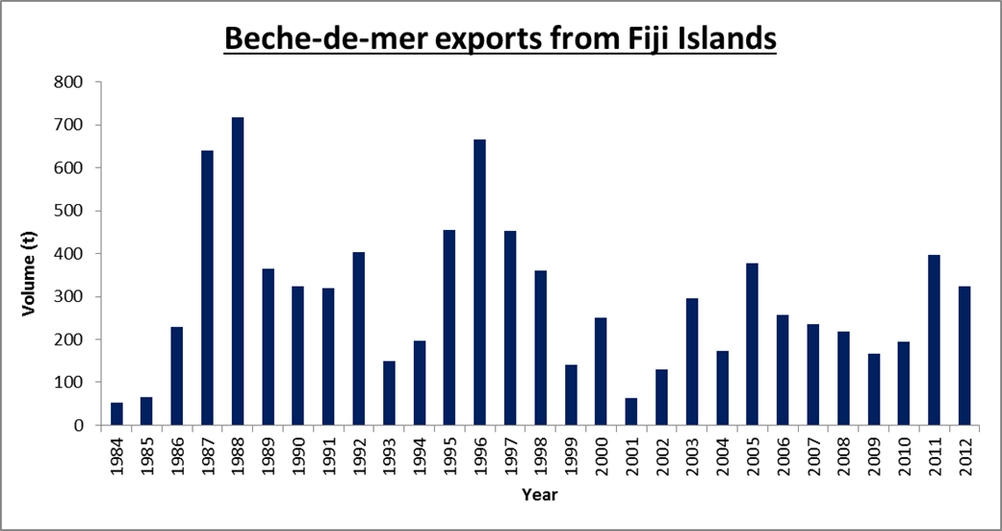
Fiji’s export status
Source: Ministry of Fisheries and Forests: Fiji

Slide 11
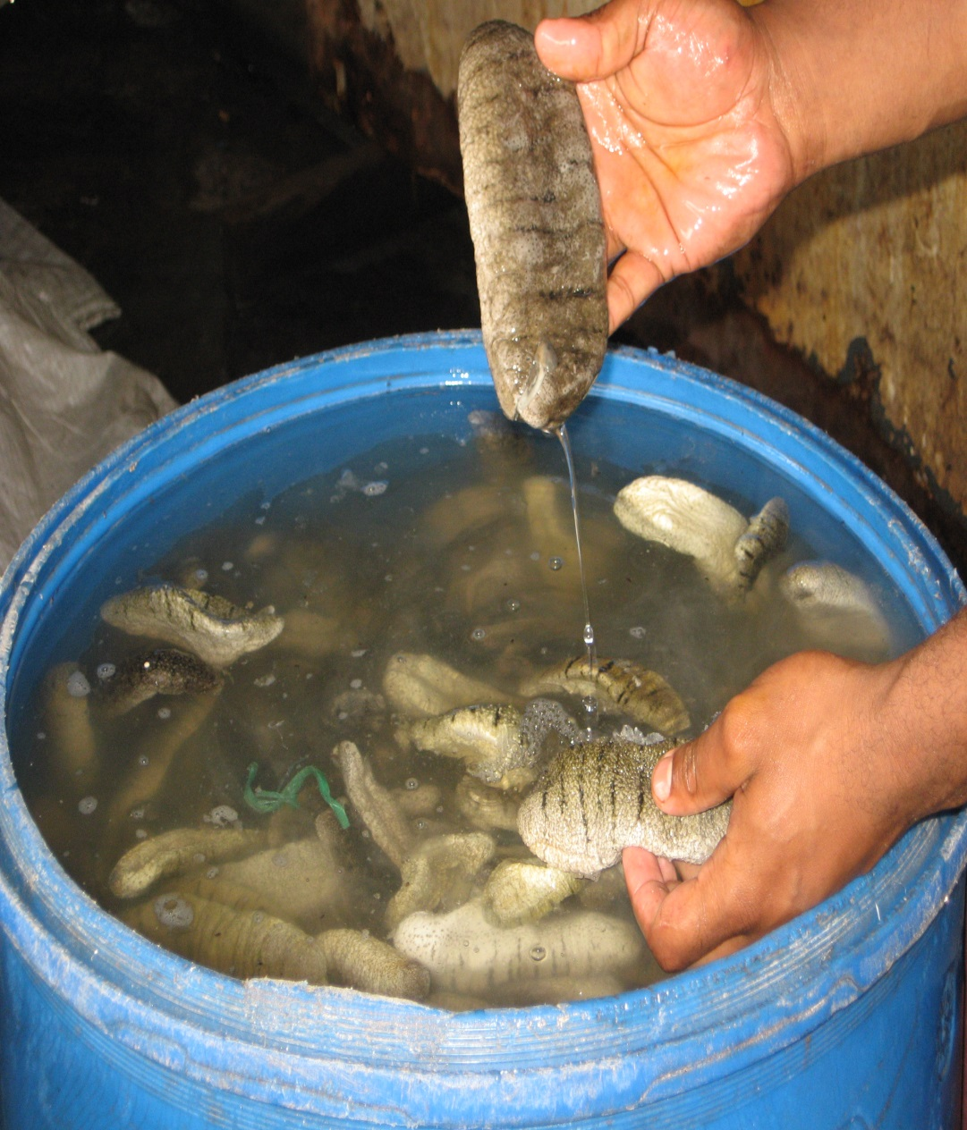
Current Status
    Holothuria scabra (Sandfish) is the only banned species since 1988 due to overexploitation
      For local consumption a decline in catch from 34t in 1986 – 1991 to 14t in 2003 – 2005.
      Unreported data on export status has not been documented.

Slide 12
Current Status
    No management plan for future
    No seasonal closure since the BDM fishery began in 1800’s (recent studies indicated Fiji needs a season closure period)

Slide 13
Current status
    Lack of enforcement and regulations in harvesting sea cucumbers from the deep
      Lack of community based education and awareness
      Use of SCUBA (9 in 2010 to 25 in 2013) (> 30m)
      Number of companies rose from 7 in 2003 to 11 in 2013 (Fiji fisheries report, 2013)

Slide 14
Resolving current problems
Complete ban on SCUBA (>108 deaths reported)
Seasonal closure
Harvesting quotas allocated to the fishers and exporters
Eliminating the use of sea cucumber “bomb”

Slide 15
Resolving current problems
Adding value to the medium-low value species since there is a shift of exploitation from high value species to low valued species (since 2003 – 2012 a decline in high value species volume was recorded from 14 – 8% and medium rose from 50 – 59%.
Decreasing the issue of bêche-de-mer export license
Use of marine protected areas to start sea ranching program
Study needs to be done on the reproductive biology of all commercial sea cucumber species (information will help understand the actual length and weight to be harvested) current 76mm size is applied to all the species.

Slide 16
Future problems
Global warming and global sea temperature rise will affect sea cucumber reproduction
Emergence of holothurian diseases that will affect broodstock and juvenile sea cucumbers
Overfishing (8 species in IUCN redlist)
Ecosystem balance will be altered

Slide 17
List of IUCN species
Adapted from Conand et al (2014)

Slide 18
Conclusion
Proper/revised sea cucumber management plan needs to established in Fiji since the ACT is old
The harvests in Fiji is slowly shifting from high value species to medium to low value species.

Slide 19
References
Carleton C., Hambrey J., Govan H., Medley P. and Kinch J. 2013. Effective management of sea cucumber fisheries and the beche-de-mer trade in Melanesia. SPC Fisheries Newsletter 140:24–42.
Friedman K., Eriksson H., Tardy E. and Pakoa K. 2010. Management of sea cucumber stocks: Patterns of vulnerability and recovery of sea cucumber stocks impacted by fishing. Fishing and Fisheries 12(1):75–93.
Purcell, S., Managing sea cucumber fisheries with an ecosystem approach, A. Lovatelli, M. Vasconcellos, and Y. Yimin, Editors. 2010, FAO Fisheries and Aquaculture Technical Paper No. 520.: Rome; FAO. p. 157.

Slide 20
Thank You
??

