Slide 1

The Singapore Eye Research Institute
Breaking Down barriers to promote effective antibiotic action
Roger W. Beuermqn
Singapore Eye Research Institute
Duke-NUS
Ophthalmology, NUS

Slide 2
Disclaimer
Multiple Patents in Area
CSO-SinSa Labs, Montreal
Consultant-Allergan

Slide 3
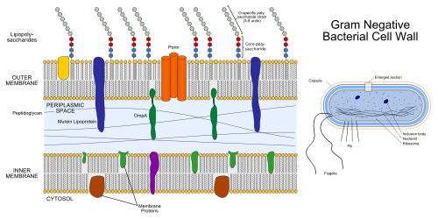
All Bacteria have a Common Weakness,…their inner membrane which is markedly different than the human cell membrane
The so-called natural antibiotics-the defensins have used this weakness for millions of years to kill Gram negative and Gram positive pathogens (also virus and fungus) with out developing resistance.
But they just provide some coverage and in therapeutic concentrations can be inflammatory or toxic to human cells

Slide 4
Initial Tox screening
LDH, ATP human conjunctiva cells, RBC lysis
Molecular Design
Synthesis Our lab
MIC Screening Gram -/+, fungus
Success
Protein chemistry
Small molecule chemistry
Microbiology
Biophysics
NMR
MD
Animal models
Permeability, CYP, metabolism
Mouse model of corneal infection,
Extensive MIC clinical and resistant organisms
Developmental Path-Antibiotics Targeting the Bacteria/Fungal Membrane

Slide 5
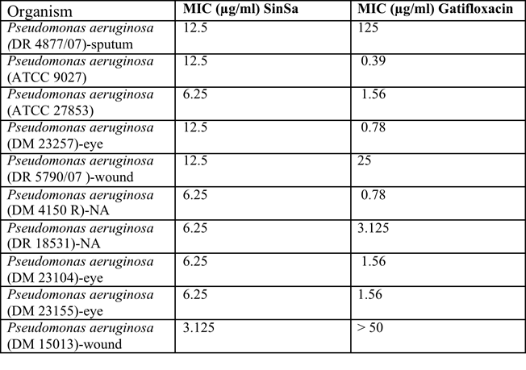
MIC assay
Extended Gram Negative Organisms
 | Test Organism | MIC₉₉ Value (µg/ml)
1 | E.Coli ATCC 25922 | 3.125
2 | E.Coli ATCC 8739 | 3.125
3 | Klebsiella pneumoniae ATCC 10031 | 3.125
4 | Serratia marcescens ATCC 8100 | 6.25
5 | Citrobacter koseri DM4432 | 6.25
6 | Proteus vulgaris DM 4635 | 25
Zhou L, Liu SP, Chen LY, Li J, Ong LB, Guo L, Wohland T, Tang CC, Lakshminarayanan R, Mavinahalli J, Verma C, Beuerman RW.
The structural parameters for antimicrobial activity, human epithelial cell cytotoxicity and killing mechanism of synthetic monomer and dimer analogues derived from hBD3 C-terminal region. Amino Acids. 2011 Jan;40(1):123-33.
CONFIDENTIAL

Slide 6
Averting Resistance-Simulation in the
Laboratory and Induced During treatment of an experimental infection of the Mouse Cornea
Treatment induced resistance
Gatifloxicin MIC increased 4-8X
7B
Laboratory simulation of resistance
(Pseudomonas isolate from eye)
150
Gentamicin
Fold increase MIC
V2D
100
Norfloxacin
50
Gentamicin
Norfloxicin
0
B2088/99
0
5
10
15
Serial passage number

Slide 7
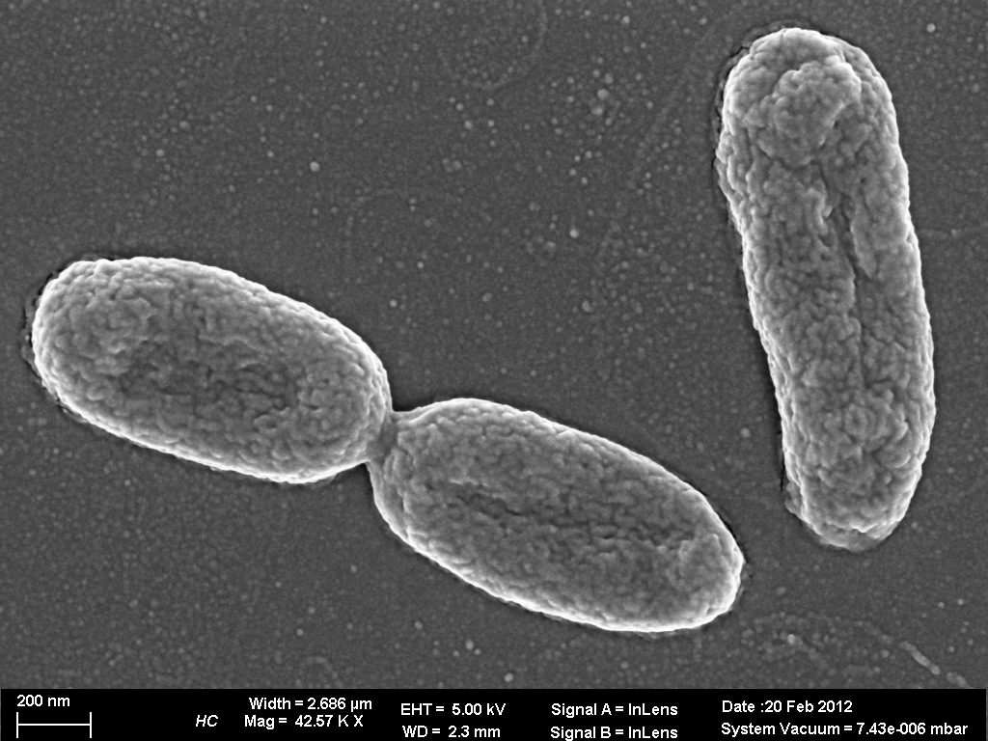
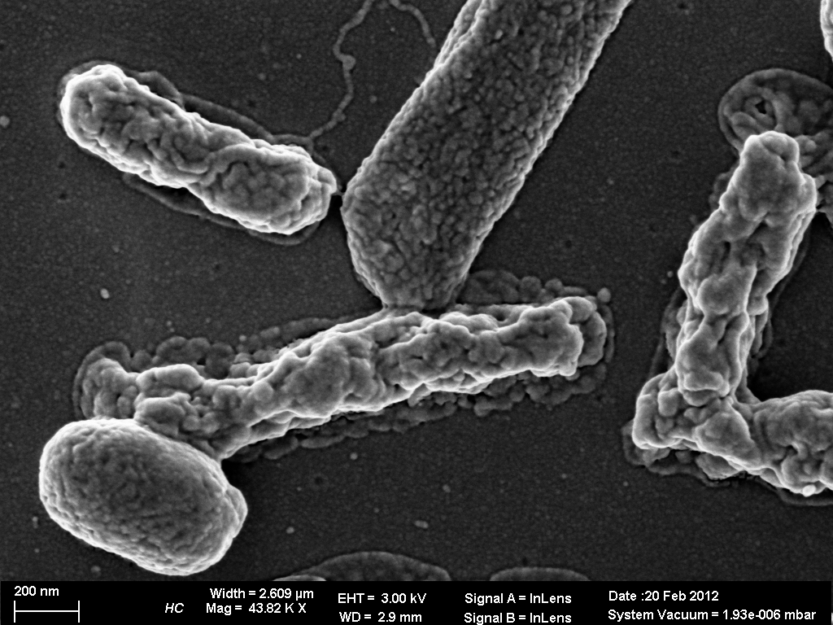
Rapid Killing-V2D
Pseudomonas aeruginosa ATCC 9027
PBS 30min
Design and synthesis of amphiphilic xanthone-based, membrane-targeting antimicrobials with improved membrane selectivity.
Zou H, Koh JJ, Li J, Qiu S, Aung TT, Lin H, Lakshminarayanan R, Dai X, Tang C, Lim FH, Zhou L, Tan AL, Verma C, Tan DT, Chan HS, Saraswathi P, Cao D, Liu S, Beuerman RW.
J Med Chem. 2013 Mar 28;56(6):2359-73. Compared vancomycin and daptomycin
2XMIC 30min

Slide 8
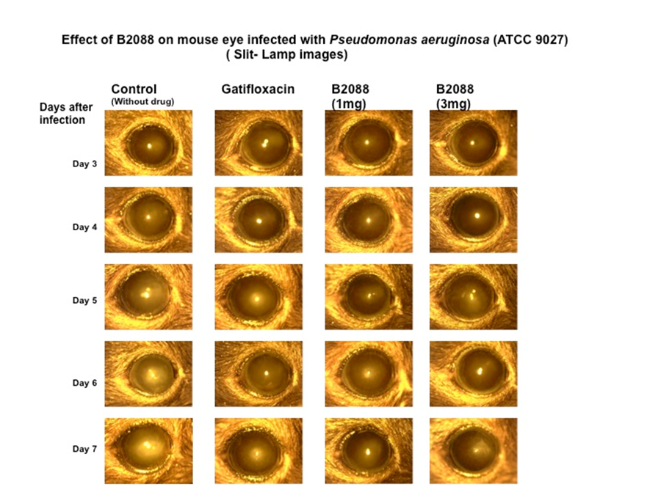
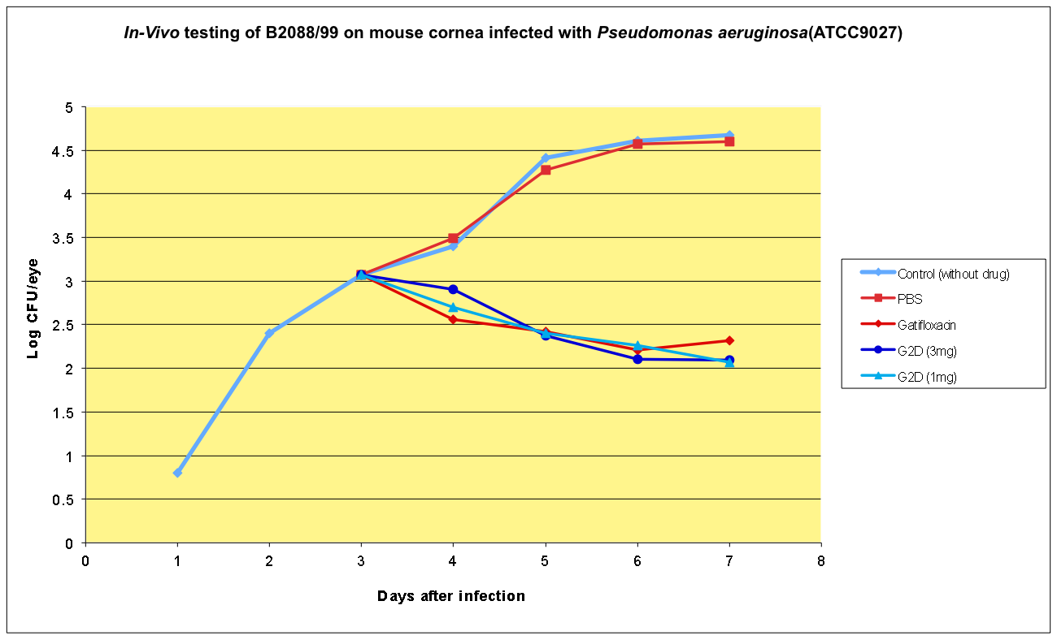
Effective at 1/3 concentration of gatifloxicin
Mouse model of Corneal Infection

Slide 9
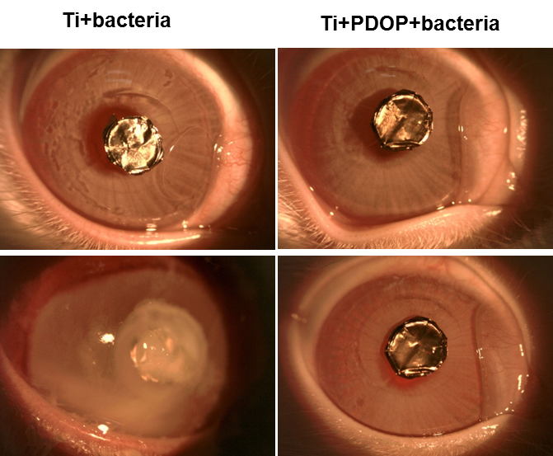
Antimicrobial coating for medical devices.
  E.g keratoprostheses devices for the eye and other implants
  Effective with Pseudomonas and Staph
  More effective than an aggressive antibiotic strategy

Slide 10
FAS Technology
Facilitated Antibiotic Synergism, FAS, using Current Antibiotics, FAS Acts at submicrogram, sub MIC values to increase activity of existing antibiotics even on resistant forms of Pseudomonas and CREs , the carbapenem-resistant Enterobacteriaceae, such as E. coli and K. pneumoniae
FAS Technology helps to avoid resistance: kills bugs faster and at a lower concentration of antibiotic

Slide 11
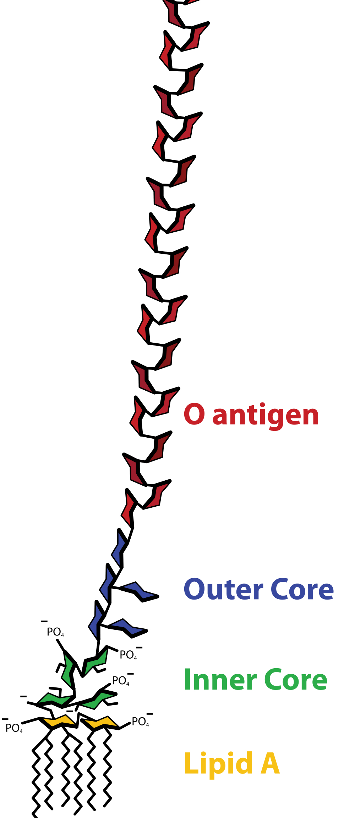
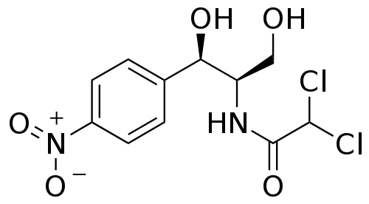
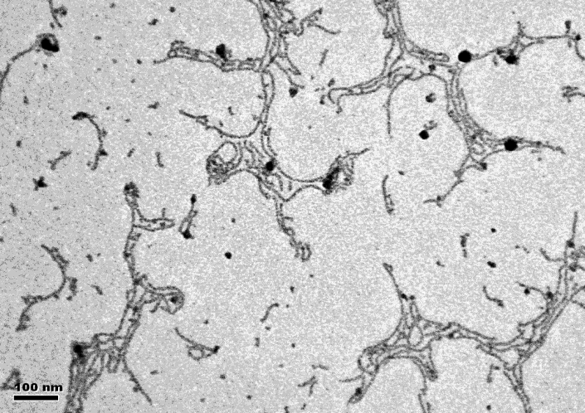
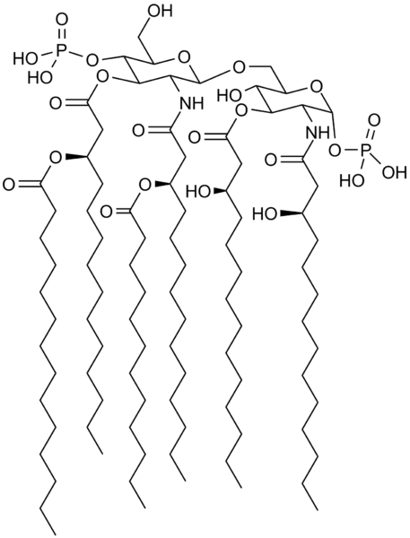
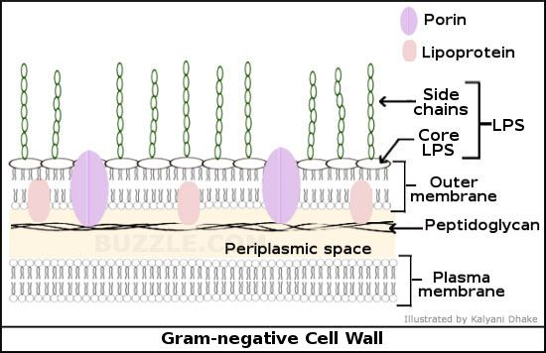

SpearHead Technology: Molecules designed by SinSa breakdown the polyanionic LPS barrier and allow entry of antibiotics. Antibiotics tend to be either hydrophobic or large hydrophilic molecules.
Antibiotic
LPS: Without SHT
TARGETS
SHT Molecule
LPS: After SHT)
The Gram negative cell wall, at left is protected by LPS, seen above expanded. The porins allow only small hydrophilic molecules to pass into the cytoplasm.

Slide 12
FAS Technology
Effective with Different Classes of Antibiotics
Chloramphenicol
Erythromycin
Gatifloxicin
Ciprofloxicin
Gentamycin
Kanamycin
Imipenam
Tobramycin
We have developed several different classes of molecules that are effective when paired with these antibiotics

Slide 13
Summary of Synergistic Action with other Antibiotics
ªFor gentamycin P. aeruginosa ATCC 9027 was used to determine the FICI.
For all other antibiotics a clinical isolate, P. aeruginosa DR 4877 (multi drug resistant strain) was used

Slide 14
E coli Mutants with Outer Membrane Truncation
B2088, B2088_99 and Polymyxin B binds to lipid A portion of LPS
B2089, B2099 bind to O-antigen domain
B2499 binds to Outer core region

Slide 15
Time-Kill Kinetics of B2088/B2088_99 with Gatifloxacin
P. aeruginosa 27853
P. aeruginosa 9027
Combination of B2088/B2088_99 and Gati at Sub MIC displayed pronounced
bactericidal effect

Slide 16
Synergy-increase the activity of current antibiotics
ATP and LDH release-no toxicity at 1000ug/ml

Slide 17
Chloramphenicol
A good antibiotic but with limited effectiveness against Gram Negative organisms

Slide 18
Mouse Model of Cornea Infection
Log CFU average 3 corneas
Infection with Pseudomonas aeruginosa ATCC 9027
Treatment 3X/day starting on Day 2

Slide 19
Summary
Facilitated Antibiotic Synergy (FAS)
FAS Technology deals with some of the most difficult pathogens-such as Pseudomonas and the CREs.
FAS does the following:
1-Extends the action spectrum of some antibiotics
2-In many cases it will allow the use of lower concentrations of antibiotics to achieve the same therapeutic effect
3-FAS Technology can decrease bacteria kill times from 18-22hrs to 3-4hrs

Slide 20
Summary-2
4-Importantly it has the ability to lower the cost of development, should require fewer studies for IND filing, and more rapid entry into clinical use with Phase II trials
5-Importantly for patients offers better and quicker eradication of infections
6-FAS technology works with several classes of antibiotics
7-Improved therapeutic index
8-Health care costs should be lower

Slide 21
With appreciation
SERI
Shouping Liu
R. Lakshminarayanan
Thet Aung
Zhou Lei
Donald Tan
Jun Jie Koh
S. Padamanbhan
Jod Mehta
Hanxun Zou
Xiaping Dai
Eunice Goh
NTU School of Biological Sciences
Konstatin Pervusin
Bai Yong
Bioinformatics Institute
Chandra Verma
Jianguo Liu (SERI)
Genome Institute
Swaine Chen
University of Geneva
Howard Reizman
NUS Engineering
Seeram Ramakrishna
SGH-Pathology
Tan Ai Ling
Funding: NMRC, BMRC, TCR-NRF, SingHealth Foundation, Exploit

Slide 22
Thank you

