Slide 1
About OMICS Group
OMICS Group International is an amalgamation of Open Access publications and worldwide international science conferences and events. Established in the year 2007 with the sole aim of making the information on Sciences and technology ‘Open Access’, OMICS Group publishes 400 online open access scholarly journals in all aspects of Science, Engineering, Management and Technology journals. OMICS Group has been instrumental in taking the knowledge on Science & technology to the doorsteps of ordinary men and women. Research Scholars, Students, Libraries, Educational Institutions, Research centers and the industry are main stakeholders that benefitted greatly from this knowledge dissemination. OMICS Group also organizes 300 International conferences annually across the globe, where knowledge transfer takes place through debates, round table discussions, poster presentations, workshops, symposia and exhibitions.

Slide 2
About OMICS Group Conferences
OMICS Group International is a pioneer and leading science event organizer, which publishes around 400 open access journals and conducts over 300 Medical, Clinical, Engineering, Life Sciences, Pharma scientific conferences all over the globe annually with the support of more than 1000 scientific associations and 30,000 editorial board members and 3.5 million followers to its credit.
OMICS Group has organized 500 conferences, workshops and national symposiums across the major cities including San Francisco, Las Vegas, San Antonio, Omaha, Orlando, Raleigh, Santa Clara, Chicago, Philadelphia, Baltimore, United Kingdom, Valencia, Dubai, Beijing, Hyderabad, Bengaluru and Mumbai.

Slide 3
Asteroid Redirection Using Synchronized Femtosecond Pulse Trains
Richard Fork
Electrical and Computer Engineering Department
University of Alabama Huntsville

Slide 4
One 31.4 mJ optical pulse of
<100 femtosecond duration delivers
the same energy as:
fission of
one billion Uranium 235 nuclei
Femto is Norwegian and Danish for “fifteen”

Slide 5
Energetic femtosecond pulse means an optical pulse that will deliver a very large amount of energy in a very short time in a very small volume provided you focus it in a very small volume.
Focus the “energetic femtosecond” pulse on the surface of an asteroid from a nearby location and you can access a novel state of matter

Slide 6
Very small volume containing a very large amount of energy delivered in a very short time
This could be useful for highly efficient propulsive thrust in the vacuum and microgravity of space involving novel physical phenomena

Slide 7
Energetic femtosecond pulse for efficient
propulsive thrust in the space
Focus a transform limited optical pulse of <100 fs duration into material at order of 14.4 J/cm²
200 nanometers
336 microns
Optical Micro-Engine

Slide 8
If focused as a transform limited optical pulse of <100 fs duration onto the surface of a wide range of materials at order of 14.4 J/cm²
200 nanometers
336 microns
Optical Micro-Engine
Novel highly transient state of matter

Slide 9
< 0 ps
1 ps
> 1ps
10 ps

Slide 10
EFFICIENT PRECISE REDIRECTION OF AN ASTEROID
Ejecta provide efficient propulsive thrust events
Asteroid
Spacecraft
Energetic femtosecond pulses
Configured local areas create specifically oriented “optical micro-engines”
Collimated ejecta

Slide 11
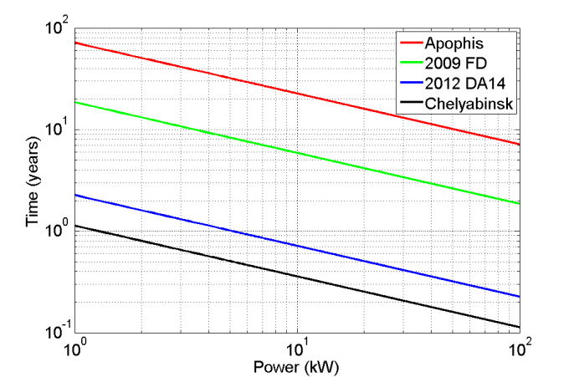

Slide 12
Summary
Gravity Tractor
Ion-Beam Deflection
Kinetic Impactor
*Laser Ablation (NASA endorsed)
Short range
Can apply the same energy as a nuclear detonation, however, quasi-continuously over an allowing
continuous optimization and correction

