Slide 1
About OMICS Group
OMICS Group International is an amalgamation of Open Access publications and worldwide international science conferences and events. Established in the year 2007 with the sole aim of making the information on Sciences and technology ‘Open Access’, OMICS Group publishes 400 online open access scholarly journals in all aspects of Science, Engineering, Management and Technology journals. OMICS Group has been instrumental in taking the knowledge on Science & technology to the doorsteps of ordinary men and women. Research Scholars, Students, Libraries, Educational Institutions, Research centers and the industry are main stakeholders that benefitted greatly from this knowledge dissemination. OMICS Group also organizes 300 International conferences annually across the globe, where knowledge transfer takes place through debates, round table discussions, poster presentations, workshops, symposia and exhibitions.

Slide 2
About OMICS Group Conferences
OMICS Group International is a pioneer and leading science event organizer, which publishes around 400 open access journals and conducts over 300 Medical, Clinical, Engineering, Life Sciences, Phrama scientific conferences all over the globe annually with the support of more than 1000 scientific associations and 30,000 editorial board members and 3.5 millionfollowers to its credit.
OMICS Group has organized 500 conferences, workshops and national symposiums across the major cities including San Francisco, Las Vegas, San Antonio, Omaha, Orlando, Raleigh, Santa Clara, Chicago, Philadelphia, Baltimore, United Kingdom, Valencia, Dubai, Beijing, Hyderabad, Bengaluru and Mumbai.

Slide 3
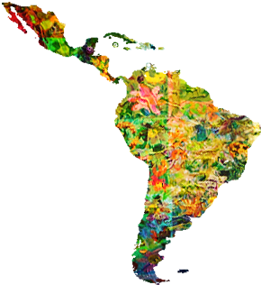
BUSINESS AND REGULATORY ENVIRONMENT OF BIOPHARMACEUTICALS AND BIOSIMILARS IN LATIN AMERICA
RICARDO IBARRA-CABRERA

Slide 4
INBIOXICA
INBIOXICA is a firm dedicated to transform ideas into innovative products and technology that improve quality of life and the environment.
We help companies and entrepreneurs reach their full potential through consulting services in the field of innovation and quality management.
Additionally, we invest in our own R&D projects in life sciences
and collaborate with other organizations through an open innovation process.

Slide 5
INBIOXICA
Consulting services: Innovation management Idea generation R&D projects Total quality management Courses and trainings Identification of business opportunities Grant funding Recommendations for policy makers | R&D projects: Biopharmaceuticals and biosimilars Bio-based products Emerging contaminants adsorption materials Technologies for the removal of Emerging contaminants Phytochemicals in functional foods

Slide 6
1. BIOPHARMACEUTICALS AND BIOSIMILARS

Slide 7
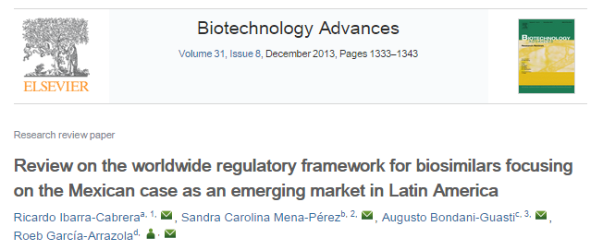

Slide 8
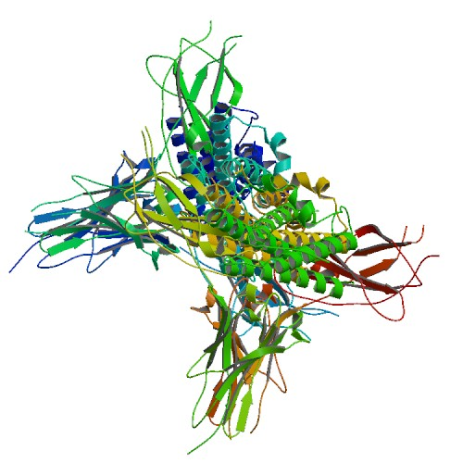
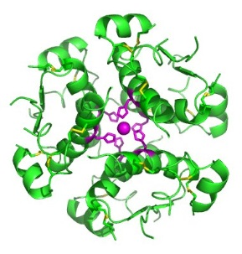
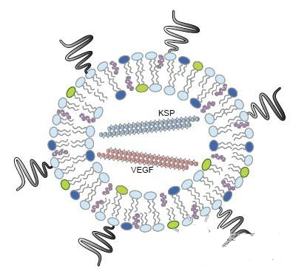
BIOPHARMACEUTICALS
Drugs that include proteins, antibodies, hormones, vaccines, blood products, gene therapies, etc. obtained through biotechnology.
Insulin
ALN-VSP02
Filgrastim (G-CSF)

Slide 9
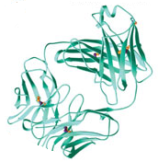
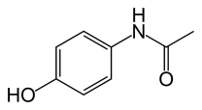
CHEMICALLY SYNTHESIZED VS BIOTECHNOLOGY DRUGS
Property | Chemically synthesized drug | Biopharmaceutical
Molecule | Paracetamol | Trastuzumab
Type | Amide | Monoclonal antibody
Molecular weight | 151 Da | 185 kDa
Stability | Very stable | Propensity for degradation
Manufacture | Chemical reactions | Recombinant DNA-humanized mAb
Immunogenicity | Decreases immunogenicity | Concern for biosimilars
Indication | Analgesic and antipyretic | Her2 positive breast cancer

Slide 10
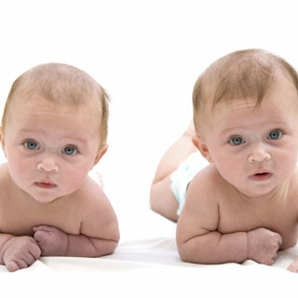
BIOSIMILARS
Subsequent versions of biopharmaceuticals after patent expiration. Biosimilars ≠ Generics
How similar is similar enough?

Slide 11
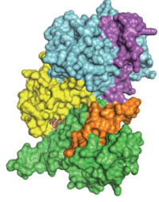
BIOSIMILARS
Biosimilars are highly similar but not identical to reference products due to the process potentially affects the product:
Host-cells selection
Cell physiology variability
Bioprocess variables
Higher-order structure of proteins
Post-translational modifications
Stability and purification
Slight differences with reference product, whose clinical impact is still unkown

Slide 12
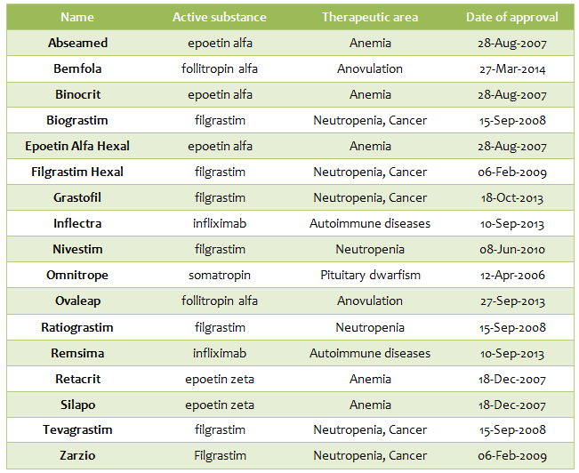
Despite the slight differences with their reference products, biosimilars are recognized around the world as safe and effective medicines. The EMA has authorized 17 biosimilars:
http://www.ema.europa.eu/

Slide 13
2. GLOBAL REGULATORY STATUS OF BIOSIMILARS

Slide 14
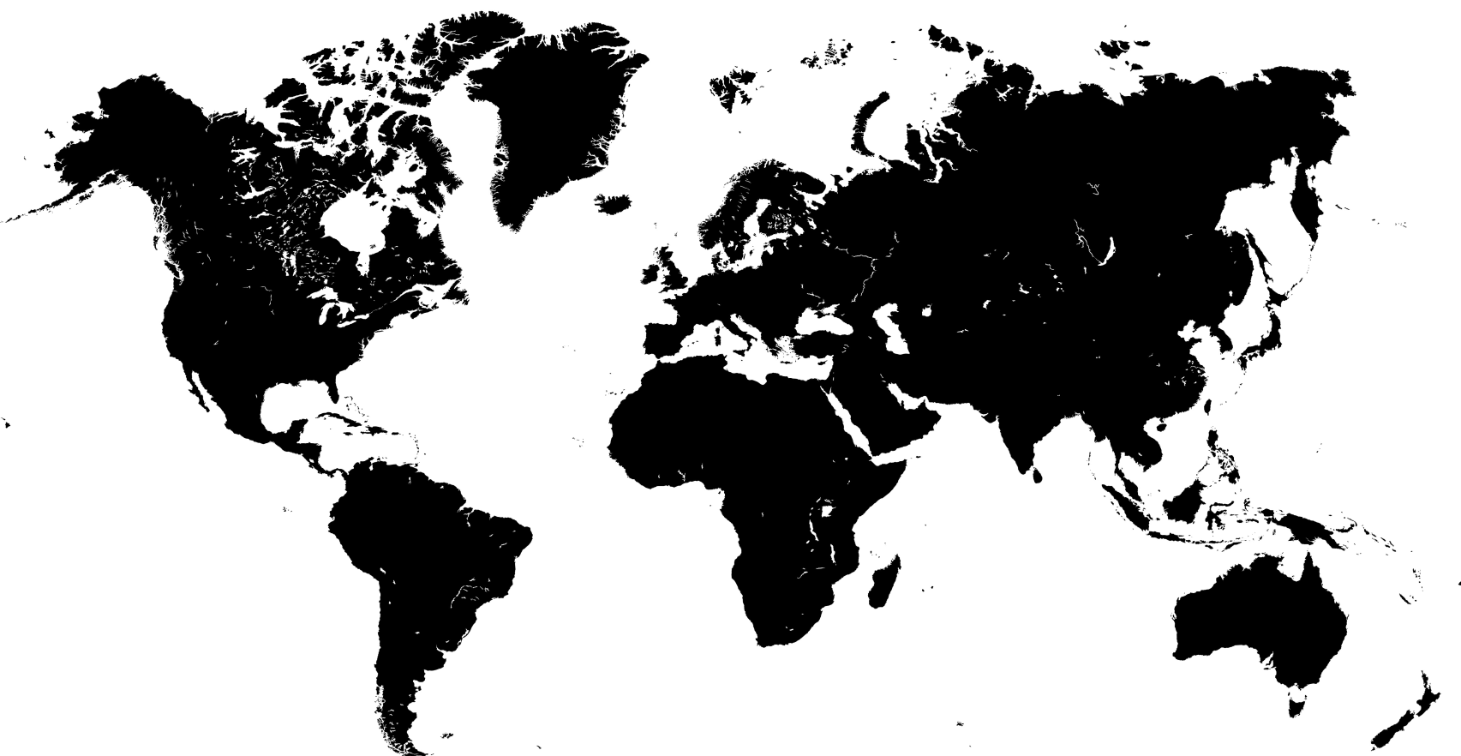
GLOBAL STATUS OF BIOSIMILARS
Requirements for Subsequent Entry Biologics (SEBs), March 2010
EMA, Scientific Guidelines on biosimilar medicines, 2005
FDA Draft Guidance on Biosimilars,
February 2012
MHLW Guidelines 2009
Turkey, Biosimilar medicinal products guide, 2008
Biosimilars Registration Guideline, 2010
KFDA, Guideline on Evaluation of Biosimilar Products, 2009
Resolution No. 56/2011 Known biological products
Guidance documents, 2008
Mexican Official Norm on biopharmaceuticals and biosimilars, 2012
Guidelines on
Biosimilars, 2010
Guidance on registration of similar biological products, 2009
Venezuela,
Regulatory Norm for products obtained by rDNA, 1993
Guidelines on similar biologics, 2012
ANVISA, Resolution No. 55/2010
Evaluation of biosimilars, 2013
Biosimilar guidelines, 2010
Disposition 7075-11 ANMAT, 2011

Slide 15
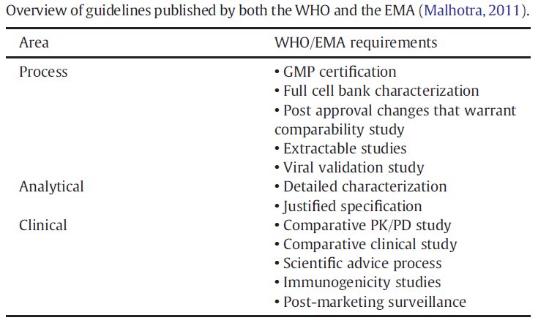
WHO GUIDELINES

Slide 16
3. BUSINESS ENVIRONMENT OF BIOSIMILARS IN LATIN AMERICA

Slide 17
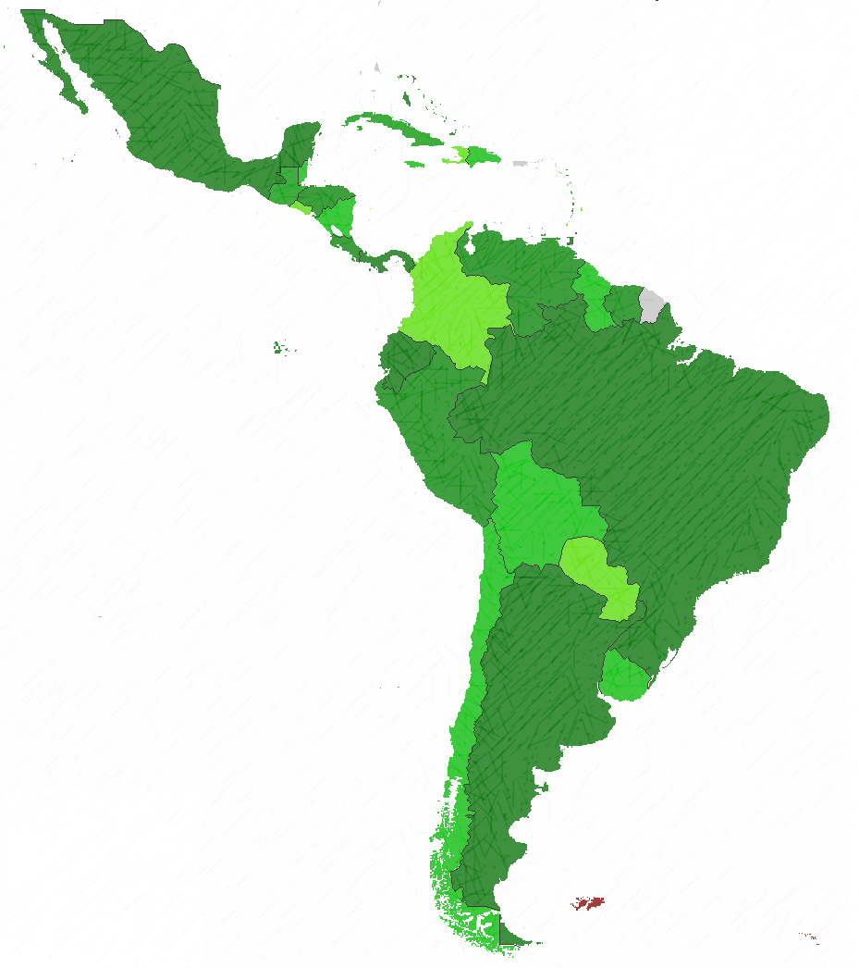
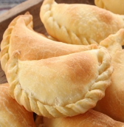
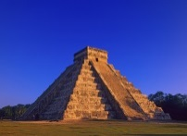
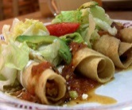
LATIN AMERICAN REGION
Nearly 600 million people living in 24 countries, speaking 2 major languages, Spanish and Portuguese.
Although there are cultural differences, we share ancestral roots with America, Europe and Africa.

Slide 18
LATIN AMERICAN BUSINESS ENVIRONMENT
Biosimilars in LATAM
Key trends
Market forces
Macro-economic forces
Industry forces

Slide 19
KEY TRENDS
Regulatory trends
100 copies of reference products were authorized before adoption of proper evaluation guidelines.
Regulations varies widely among countries, some are in the process of creating them, and some are too vague.
Some countries have developed abbreviated regulatory pathways (Mexico, Brazil and Argentina).
Regulation is evolving towards increasing quality standards.
The trend is to adopt international standards (e.g. WHO guidelines by Argentina, Brazil, Chile, Costa Rica, Guatemala, Panama and Peru).

Slide 20
KEY TRENDS
Technology trends
Increase of high-quality manufacturing
Patent expiration of innovative biopharmaceutical products.
Technology-transfer agreements between local companies (e.g. co-development of biosimilars by Brazilian company Libbs and Argentinean company mAbxience, part of Insoud group)
Increase of technical know-how and capabilities

Slide 21
KEY TRENDS
Socioeconomical trends
Population growth of 14%.
Ageing population: 100 million people will be over 60 years old by 2020.
163 cancer patients per 100,000 people, 13 deaths per 22 cases.
Substantial growth of middle class.
Unprecedented period of economic growth.
Biotherapeutics are still very expensive for Governments.

Slide 22
MARKET FORCES
Biosimilars emerge as a new type of pharmaceutical market
Patients and Governments demanding medicines at lower costs
Potential of early revenue streams (30% in 2020-25)
Current therapy penetration is extremely low compared to mature markets
Emerging markets to become larger markets by 2020

Slide 23
INDUSTRY FORCES
Large companies entering LATAM landscape with financial resources and technical expertise. Big pharma expected to be last in the market, but strongest
Commercial partnerships between local and foreign manifacurers
Local developers gaining advantage in domestic markets
Probiomed in Mexico, Bionovis and Orygen in Brazil, Grupo Insud in Argentina.
Need to develop biosimilars abroad + Need to gain local expertise
Sandoz, Boehringer Ingelheim, Pfizer and MSD
Source: PMLIVE. http://www.pmlive.com/pharma_intelligence/unfolding_the_biosimilar_landscape_in_latin_america_470137

Slide 24
MACROECONOMIC FORCES
According to the World Bank, health expenditure in LATAM was 7.59% of the Gross Domestic Product in 2011, (i.e. 500 billion USD)¹. The middle class is significantly growing, so health expenditure has more than doubled in 10 years. Biosimilars are high on the health policy agenda due to it is expected they offer 35% lower prices. Thus, they have the potential to increase access to life-saving drugs.
1. http://www.tradingeconomics.com/latin-america-and-caribbean/health-expenditure-total-percent-of-gdp-wb-data.html

Slide 25
PRODUCT APPROVALS
Some copies of original biopharmaceuticals were approved before regulations being in place:
Country | Drug
Colombia | Etanar (etanercept)
Bolivia, Chile and Peru | Reditux (rituximab)
Mexico | 12 erythropoietin copies Kikuzumab (rituximab)

Slide 26
PRODUCT PIPELINE
Biosimilar products under development in LATAM¹:
Active substance | Indication | Company | LATAM partner
bevacizumab | Breast, lung, ovarian cancer | Biocad | Biocad Brazil
infliximab | Autoimmune diseases | Celltrion | Oli Med
etanercept | Arthritis, psoriasis | Shanghai CP, Grupo Insud Amega Biotech Biosidus (Argentina) | EMS
rituximab | Rheumatoid arthritis, lymphoma, leukaemia | Sandoz, Celltrion, Boehringer Ingelheim, Pfizer, MSD, Mabion, Grupo Insud, Biocad, Biosidus | Oli Med
trastuzumab | Breast and stomach cancer | Celltrion, Biocad, Grupo Insud | Oli Med, Biocad Brazil
1. GaBi Online. http://gabionline.net/Biosimilars/General/Similar-biotherapeutic-products-under-development-in-Latin-America

Slide 27
4. REGULATORY ADVANCES IN LATIN AMERICA

Slide 28
REGULATORY ADVANCES
 | Country | Name | Year | Laws and Regulations
 | Mexico | Biocomparable Biotechnological medicine | 2009 - 2013 | Ley General de Salud, 2009 Article 222bis – Mexican Health Law Article 39- Ley Orgánica de la Administración Pública (Public Administration Organic Law) NOM-177-SSA1-2013 NOM-EM-001-SSA1-2012
 | Colombia | Medication of successor biological origin | 2013 | Under development Ministerial decree 677/1995
 | Chile | Biosimilares | 2011 | Developing Technical Norm for the Sanitary Registration of Biotechnological Products Derived from recombinant DNA
 | Brasil | Follow-on biological products | 2010 | Resolution no.55/2010

Slide 29
REGULATORY ADVANCES
 | Country | Name | Year | Laws and Regulations
 | Venezuela | Not defined | 2007 | Biologics evaluation unit since 1971. Creation of the National Monitoring Biological Products Division, 1991 Regulatory norm for products obtained by recombinant DNA, 1993 Specific requirements for sanitary registration, 2005 National Laboratory for the Control of Biotechnology products, 2007 – Evaluation of all biopharmaceuticals
 | Argentina | Similar biological medicines | 2008, 2011 | Legislation numbers 7075 and 7729 (requirements for biosimilars)
 | Peru | Similar biological product | 2012 | Supreme Decree no. 016-2011-SA

Slide 30
REGULATORY ADVANCES
 | Country | Name | Year | Laws and Regulations
 | Guatemala | Biosimilar/ Biocomparable | 2010 | Technical standard 67-2010
 | Cuba | Known biological product | 2011 | Resolution no.56/2011
 | Bolivia | Not stated | - | No regulation
 | Costa Rica | Biosimilar medication | 2012 | Decree no. 37006
 | Panama | Not stated | 2007 | Executive Decree no. 340

Slide 31
5. ANALYSIS

Slide 32
ANALYSIS OF REGULATIONS
Regulations for biosimilars in LATAM are heterogeneuos
Mexico, Brasil, have developed abbreviated pathways
Venezuela, Costa Rica, Panama, Peru, Chile are most likely to follow EMA and WHO guidelines
Colombia is still developing regulations
Governments realize the potential savings associated with biosimilars relative to innovative drugs
LATAM regulations leave the Regulatory Authority the possibility of asking for more studies and they are vague in their requirements

Slide 33
SWOT ANALYSIS
Strengths
Developing higher quality standards
Increase of technical know-how
Technology Agreements
Low cost products
Weaknesses
Lack of homogenous regulations
Vague regulations
Medical hesitation
Approval of products before regulations
Opportunities
Increasing demand
Increasing competitiveness
Market growth
High costs of original drugs
Revenue attractiveness
Threats
Regulatory constraints
Political risk
Economical crisis
Big Pharma strategies

Slide 34
6. CONCLUSION

Slide 35
CONCLUSION
LATAM landscape is full of opportunities regarding biosimilars business, however there are still some issues to work out and improve. The greatest challenge for biosimilars is to meet stakeholders’ requirements and needs in order to become such promising medicines for the future.

Slide 36
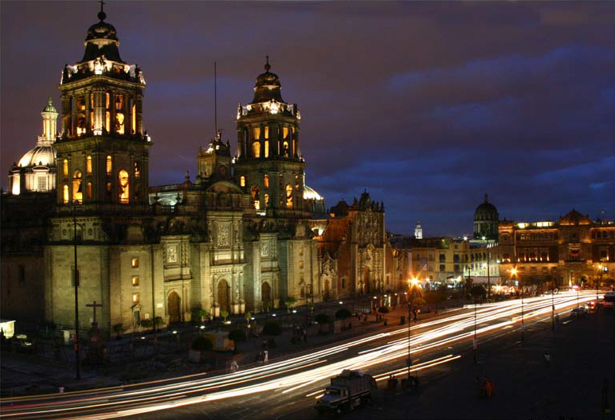
THANK YOU
Feel free to contact me
Ricardo Ibarra
ricardoibarra27@gmail.com

Slide 37
Let Us Meet Again
We welcome you all to our future conferences of OMICS Group International
Please Visit:
regulatoryaffairs.conference@omicsgroup.us regulatoryaffairs@conferenceseries.net
http://regulatoryaffairs.pharmaceuticalconferences.com/

