Slide 1
About OMICS Group
OMICS Group International is an amalgamation of Open Access publications and worldwide international science conferences and events. Established in the year 2007 with the sole aim of making the information on Sciences and technology ‘Open Access’, OMICS Group publishes 400 online open access scholarly journals in all aspects of Science, Engineering, Management and Technology journals. OMICS Group has been instrumental in taking the knowledge on Science & technology to the doorsteps of ordinary men and women. Research Scholars, Students, Libraries, Educational Institutions, Research centers and the industry are main stakeholders that benefitted greatly from this knowledge dissemination. OMICS Group also organizes 300 International conferences annually across the globe, where knowledge transfer takes place through debates, round table discussions, poster presentations, workshops, symposia and exhibitions.

Slide 2
About OMICS Group Conferences
OMICS Group International is a pioneer and leading science event organizer, which publishes around 400 open access journals and conducts over 300 Medical, Clinical, Engineering, Life Sciences, Pharma scientific conferences all over the globe annually with the support of more than 1000 scientific associations and 30,000 editorial board members and 3.5 million followers to its credit.
OMICS Group has organized 500 conferences, workshops and national symposiums across the major cities including San Francisco, Las Vegas, San Antonio, Omaha, Orlando, Raleigh, Santa Clara, Chicago, Philadelphia, Baltimore, United Kingdom, Valencia, Dubai, Beijing, Hyderabad, Bengaluru and Mumbai.

Slide 3
Psychosocial predictors of consistent condom use among women at risk of sexually transmitted disease: Comparing Rasch and Classical methods for item selection
Resmi Gupta
Division of Biostatistics and Epidemiology
Cincinnati Children’s Hospital Medical Center
OMICS Group Conferences
Biometrics and Biostatistics
October 20-21, 2014
Baltimore, USA

Slide 4
Outline
Introduction
Study Aims
Methods
Results
Interpretations
Future direction

Slide 5
Introduction
The original study was undertaken to evaluate the efficacy of condoms and spermicide products, used alone or in combination in preventing gonorrhea and chlamydia among women attending an STD clinic
Women were recruited from 2 public STD clinics in Alabama
Participated at baseline and 6 monthly follow-up visits
At baseline, responded to a behavioral questionnaire, providing background information on sexual, reproductive and medical history, use of alcohol, drugs or tobacco
Participated in behavioral intervention, received physical examination, were trained to keep a sexual diary to record sexual activity and condom use
At follow-up visits, participated in questionnaire interview, physical exam with STD test, sexual diary and product use review, counselling

Slide 6
Introduction
Outcome
Consistency in condom use reported during baseline
and over follow-up visits
If p=1 ---> consistent in condom use

Slide 7
Study Aims
To reduce the number of items measuring pre-determined psychosocial measures at baseline: attitude , communication and confidence
To predict consistency in condom use at baseline and over follow-up visits by reduced form items measuring attitude, communication, and, confidence using Classical test theory and Rasch modeling

Slide 8
Items Measured at Baseline
Attitude : 16 items (Strongly agree, Agree, Disagree, Strongly disagree)
Communications : 12 items (Yes, No)
Confidence : 6 items (Very sure, Somewhat sure, Somewhat unsure, Very unsure)

Slide 9
Statistical Analyses
Conducted in 3 distinct phases
- Item reduction phase
- Predictive modeling phase
- Sensitivity analysis to assess impact of
attrition

Slide 10
Statistical Analyses
Items reduction phase
- Classical test theory (CTT)
- Rasch modeling (RM)

Slide 11
Item Reduction: Classical Test Theory
y_{ij} = t_{ij} +e_{ij}
cov (e_{ij},e_{i’j’}) =0 for i ≠ i’ , j ≠ j’ , and , cov(e_{ij}, e_{i’j}) =0 for i ≠ i’
E(e_{ij}) =0
Cov(t_{ij}, e_{ij})=0
Observed score of
item i for person j
Error score
True score of item i for person j

Slide 12
Item Reduction: Classical Test Theory
Exploratory factor analysis using orthogonal rotation
Factors retained if
- Eigen values > 1
- Factor loadings on the main factor > 0.40
Item-item correlation
Item-total correlation
Cronbach α to measure internal consistency of the score with reduced number of items within each measure

Slide 13
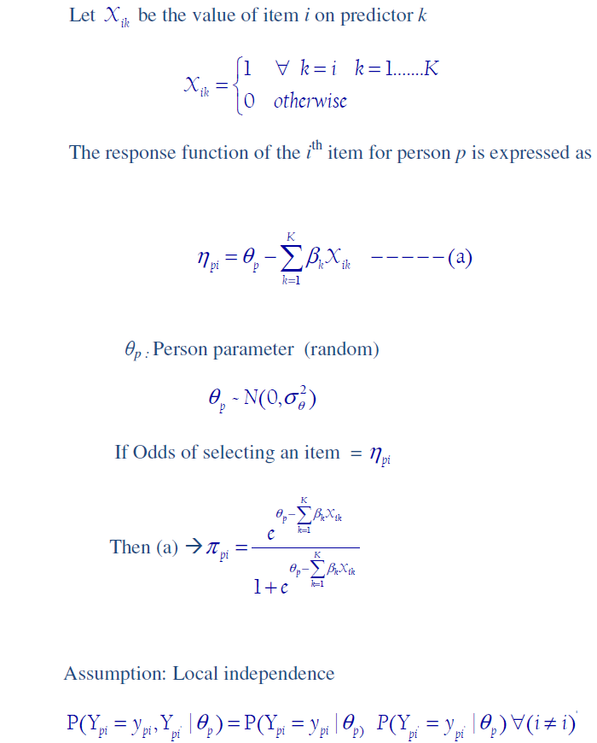
Item Reduction: Rasch Modeling

Slide 14
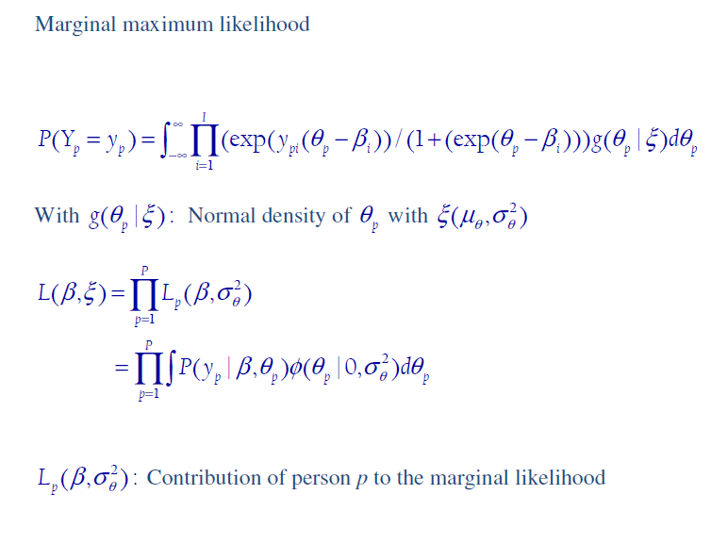
Item Reduction: Rasch Modeling

Slide 15
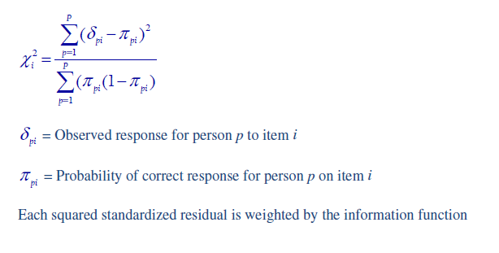
Item Reduction: Rasch Modeling
Fit Statistics (Unidimensionality of scale)

Slide 16
Item Reduction: Rasch Modeling
Evaluation of items
- Distribution of item score
- Point measure correlation
- Item fit statistics

Slide 17
Predictive Modeling Phase
Generalized estimating equations

Slide 18
Results – Descriptives Baseline
Original polytomous items were recoded as binary
 | BL | v1 | v2 | v3 | v4 | v5 | v6
Consistency in condom use | 28% | 51.58% | 53.32% | 51.44% | 54.72% | 54.28% | 52.16%
Construct | Item-item correlation (Range) | Item-total correlation (Range)
Attitudes | 0.01-0.60 | 0.06-0.57
Communication | 0.06-0.62 | 0.34-0.68
Confidence | 0.005-0.60 | 0.31-0.77

Slide 19
Results - CTT
Attitudes: 2 factor solution
Women’s beliefs Perceptions
(7 items) (4 items)
Communication: 2 factor solution
Communication Communication
with partners with relatives
(6 items) (4 items)
Confidence: 1 factor solution (5 items)

Slide 20
Results- Rasch Model: Attitude
Item number | Measure | Model SE | Infit | Outfit | Point measure correlation
9 | 2.36 | 0.09 | 1.0 | 1.5 | 0.25
1 | 2.06 | 0.08 | 1.8 | 2.3 | 0.20
5 | 1.64 | 0.08 | -0.2 | 0.0 | 0.44
8 | 0.67 | 0.07 | 2.2 | 1.8 | 0.32
13 | 0.61 | 0.07 | -1.2 | -0.9 | 0.53
7 | 0.25 | 0.07 | -1.3 | -0.9 | 0.53
16 | 0.21 | 0.15 | -0.7 | -0.3 | 0.52
12 | 0.11 | 0.07 | -1.0 | -0.9 | 0.52
14 | -0.06 | 0.15 | -0.4 | -0.3 | 0.48
6 | -0.63 | 0.08 | -0.2 | -0.1 | 0.45
3 | -0.78 | 0.08 | -1.3 | -1.2 | 0.53
15 | -0.79 | 0.17 | -0.8 | -0.7 | 0.54
2 | -0.81 | 0.08 | -0.5 | -0.5 | 0.47
11 | -0.93 | 0.08 | -0.1 | -0.3 | 0.43
10 | -1.31 | 0.09 | -0.2 | -0.1 | 0.41

Slide 21
Results- Rasch Model: Attitude
Item number | Measure | Model SE | Infit | Outfit | Point measure correlation
9 | 2.36 | 0.09 | 1.0 | 1.5 | 0.25
1 | 2.06 | 0.08 | 1.8 | 2.3 | 0.20
5 | 1.64 | 0.08 | -0.2 | 0.0 | 0.44
8 | 0.67 | 0.07 | 2.2 | 1.8 | 0.32
13 | 0.61 | 0.07 | -1.2 | -0.9 | 0.53
7 | 0.25 | 0.07 | -1.3 | -0.9 | 0.53
16 | 0.21 | 0.15 | -0.7 | -0.3 | 0.52
12 | 0.11 | 0.07 | -1.0 | -0.9 | 0.52
14 | -0.06 | 0.15 | -0.4 | -0.3 | 0.48
6 | -0.63 | 0.08 | -0.2 | -0.1 | 0.45
3 | -0.78 | 0.08 | -1.3 | -1.2 | 0.53
15 | -0.79 | 0.17 | -0.8 | -0.7 | 0.54
2 | -0.81 | 0.08 | -0.5 | -0.5 | 0.47
11 | -0.93 | 0.08 | -0.1 | -0.3 | 0.43
10 | -1.31 | 0.09 | -0.2 | -0.1 | 0.41

Slide 22
Results- Rasch Model: Communication
Item number | Measure | Model SE | Infit | Outfit | Point measure correlation
12 | 0.75 | 0.04 | 0.8 | 1.1 | 0.64
5 | 0.21 | 0.07 | 1.0 | 0.7 | 0.55
7 | 0.20 | 0.07 | -1.2 | -1.1 | 0.67
8 | 0.14 | 0.07 | 1.1 | 0.5 | 0.56
6 | 0.13 | 0.07 | -0.5 | -0.5 | 0.62
10 | 0.02 | 0.04 | -0.7 | -0.9 | 0.62
1 | -0.03 | 0.04 | 0.8 | 1.1 | 0.52
9 | -0.14 | 0.04 | -0.4 | -0.6 | 0.58
11 | -0.17 | 0.04 | -1.9 | -1.9 | 0.62
2 | -0.20 | 0.04 | 0.3 | 0.7 | 0.50
3 | -0.42 | 0.04 | -1.0 | -0.5 | 0.51
4 | -0.50 | 0.04 | 1.2 | 1.4 | 0.43

Slide 23
Results- Rasch Model: Communication
Item number | Measure | Model SE | Infit | Outfit | Point measure correlation
12 | 0.75 | 0.04 | 0.8 | 1.1 | 0.64
5 | 0.21 | 0.07 | 1.0 | 0.7 | 0.55
7 | 0.20 | 0.07 | -1.2 | -1.1 | 0.67
8 | 0.14 | 0.07 | 1.1 | 0.5 | 0.56
6 | 0.13 | 0.07 | -0.5 | -0.5 | 0.62
10 | 0.02 | 0.04 | -0.7 | -0.9 | 0.62
1 | -0.03 | 0.04 | 0.8 | 1.1 | 0.52
9 | -0.14 | 0.04 | -0.4 | -0.6 | 0.58
11 | -0.17 | 0.04 | -1.9 | -1.9 | 0.62
2 | -0.20 | 0.04 | 0.3 | 0.7 | 0.50
3 | -0.42 | 0.04 | -1.0 | -0.5 | 0.51
4 | -0.50 | 0.04 | 1.2 | 1.4 | 0.43

Slide 24
Results- Rasch Model: Confidence
Item number | Measure | Model SE | Infit | Outfit | Point measure correlation
4 | 1.30 | 0.09 | -0.1 | 0.1 | 0.65
3 | 1.04 | 0.09 | -0.4 | -0.4 | 0.67
5 | 0.26 | 0.09 | -1.5 | -1.5 | 0.70
1 | -0.39 | 0.09 | -0.9 | -0.7 | 0.63
6 | -0.43 | 0.09 | 1.8 | 2.0 | 0.41
2 | -0.47 | 0.09 | -0.4 | -0.2 | 0.59
7 | -1.32 | 0.10 | 0.5 | 0.4 | 0.47

Slide 25
Results- Rasch Model: Confidence
Item number | Measure | Model SE | Infit | Outfit | Point measure correlation
4 | 1.30 | 0.09 | -0.1 | 0.1 | 0.65
3 | 1.04 | 0.09 | -0.4 | -0.4 | 0.67
5 | 0.26 | 0.09 | -1.5 | -1.5 | 0.70
1 | -0.39 | 0.09 | -0.9 | -0.7 | 0.63
6 | -0.43 | 0.09 | 1.8 | 2.0 | 0.41
2 | -0.47 | 0.09 | -0.4 | -0.2 | 0.59
7 | -1.32 | 0.10 | 0.5 | 0.4 | 0.47

Slide 26
Results – Items Selected by Rasch Modeling
6 items for attitude
6 items for communications
4 items for confidence
Consistency : range – 0.68-0.80
SEM=0.07;
Factor analysis demonstrated 1 factor solution
Low value of residuals
Correlations between item residuals close to zero

Slide 27
Results - Predictive Modeling
Effects | CTT |  | Rasch
 | Baseline OR (p-value) | Follow-up OR (p-value)
Age at initial visit | 0.96 (0.01) | 1.01 (0.35)
STD in last 6 months | 1.13 (0.05) | 0.99 (0.82)
Number of life partners | 1.00 (0.93) | 0.90 (0.13)
Attitudes/Beliefs
Women’s beliefs (CTT) | 1.89 (<0.01) | 1.41 (<0.01)
Perceptions (CTT) | 1.63 (<0.01) | 1.24 (0.02)
Attitudes (Rasch) | N/A
Communication
Communication with partners (CTT) | 1.34 (<0.01) | 1.01 (0.87)
Communication with relatives (CTT) | 1.16 (0.17) | 1.09 (0.20)
Communication (Rasch)
Confidence | 1.18 (<0.01) | 1.04 (0.19)

Slide 28
Results - Predictive Modeling
Effects | CTT |  | Rasch
 | Baseline OR (p-value) | Follow-up OR (p-value) | Baseline OR (p-value | Follow-up OR (p-value)
Age at initial visit | 0.96 (0.01) | 1.01 (0.35) | 0.96 (0.01) | 1.01 (0.33)
STD in last 6 months | 1.13 (0.05) | 0.99 (0.82) | 1.15 (0.03) | 0.99 (0.73)
Number of life partners | 1.00 (0.93) | 0.90 (0.13) | 0.99 (0.97) | 0.87 (0.08)
Attitudes/Beliefs
Women’s beliefs (CTT) | 1.89 (<0.01) | 1.41 (<0.01) | N/A | N/A
Perceptions (CTT) | 1.63 (<0.01) | 1.24 (0.02) | N/A | N/A
Attitudes (Rasch) | N/A |  | 1.46 (<0.01) | 1.20 (<0.01)
Communication
Communication with partners (CTT) | 1.34 (<0.01) | 1.01 (0.87) | N/A | N/A
Communication with relatives (CTT) | 1.16 (0.17) | 1.09 (0.20) | N/A | N/A
Communication (Rasch) |  |  | 1.08 (0.14) | 1.04 (0.26)
Confidence | 1.18 (<0.01) | 1.04 (0.19) | 1.28 (<0.01) | 1.10 (0.02)

Slide 29
Consistency of Condom Use at Baseline
CTT
Consistency of condom use at baseline increases with unit increase in women's beliefs and perceptions, better communication with partners, and, confidence
Unit increase in age was associated with less consistency of condom use
Women reported having STD in last 6 months was associated with higher odds of consistency of condom use
Rasch
Same results , only communication was not statistically significant

Slide 30
Consistency of Condom Use Over Follow-up
CTT
Consistency of condom use increases over time with unit increase in women's beliefs and perceptions measured at baseline
Rasch
Consistency of condom use increases over time with unit increase in women's attitudes and confidence measured at baseline

Slide 31
Model Comparison
Model fitting CTT Rasch
Baseline
Log likelihood | 500.21 | 504.28
BIC | 1066.90 | 1063.33
Follow-up
QIC | 3842.70 | 3840.83
Rasch -> Higher log-likelihood and lower BIC and QIC

Slide 32
Sensitivity Analysis
Conducted in two ways
- Baseline information was carried forward for information
missing at follow-up
- Previous visit’s information was imputed
The results were similar in both cases
No change in findings between analysis with or without missing data

Slide 33
Conclusion
Equivalent model fit
Fewer items were selected using Rasch modeling
Predictive model using Rasch selected items used fewer parameters than CTT (hence higher degrees of freedom)
Rasch model provided additional insights of psychosocial constructs for the same predictive model
Rasch model – Efficient

Slide 34
Future Direction
Test-retest reliability of reduced scale and compare with pre-determined behavioral measures
Incorporate information from sexual diary and products returned at the end of each follow-up visit

Slide 35
Acknowledgement : Dr. Maurizio Macaluso,
Division of Biostatistics and Epidemiology
Cincinnati Children’s Hospital Medical Center
Thank you

Slide 36
Appendix

Slide 37
Results - CTT
 | Item-item correlation (Range) | Item-total correlation (Range) | Consistency
Women’s Beliefs (7 items) Perceptions (4 items) | 0.09-0.47 0.03-0.69 | 0.34-0.66 0.46-0.79 | 0.77 0.76
Communication with partners (6 items) Communication with relatives (4 items) | 0.17-0.75 0.40-0.64 | 0.44-0.58 0.71-0.83 | 0.72 0.89
Confidence (5 items) | 0.38-0.61 | 0.71-0.79 | 0.88

Slide 38
Correlations Between Classical and Rasch Selected Items
Scale | Women’s Beliefs | Perceptions
Attitudes | 0.55 | 0.66
Scale | Communication with partners | Communication with relatives
Communication | 0.77 | 0.73
Scale | Confidence
Confidence | 0.92

Slide 39
Results – Items Selected by Rasch Modeling
 | Item-item correlation (Range) | Item-total correlation (Range) | Consistency (Cronbach’s α)
Attitudes | 0.04-0.68 | 0.34-0.69 | 0.68
Communication | 0.12-0.62 | 0.49-0.66 | 0.71
Confidence | 0.02-0.61 | 0.37-0.77 | 0.80

Slide 40
Original items as Baseline
Measure
Attitude | Condoms make sex less messy Condoms are inconvenient (2) Condoms interrupt love making Condoms’ aren’t worth the trouble Men don’t like condoms Condoms can make sex last too long (6) Condoms make sex feel unnatural Condoms can cause a rash Women who carry condoms are taking charge (9) A condom is not necessary when you know enough about the person to trust him(10) A condom is not necessary when you are with the person for a long time If you ask your regular partner to use a condom, he’ll think you’ve been unfaithful(12) If you ask your regular partner to use a condom, he’ll think you don’t trust him(13) If you ask your regular partner to use a condom, he’ll think you play around If you ask your regular partner to use a condom, he’ll think you have a sexually transmitted disease If you ask your regular partner to use a condom, he’ll think you believe he has sexually transmitted disease

Slide 41
Original items as Baseline
Measure
Communications | Have you talked to him about problems you have had using different birth control methods Have you talked to him about whether you need to use condoms with each other for protection (2) Have you talked to him about your feelings about condoms (3) Have you talked to him about what you like sexually Have you talked to him about what the two of you would use about birth control Have you talked to him about whether you need to use condoms with each other for protection (6) Have you talked to him about your feelings about condoms (7) Have you talked to him about what you like sexually Have you talked to them about problems you have had using different birth control methods Have you talked to them about whether you should be using condoms for protection (10) Have you talked to them about your feelings about condoms Have you talked to them about problems you were having to convince your partner to use condoms (12)

Slide 42
Original items as Baseline
Measure
Confidence | How sure are you that you can convince your regular partner to use a condom even if he doesn’t want to (1) How sure are you that you can refuse to have sex with your regular partner if he won’t wear a condom How sure are you that you could use condoms every time you have sex with your regular partner if you had been using alcohol or other drugs How sure are you that you could use condoms every time you have sex with your regular partner if you were really turned on (4) How sure are you that you can convince your next new partner to use a condom even if he doesn’t want to (5) How sure are you that you can refuse to have sex with your next new partner if he won’t wear a condom

Slide 43
Results- Items selected by CTT and Rasch Modeling for Attitude
Rasch (Attitude) | CTT (Women’s belief) (Perception)
Condoms are inconvenient Condoms can make sex last too long Women who carry condoms are taking charge A condom is not necessary when you know enough about the person to trust him If you ask your regular partner to use a condom, he’ll think you have been unfaithful If you ask your regular partner to use a condom, he’ll think you don’t trust him | Condoms are inconvenient (0.66) Condom interrupt love making (0.77) Condoms aren’t worth the trouble (0.52) Condoms can make sex last too long (0.44) Condoms make sex feel unnatural (0.64) A condom is not necessary when you know enough about the person to trust him (0.56) A condom is not necessary when you are with the person for a long time (0.57) | If you ask your regular partner to use a condom, he’ll think you have been unfaithful (0.77) If you ask your regular partner to use a condom, he’ll think you don’t trust him (0.79) If you ask a man other than your regular partner to use a condom he’ll think you play around (0.81) If you ask a man other than your regular partner to use a condom he’ll think you believe he has a sexually transmitted disease (0.84)

Slide 44
Results- Items selected by CTT and Rasch Modeling for Communication
Rasch (Communication) | CTT Communication with partner Communication with relatives
Have you talked to your regular partner about whether you need to use condoms with each other for protection Have you talked to your regular partner about your feelings about condoms Have you talked to other than your regular partner about whether you need to use condoms with each other for protection Have you talked to other than your regular partner about your feelings about condoms Have you talked to your female relatives whether you should be using condoms for protection Have you talked to your relatives about problems you were having convincing your partner to use condoms | Have you talked to your regular partner about whether you need to use condoms with each other for protection (0.77) Have you talked to your regular partner about your feelings about condoms (0.83) Have you talked to your regular partner about what you like sexually (0.71) Have you talked to other than your regular partner about what the two of you would use for birth control (0.92) Have you talked to other than your regular partner about whether you need to use condoms with each other for protection (0.91) Have you talked to other than your regular partner about your feelings about condoms (0.89) | Have you talked to your female relatives about problems you have had using different birth control methods (0.85) Have you talked to your female relatives whether you should be using condoms for protection (0.91) Have you talked to your female relatives about your feelings about condoms (0.93) Have you talked to your relatives about problems you were having convincing your partner to use condoms (0.76)

Slide 45
Results- Items selected by CTT and Rasch Modeling for Confidence
Rasch | CTT
How sure are you that you can convince your regular partner to use a condom even if he doesn’t want to How sure are you that you could use condoms every time you have sex with your regular partner if you were really turned on How sure are you that you could use condoms every time you have sex with your regular partner if you thought he might get angry or upset How sure are you that you can refuse to have sex with next new partner if he won’t wear a condom (4) | How sure are you that you can convince your regular partner to use a condom even if he doesn’t want to (0.90) How sure are you that you can refuse to have sex with your regular partner if he won’t wear a condom (0.79) How sure are you that you could use condoms every time you have sex with your regular partner if you had been using alcohol or other drugs (0.79) How sure are you that you could use condoms every time you have sex with your regular partner if you were really turned on (0.80) How sure are you that you could use condoms every time you have sex with your regular partner if you thought he might get angry or upset (0.89)

