Slide 1
Antagonism between miR-21 and 338-3p in prostate cancer invasion through regulation of matrix metalloproteinase 9
Renato Ivanovic*, São Paulo - SP, Brazil, Denis Reis, São Paulo, Brazil, Nayara Viana, Katia Leite, São Paulo, Brazil, Alexandre Iscaife, São Paulo, Brazil, Alberto Antunes, São Paulo, Brazil, Jose Pontes Jr, William Nahas, Miguel Srougi, Sabrina Reis.
School of Medicine of São Paulo University, São Paulo – Brazil
Notes:
Good morning. I am very glad to be here and to present the results of our research. This study, called ….; is one of the results of our main focus of research.. Mirna and cancer, mainly prostate cancer

Slide 2
MicroRNAs
-19-25 nucleotides.
- Non coding RNAs
-Regulates gene expression
- Post transcriptional level
Ha M, Kim VN. Regulation of microRNA biogenesis. Nat Rev Mol Cell Biol. 2014 Aug;15(8):509-24
Notes:
As most of us already know, mirna are 19-25 nucleotides, non coding rnas. That regulates gene expression in a manner post transcriptionally

Slide 3
Reis ST et al miR-21 may acts as an oncomir by targeting RECK, a matrixmetalloproteinase regulator in prostate cancer.
BMC Urol. 2012 May 29;12:14.
Notes:
A previous work of our lab, showed the importance os mir21 and prostate cancer. This slide sumarizes it all.
First; mir21 down regulates reck protein in DU145 cells, which in turn increases mmp-9.
Analising patients with a over expression of mirna 21 and down regulatios of reck, more that 90% were pt3, a stage were prostate cancer advances outside the prostate.
This Could be possible because of increasead expression of mmp9 activity, degrading the EMC
So mirna, throurg mmp-9 could
Prostate cancer patientes who were staged pt3, were had more frequently and imbla

Slide 4
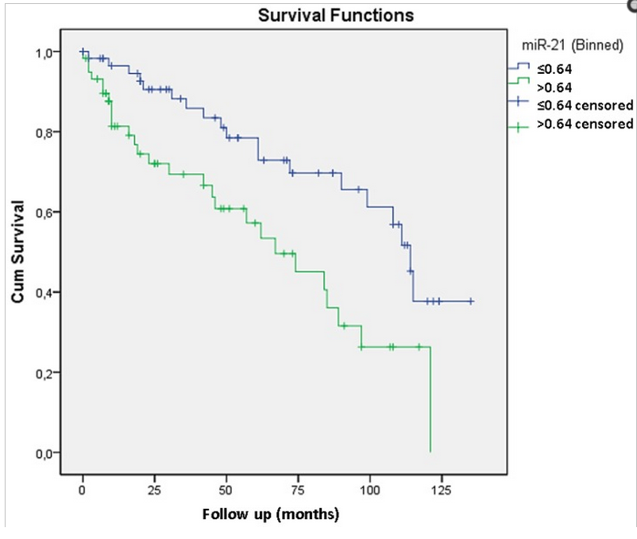
Leite KR et al. Controlling RECK miR21 Promotes Tumor Cell Invasion and Is Related to Biochemical Recurrence in Prostate Cancer.
J Cancer. 2015 Jan 21;6(3):292-301.
Notes:
Recently, we' ve showed again the relation of mir21 and reck and that when mir21 is overexpressed, there is increased risk of bioquemical recurrence

Slide 5
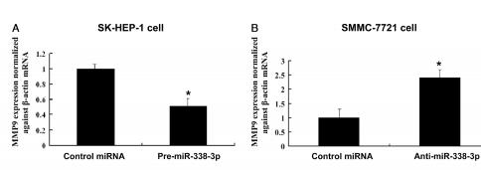
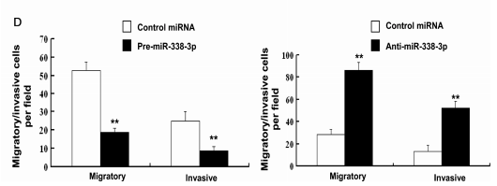
miR-338-3p
- Low expression in cancer liver cells
- increase in MMP-9 expression and invasion
- Smoothened (Hedgehog cascade component)
Xiao-Hui Huang et al. miR-338-3p suppresses invasion of liver cancer cell by targeting smoothened.
J Pathol 2011; 225: 463–472
Notes:
Regarding to mir 338-3p, there are not many studies with focus on prostate cancer and this mirna, however, previuous reseach has payed attention to the fact that mirna 338-3p has low expression in liver cancer
Increase mmp-9 expression and invasion, probably through interference to the smo protein
Smo Is a protein related do G protein coupled receptors, and is a activator of hedgehog pathway

Slide 6
Objectives
miR-21 miR338-3p
MMP-9 expression
Invasion
Notes:
So, after these introduction, we hipotesized if regulation of mmp-9 through this 2 mirnas could influence invasion of prostate cancer cells

Slide 7
Material and methods
DU145, PC3 and LnCaP prostate cancer cell lines – 6x10⁴ cells
mir21, mir338-3p or their antagonists (lipofectamin)
MMP-9 and RECK mRNA expression (2 ^{–ΔΔCT –} Livak et al, 2001)
MMP-9 detection was conducted with ELISA
Matrigel Assay:
3x10⁴ cell (after transfection – 50microL of Matrigel)
24hs
Conditioned Media
Notes:
“to achieve this we, used those 3 cell lines,
- Todas as transfeccoes foram confirmadas por RT-PCR
Briefly in our protocol, cells are kept in culture with RPMI-1640, DMEN e MEM + S10% Serum + ntibiotics 1%. For each space 60.000 cell in 400microliters were used for RT-PCR experiments
For transfection we used
100nm miR-21, miR-338-3p, miR negative control and its antagomiR
which were mixtured with 1,5microliters of lipofectamin and 100microliters of OPTI-MEM-1.
For combined transfection we manteined the protocol, simply adding the final mixture to the cell plate.
50 microliters of matrigel
30000 cells/chambre
inferior part 750microliters os culture media with 10% Fetal sérum
24hs
Cells were fixed with formaldehide and stained with cristal violet 2%.
Counted under optical microscope

Slide 8
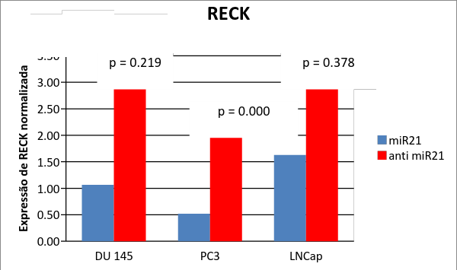
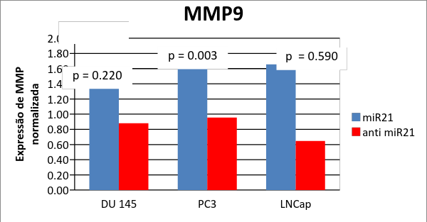
miR-21
Supresses RECK mRNA expression PC3 (*)
Du145
LncaP
(*) p=0.00
Notes:
And what we see here is first, a confirmation of our 2012 study, that mir21 reduces RECK expression, which in turn leads to increased MMP-9 expression. Althoug significat only on pc3, the other lineages had the same trend and we proved such thing in 2012 in DU145.
Obs.: em 2012, o trabalho utilizou apenas a du145 e agora foram utilizadas as 3 linhagens celulares

Slide 9
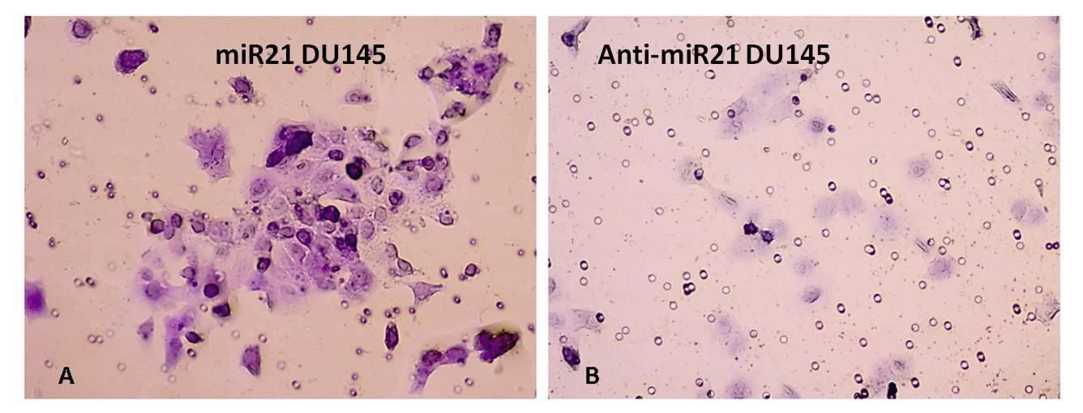
miR-21 – Matrigel Assay
Increased Invasion
DU145 p= 0.015
PC3 p= 0.012
J Cancer. 2015 Jan 21;6(3):292-301
 | MMP-9 – ELISA ASSAY
 | DU145 | P-value | PC3 | P- value
miR-21 | 0.140 | 0.101 | 0.128 | 0.06
AntimiR-21 | 0.053 | 0.359 | 0.052 | 0.217
Notes:
And, what does this mmp9 increement it represents? It leads to increased invasion of du145 and pc3 cells transfected with mir21. and after ELISA experiment with the conditioned media of tre matrigel assay, se can see more MMP9 detecd not only in pc3, but also du145.
So, possibly, mmp9 could have degradet the matrigel membrane.

Slide 10
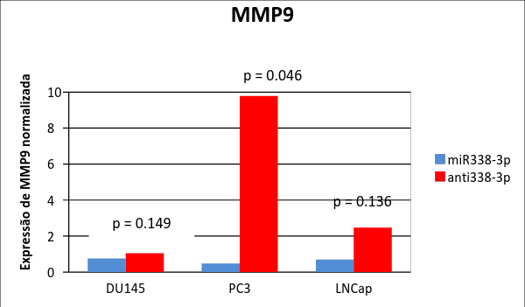
miR-338-3p
Notes:
and we achieved similar results regarding mir338-3p. It does exert its effect over mmp9 in a different manner of mir21 (I mean, not related to reck). However, mmp-9 expresseion is reduced when mir338-3p is transfected.

Slide 11
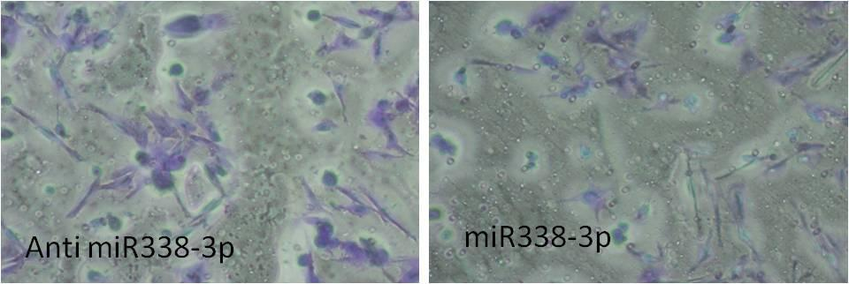
PC3
Decreases Invasion
PC3 p=0.058
DU145 p=0.002
LnCaP p=0.085
 | MMP-9 – ELISA ASSAY
 | DU145 | P-value | PC3 | P- value
miR-338-3p | 0.04 | 0.228 | 0.061 | 0.066
antimiR-338-3p | 0.182 | 0.259 | 0.095 | 0.098
Notes:
And again, what does it represents? Decreased invasion with mirna 338-3p transfection, probably because of decreased mmp-9 production, as we can see here, on the ELISA results.
Less mmp9 is detected when microrna 338-3p is transfected.

Slide 12
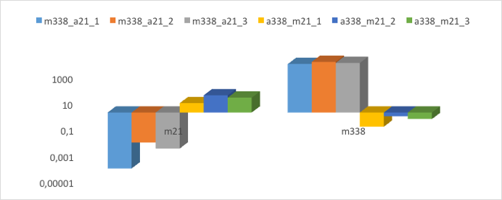
Notes:
So, mmp9 can be overexpressed by transfection of mir21 and anti-338-3p. The contrary is also true.
Then, we sought to discover what would happen to mmp-9 and invasion of cells if we transfect this combination of mirnas
Briefly, we prepared the mirnas separetedely and added over the cells only by the time of transfection. This simple method, alowed an efficient transfection as we can se up here. As the experiments were performed in triplicates, the coluns light blue, orange and grey represnets mir21 blockage with (anti21) and estimulation of mir338-3p. The coluns yellow, dark blue and green, represents m21 estimulation and blockage of mir338-3p (with anti338-3p)

Slide 13
p=0.001
p=0.325
Notes:
And here are the results os the combined transfection and comparisson with isolated transfections in terms of MMP9 mRNA expressions. We se here that the lowest amount of MMP9 expression was achieved with the combined transfection of antimirna 21 and mirna338-3p.

Slide 14
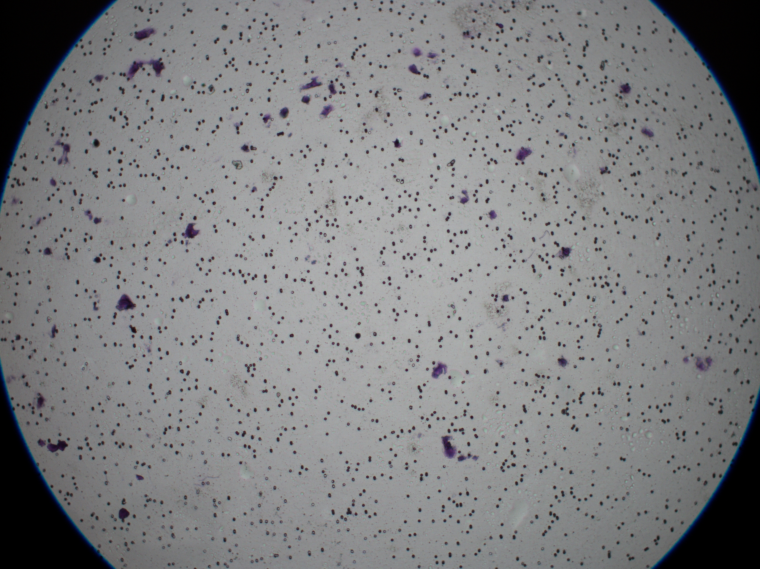
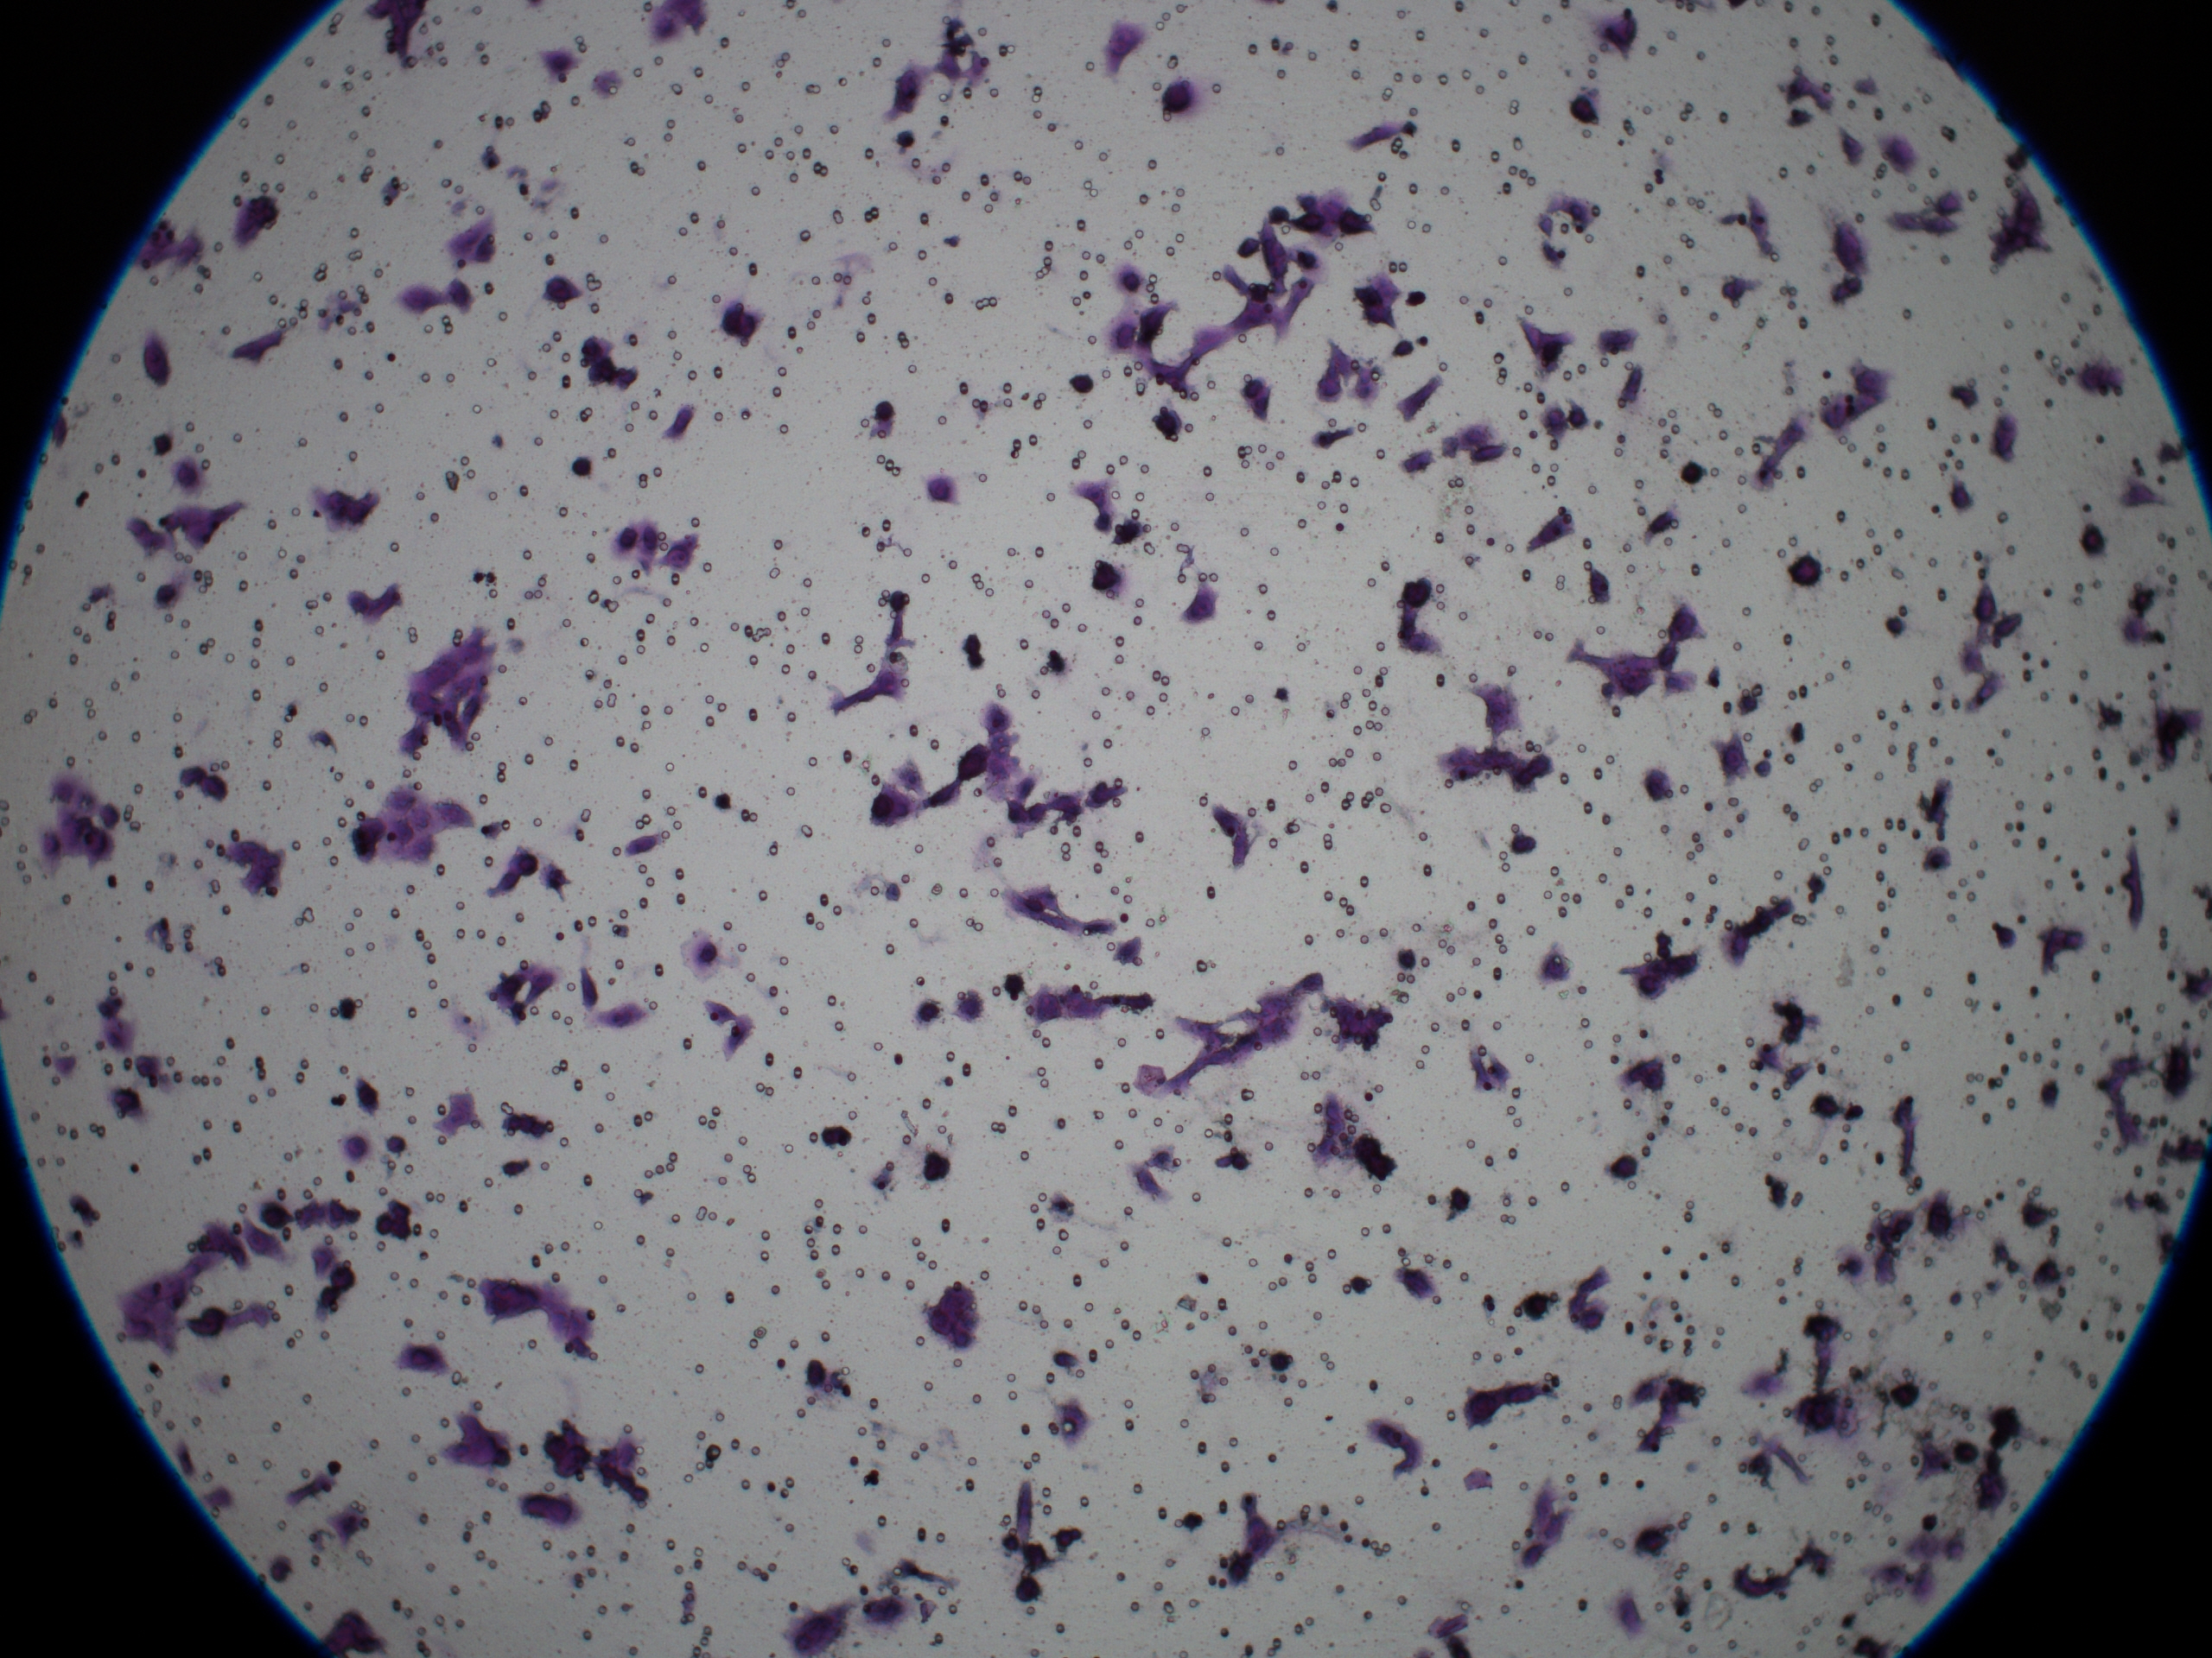
Number of Cells:
114,67 x 304 (p=0.133)
antagomiR-21+mir338-3p
mir21+AntagomiR-338-3p
ELISA FOR MMP-9
 | Mean
AntimiR-21+ miR-338-3p | 2.573 | P=0.275
mir-21+anti-mir-338-3p | 21.96
Notes:
And again, less cells invaded the matrigel with the combination of mirna that decreases the amount of MMP-.9. As we can see here with the ELISA is that the ratio of reduction is almost 10x between them.

Slide 15
Conclusions:
MMP-9 has its role in Invasion
miR-21 acts as an oncomir, through RECK regulation
miR338-3p acts as a suppressor
Lowest level of MMP-9 expression was achieved with co-transfection
Co-transfection can be performed in an easy way
In vivo study is under development
Notes:
Finalyy, we conclued that mmp-9 has a role in invasion ability of prostate cancer cells, at least in vitro, and this MMP can be up or downregulated by mir21 and mir338-3p in different ways. The first acting like an oncomir, and the other as as protector.
Transfecting together those mirnas that decreases al most the mmp9 ammount , leads to decreased invasion, something that can be of great value in the future for treating prostate cance patients.
Como conclusao: a mmp9 aumenta a invasao celular
Trabalho é inicio de linha de pesquisa e que experimentos in vivo estao em andamento
Outra conclusao: co-transfeccao é factivel, procuramos trabalhos que tivesse feito a co transfeccao, porem nao encontramos. Pioneiramente demosntramos ser facitvel
Apos a co transfeccoa é possivel inibir mais ainda a mmp9 e assim a invasao das celulas do cancer de prostata.
Thank you very much and now, I would be glad to comment any questions.

Slide 16
Notes:
Why RECK: reck is a tumoral supressor gene. Before we published the role of reck in regulating mmp9 in prostate cancer in 2012, others researchers had already shown that in other kinds of malignancy, although not on prostate cancer. This is the same as for miR-21. That’s way we decided to test this on our prostate cancer material.

