Slide 1
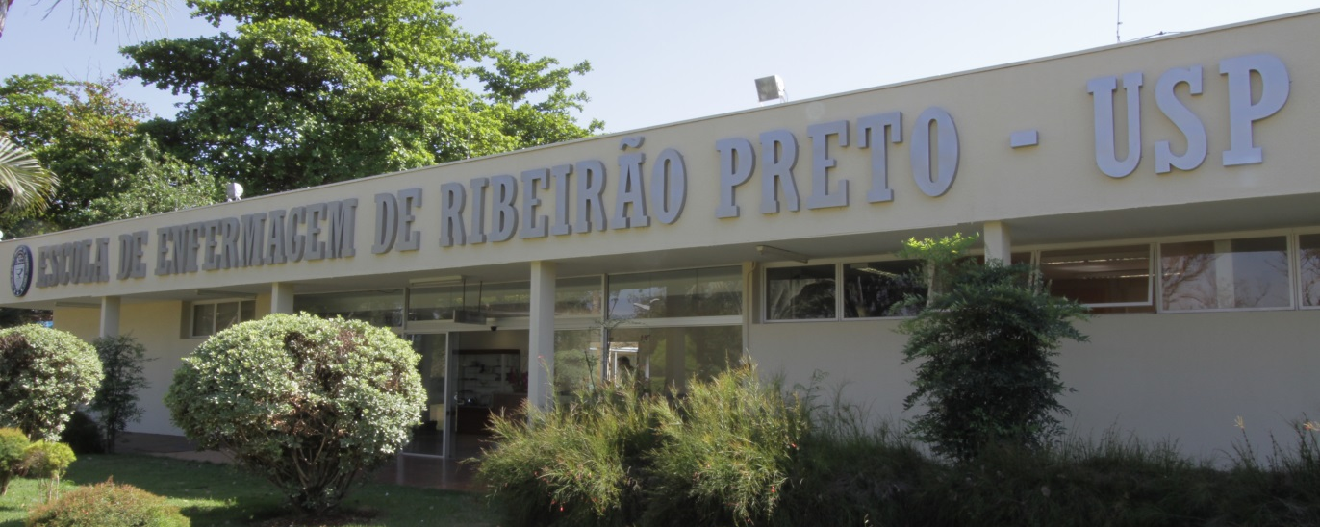
Prevalence of and Factors Associated with Depressive Symptoms in Individuals Living with HIV/AIDS in Brazil
Profª Dra Renata Karina Reis

Slide 2
Introduction
People living with HIV / AIDS also experience difficulties resuming or maintaining their life projects and often experience conflict and situations of embarrassment, vulnerability, and the violation of their rights as citizens
HIV infection as a chronic condition brought with it new challenges for care delivery because the side effects of the prolonged use of the antiretroviral therapy (ART) leads to the appearance of lipodystrophy and changes in body perception.

Slide 3
Introduction
These situations and conditions may lead to low self-esteem, lack of belonging, and loss of social and psychological identity, which may trigger psychological distress and mental disorders
Among mental disorders, depression is one of the most common comorbidities with a high prevalence among people living with HIV/AIDS both in Brazil and in other countries

Slide 4
Introduction
Depressive symptoms are a common mental disorder and are characterized by sadness, loss of interest and guilt feelings that negatively impact one’s ability to deal with life, adherence to antiretroviral therapy and affect quality of life.
In this sense, the identification of depressive symptoms among people living with HIV/AIDS is an important step in promoting interdisciplinary therapeutic interventions directed to these individuals.

Slide 5
Objective
Identify the prevalence of depressive symptoms and associated factors among people living with HIV/AIDS.

Slide 6
Methods
This is a descriptive cross-sectional
Non-probability sample of two services specializing in AIDS care in Ribeirão Preto, São Paulo, Brazil
Individual, private interviews, confidentiality of date; ethical aspects covered

Slide 7
Methods
Semi-strucutured questionnaire – socio-demografic (sex, age, income) and clinical aspects (CD4 cell count, comorbidities) and comportamentais (alcohol consumption/ how many times a week) variables
The Beck Depression Inventory (BDI) was used to assess the intensity of depression
The instrument’s minimum score for each item is 0 and the maximum is 3, where 0 means the lack of depressive symptoms and 3 indicates the presence of symptoms. The final score is obtained by the sum of all the points

Slide 8
Results
331 PVHIV
167 (50,5%) men and 164 (49,5%) women
267 (80,7%) had CD4 T cells grater than 200/mm³
29,6% was the prevalence of BDI scores indicative of depression
176 (53,2%) didn’t have any co-morbidity or associated co-infection

Slide 9
Percentage of depression symptoms between men and women

Slide 10
Association of income and depression symptoms

Slide 11
Association of CD4 cells and symptoms of depression

Slide 12
Factors associated with symptoms of depression among people living with HIV/aids
Variable | Levels | Depression |  | Raw OR | IC 95% |  | Adjusted OR | IC 95%
 |  | Absent | Present |  | LI | LS |  | LI | LS
Sex | Male | 130(77,8%) | 37(22,1%) | 2,081 | 1,283 | 3,374 | 1,694 | 1,002 | 2,863
 | Female | 103(62,8%) | 61(37,2%) | 1 |  |  | 1
Income | > 3 | 35(89,7%) | 4(10,2%) | 4,154 | 1,435 | 12,028 | 3,248 | 1,076 | 9,803
 | < 3 | 198(67,8%) | 94(32,1%) | 1 |  |  | 1
CD4 cells | ≥ 500 | 107(80,4%) | 26(19,5%) | 2,816 | 1,459 | 5,435 | 2,739 | 1,387 | 5,409
 | 499 – 200 | 88(65,6%) | 46(34,3%) | 1,309 | 1,309 | 2,417 | 1,202 | 0,634 | 2,277
 | ≤ 200 | 38 (59,3%) | 26(40,6%) | 1 |  |  | 1

Slide 13
Discussion
This study’s results showed that 29.6% of the individuals living with HIV/AIDS presented depressive symptoms (BDI > 16) and the factors associated with depression were sex, income, and immunological status
Studies conducted in Brazil addressing people with HIV/AIDS report that the prevalence of depressive symptoms may range from 25,8% and 53,3%
Dal-Bó, 2013; Reis et al., 2011; Schimit & Silva, 2009; Silveira al., 2012; Mello & Malbergier, 2006

Slide 14
Discussion
Association between depression and clinical diseases occurs frequently, which may worsen both an individual’s psychiatric condition and the clinical disease itself, leading to lower adherence to a therapeutic regimen, in addition to greater levels of morbidity and mortality
Additionally, there is a perception that symptoms are merely adverse consequences of diseases (hopelessness and low self-esteem)
Teng, Humerio & Demetrio, 2005

Slide 15
Discussion
The socio-demographic aspects revealed that depressive symptoms were associated with sex, while men were 1.6 times more likely (CI 95% 1.0-2.8) not to develop depressive symptoms than women
Women in general have a higher prevalence of chronic diseases, including mood mental disorders, such as depression
Barros, César, Carandina &Torre, 2006; Bromet et al. 2011; Viana & Andrade, 2012

Slide 16
Discussion
Income was a risk factor associated with depressive symptoms: individuals with lower incomes (less than 3 times the minimum wage) were 3.2 times more likely (CI 95% 1.0-9.8) to experience depressive symptoms than individuals with higher incomes
This finding is also observed in studies reporting that financial hardship is associated with depression among individuals with HIV/AIDS
Silveira et al. 2012; Rodkajaer, Laursen, Balle & Sodemann, 2010

Slide 17
Discussion
The results show that individuals with CD4 T cells below 200/mm3 are 2.7 times more likely (CI 95% 1.3-5.4) to develop depression than those with CD4 T cells above 500/mm3
These results suggest that psychosocial factors such as depression may affect clinical and immunological responses, as reported in other studies), reinforcing the importance of the early detection and treatment of depression
ICKOVICS et al. 2001; PENCE et al. 2007; PRIMEAU et al. 2013

Slide 18
Final Consideration
This study’s results indicate a high prevalence of depressive symptoms among people living with HIV/AIDS in the studied services and show that risk factors include sex, income and immunological condition.
There is a need to systematically assess the presence of depressive symptoms in people living with HIV/AIDS during clinical practice, since these are prevalent in this population.

Slide 19
Final Consideration
The authors declare the absence of conflicts of interest concerning this article.
Contact Author:
Renata Karina Reis. University of São Paulo. Nursing School of Ribeirão Preto. Department of General and Specialized Nursing. Av. Bandeirantes, 3900. Neighborhood: Monte Alegre. CEP: 14040-902, Ribeirão Preto, SP, Brazil
Email: rkreis@eerp.usp.br

Slide 20
References
Alencar, T.M.D., Nemes, M.I.B., Velloso, M.A. (2008). From "acute AIDS" to "chronic AIDS": body perception and surgical interventions in people living with HIV and AIDS Ciênc. saúde coletiva, 13(6):1841-1849. doi.org/10.1590/S1413-81232008000600019.
Araújo, M.A.L., Queiroz, F.P.A., Melo, S.P., Silveira, C.B., Silva, R.M. (2008). Pregnants infected with HIV: Facing and perception of a new reality. Cienc Cuid Saude. 7(2):216-223
Bó-Dal, M.J., Manoel, A.L., Beltran Filho, A.O., Silva, B.Q.T., Cardoso, Y,S, Cortez, J., Tramujas, L., Silva, R.M. (2013). Depressive Symptoms and Associated Factors among People Living with HIV/AIDS. Journal of the International Association of providers of AIDS Care. 19:1-5
Bromet, E., Andrade, L.H., Hwang, I., Sampson, N.A., Alonso, J., Girolomo, G. et al. (2011). Cross-national epidemiology of DSM-IV major depressive episode. BMC Medicine 9:90:2-16
Ciesla, J.A., Roberts, J.E. (2001). Meta-analysis of the relationship between HIV infection and risk for depressive disorders. Am. J Psychiatry, 158(5)-725-730
Gorenstein, C., Andrade, L., Filho Vieira, A.H.G., Tung, T.C.; Artes, R. (1999). Psychometric Properties of Portuguese Version of Beck Depression Inventory on Brazilian College Students. Journal of Clinical Psychology. 55(5), 554-562.

