Slide 1

Enhanced removal of BTEX/TCE/cis-DCE mixture using waste scrap tires immobilized with indigenous Pseudomonas sp.
Q. Lu¹, R.A. de Toledo ¹, F. Xie¹, J. Li^{1,2}, H. Shim¹
¹Department of Civil and Environmental Engineering, Faculty of Science and Technology, University of Macau, Macau SAR, China.
² College of Natural Resources and Environmental Science, South China Agricultural University, Guangzhou, China.

Slide 2

INTRODUCTION
Waste Tires Recycling
3 billion car and truck tires are discarded

Slide 3
INTRODUCTION
Car tire composition
Two-Phase Partitioning Bioreactor (TPPB) with 10% and 15% (v/v) tires*
Waste tires: sorption phase
2,4-dichlorophenol (83% removal)
4-nitrophenol (~100% removal)
* Tomeia MC, Angeluccia DM, Daugulis AJ (2014) Environ Technol 35:75-81

Slide 4

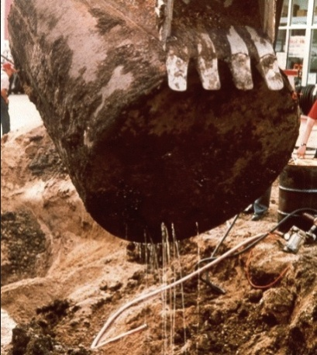
BACKGROUND
BTEX: Benzene, Toluene, Ethylbenzene, and Xylenes (ortho-, meta-, and para-)
    Major monoaromatic components in petroleum products
    Industrial solvents and equipment cleansing
    Among priority pollutants (US EPA)
    Benzene (carcinogen)
Common source of BTEX contamination:
Spills from leaking oil tanks

Slide 5
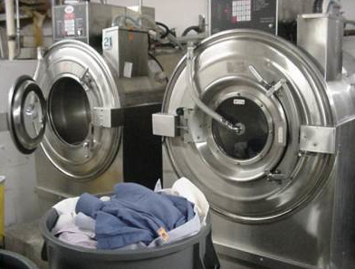
BACKGROUND
Chlorinated Aliphatic Hydrocarbons (CAHs):
      Most widespread contaminants in subsurface
      Cleaning and degreasing solvents
Perchloroethylene (PCE), trichloroethylene (TCE), dichloroethylenes (DCEs), vinyl chloride (VC).
      TCE: the most frequently found contaminant in groundwater (US)
      Carcinogen

Slide 6
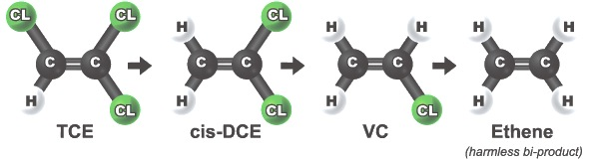
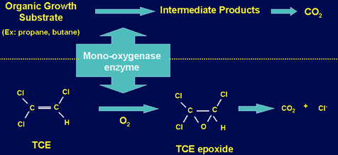
BACKGROUND
Microbial degradation of CAHs:
anaerobic reductive dechlorination (Dehalococcoides)
Aerobic cometabolism
6

Slide 7
BACKGROUND
Soil
Water
Biological
Chemical
Physical
BTEX and CAHs:
Cost-effective
Environmental-friendly
Contaminant mineralization
BTEX/CAHs mixture: biological
Further improvements: CAHs removal
Hybrid technology (biological + physical)

Slide 8
OBJECTIVES
To remove BTEX/cis-DCE/TCE mixture from artificially contaminated water using indigenous bacterial isolate, Pseudomonas plecoglossicida
To utilize scrap tires (waste) for hybrid/enhanced removal of mixture; physical/adsorption and biological/immobilization

Slide 9
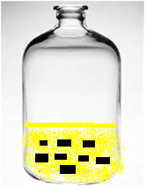
MATERIALS AND METHODS
Experimental setup
Microcosms: suspended and immobilized systems
Serum bottle: MSM (mineral salts medium) solution (45 mL)
Contaminants
Inoculum (5 mL)
Scrap tires (1.3, 2.8, and 4.0 g).
Incubation: 150 rpm , 25°C, pH 7, 5 days.
Contaminants concentrations:
BTEX (300 mg L⁻¹): based on mass fractions in crude oil (benzene: toluene: ethylbenzene: o-xylene: m-xylene: p-xylene at 22.7%: 48.3%: 4.6%: 6.3%: 6.9%: 11.1%)
TCE (10 mg L⁻¹) and cis-DCE (5 mg L⁻¹)
9

Slide 10
MATERIALS AND METHODS
Adsorption kinetics of BTEX onto tire surface
Concentrations used in bioremoval experiments
BTEX: 300 mg L⁻¹
TCE: 10 mg L⁻¹
cis-DCE: 5 mg L⁻¹
Sampling: 0.25, 0.5, 1, 1.5, 24, 48, and 72 h
Sorption capacity (q_{e}) of adsorbent calculated by:
C₀ and C_{e}, initial and equilibrium concentrations (mg L⁻¹);
m, mass of adsorbent (g);
V, solution volume (L).
10

Slide 11
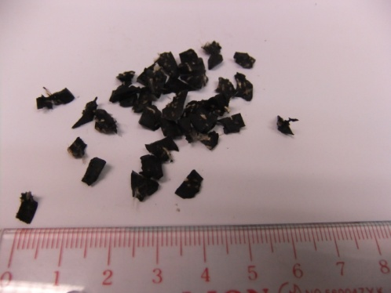
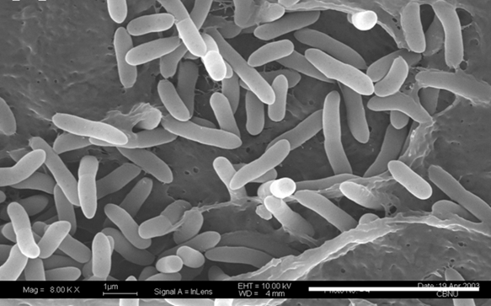
MATERIALS AND METHODS
Scrap tires
Bridgestone (BATTLAX BT-39 tubeless)
Cut into small pieces (0.2 cm x 0.2 cm x 0.2 cm)
Weighed and autoclaved for 1 h (121°C, 103.5 kPa)
Microbial culture
Pure culture of Pseudomonas plecoglossicida
Isolated from a heavily petroleum-contaminated site (Xiamen, China)

Slide 12
RESULTS
Adsorption studies
Adsorption kinetics of individual BTEX compounds (total concentration, 300 mg L⁻¹), TCE (10 mg L⁻¹), and cis-DCE (5 mg L⁻¹). Mass of tire: 26 mg/mg.
12

Slide 13
RESULTS
Adsorption studies (each BTEX, 100 mg L⁻¹)
(a)
(b)
  Octanol-water partitioning coefficient (K_{ow})
  3.15 (xylenes and ethylbenzene)
  2.73 (toluene)
  2.13 (benzene)
Adsorption kinetics of individual BTEX (100 mg L⁻¹).
Mass of tire: 26 mg/mg.
(b) Removal efficiencies for individual BTEX in multi and single solution.

Slide 14
RESULTS
Bioremoval by immobilized (attached) microorganisms
Removal efficiency (%) for each compound in mixture under different conditions
after 5 days of incubation
Surface area (cm²) | Benzene | Toluene | Ethylbenzene | m,p-Xylene | o-Xylene | cis-DCE | TCE
T^{1.5}7.2 | 70.6±3.2 | 75.4±2.3 | 92.8±1.4 | 92.0±1.1 | 92.1±0.9 | 47.0±3.4 | 54.1±3.4
T^{3.0}14.4 | 84.2±2.1 | 82.4±1.2 | 95.6±1.8 | 96.8±0.4 | 97.2±0.3 | 53.7±3.1 | 64.0±2.8
T^{4.0} 19.2 | 88.6±1.3 | 82.8±2.2 | 98.3±0.3 | 97.6±0.2 | 97.9±0.4 | 64.6±2.2 | 62.5±2.5
MT^{1.5}7.2 | 99.6±0.2 | 100 | 95.5±0.7 | 96.5±0.3 | 98.2±0.2 | 60.0±1.7 | 70.3±1.7
MT^{3.0}14.4 | 100 | 100 | 97.8±0.4 | 96.3±0.4 | 98.5±0.3 | 60.8±2.4 | 71.6±2.5
MT^{4.0}19.2 | 100 | 100 | 100 | 96.8±0.3 | 99.0±0.1 | 61.6±0.9 | 73.0±2.8
BM | 99.5±0.2 | 97.6±0.1 | 88.0±0.4 | 64.5±3.3 | 56.0±2.7 | 20.4±1.2 | 36.3±2.0
T: Tire in the absence of microorganisms
MT: Tire with microorganisms
BM: Microorganisms only
1.5, 3.0, 4.0: Different mass of tires

Slide 15
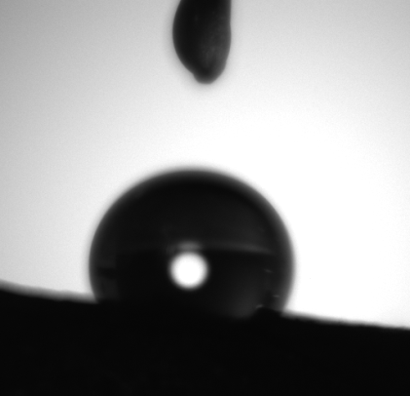

RESULTS
Contact angle (93.4±4.1°)
a
b
==
Measurement of contact angle for tire sample over time. Drop volume: 5 μL. a) Water drop before experiment; b) Water drop after experiment.
15

Slide 16
CONCLUSION
Scrap tire (waste) is considered a good candidate to enhance removal of VOCs such as BTEX, cis-DCE, and TCE from liquid phase, due to remarkable adsorption properties as well as capability to immobilize (attach/entrap) microorganisms.
Further studies are in progress to evaluate whether the immobilized microorganism possess the same initial removal efficiency after the reutilization cycles, including whether higher concentrations of contaminants can also be applied.

Slide 17

ACKNOWLEDGEMENTS
University of Macau Multi-Year Research Grant (MYRG2014-00112-FST)
Macau Science and Technology Development Fund (FDCT/063/2013/A2)
Mr. Lu, PhD student; Dr. Li, SCAU/China; Mr. Xie, MS student

