Slide 1
Improved Implements and Agricultural Practices for Inclusive Growth of Farmers in Dryland: Opportunities and Challenges
By
Ravikant V. Adake
Senior Scientist (Farm Machinery)
Central Research Institute for Dryland Agriculture,
Santoshnagar, Hyderabad-500 059

Slide 2
Present Issues in Dryland Agriculture
Difficulty in managing the small farms
Reduction in Bullock Power and increase in tractor hiring costs
Non Availability of labour for precision operations like sowing and harvesting etc
Poor soil conditions because of lack of interest from the farmers on soil improvement activities
Uneven rainfall

Slide 3
Source, IMD, 2008

Slide 4
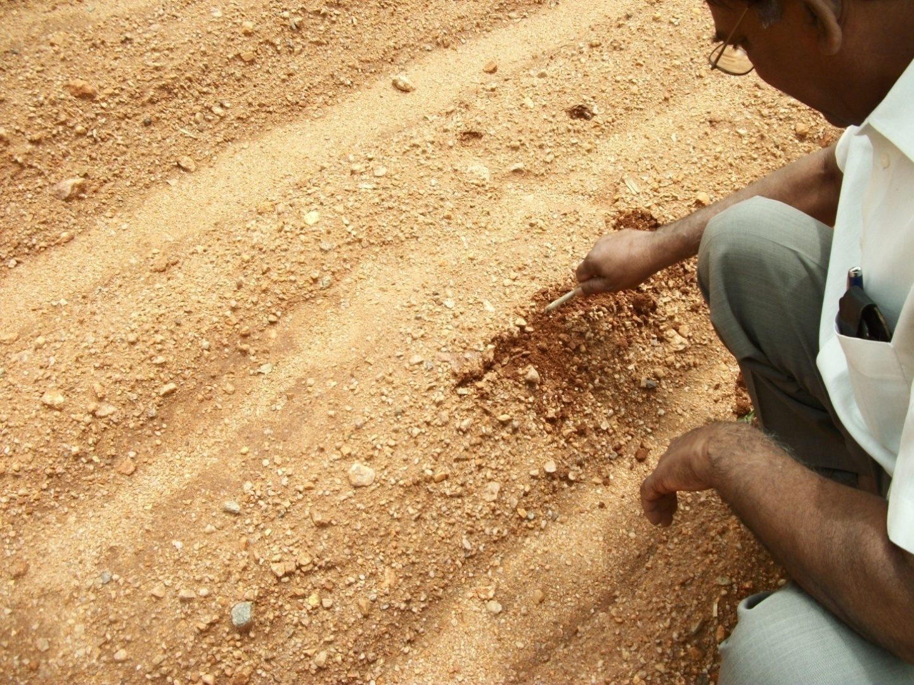
Soil crusting is major problem under dryland

Slide 5
Challenges
Though much emphasis is given for small farm mechanization, the results are not up to the mark due to non profitability.
Small land holdings and high initial/rental cost of large machinery discourages the small and medium farmers to opt for it.
Timely availability of the machinery is a big question mark

Slide 6
Challenges
No industry support for Precision and quality machinery for small farms
More number of fabricating industries with least standards
Maintenance Problems with self propelled machinery
Drastic reduction in Bullock population year by year
Missing link-Training on supplied machinery to the farmers

Slide 7
Opportunities for Dryland Mechanization
Enhanced farm power supply
Increased farm power availability from 0.25 kW/ha (1951) to 1.68 kW/ha (2011)
Increased growth of tractors
from 2.47 lakh (2004-05) to 6.07 lakh (2011-12)
Increased growth of power tillers
From 175000 (2004-05) to 60000 (2011-12)

Slide 8
CRIDA experience on farm mechanization
Methodology adopted:
1. Designing the location specific Farm machinery at Research workshop.
2. Testing in the farmer’s field and refinement on farmer’s feed back
3. Publicity through Kisan mela and participation in exhibitions
4. Finding industry partner for production and sale

Slide 9
CRIDA experience on farm mechanization
Number of Improved Machinery Developed By CRIDA: 23
MoU Signed with Industries for Mass Production:22

Slide 10
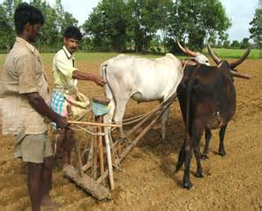
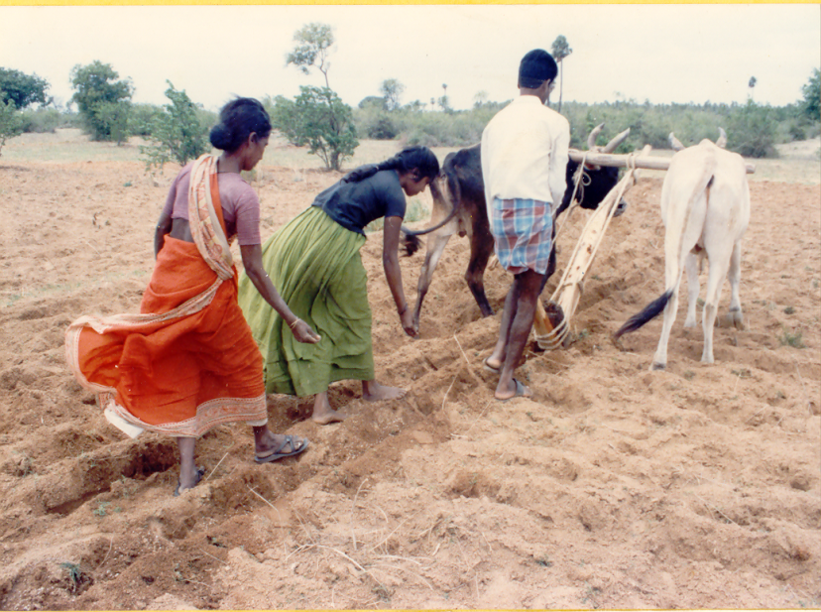
Conventional methods of Sowing
Uneven distribution of seeds and fertilizer
Higher wages
Poor efficiency
Bullock power dependent

Slide 11
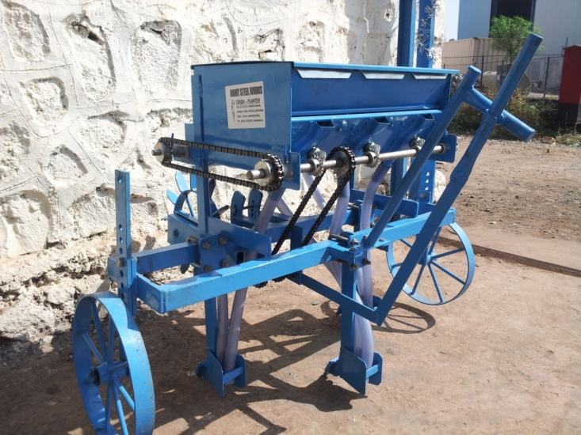
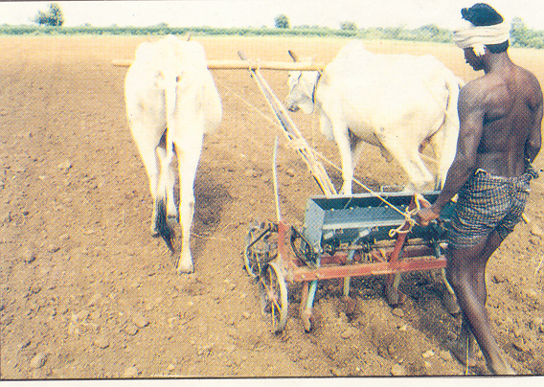
CRIDA Bullock Drawn Planters
3 row planter
2 row planter
Useful for small and medium holding farmers
Savings in seed and fertilizer
Saving in wages
4 row planter

Slide 12
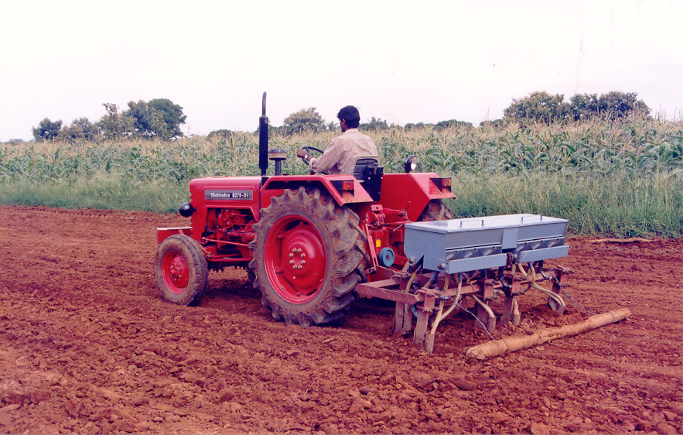
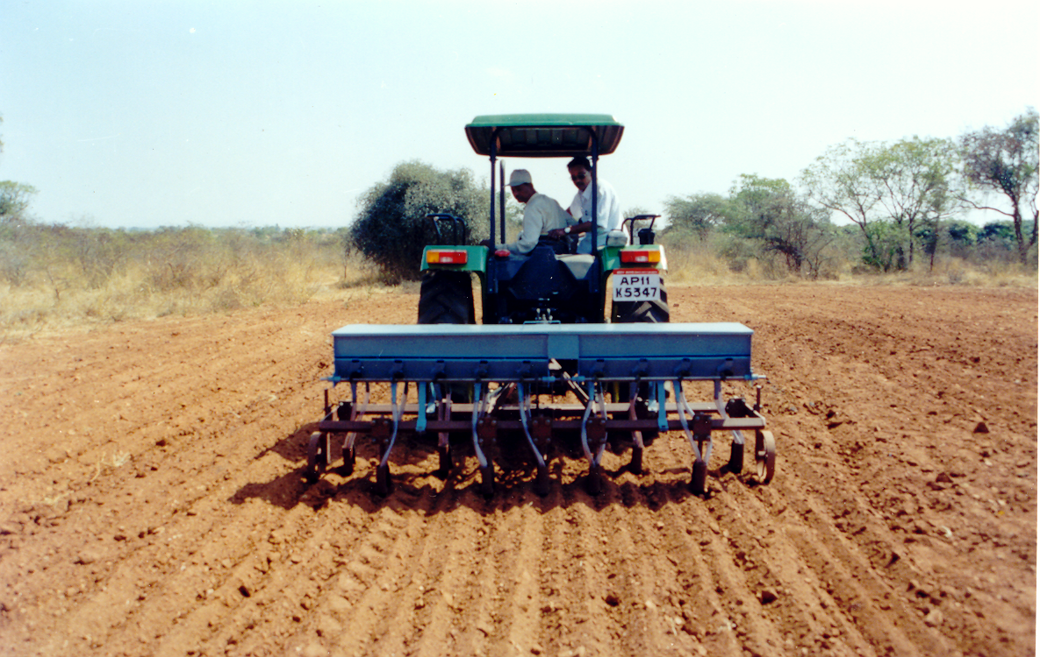
CRIDA Tractor Drawn Planters for timely sowing
6- row planter
9-row planter
Useful for different cropping system
Large area coverage (10-15 ha/day) for timely sowing
Maintains plant spacing

Slide 13
Metering Plates for Different Crops
Sr. No | Crops | Spare part No | No of cells | plant to plant
 |  |  | on metering Plate | distance , cm
1 | Soybean | SP1 | 23 | 5
2 | Redgram | SP2 | 12 | 10
3 | Bengal gram (N) | SP3 | 12 | 10
4 | Bengal gram (Kabuli) | SP4 | 16 | 8
5 | Jawar, Bajra, Green | SP5 | 12 | 10
 | gram, Blackgram
6 | Maize | SP6 | 4,5,6,7,8 | 15-30
7 | Groundnut (Medium) | SP7 | 12 | 10
8 | Ground nut (Bold) | SP8 | 16 | 7.5
9 | Onion | SP9 | 24 | 5

Slide 14
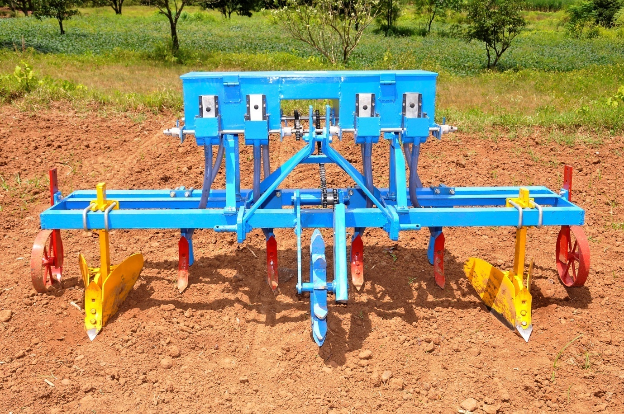
Tractor drawn BBF Planter
Major Components:
Planter with seed and fertilizer box
Furrow openers (2)
Tynes (4)
Supporting wheels (2)
Drive Wheel
Transmission Mechanism
Tractor required 35 hp
Overall Dimension mm: L-2250, W-1133mm, H- 868 mm
Frame Dimensions mm: L-2250mm, W-480mm
Weight, Kg: 285

Slide 15
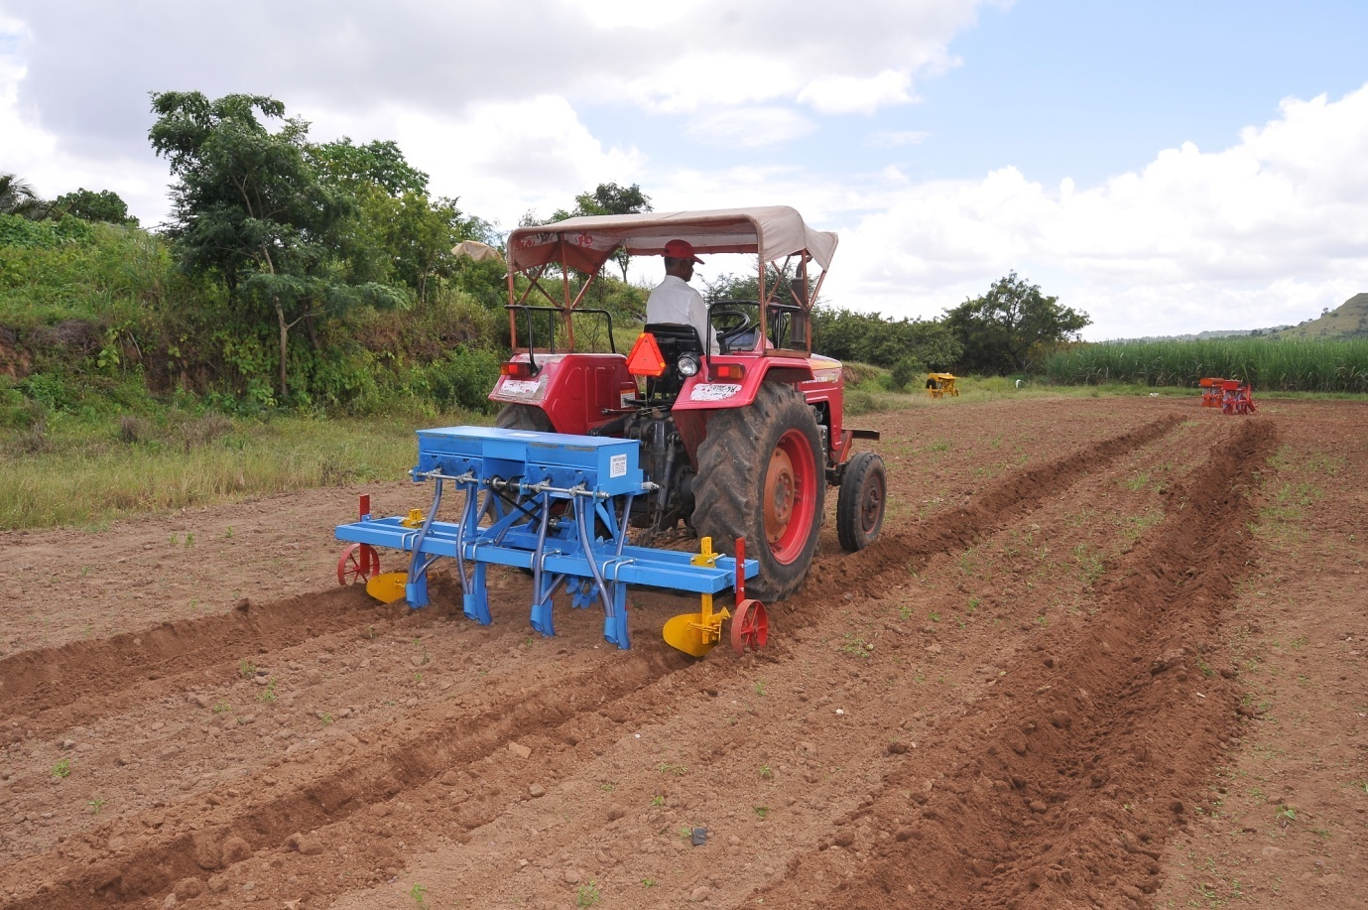
BBF Planter in Operation
BBF Planter Utility:
To conserve rain water and minimize effect of drought
To drain the water in case of excess rainfall
Useful for all dryland crops
Area coverage, 6-8 ha/day

Slide 16
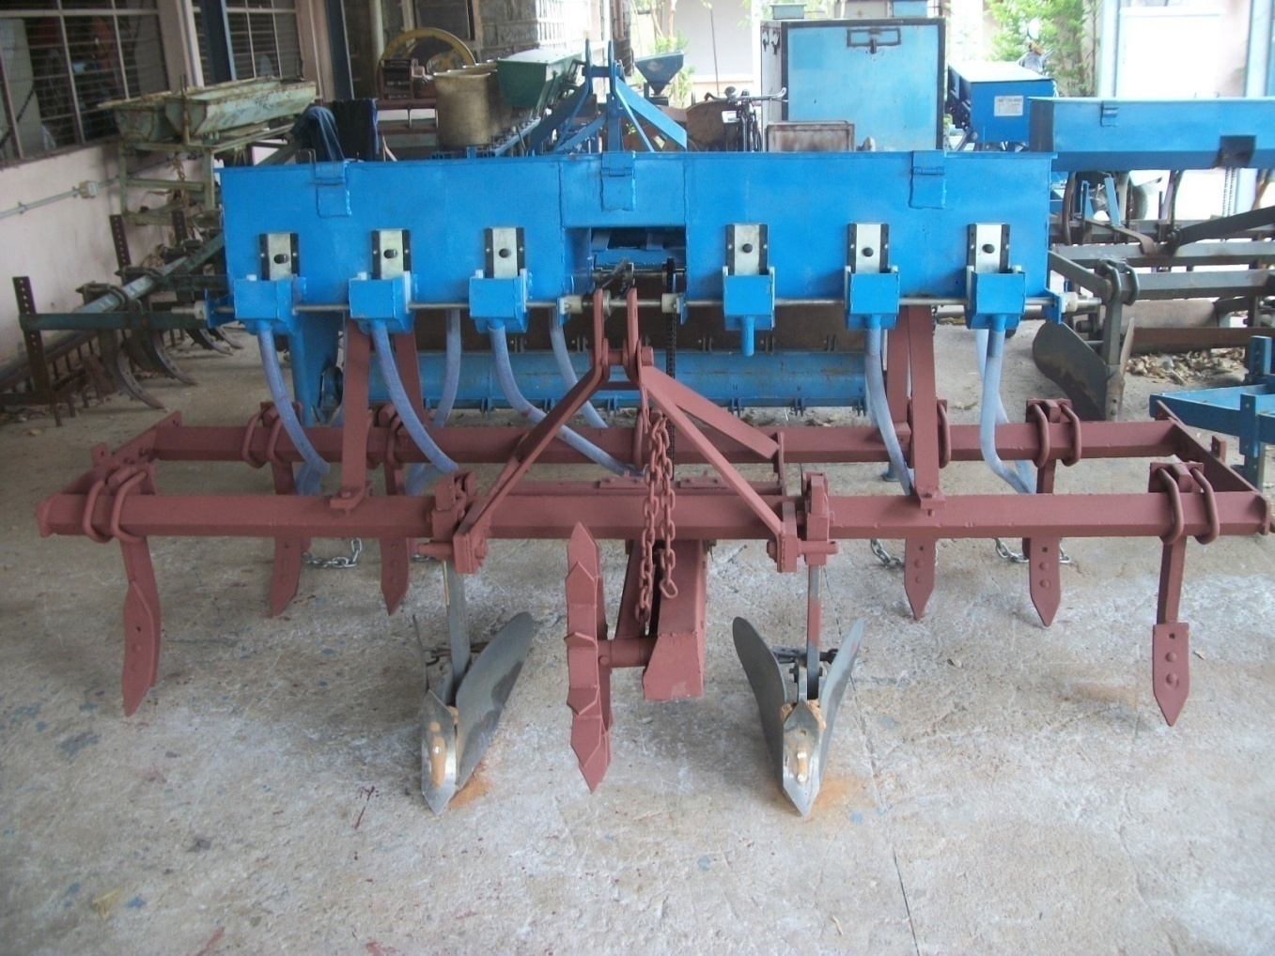
Double furrow multicrop planter developed for Redgram-soybean
Cropping system (Developed based on farmer’s request-location specific) cum BBF planter for improved water conservation

Slide 17
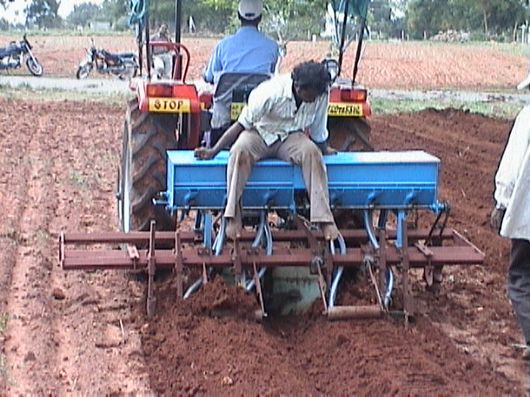
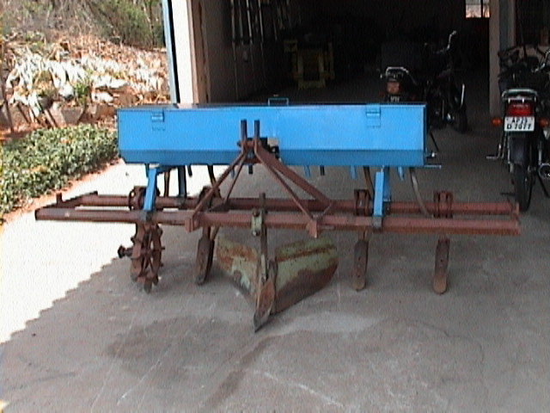
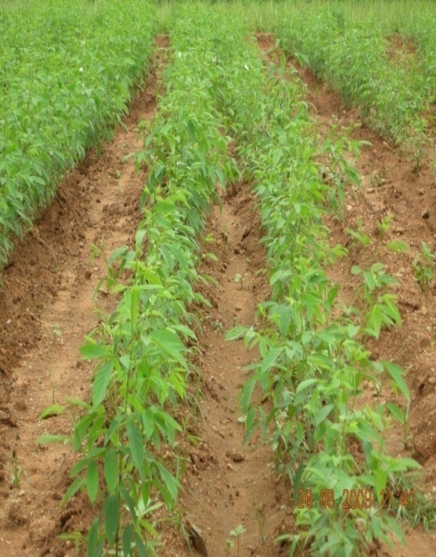
CRIDA Paired Row cum BBF Planter
*
*
60 cm
*
*
120 cm
*
*
60 cm
*
*
60 cm
60 cm
*
*
120 cm
*
*

Slide 18
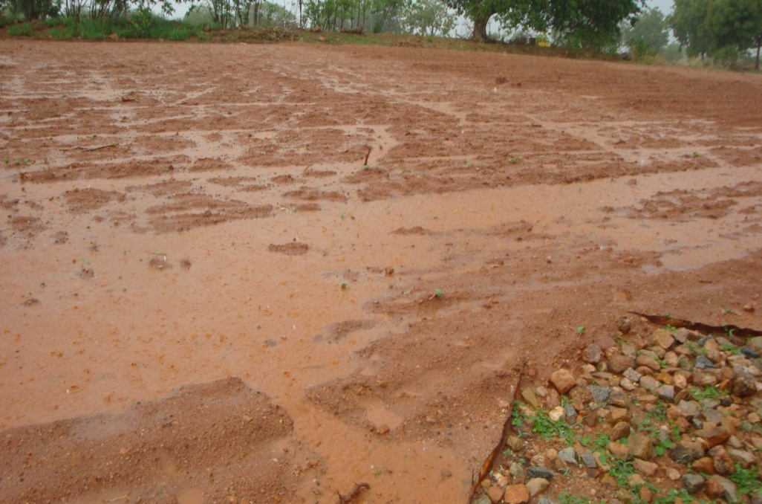
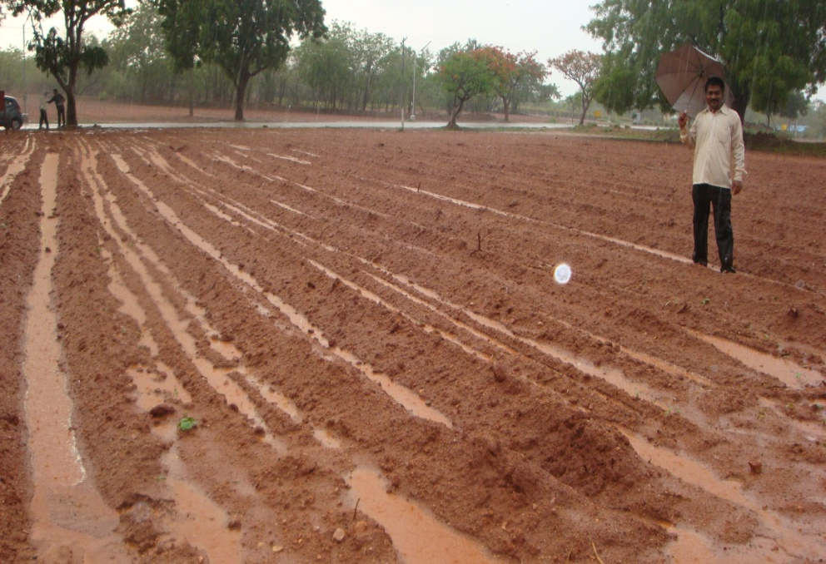
In situ water conservation
Pigeon pea | Runoff ,mm
Conventional | 64
Conventional+ Intercrop | 52
Paired row with furrow | 6.2
Paired row with furrow+ Intercrop | 4.4
Pigeon pea system | Pigeon pea Equi. yields Kg/ha
Conventional | 1900
Conventional+ Intercrop | 1700
Paired row with furrow | 2200
Paired row with furrow+ Intercrop | 2270

Slide 19
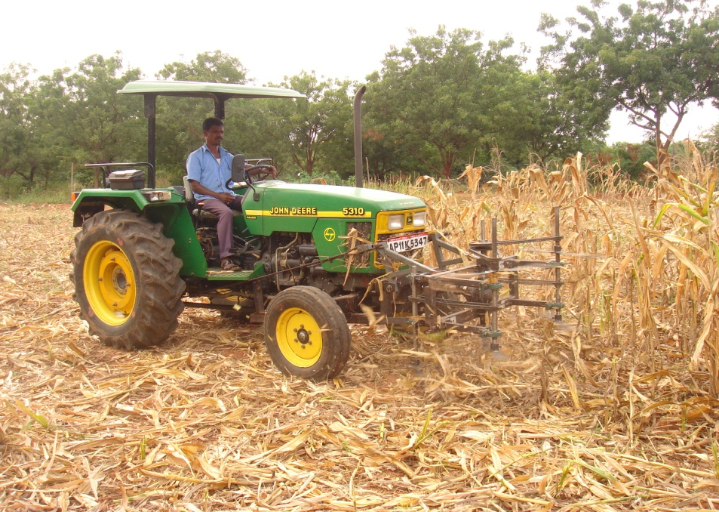
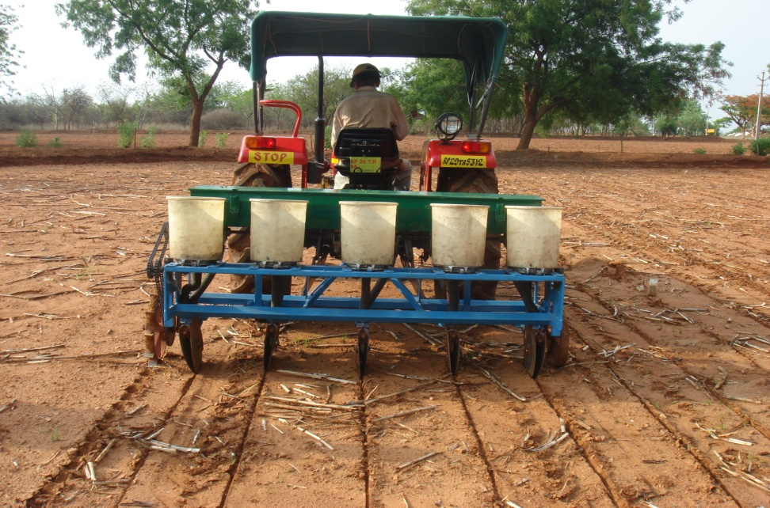
Improved Machinery for Crop Residue Management

Slide 20
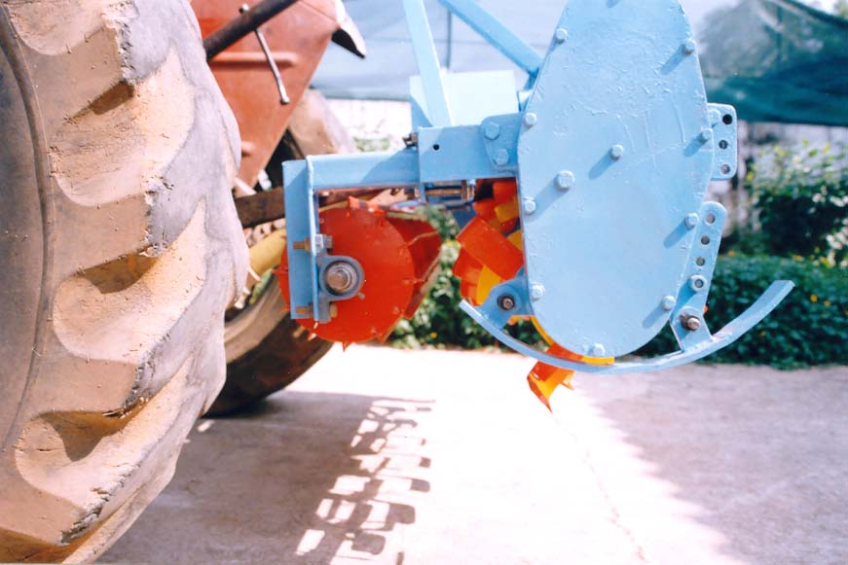
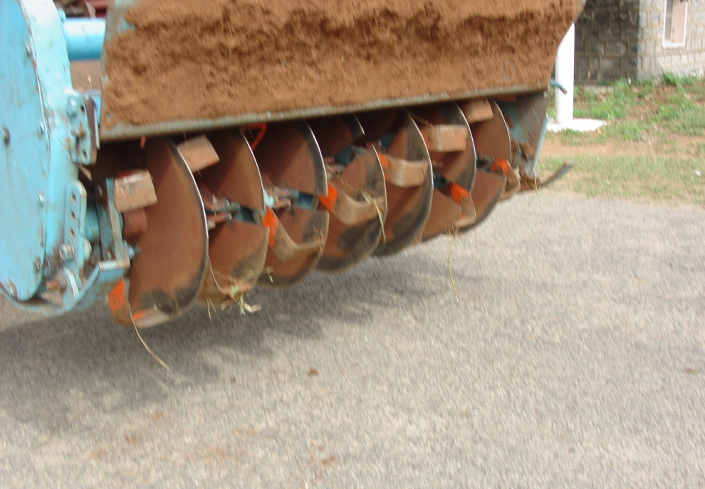
Improved Machinery for Crop Residue Management
Incorporation efficiency:78% Chopping efficiency:70% Rotor speed: 3.6 m/s

Slide 21
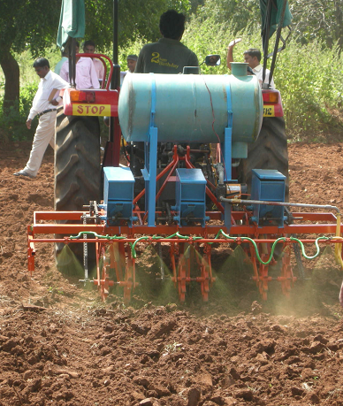
CRIDA Precision planter cum herbicide applicator for conservation agriculture
It can do three operations at a time viz., seed sowing, fertilizer application and herbicide spraying.
It can work well in two way sloppy lands because of individually operated spring loaded tines.
Separate seed and fertilizer boxes are available for inter-cropping.
Separate seed metering plates are available for different crops.
Field coverage about 0.48 hectare/ hour.
The cost of operation Rs.1250/- per hectare.

Slide 22
Performance of Precision planter

Slide 23
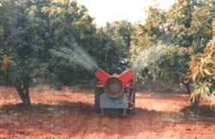
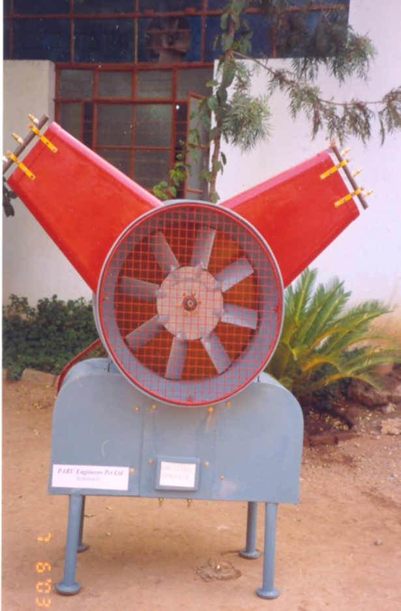
Improved Orchard Sprayer
Air carries the atomized fine spray deep in canopy,
Saving in chemical spray (48%), cost of operation (55%)timely spray,

Slide 24
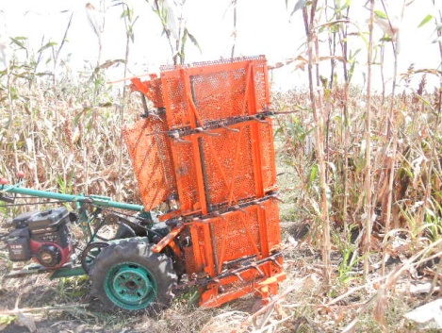
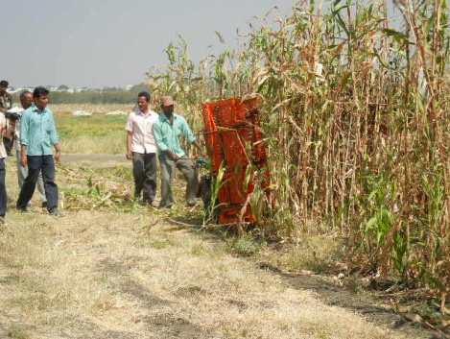
Development of small harvesters for dryland crops
Newly designed single row self propelled Harvester in action
6.5 h.p. petrol engine with 45 cm cutting Row space with horizontal disc blade

Slide 25
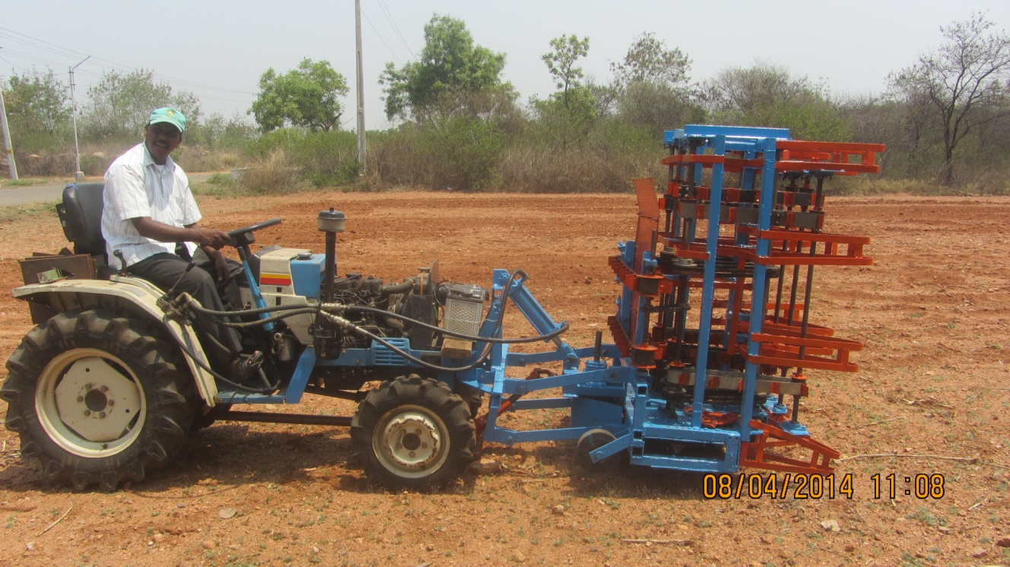
Newly developed mini tractor mounted harvester
Prototype is
Ready for
commercialization

Slide 26
Custom Hiring Center: A strategy for promotion of Improved Implements
Established in 100 KVK villages under National Initiative on Climate Resilient Agriculture
Operated by Village Climate Risk Management Committee
There are 27 different types of farm machinery stocked in 100 CHC
Each Centre was established at a capital cost of Rs 6.25 Lakh funded by NICRA Project

Slide 27
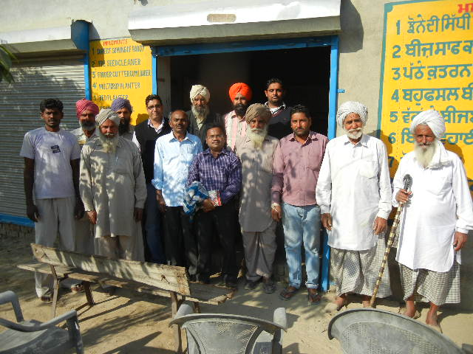
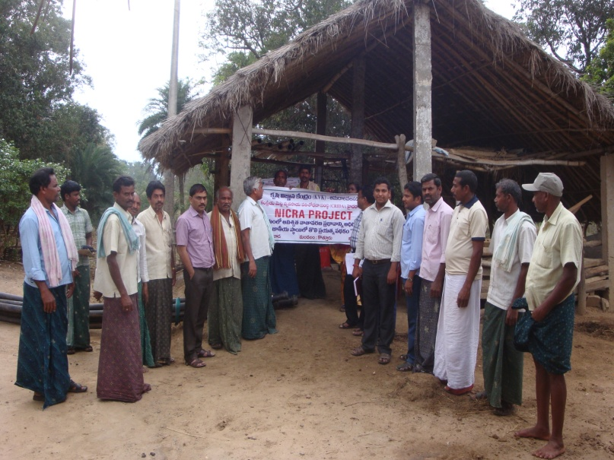
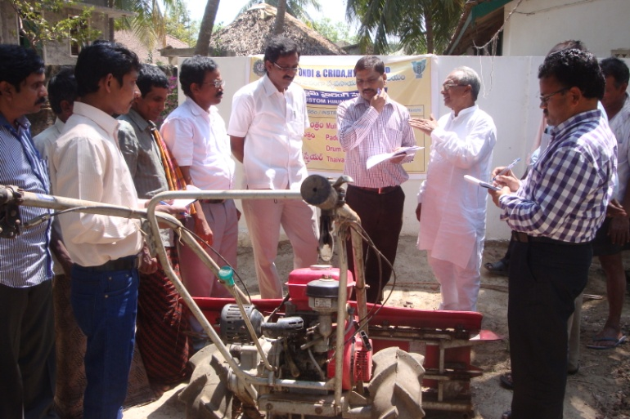
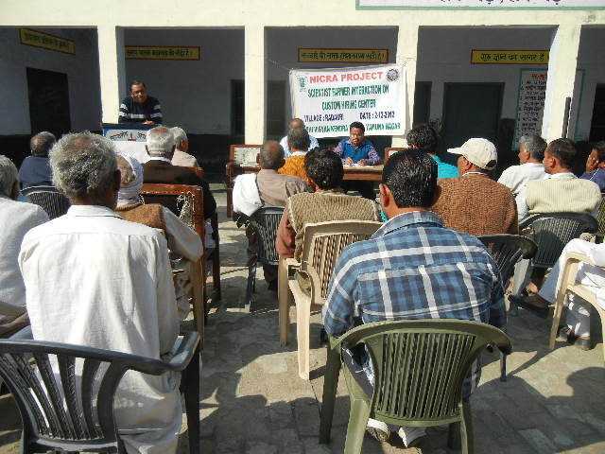
Monitoring and Technical Back-up

Slide 28
Revenue generated from CHC
Zone | KVKs (Number) | Revenue (Rs)
I | 12 | 164540
II | 15 | 284822
III | 17 | 341955
IV | 13 | 94158
V | 13 | 332124
VI | 7 | 519605
VII | 14 | 437986
VIII | 9 | 422648
Total | 100 | 2597838

Slide 29
Impact of CHC
Demonstration of In-situ conservation of soil and water sowing across the slop in 10 ha area covering 25 farmers resulted in 11-13% in soybean yield (Nandurbar, MS)
Use of BBF planter for soybean crop avoided damage to the crop due to excess rainfall in kharif, 2013 and realized about 40% more yield compared conventional sowing (Datia, MP)
Demonstration of zero till after harvest of rice in 25 ha covering 105 farmers, zero tillage saved cost of field preparation and increased 15% grain yield (Aurangabad, Bihar)
Furrow irrigated raised bed system for wheat cultivation was promoted to enhance crop yield (10-15%) in 40 farmers field. It saved 25% seed, and 30% irrigation water (Kota, Rajasthan)

Slide 30
Way Forward
Use of improved farm implements and agricultural practices can enhance inclusive growth of farmers in dryland through increased crop yield and reduced cost of operation and custom hiring service makes the implements accessible to the farmers at affordable rental price

Slide 31
Thank you

