Slide 1
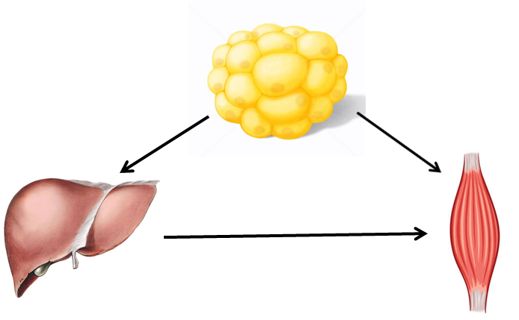
Effects of growth hormone secretagogue receptor agonist and antagonist in non-obese type 2 diabetic MKR mice
Rasha Mosa
(MBCHC, M.D, PhD candidate)
School of Biomedical Sciences
University of Queensland

Slide 2
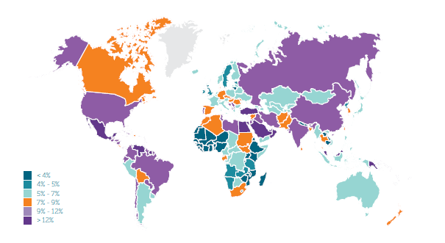
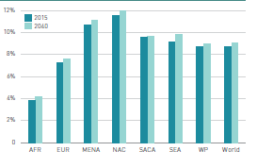
Diabetes is on the rise worldwide
Global prevalence:
  2015: 8.8% (7.2-11.4%) 415 million people
  2040: 10.4% (8.5-13.5%) 642 million people

Slide 3
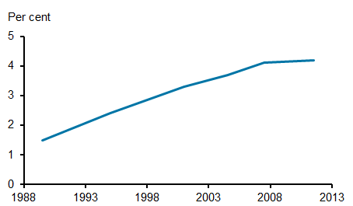
Diabetes in Australia
280 Australians develop diabetes every day.
Around 1.7 million Australians have diabetes.
Total annual cost impact of diabetes in Australia estimated at $14.6 billion
AIHW
Authoritative information and statistics to promote better health and wellbeing

Slide 4
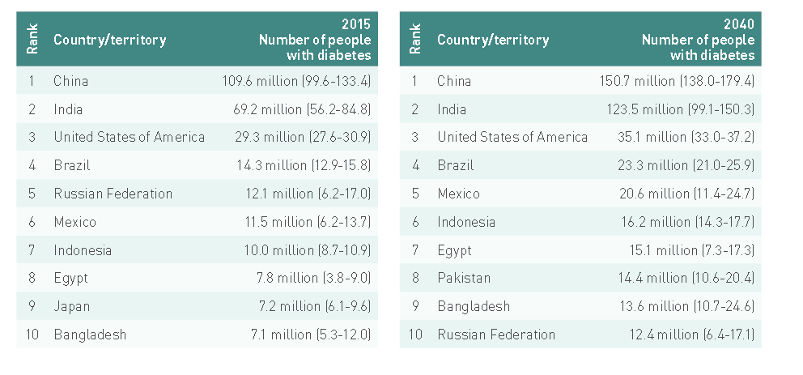

Diabetes in Egypt
There were over 7.8 million cases of diabetes in Egypt in 2015.
Egypt have more people under the age of 60 with diabetes compared to the world average.

Slide 5
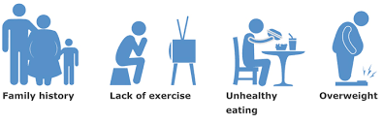
Type 2 diabetes
Type 2 diabetes mellitus is a complex endocrine and metabolic disorder.
The risk factors include interaction between several genetic and environmental factors.
Overweight and obesity are major contributors to the development of insulin resistance and impaired glucose tolerance.

Slide 6

Normal weight yet metabolically obese
WHO defined obesity as abnormal or excessive accumulation of fat that presents risk to health.
Individuals who have high risk of insulin resistance have a tendency to accumulate of fat in the visceral compartment and in non- adipose compartments such as liver and muscle
Waist circumference measurements provides a simple clinical tool to screen those who have expanded visceral fat compartments.

Slide 7
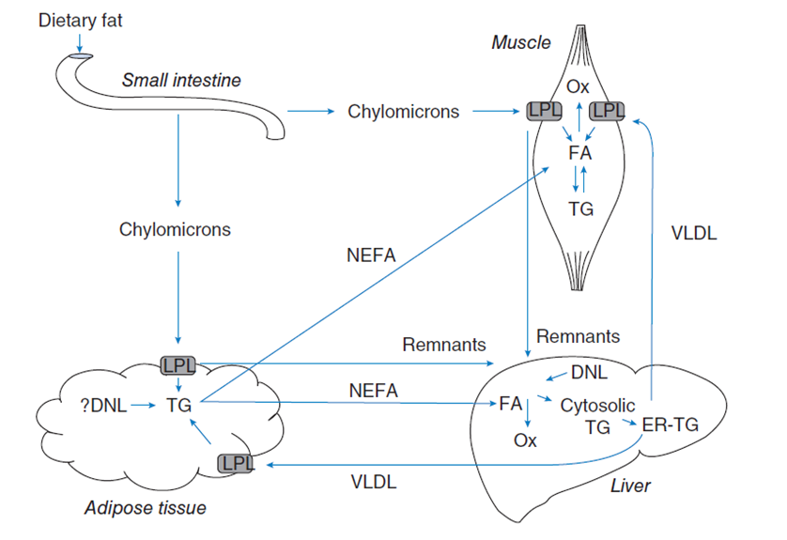
Adipose tissue and glucose homeostasis
The adipose tissue, in spite of being a minor site for glucose uptake, play a major role in controlling overall glucose metabolism.
Adipose tissue functioning as a sink for fatty acids to prevent an overload of lipid to other tissues.
Adipose tissues secretes adipokines such as leptin and adiponectin.
Transgenic ablation of white adipose tissue in mice leads to severe insulin resistance.
Adapted from Keith N. Frayn et al, 2006

Slide 8
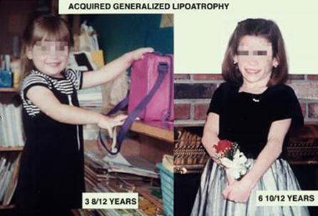
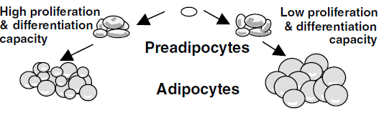
Mechanism of ectopic fat deposition
Failure to develop adequate subcutaneous fat
(lipodystrophy).
Failure of new fat cell formation
Small adipocytes have the ability to accumulate triglyceride than the larger adipocytes.
Large adipocytes are likely to secrete an entirely different pattern of hormones than small adipocytes
Increase lipolysis of adipose tissue.

Slide 9
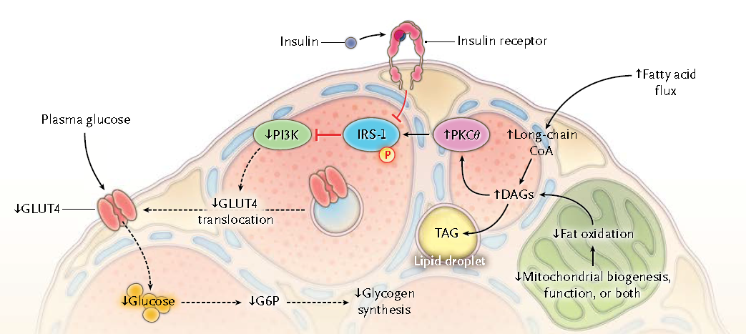
Impaired fat oxidation
adapted from Gerald I. Shulman, 2014

Slide 10





Role of PPAR-α and γ in insulin sensitization
PPAR-α
PPAR-γ
Liver
Muscle
Heart
Kidney
Adipose tissue
Liver
Muscle
Increase fatty acid uptake
and oxidation
Regulation of inflammation
Lipid storage in SC fat
Adipose development and
differentiation
Increase adiponectin levels
Integrated activation of PPAR-α and PPAR-γ
Improved insulin sensitivity ?

Slide 11
Growth hormone releasing peptides (GHRPs)
The GHRPs are small synthetic peptides stimulate growth hormone release through binding to the GH secretagogue receptor 1a (GHS-R1a), in hypothalamus and pituitary and later recognized as the receptor for ghrelin.
Ghrelin, an endogenous GHS induce food intake, adiposity, and body weight gain.

Slide 12
Hexarelin
Hexarelin is one of GHS which has GH-independent effects on:
  Protection against cardiac ischemia and impairment of vascular endothelium function
  Orexigenic properties
  Fat metabolism
  Bone cell differentiation

Slide 13
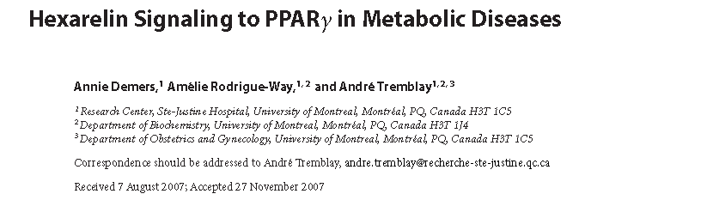
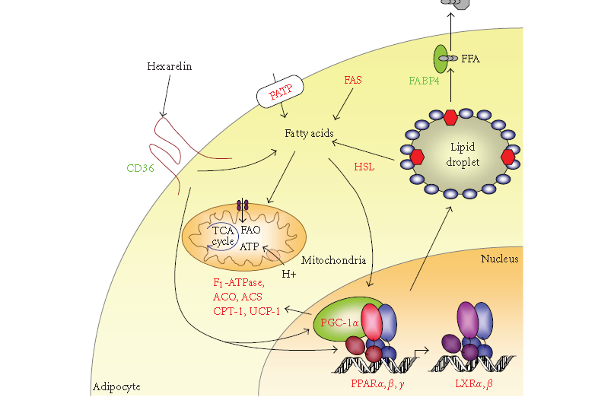
Hexarelin promote PPARγ activation to adipocytes and macrophages.
Many genes of fatty acid oxidation and mitochondria morphology upregulated by hexarelin.
Hexarelin can also promote PPARα and PPARβ/δ activation.

Slide 14
DNA microarray analysis of differentiated adipocytes treated with troglitazone, or hexarelin.
Hexarelin induced the expression of genes associated with fatty acid oxidation similar to Troglitazone treatment.

Slide 15
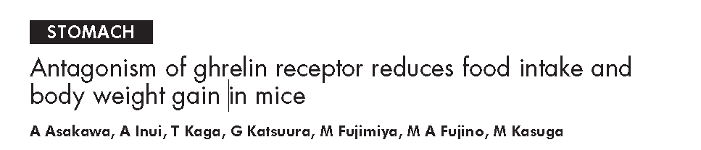
Peripherally administered GHS-R antagonists [D-Lys-3]- GHRP-6 and substance P decreased food intake in lean mice, in mice with diet induced obesity, and in ob/ob obese mice.
Repeated administration of [D-Lys-3]-GHRP-6 decreased body weight gain and improved glycaemic control in ob/ob obese mice.
Notes:
Several pharmacologic studies have shown that the use of antagonist of GHSR
could improve glucose tolerance and insulin resistance in the long term, which
suggest that this compound could be a future therapy for the treatment of type 2
diabetes

Slide 16
Mouse model-MKR mice
Overexpress a dominant-negative IGF-I receptor in skeletal muscle.
Insulin resistance characterized by:
  An early-onset type 2 diabetes
  Dyslipidemia
  Hyperinsulinemia
  Excessive lipid stores in muscle and liver
  Beta-cell dysfunction
  Impaired capacity to utilise fatty acids results in a compensatory increase in glucose disposal.

Slide 17
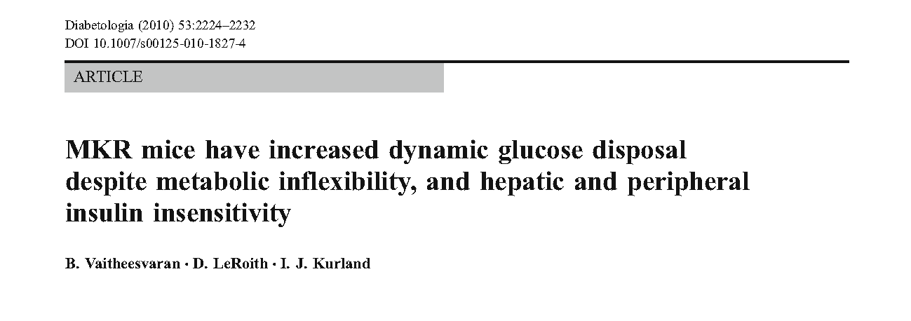
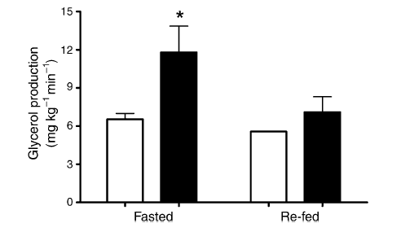
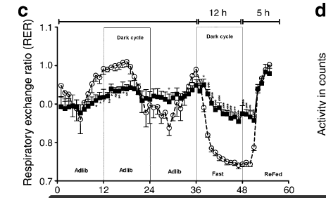
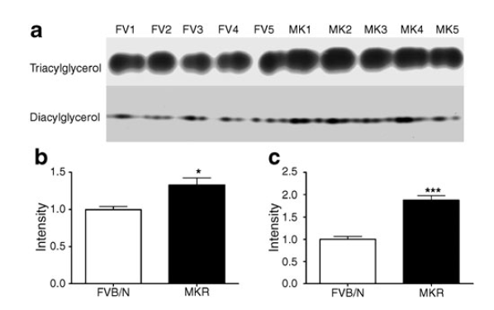

Slide 18
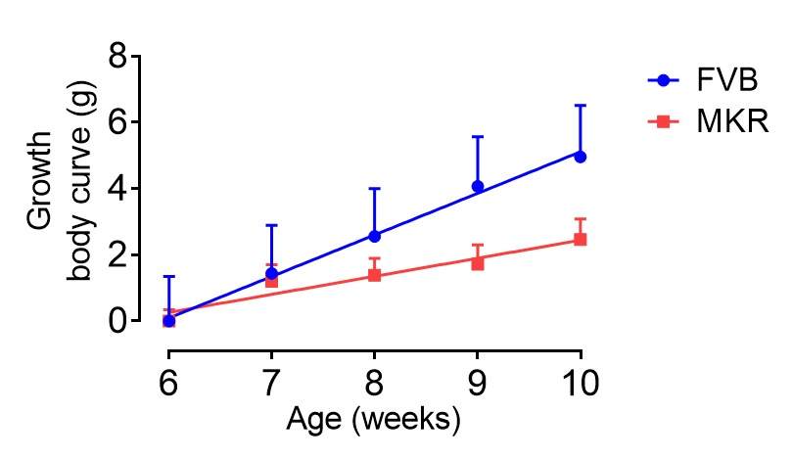
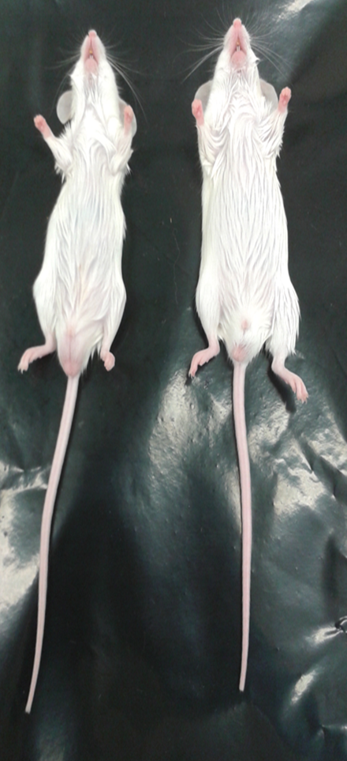
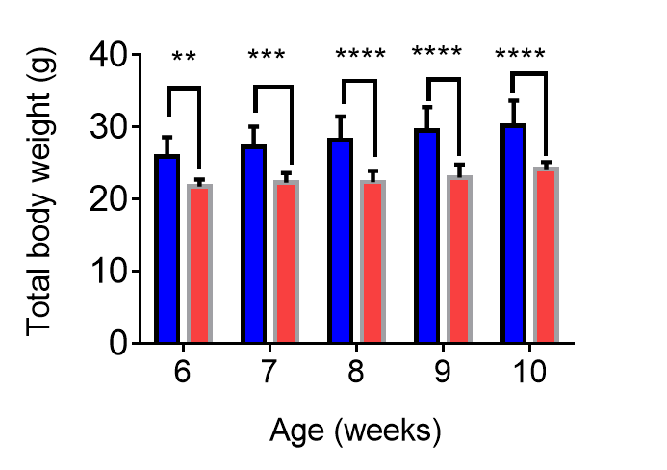
MKR mice have lower body weight compared to FVB mice (6-10 weeks)
MKR
FVB
MKR
Notes:
Gross appearance of MKR and FVB at 10 weeks of age (A). Note that MKR mice are smaller in size compared
to their control FVB. Body weight curve of MKR and FVB mice at 6-10 weeks old (B).

Slide 19
Hexarelin improved glucose tolerance test in MKR mice after 12 days of treatment
Intraperitoneal glucose tolerance test (2g/kg) performed on mice fasted for 6 hours. The results are presented as mean + SEM (n=5-6) * P<0.05 vs. the saline-treated MKR mice. ##, P <0.01 vs. the saline-treated WT mice

Slide 20
Hexarelin improved insulin tolerance test in MKR mice
Intraperitoneal insulin tolerance test (0.75 U/kg) performed on mice fasted for 6 hours. The results are presented as mean + SEM (n=5-6) **P<0.01 vs. the saline-treated MKR mice. ##, P <0.01 vs. the saline-treated WT mice.

Slide 21
Hexarelin did increase GH secretion but not affect basal blood glucose in both MKR and WT mice
Effect of hexarelin and (D-LYS)-GHRP-6 on pulsatile GH secretion profiles and basal blood glucose in MKR mice (A, C) and corresponding wild type (B, D). Samples were collected for 2 h at 15 min intervals, after drug injection.(n=3-4). * P<0.05, .***P<0.001, ****P <.0.0001 vs. the saline-treated MKR mice.

Slide 22
Effect of treatment on food intake

Slide 23
Hexarelin increased body weight in both MKR and FVB mice
The effect of hexarelin and (D-Lys)-GHRP-6 on body weight in mice (n = 5/group). Cumulative increase of body weight during a treatment period of 12 d was significant in Hexarelin treated MKR and FVB (*P <0.05,**P<0.01). One-way ANOVA was used, followed by Tukey test for multiple comparisons.

Slide 24
(D-Lys)-GHRP-6 decreased fat mass and increased lean mass in both MKR and FVB mice
Percentage lean mass and fat mass were calculated as a proportion of the animal’s total body weight using low-resolution nuclear magnetic resonance (NMR). Change of body composition after 18 d of treatment with (D-Lys)-GHRP-6 over 12 d in both MKR and FVB mice (*P <0.05,**P<0.01). One-way ANOVA was used, followed by Tukey test for multiple comparisons.

Slide 25
Effect of treatment on different fat tissues
Various fat depots ( Gonadal, subcutaneous and brown adipose tissues) were not affected significantly between treatment groups. However, epididymal pad weight tend to decrease by hexarelin treatment in MKR mice.

Slide 26
RQ were measured by indirect calorimetry
Hexarelin decreased RQ during night in MKR mice

Slide 27
Hexarelin decreased respiratory quotient during night indicative of improved fat oxidation
RER values plotted as Area under curve of 12-hour averages representing either dark or light periods of both MKR and FVB mice. Hexarelin
treated MKR mice showed significantly decreased RQ during the dark but no significant differences during light.
In contrast, (D-Lys)-GHRP-6 treated FVB mice showed a significantly increased RQ during dark compared to other treated groups, (*P <0.05,**P<0.01).

Slide 28
Hexarelin decreased liver glycogen in MKR mice

Slide 29
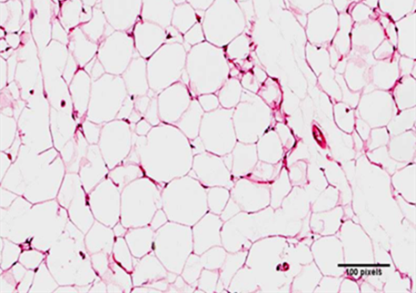
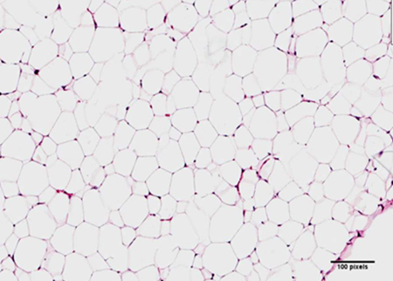
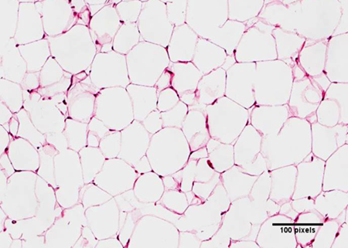
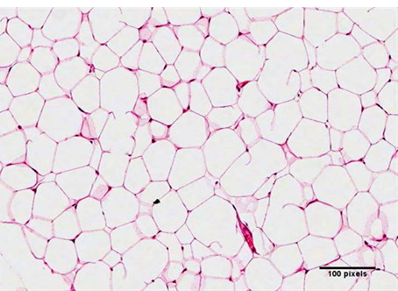
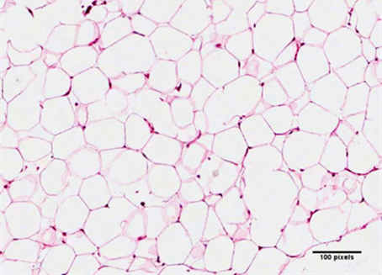
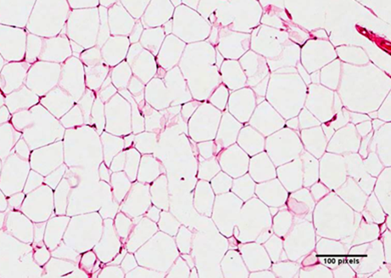
Hexarelin improved adipocyte structure and differentiation in MKR mice
Saline
Hexarelin
[D-Lys3]-GHRP-6
MKR
FVB
The size of adipocytes was smaller after hexarelin treatment in MKR mice

Slide 30
Summary
Ectopic fat deposition plays a critical role in the pathogenesis of insulin resistance and type 2 diabetes.
Chronic peripheral treatment with hexarelin improved glucose and insulin intolerance in MKR diabetic mice.
Hexarelin stimulated weight gain and food intake in both wild-type and MKR mice without increasing in fat mass.
Hexarelin-induced decrease in RQ and proliferation of adipocytes which might contribute to improving lipid utilization and insulin sensitivity in MKR diabetic mice
Hexarelin decreased hepatic glycogen possibly through decreasing gluconeogenesis.

Slide 31
Conclusion
The mechanism by which hexarelin exerts its metabolic effects represents a promising avenue which deserves further investigation to face problems related to ectopic fat deposition associated with metabolic syndrome.

Slide 32
Acknowledgements

Slide 33
Acknowledgements
Supervisors: Histological Facility
Professor Chen Chen Darryl Whitehead
Dr. Lili Huang (UQ, SBMS) Arnault Gauthier
Chen Lab AIBN Animal House Facility
Ms Chung Yan Fung Barb Arnts
Mr Michael Alexander Grist Jana Dwyer
Yeda Wu SBMS imaging facility
Hongzhuo Li Shaun Walters
Peter Lab Phenomaster Facility
Hoang Oanh Do Melanie Flint
Miss Christine Ludick Scholarships
Egyptain Scholarship
UQ international Scholarships

