Slide 1
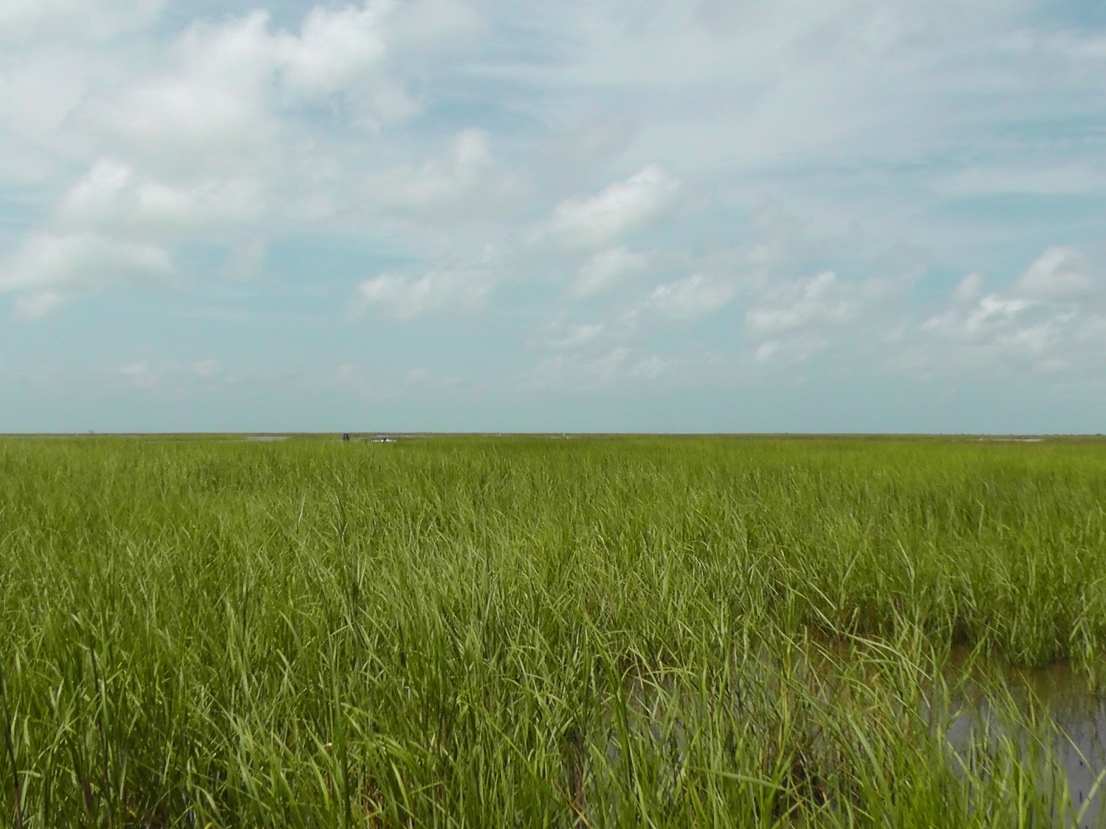
Role of elevation, relative sea level history & land cover conversions in determining carbon distributions in Spartina alterniflora dominated salt marshes in Galveston, Texas
Ranjani W. Kulawardhana^{1,2}, Rusty A. Feagin², Sorin C. Popescu², Tomas W. Boutton² & Paul B. Tchounwou¹
¹Department of Biology/ Environmental Science Program, Jackson State University, MS, USA
²Department of Ecosystem Science and Management, Texas A&M, College Station, Texas, USA

Slide 2
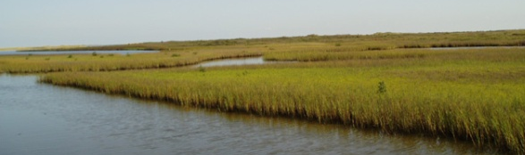
Coastal Salt marshes
Background
Cover less than 1% of the Earth's surface, yet comprise ~ 25% of the global soil carbon sink
Rates of carbon sequestration are an order of magnitude higher than that of comparably-sized rainforests
Serve as major terrestrial carbon sinks

Slide 3
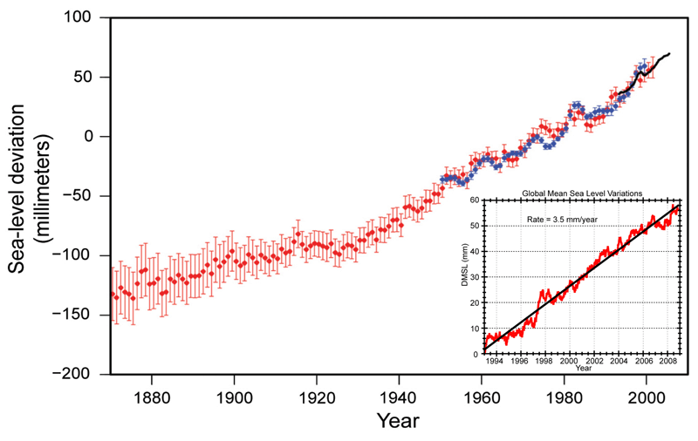
Background
Introduction
Global warming and rising sea levels create increasing threats for the wetland ecosystems
They are highly productive and must be preserved as future carbon sinks
  “Estuarine wetlands sequester carbon at a rate of about 10-fold higher on an area basis than any other wetland ecosystem” - Brigham et al. (2006)”
Annual averages of global sea level (Red: sea-level since 1870;
Blue: tide gauge data;
Black: based on satellite observations.
The inset shows global mean sea level rise since 1993 - a period over which sea level rise has accelerated)

Slide 4
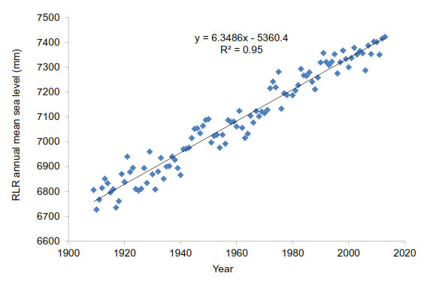
Background
Introduction
Local sea level rise rates for the study area

Slide 5
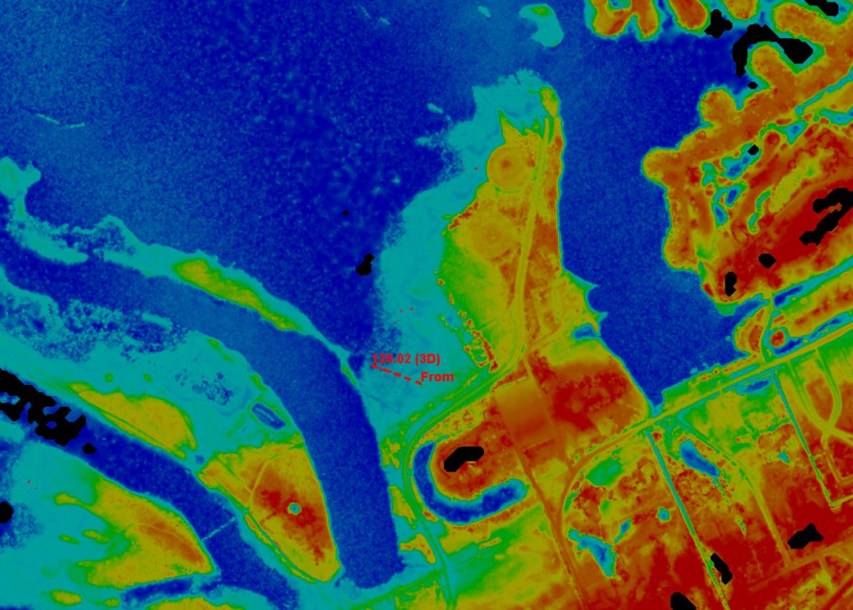
Background
Introduction
Current status & future roles of coastal salt marshes as terrestrial C sinks??

Slide 6
Background
Introduction
Current status & future roles of coastal salt marshes as terrestrial C sinks??
Their aerial extents are rapidly declining under changing climate scenarios (i.e. Global warming & rising sea levels)
Assumptions of static landscape predicts a loss of 20-60% of world’s coastal wetlands

Slide 7
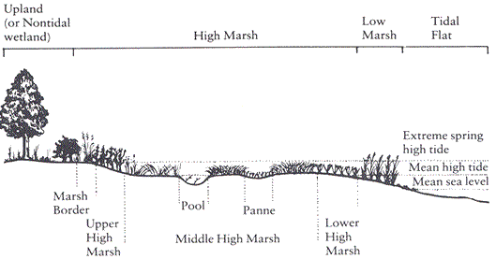
Background
Introduction
Current status & future roles of coastal salt marshes as terrestrial C sinks??
Vegetation transition over a marsh cross section

Slide 8
Objectives
Objectives
  To understand variations in vegetation characteristics and biomass distribution along the elevation gradient
  To understand variations in soil carbon storage across different depths of the soil profile
  To evaluate possible linkages between the changes in above ground environment (i.e. vegetation transition as affected by relative sea level history) to the changes in soil carbon storage

Slide 9
Study Area
S. alterniflora dominated coastal salt marshes of Galveston, Texas

Slide 10
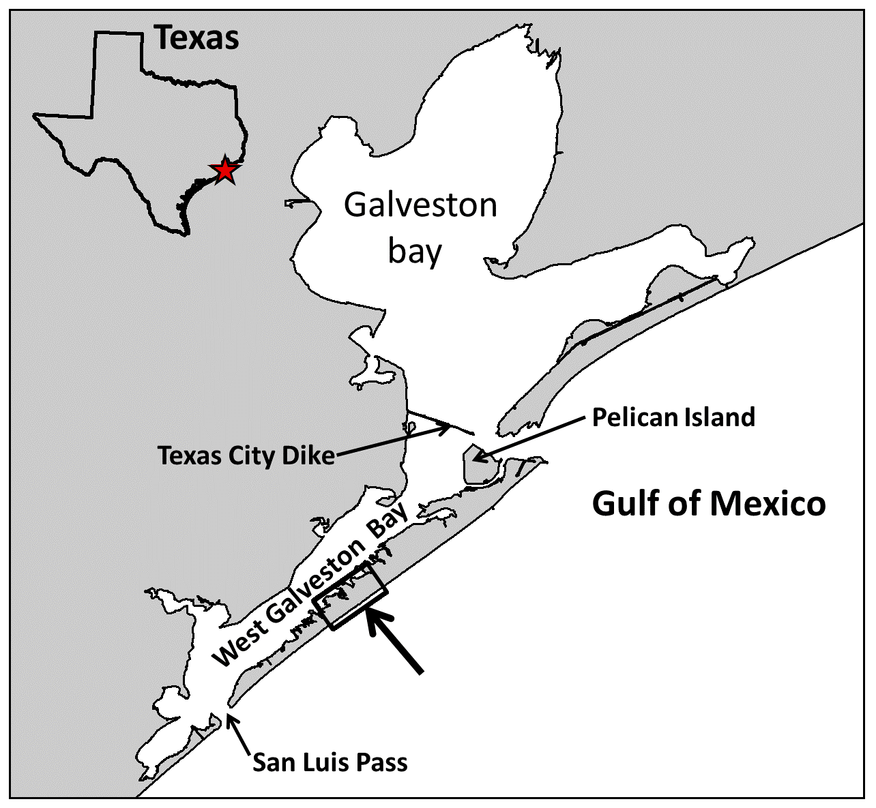
Study area
Coastal salt marshes of Galveston, Texas - Location
Galveston Island State Park

Slide 11
Study area
Galveston Island State Park, Texas – May 2012

Slide 12
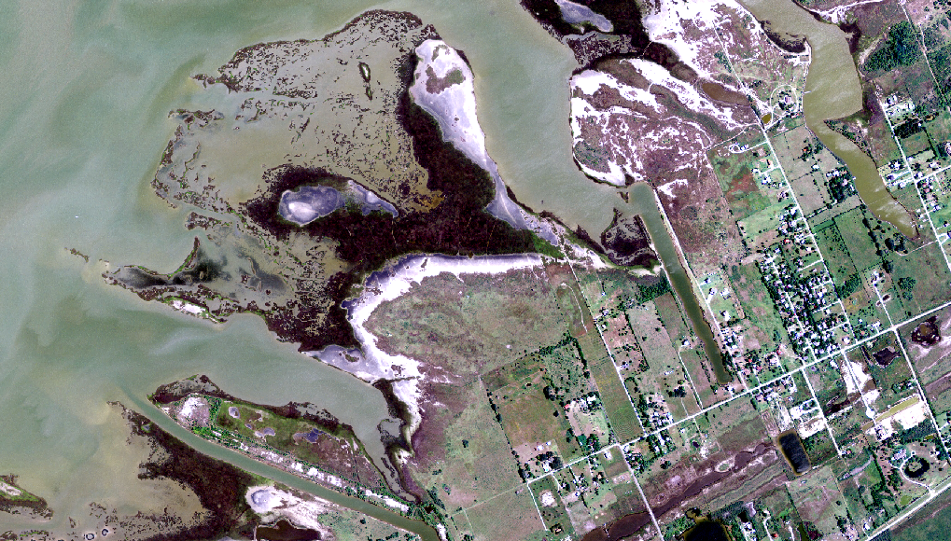
Study area
Galveston Island State Park, Texas – May 2012

Slide 13
Study area
Galveston Island State Park, Texas – May 2012
Salt pannes
Low marsh
High marsh

Slide 14
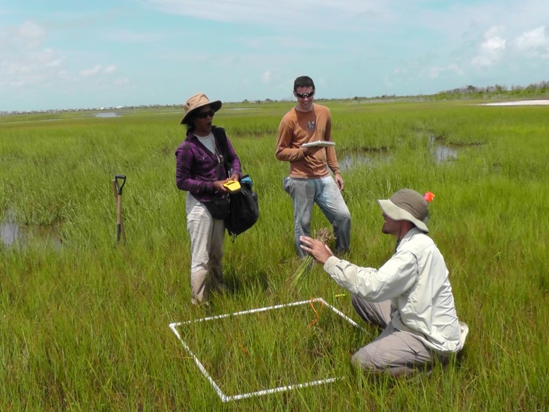
Study area
Galveston Island State Park, Texas – May 2012

Slide 15
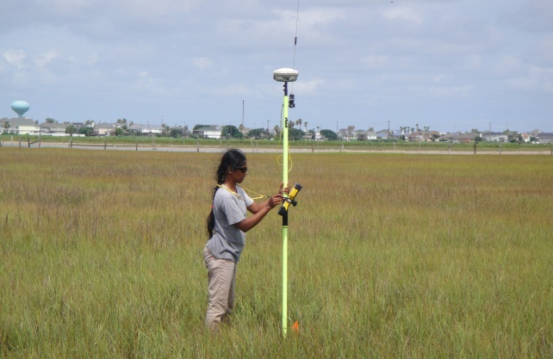
Study area
Galveston Island State Park, Texas – May 2012

Slide 16
1. Variations in the above ground environment – plant characteristics, biomass and Carbon storage
2. Variations in the soil profile – across different depths
3. Sea level history, land cover change and the changes in the soil profile
Data, Methods & Results

Slide 17
Data & methods
  Data, data processing and analyses
Vegetation
Elevation
(GPS)
Remote sensing data
Soil
height
lidar
<30cm
30-40cm
>40cm
elevation zones (3)
cover
Stem
density
biomass
(live, dead)
carbon
(live, dead)
Wilcoxon Kruskal-Wallis Test

Slide 18
Results – Variations along the elevation gradient
Spatial variations along the elevation gradient – Spatial patterns of vegetation characteristics
 | Elevation (cm) |  |  | Pr>χ²
 | <30 | 30-40 | >40
Plant height mean (cm) | 48 | 44 | 43 | 0.008
Culm height mean (cm) | 14 | 12 | 8 | <0.0001
% Cover | 82 | 81 | 93 | 0.009
Stem density (#/m²) | 351 | 360 | 344 | 0.68

Slide 19
Results – Variations along the elevation gradient
Spatial variations along the elevation gradient – Distribution of above-ground C quantities
Above-ground C (g/m²) | Elevation (cm) |  |  | Pr>χ²
 | <30 | 30-40 | >40
Live | 251 | 222 | 200 | 0.04
Dead | 80 | 88 | 168 | 0.0004
Total | 331 | 310 | 367 | 0.18

Slide 20
Data & methods contd.
  Data, data processing and analyses
Vegetation
Elevation
(GPS)
Remote sensing data
Soil
height
bulk density
lidar
<30cm
30-40cm
>40cm
elevation zones (3)
cover
Stem
density
% carbon
biomass
(live, dead)
carbon (g/m²)
variation across depth
carbon
(live, dead)
Wilcoxon Kruskal-Wallis Test

Slide 21
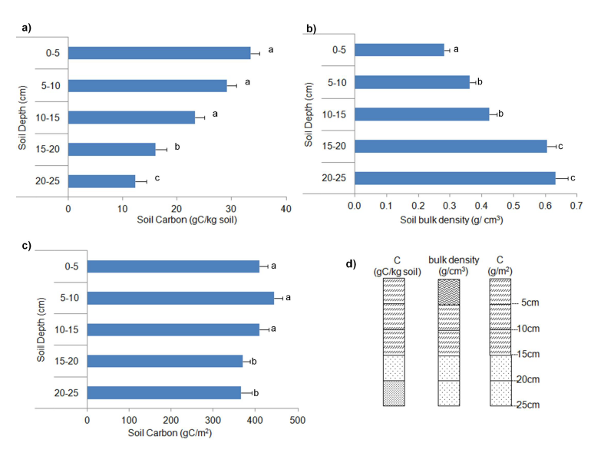
Results – Variations across different depths of the soil profile
Temporal changes: Soil carbon storage

Slide 22
Data & methods contd.
Vegetation transition over a marsh cross section

Slide 23
Data & methods contd.
  Data, data processing and analyses
Vegetation
Elevation
(GPS)
Remote sensing data
Soil
height
1954, 2012
bulk density
Lidar
Aerial images
<30cm
30-40cm
>40cm
elevation zones (3)
cover
Stem
density
% carbon
biomass
(live, dead)
carbon (g/m²)
variation across depth
carbon
(live, dead)
Wilcoxon Kruskal-Wallis Test

Slide 24
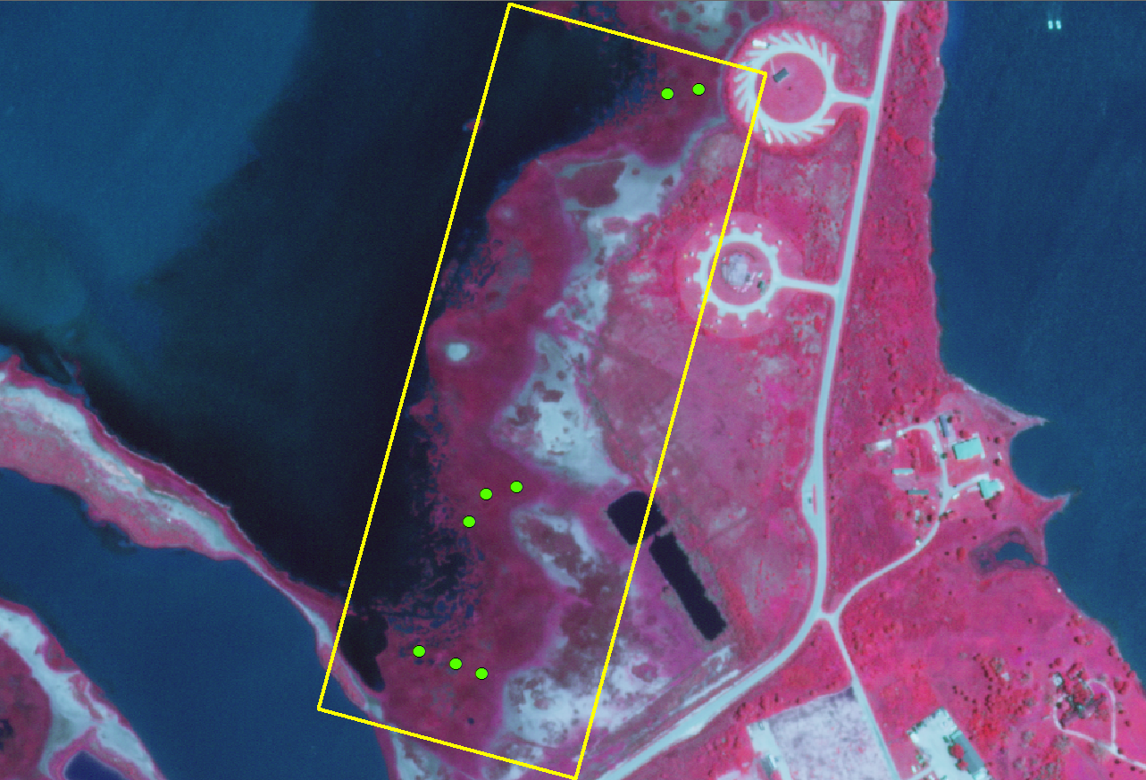
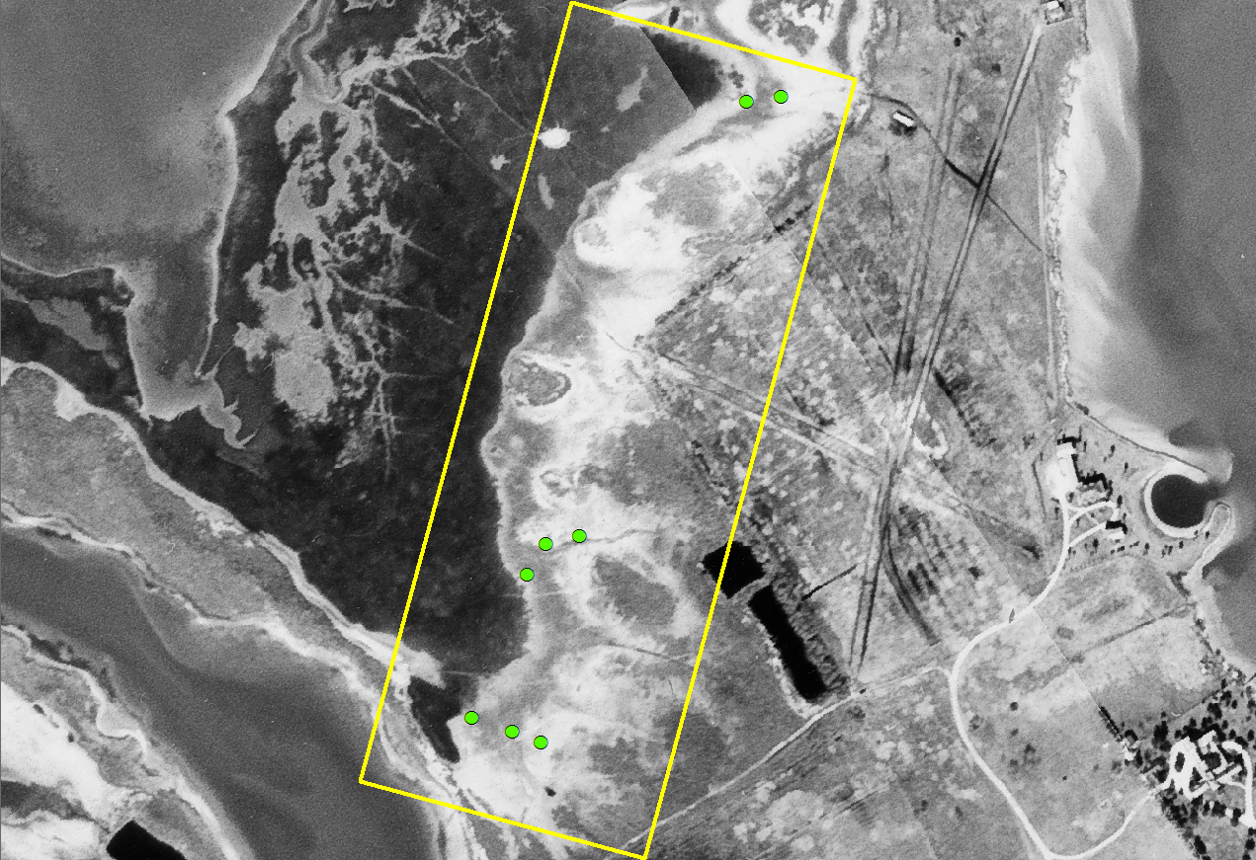
Results – Vegetation transition & relative sea level
Temporal changes: Relative sea level history and vegetation transition
2012
1954

Slide 25
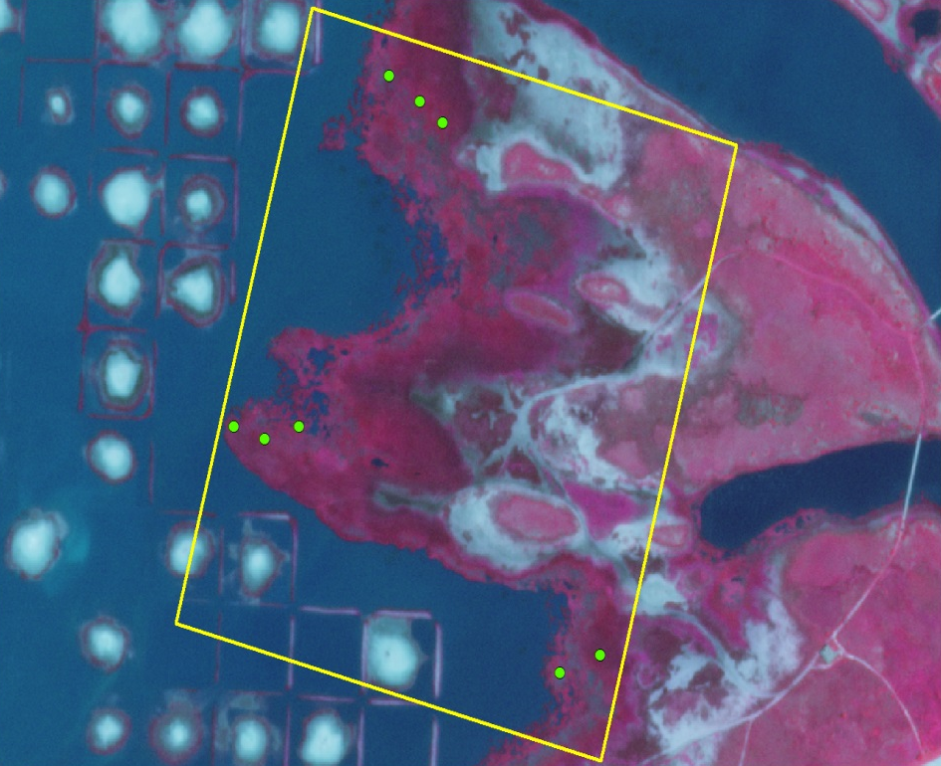
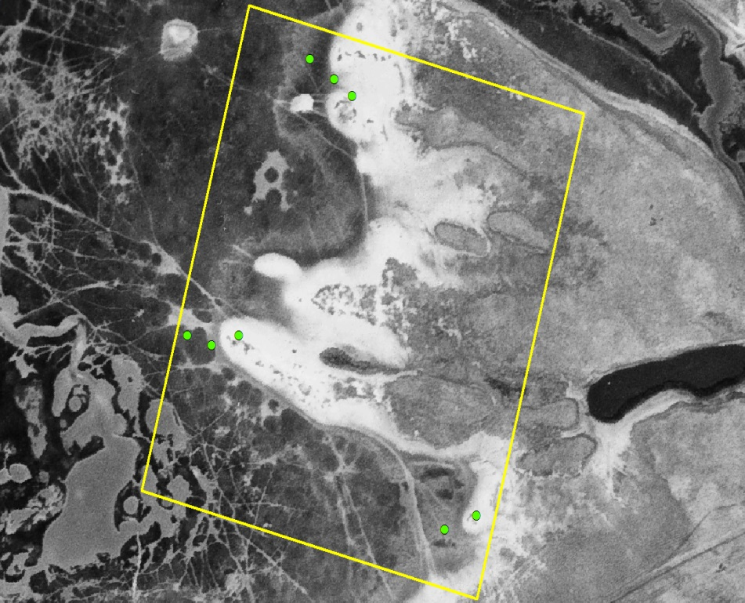
Results – Vegetation transition & relative sea level
Temporal changes: Relative sea level history and vegetation transition
1954
2012

Slide 26
Data & methods contd.
  Data, data processing and analyses
Vegetation
Elevation
(GPS)
Remote sensing data
Soil
height
1954, 2012
bulk density
lidar
Aerial images
<30cm
30-40cm
>40cm
elevation zones (3)
cover
Stem
density
% carbon
LM, SP, HM
Land cover history (3)
biomass
(live, dead)
carbon (g/m²)
variation across depth
carbon
(live, dead)
Wilcoxon Kruskal-Wallis Test
Wilcoxon Kruskal-Wallis Test

Slide 27
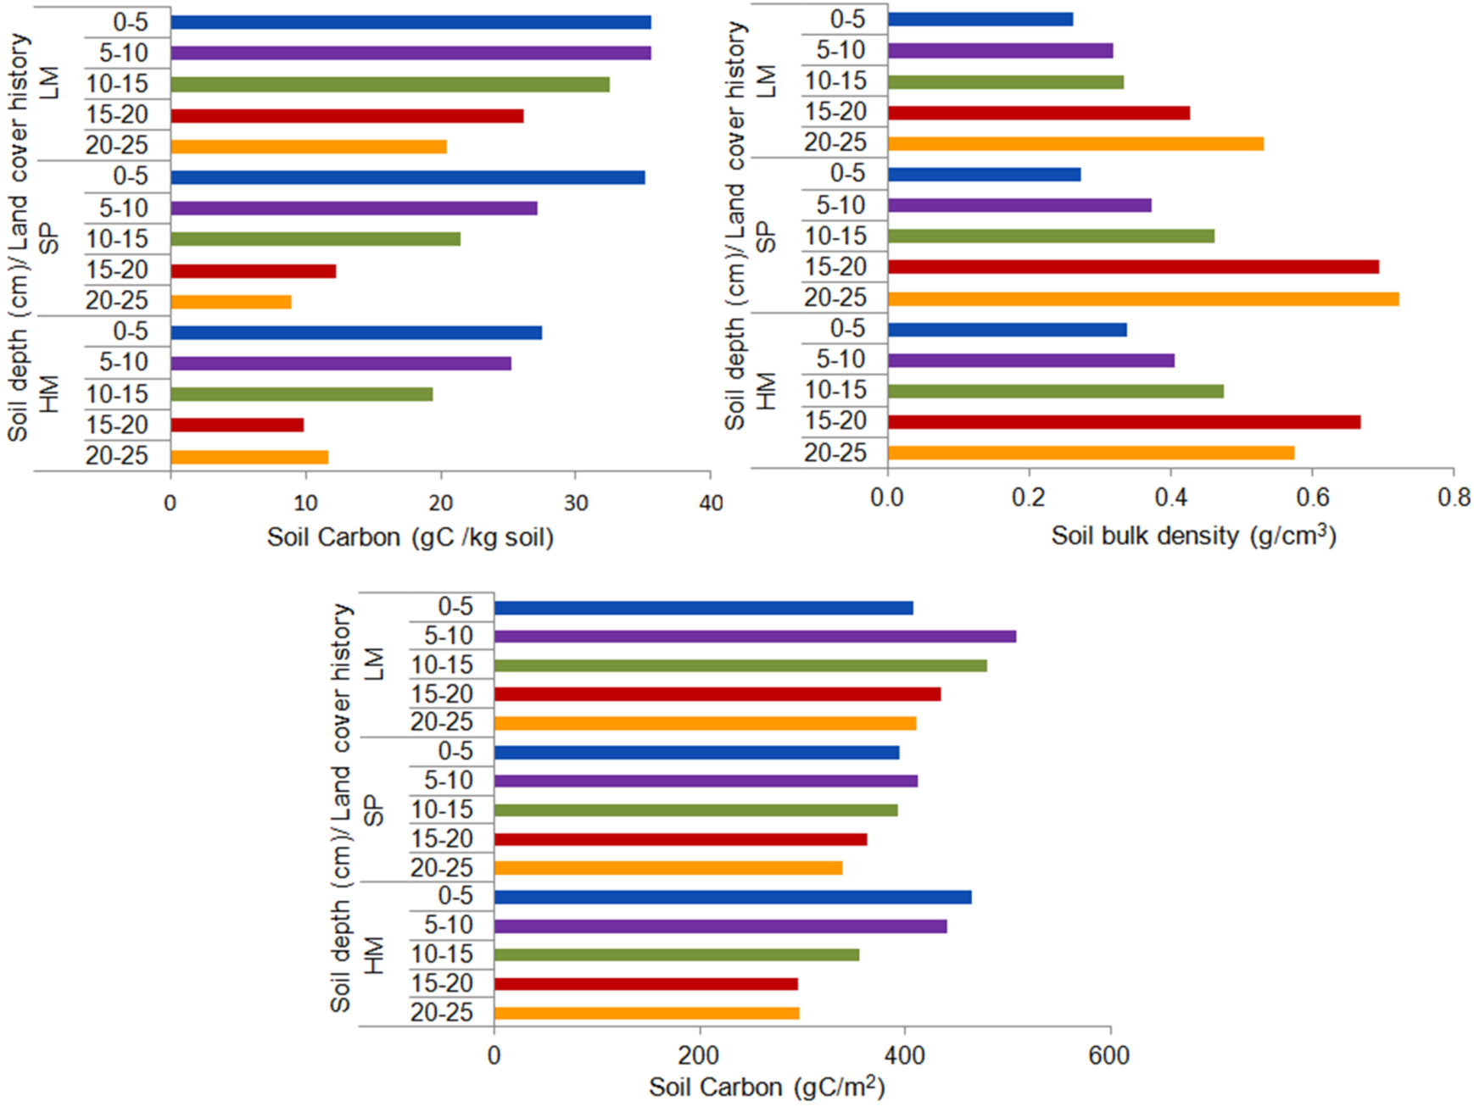

Results – Variations in the soil profile vs. vegetation transitions
Temporal changes: Relative sea level history, vegetation transition and soil carbon storage
  Average accretion rates for this area - 0.25cm/ year
Corresponds to the marsh build up over 58 year period

Slide 28
Conclusions
Conclusions
Terrain characteristics (i.e. elevation gradient) play a key role in determining the vegetation distribution and thus carbon storage in the above ground environment
Variations in soil properties along the soil depth were linked to the temporal changes in sediment deposition on the marsh surface, relative sea level history, and resulting vegetation transitions
Amounts of soil carbon stored in recently established marshes were significantly lower than those that have remained in situ for a longer period of time
Status of the salt marsh as a carbon sink varies as a function of both space and time

Slide 29
Acknowledgements
Acknowledgement
Fellowships & Grants
  Schlumberger Faculty for Future Fellowship – Schlumberger Inc.
  Tom Slick Senior Graduate Fellowship - College of Agriculture and Life Sciences, Texas A&M
  NASA New Investigator grant - NNX08AR12G
Department of Ecosystem Science and Management (ESSM), Texas A&M
  Dr. Ricardo Colon-Rivera & Trevor Pattillo
Jackson State University (JSU)
  NOAA Environmental Corporative Science Center (NOAA ECSC)
  Research Centers for Minority Institutions (RCMI)
  Department of Biology

Slide 30
Questions???
Read for more information
Kulawardhana R. W., Feagin R. A., Popescu S. C., Boutton T. W., Yeager K. & Bianchi T. S. (2015)
– Estuarine Coastal and Shelf Sciences http://www.sciencedirect.com/science/article/pii/S0272771414004119
Kulawardhana R. W., Popescu S. C. & Feagin R. A. (2014)
- Remote Sens. of Environment (Special Issue) http://www.sciencedirect.com/science/article/pii/S0034425714000959

Slide 31
Contacts
Profile:
http://www.jsums.edu/biology/dr-kulawardhana/
E-mail me @ wasanthkula@yahoo.com

