Slide 1
Polio returns to Middle East: situation analysis, strategies and way forward
Randa Hamadeh, MPH, PhD
Ministry of Public Health, Lebanon
Birmingham , Aug. 2015

Slide 2
Outline
ME Outbreak overview
Current status of polio outbreak response in Middle East
Conclusions

Slide 3
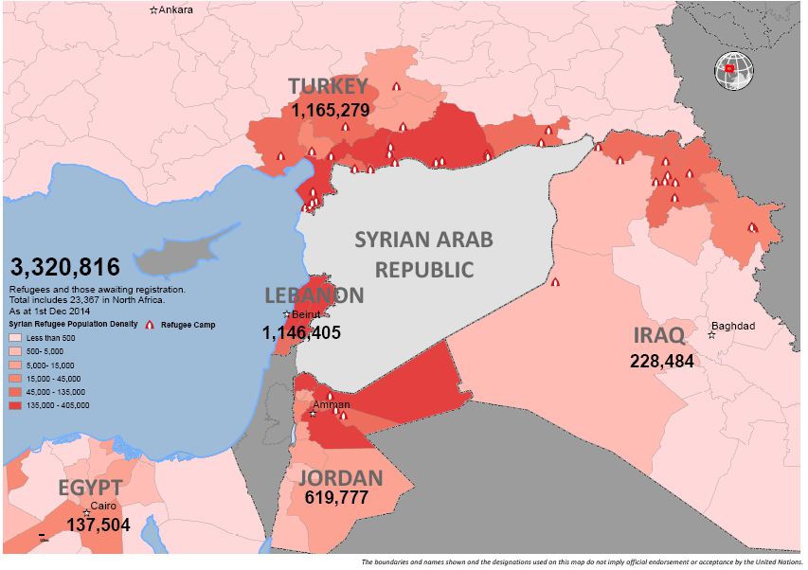
Regional context
ME Outbreak overview
Complex emergency
In Syria
More than 3 million refugees in neighbouring countries
6 million internally displaced
Source: http://data.unhcr.org/syrianrefugees/regional.php#

Slide 4
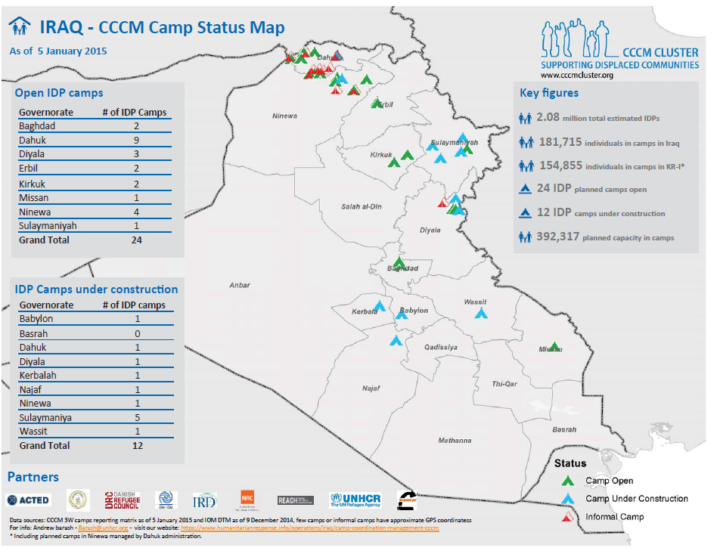
ME Outbreak overview
Regional context
Complex emergency in Iraq commencing mid-2014
Significant internal displacement (more than 2 million people)
Source: http://data.unhcr.org/syrianrefugees/regional.php#

Slide 5
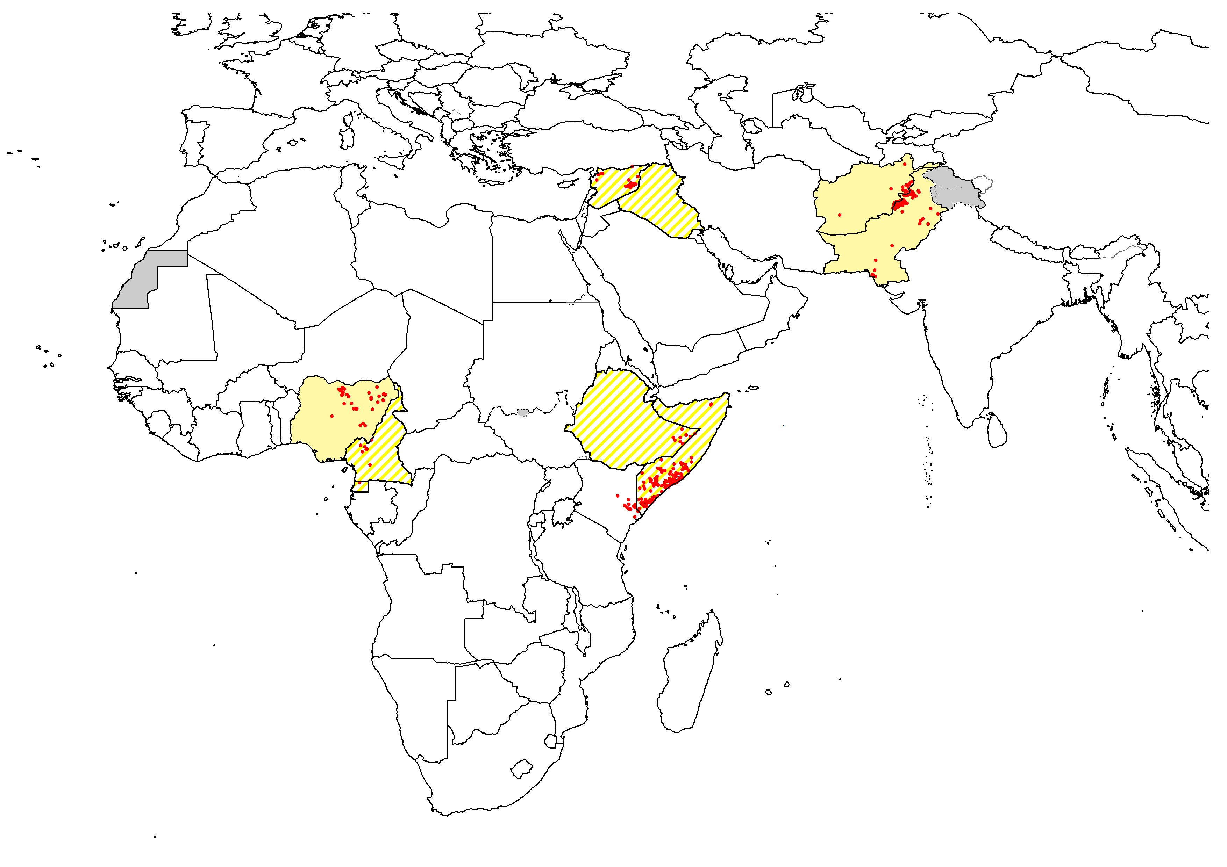
The Middle East Polio Outbreak
The polio virus caused the ME outbreak is closely linked to the polio virus circulating in Pakistan.
Paralytic poliomyelitis cases and diseases transmission occurred within Syria (October 2013)
Disease spread to Iraq (Feb 2014)

Slide 6
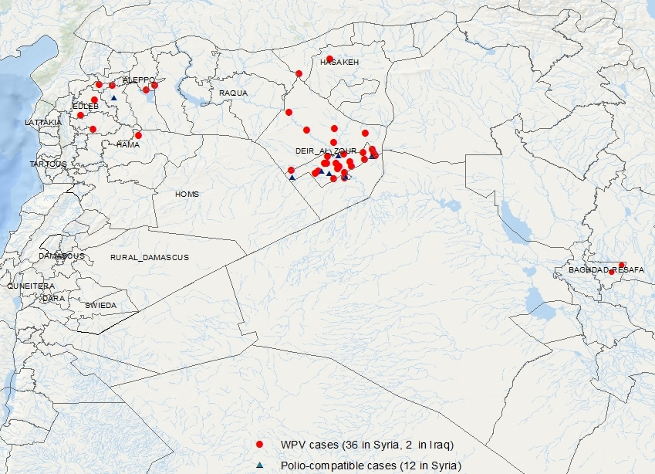
The Middle East Polio Outbreak
38 cases since October 2013
36 Syria
2 Iraq
Most recent Case in Syria:
onset 21 January 2014
Hama governorate
Most recent Case in Iraq:
onset 7 April 2014
Baghdad-Resafa governorate

Slide 7
Response Overview

Slide 8
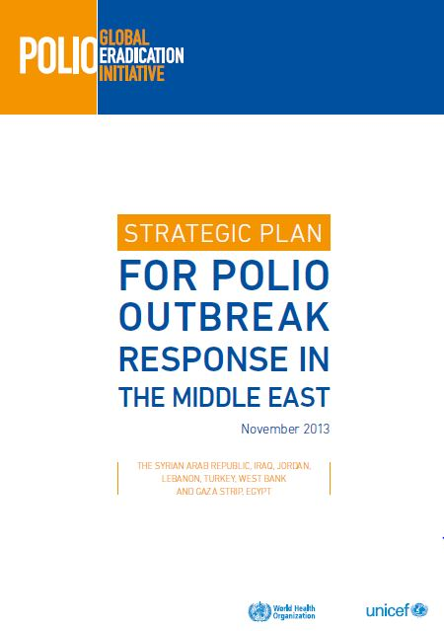
Phase I Goal & Strategic Approach
Interrupt polio in Syria & surrounding countries by end-March 2014 by:
DETECT: to enhance reporting & investigation of acute flaccid paralysis cases (AFP) to ensure rapid detection and tracking of polio virus
RESPOND: implement large scale and repeated Supplementary Immunization Activities (SIAs)
PREVENT: improve routine immunization coverage

Slide 9
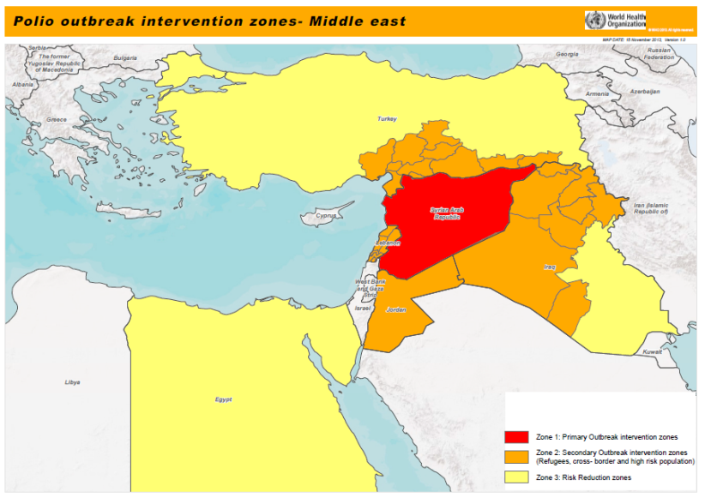
Middle East – Actions Phase I Response Oct 2013 – April 2014
Zone 1: Primary Outbreak Intervention Zone: Syrian Arab Republic
Zone 2: Secondary Outbreak Intervention Zone: Areas in surrounding countries (Iraq, Turkey, Lebanon and Jordan) at immediate risk.
Zone 3: Risk Reduction Zone: Rest of neighboring countries

Slide 10
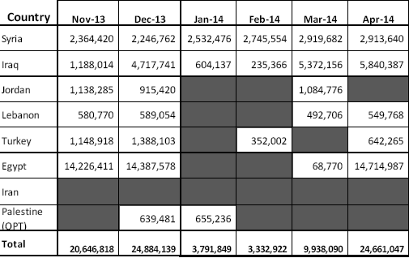
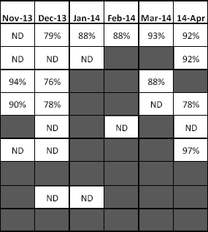
Implementation & children vaccinated Post-campaign monitoring (Recall) November 2013 – April 2014
Number of children vaccinated
PCM result by recall
ND – Not Done

Slide 11
Phase I plan impact on the outbreak
The size of polio outbreak has been reduced to the minimum in Syria in 2014 (35 cases in 2013 and one case in 2014,
BUT…
Unfortunately spread of WPV to Iraq
No WPV detected in Jordan, Lebanon, Egypt, Turkey
Absence of WPV in environmental samples in Palestine since March 2014
* all sources

Slide 12
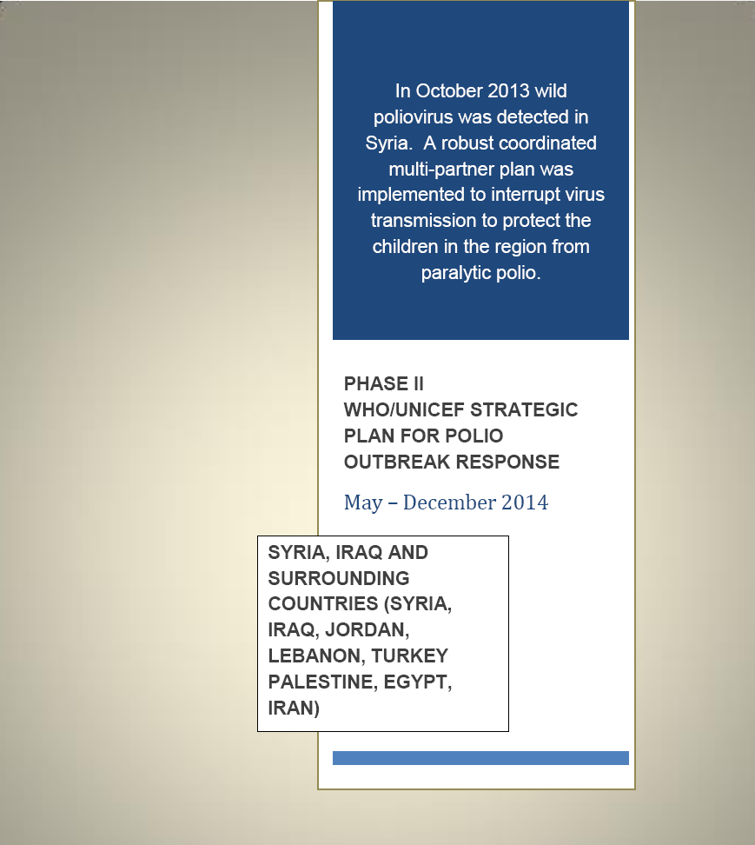
The GOAL has been updated:
Interrupt polio virus transmission by August 2014

Slide 13
Phase II Response: Objectives
The objectives remained as follows:
Detect-AFP
Respond-SIAs
Prevent-RI

Slide 14
Phase II Response: Objectives
Phase II focus:
Quality: Improving the quality and intensity of key activities including SIAs, AFP Surveillance and Routine Immunization services, with emphasis on monitoring during and after campaigns
Reach: Systematic mapping of hard to reach populations wherever they may be and specific targeting of these populations in subsequent SIAs, Routine Immunization and surveillance services

Slide 15
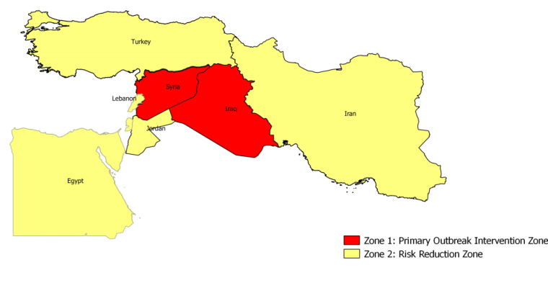
Risk Assessment
Phase II Outbreak response Plan
May 2014 – Dec 2014
Zone 1: Primary Outbreak Intervention Zone:
Syria
Iraq
Zone 2: Risk Reduction Zone:
Turkey
Lebanon
Jordan
Palestine
Egypt
Iran

Slide 16
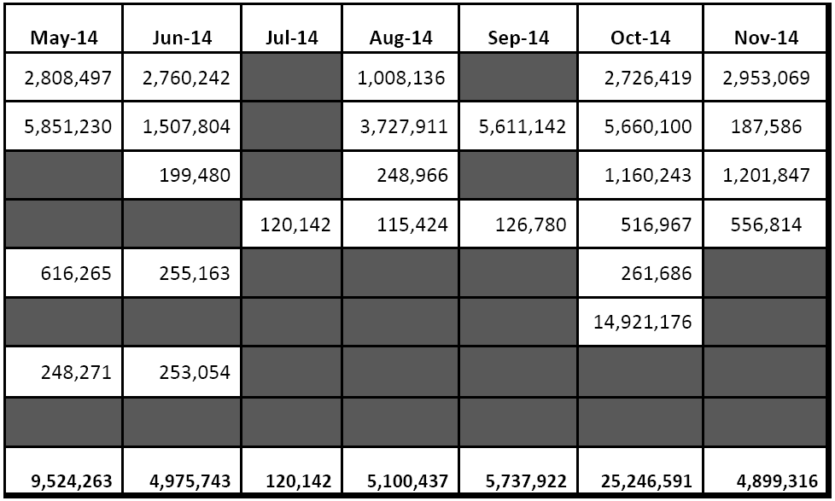
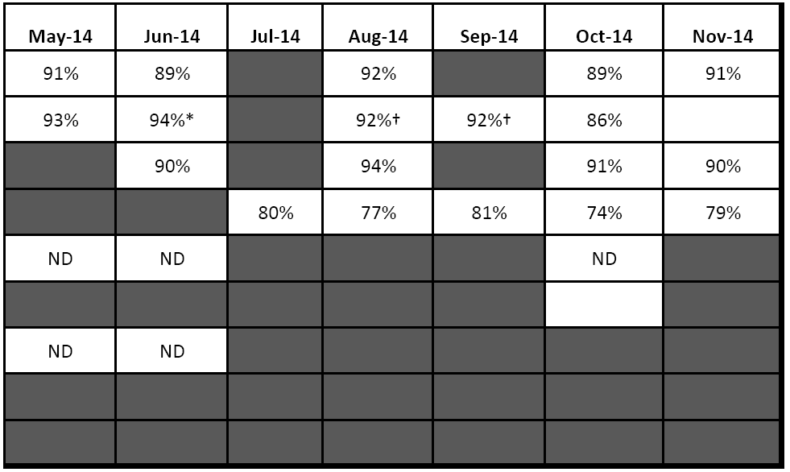
Implementation & children vaccinated Post-campaign monitoring (Recall) May 2014 – December 2014
Number of children vaccinated
PCM result by recall
ND – Not Done

Slide 17
SIAs in Lebanon as a response to polio virus in the Middle East
 | 2013 |  |  |  |  |  | 2014
 | Jul | Aug | Sep | Oct | Nov | Dec | Jan | Feb | Mar | Apr | May | Jun | Jul | Aug | Sep | Oct | Nov | Dec
Syria
Iraq
Lebanon
Vaccinated Children |  |  |  |  | 580,770 | 589,054 |  |  | 492,706 | 549,768 |  |  | 120,142 | 115,424 | 126,780 | 516,967 | 556,814
Polio confirmed case first and most recent
National Campaign
Sub-national Campaign
2,6 Million OPV doses were administered
Target of Lebanese and non-Lebanese is 0.5 Million

Slide 18
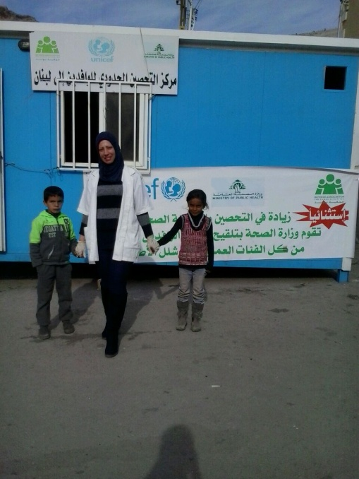
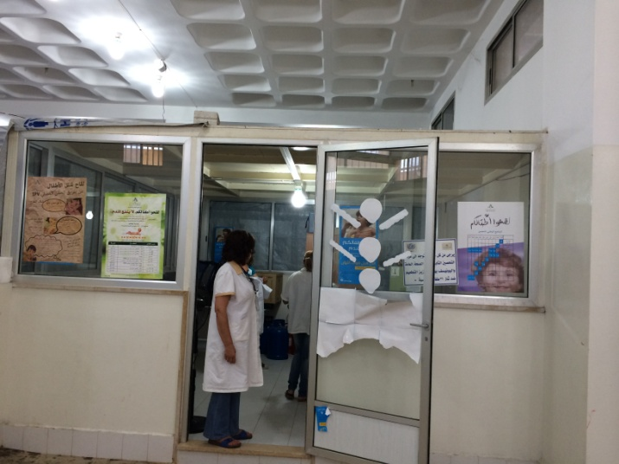
Cross border, UNHCR centers and airport vaccination activities 2014, Lebanon
Cross Border check points
Sites | Abboudieh | Aarida | Bkayah | Masnaa | Airport
OPV | 16,217 | 12,873 | 8,917 | 41,819 | 53,623
UNHCR
UNHCR Registration sites
Sites | Beirut/M Lebanon | Tripoli | Zahle | Tyre
OPV | 11,110 | 58,110 | 87,908 | 24,594
Border Teams
80,000 OPV doses have been given at the Border
180,000 OPV doses have been given at UNHCR registration centers
53,000 OPV doses have been given at Airport for all ages coming from infected countries

Slide 19
Vaccination team at airport

Slide 20
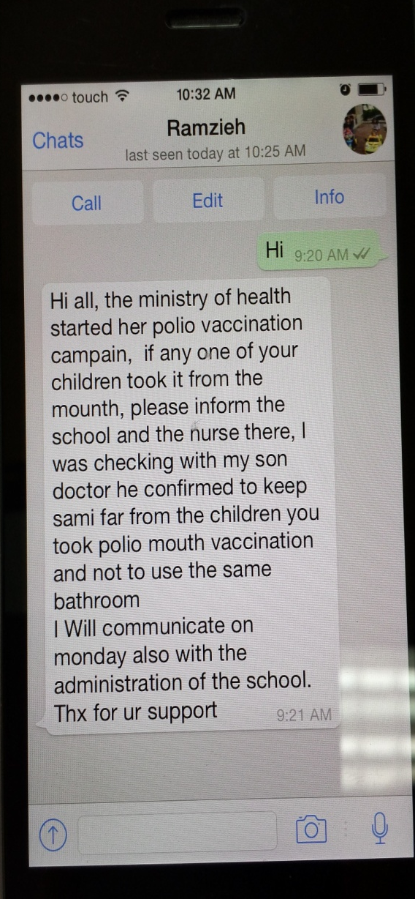
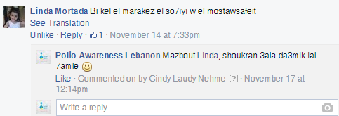
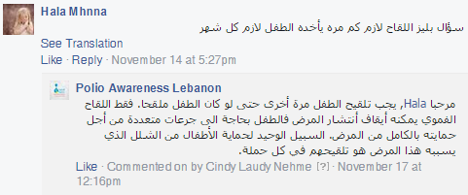
For any action, immediate reaction
WhatsApp against
Facebook Engagement
The Facebook page became the go-to platform for Lebanese to request information, interact with the campaign and encourage their peers to vaccinate their children. As usual, electronic platforms are also a source for misinformation – by being aware of this, however, we also have the opportunity to respond and correct.

Slide 21
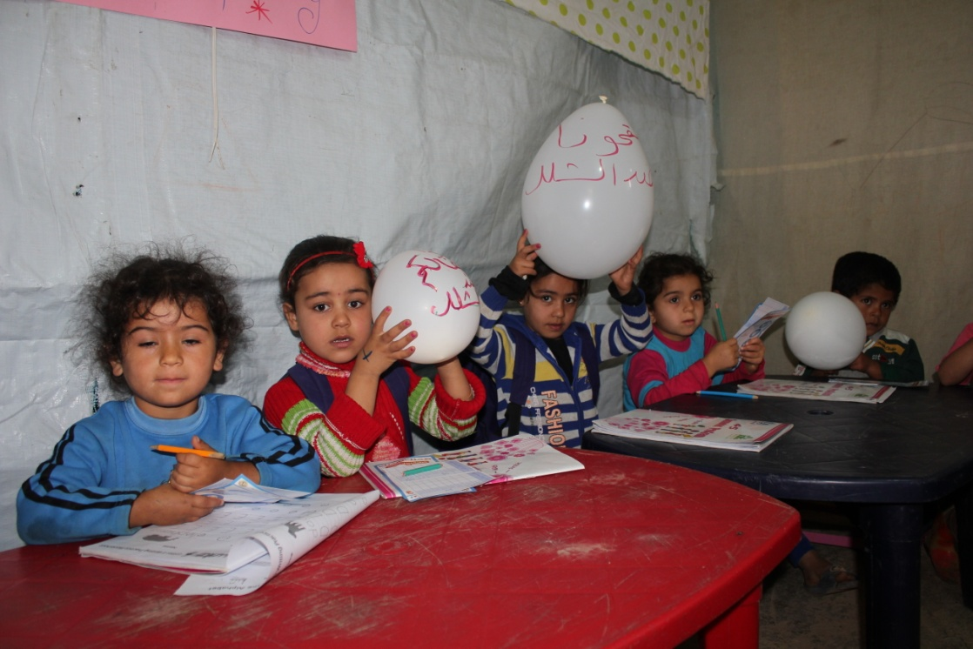
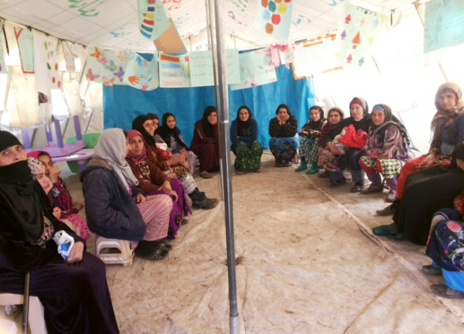
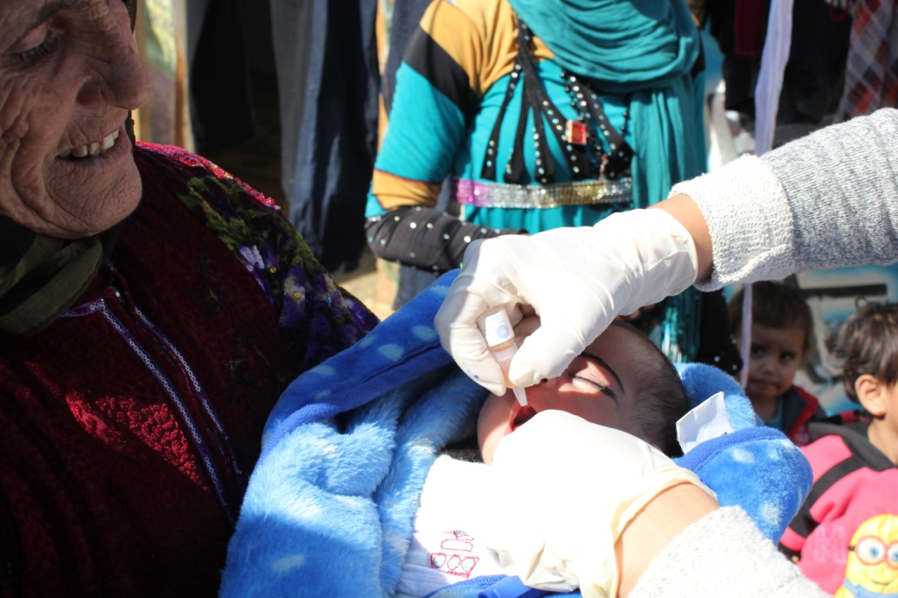
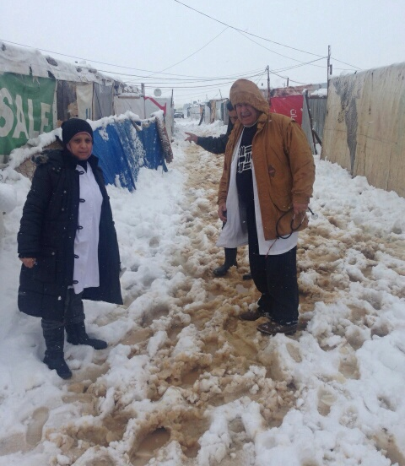
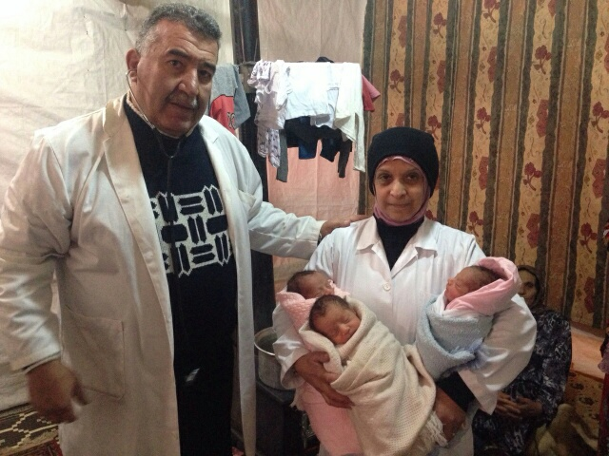
Beyond Polio in ITS
HealthEducation
School Education
Tent to tent OPV
Difficult to access in the winter but succeeded to reach in time to attend the delivery

Slide 22
Total SIAs response
56 SIAs rounds conducted across the ME countries(in coordination with UNICEF, WHO,NGOs, Beyond,IRC,and Rotary in Lebanon)
142,859,279 OPV doses administered

Slide 23
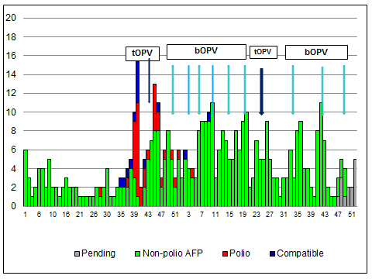
Impact of response on polio cases – Syria

Slide 24
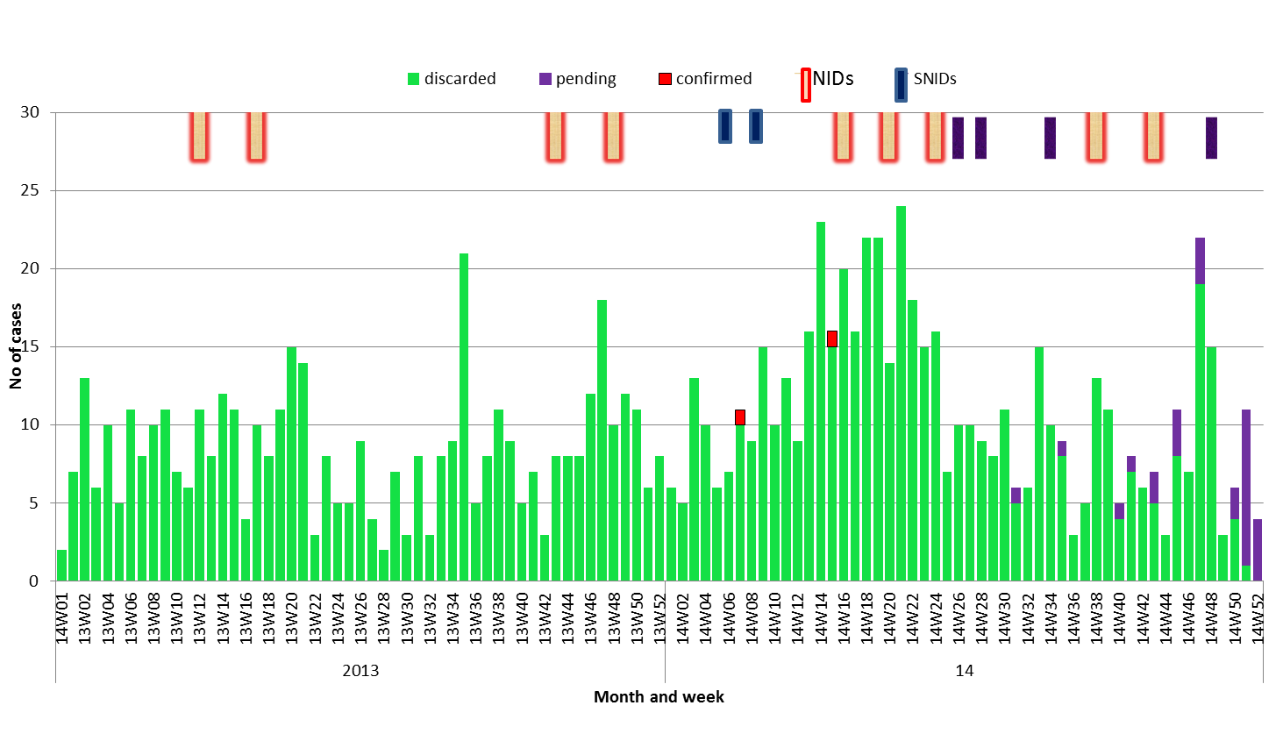
Impact of response on polio cases – Iraq

Slide 25
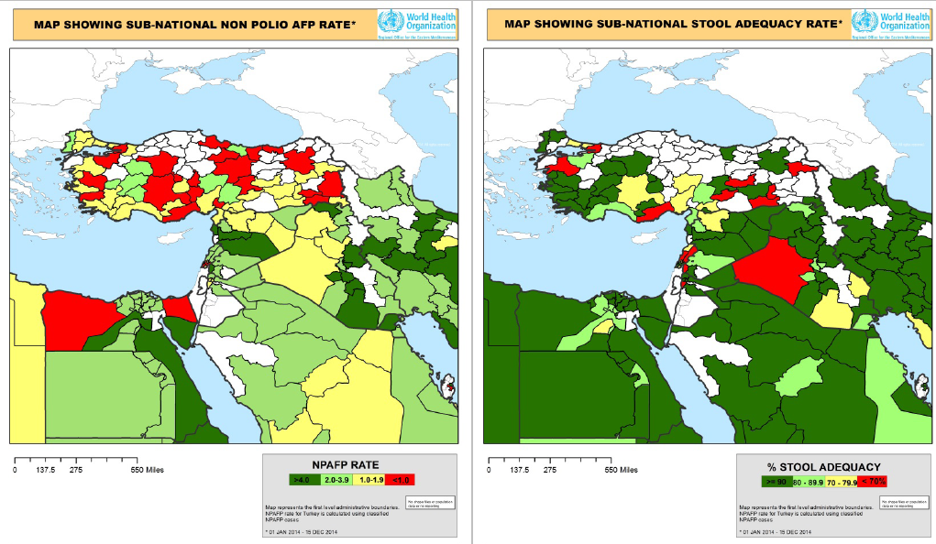
Sub-national AFP and adequacy rates

Slide 26
Conclusions: Middle East Outbreak
Phase I and II response completed successfully
Despite serious & continuing conflict, SIAs & surveillance activities have been implemented
Immunization status of children in all response countries has improved
AFP surveillance has improved
It seems that ME polio outbreak came under control, however we have to be cautiously optimistic ….No complacency!
Major risks revolve around conflict, population movement, and changes in access

Slide 27
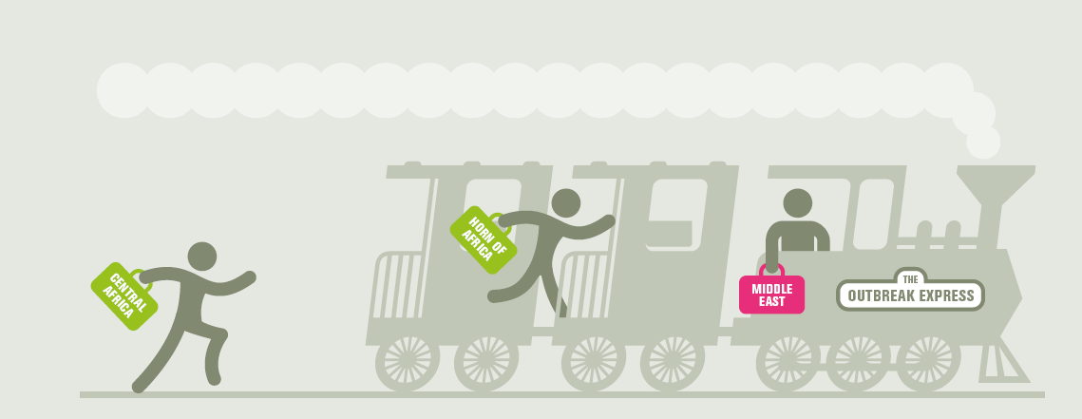
Thank you

