Slide 1
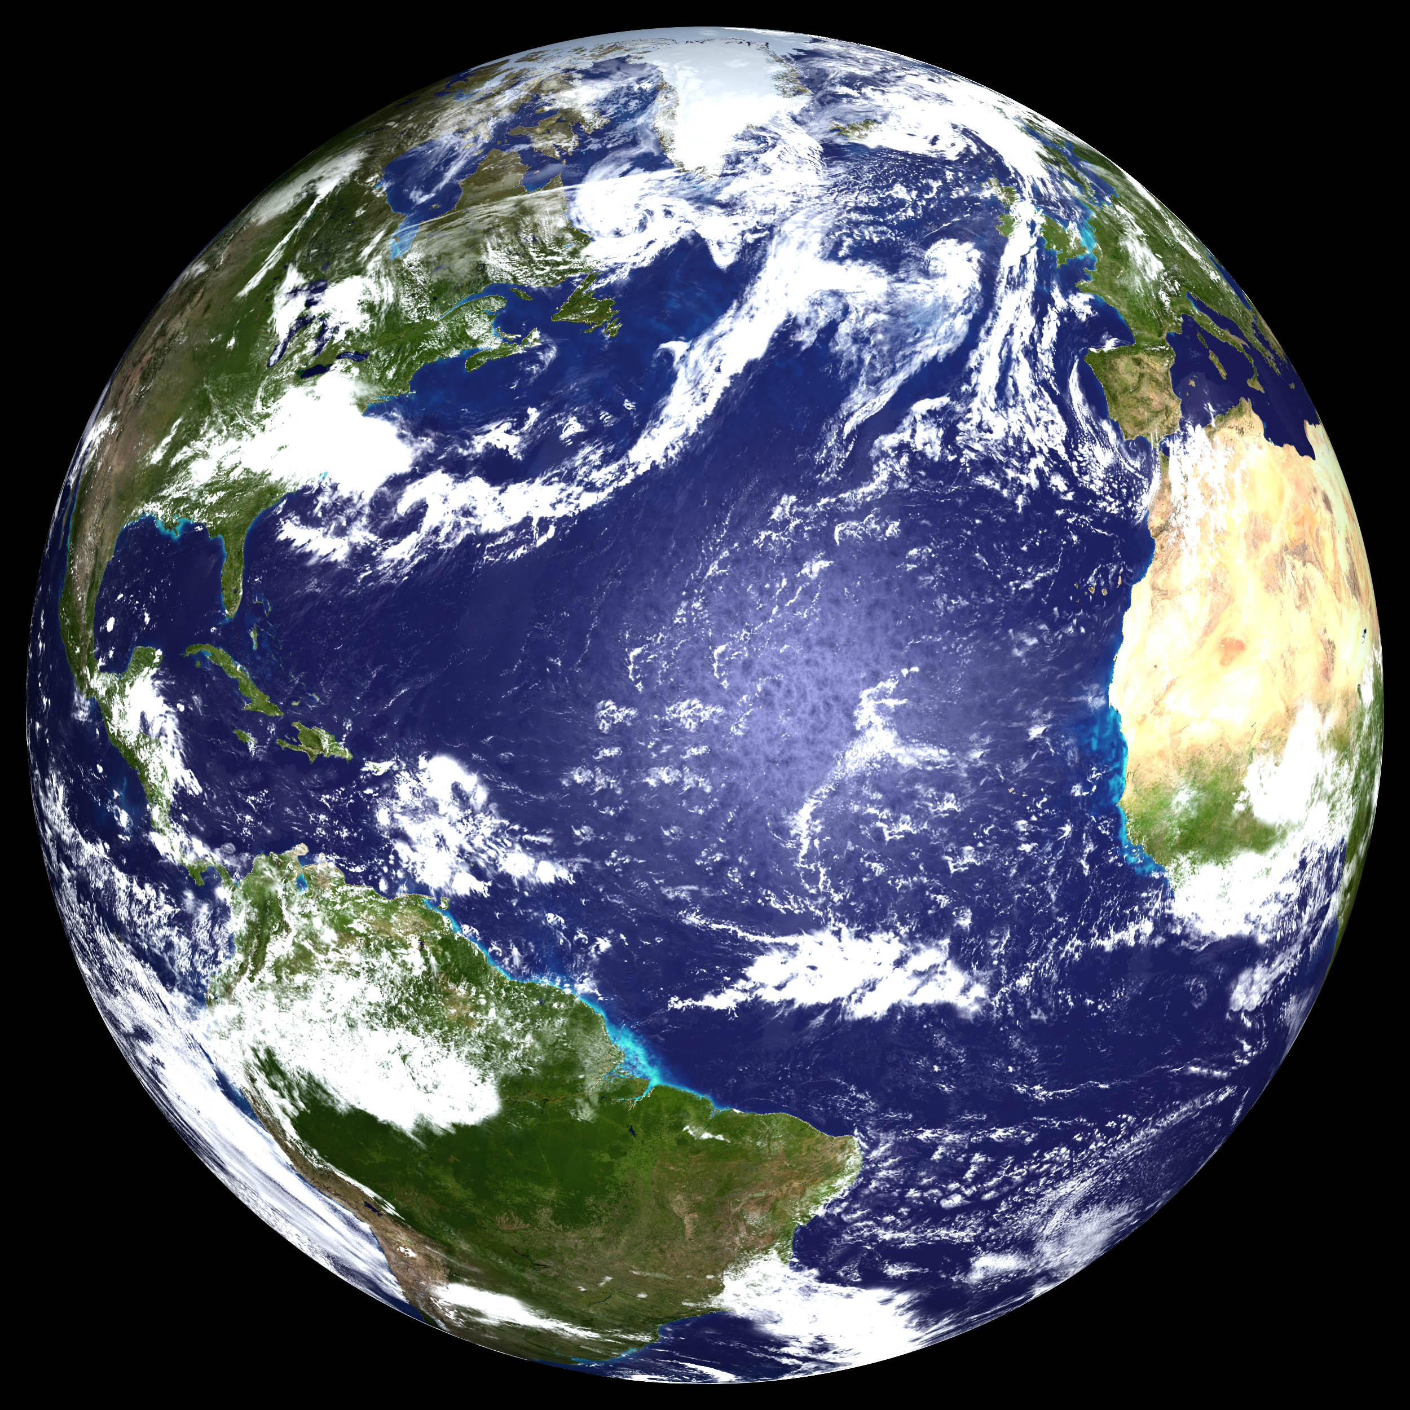
Invariant Mathematical Structures & Angular Momentum in Ocean Dynamics and Implied drift of Oceanic Monopolar Planetary Vortices
Ramses van der Toorn
Delft University of Technology

Slide 2
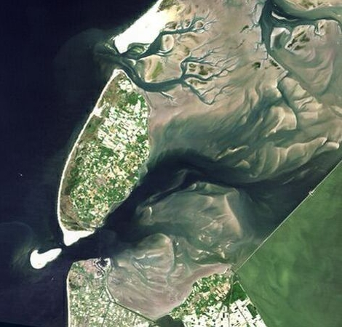
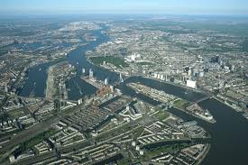
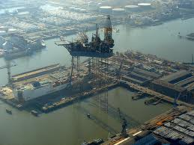
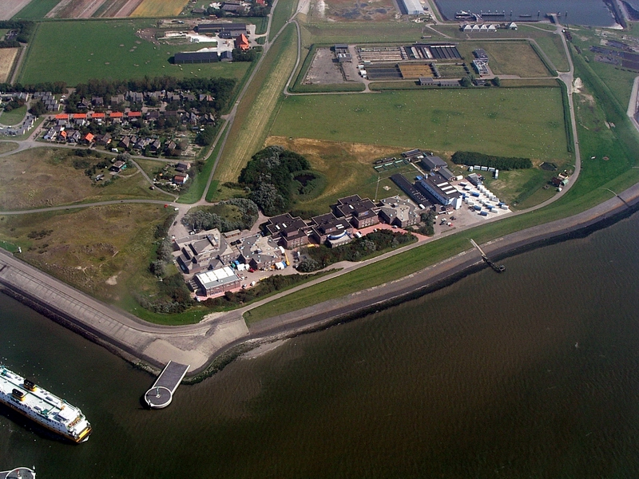
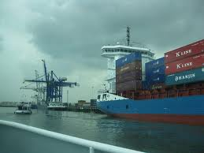
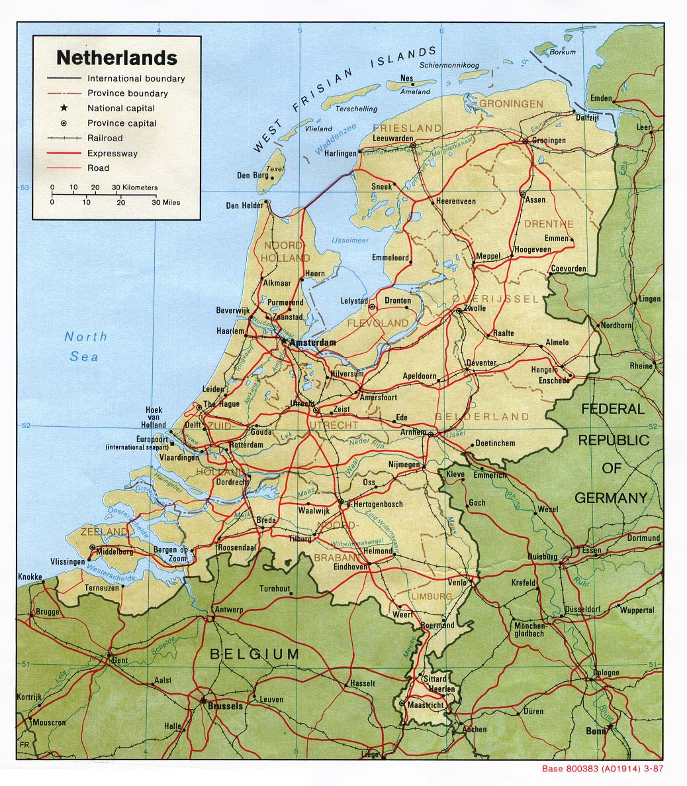
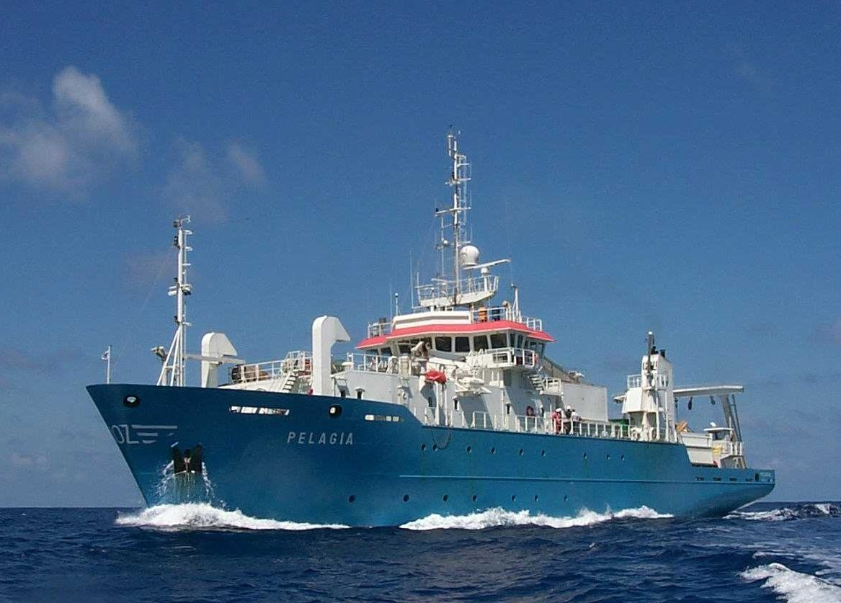
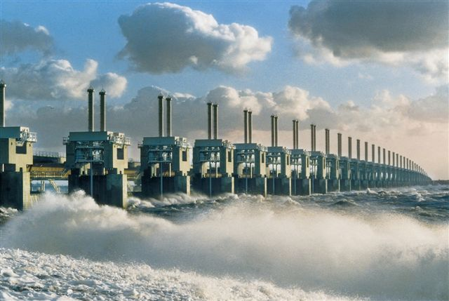
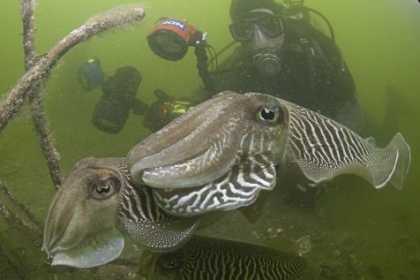
The Netherlands: water land
Netherlands Institute for Sea Research
Oosterscheldekering (1986)

Slide 3
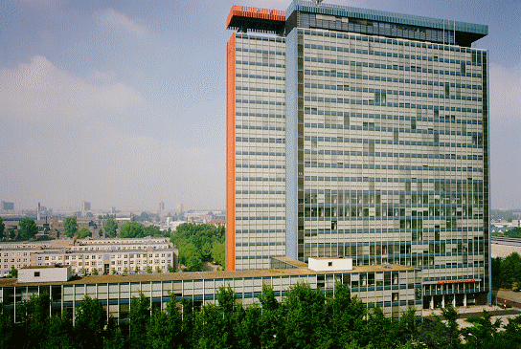
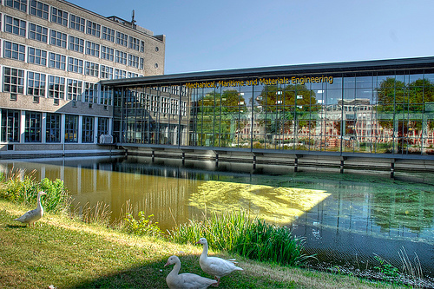
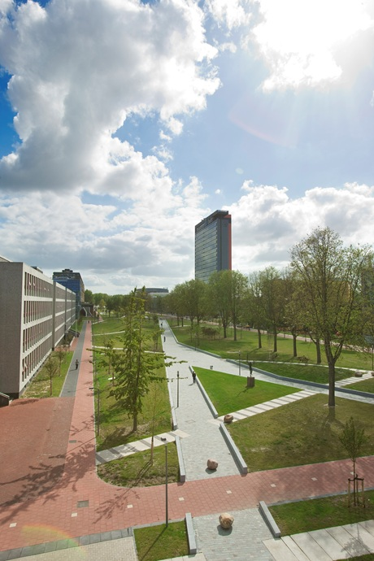
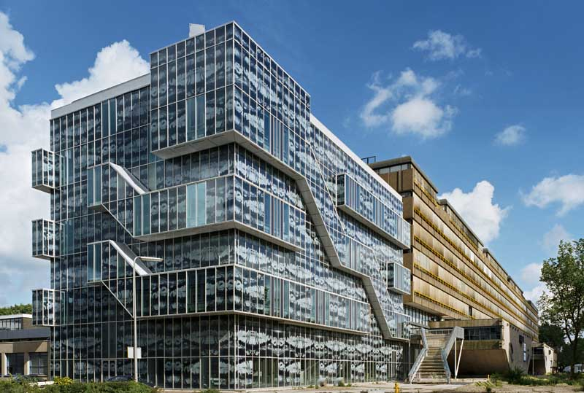
Delft University of Technology
Math, Computer Sc. and E-Engineering
Maritime Engineering
Geo- and Civil Engineering

Slide 4
Overall Research Theme
Math, Computer Sc. and E-Engineering
Application / Applicability of Math
to
Conceptual Understanding
of
Processes in the Oceans

Slide 5

This Presentation
Math, Computer Sc. and E-Engineering
Application / Applicability of Math
to
Conceptual Understanding
of
Processes in the Oceans
Intrinsic Drift of Monopolar Vortices

Slide 6
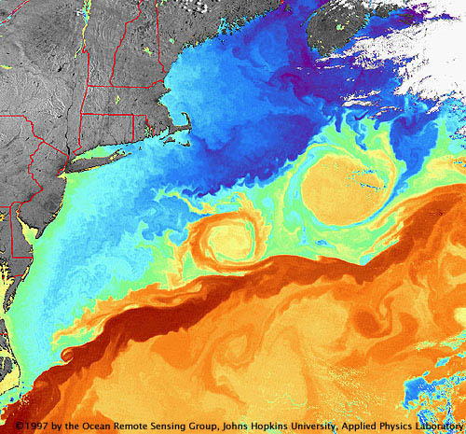
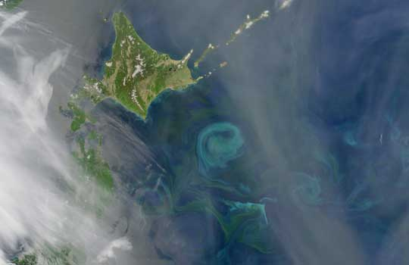
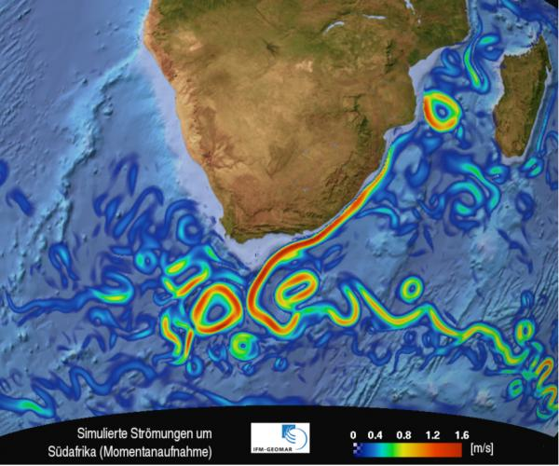
Mesoscale Oceanic Monopoles
Gulf Stream Rings...
swirling phytoplankton where warm Kuroshio Current collides with the frigid Oyashio Current
Ring shed from
Agulhas current
Strong Western Boundary Currents Shed Strong Oceanic Vortices

Slide 7
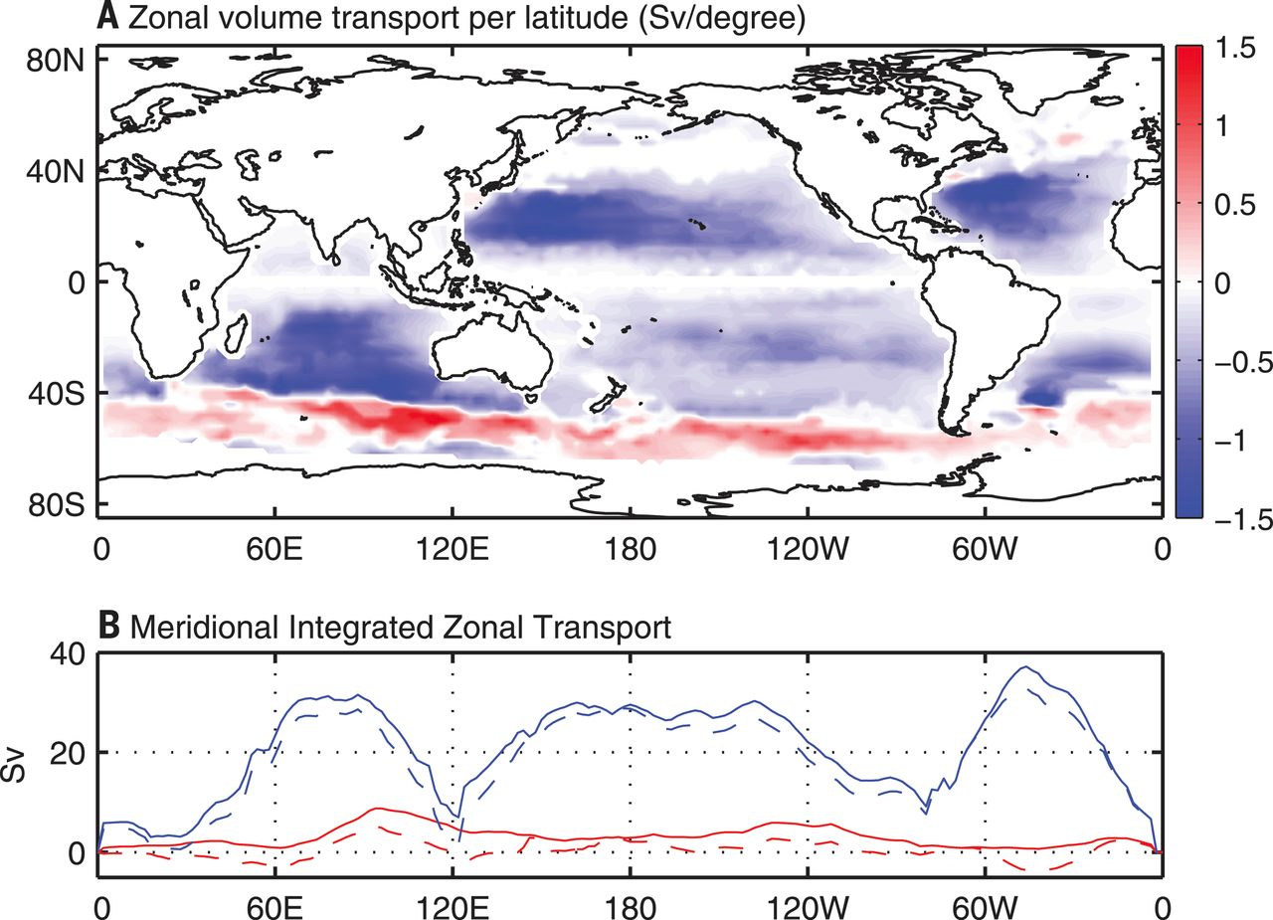
Mesoscale Oceanic Monopoles
Observed zonal transport by mesoscale eddies in the oceans:
"..magnitude comparable to large scale wind- and thermohaline-driven circulations."
(Zhang & Qiu,
Science, June 2014)

Slide 8
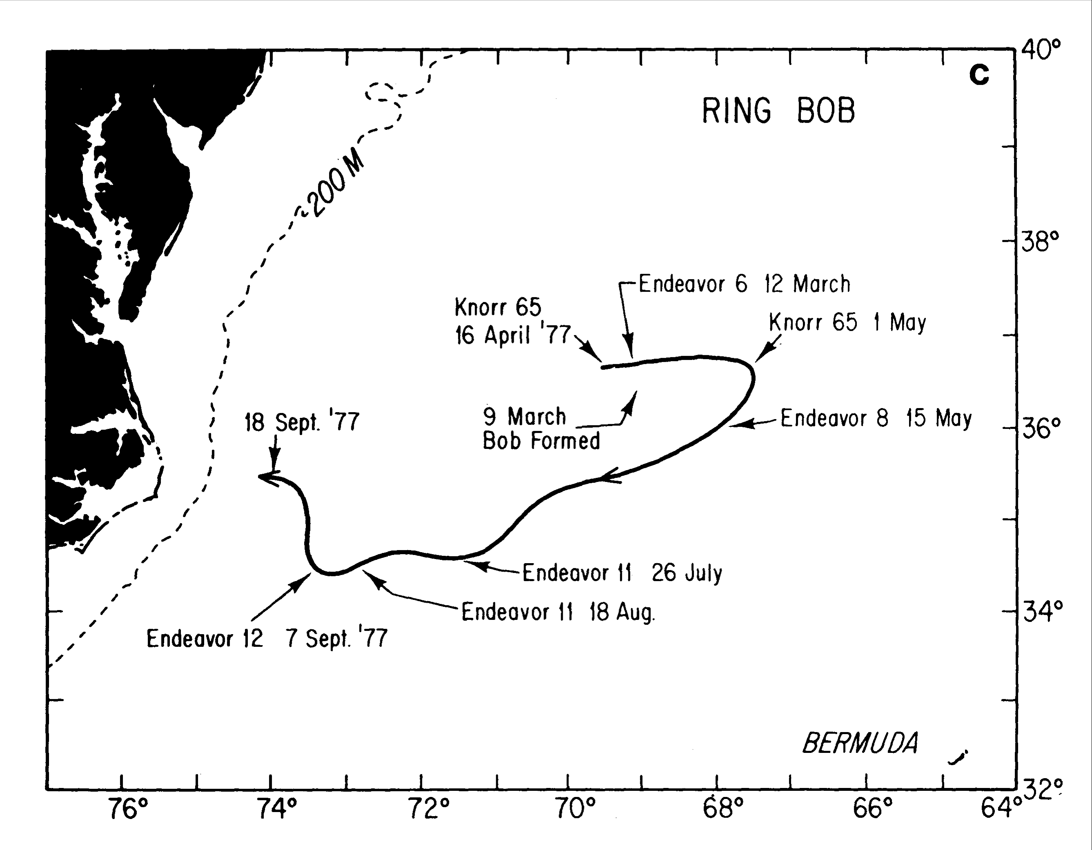
Intrinsic Drift; Observations
“Bob” (1977)
Polymode (‘77 – ’78)
The Soviet Polymode experiment (‘77 – ’78) directly demonstrated intrinsic drift of oceanic vortices: 1 .. 6 cm/s.
Meddy (1976)

Slide 9
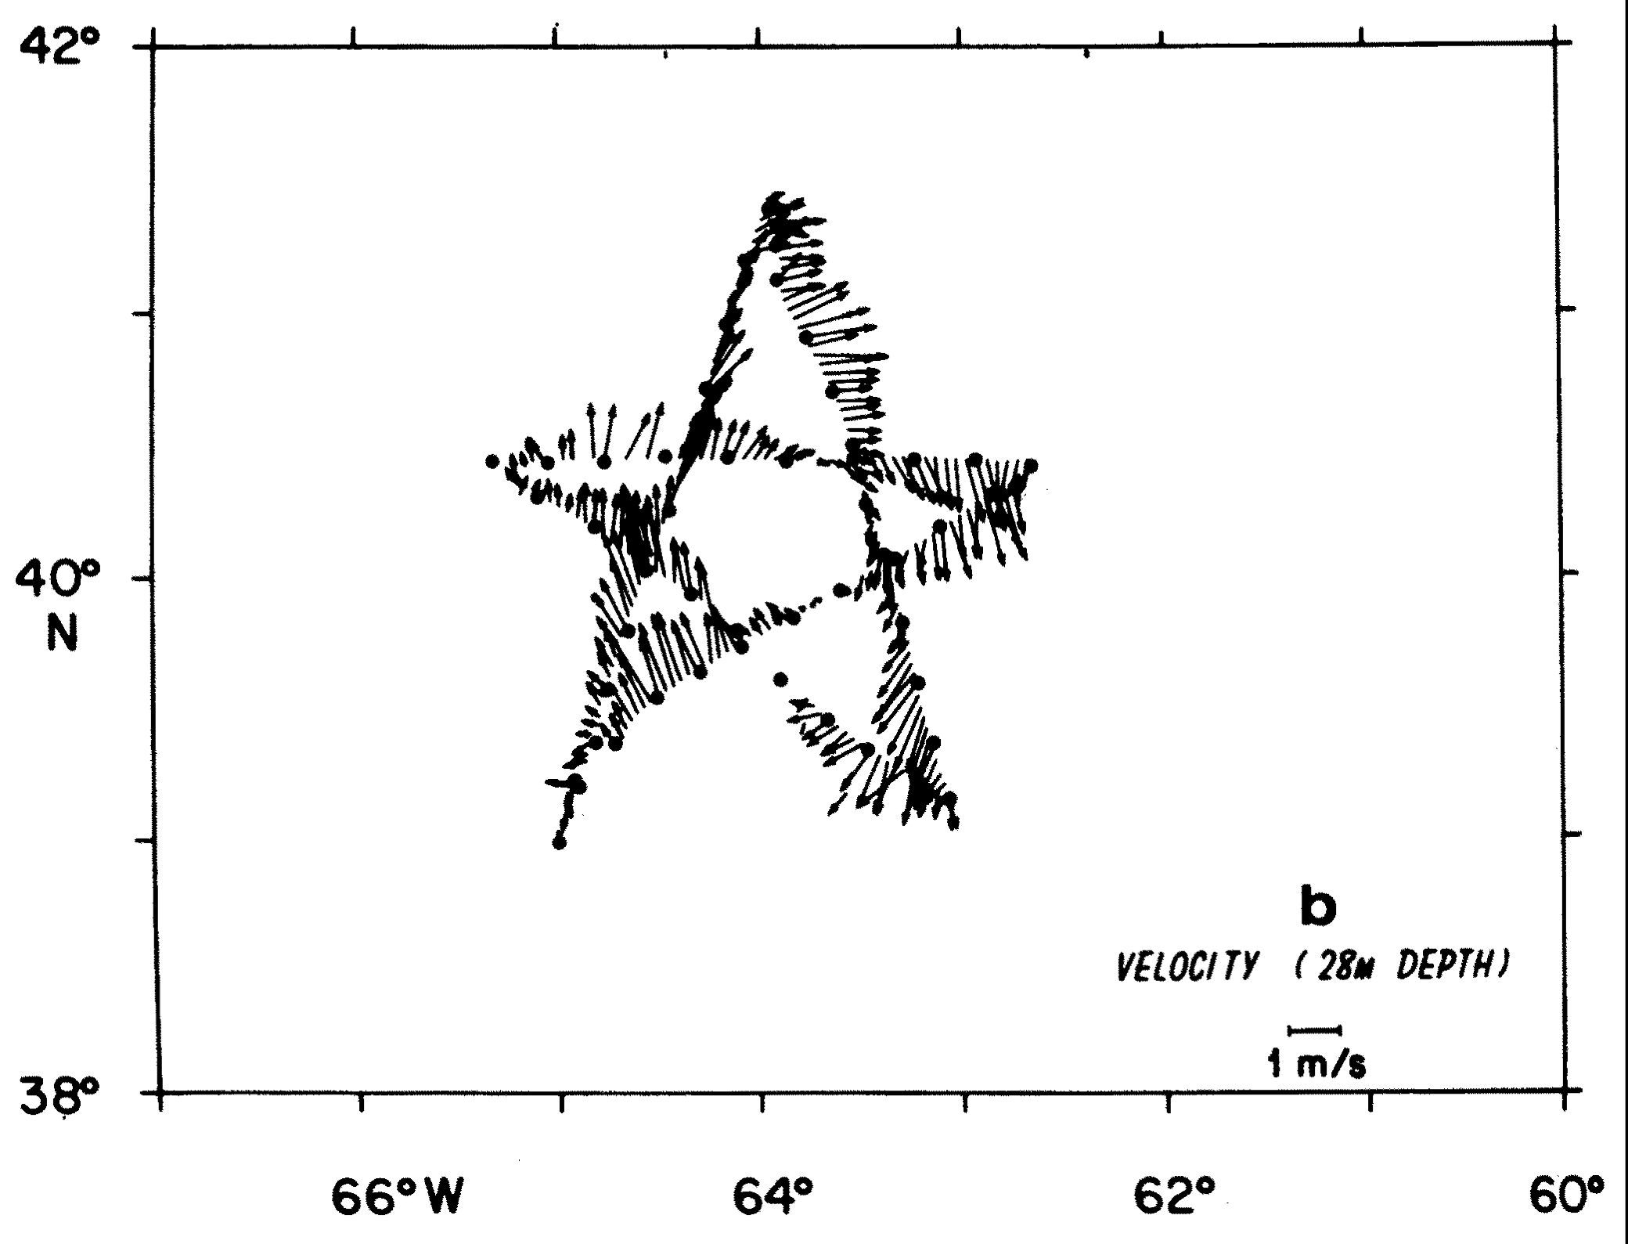
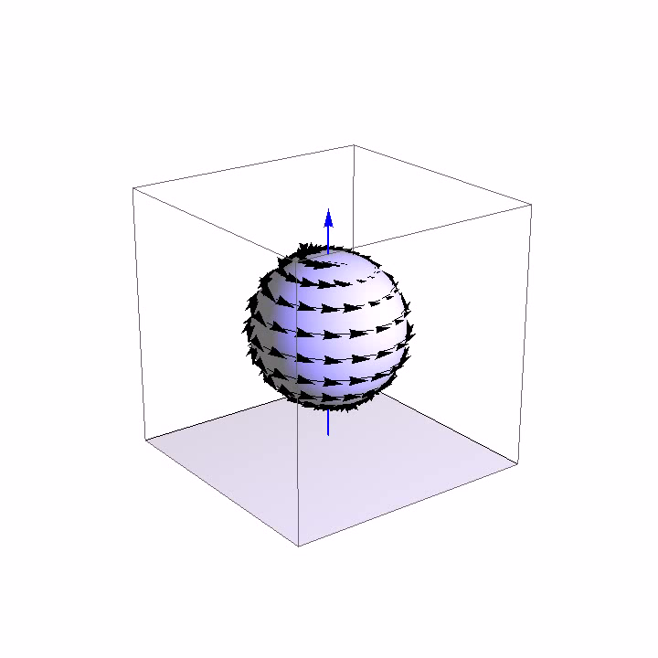
Scientific Method
Applied Math / Mathematical Physics
Mathematics
a
Science of Structures,
as such
?

Slide 10
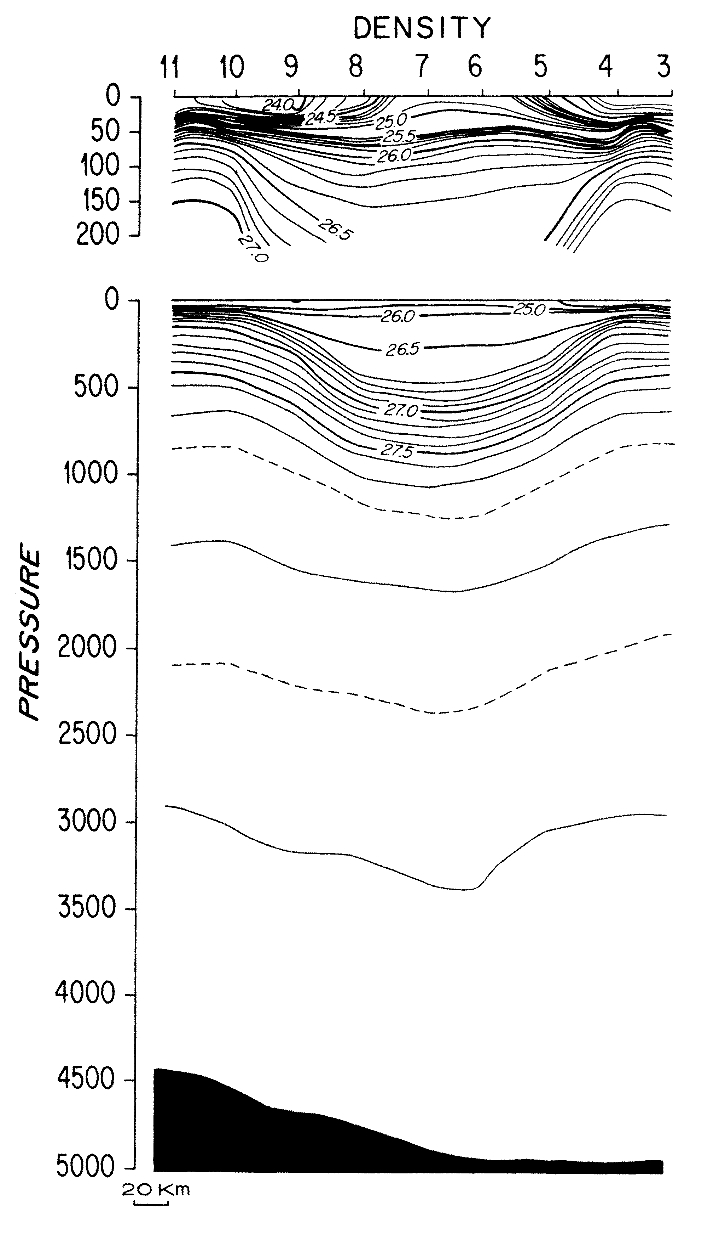
Sc. Method: "Mathematical Structures 1"
Simple Mathematical Structures in the Ocean Sciences:
Directly observable:
scalar fields:
density distributions
vector fields:
velocity distributions
Structure of an Anti-Cyclonic Gulf Stream Ring (Joyce, JPO, 1984)

Slide 11
Sc. Method: "Mathematical Structures 2"
Fundamental Mathematical Structures in the Ocean Sciences:
"Laws of Nature":
Universal, preserved, obeyed patterns in the apparently ever changing world
Differential Equations :
conservation laws:
    e.g. mass
  dynamics:
    e.g: momentum balance

Slide 12
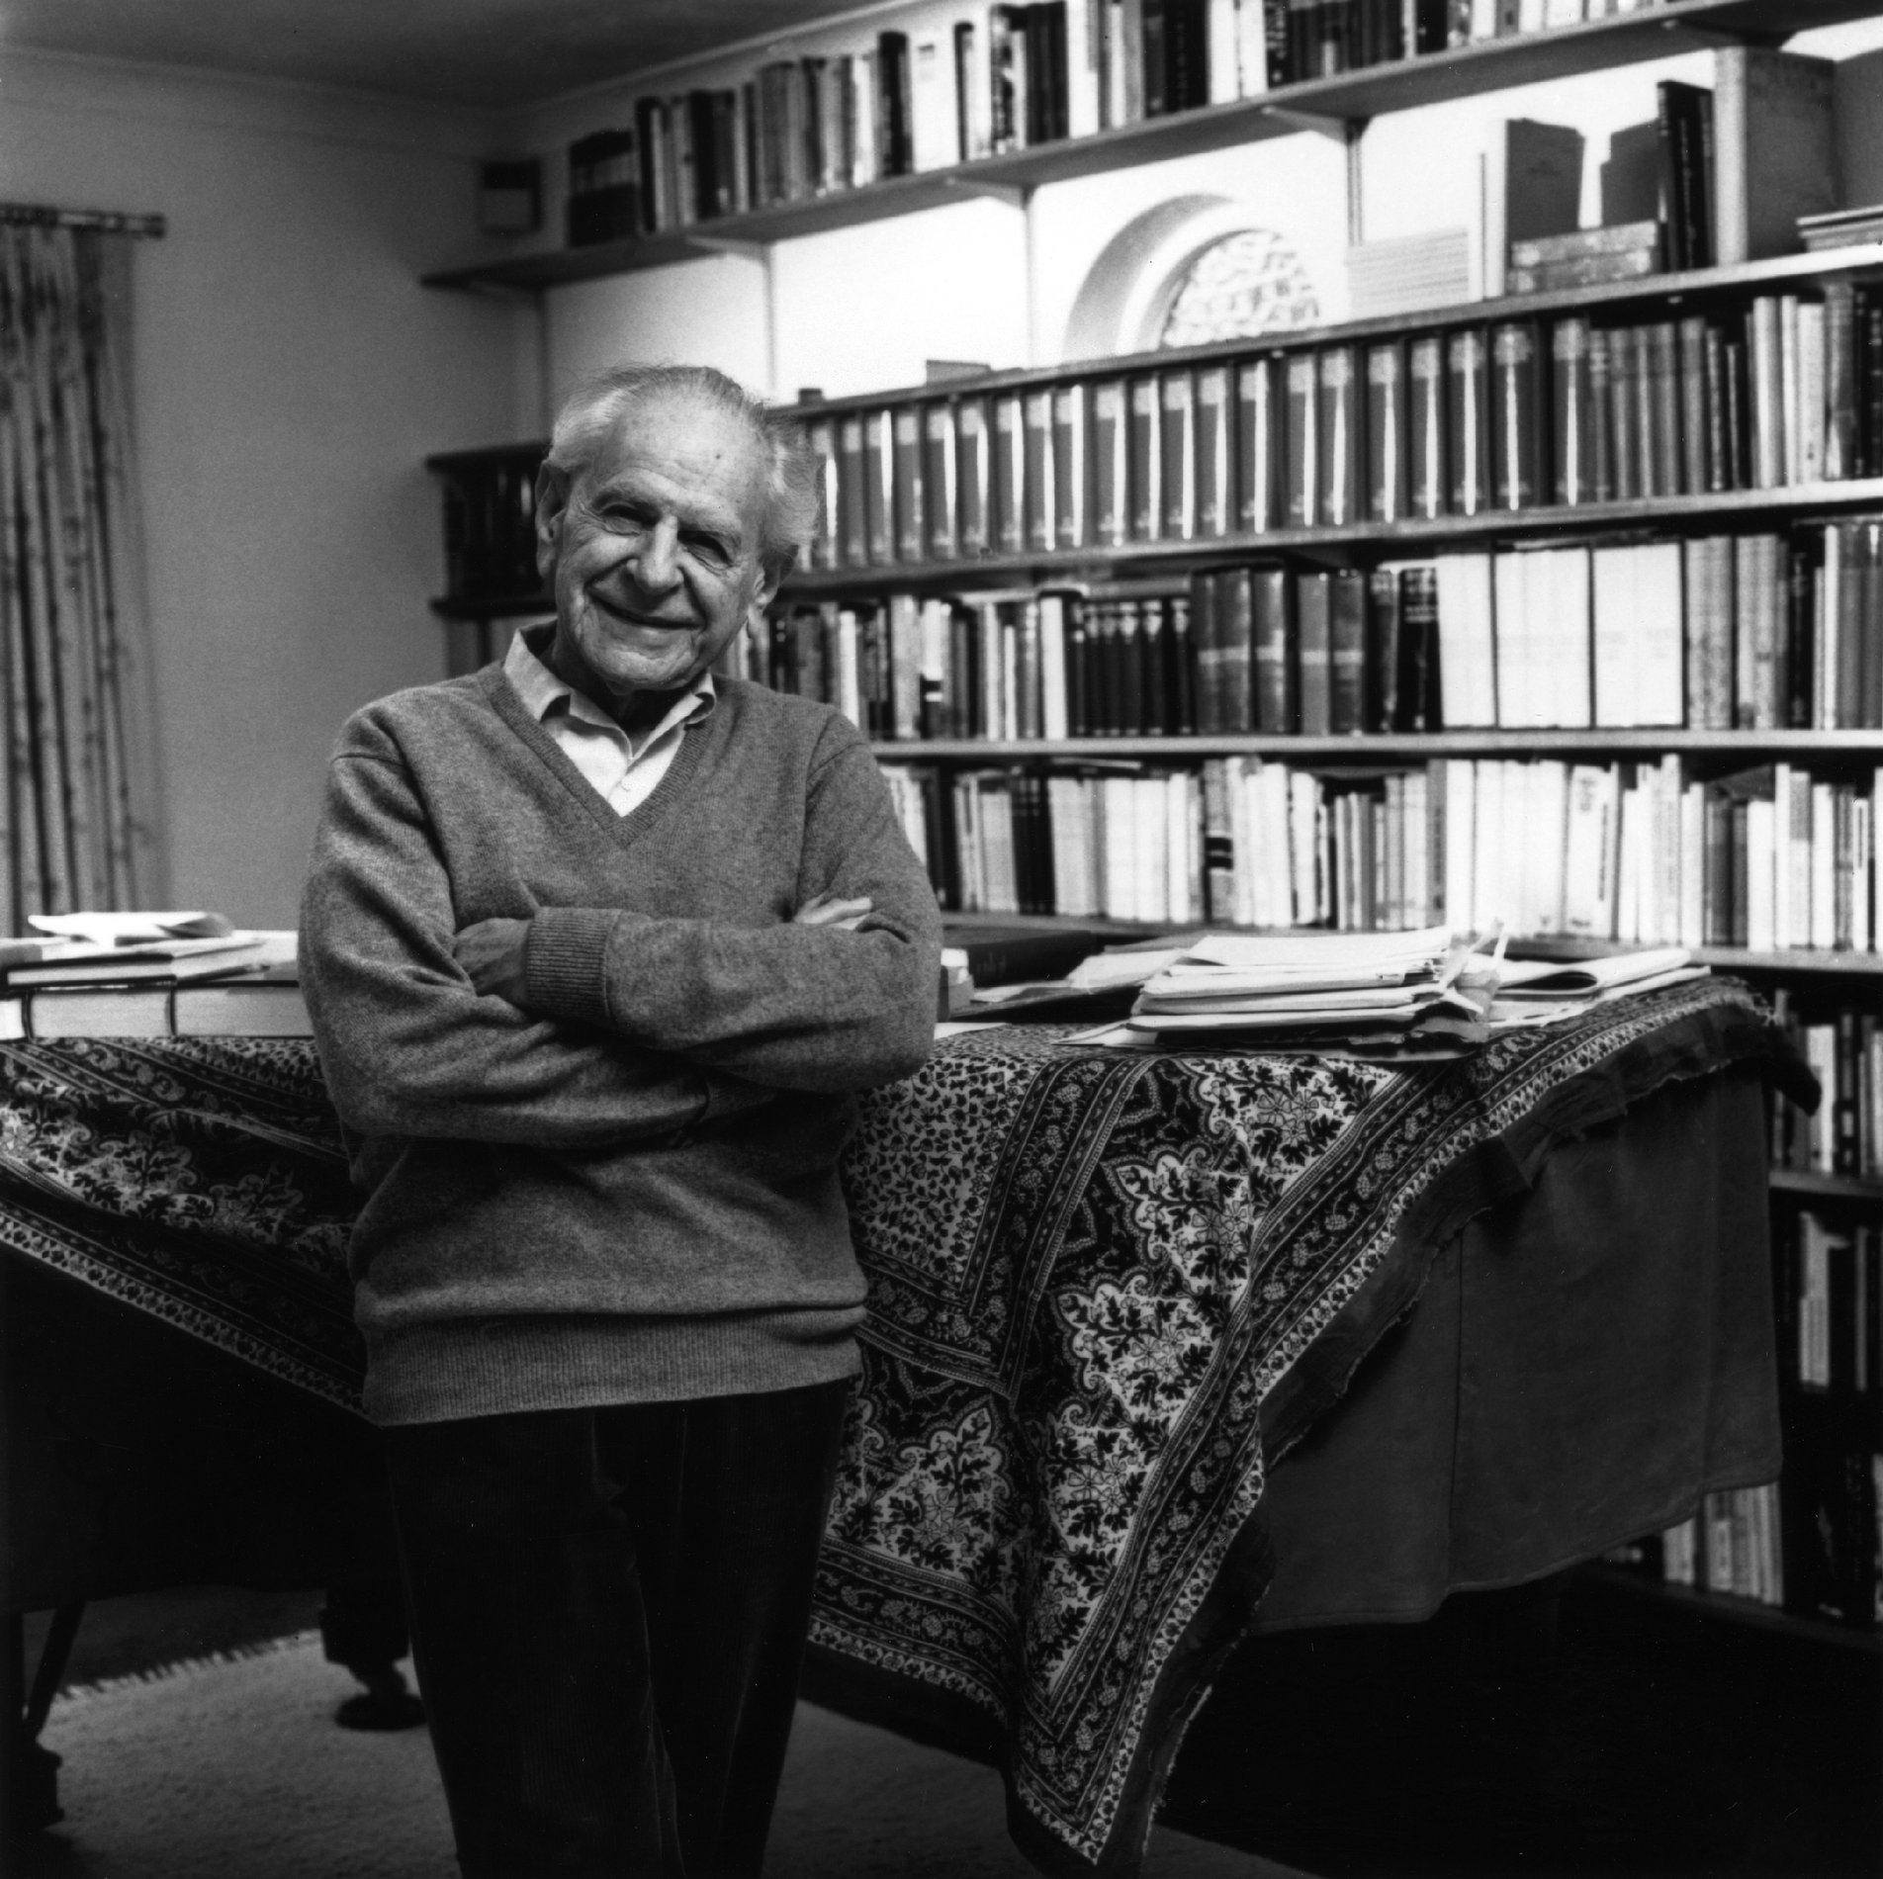
Sc. Method: "Implications of the Laws"
Fundamental Mathematical Structures in the Ocean Sciences:
"Laws of Nature":
Universal, preserved, obeyed patterns in the apparently ever changing world
Differential Equations :
Mathematics of solving DE's:
  study the implications of the Laws
  show observed functions obeys them indeed (i.e. test* of our knowledge of the physical world)
*: "Logik der Forschung",
Karl Popper (1935)

Slide 13
Mathematical Structures 3
Deeper Mathematical Structures in the Ocean Sciences:
"Invariants":
Remark: functions describing observable fields change with change of coordinate system
behind these different descriptions, are the invariable, independently existing entities.
Geometrical Objects :
branches of Mathematics:
  general tensor calculus
  group theory
  ..

Slide 14
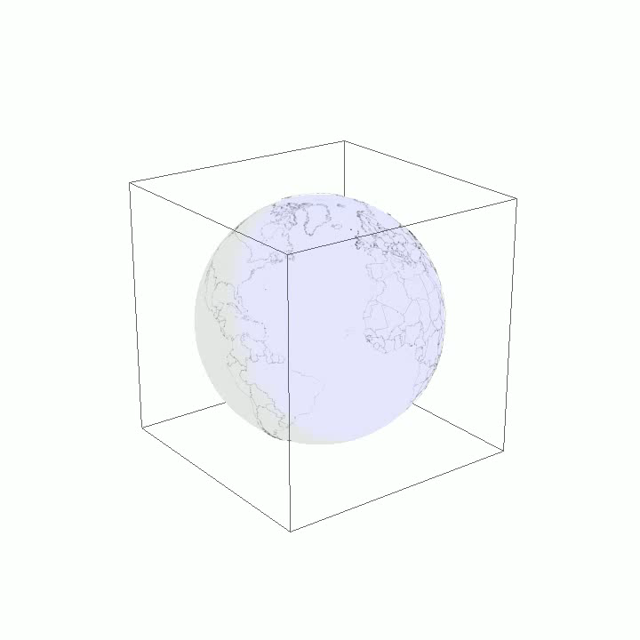
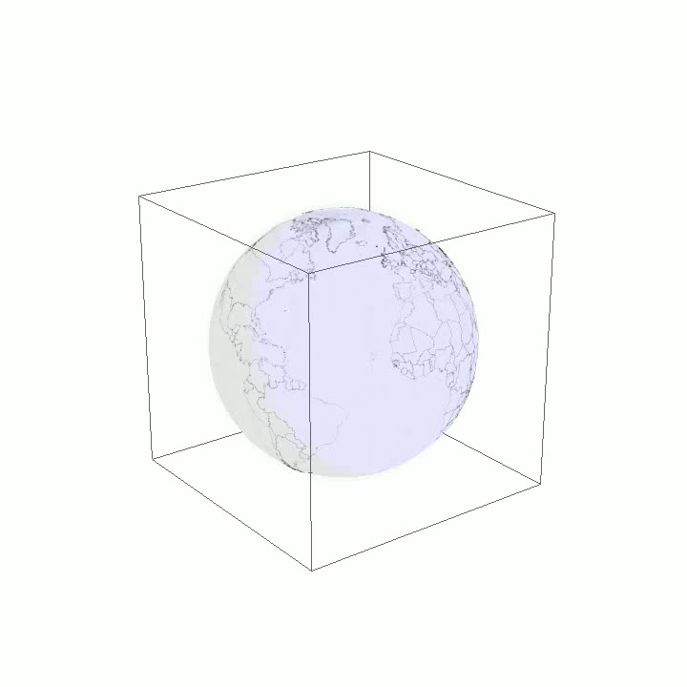
Mathematical Structures 3
Deeper Mathematical Structures in the Ocean Sciences:
Game: change coordinates and construct objects that don't change along.

Slide 15
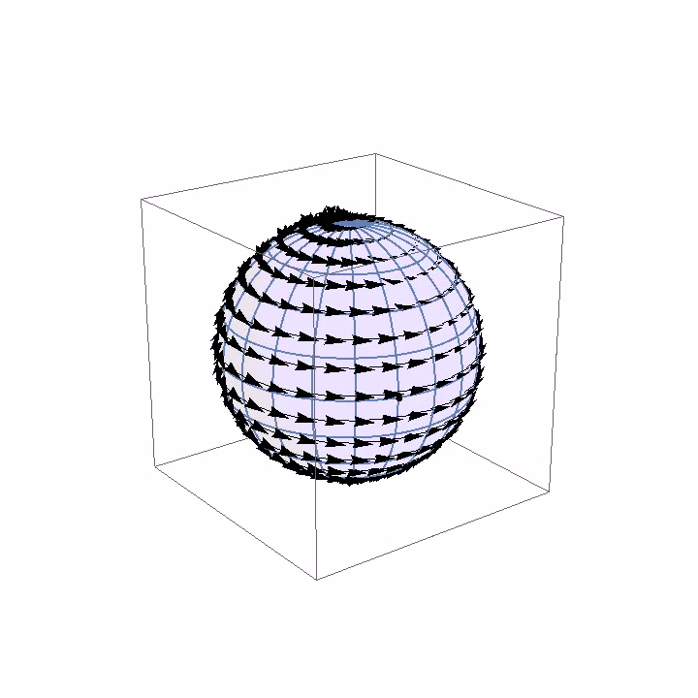
Invariants
Invariants: what lies behind the coordinate representations??

Slide 16
Symmetry of a Sphere
A Sphere is symmetrical
Shape is invariant, when we rotate it.
An infinite sea of possible rotations exists.
  We can e.g. choose from an infinite amount of different orientations of the axis of rotation.

Slide 17
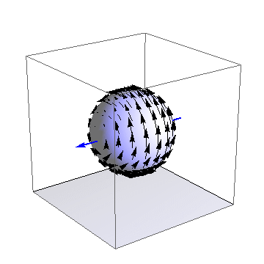
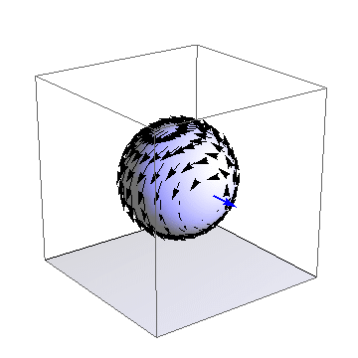
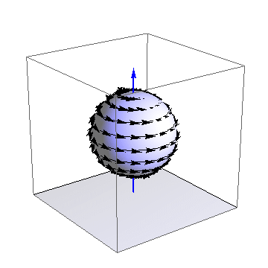
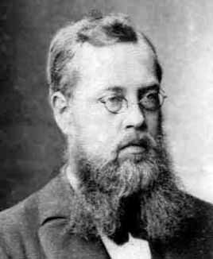
Lie Group of Rotations
Rotations form a Lie group
Sophus Lie (1842 – 1899)

Slide 18
Lie Group of Rotations
r₁
r₂
Rotations: Lie group so(3):
All rotations can be generated from a weighted sum of 3 basic generators
product [.,.]: [r₁, r₂] = -r_{3 .....} and cyclic
=> “Lie Algebra”
=> closed structure, under this sum and product,
r₃

Slide 19
Lie Group of Rotations
r₃
r₃
r₂
r₁
r₂
r₁
Rotations: Lie group so(3):
All rotations can be generated from a weighted sum of 3 basic generators ( => 3-dimensional)
Lie product [.,.]: [r₁, r₂] = -r_{3 .....} and cyclic => “Lie Algebra”
inner product: <r_{i}, r_{j}> = δ_{ij} => enables projection of fields
onto the so(3) algebra ...

Slide 20
Lie Group of Rotations
r₃
r₃
r₂
r₁
r₂
r₁
Rotations: Lie group so(3):
inner product: <r_{i}, r_{j}> = δ_{ij} => enables projection of fields
onto the so(3) algebra ...
so any vector field has 3 independent so(3) components
one can construct the dynamics of these!

Slide 21
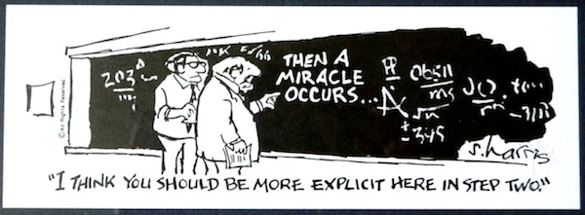
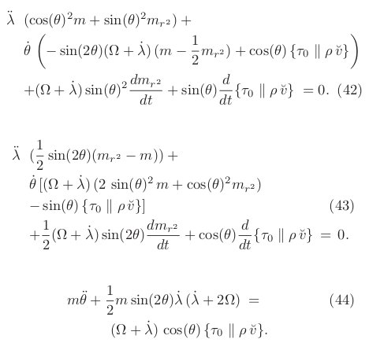
Mathematical formulation:
  3 equations (ODE): one for each basis element of the so(3) Lie algebra:
  momentum balance is projected on these
  Physics: Integral Angular Momentum Equations.
(v.d Toorn & Zimmerman; Journal of Mathematica Physics, August 2010)

Slide 22
The Angular Momentum Balance
Mathematical formulation:
  3 equations (ODE): one for each basis element of the so(3) Lie algebra:
  momentum balance is projected on these
  Physics: Integral Angular Momentum Equations.
(v.d Toorn & Zimmerman; Journal of Mathematica Physics, August 2010)

Slide 23
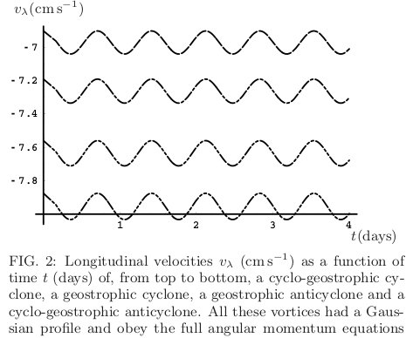
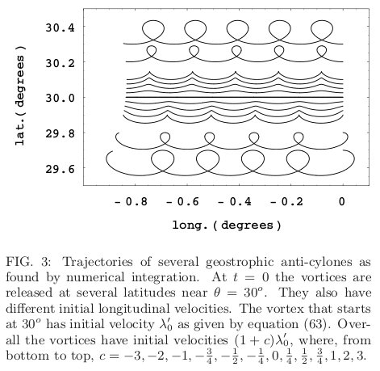
Results: Velocities, Trajectories.
(v.d Toorn & Zimmerman; Journal of Mathematica Physics, August 2010)

Slide 24
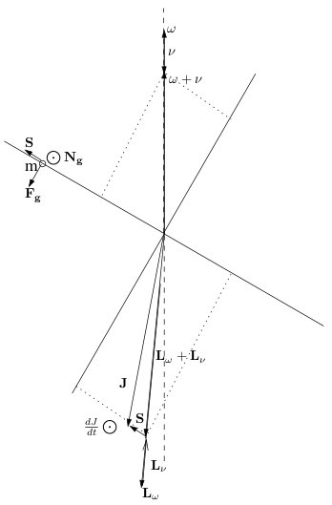
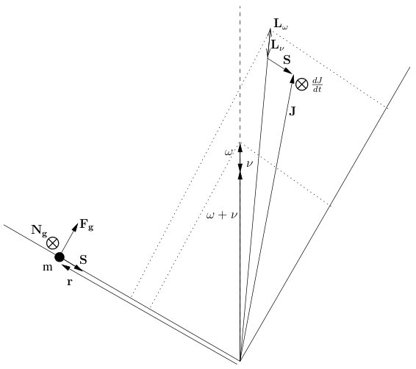
Ocean Vortex Angular Momentum Balance
Cyclones vs. Anti-Cyclones
Opposite Orientation of Spin
Opposite sign of (surplus) Mass
  Low Pressure vs. High pressure cores!
All go Westwards
(as opposed to the gyroscope)

Slide 25
Inventory of Results
Reproduced Intrinsic Westward Drift of Oceanic Monopoles
  right direction, correct speed,
  including well known integrals in GFD lit. for this speed
  global result: "westward" = along latitude circles
Demonstrated that 1 is implied by Classical Fluid Mechanics,
projected onto so(3).
Results at a deeper level:
  identified relevant invariants (metric, isometry group)
  shown how these form building blocks for the "laws of nature"
  show how all this implies vortex drift
  unified vortex drift with rigid body mechanics ("spinning tops")

Slide 26
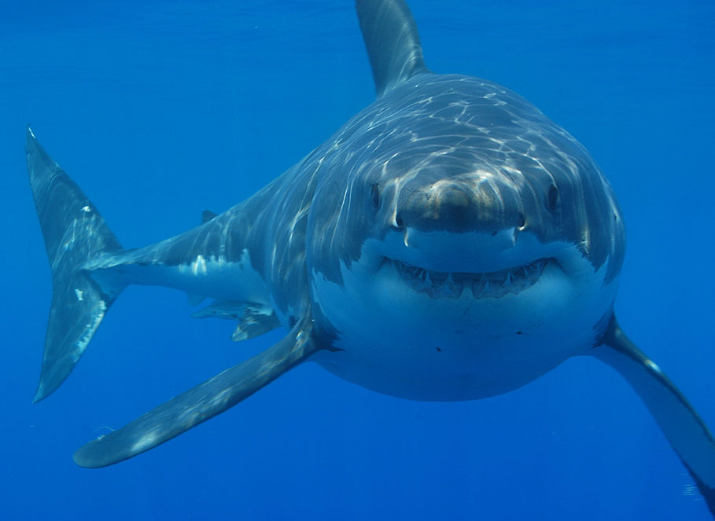
Thank you. Any questions?

Slide 27
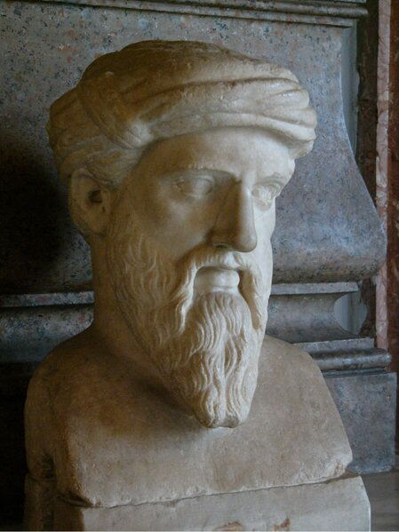
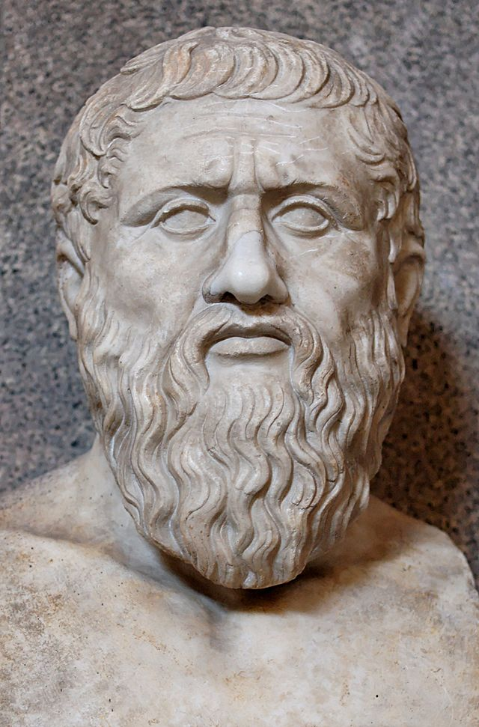
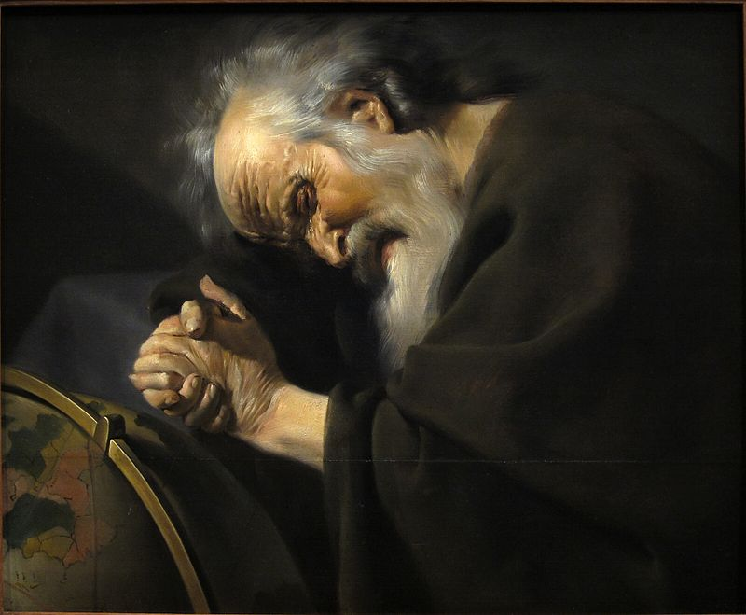
"The Problem of Scientific Knowledge*"
Mathematical Structures in the Ocean Sciences:
Constant Quantities
and Qualities..
..in the real world,
which is in flux.
**: Pythagoras (Πυθαγόρας)
(572 – 500 BC)
Plato (427 - 347 BC.)
Heraclitus (Ephesus,535 – c. 475 BC),
by Johannes Moreelse(1603-1634)
*cf, eg: "Logik der Forschung", Karl Popper (1935)

Slide 28
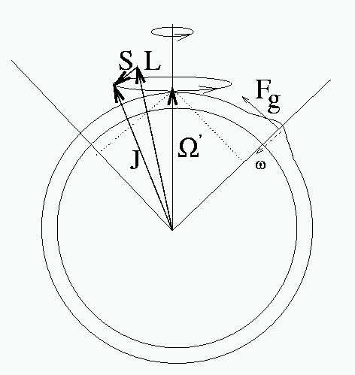
The Full Picture: Vortex on a Rotating Sphere
Broken Spherical Symmetry
  Due to spinning of planet
=> Angular Momentum Dynamics
  Not Constant Angular Momentum
  Yet (Relatively) Simple Dynamics
Angular Momentum Dynamic Balance
Rate of Change of Total Angular Momentum
Horizontal Surplus/Deficit of Gravitation in Coordinate System, fixed to the Vortex, hence Rotating with Respect to the Planet.
(v.d Toorn & Zimmerman; Journal of Mathematica Physics, August 2010)

Slide 29
Dimension of Group of Rotations
situation's dimension?
  A: 1
  B: 2
  C: 3 is the number of variables (x, y, z) needed to fully characterize any rotation!
  D: infinite
z
axial vector
y
x

Slide 30
Spinning sphere: big centrifuge
situation's dimension?
  A: 1 dominating
  axis of spin!
  B: 2
  C: 3
  D: infinite
On a spinning homogeneous sphere, the size of the earth, the depth of the oceans would be:
if 2 km at the poles
then 13 km at the equator!

Slide 31
Real Planet: Horizontal Gravitation
In reality, the oceans are approximately of constant depth all over the planet
Centrifugal effect tends to make it considerably deeper at the equator that at poles,
however, it is compensated...

Slide 32
Horizontal Gravitation
F_{g}
Ocean is approximately of constant depth all over the planet
Centrifugal effect tends to make it considerably deeper at the equator that at poles
Hence centrifugal force must be balanced:
  By horizontal component of gravitation
  as induced by deformation of the solid planet.
F_{c}

Slide 33
Horizontal Gravitation
F_{g}
Centrifugal force is balanced:
  By horizontal component of gravitation
  as induced by a deformation of the planet.
  only a slight deformation is sufficient:
  this deformation is geometrically negligible.
F_{c}
(v.d.Toorn & Zimmerman,
J.Geophysical Astrophysical Fluid Dynamics, August 2008)

Slide 34
The shallow ocean
F_{g}
situation's dimension?
  A: 1
  B: 2-dimensional sheet of fluid on a sphere!
  C: 3
  D: infinite
F_{c}
Because the depth of the ocean (~4 km) is small compared to
vortex size (> 100 km)
earth radius (~ 6360 km)

Slide 35
