Slide 1
A
International Conference on Hydrology and Meteorology
On
APPLICATION OF WATER QUALITY INDEX FOR
GROUND WATER QUALITY ASSESSMENT
IN MINING TALUKAS OF GOA
Presented
By
(Research Scholar)
Department of Environmental Science & Engineering
Indian School of Mines,
Dhanbad, Jharkhand
Rakesh Kant Kamal

Slide 2
INTRODUCTION
Groundwater comprises 97 percent of the world’s readily accessible freshwater and provides the rural, urban, industrial and irrigation water supply needs of 2 billion people around the world.
In India almost 80% of the rural population depending on untreated ground water for potable water supplies (Reza et al., 2009).
Groundwater pollution has become a major subject of public concern the world over.
Mining is the major economic activity contributing about 20.4% of GSDP to the State’s economy.

Slide 3
PHYSIOGRAPHY
Goa lies - between N14° 53’ and N 15° 48’ and E 73° 39’ and E 74° 20’ respectively.
Classified in to three types of terrain grading from:
  Low-lying coastal estuarine plains to the west
  Undulating region in the central part
  The steep slopes of the Western Ghats on the eastern border of the state.
STRUCTURAL FEATURES
Goa group -folded and intruded by granite gneiss, felspathic gneiss, hornblende granite and porphyritic granite, followed by basic intrusives
Exhibit evidences of three cycles of folding -resulted in green schist facies of metamorphic rocks
Recent and sub-recent - rocks underwent laterisation resulting in Laterite cover of varying thickness.

Slide 4
IRON ORE RESERVES AND ITS CHARACTERISTICS
Location
North Goa Sector
Central Goa Sector
South Goa Sector
Structure
The rocks trend -NWSE to NNW-SSE in central Goa and the trends towards EW in South Goa
Litho units- highly folded and the rocks attained green schist facies grade of metamorphism
Mineralization
Ore zones -cumulative strike length of 46 Km & width varying 10 m to 1Km
Minerals of iron ore -Hematite, Magnetite and Limonite/ Goethite
Mode of occurrence
Deposits confined to the pink phyllite horizon (Bicholim Formations)
Occurs as blanket and lensoid bodies of varying dimensions
Distribution of Ore
Iron ore deposits- localised in a general NW-SE direction over a length of 95Km from Naibagha in the northwest on the Goa-Maharashtra border, to Saliguinim in the South east near Goa-Karnataka border
Distinct decrease in iron concentration and increase in manganese concentration
Largest iron ore deposits - situated in north Goa

Slide 5
Hydrogeology
PARTICULARS | NORTH GOA | SOUTH GOA
1. Major Water Bearing Formations | Laterite, Alluvium, Granite, Granite Gneiss, Meta Volcanics & Meta Sedimentaries
2. Pre - monsoon depth to water level during May 2011 (in m bgl) | 2.17 to 19.23 | 2.39 to 18.64
3. Post – monsoon depth to water level during November 2011 (in m bgl) | 0.43 to 14.90 | 1.20 to 14.52
Long term water level trend in 10 years (2001 – 2010) (in m/year)
1. Pre - monsoon | Range from a Decline of 8.43m to Rise of 2.72m | Range from a Decline of 0.03m to rise of 2.07m
2. Post - monsoon | Range from a Decline of 1.62m to Rise of 4.13m | Range from a Decline of 0.06m to Rise of 8.24m
Goa: Water Table
On an average from the Surface, water table is encountered at the depth ranging between 10m to 40m bgl (Below Ground Level) and 40m to 10m with respect to MSL.

Slide 6
Aquifer Systems Encountered In The Goa Region
Formation/ Aquifers | Yield (l/s) | Drawdown (m) | Sp. Capacity (m³/d/m) | Transmissivity (m²/day)
1. Granites & Gneisses | 0.34- 8.8 | 17.68- 34.61 | 0.27- 43.00 | 0.2-30.6
2. Metabasalts | 0.18- 9.9 | 1.9- 33.78 | 0.46- 141.20 | 0.2 - 232
3. Metasedimentaries | 0.22 - 10 | 1.32- 34.40 | 0.47- 159.60 | 0.12 – 346
4. Alluvium | 1.8- 2.5 | 0.87- 9.1 | 27 - 200 | 21 – 1776
Source: CGWB 2010

Slide 7
Dynamic Ground Water Resource (March 2009)
PARTICULARS | NORTH GOA | SOUTH GOA
(1) Net ground water availability (ham) | 7,802 | 5,473
(2) Total Annual Ground Water Draft (ham) | 2,547 | 1,837
(3) Projected demand for domestic & industrial uses upto 2025 (ham) | 2,110 | 1,639
(4) Stage of Ground Water Development (%) | 33 % (SAFE) | 34 % (SAFE)
GROUND WATER CONTROL & REGULATION
PARTICULARS | NORTH GOA | SOUTH GOA
(1) Number of Over Exploited (OE) Blocks | NIL | NIL
(2) Number of Critical Blocks | NIL | NIL
(3) Number of Notified Blocks | NIL | NIL

Slide 8
Major Ground Water Problems
NORTH GOA | SOUTH GOA
1. Ground water in dug wells & borewells in areas around Baga & along Chapora river is brackish to saline due to seawater ingress. 2. Ground water in areas adjacent to stream course in NE of Panjim is polluted due to domestic sewage. 3. Scarcity of ground water during summer months due to high sub – surface run off in hilly topography and highly permeable nature of phreatic aquifer. This results in lowering of water level or drying of wells during summer months. | 1. Scarcity of ground water is observed during summer months as a result of high sub – surface and surface run off due to hilly topography and highly permeable nature of phreatic aquifer system. This results in lowering of water levels or drying of wells in some areas in summer months. 2. Seawater ingress: Water table aquifers around Marmugao, especially locations close to and in the vicinity of creeks shows high electrical conductivity & chloride indicating brackish to saline nature of ground water. 3. In areas confined to the vicinity of creeks of Sal River, ground water is brackish and unsuitable for drinking. Salinity is more pronounced during May when fresh water flow is minimum and maximum seawater ingress takes place.

Slide 9
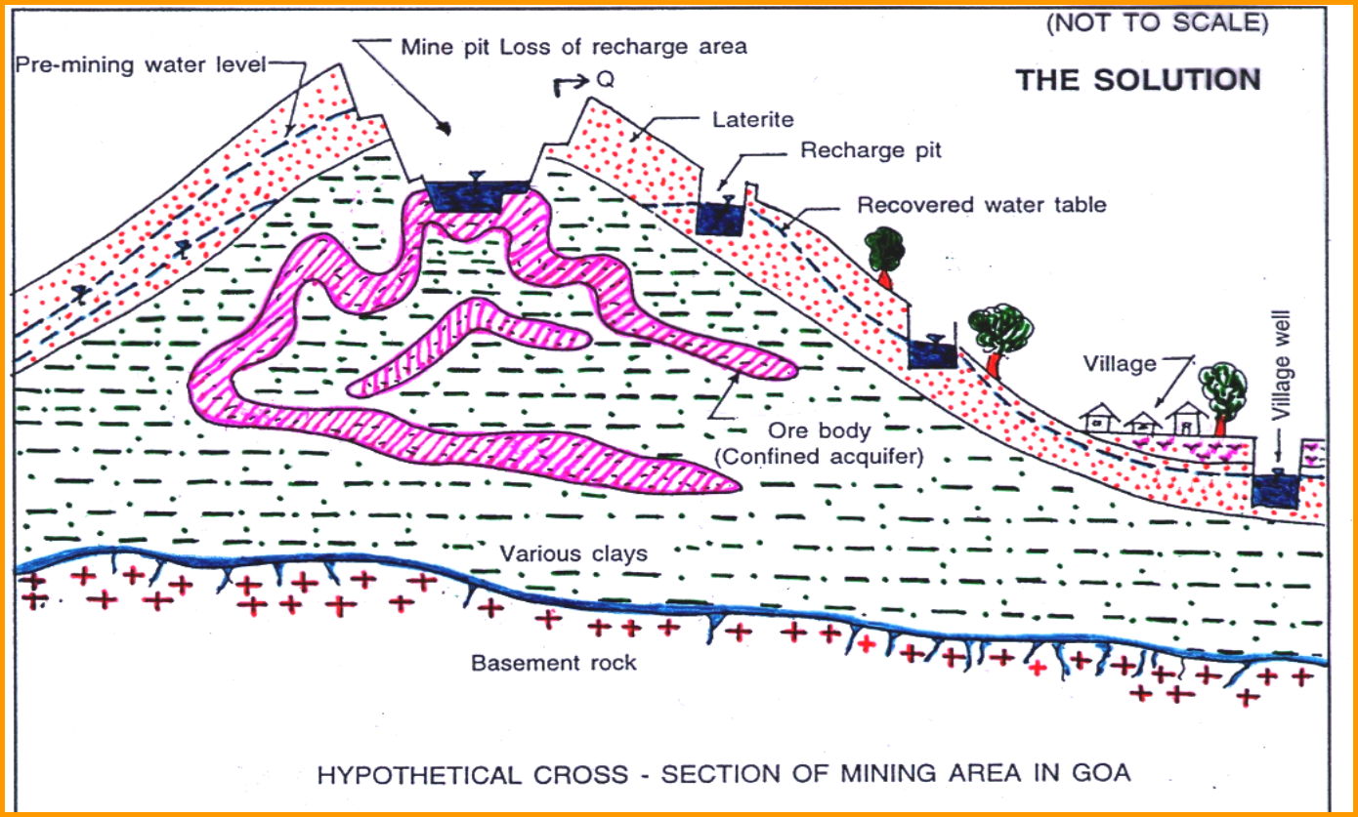
HYPOTHETICAL CROSS SECTION OF MINING AREA IN GOA

Slide 10
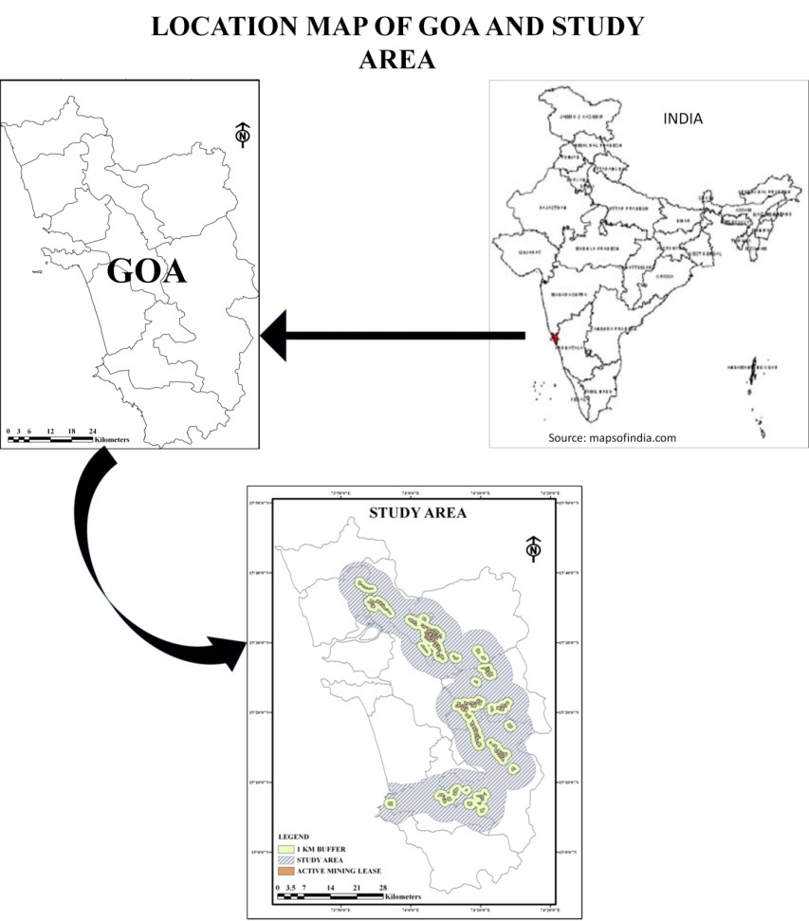
STUDY AREA
The study area comprises of 5 mining Talukas namely Bicholim, Sattari, Dharbandora, Quepem and Sanguem encompassing an area of 1513 km².
Study area entails all the areas wherein mining activities of Goa are encompassed along with a belt of five km from the lease boundary

Slide 11
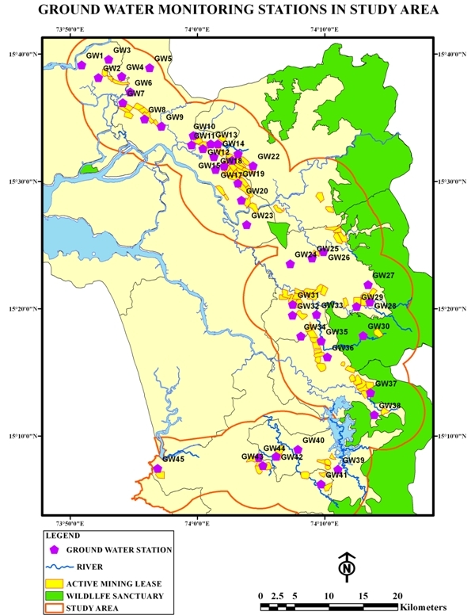

Slide 12
SAMPLING LOCATIONS
The water samples were collected from forty five (45) different open and tube wells during Post-monsoon, winter, summer and monsoon seasons
The Ground water samples were collected in acid washed plastic container to avoid unpredictable changes in charecteristics as per American Public Health Association (APHA), 2005
Water Quality Index
Water quality index (WQI) is valuable and unique rating to depict the overall water quality status in a single term that is helpful for the selection of appropriate treatment technique to meet the concerned issues.
The WQI has been calculated by using the standards of drinking water quality recommended by the World Health Organization (WHO), Bureau of Indian Standards (BIS), and Indian Council for Medical Research (ICMR).The weighted Arithmetic index method (Brown et. al.) has been used for the calculation of WQI of the water body.

Slide 13
The overall water quality index was calculated by aggregating the quality rating with the unit weight linearly:
W_{n}= Unit weight for the n^{th} parameters,
S_{n}= Standard value for n^{th} parameters,
K = Constant for proportionality

Slide 14
WATER QUALITY RATING
Water Quality Index Level | Water Quality Status
0-25 | Excellent Water Quality
26-50 | Good Water Quality
51-75 | Moderate Water Quality
76-100 | Poor Water Quality
>100 | Unsuitable for Drinking
(Source: Rao 1997; Mishra and Patel 2001; Rao et al. 2002; Mahanta et al. 2004)

Slide 15
RESULT AND DISCUSSION
Seasonal Variation in Water Quality of Ground Water

Slide 16
On the basis of descriptive categories of WQI values, all (100%) of samples were found in very good category. During post monsoon season, 98% of samples were found in very good category and only 2% of samples in good category.
In the case of post-monsoon the water quality was lower as compare to monsoon season.
In summer season, the ground water is stagnant and the source of contamination was only the natural source ofrock-water interaction while anthropogenic activities arealso contributing the pollution load on ground water.

Slide 17
CONCLUSION
The above study indicates that natural (ground water influenced by local litho logy, weathering moving and percolating) as well as anthropogenic sources are contaminating the groundwater in study area.
The study reveals that the groundwater of a few locations needs some degree of treatment before consumption and it also needs to be protected from the perils of the prevailing contamination.

Slide 18
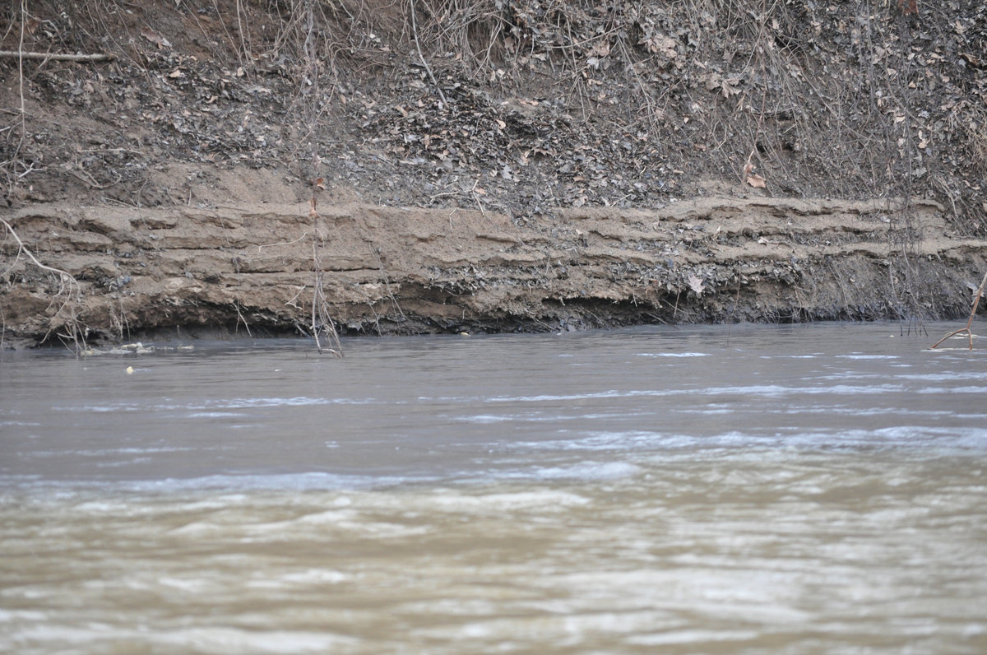
THANK YOU

