Slide 1
GENETIC VARIABILITY FOR QUANTITATIVE TRAITS IN CHINA ASTER [Callistephus chinensis (L.) NEES]
Rajiv Kumar, Gayatri Khangjarakpam, T. Manjunatha Rao and M.V. Dhananjaya
Division of Ornamental Crops
ICAR-Indian Institute of Horticultural Research
Hessaraghatta Lake Post, Bangalore 560 089

Slide 2
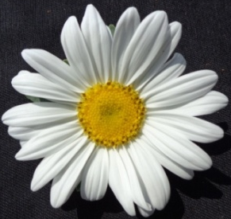
INTRODUCTION
China aster [Callistephus chinensis (L.) Nees]
Family Asteraceae
Annual flowering plant
Single species i.e. C. chinensis (2n=18) (Huziwara, 1954).
Flowers are solitary, singles, semi-doubles, doubles
Prominent flower colours: blue, pink and white
Traditionally grown for loose flowers, cut flower, landscape, floral decorations, making garlands
States: Karnataka, Andhra Pradesh, Tamil Nadu, West Bengal and Maharashtra
Single
Semi-double
Double

Slide 3
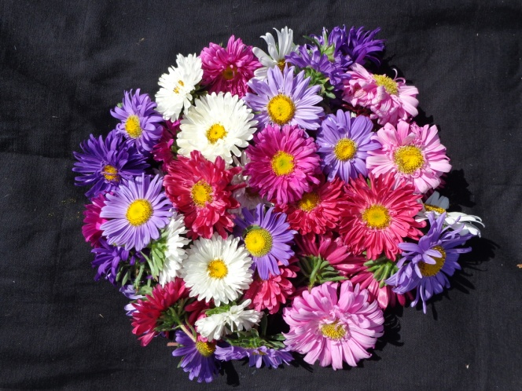
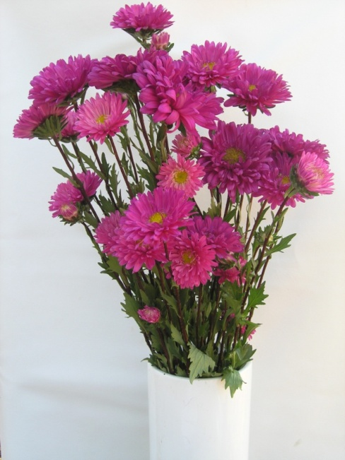
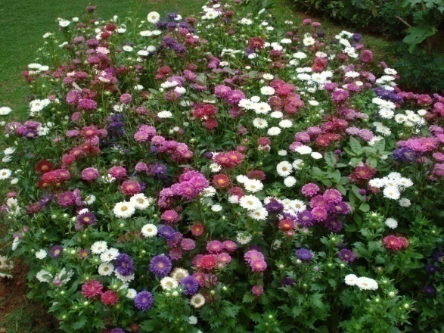
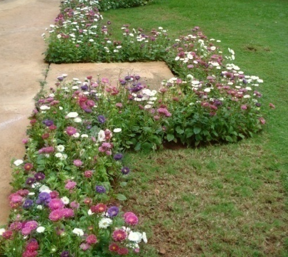
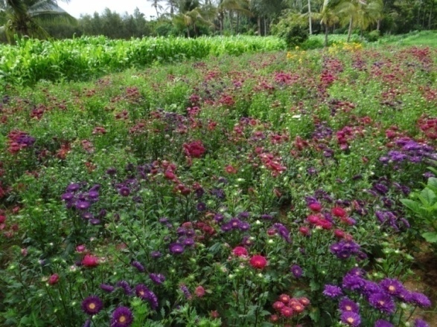
IMPORTANCE OF THE CROP
Loose flower
Cut flower
Pot plant
Landscape
Borders
Commercial

Slide 4
OBJECTIVES
To estimate the genetic variability, heritability and genetic advance in twenty genotypes of China aster.
To workout the relationships among different characteristics through correlation co-efficient and to assess direct and indirect effects of characters on flower yield through path analysis.

Slide 5
METHODOLOGY
The experimental material:
Twenty genotypes
Location: Indian Institute of Horticultural Research, Bangalore, during 2012-13 (13º 58' N Latitude, 78º E Longitude and elevation of 890 m asl.)
Experimental Design: Randomized Complete Block Design with three replications.
Statistical package used ‘Biostat IIHR, version 1.0’ .

Slide 6
OBSERVATIONS RECORDED
Plant height (cm)
Number of branches/plant
Number of leaves/plant
Plant spread (cm)
Days to first flower opening
Days to 50% flowering
Flower diameter (cm)
Number of flowers/plant
Weight of flowers/plant (g)
Number of ray florets/flower head
Number of disc florets/flower head
Flower stalk length (cm)
Flowering duration (days)
Vase life (days)
Shelf life (days)

Slide 7
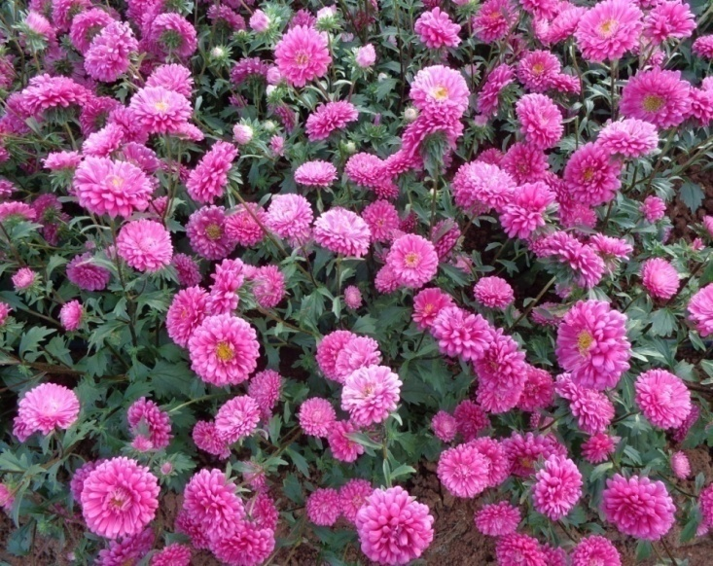
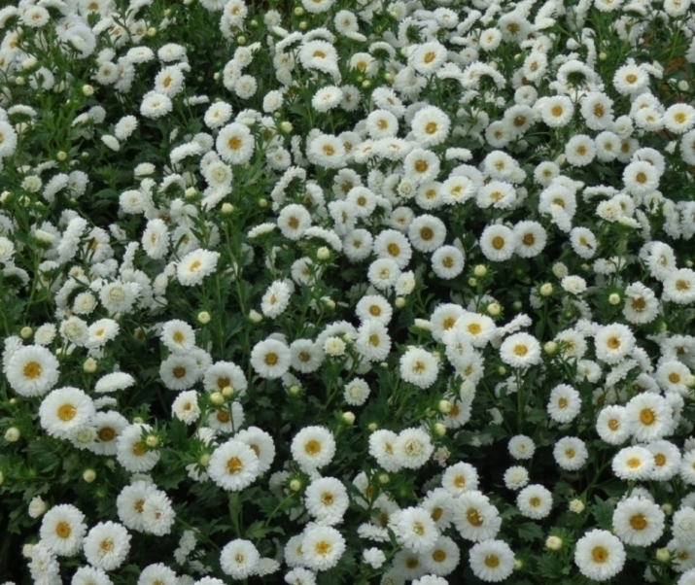
IIHR RELEASED CHINA ASTER VARIETIES
KAMINI
POORNIMA
SHASHANK
VIOLET CUSHION
ARAK AADYA
ARKA ARCHANA

Slide 8
EXPERIMENTAL PLOT

Slide 9
RESULTS

Slide 10
TRAITS OF ECONOMIC INTEREST IN CHINA ASTER
Plant height
Plant spread
No. of branches/plant
No. of flowers/plant
Weight of flowers/plant
Flower diameter
Vase life/shelf life

Slide 11
Table 1. Mean, range and coefficient of variation for different traits in China aster

Slide 12
GENETIC VARIABILITY
PCV values were higher than the GCV for all the traits, which indicated greater genotype and environment interaction.
High GCV and PCV were recorded for weight of flowers/plant, number of flowers/plant, flower stalk length, number of leaves/plant, flower diameter, number of ray florets/flower head, number of branches/plant, plant height and number of disc florets/flower head.
High GCV coupled with narrow difference between the GCV and PCV was recorded for plant height, number of branches, leaves/plant, flower diameter, number of ray florets/flower head, number of disc florets/flower head, flower stalk length and weight of flowers/plant
Hence, these traits could be utilized for improvement through selection .

Slide 13
Table 2. Estimates of genotypic and phenotypic coefficient of variation, heritability and genetic advance for different traits in China aster

Slide 14
HERITABILITY AND GENETIC ADVANCE
The high heritability was recorded for all the characters except for flowering duration.
Heritability ranged from 28.30 per cent (flowering duration) to 99.54 per cent (flower diameter).
High heritability coupled with high genetic advance as per cent mean was recorded for flower diameter, flower stalk length, number of branches/plant, weight of flower/plant, days to first flower opening, days to 50 per cent flowering, plant height, number of leaves/plant, number of ray florets/head, number of disc florets/head, number of flowers/plant, indicating the possible role of additive gene action.
Thus, these characters can be improved through pureline selection, mass selection, progeny selection, hybridization and selection with pedigree.

Slide 15
Table 3. Estimates of phenotypic (r_{p}) and genotypic (rg) correlation among different characters in China aster

Slide 16
CORRELATION ANALYSIS
The number of branches/plant was highly significant and positively correlated with number and weight of flowers/plant.
The number of flowers/plant was highly significant and positively correlated with plant height, number of branches and leaves/plant, flower stalk length and weight of flowers/plant. The direct selection of this character results quality flowers with higher yield.
The flower diameter showed highly significant and positive correlation with number of leaves/plant, days to first flower opening and days to fifty per cent flowering.

Slide 17
Table 4. Phenotypic and genotypic direct (diagonal bold) and indirect effects among different quantitative traits in China aster

Slide 18
PATH CO-EFFICIENT ANALYSIS
Plant height had positive direct effect on weight of flowers per plant, however, its correlation with weight of flowers per plant was positive and highly significant.
This character indirectly contributed to weight of flower per plant via number of branches per plant, flower stalk length, flowering duration and number of flowers per plant.
Number of branches per plant had positive direct effect and highly significant correlation with weight of flower per plant.

Slide 19
CONCLUSION
Observations recorded on 15 potential traits indicated highly significant genotypic differences for all the characters.
Traits viz., plant height, flower diameter, number of ray and disc florets/flower head, flower stalk length, number and weight of flowers/plant showed high GCV, heritability and genetic advance. These characters can be useful in breeding programme of China aster.
Characters contributing in improvement in yield of flowers are number and weight of flowers/plant, plant height, number of branches/plant and flower stalk length.

Slide 20
Thank You

