Slide 1
3rd International Seminar
on Hydrology and Meteorology,
Sept.15 and 16, 2014 HICC, Hyderabad
WELCOME TO ALL
NAMASTAE JOHAR

Slide 2
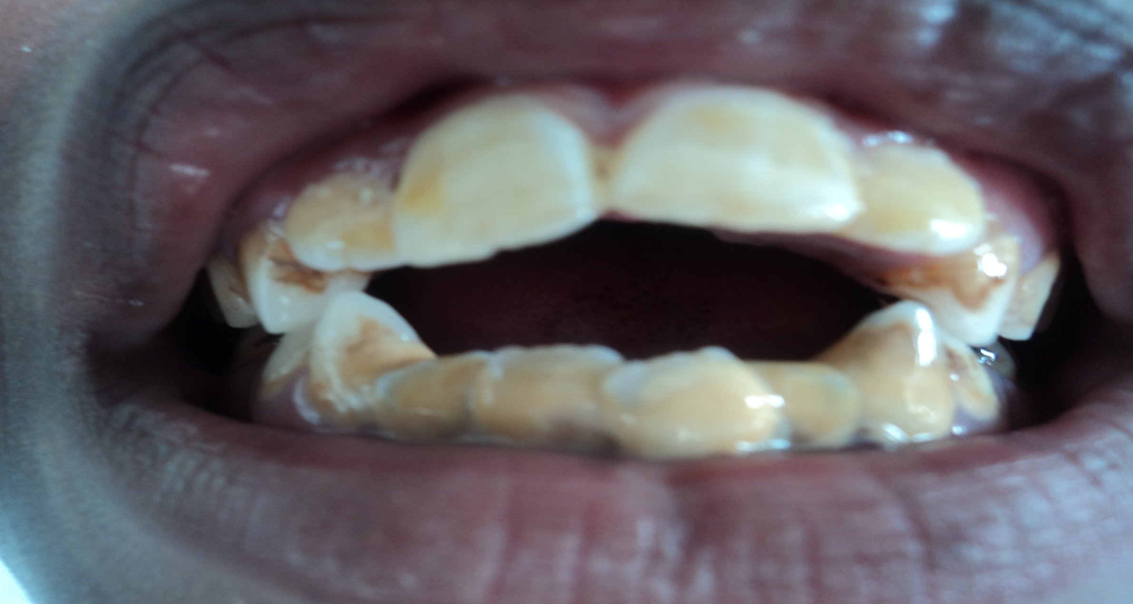
3rd Seminar on Hydrology and meteorology, Sept. 15-16, 2014, HICC, Hyderabad.
TOPIC : EFFECT OF FLUORIDE ON HEALTH OF TEETH OF SCHOOL CHILDREN IN BARKAGAON, HAZARIBAG, JHARKHAND, INDIA
RAJENDRA KUMAR AND D. N. SADHU
VINOBA BHAVE UNIVERSITY, HAZARIBAG JHARKHAND, INDIA
Email: rajendra.hzb2@gmail.com and dns_hzb@yahoo.com

Slide 3
3rd Seminar on Hydrology and Meteorology, Sept. 15-16, 2014, HICC, Hyderabad.
INTRODUCTION
WATER IS MOST ESSENTIAL THING FOR THE ENTIRE LIVING SYSTEM.
ABOUT 3% WATER IS PRESENT IN SURFACE AND UNDEGROUND OUT OF WHICH 1% IS POTABLE.
DUE TO POPULATION EXPLOSION, MODERNIZATION AND ANTHROPOGENIC ACTIVITIES INCLUDING EXCESS MINERAL EXPLORATION, THE POTABLE WATER BECOMING UNFIT FOR USE.
MORE THAN 80% DISEASES OF MANKIND IS WATERBORNE (WHO, 1996)
FLUORIDE, ONE OF THE MOST ESSENTIAL ELEMENTS FOR CALCIFICATION OF BONES AND TEETH, IF TAKEN WITHIN A PERMISSIBLE LIMIT (1.5mg/lit)
CONT.

Slide 4
3rd International Seminar on Hydrology and meteorology, Sept. 15- 16, 2014, HICC, Hyderabad.
EXCESS FLUORIDE INTAKE MAY CAUSE DENTAL FLUOROSIS.
WATER IS UNIVERSAL SOLVENT, DISSOLVES THE MINERALS OF ROCKS DURING ITS PASSAGE AND STORAGE, ULTIMATELY CHANGING THE QUALITY OF POTABLE WATER.
EXCESS FLUORIDE IS GLOBAL PROBLEM INCLUDING OUR COUNTRY.
200 DISTRICTS OF 20 STATES OF INDIA ARE SUFFERING FROM FLUOROSIS (Kumar and Sadhu, 2013)
IN JHARKHAND LITTLE STUDY HAS BEEN DONE ON THE OCCURANCE OF FLUORIDE IN POTABLE WATER AND ITS IMPACT ON TEETH.
IN VIEW OF ABOVE THE PRESENT STUDY HAS BEEN UNDERTAKEN AMONG SCHOOL CHILDREN BETWEEN 06-11 YEARS IN SOME TRIBAL DOMINATED AREA.
CONT.

Slide 5
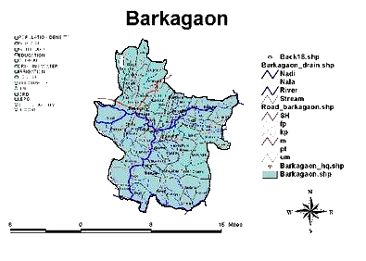
3rd International Seminar on Hydrology and meteorology, Sept. 15 -16, 2014, HICC, Hyderabad.
STUDY AREA
STUDY AREA, BARKAGAON AND ITS SURROUNDING IS LOCATED AT 23°52ʼ5˝ N LATITUDE AND 84° 14ʼ15˝ E LONGITUDE AS SHOWN IN MAP (1,2,3,4 AND 5 SHOWING THE LOCATION OF THE STUDY AREA).
1
2
5
3
4

Slide 6
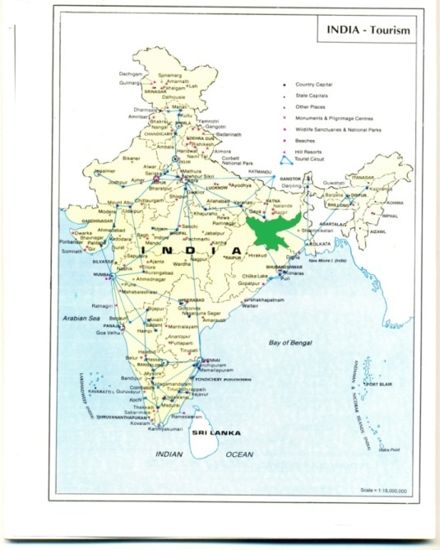
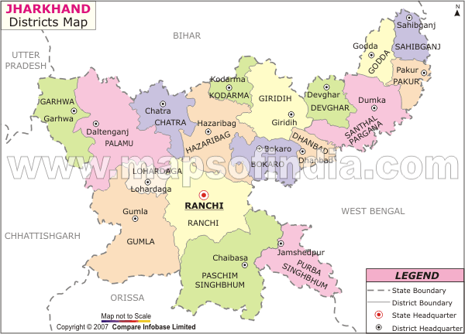
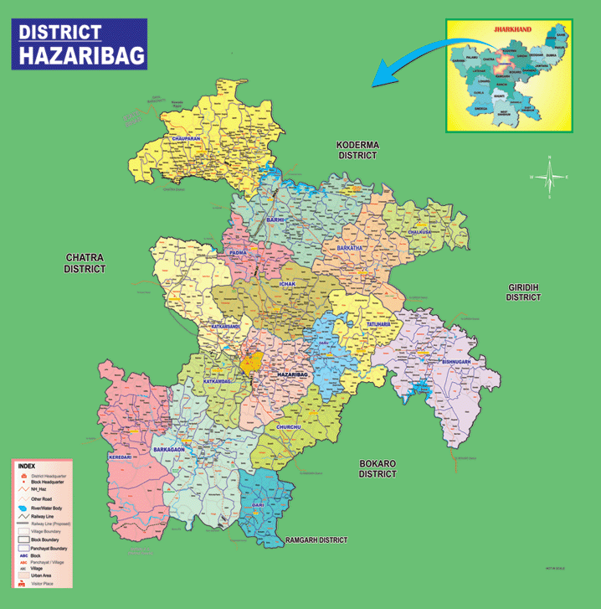
3rd International Seminar on Hydrology and meteorology, Sept. 15- 16, 2014, HICC, Hyderabad.
Showing the location of the Study area (23⁰ 52′ 5′′ N latitude and 85⁰ 14′ 15′′ E longitude (Not to scale)

Slide 7
3rd International Seminar on Hydrology and meteorology, Sept. 15- 16, 2014, HICC, Hyderabad.
MATERIAL METHOD
PROTOCOL OF APHA, 2005 HAS BEEN FOLLOWED AND THE DENTAL HEALTH OF THE CHILDREN WAS COMPARED WITH DEAN’S INDEX.
CONT.

Slide 8
3rd International Seminar on Hydrology and meteorology, Sept. 15- 16, 2014, HICC, Hyderabad.
RESULT Table-1: Showing the seasonal variation of fluoride content in ground water
Season | Month | Site of Sampling
 |  | Mean+S.E. in mg. | Mean+S.E. in mg. | Mean+S.E. in mg. | Mean+S.E. in mg. | Mean+S.E. in mg.
 |  | SITE - I | SITE - II | SITE - III | SITE - IV | SITE - V
Rainy | July11 | 2.10±0.7 | 2.35±0.8 | 2.40±0.7 | 2.50±0.7 | 2.15±0.7
 | Aug 11 | 1.75±0.7 | 1.94±0.6 | 1.70±0.8 | 1.90±0.8 | 1.65±0.8
 | Sept 11 | 1.80±0.6 | 1.73±0.7 | 1.96 ±0.6 | 2.15±0.7 | 1.95±0.5
 | Oct 11 | 2.73±0.6 | 1.95±0.6 | 2.63 ±0.6 | 2.10±0.7 | 2.28±0.7
 | AV:Values | 1.89±0.8 | 1.99±0.7 | 2.04±0.6 | 2.16±0.8 | 1.98±0.7
Winter | Nov 11 | 2.02±0.7 | 2.85±0.8 | 2.34±0.7 | 2.96±0.8 | 2.41±0.7
 | Dec 11 | 1.92±0.7 | 2.90±0.8 | 2.72±0.8 | 3.70±0.8 | 2.64±0.7
 | Jan 12 | 2.16±0.7 | 3.17±0.9 | 2.87±0.8 | 3.92±0.9 | 2.90±0.8
 | Feb 12 | 2.39±0.7 | 3.35±0.9 | 3.51±0.9 | 3.39±0.9 | 3.23±0.9
 | AV:Values | 2.12±0.7 | 3.06±0.9 | 2.86±0.8 | 3.49±0.9 | 2.79±0.8
Summer | March 12 | 2.52±0.7 | 3.46±0.9 | 3.32±0.8 | 3.61±0.9 | 3.54±0.9
 | April 12 | 2.91±0.8 | 3.64±0.9 | 3.75±0.8 | 3.88±0.9 | 3.79±0.8
 | May 12 | 3.00±0.7 | 3.25±0.8 | 2.70±0.7 | 3.10±0.7 | 2.77±0.7
 | June 12 | 3.35±0.7 | 4.90±0.9 | 4.53±0.9 | 4.80±0.7 | 3.92± 0.7
 | AV:Values | 2.94±0.7 | 3.81±0.8 | 3.57±0.8 | 3.84±0.8 | 3.50±0.8

Slide 9
3rd International Seminar on Hydrology and meteorology, Sept. 15- 16, 2014, HICC, Hyderabad.
Table-2: Showing the percentage occurrence of fluoride - affected teeth of children as per Dean’s Index
Sl. No. | Site of Sampling | Number of cases ( 06-11 yrs) | Dean’s Index
 |  |  | Normal | Questionable | Very mild | Mild | Moderate | Severe
01. | SITE - I | 114 | 21.05% | 18.42% | 16.67% | 19.30% | 11.40% | 13.16%
02. | SITE - II | 84 | 8.34% | 11.90% | 28.58% | 25% | 19.04% | 7.14%
03. | SITE - III | 88 | 10.22% | 12.50% | 30.69% | 25% | 14.78% | 6.81%
04. | SITE - IV | 77 | 7.79% | 19.48% | 18.18% | 23.38% | 20.78% | 10.39%
05. | SITE - V | 63 | 14.28% | 11.11% | 20.64% | 28.58% | 19.08% | 6.35%
Total Percentage of F– affected teeth |  |  | 12.91% | 15.02% | 22.78% | 23.70% | 16.44 % | 9.15 %

Slide 10
3rd International Seminar on Hydrology and meteorology, Sept. 15- 16, 2014, HICC, Hyderabad.
Fig. 2: Showing the seasonal variation of fluoride concentration of ground water
in mg/lit. in Column
SITE - I SITE - II SITE - III SITE - IV SITE - V

Slide 11
3rd International Seminar on Hydrology and meteorology, Sept. 15- 16, 2014, HICC, Hyderabad.
Fig. 3: Showing the degree of fluorosis on children’s teeth in Column
SITE - I SITE - II SITE - III SITE - IV SITE - V

Slide 12
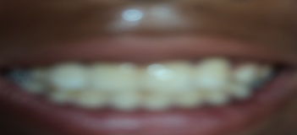
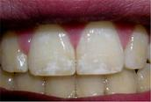
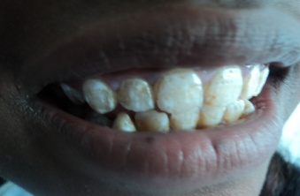
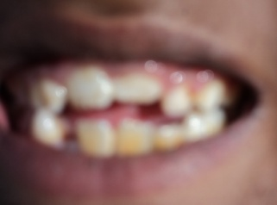
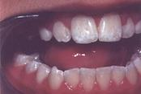
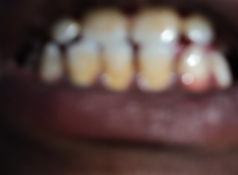
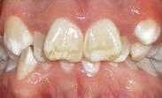
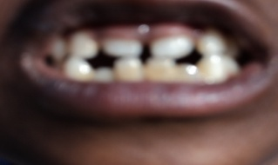
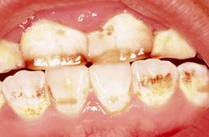
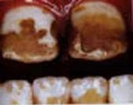
3rd International Seminar on Hydrology and meteorology, Sept. 15- 16, 2014, HICC, Hyderabad.
Fig. 4: Showing the comparison of teeth of children of the study area with Dean’s Index to identify the degree of fluorosis
Sl. No. | Category of Dean’s Index | Characters | Dean’s Index Teeth | Observation of the teeth
01 | Normal | Enamel is smooth and uniform in color
02 | Questionable | Enamel may exhibit some white flecks or small white spots. These are cases where there is not definitive fluorosis, but teeth do not qualify as "normal" either.
03 | Very mild | Less than 25% of the tooth surfaces display irregular white areas. Often these include cases where there are 1-2 mm of the tooth surface just at the cusp tips are affected.
04 | Mild | More than 25% of the tooth surface but less than 50% is affected.
05 | Moderate | Generalized areas of hypo calcification on all surfaces of the tooth, may exhibit attrition on susceptible tooth surfaces and brown spots may be present.
06 | Severe | Generalized pitting of the enamel on all surfaces, generalized brown discolorations, tooth shape may be affected as well.

Slide 13
3rd International Seminar on Hydrology and meteorology, Sept. 15- 16 2014, HICC, Hyderabad.
DISCUSSION
ALL THE WATER SAMPLES SHOWED HIGHER CONCENTRATION OF FLUORIDE THROUHT THE YEAR (RANGE 1.65 ± 0.5 TO 4.9 ± 0.8mg/lit.)
THE HIGHER FLUORIDE CONCENTRATION IN THE STUDY AREA IS PROBABLY DUE TO EXCESS EXPLOSION AND MINERAL EXPLOITAION.
STUDY ON 152 SCHOOL CHILDREN REVEALS THAT ABOUT 87% CHILDREN HAVING DENTAL FLUOROSIS.
BOTH THE RESULTS INDICATE THAT DENTAL FLUOROSIS IS DIRECTLY RELATED TO FLUORIDE CONCENTRATION IN POTABLE WATER.
CONT.

Slide 14
3rd International Seminar on Hydrology and meteorology, Sept. 15- 16 2014, HICC, Hyderabad.
CONCLUSION
WATER IS LIFE, BUT UNFORTUNATELY QUALITY POTABLE WATER IS NOT AVILABLE AS PER REQUIRENENT IN THE STUDY AREA.
ROUTINE MOINITORING OF POTABLE WATER SHOULD BE DONE BY STATE, CENTRAL GOVT. OR NGOs ETC.
EFFECTIVE UNIT OF ORAL HEALTH AND HYGIENE SHOULD BE ESTALISHED IN THE AREA FOR REGULAR QUALITY CHECKUP AND MASS AWARENESS.

Slide 15
3rd International Seminar on Hydrology and meteorology, Sept. 15- 16 2014, HICC, Hyderabad.
THANKS

