Slide 1
About OMICS Group
OMICS Group International is an amalgamation of Open Access publications and worldwide international science conferences and events. Established in the year 2007 with the sole aim of making the information on Sciences and technology ‘Open Access’, OMICS Group publishes 400 online open access scholarly journals in all aspects of Science, Engineering, Management and Technology journals. OMICS Group has been instrumental in taking the knowledge on Science & technology to the doorsteps of ordinary men and women. Research Scholars, Students, Libraries, Educational Institutions, Research centers and the industry are main stakeholders that benefitted greatly from this knowledge dissemination. OMICS Group also organizes 300 International conferences annually across the globe, where knowledge transfer takes place through debates, round table discussions, poster presentations, workshops, symposia and exhibitions.

Slide 2
About OMICS Group Conferences
OMICS Group International is a pioneer and leading science event organizer, which publishes around 400 open access journals and conducts over 300 Medical, Clinical, Engineering, Life Sciences, Phrama scientific conferences all over the globe annually with the support of more than 1000 scientific associations and 30,000 editorial board members and 3.5 million followers to its credit.
OMICS Group has organized 500 conferences, workshops and national symposiums across the major cities including San Francisco, Las Vegas, San Antonio, Omaha, Orlando, Raleigh, Santa Clara, Chicago, Philadelphia, Baltimore, United Kingdom, Valencia, Dubai, Beijing, Hyderabad, Bengaluru and Mumbai.

Slide 3
The Work of
Supervisor
Forensic Artists
in Germany
Captain Rainer Wortmann
Department of Biometrics
State Office of Criminal Investigation
Baden-Württemberg
Germany

Slide 4
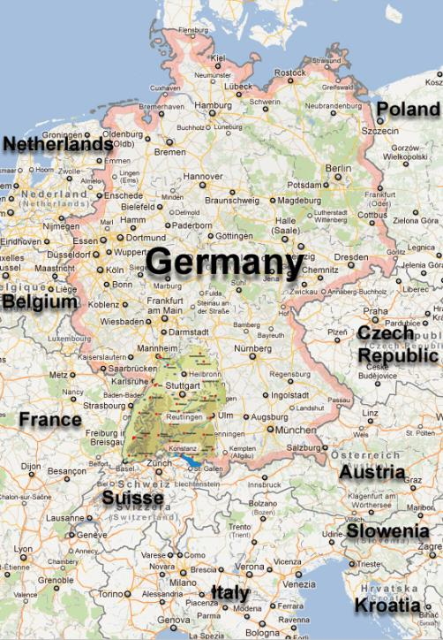
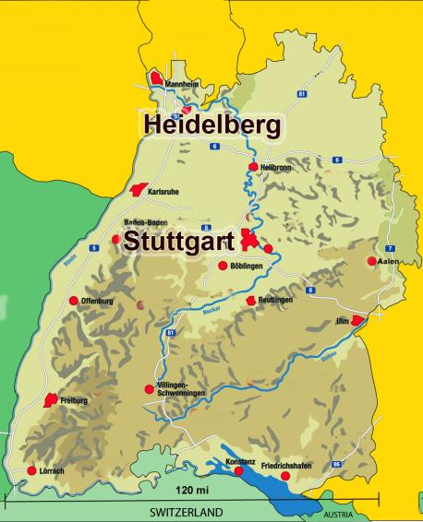
Population Baden-Württemberg: ca. 10 Million

Slide 5
Scope of Duties
Educate Forensic Artists
Software and Hardware for creating composites
Database with reference material
Present and promote information about Forensic Artistry
Committee work
Organize and present national workshops
Develop international cooperation
Create composites in special and difficult cases

Slide 6
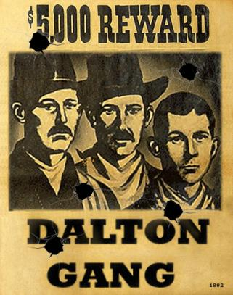
A Short History
For centuries
Wanted-posters wild west era

Slide 7
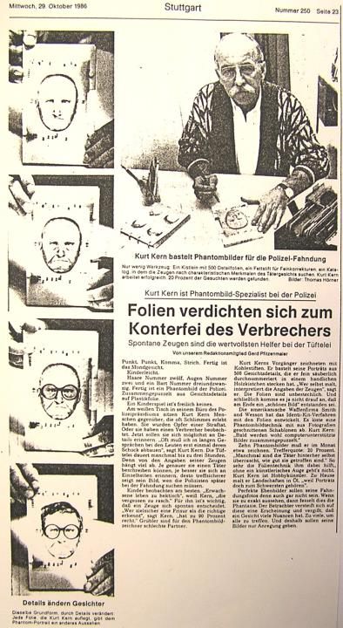
Composites in Germany
Artists draw sketches by hand
Creating composites with IdentiKit (Slides-System) since 1980

Slide 8
1996 began drawing composits using computer software
2001 regional support system created for Baden-Württemberg
12 departments
40 police artists

Slide 9
Today we have...
Trained Forensic Artists
Special interview techniques (CI)
The visualization of memory
Visual interviewing with reference materials

Slide 10
A picture is worth a thousand words
→ Example: Male, European, age 55-60 years, big nose

Slide 11
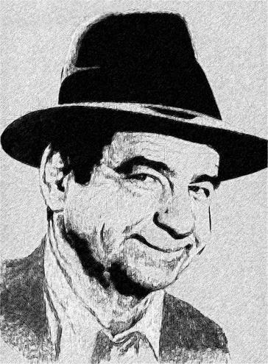
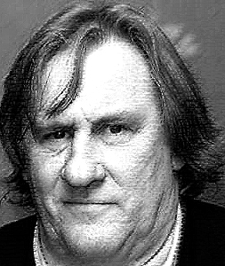
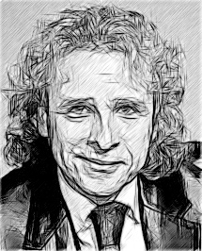
who?

Slide 12
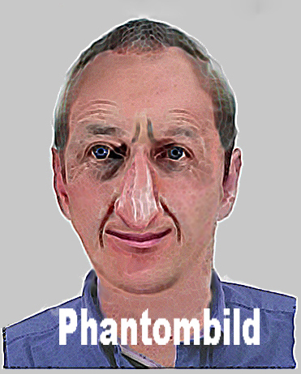
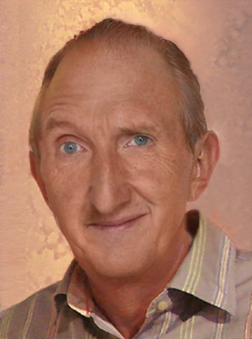
Actor Mike Krüger

Slide 13
Education for Forensic Artists
Three weeks
one week basic course
one week digital software
one week advanced course
One week worshop for creating reference materials
Two weeks per year
Police College Wertheim, Baden-Württemberg, Germany

Slide 14
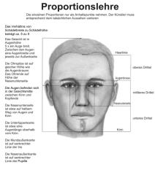
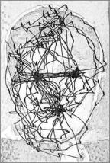
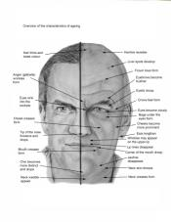
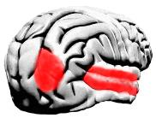
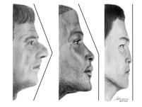
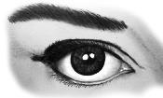
Education Content
Using digital software
Drawing by hand
Psychology (brain resarch)
Cognitive Interview
Work with different victims (traumatized, children etc)
Laws of proportion
Role of races
Further support
Aging
Whole body and groups, objects
facial reconstruction

Slide 15
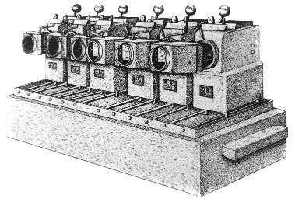
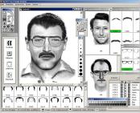
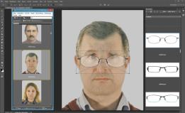
Soft- and Hardware Always searching for best system
Drawing by hand versus using computer and software
Continuous market observation
Currently Adobe Photoshop and Bridge
Prerelease tester
PC / Notebook / Drawboard

Slide 16
Reference Material
4000 faces different people, male and female
Different age
Different race
Accessoires
Glasses
Caps/Hats
Jewelery
Masks
Clothing
Weapons
Vehicles

Slide 17
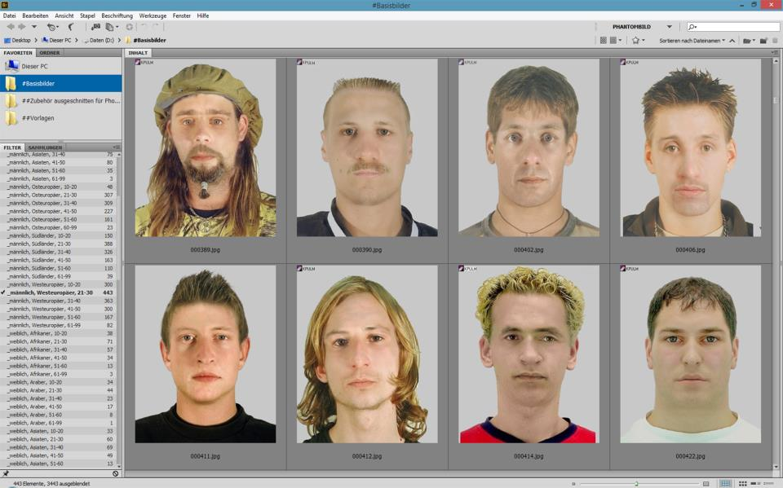
Reference Material Portraits

Slide 18
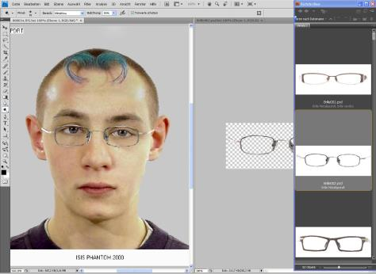
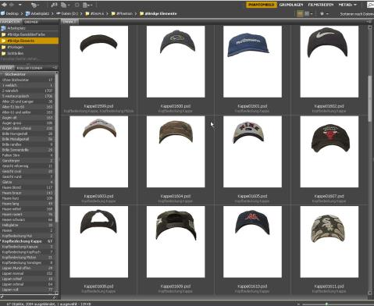
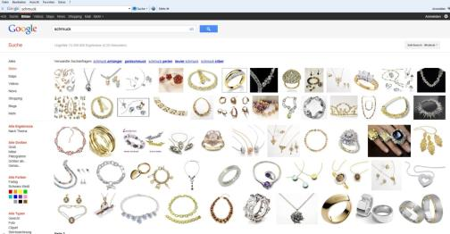
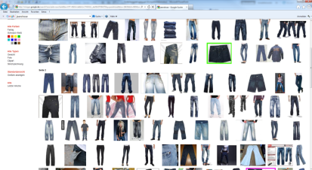
Accessoires

Slide 19
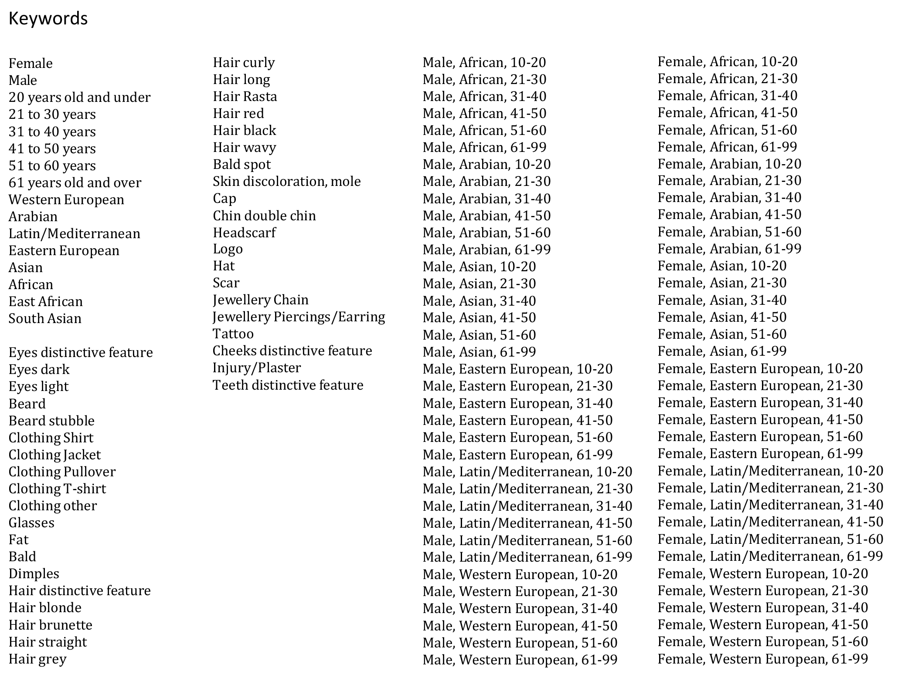

Slide 20
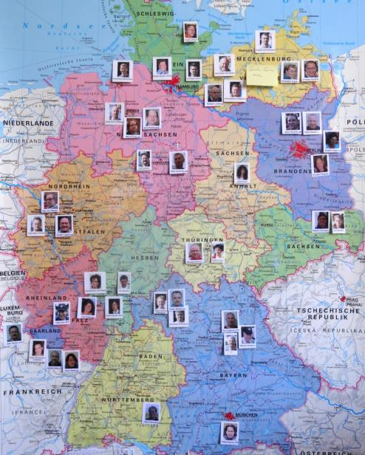
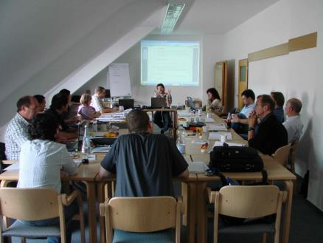
Committee Work

Slide 21
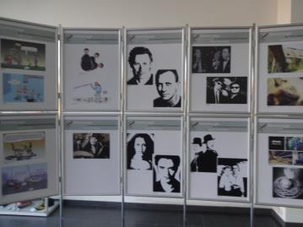
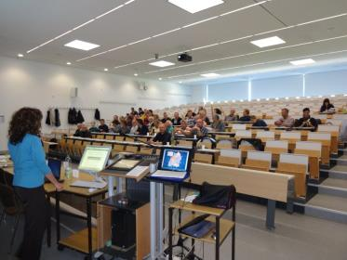
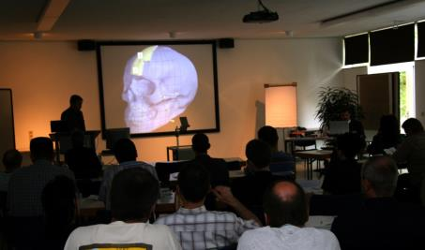
8. (Inter)National Conference Forensic Artists 2015
Next Event: May 11th-13th
Police College Wertheim, Baden-Württemberg, Germany

Slide 22
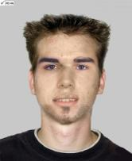
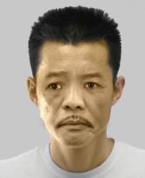
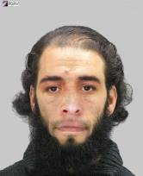
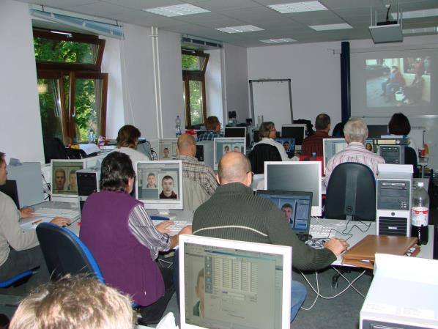
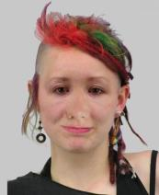
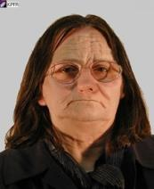
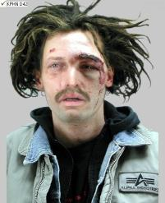
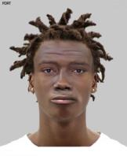
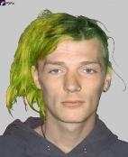
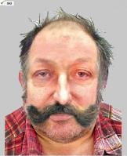
Workshops
Reference Material
Fake Pictures

Slide 23
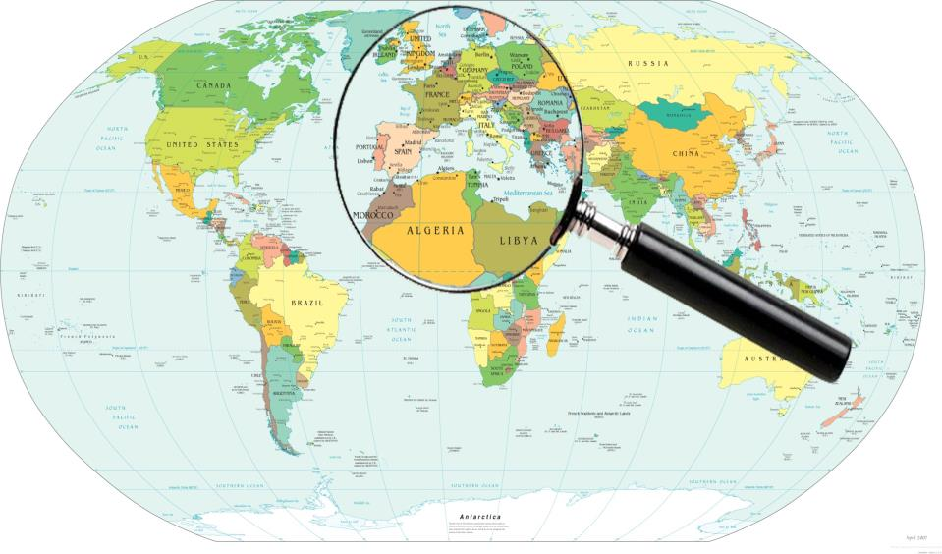
International Cooperation and Support

Slide 24
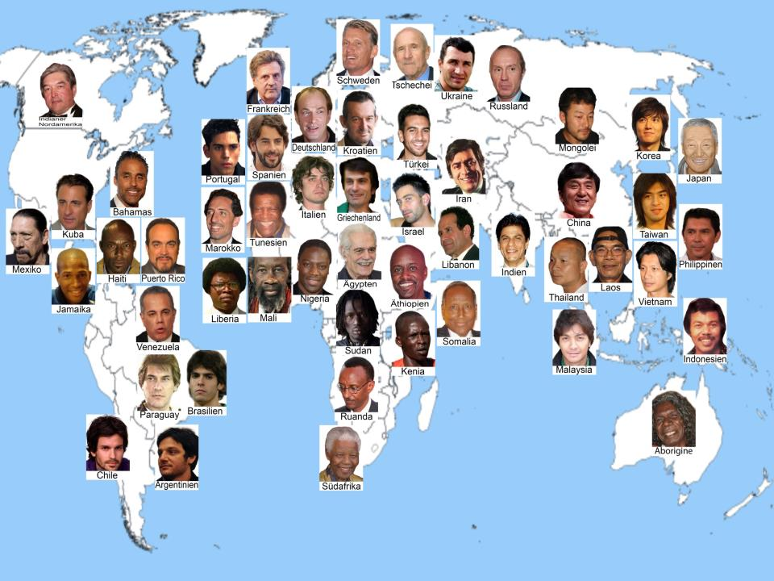

Slide 25
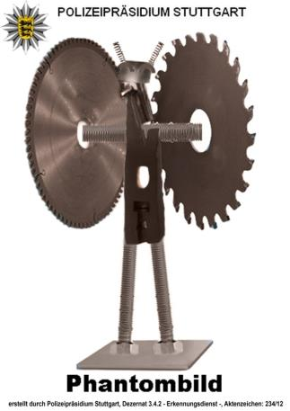
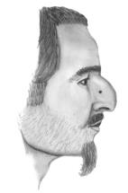
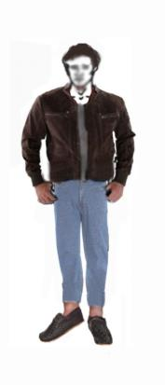
Creating Composites in Special and Difficult Cases

Slide 26
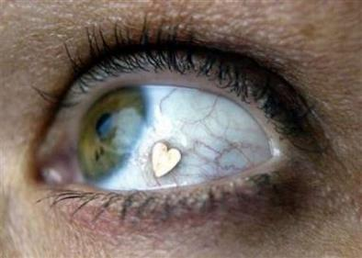
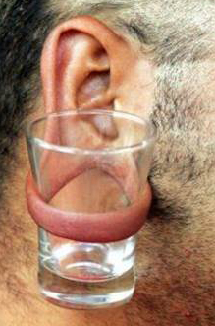
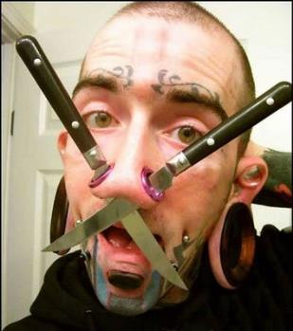
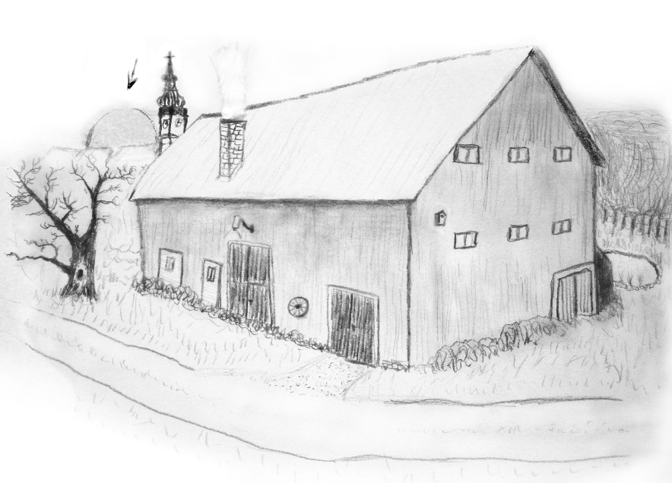
No Limits

Slide 27
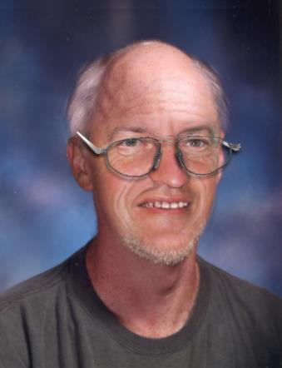
Aging
NCMEC
ICMEC
www.missingkids.com

Slide 28
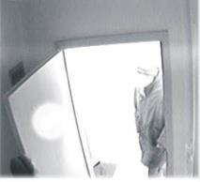
- Facial Reconstruction – no pictures Thanatopraxy (e.g. drowned or burned body) - Portrait Construction - Reprocessing Digital Images

Slide 29
www.rainerwortmann.de

Slide 30
Thank you for attention

Slide 31
Let Us Meet Again
We welcome you all to our future conferences of OMICS Group International
Please Visit: www.omicsgroup.com
www.conferenceseries.com

