Slide 1
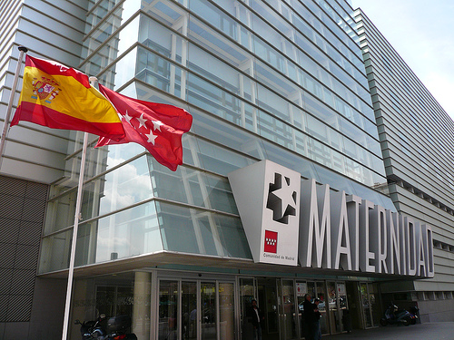

3rd International Conference and Exhibition on
Clinical & Cellular Immunology
September 29 - October 01, 2014 Baltimore, USA
Immune mechanisms implicated in the tolerance induction to food allergens in children
Rafael Correa Rocha
Laboratory of Immune-regulation
Institute of Health Research “Gregorio Marañón” (IISGM). Madrid (Spain)

Slide 2
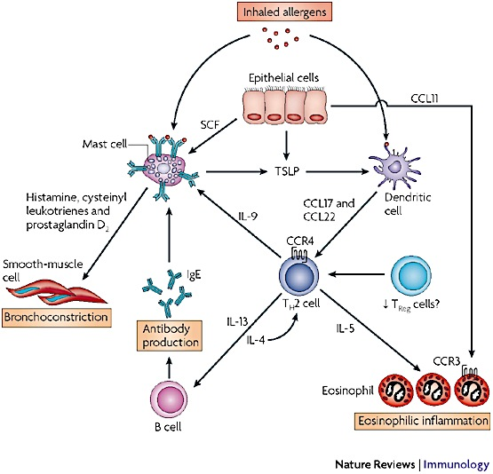
Allergy is caused by a reaction of the immune system against substances that are normally innocuous
Allergy
Notes:
Funciona pero se desconoce el mecanismo
Este era un modelo ideal para estudiar que papel juegan las Treg
Pero también para estudiar cuales son los mecanismos inm responsables de la tolerancia

Slide 3
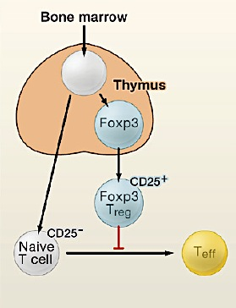
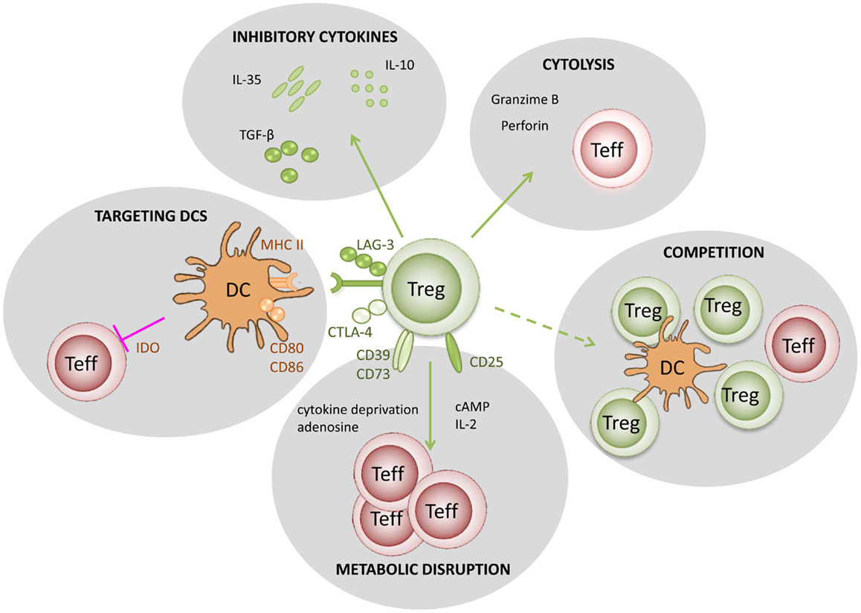
Treg cells
Regulatory T cells (Treg) → Subpopulation of CD4+ T cells with a suppressive activity
Treg are identified as CD4+CD25+Foxp3+ cells
Treg are considered a crucial component of immune system for preserving peripheral tolerance and the correct immune homeostasis

Slide 4
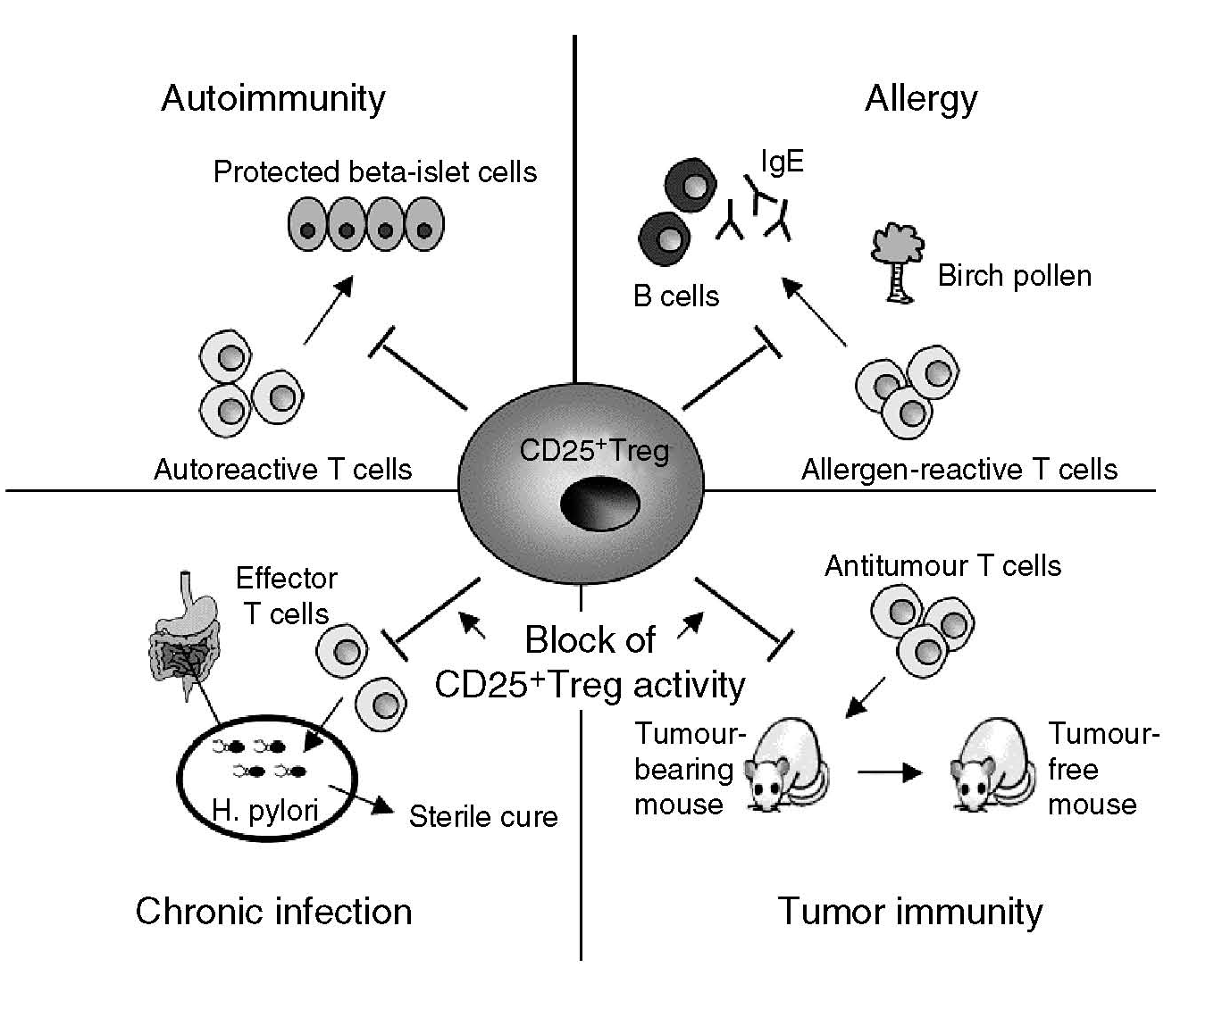
Células Treg
Treg cells play a crucial role preserving the Immune Homeostasis
Treg induce tolerance to self-antigens (autoinmune dis.) and non-self antigens (transplant)
Treg induce tolerance to allergens and reduce inflammation
Treg have a dual role in infections, reducing the inflammation but also reducing specific responses.
Treg inhibit immune responses to tumour antigens, promoting tumour growth.

Slide 5
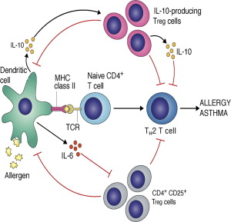
Mast
Eosf
Basf
Treg
Linf.T
Treg cells
Notes:
Funciona pero se desconoce el mecanismo
Este era un modelo ideal para estudiar que papel juegan las Treg
Pero también para estudiar cuales son los mecanismos inm responsables de la tolerancia

Slide 6
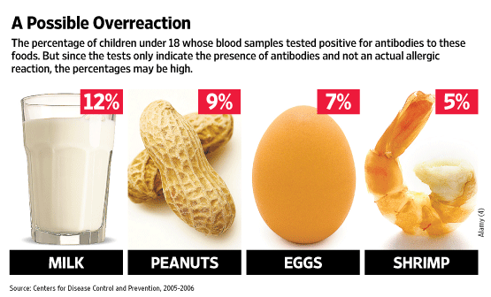
Food Allergy
estimated prevalence of > 5% in children
most frequent reason for anaphylactic reactions
Precedents
In most of the cases Food Allergy could be reverted in Children (SOTI)
Children have a preserved thymic function and a high plasticity of the immune system
Thymic generation of Treg (suppressive) cells could be related with the tolerance achievement
SOTI
Allergic
Desensitization
Tolerant
¿ Which are the immune mechanism implicated in tolerance achievement ?
T0
Tend
Notes:
Funciona pero se desconoce el mecanismo
Este era un modelo ideal para estudiar que papel juegan las Treg
Pero también para estudiar cuales son los mecanismos inm responsables de la tolerancia

Slide 7
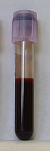
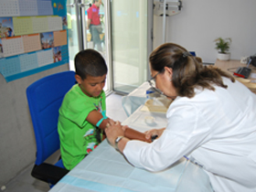
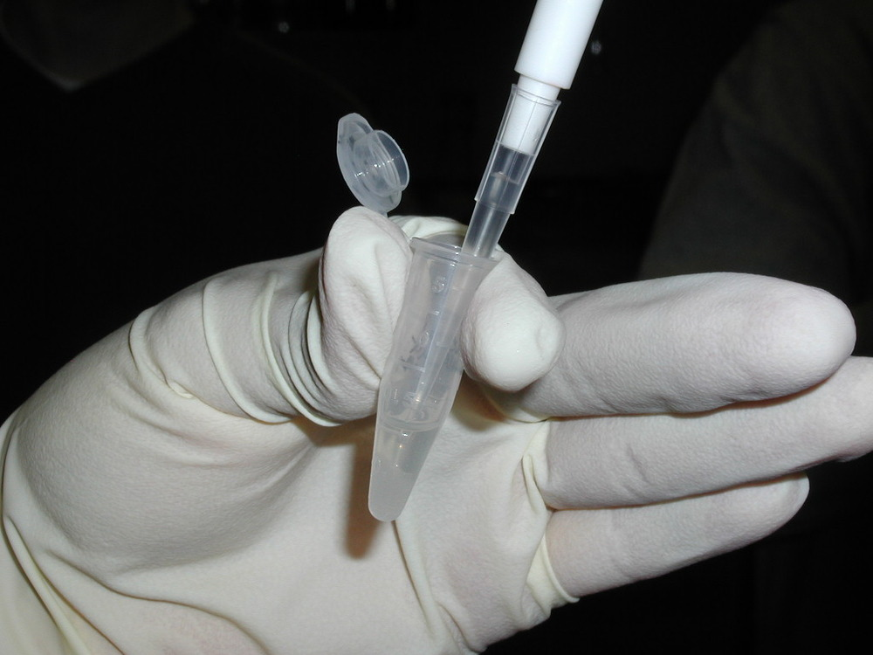
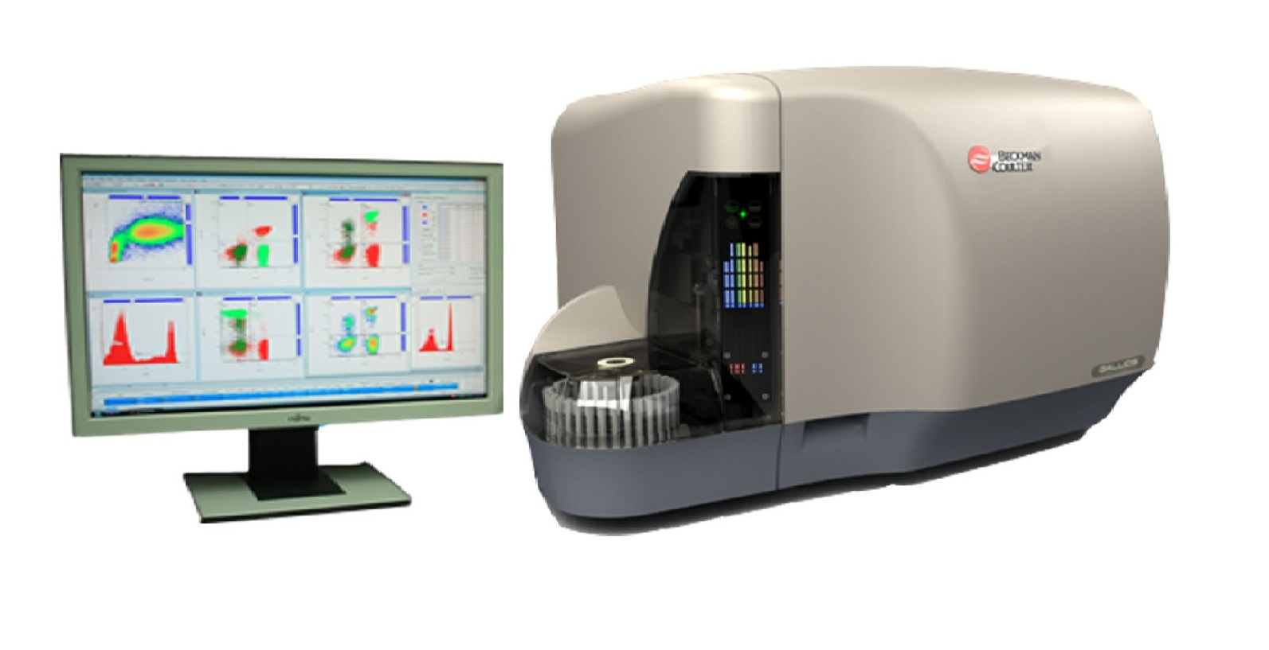
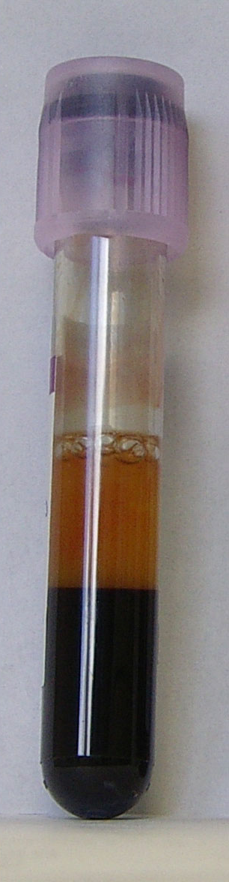
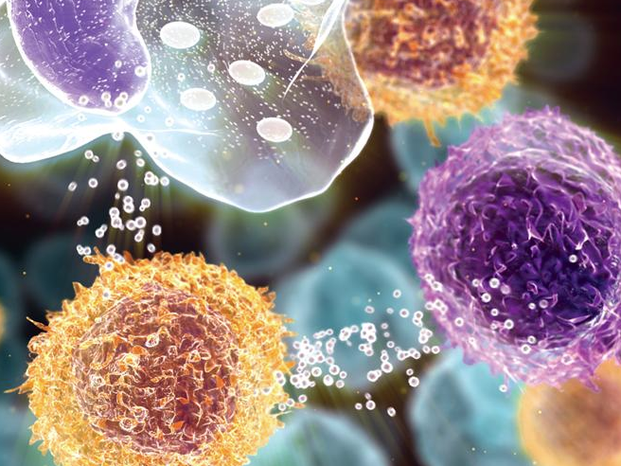
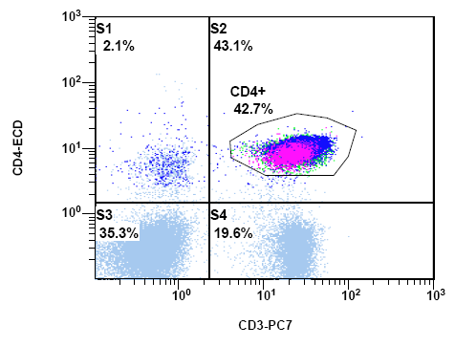
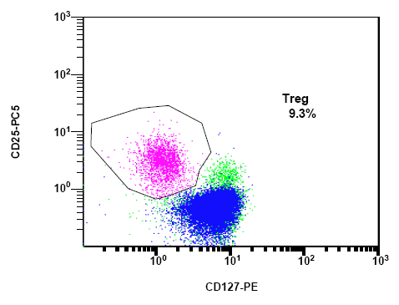
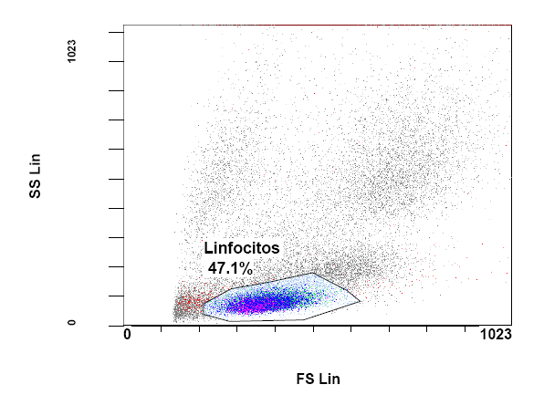
Methods

Slide 8
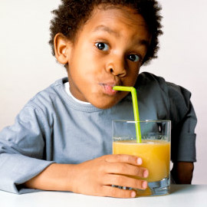
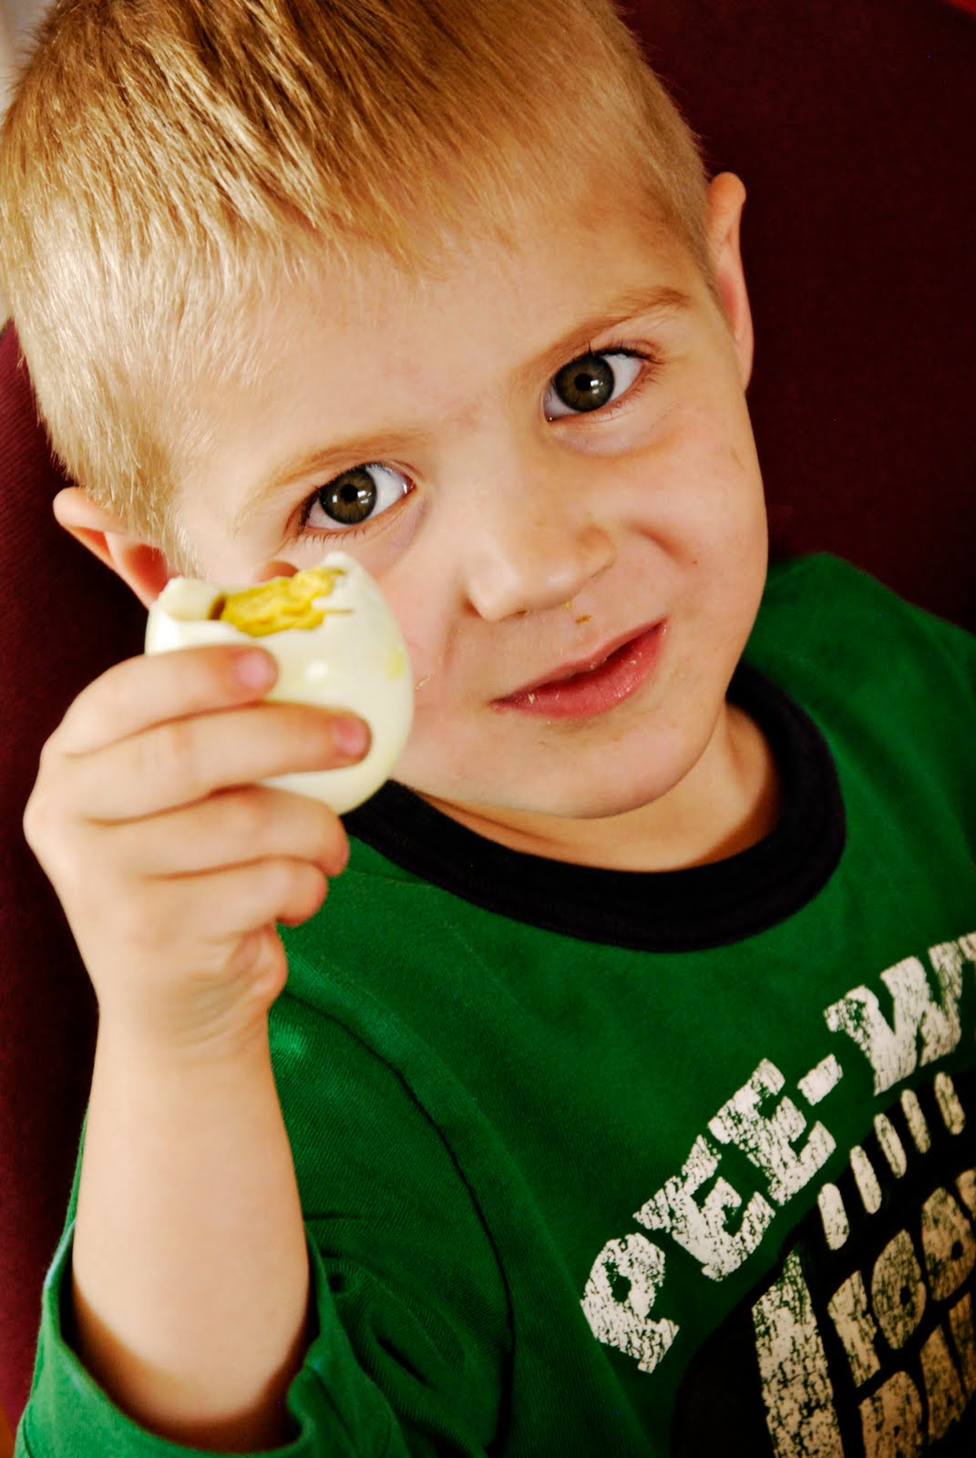
19 Children with Egg allergy + 12 Healthy Controls
Specific Oral Tolerance Induction (SOTI)
Oral administration of increasing amounts of a food allergen to achieve clinical tolerance
Powdered pasteurized egg mixed with juice or milkshakes
Day 1: 1 → 3 → 9 → 18 (Total: 31 mg)
weekly increases until 10 g of powdered egg (1 egg)
Tolerance of 10 g → desensitised
Normal diet
SOTI
Notes:
Huevo en polvo mezclado con zumos de frutas o batidos

Slide 9
Immune changes after SOTI
ALLERGY → TOLERANCE
16/19 (84,2%) Desensitized
9,7 weeks
 | Percentage |  |  | Cells/μL
 | T0 | Tend | p | T0 | Tend | p
Monocytes | 5.63 (4.91-7.38) | 6.54 (4.95-7.93) | 0.723 | 327 (263-475) | 383 (286-506) | 0.717
Basophils | 1.26 (0.91-1.87) | 1.18 (0.74-1.57) | 0.985 | 71 (52-86) | 75 (52-87) | 0.655
Granulocytes | 49.40 (42.8-55.4) | 48.31 (40.8-52.1) | 0.179 | 2624 (1772-3911) | 2499 (2096-3207) | 0.334
Neutrophils | 84.17 (74.3-87.7) | 84.06 (76.4-90.2) | 0.642 | 2084 (1530-3337) | 1982 (1744-2654) | 0.281
Eosinophils | 14.36 (10.9-23.6) | 14.25 (8.9-20.0) | 0.796 | 339 (231-660) | 460 (274-631) | 0.427

Slide 10
Immune changes after SOTI
 | Percentage
 | T0 | Tend | p
Total Lymphocytes | 40.1 (30.9-45.4)# | 41.1 (35.5-43.3)# | 0.673
CD4+ T cells | 39.9 (34.7-42.7) | 41.2 (37.6-42.4) | 0.279
CD8+ T cells | 24.4 (21.5-26.7) | 22.2 (20.4-25.4) | 0.565
NK cells | 9.39 (6.9-10.2) | 8.07 (7.2-10.8) | 0.768
NKT cells | 1.22 (0.9-2.1) | 1.44 (1.0-1.8) | 0.678
B cells | 15.2 (12.5-18.6) | 15.8 (13.4-18.1) | 0.972
CD4+ T cells
Naive | 57.1 (52.9-62.6) | 58.1 (50.4-68.8) | 0.638
Memory | 34.2 (29.2-36.4) | 30.6 (25.6-36.8) | 0.488
Activated | 3.92 (3.0-4.8) | 3.92 (2.3-5.8) | 0.348
Effector | 0.56 (0.45-1.5) | 0.29 (0.16-0.58) | 0.128
RTEs | 42.4 (39.2-49.2) | 43.5 (40-56.1) | 0.463
CD38⁺CD45RO⁻ | 42.6 (31.4-51.7) | 50.4 (42.6-57.6) | 0.084
CD8+ T cells
Naive | 57.5 (51.7-63.6) | 57.6 (51.3-65.6) | 0.920
Memory | 24.8 (16.6-25.6) | 22.6 (16.1-28.4) | 0.826
Activated | 4.18 (2.0-6.7) | 6.68 (2.4-8.3) | 0.282
Effector | 14.5 (3.9-22.1) | 15.5 (10.8-20.3) | 0.776
RTEs | 55.9 (46.1-58.6) | 51.5 (48.2-61.4) | 0.739
Cells/μL
T0 | Tend | p
2217 (1750-2818) | 2533 (2030-2892) | 0.312
804 (697-1090) | 942 (881-1220) | 0.144
548 (390-695) | 600 (453-703) | 0.668
185 (153-270) | 204 (152-260) | 0.775
33 (20-48) | 38 (22-44) | 0.910
353 (203-507) | 375 (287-493) | 0.668
477 (382-625) | 621 (478-758) | 0.058
287 (242-410) | 329 (253-418) | 0.315
36 (26-48) | 41 (27-73) | 0.183
5 (3-12) | 3 (1.2-4.7) | 0.027*
368 (277-489) | 514 (404-650) | 0.033*
353 (263-596) | 638 (415-718) | 0.008*
303 (254-372) | 327 (286-365) | 0.775
140 (79-193) | 150 (115-231) | 0.433
22 (11-44) | 51 (13-63) | 0.073
76 (22-125) | 95 (59-134) | 0.410
270 (227-316) | 322 (263-355) | 0.541

Slide 11
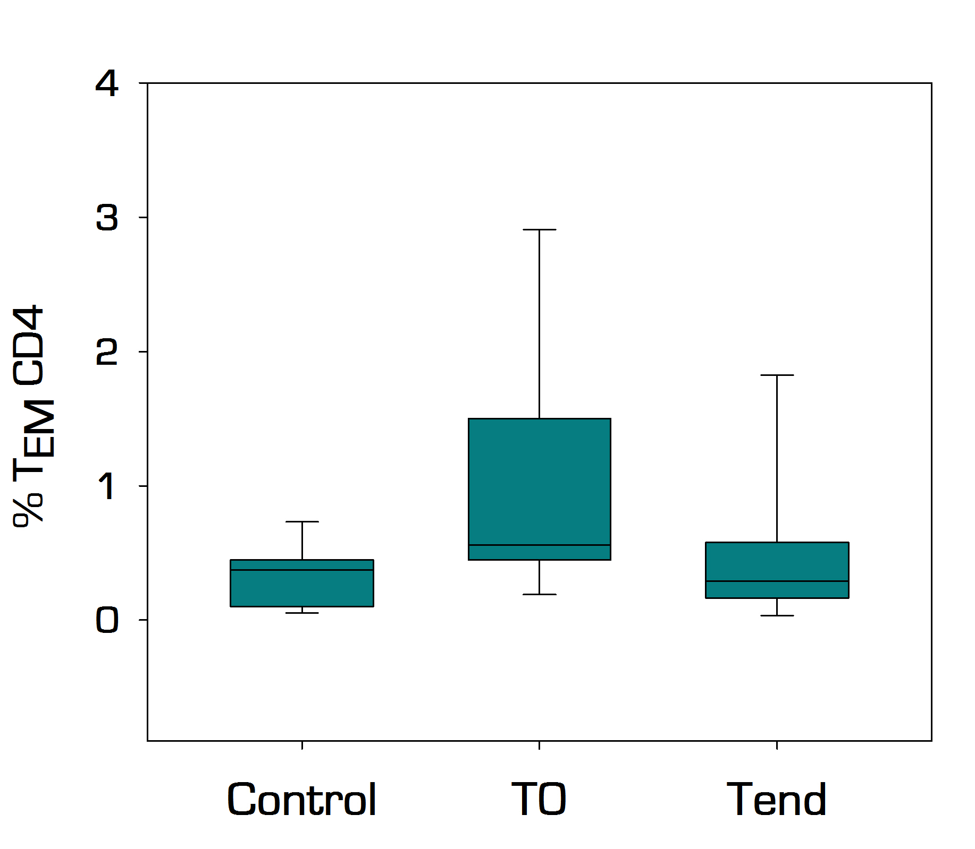
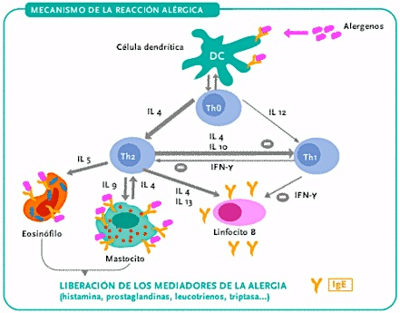
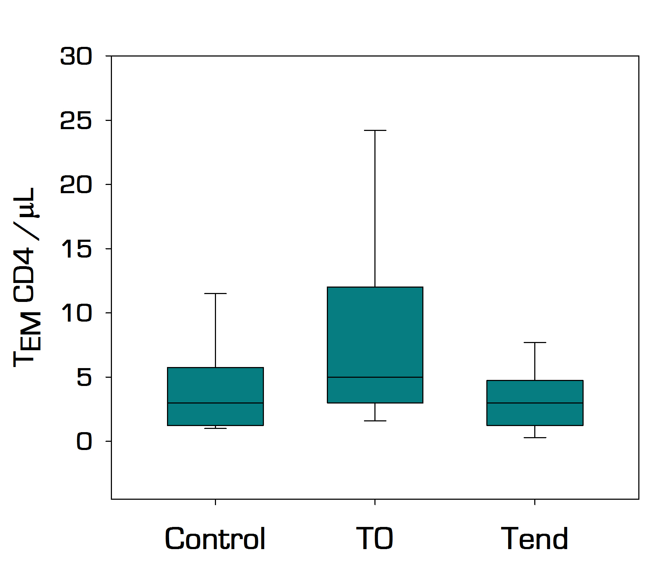
Effector CD4+ T cells
N.S.
***
*
N.S.
**
**
T effector cells are increased in allergic children and decrease markedly after SOTI

Slide 12
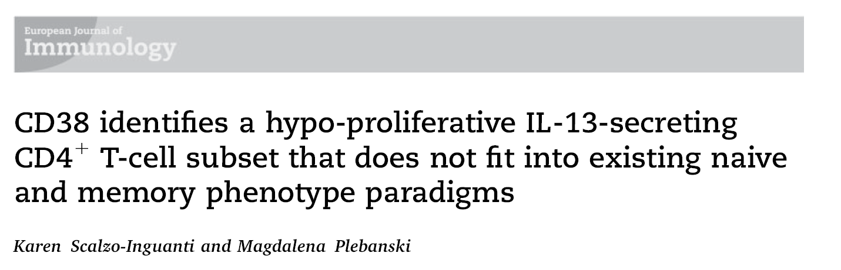
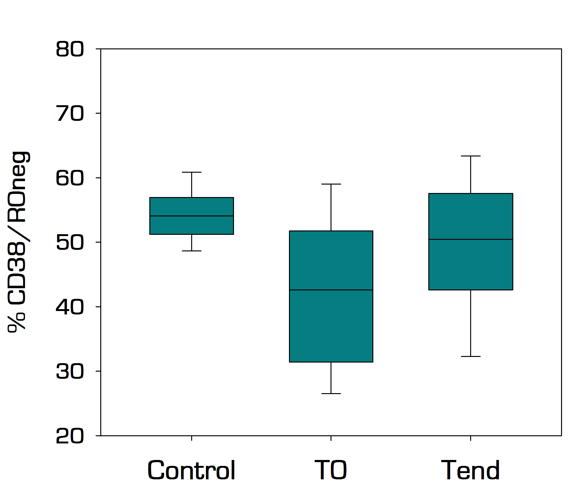
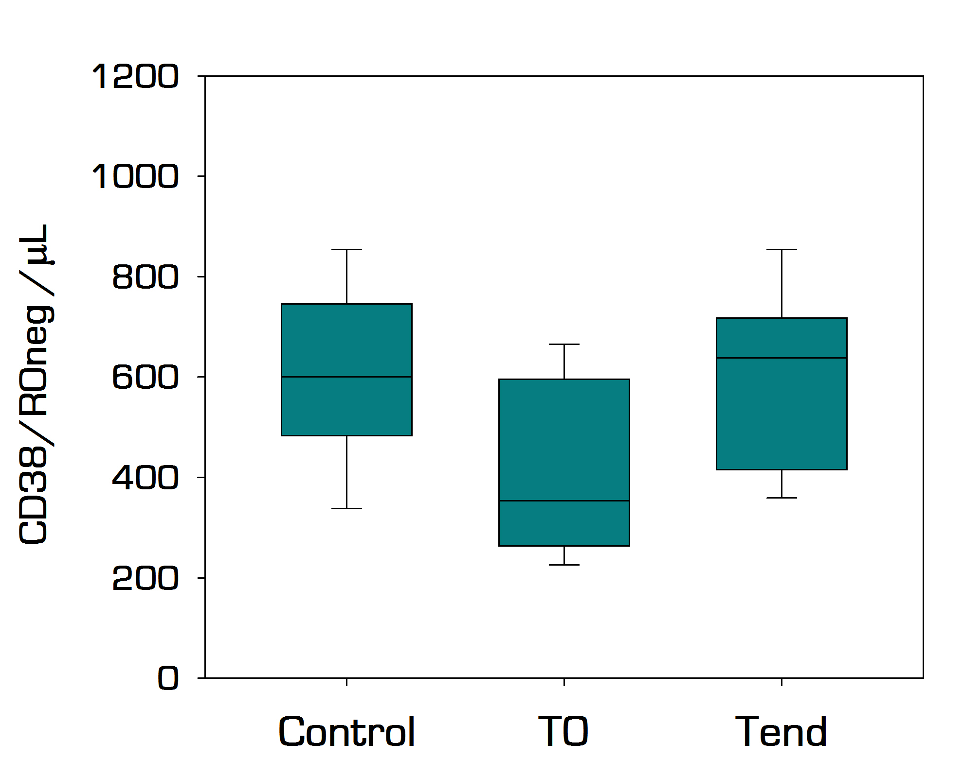
New CD4 subset
N.S.
N.S.
**
N.S.
**
**
p = 0,003
CD38/ROneg cells have a hypo-proliferative phenotype
These cells are diminished in allergic children and are recovered with the desensitization
Pediatric Allergy and Immunology (2012). 23(7): 648-53
Notes:
CD38 marcador de activación pero esta población no expresaba ni HLA-DR ni CD45RO

Slide 13
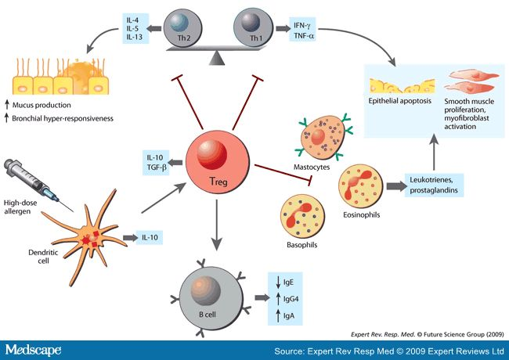
Are Treg cells responsible of the control of effector cells in the acquisition of tolerance ?

Slide 14
Treg cells
 | Percentage |  |  | Cells/μL
 | T0 | Tend | p | T0 | Tend | p
Treg Cells | 7.89 (7.11-9.99) | 8.42 (7.41-9.81) | 0.010* | 73 (49-93) | 84 (61-105) | 0.037*
Naïve Treg | 48.35 (43.7-55.2) | 51.88 (44.5-55.6) | 0.948 | 34 (24-49) | 39 (32-59) | 0.064
Suppressive Treg | 52.21 (45.4-56.5) | 48.64 (45.0-56.1) | 0.879 | 35 (26-48) | 43 (31-55) | 0.031*
SOTI → Increases Treg values
The balance Treg/effector is restablished
Pediatric Allergy and Immunology (2013). 25(1): 103-6
Notes:
La adquisición de tolerancia se asocia con un aumento significativo en % y nº de Treg
Los mayores valores de efectoras se observaron en los niños que menor cantidad de Treg circulantes tenían

Slide 15
Treg cells
p = 0.009
p = 0.008
Increased values of circulating Treg cells are related with a decrease in the effector cells associated with allergic symptoms
Pediatric Allergy and Immunology (2013). 25(1): 103-6
Notes:
La adquisición de tolerancia se asocia con un aumento significativo en % y nº de Treg
Los mayores valores de efectoras se observaron en los niños que menor cantidad de Treg circulantes tenían

Slide 16
IgG / cytokines
 | Immunoglobulins
 | T0 | Tend | p
IgE (total) (kU/L) | 738 (282-1578) | 772 (329-1550) | 0.900
IgE white | 8.18 (3.6-14.2) | 9.51 (4.1-15.1) | 0.792
IgE ovalbumin | 4.63 (3.0-12.4) | 4.61 (1.7-7.9) | 0.290
IgE ovomucoid | 6.08 (2.2-12.8) | 8.30 (2.6-17.8) | 0.725
IgG white (mg/L) | 5.02 (3.2-7.0) | 20.8 (8.2-44.5) | 0.027*
 | Cytokines
 | T0 | Tend | p
IL-12 | 37.95 | 12.68 | 0.068
IFN-ϒ | 156.1 | 87.48 | 0.036
IL-17A | 267.1 | 235.53 | 0.006
IL-2 | 110.32 | 66.70 | 0.041
IL-10 | 31.19 | 24.09 | 0.025
IL-9 | 73.26 | 58.97 | 0.021
IL-22 | 417.26 | 370.45 | 0.028
IL-6 | 0.34 | 1.93 | 0.180
IL-13 | 112.58 | 161.85 | 0.657
IL-4 | 77.84 | 52.16 | 0.097
IL-5 | 64.12 | 30.20 | 0.028
IL-1β | 129.41 | 94.41 | 0.059
TNF-α | 24.67 | 12.71 | 0.046
SOTI → Decreases “allergic” cytokines

Slide 17
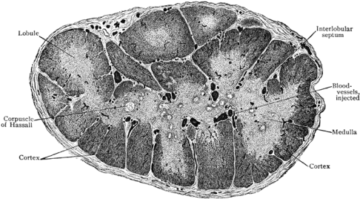
Treg
Efect.
Efect.
CD38
CD38
Efect.
CD38
Efect.
CD38
Efect.
Efect.
CD38
ALLERGY
TOLERANCE
SOTI
Negative Selection
RTES
Thymus
Notes:
Desaparecen las Teff con la participación de las Treg
El timo repone la población de células T pero en presencia del alergeno sufren selección negativa las T reactivas

Slide 18



Laboratory of Immune-regulation. IiSGM, Madrid (SPAIN)
Laura Perezabad
Jacobo López-Abente
Elena Seoane Reula
Rafael Correa-Rocha*
Department of Pediatric Allergy.
Hospital Gregorio Marañón. HGUGM, Madrid (Spain)
Elena Alonso
Victoria Fuentes
Lidia Zapatero
Sonsoles Infante
*: rafael.correa@iisgm.com

