Slide 1


3rd International Conference and Exhibition on
Clinical & Cellular Immunology
September 29 - October 01, 2014 Baltimore, USA
HIV infection of Human Treg cells downregulates Foxp3 expression and produces a loss of the suppressive capacity of these cells
Rafael Correa Rocha
Laboratory of Immune-regulation
Institute of Health Research “Gregorio Marañón” (IISGM). Madrid (Spain)

Slide 2
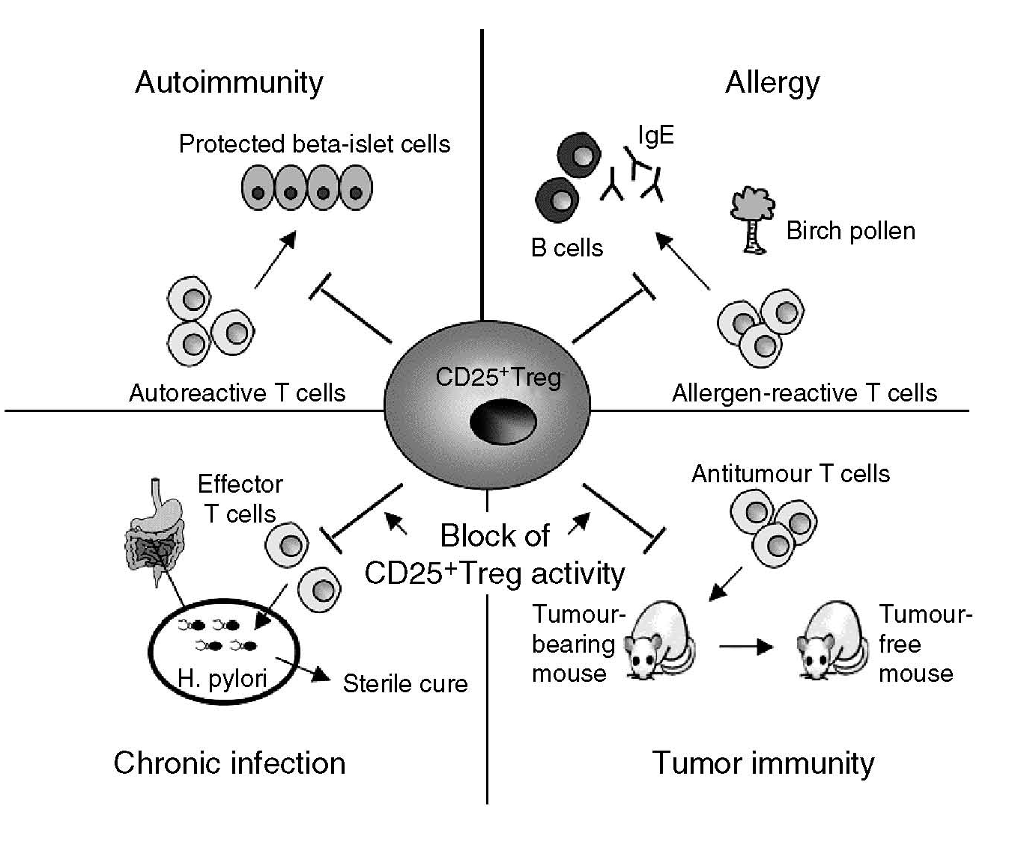
Treg cells
Regulatory T cells (Treg) → Subpopulation of CD4+ T cells with a suppressive activity
Treg are identified as CD4+CD25+Foxp3+ cells
Treg are considered a crucial component of immune system for preserving peripheral tolerance and the correct immune homeostasis

Slide 3
Treg cells in infections
The potent suppressor function of Tregs might present a serious obstacle to establishing robust protective immunity toward pathogens.
Tregs play an essential role in controlling immune response-mediated inflammation.
Studies suggest that by limiting late immune responses to an infectious agent, Tregs minimize associated tissue damage but also diminishing pathogen clearance.
Thus, with several scenarios proposed, the role for Tregs during HIV infection remains unclear.

Slide 4
Y
Plasma B cell
Y
HIV
Y
Y
Linf.
T
?
Y
Y
Inflamation
Activation
B cell
Y
Y
Treg
Tissue damage
HIV
↑ Inf.
Celular death
T CD4
HIV
T CD8
HIV
Treg-HIV

Slide 5
Precedents
Treg are recruited and expanded in infections to control the immune hyperactivation. Does not work in HIV-infected patients
Treg cells express CD4, CCR5 and CXCR4 (viral entry) and could be susceptible of being infected by HIV
The effect of HIV infection in the phenotype and function of Treg was unknown.
Objectives
To investigate whether Treg cells from healthy donor are infected in vitro by HIV.
In that case, to study the effects of HIV infection on the phenotype and function of Treg
To investigate the role of Treg cells in HIV-infected patients
Treg-HIV

Slide 6
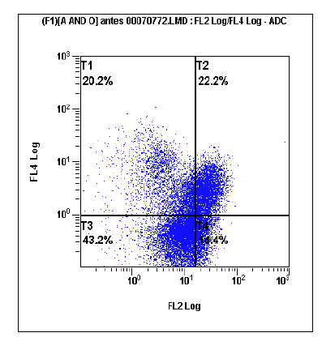
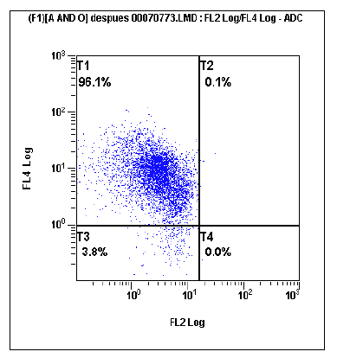
Phenotype
Cytometry: Foxp3; CD4
Blood from 15 healthy volunteers
Age: 25-40 years
Purity of isolated Treg > 95 %
PBMC
Treg
Gene Expression
Q-PCR: Foxp3; DNMTs
sorter
HIV
infection
Treg suppressive function
Sorter
Methods

Slide 7
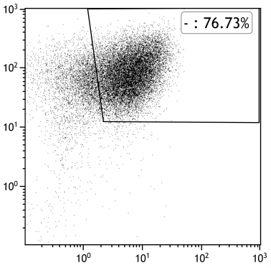
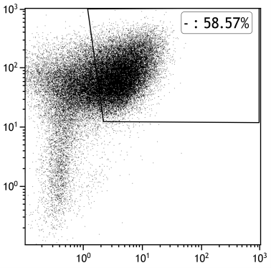
HIV infection of Treg
HIV infection
2 hours
Wash virus
Treg culture
3 → 7 days
Day 3
Non-Infected
HIV 0.1
p24 (HIV)
76.73%
58.57%
CD25
Foxp3
HIV infects and replicate in Treg cells
HIV-infection decrease Foxp3 expression

Slide 8
HIV infection of Treg
Normalised Foxp3 expression
Day 3
Day 5
Day 7
HIV 0.01
HIV 0.1
HIV effect on Foxp3 expression is dose-dependent ….
but is not observed with R5-tropic viruses

Slide 9
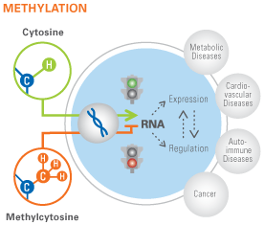
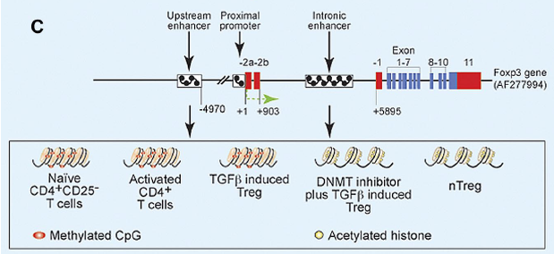
Foxp3 expression
Epigenetic Control
↑ DNMT
CD4
HIV infection of Treg cells modifies the methylation pattern of Foxp3 gene ?

Slide 10
Mechanism ⬇ Foxp3
Increased DNMT3b expression and subsequent methylation would be responsible of HIV-mediated decrease in Foxp3
“de novo” methylation
binding site in Foxp3 gene

Slide 11
Treg suppressive function
*
*
Teff-NT
Teff-act.
0.1:1
0.2:1
1:1
Ratio Treg:Teff
aCD3
APC
aCD3
Linf. TCD4
Treg
Linf. TCD4

Slide 12
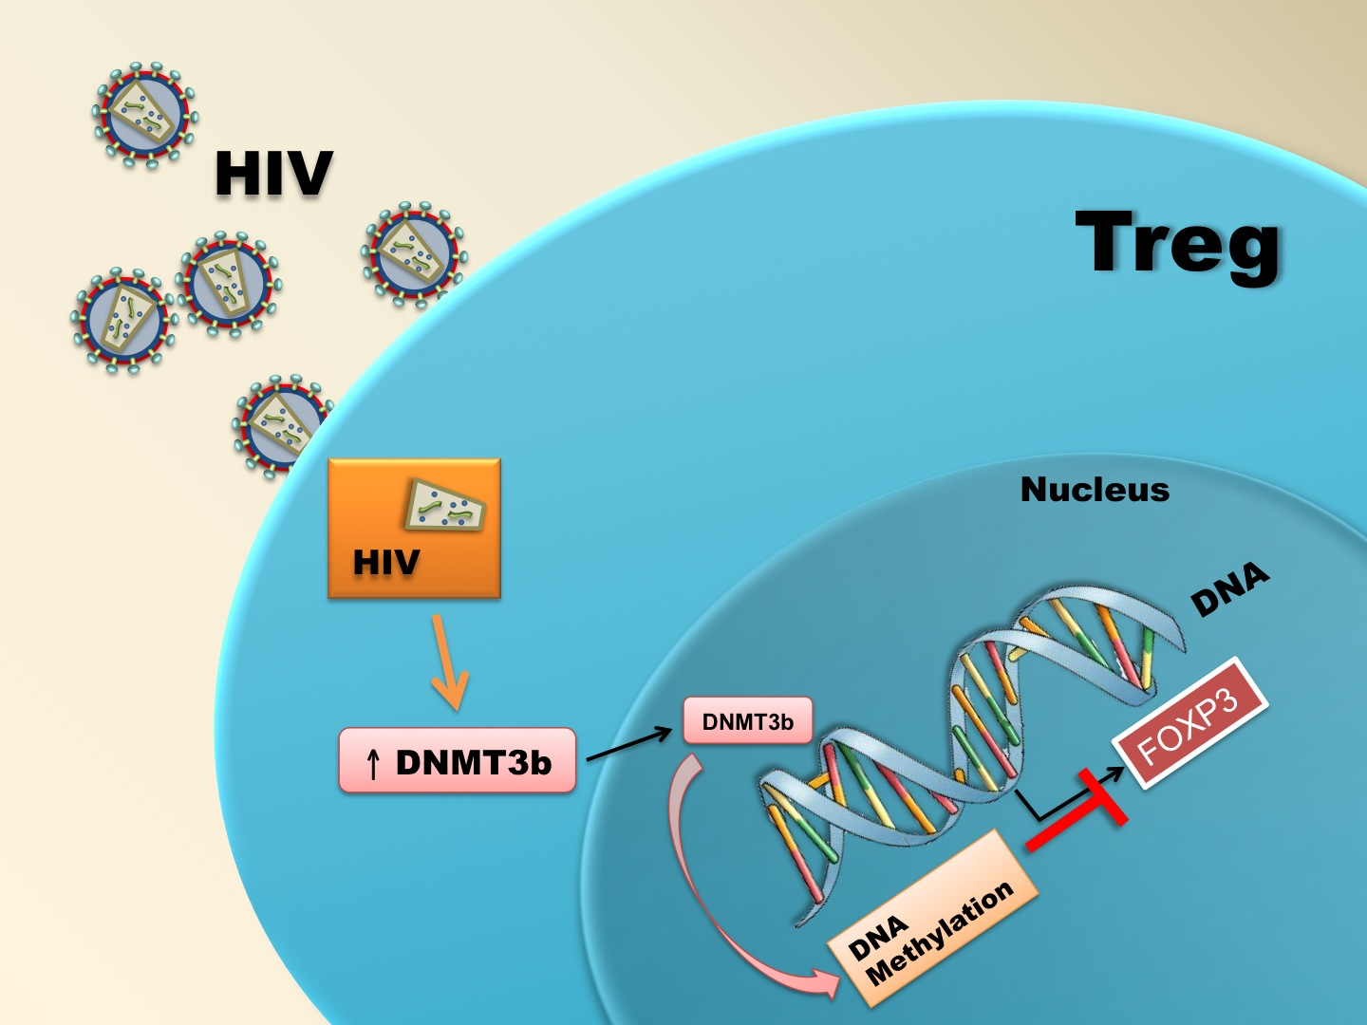
HIV-infected Treg loss the Foxp3 expression and decrease its suppresive capacity
The impairment in Treg population and the loss of its suppresive function could be related with the presence of the immune hyperactivation in HIV-infected patients, which has been correlated with the progression of the disease
Pion et al. AIDS. (2013). 27:2019-29

Slide 13
HIV-infected patients
14 non-infected Controls
20 HIV-infected patients with undetectable VL
15 HIV-infected patients with VL >5,000 copies
Treg absolute counts (cells/uL)
Non-HIV
Controls
HIV
u.d. VL
HIV
high VL
HIV-infected patients has decreased number of Treg cells
Which is the effect of VL in Treg counts ?
Treg decrease is related with immune hyperactivation ?
(Data not published)

Slide 14
HIV-infected patients
HIV-infected Patients
p=0.004
Viral Load (cp/mL)
Treg counts (cel/uL)
u.d. VL
high VL
p=0.013
p=0.289
Activated CD4+ T-cells (cel/uL)
(Data not published)
Treg counts (cel/uL)

Slide 15
Mechanism of Treg/ T-effector imbalance
in HIV-infected patients
The balance between Treg and effector T-cells is broken in HIV-infected patients

Slide 16
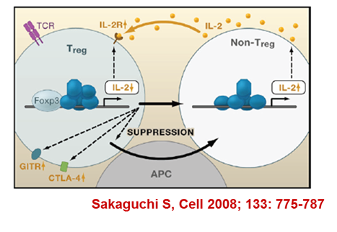
p=0.031
Treg from HIV-infected patients show a deficient expression of IL2-Rc (CD25)
In vitro experiments confirms that CD25 downregulation is due to the direct HV infection

Slide 17
HIV infection decreases IL2-Rc expression in Treg, diminishing the IL-2 signal that maintain the balance between effector and Treg cells
Méndez-Lagares et al. J Acquir Immune Defic Syndr (2014). 65:278–282

Slide 18
HIV-infected patients
Treg
Linf. TCD4
PBMC alone
+ Treg non-HIV control
+ Treg HIV
The suppressive capacity of Treg cells is impaired in HIV-infected patients
% of activation marker
(Data not published)

Slide 19
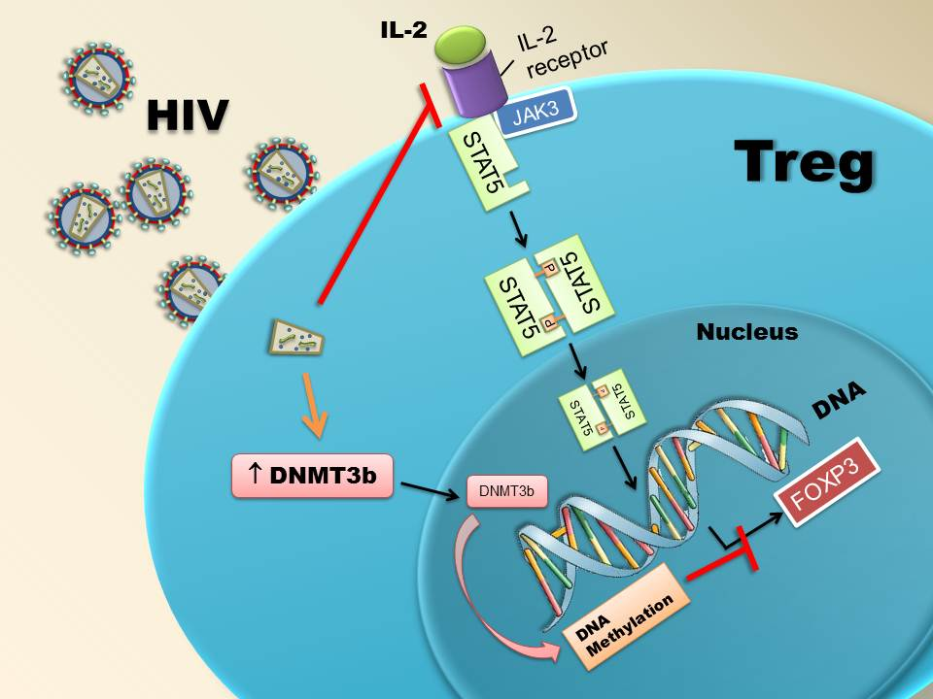
The impairment of Treg suppressive function could be responsible of immune hyperactivation in HIV-infected patients, which is related with the progression of the disease.
Preserving or boosting Treg population could avoid the deterioration of immune system and to improve the immune homeostasis in these patients.
Treg-HIV

Slide 20



Laboratory of Immune-regulation. IiSGM, Madrid (SPAIN)
Didiana Jaramillo
Jacobo López-Abente
Rafael Correa-Rocha*
Laboratory of Molecular Immunobiology. IiSGM
Marjorie Pion
Marta Martínez-Bonet
Alberto Martínez
Mª Angeles Muñoz-Fernández
Hospital Virgen del Rocío. IBIS, Sevilla (Spain)
Gema Méndez-Lagares
Manuel Leal
Yolanda Pacheco
*: rafael.correa@iisgm.com

