Slide 1
Brucellosis in Cattle and Buffaloes in and around Bikaner, Rajasthan, India
Prof. (Dr.) R.K. Tanwar
Director Clinic (Ex.)
College Of Veterinary & Animal Science,
Rajasthan University Of Veterinary & Animal Sciences, Bikaner - 334001, Rajasthan, India

Slide 2
Bovine brucellosis, caused by the bacterium Brucella abortus is a serious livestock disease that has significant animal health, public health and national and international trade consequences.
The current status of bovine brucellosis in India is not clear. However, the incidence of the disease is increasing in all the states of the country.

Slide 3
WHO considers brucellosis as the world’s most spread of all zoonoses and apart from its toll on people, it has enormous impact on the animals industry.

Slide 4
Cattle and Buffaloes are valuable and prestigious component of rural house hold having great socio-economic importance.
As per 19th Livestock Census -2012, the livestock population of India is 512 millions.

Slide 5
Brucellosis is widely prevalent throughout India causing economic losses to the tune of Rs. 350 million.
In India, Brucellosis was first recognized in 1942. The disease occurs in cattle, buffalo, sheep, goat, pigs, camel, yak, mithun, dogs, wild animals and humans.
B. Abortus biotype-1 in cattle and buffaloes.
B. Melitensis biotype-1 in sheep, goat and humans.
Other causative agents of Brucellosis are
Brucella ovis
Brucella suis
Brucella canis

Slide 6
The principal manifestations of brucellosis are reproductive failure such as abortion, retention of placenta, metritis in female and orchitis, epididymitis with frequent sterility in male.
Hygroma of knee joints is also encountered in affected animals.
Persistent (life long) infection is characteristic of this facultative intracellular organism with shedding in reproductive and mammary secretions.

Slide 7
IN THE PRESENT STUDY
200 blood samples each of cattle and buffaloes were collected for serological studies.
Brucella reactors were determined by using Rose Bengal Plate Test (RBPT) and Avidin – Biotin Enzyme Linked Immnosorbent Assay (AB-ELISA).
In cattle seroprevalence was 14.5% with RBPT and 19.0 with (AB-ELISA).
In buffaloes serprevalence was 9.0% with RBPT and 15% with AB-ELISA.

Slide 8
National control programme on brucellosis (NCPB) has been launched.
It is a time bound 5 year intensive location control programme.
The aim is to reduce the impact of brucellosis on human health and to reduce the economic losses.

Slide 9
In NCPB – periodical surveillance using Milk Ring Test for pooled milk and ELISA for random or herd screening will be done.
In NCPB – Biannual village level screening of pooled milk samples and B. abortus vaccination for female calves of 4 to 8 months age is to be done.

Slide 10
CONTROL PROGRAMME
In brucellosis free countries, test and slaughter of positive animals has proved as effective method.
In India, test and segregation in conjunction with vaccination is perhaps the only method which is practical and feasible in India.
However, segregation of seropositive cows until their death will therefore be necessary but very costly.
B. abortus strain 19 induces reasonable protection against B. abortus only.

Slide 11
Constraints in the control of brucellosis disease confirmation are leading to distress sale and spread of infection.
Increased trade movements of animals and commercial dairy farming is spreading the disease across the states easily.

Slide 12
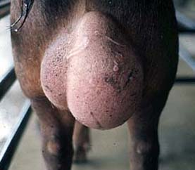
Orchitis

Slide 13
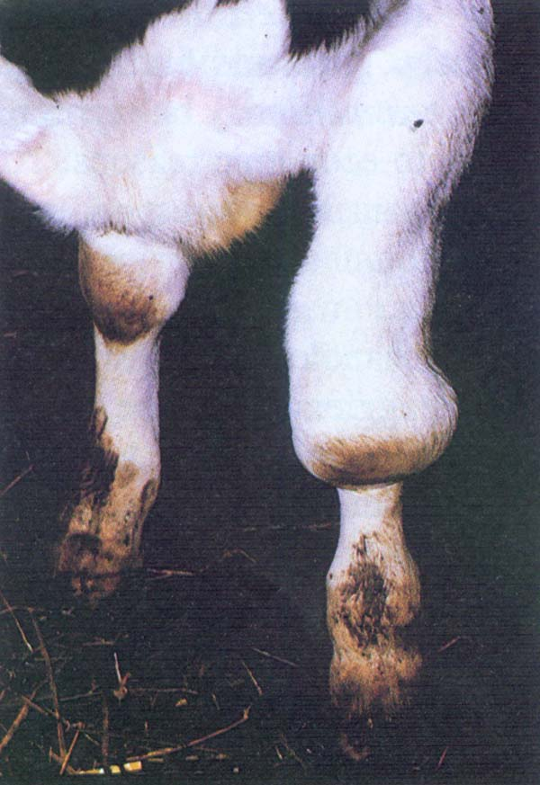
Hygroma of Knee Joints

Slide 14
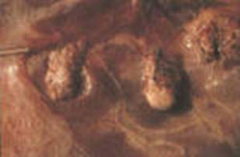
Degeneration of cotyledons

Slide 15
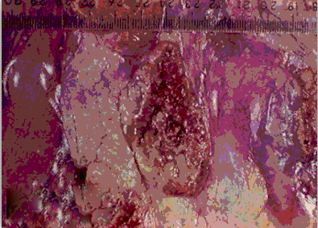
Degeneration of cotyledons

Slide 16
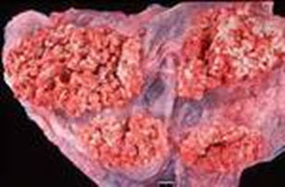
Degeneration of cotyledons

Slide 17
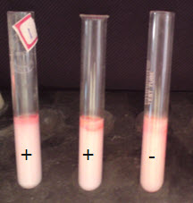
Milk ring test

