Slide 1
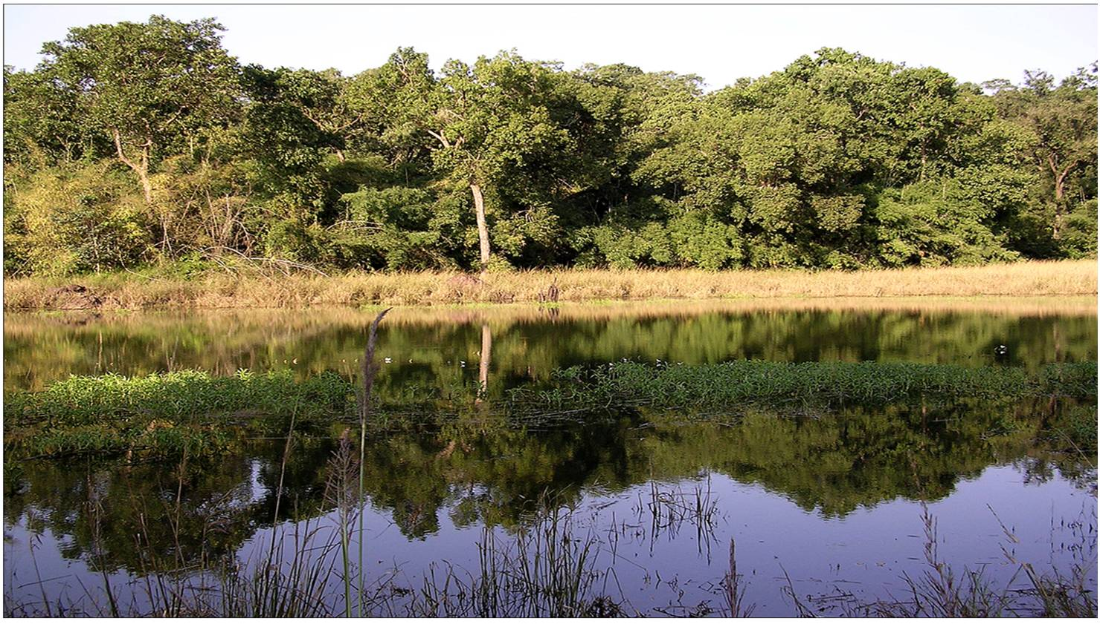
Community Oriented Integrated Ecosystem Approach for Conservation and Sustainable Management of
Forest Genetic Resources:
Challenges in Biodiversity Conservation in Natural Tropical Forest – India
Dr R K Pandey
Head, Forest Ecology & Environment Division
Madhya Pradesh State Forest Research Institute, Jabalpur, India
(pandeyrk1@yahoo.com)

Slide 2
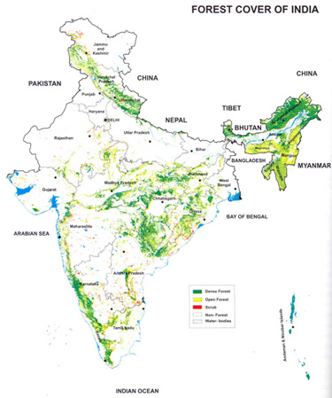

India has a long history of conservation and management of biodiversity/medicinal & aromatic plants.
SFRI, Jabalpur

Slide 3
India is one of the 12 mega diversity countries
Wide range of physical and climatic conditions provide:
    Diverse ecological habitats
    Diverse Forest Types:
      Alpine Forests in Himalayas
      Dry and Moist Tropical Deciduous
      Wet Evergreen Forests
      Mangroves.
SFRI, Jabalpur

Slide 4
Contribution of Forests: Ecosystem services supporting to:
7% of the worlds biodiversity
16% of world population
18% of cattle population
2.5% of world’s geographic area and about 2% of forest area
7% of world's flora
(328 families with 21,000 representative plant species)
SFRI, Jabalpur

Slide 5
Contribution of Forests: Ecosystem services supporting to …..
7.6% of world’s mammals
12.6% of world’s bird species
6.2% of world’s reptile species
4.4% of world’s amphibians
11.7% of world’s fish species
Several species endemic to India
(Source: FSI, 2004)
SFRI, Jabalpur

Slide 6
Insights
Recorded forest area of the country: 23.38%
Second largest land use after agriculture.
Owner State Government.
About 300 million poor people depend for livelihood.
About 70% supply of raw material to Pharmaceutical industries.
SFRI, Jabalpur

Slide 7
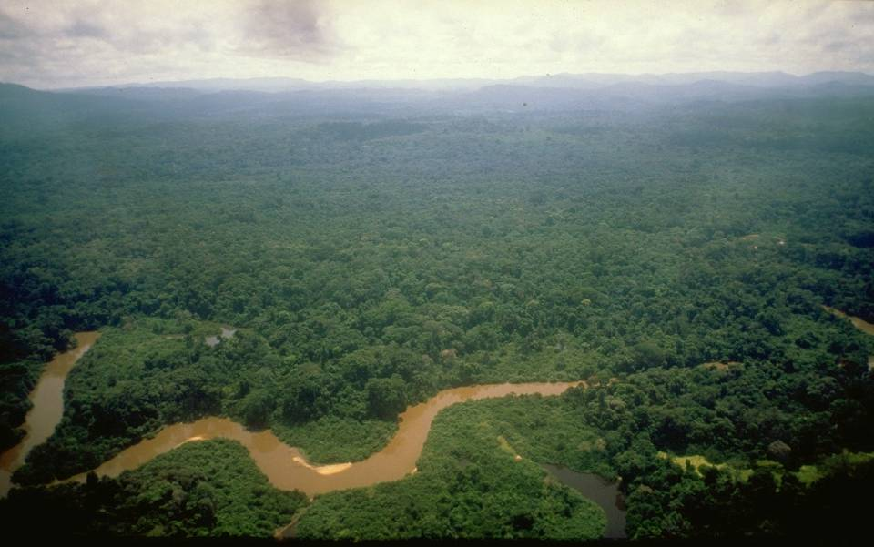
How forests support the
“natural infrastructure”
Ecosystem Goods & services ecological,economical,societal
Air quality Pest & disease control
Watershed protection and regulation
Wild species & habitat protection
_{Plant pollination}
Carbon sequestration and storage
_{Soil formation and fertility}
Decomposition of wastes Landscape beauty

Slide 8
Vicious Spiral
Poverty and unemployment
Over
exploitation
Ecological imbalance
Depletion of natural resources
SFRI, Jabalpur

Slide 9
Needs and Risks associated with increased dependency
Contribution of Native biodiversity
Major NTFPs for livelihood of dependent people
500 m people rely for subsistence
About 40% of total forest revenue
55% of forest based employment
Supply of raw materials from forests to Pharmaceutical industries
SFRI, Jabalpur

Slide 10
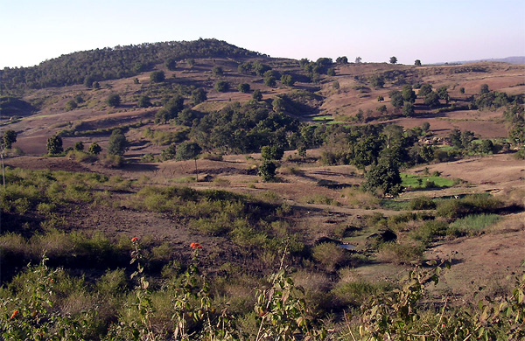
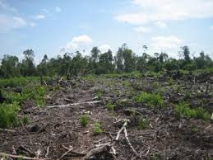
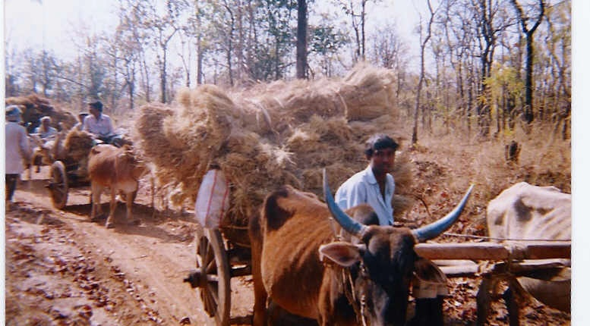
Challenges for conservation
Progressive degradation of forest
About 40% categorized as degraded forests.
Emerging challenges on regional biodiversity conservation & unsustainable management
    Qualitative
    Quantitative &
    Functional

Slide 11
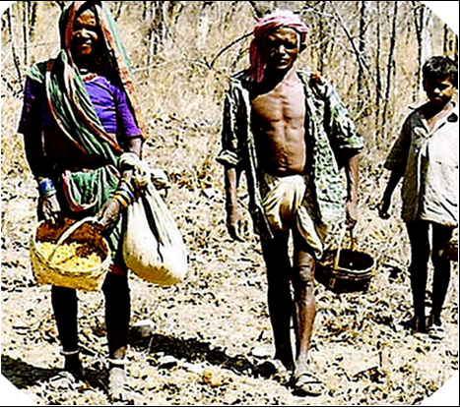
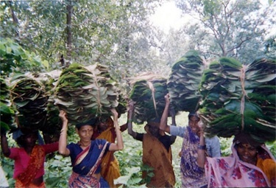
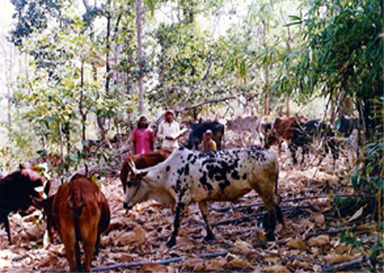
Over exploitation of resources
  Dependency for livelihood
  Ignorance of traditional practices for collection
  Over demand / trade
SFRI, Jabalpur

Slide 12
  Unregulated biotic factors
    Forest land diversion, grazing, fire etc.
  Habitat loss
  Emergence of ecologically non congenial condition
  Invasion of alien species.
  Direct impact on native FGR
  Impact of climate change
  Threat to native FGR in-situ
SFRI, Jabalpur

Slide 13

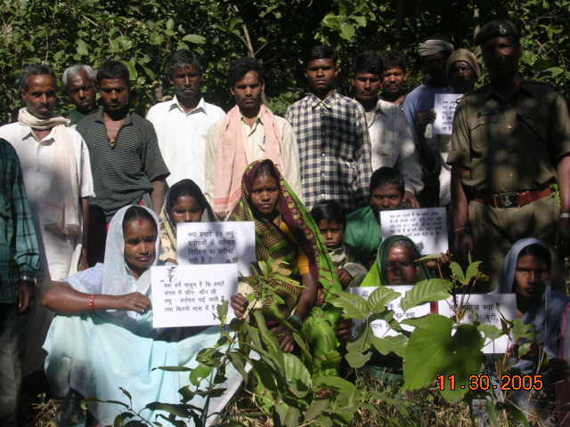
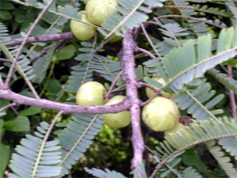
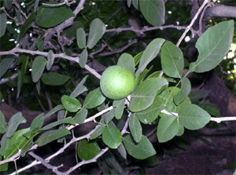
Un-sustainable use
not beneficial
"Neither in ecological
nor in social terms"
Phyllanthus emblica L.
“Aonla”
Aegle marmelos (L.) Correa “Bel”
SFRI, Jabalpur
Notes:
Changed photo

Slide 14
Impact on biodiversity
Forest resources(NTFPs)
Users
Owners
Forest dependent communities
(Users Stakeholders)
Govt. forest departments/ (Institutional stakeholders)
Over demand of NTFPs from forests
Management Plan
Source of livelihood & income generation
Inadequacy on sustainable management plan for NTFPs
Free access for collection
Ignorance of sustainable/traditional harvesting practices
Sustainable management of timber species
Overexploitation/non-sustainable harvesting
Critical status of commercially important resources in in-situ
Threatened
Rare
Endangered
Vulnerable
Vanish

Slide 15
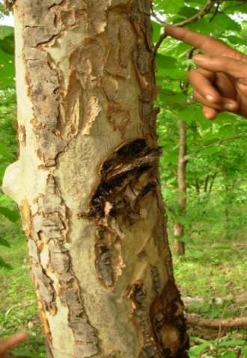
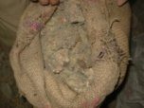
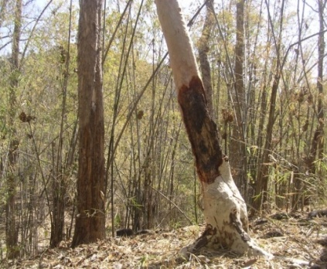
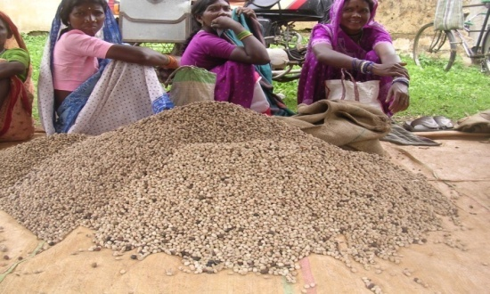
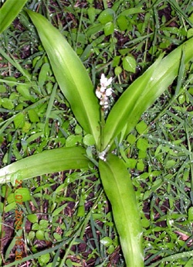
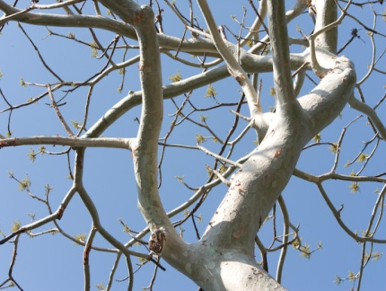
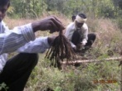
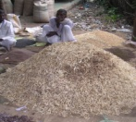
Emerging threats
Ecological Perspective:
Destructive Harvesting of tubers, roots, leaves, fruits, flowers, bark, gum, resins and dyes by local dependent communities from natural forests.
Boswellia serreta: Gum
Sterculia urens:
gum
Litsea glutinosa:
Bark
Buchanania lanzan :
Fuits
Chlorophytum
tubersoum : Root
SFRI, Jabalpur

Slide 16
Emerging threats .....
Social Perspective:
Dependency of poor people for
Sources for income and livelihood security
Ignorance of traditional practices
Lack of Knowledge of scientific input of harvesting and primary processing
Economic Perspective:
Growing demand on herbal medicines
Gap in demand and supply
Decreasing trend of resources supply from forests
SFRI, Jabalpur

Slide 17
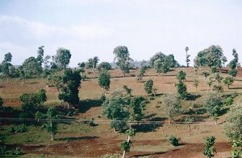
Now the questions are :
Threat on FGR committed to perpetuation/ sustainability in-situ ?
The conditions of forest and its users acceptable?
Prevailing management intervention adequate?
Extinct wild genetic resources can be retrieved ?
SFRI, Jabalpur

Slide 18
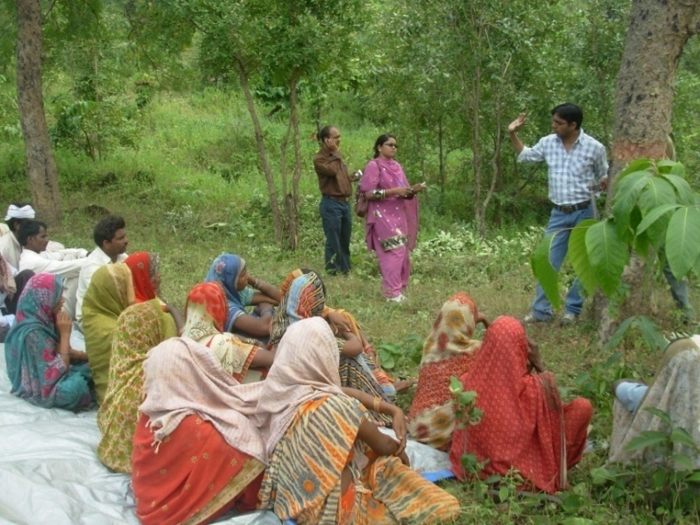
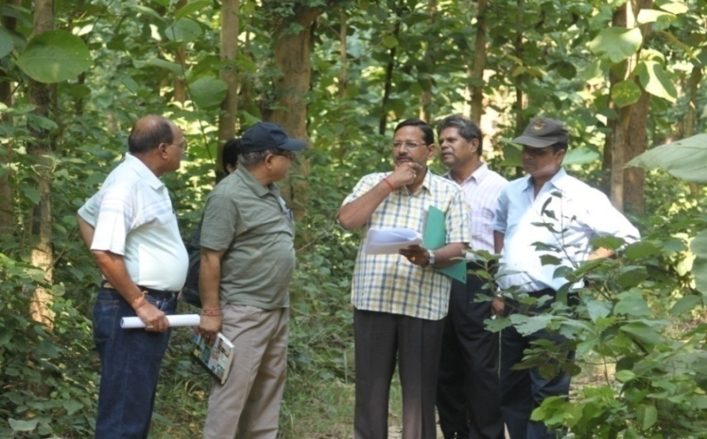
No specific community based
co-management system
About 60% production of the collected NTFPs is unrecorded due to inadequate management interventions.
No authoritative information on resource availability (Threshold limit) and sustainable management in natural forests.
SFRI, Jabalpur

Slide 19
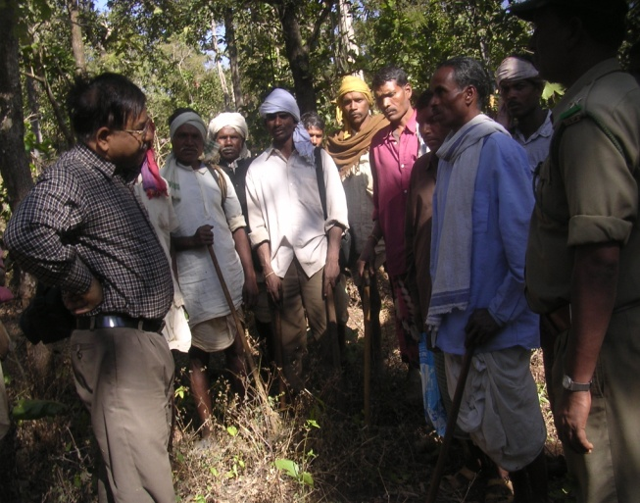
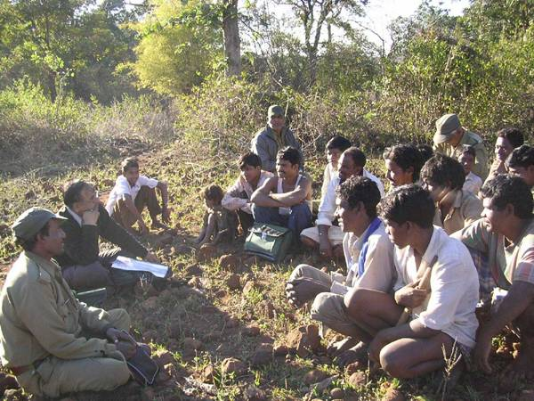
Threat….
  Lacunae in policy implementation:
    Management intervention: unregulated, non sustainable, unscientific collection
    Right of free access of collection of NTFPs
    Species specific management plan for NTFPs
    Integrated co-management system
SFRI, Jabalpur

Slide 20
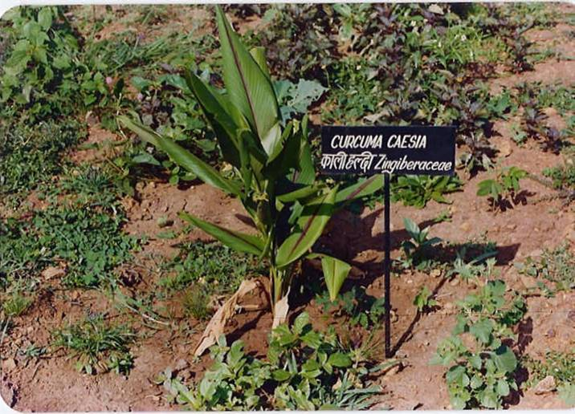
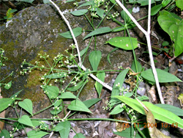
Need of strategic interventions for:
Conservation and sustainable management of FGR in: Ecological, Social Economic and Policy terms.
Collaborative integrated approach: institutional/users stakeholders.
Regulated commercial exploitation, strict legal provisions to prevent destructive harvesting.
Curcuma caesia: (Kali haldi)
Use: Roots are used in Asthama
Rubia manjith Roxb. : (Manjitha)
Use: Roots are used in jaundice.
SFRI, Jabalpur

Slide 21
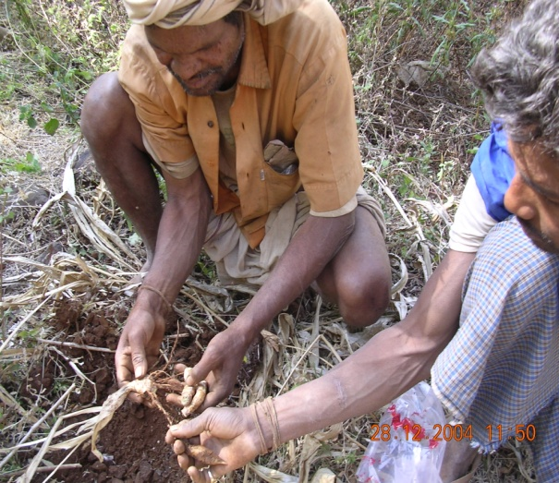
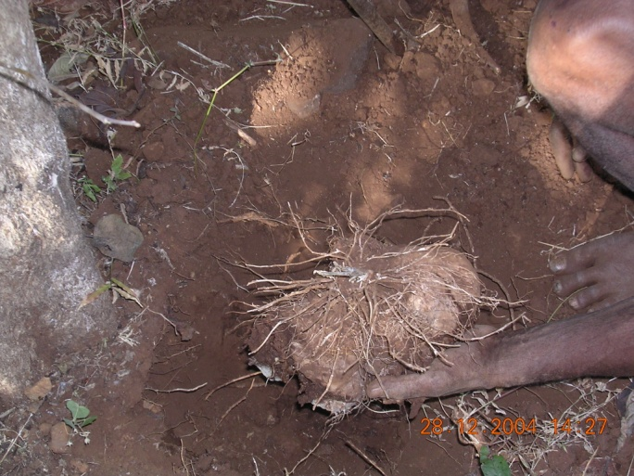
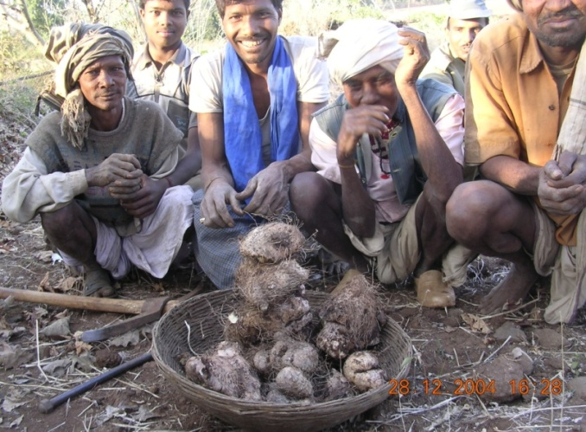
Need of strategic interventions for:.......
Strict implication of sustainable harvesting limit of NTFPs collected from natural forests.
Economical viable, user friendly and socially accepted techniques
Trainings and capacity building programme for dependent communities
SFRI, Jabalpur

Slide 22
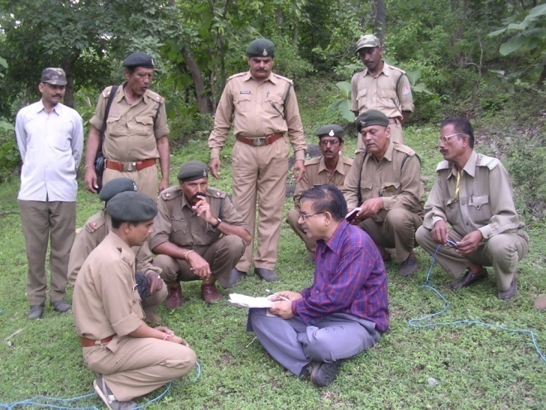
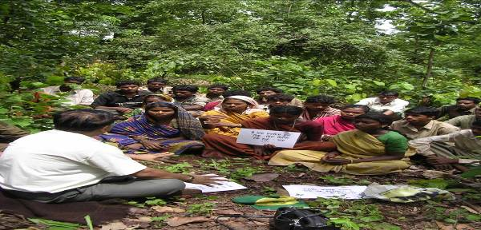
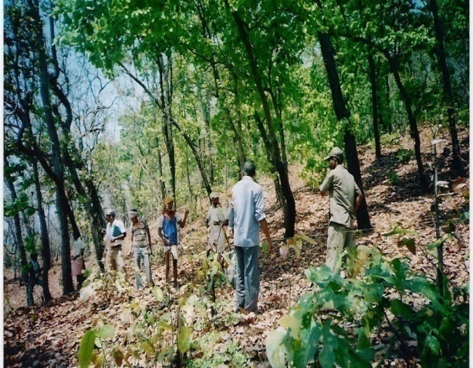
Contd…
Community oriented “Self Assessment Technique” for conservation of biodiversity.
Creating massive people’s participation.
Site specific models for enhancement of goods and services.
SFRI, Jabalpur

Slide 23
Need of strategic planning for determination of sustainable harvesting limits of utilizable NTFPs with community participations

Slide 24
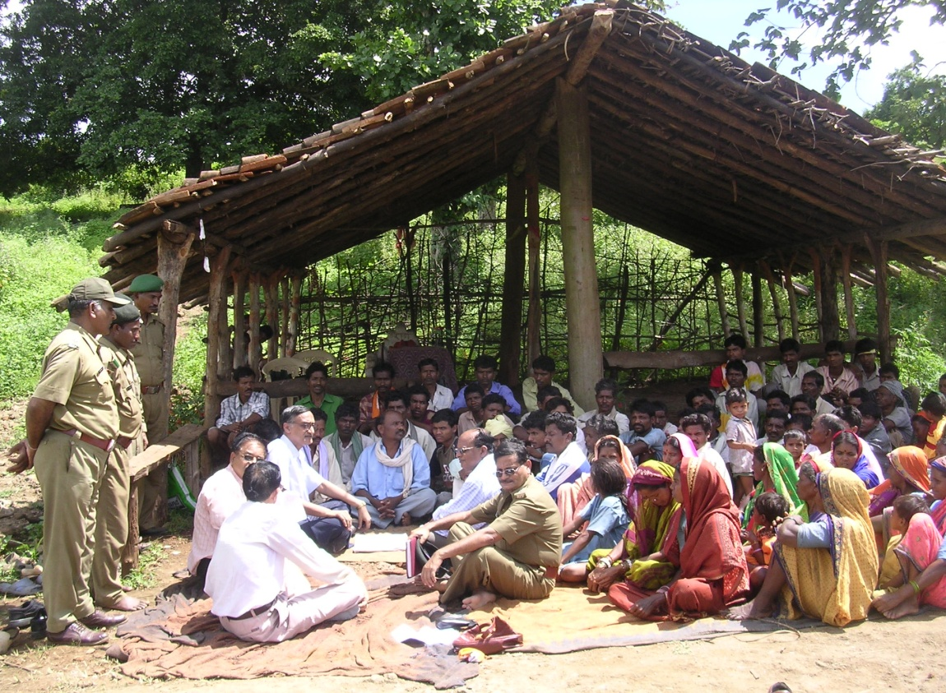
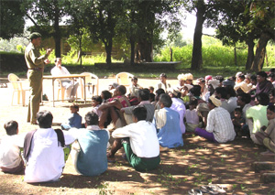
Role of Institutional and users stakeholders
Regular monitoring and evaluation with scientific inputs.
Importance of natural forests in balancing ecological and economic benefits.
Viable management partnership.
SFRI, Jabalpur

Slide 25
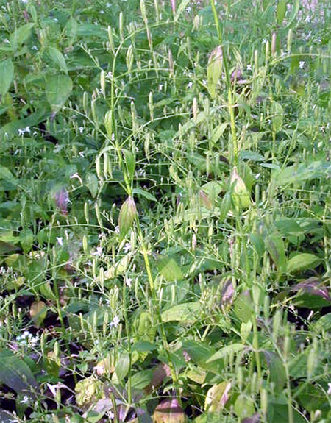
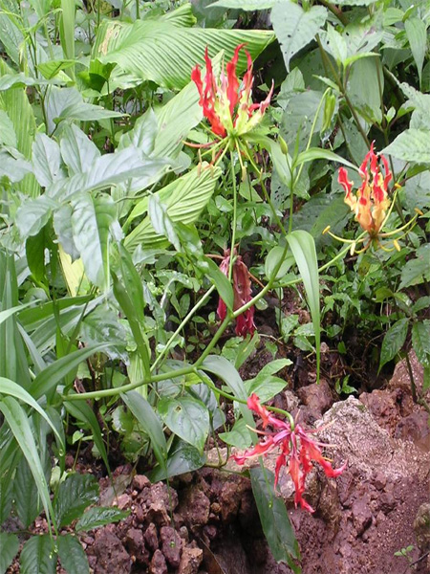
Innovation in limit determination of sustainable harvesting in natural forests with community participation : Case study
Determination of sustainable harvesting technologies with dependent community participation.
Identification and protection of potentially rich biodiversity areas in-situ.
SFRI, Jabalpur

Slide 26
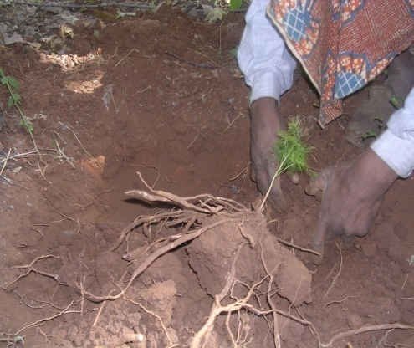
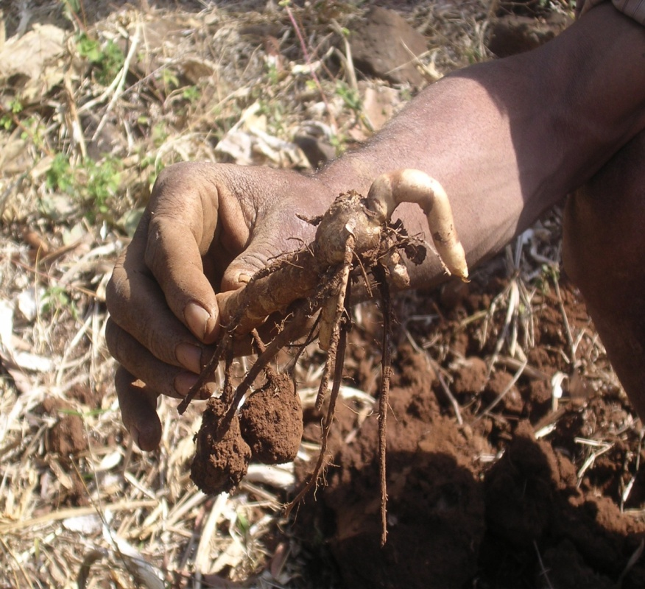
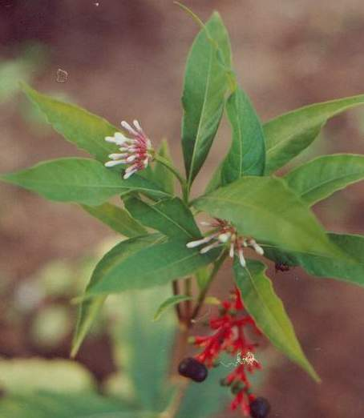
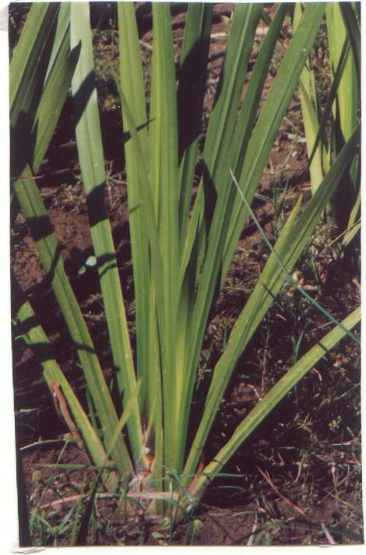
Innovation in determination of limit of sustainable.....
Resource Inventory to evaluate present status/ availability/threats (quantitative assessment).
Sustainable harvesting regimes (species specific Regeneration potential) in-situ conditions.
SFRI, Jabalpur

Slide 27
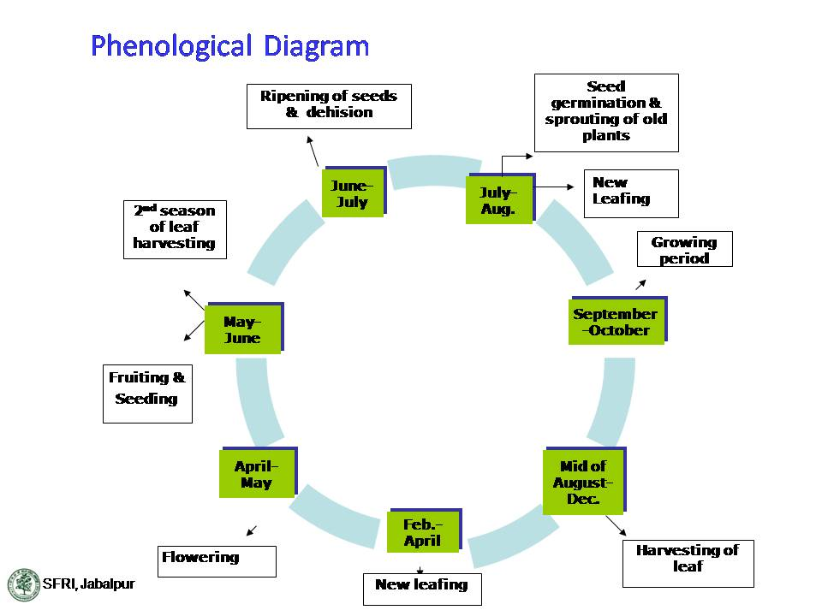

Slide 28
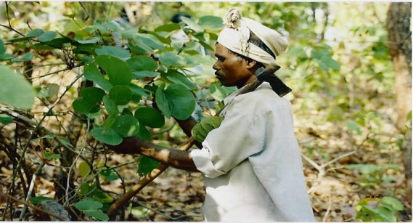
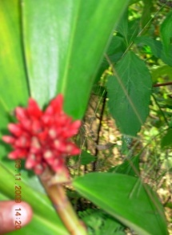
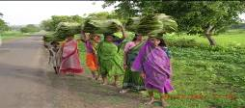
Sustainable harvesting limits of some commercially important NTFPs with active community participation (Pandey & Saini ,2008 and Pandey et al , 2011)
S. No. | Name of Species | SHL (%)
1 | Chlorophytum tuberosum (Safed Musli) | 30%
2 | Curculigo orchioides (Kali Musli) | 68%
3 | Curcuma angustifolia (Tikhur) | 64%
4 | Dioscorea daemona (Baichandi) | 44%
5 | Plumbago zeylanica (Chitrak) | 64%
6 | Asparagus racemosus (Satavar) | 52%
7 | Bauhinia vahlii (Mahul bela) | 58%
8 | Embelia basaal (Baibidang) | 80%
9 | Costus speciosus (Keokand) | 58%
10 | Phyllanthus amara (Bhui aonla) | 71%
11 | Andrographis paniculata (Kalmegh) | 42 %
SFRI, Jabalpur

Slide 29
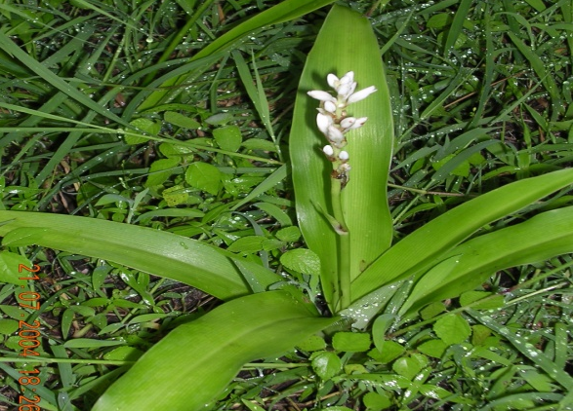
Determination of sustainable harvesting limits.....
1. Chlorophytum tuberosum (Safed Musli)
Curve Fit model of Linear regression for determination of SHL
Index: harvesting treatments
1=20%; 2=40%;
3=60%;
4=80%
SHL= 30%
*(PSY= >30%)
SHL
SFRI, Jabalpur
*= Progressive Sustainable Yield

Slide 30
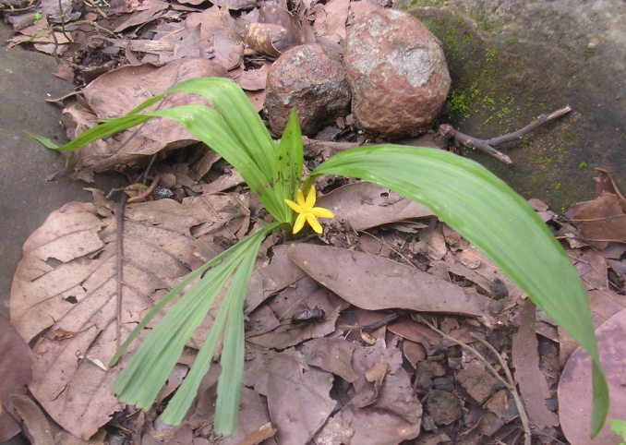
2. Curculigo orchioides (Kali Musli)
Determination of sustainable harvesting limits.....
Curve Fit model of Linear regression for determination of SHL
Index:
1=20%;
2=40%;
3=60%;
4=80% harvesting percentage
SHL= 68 %
*(PSY= >68%)
SHL
*= Progressive Sustainable Yield
SFRI, Jabalpur

Slide 31
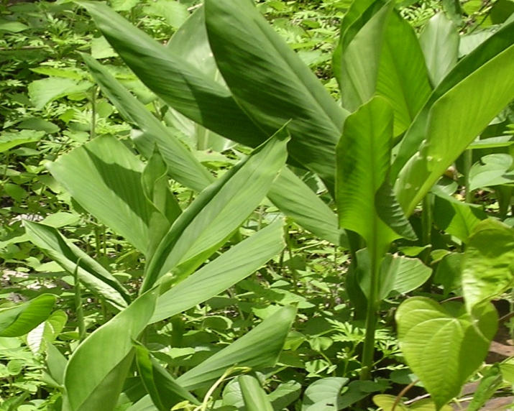

3. Curcuma angustifolia (Tikhur)
Contd......
Curve Fit model of Linear regression for determination of SHL
SHL
Index: 1=20%; 40%; 3=60% and 4=80% harvesting treatment
SHL = 64% , *(PSY= >64%)
*= Progressive Sustainable Yield
SFRI, Jabalpur

Slide 32
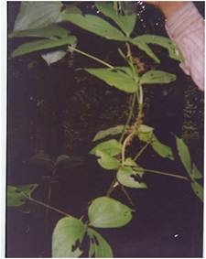
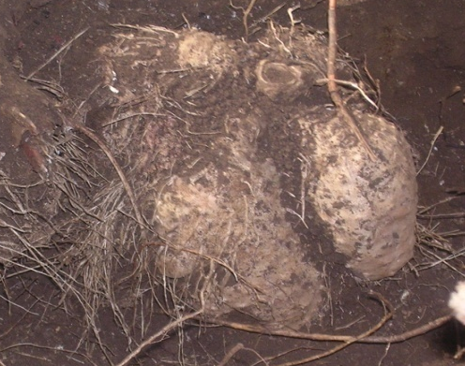

4. Dioscorea daemona (Baichandi)
Curve Fit model of Linear regression for determination of SHL
SHL
Index: 1: 20 %; 2:40%; 3: 60% and 4: 80% harvesting Groups
SHL = 44% , *(PSY= >44%)
*= Progressive Sustainable Yield

Slide 33



Contd......
5. Plumbago zeylanica (Chitrak)
Curve Fit model of Linear regression for determination of SHL
SHL
Index: 1=20%; 2=40%; 3=60% and 4=80% harvesting
SHL= 64%, *(PSY= >64%)
*= Progressive Sustainable Yield

Slide 34


Contd......
6. Bauhinia vahlii (Mahul leaves)
Curve Fit model of Linear regression for determination of SHL
SHL
Index: 1= 20 %, 2=40%, 3=60%, 4=80% and 5=100 % harvesting intensity.
SHL: 58% , *(PSY= >58%)
*= Progressive Sustainable Yield
SFRI, Jabalpur

Slide 35

7. Asparagus racemosus (Satavar):
Contd......
Curve fit Model for Asparagus racemosus.
SHL
Index: 1=20%, 2=40%,3=60%, 4=80% harvesting Treatment
SHL= 52%, *(PSY= >52%)
*= Progressive Sustainable Yield
SFRI, Jabalpur

Slide 36
    Need of scientific inputs:
An innovative “Self-Assessment” method with community participation.
Status: inventory, ecology, distribution, phenological observation
Habitat requirements
Regeneration/growth dynamics
Yield-potential
Assessment/monitoring of the consequences of commercial harvesting from forests.
Encourage traditional practices for conservation and sustainable use
Institutional role to analyze rules, regulations in favor of conservation and sustainable management of FGR
SFRI, Jabalpur

Slide 37



Thanks

