Slide 1
Plant-based Monitoring for Yield Prediction of Citrus under Differential Irrigation Dr P. Panigrahi Scientist ‘SS’ Directorate of Water Management, Bhubaneswar, Odisha, India

Slide 2
Introduction
Water is the major constraint to crop production in many parts of the world.
To sustain crop production in water scarce environments, deficit irrigation (DI) is a suggestable irrigation practice.
DI is an irrigation strategy in which water is applied less than the full water requirement of the crop.
Citrus, the third important fruit crop in India, has low productivity and it varies widely from year to year depending upon climate and water availability in different regions of the country.
In changing climate scenario, it is utmost essential to optimize water management and prediction of yield of the crop.

Slide 3
Treatment details of sustained deficit irrigation (DI) and Partial root zone drying (PRD) irrigation Scheduling
DI₅₀: Irrigation at 50% ETc
DI₇₅: Irrigation at 75% ETc
PRD₅₀: Irrigation at 50% ETc through PRD
PRD₇₅: Irrigation at 75% ETc through PRD
FI : Irrigation at 100% ETc throughout the crop period
Replication: 4; Plants per replication: 2; Design: RBD

Slide 4
Layout of drip emitters in tree basin and their wetted zone under PRD
1.2 m
0.9 m
Tree stem
Lateral pipe
Drip emitter
Wetted zone of emitter
1.0 m
Micro tube

Slide 5
Irrigation water quantity estimation
The water application for fully-irrigated trees was computed as:
ETc = Kp x Kc x Ep
The volume of water applied under 100% ETc was estimated based on the formula (Germanà et al., 1992):
V_{id} = π (D² / 4) × (ET_{c} – R_{e}) / E_{i}

Slide 6
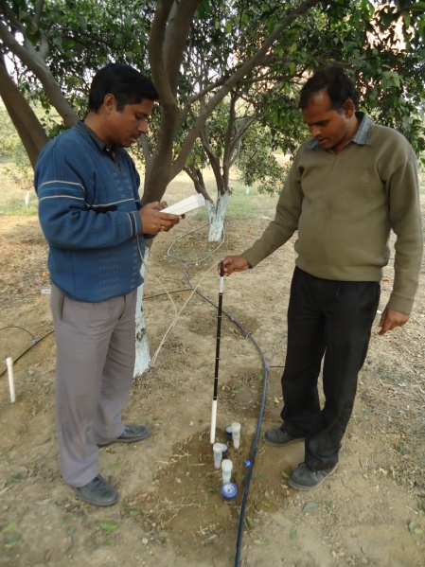
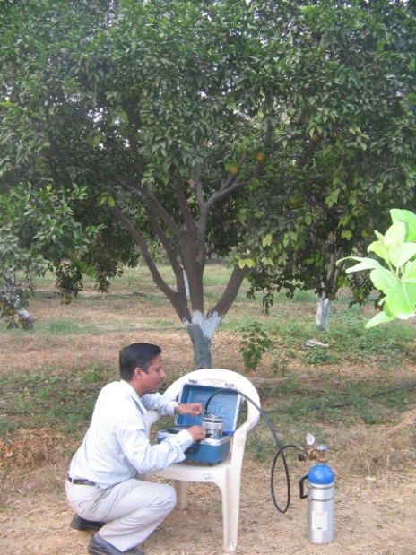
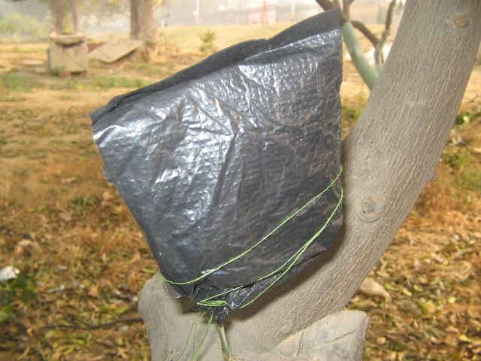
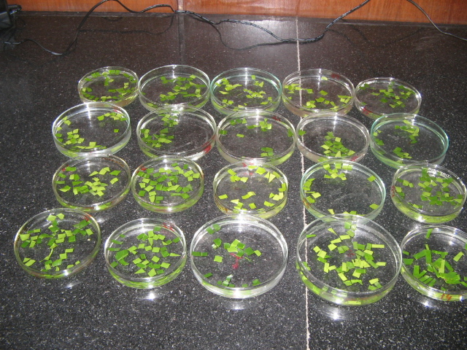
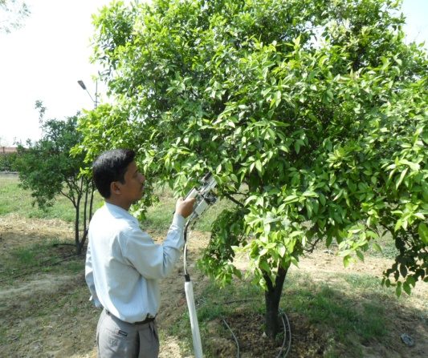
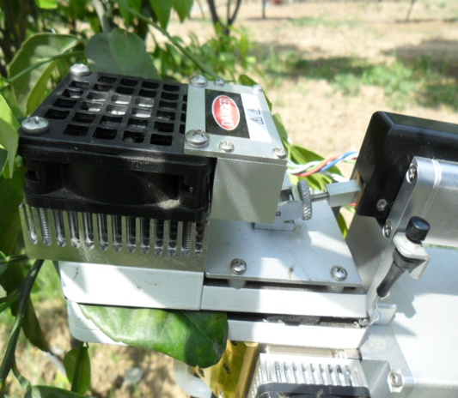
Measurements and analysis
Soil water measurement
Leaf and stem water potential measurement
For Relative leaf water content
Leaf physiological parameters

Slide 7
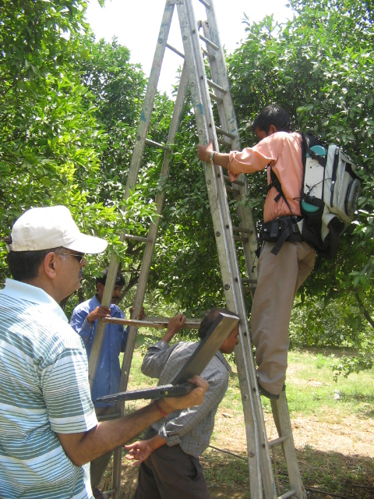
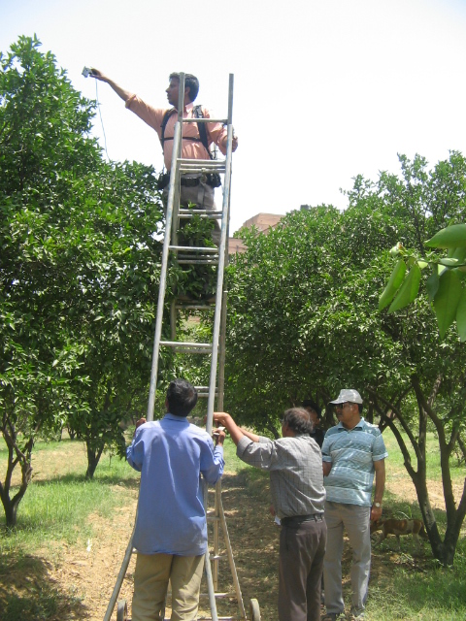
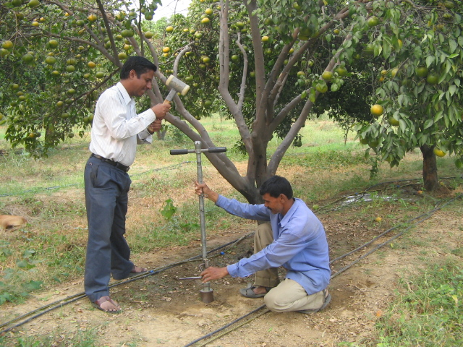
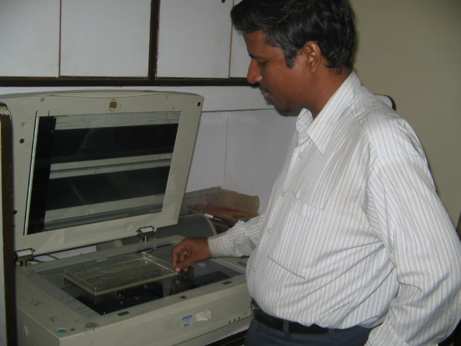
Canopy reflectance
Root sampling and analysis

Slide 8
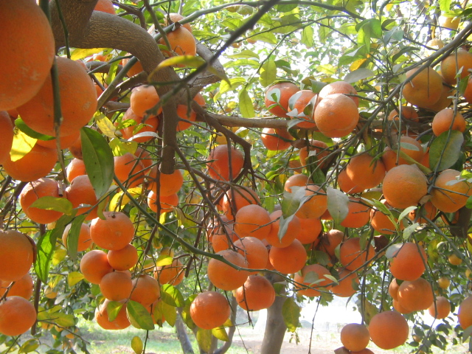
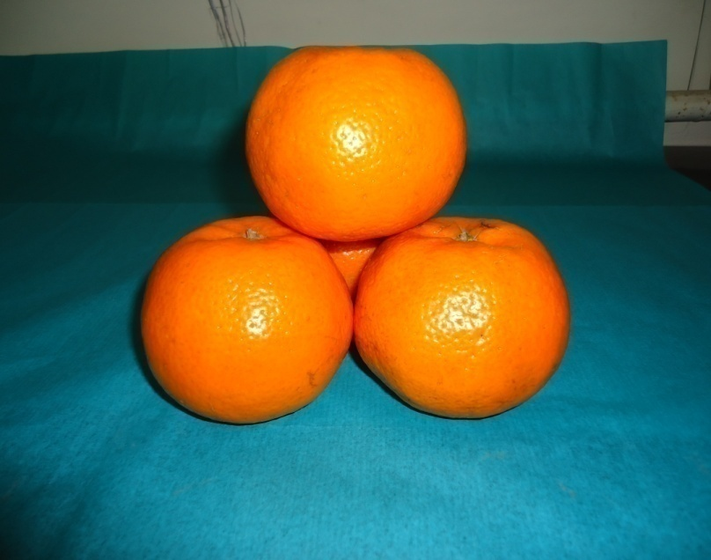
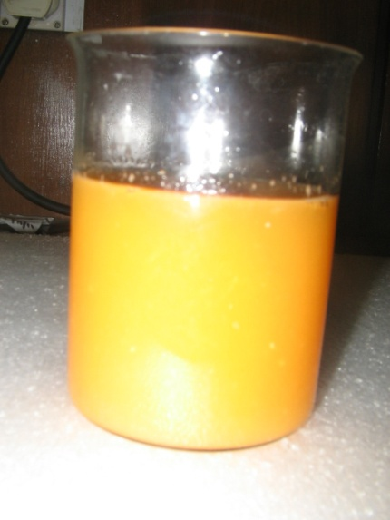
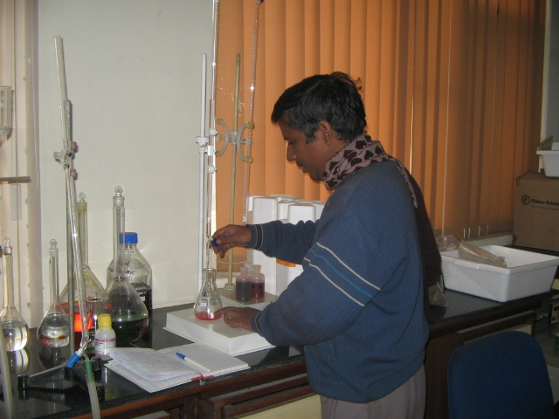
Mature Kinnow fruits on trees
Harvested Kinnow fruits
Juice of Kinnow
Analysis of Juice

Slide 9
Indices
The water stress integral (S_{ψ}) for each treatment was calculated using the midday leaf and xylem water potential data, according to the equation defined by Myers (1988):
S_{ψ} =
where S_{ψ} is water stress integral (MPa day), ψ _{i, i+1} is average midday leaf/stem water potential for any interval i and i+1 (MPa), c is maximum leaf/stem water potential measured during the study and n is number of days in the interval.
2. a. Relative leaf water content (RLWC )was determined by the formula (Bowman, 1989):
RLWC (%) = {(FW - DW) / (TW - DW)} x 100
b. Leaf water concentration (LWC) was determined using the formula (Peñuelas et al., 1997):
LWC = {(FW−DW) / (FW)} x 100

Slide 10
3. The spectral reflectance indices related to water deficit conditions are calculated as:
Water band index (WBI) = (R₉₀₀) / (R₉₇₀) (Penuelas et al., 1995);
Normalized Difference water index (NDWI) = (R₈₅₇ – R₁₂₄₁) / (R₈₅₇ + R₁₂₄₁) (Gao, 1995);
Moisture stress index (MSI) = (R₁₅₉₉) / (R₈₁₉) (Hunt et al., 1989); Normalised difference infrared index (NDII) = (R₈₁₉-R₁₆₄₉) / (R₈₁₉+R₁₆₄₉) (Jackson et al., 2004),
Simple ratio (proposed) = (R₁₃₆₀) / (R₂₂₅₀)
where R and the subscript numbers indicate the light reflectance at the specific wavelength (in nm).

Slide 11
Total N, P and K in leaf (%, dry weight basis) of ‘Kinnow’ mandarin as affected by various irrigation treatments
Treatments | 2010 |  |  |  | 2011
 | N | P | K |  | N | P | K
DI₅₀ | 2.31a | 0.15a | 1.42a |  | 2.43a | 0.16a | 1.44a
DI₇₅ | 2.46a | 0.19a | 1.54b |  | 2.46b | 0.19a | 1.56c
PRD₅₀ | 2.35a | 0.18a | 1.48c |  | 2.45b | 0.18a | 1.49d
PRD₇₅ | 2.47b | 0.21a | 1.59a |  | 2.49c | 0.19a | 1.61b
FI₁₀₀ | 2.69c | 0.22a | 1.64c |  | 2.72d | 0.20a | 1.66d
Optimum range of leaf-N (2.28–2.53%), P (0.10–0.13% ), and K (1.28–1.63% ) for Kinnow (Hundal and Arora, 2001; Srivastava, 2011).

Slide 12
Total Fe, Mn, Cu and Zn in leafs (ppm, dry weight basis of ‘Kinnow’ mandarin as affected by various irrigation treatments
Treatments | 2010 |  |  |  |  | 2011
 | Fe | Mn | Cu | Zn |  | Fe | Mn | Cu | Zn
DI₅₀ | 54.0a | 48.6a | 7.3a | 24.7a |  | 56.8a | 50.3a | 7.8a | 24.9a
DI₇₅ | 58.4a | 57.8a | 7.9a | 25.6a |  | 58.7a | 58.2a | 8.2a | 24.1a
PRD₅₀ | 55.6a | 51.2a | 7.3a | 25.2a |  | 56.7a | 51.8a | 7.9a | 25.5a
PRD₇₅ | 59.9a | 58.4a | 8.2a | 25.8a |  | 61.4a | 58.9a | 8.4a | 26.9a
FI₁₀₀ | 62.6b | 61.5b | 8.2a | 26.9b |  | 62.8b | 61.6a | 8.9a | 27.2b
Optimum values (62.3–89.4 ppm Fe, 58.7 – 76.3 ppm Mn, 8.1 – 10.3 ppm Cu and 26.3 – 28.5 ppm Zn) of Kinnow mandarin (Hundal and Arora, 2001; Srivastava, 2011).

Slide 13
Leaf/stem water potential and leaf /stem water stress integral during 2010 and 2011

Slide 14
RLWC and LWC in 2010 1nd 2011

Slide 15
Leaf physiological parameters under different irrigation treatments in 2010 and 2011
Treatments | 2010 |  |  |  |  | 2011
 | Pn | gs | Tr | LWUE |  | Pn | gs | Tr | LWUE
DI₅₀ | 2.89a | 21.07b | 1.66b | 1.74c |  | 2.94a | 20.50b | 1.53b | 1.92a
DI₇₅ | 2.92a | 24.80d | 1.84d | 1.58a |  | 3.41b | 23.48d | 1.60d | 2.13b
PRD₅₀ | 2.90a | 20.13a | 1.43a | 2.02e |  | 3.38b | 20.04a | 1.31a | 2.58d
PRD₇₅ | 2.95b | 23.13c | 1.79c | 1.65b |  | 3.45b | 22.83c | 1.57c | 2.17b
FI₁₀₀ | 3.88c | 37.78e | 2.08 | 1.86d |  | 4.37c | 31.07e | 1.74e | 2.51c

Slide 16
Tree growth under various irrigation treatment
Treatments | 2010 |  |  |  |  | 2011
 | TH | SD | CD | CV |  | TH | SD | CD | CV
DI₅₀ | 33.4a | 20.4a | 25.8a | 0.81a |  | 21.7a | 19.2a | 20.1a | 0.64a
DI₇₅ | 36.2b | 22.5b | 31.3b | 0.83a |  | 26.7b | 20.9b | 27.5b | 0.77a
PRD₅₀ | 32.5a | 19.7a | 25.3a | 0.79a |  | 21.0a | 19.0a | 18.8a | 0.60a
PRD₇₅ | 35.9b | 22.0b | 30.9b | 0.80a |  | 26.5b | 20.9b | 26.9b | 0.74a
FI₁₀₀ | 40.7c | 26.2c | 48.7c | 0.86b |  | 36.0c | 25.6c | 32.3c | 0.98b

Slide 17
Mean water band index (WBI), normalised difference water index (NDWI), moisture stress index (MSI) and Normalised difference infrared index (NDII) of Kinnow mandarin under various irrigation treatments.
Treatments | Hyperspectral Indices
 | 2010 |  |  |  |  |  | 2011
 | WBI | NDWI | MSI | NDII | SR |  | WBI | NDWI | MSI | NDII | SR
DI₅₀ | 1.056 | 0.042 | 0.561 | 0.266 | 3.002 |  | 0.992 | 0.081 | 0.462 | 0.219 | 2.937
DI₇₅ | 0.966 | 0.035 | 0.472 | 0.243 | 2.802 |  | 0.981 | 0.064 | 0.417 | 0.206 | 2.811
PRD₅₀ | 1.006 | 0.037 | 0.481 | 0.251 | 2.862 |  | 0.984 | 0.076 | 0.431 | 0.207 | 2.828
PRD₇₅ | 0.932 | 0.034 | 0.471 | 0.241 | 2.847 |  | 0.952 | 0.057 | 0.406 | 0.205 | 2.796
FI₁₀₀ | 0.917 | 0.033 | 0.469 | 0.239 | 2.711 |  | 0.815 | 0.031 | 0.384 | 0.203 | 2.629
Parameters are significantly different from each other

Slide 18
Fruit yield, IWUE, and WUE in 2010
Treatments | 2010
 | No. fruits dropped/tree | No. fruits harvested/tree | Average fruit weight (g) | Fruit yield (t ha⁻¹) | IWUE (t ha⁻¹ mm⁻¹) | WUE (t ha⁻¹ mm⁻¹)
DI₅₀ | 170d (96*, 52**, 22***) | 671a | 152.7a | 51.23a | 0.108c | 0.056c
DI₇₅ | 135c (77, 40, 18) | 718b | 161.6b | 58.01c | 0.081b | 0.051b
PRD₅₀ | 148b (80, 48, 20) | 703b | 160.7b | 56.48b (8.7%) | 0.119d (83%) | 0.062c
PRD₇₅ | 100a (61, 28, 11) | 755c | 163.0b | 58.73c | 0.082b | 0.053b
FI₁₀₀ | 92a (64, 15, 13) | 763c | 162.3b | 61.91d | 0.065a | 0.047a

Slide 19
Fruit yield, IWUE, and WUE in 2011
Treatments |  | 2011
 |  | No. fruits dropped/tree | No. fruits harvested/ tree | Average fruit weight (g) | Fruit yield (t ha⁻¹) | IWUE (t ha⁻¹ mm⁻¹) | WUE (t ha⁻¹ mm⁻¹)
DI₅₀ |  | 151e (82*, 50**, 19) | 682a | 154.7a | 52.75a | 0.150c | 0.071c
DI₇₅ |  | 109c (66, 32, 11) | 739c | 163.1b | 60.26c | 0.114b | 0.067b
PRD₅₀ |  | 126d (70, 46, 10) | 711b | 161.0b | 57.23b (9.4%) | 0.163d (81%) | 0.077d
PRD₇₅ |  | 89b (52, 27, 10) | 751c | 165.2b | 62.03c | 0.118b | 0.070c
FI₁₀₀ |  | 79a (51, 20, 8) | 776d | 162.8b | 63.20c | 0.090a | 0.061a

Slide 20
Fruit quality parameters of Kinnow fruits in 2010
Treatments | 2010
 | Juice content (%) | TSS (⁰Brix) | TA (%) | Ascorbic acid (mg/l) | Reducing Sugar (mg/l) | Total Sugar (mg/l)
DI₅₀ | 43.7a | 11.4 | 1.02f | 120.4a | 50.4c | 73.8c
DI₇₅ | 46.7b | 10.9c | 0.82b | 112.1a | 42.9b | 61.7a
PRD₅₀ | 45.5b | 11.2b | 0.84b | 119.8a | 59.3d | 67.4b
PRD₇₅ | 48.2b | 10.8b | 0.82b | 109.0c | 47.1c | 60.1a
FI₁₀₀ | 49.6c | 10.8c | 0.81b | 116.3b | 37.2a | 66.4b

Slide 21
Fruit quality parameters of Kinnow fruits in 2011
Treatments |  | 2011
 |  | Juice content (%) | TSS (⁰Brix) | TA (%) | Ascorbic acid (mg/l) | Reducible sugar (mg/l) | Total sugar (mg/l)
DI₅₀ |  | 43.1a | 11.7 a | 0.96f | 128.7a | 54.7c | 75.4c
DI₇₅ |  | 45.9b | 11.2c | 0.80d | 114.7a | 45.9b | 64.7a
PRD₅₀ |  | 44.3b | 11.4b | 0.83e | 123.6a | 61.7d | 69.3b
PRD₇₅ |  | 47.9b | 11.1b | 0.80b | 111.9c | 49.2b | 63.2a
FI₁₀₀ |  | 49.5c | 10.9c | 0.79b | 119.1b | 38.7a | 68.7b

Slide 22
Correlation matrix (Pearson’s) for plant-based observations during 2010 and 2011 under DI
Parameters | Fruit Yield | SD | CV | Leaf-N | Leaf-K | Leaf- Fe | Leaf- Zn | SΨ_{l} | SΨ_{s} | RLWC | LWC | Pn | Tr | gs | LWUE | WBI | NDWI | MSI
SD | 0.25*
CV | 0.33* | 0.69*
Leaf-N | 0.57⁺ | NS | 0.29*
Leaf-K | 0.61⁺ | NS | 0.41* | 0.43*
Leaf- Fe | NS | NS | NS | NS | NS
Leaf-Zn | 0.58* | NS | NS | NS | NS | 0.41*
SΨ_{l} | 0.59⁺ | 0.21* | 0.29* | 0.43* | 0.47* | NS | NS
SΨ_{s} | 0.62⁺ | 0.26* | 0.32* | 0.52* | 0.49* | NS | NS | 0.93⁺
RLWC | 0.55⁺ | 0.20* | 0.17* | 0.32 | 0.32* | NS | NS | 0.74⁺ | 0.79⁺
LWC | 0.53⁺ | NS | NS | 0.30 | 0.25* | NS | NS | 0.59⁺ | 0.69⁺ | 0.74⁺
Pn | 0.55⁺ | NS | 0.23* | 0.85⁺ | 0.44* | 0.78⁺ | 0.36 | 0.62⁺ | 0.53⁺ | 0.66⁺ | 0.55⁺
Tr | 0.51⁺ | NS | NS | 0.69* | 0.51⁺ | 0.43* | 0.29 | 0.78⁺ | 0.83⁺ | 0.71⁺ | 0.69⁺ | 0.61⁺
gs | 0.61⁺ | NS | NS | 0.58* | 0.55⁺ | 0.45* | 0.38 | 0.79⁺ | 0.76⁺ | 0.75⁺ | 0.66⁺ | 0.58⁺ | 0.61⁺
LWUE | 0.60⁺ | NS | NS | 0.47* | 0.36* | 0.42* | 0.21 | 0.73⁺ | 0.69⁺ | 0.59⁺ | 0.48⁺ | 0.39⁺ | 0.69⁺ | 0.57*
WBI | 0.57⁺ | 0.29* | 0.29* | 0.59⁺ | 0.47* | 0.44* | NS | 0.65⁺ | 0.67⁺ | 0.69⁺ | 0.52⁺ | 0.47* | 0.55* | 0.51* | 0.30⁺
NDWI | 0.53* | NS | NS | 0.53* | NS | NS | NS | 0.38* | 0.48* | 0.57* | 0.40* | 0.33* | 0.49* | 0.40* | 0.21* | 0.59⁺
MSI | 0.79⁺ | 0.22* | 0.23* | 0.51⁺ | 0.40* | NS | NS | 0.44* | 0.41⁺ | 0.52⁺ | 0.47⁺ | 0.42⁺ | 0.43⁺ | 0.45* | 0.17⁺ | 0.59* | 0.54*
NDII | 0.49* | NS | NS | 0.43* | 0.36* | 0.27* | NS | 0.26* | 0.32* | 0.47* | 0.49* | 0.39* | 0.37⁺ | 0.39* | 0.26* | 0.55* | 0.48* | 0.51*
SR | 0.61⁺ | NS | NS | 0.54⁺ | 0.36* | NS | NS | 0.57⁺ | 0.62⁺ | 0.63⁺ | 0.58⁺ | 0.47⁺ | 0.50⁺ | 0.44* | 0.20* | 0.84⁺ | 0.59* | 0.60*

Slide 23
Correlation matrix (Pearson’s) for plant-based observations during 2010 and 2011 under PRD
Parameters | Fruit Yield | SD | CV | Leaf-N | Leaf-K | Leaf- Fe | Leaf- Zn | SΨ_{l} | SΨ_{s} | RLWC | LWC | Pn | Tr | gs | LWUE | WBI | NDWI | MSI
SD | 0.19*
CV | 0.27* | 0.59*
Leaf-N | 0.59⁺ | NS | 0.23*
Leaf-K | 0.62⁺ | NS | 0.30* | 0.21*
Leaf- Fe | NS | NS | NS | NS | NS
Leaf-Zn | 0.58* | NS | NS | NS | NS | 0.33*
SΨ_{l} | 0.63⁺ | 0.27* | 0.19* | 0.38* | 0.40* | NS | NS
SΨ_{s} | 0.69⁺ | 0.29* | 0.22* | 0.42* | 0.49* | NS | NS | 0.91⁺
RLWC | 0.55⁺ | 0.20* | 0.16* | 0.22 | 0.33* | NS | NS | 0.70⁺ | 0.87⁺
LWC | 0.51⁺ | NS | NS | 0.29 | 0.24* | NS | NS | 0.63⁺ | 0.65⁺ | 0.87⁺
Pn | 0.59⁺ | NS | 0.20* | 0.84⁺ | 0.40* | 0.74⁺ | 0.31 | 0.54⁺ | 0.55⁺ | 0.60⁺ | 0.50⁺
Tr | 0.57⁺ | NS | NS | 0.61* | 0.48⁺ | 0.38* | 0.27 | 0.80⁺ | 0.80⁺ | 0.77⁺ | 0.66⁺ | 0.59⁺
gs | 0.44⁺ | NS | NS | 0.52* | 0.50⁺ | 0.40* | 0.33 | 0.82⁺ | 0.82⁺ | 0.68⁺ | 0.60⁺ | 0.75⁺ | 0.75⁺
LWUE | 0.60⁺ | NS | NS | 0.38* | 0.33* | 0.40* | 0.28 | 0.74⁺ | 0.67⁺ | 0.50⁺ | 0.49⁺ | 0.37⁺ | 0.64⁺ | 0.59*
WBI | 0.50# | 0.21* | 0.27* | 0.58⁺ | 0.42* | 0.42* | NS | 0.69⁺ | 0.65⁺ | 0.66⁺ | 0.52⁺ | 0.44* | 0.55* | 0.50* | 0.32⁺
NDWI | 0.49* | NS | NS | 0.50* | NS | NS | NS | 0.37* | 0.44* | 0.59* | 0.40* | 0.34* | 0.44* | 0.43* | 0.17* | 0.55⁺
MSI | 0.59⁺ | 0.15* | 0.11* | 0.51⁺ | 0.41* | NS | NS | 0.46* | 0.35⁺ | 0.38⁺ | 0.47⁺ | 0.42⁺ | 0.42⁺ | 0.47* | 0.19⁺ | 0.73* | 0.50*
NDII | 0.40* | NS | NS | 0.43* | 0.39* | 0.21* | NS | 0.28* | 0.33* | 0.42* | 0.46* | 0.30* | 0.32⁺ | 0.30* | 0.29* | 0.57* | 0.61* | 0.49*
SR | 0.64⁺ | NS | NS | 0.54⁺ | 0.37* | NS | NS | 0.59⁺ | 0.59⁺ | 0.64⁺ | 0.59⁺ | 0.44⁺ | 0.51⁺ | 0.40* | 0.22* | 0.81⁺ | 0.74* | 0.63*

Slide 24
Principal components with Eigen values and variances
PC | DI |  |  |  |  | PRD
 | Variables | Eigen value | % variance | Cumulative % of variance |  | Variables | Eigen value | % variance | Cumulative % of variance
1 | SΨ_{s}, Leaf-N, Leaf-K, SΨ_{l}, RLWC | 6.964 | 40.20 | 40.20 |  | SΨ_{s}, Leaf-N, Leaf-K, SΨ_{l}, RLWC | 5.744 | 38.46 | 38.46
2 | gs, Pn | 3.716 | 33.54 | 73.74 |  | gs, Pn | 2.899 | 32.11 | 70.57
3 | WBI, SR | 2.449 | 15.28 | 89.02 |  | WBI, SR | 2.219 | 13.77 | 84.34

Slide 25
(i) For DI: Fruit yield = -0.957 (Leaf-N) + 42.441 (Leaf-K) – 0.275 (SΨ_{s}) + 0.138 (gs) + 17.510 (WBI) – 17.630 (P < 0.05; R² = 0.98; RMSE = 0.30%) (for 2010) (ii) For PRD: Fruit yield = 3.042 (Leaf-N) + 33.478 (Leaf-K) – 0.162 (SΨ_{s}) - 0.089 (gs) + 13.409 (WBI) – 7.713 (P < 0.05; R² = 0.94; RMSE = 1.31%) (for 2010)
Yield prediction under DI and PRD
For DI (2011)

Slide 26
Conclusions
PRD at 50% FI produced 9% less fruit yield, with marginally lower vegetative growth of the plants in comparison to that under FI. However, 50% water saving under PRD₅₀ boosted the irrigation water use efficiency up to 83% higher than that under FI.
Yield prediction using PC-regression with leaf-N, leaf-K, stem water potential stress index, stomatal conductance and water band index gives satisfactory result. Therefore, this technique can be used for yield forecasting of citrus orchards under differential water stress condition and such methodology may be tried for other crops also.

Slide 27
THANK YOU

