Slide 1
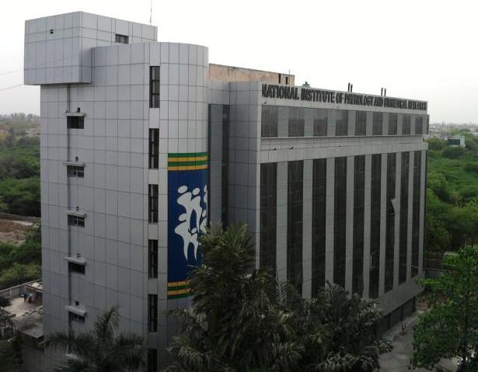


Development of genetically modified live attenuated parasites as potential vaccines against visceral leishmaniasis
Poonam Salotra
National Institute of Pathology (ICMR)
New Delhi

Slide 2
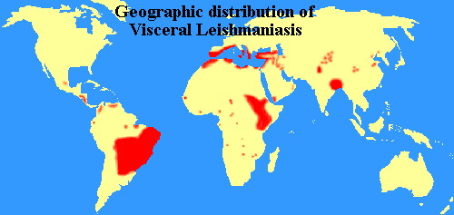
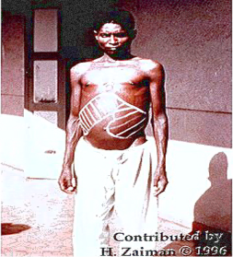
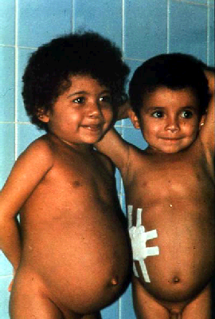
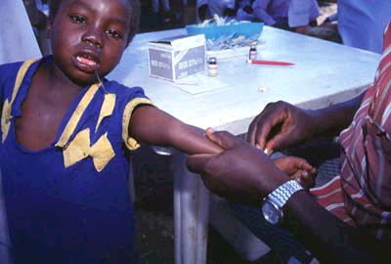
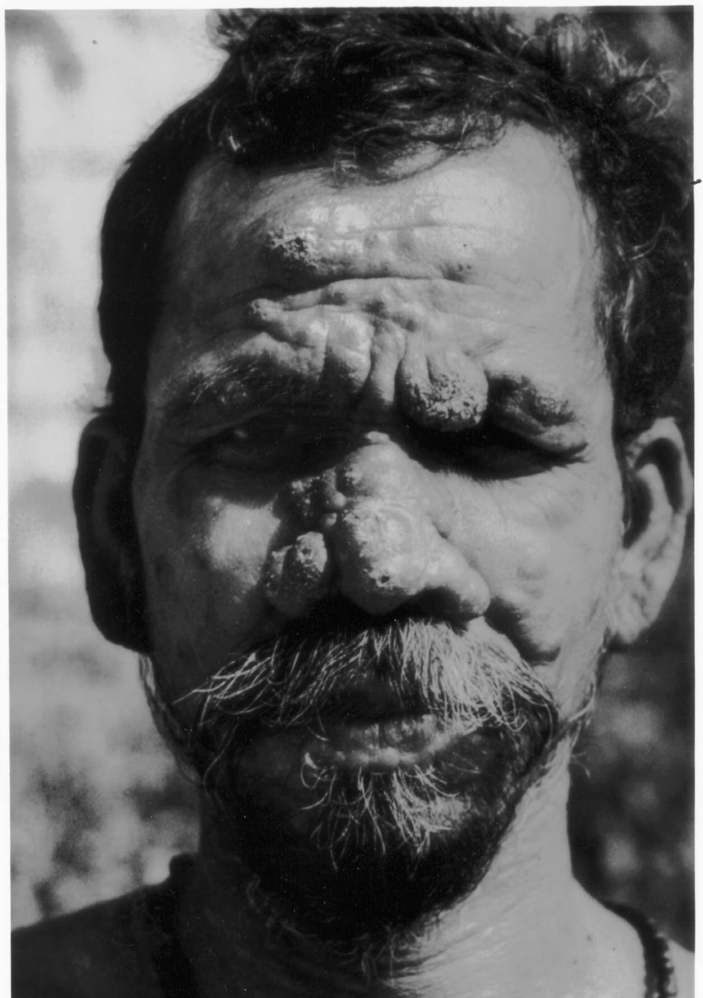
Impact of Visceral Leishmaniasis
L. infantum
L. chagasi
L. donovani
VL Fact sheet
200 Million People currently at risk for contracting VL
Countries endemic for VL
400,000 New cases per year
Post Kala-azar Dermal Leishmaniasis.
1.5-9% cases of AIDS with VL
90% of VL cases are from India,
Sudan, Nepal, Bangladesh and Brazil
Notes:
VL, fatal if not treated, is caused by L. donovani, L.
infantum, and L. chagasi .More than 90% of the visceral
cases in the world are reported from Bangladesh, Brazil,
India, and Sudan. Most affected patients (70%) are children
under 15 years of age who already suffer from concurrent
malnutrition and other secondary illnesses. The major
clinical symptoms for VL are characterized by prolonged
and irregular fever, splenomegaly, and hepatomegaly .
Kills more people than any other
parasitic disease except malaria

Slide 3
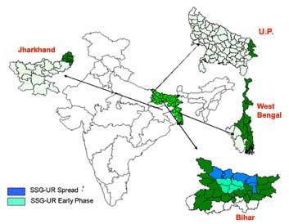
VL endemic areas in India
165 million people at risk reports from other states

Slide 4

Need for vaccine against VL
No effective vaccine is available for VL
Drugs are costly, limited, toxic and associated with high relapse rate. Development of drug resistant parasite due to prolonged use.

Slide 5
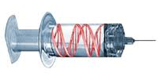
Strategies for vaccine development
  Whole cell lysates/enriched fractions
  Attenuation through long term culture
  Irradiated parasites
  Killed parasites + Adjuvants
  Recombinant and Synthetic antigens + Adjuvant
  DNA vaccines and CpG ODNs
  Leishmanization

Slide 6
Outcome
  Effective in animal models, little protection in humans
  Degree of effectiveness correlated with combined effect of several different antigens
  Reversion and or loss of attenuation
  Parasite persistence may be required to maintain the immunological memory to prevent reinfection
    Possible to achieve by live-attenuated parasite immunization
    that could persist w/o inducing disease

Slide 7

  Leishmanization
  Leishmanization experience in CL showed that some degree of parasite persistence may be required to maintain the immunological memory to prevent reinfection
  Possible to achieve by live-attenuated parasite immunization that could persist w/o inducing disease
  Persons once infected with Leishmania, after recovery are protected for life long.

Slide 8
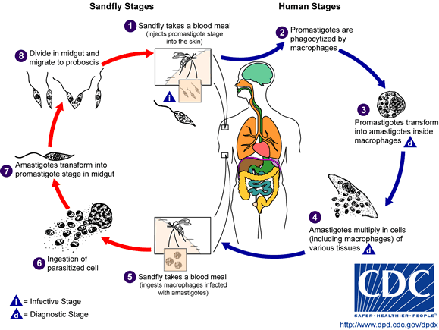
Life cycle of Leishmania
VL is caused by protozoan parasites Leishmania donovani.

Slide 9
A survey of gene knockout studies
Organism | Gene/s knocked out | Attenuation/ Protection
L. major | dhfr-ts | Mutant eliminated in mice and monkeys, No protection in monkeys.
L. major | Galactofuranosyl transferase (lpg1) | Did not infect sand fly, mouse or macrophages
L. mexicana | Cysteine proteases | Reduced infectivity in macrophages, Attenuated virulence in mice Protection in mice
L. donovani | Partial knockout of A2-A2rel gene clusters | Attenuated virulence in mice
L. donovani | Biopterin transporter (BT1) | Reduced infectivity, Cellular immunity -TH1 type response Provided protection upon challenge
L. donovani | p27 | Reduced parasite survival in macrophage and mice

Slide 10
Amastigote specific genes are considered as
potential virulence genes
Promastigote
Amastigote
Amastigote specific
gene/s (western)
Gene Knockout

Slide 11
Advantages of genetically defined live-attenuated vaccines
I. Immunogenicity:
Mimic natural course of infection
Provides complete array of antigens for presentation to immune cells
Controlled persistence without causing disease allows generation of memory response
II. Safety:
Genetically defined mutations
Amenable to further manipulations
Biomarkers of safety

Slide 12
Generation of genetically defined live-attenuated
Parasites as vaccine candidates
Genes selected for deletion :
A. Growth regulating gene:- LdCentrin1
B. Upregulated in amastigote stage:-
(1) LdHP30b (2) LdAKLP (3) LdA1
Can be propagated in large quantity as promastigote. When differentiated into the amastigote in the mammalian host will have a limited capability to replicate and cause no pathology
Limited replication should be sufficient to draw out a long lasting protective immune response in the host.

Slide 13
Leishmania donovani Centrin1 gene
Annotated by TriTrypDB as: Centrin, putative,Ca2 -binding EF- hand protein
Location in Chromosome: 36
Predicted protein size: 17 kDa
Motif(s) analysis through NCBI: Ca2⁺ binding sites

Slide 14
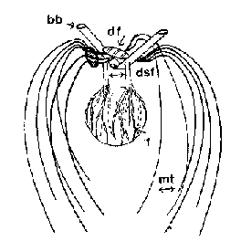
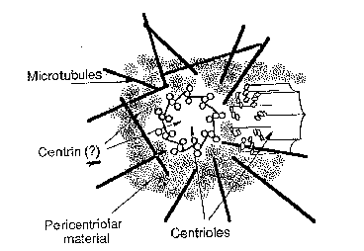
Centrin and its functions
Unicellular Organisms
Higher Eukaryotes
Centrin is a calcium-binding cytoskeletal protein found in all eukaryotes.
Localized mainly to centrosome or basal bodies,
Participate in contraction of fibers, duplication and segregation of centrosome

Slide 15
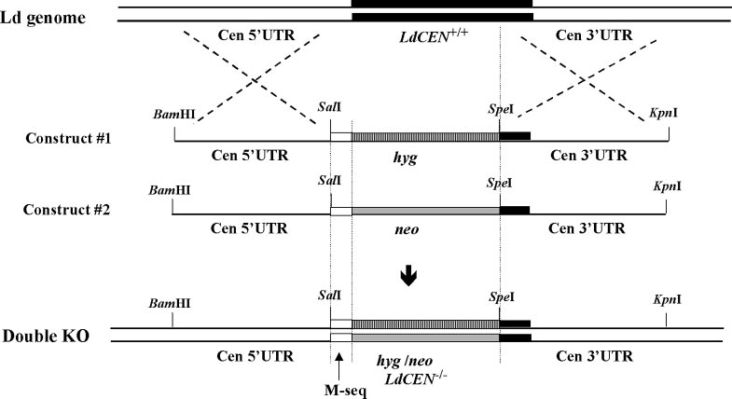
LdCEN gene disruption in L. donovani genome by homologous recombination
Design and use of constructs 1 and 2 with hyg and neo resistance genes, respectively, flanked on the 5’ and 3’ UTR

Slide 16
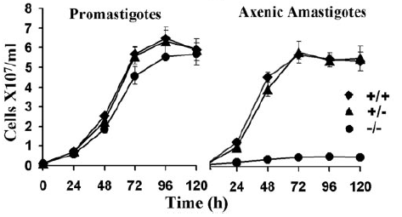
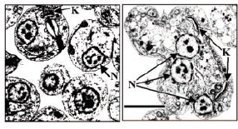
Centrin 1 gene deleted parasites (LdCen1^{-/-}) are specifically attenuated at amastigote stage
LdCen1^{+/+}
LdCen1^{-/-}
Centrin 1 gene deletion inhibit
growth at amastigote stage
Cytokinesis arrest in LdCen1^{-/-} results in large cell with
multiple nuclei and kinetoplasts

Slide 17
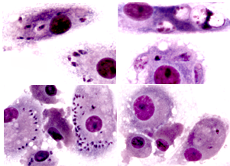
Features of Centrin KO parasites
Centrin-1 null mutants show growth arrest as amastigotes and not as promastigotes
Centrin KO are growth arrested in the G2/M phase, have multiple nuclei and are prone to cell death.
Basal body duplication does not occur in the amastigotes
Centrin deleted amastigotes do not survive in the macrophages
Leishmania centrin null mutants have a potential as live attenuated vaccine candidates.
LdCEN1^{+/+}
LdCEN1^{-/-}
120 hr
M
M
Am
240 hr
+/+
-/-
% Infected
macrophages
∗
Parasites/infected
macrophage
∗
**
Hours postinfection

Slide 18
LdHP30b gene upregulated at
amastigote stage
Annotated by TriTrypDB as: hypothetical protein
Location in Chromosome: 30
Number of amino acids: 124
Predicted protein size: 14 kDa
Motif(s) analysis through NCBI: - no motif recognized
Uniqueness: Homologs present in all
Trypanosomatids

Slide 19
Growth of Ld-HP30b single allele deleted L.donovani parasites
Promastigotes
Axenic amastigotes
Cells/ e7 X ml
Cells/ e7 X ml
Days
Days
Growth curve of Ld-HP30b single allele deleted parasites
Ld-HP30b single allele deleted amastigotes showed attenuated growth, promastigotes growth not affected

Slide 20
Ld-HP30b single allele deletion gives multinucleated amastigotes
Ld1s+/+
HP30b +/-
Bright
Field
Giemsa
stained
Scale bar: 10μM
Microscopy of Ld-HP30b single allele deleted parasites
Multinucleated amastigotes confirm defect in cytokinesis

Slide 21
LdAKLP gene over-expressed at
amastigote stage
Annotated by TriTrypDB as: Adenosine kinase-like protein
Location in Chromosome: 30
Number of amino acids: 214
Predicted protein size: 24.4 kDa
Motif(s) analysis through NCBI: Adenosine kinase. Catalyzes phosphorylation of
ribofuranosyl
Uniqueness: Homologs present only in Leishmania sp.

Slide 22
Growth of Ld-AKLP single allele deleted parasites
Promastigotes
Axenic amastigotes
No. Of parasites e7/ml
No. Of parasites e7/ml
Days
Days
Growth curve of Ld-AKLP single allele deleted parasites
Ld-AKLP single allele deleted parasite show unchanged growth as promastigotes or as amastigotes

Slide 23
LdA1gene upregulated at amastigote stage
Annotated by TriTrypDB as: hypothetical protein
Location in Chromosome: 29
Number of amino acids: 175
Predicted protein size: 20 kDa
Motif(s) analysis through NCBI: no motif recognized
Uniqueness: Homologs present only in Leishmania sp.

Slide 24
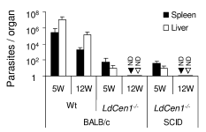
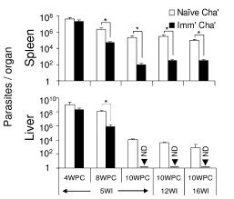
LdCen1^{-/-} is safe and protective in mice model
Avirulence and limited persistence of LdCen1^{-/-} in BALB/c and SCID mice
LdCen1^{-/-} parasite protects mice against challenge

Slide 25
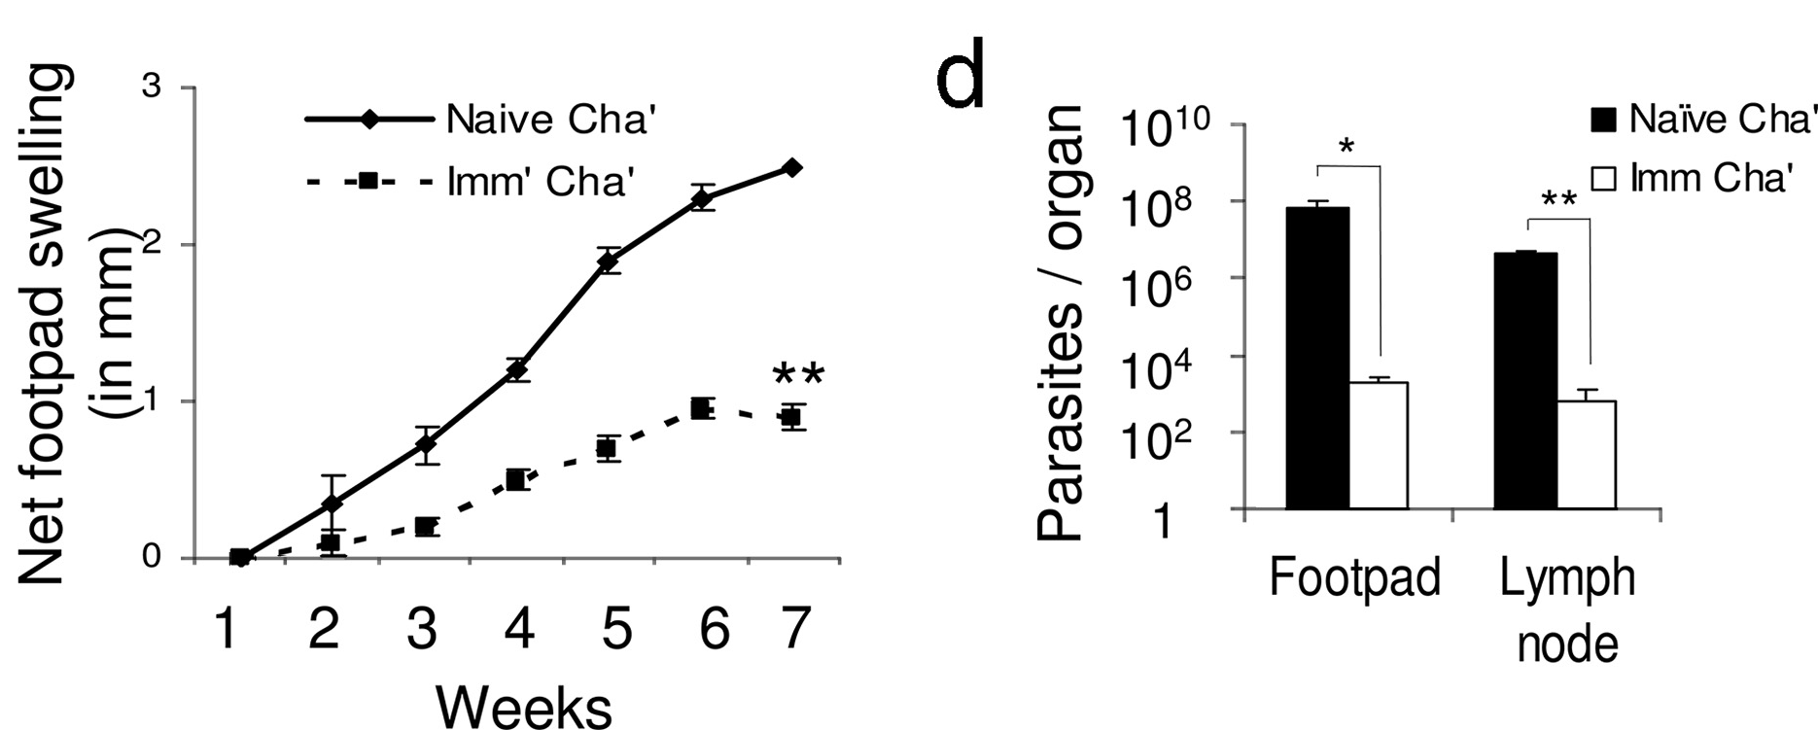
LdCen1^{-/-} cross-protects mice against other Leishmania species
Mice immunized with LdCen1^{-/-} showed significant lower
parasite burden against L. brazilensis challenge

Slide 26
LdCen1^{-/-} parasites infect human macrophages similar to wild type
Wild type
LdCen1^{-/-}
Infection of human PBMCs derived macrophages at 16 hr⁻
Infectivity of macrophages was 70-80% with both

Slide 27
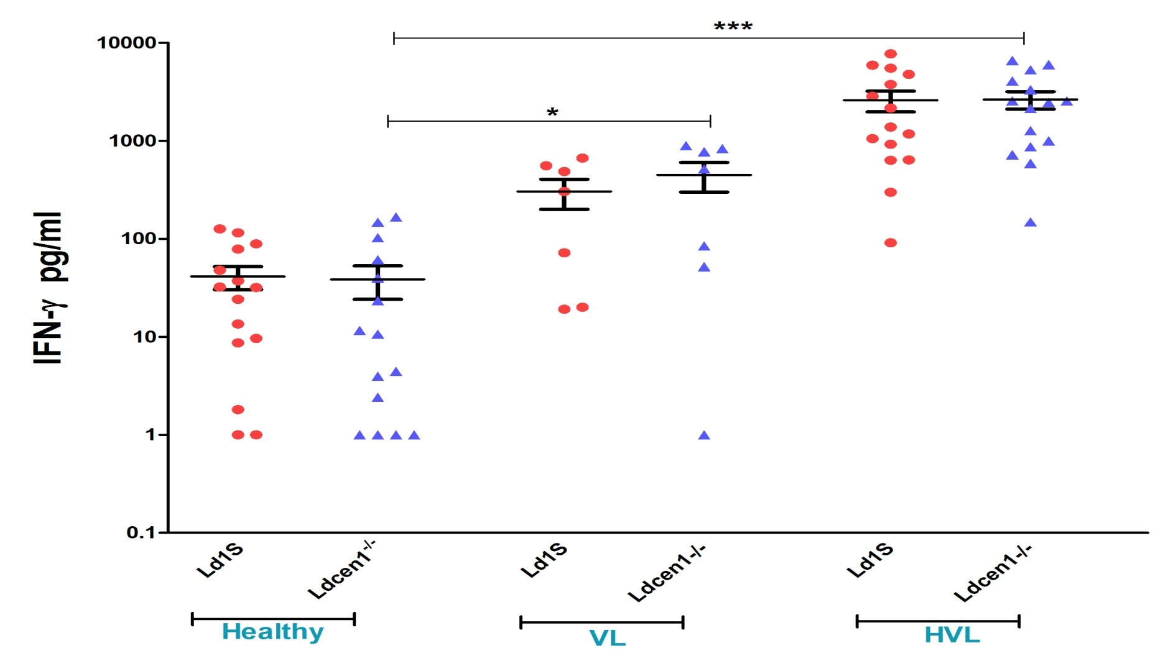
LdCen1^{-/-} induces strong Th1 response in PBMCs of HVL
(n=15)
(n=7)
(n=15)
IFN -γ in supernatant of PBMCs in response to Ld1S and LdCen1^{-/-} parasite. * = P<0.05, ***=P<0.001
Stimulation of IFN -γ in PBMCs of HVL with LdCen1^{- /-}

Slide 28
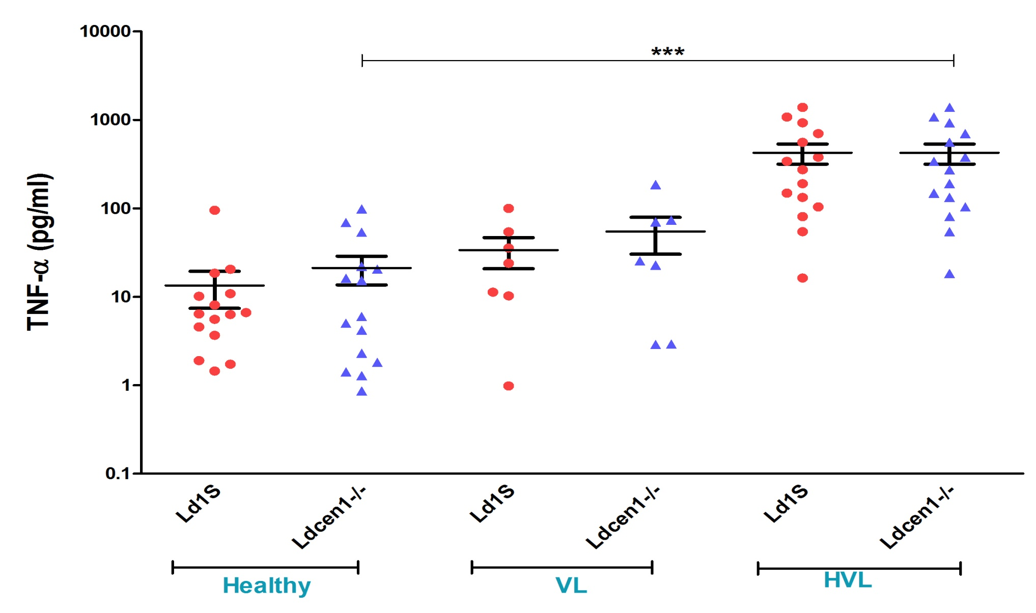
Stimulation of TNF- α in PBMCs of HVL infected with LdCen1^{-/-}
Level of TNF- α in supernatant of PBMCs in response to Ld1S and LdCen1^{-/-} parasite. ***=P<0.001

Slide 29
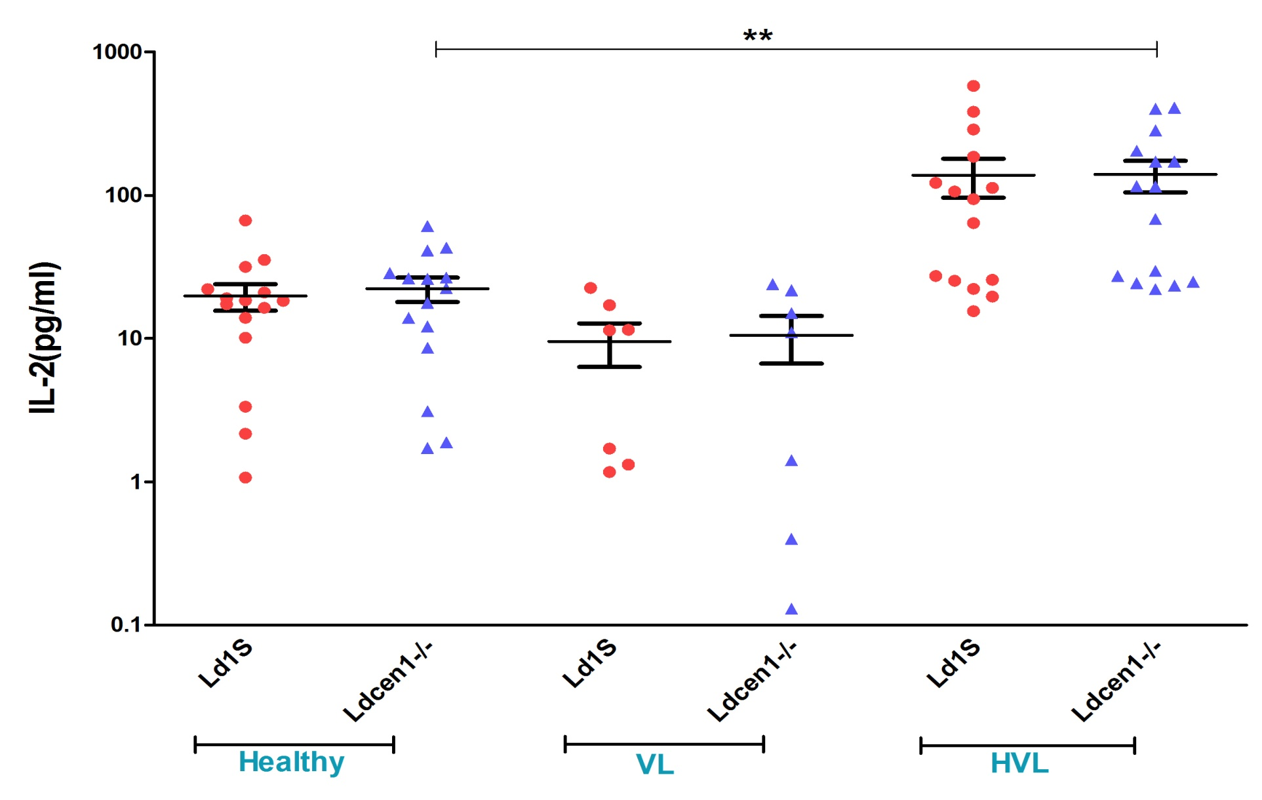
Stimulation of IL-2 in PBMCs of HVL infected with LdCen1^{-/-}
Level of IL-2 in supernatant of PBMCs from Healthy VL and HVL groups in response to Ld1S and LdCen1^{-/-} parasite. **=P<0.01

Slide 30
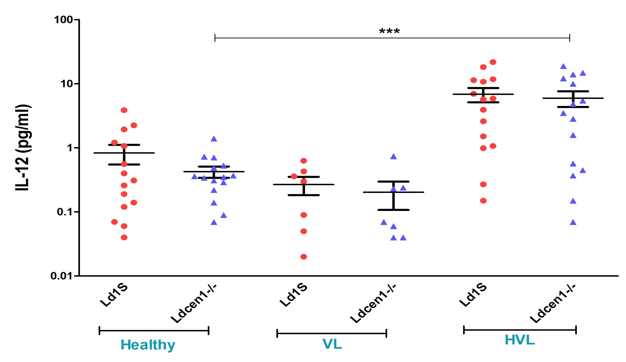
Stimulation of IL-12 in PBMCs of HVL infected with LdCen1^{-/-}
Level of IL-12 in supernatant of PBMCs from Healthy VL and HVL groups in response to Ld1S and LdCen1^{-/-} parasite. ***=P<0.001

Slide 31
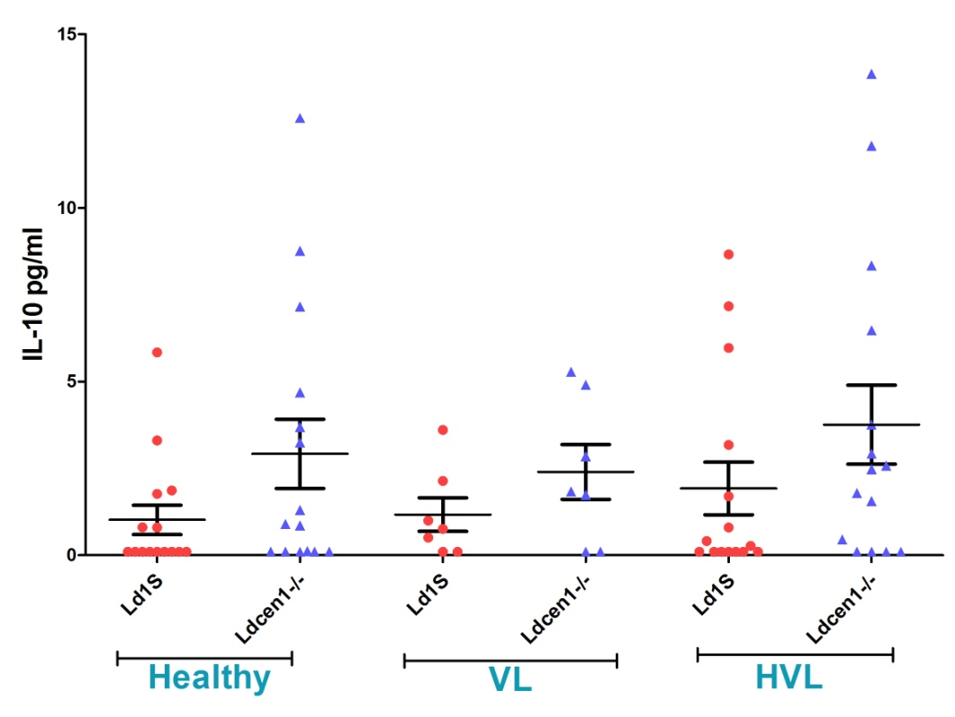
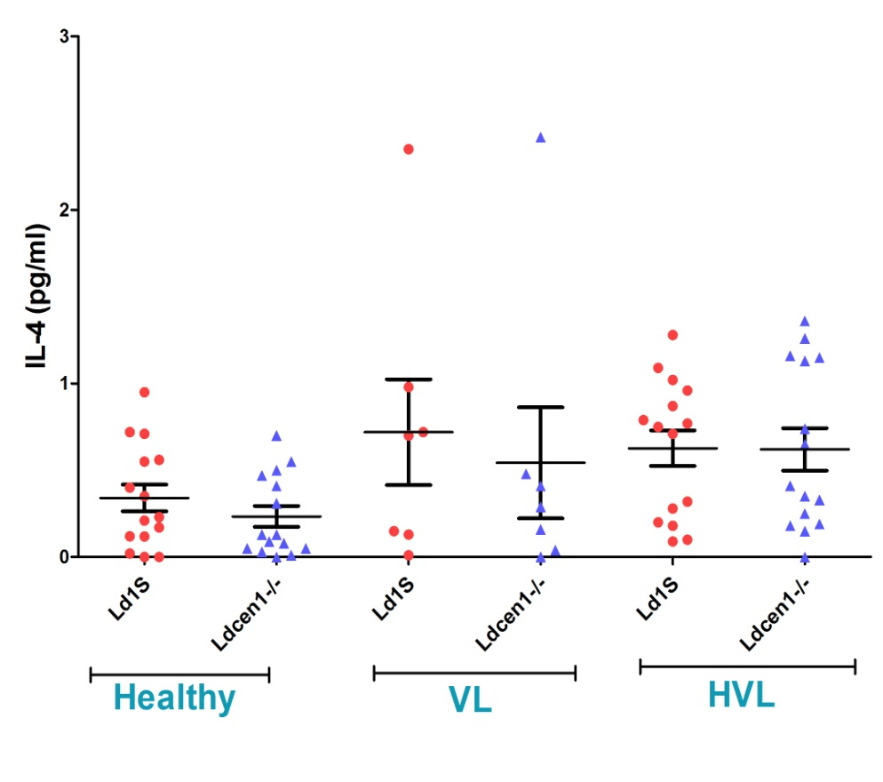
LdCen1^{-/-} parasites do not induce Th2 response
IL-10
IL-4
Level of IL-10 and IL-4 in supernatant of PBMCs from Healthy VL and HVL groups in response to Ld1S and LdCen1^{-/-} parasite
No significant stimulation of IL-10 or IL-4 upon infection with LdCen1^{-/-} in any group

Slide 32
Pre-clinical evaluation of LdCen1^{-/-} live attenuated vaccine candidate
  Immunogenicity
    Protective immune response in mice, hamsters,
    dogs and ex vivo in human PBMCs
    Cross protection across VL, CL and MCL
  Safety
    Lack of pathogenicity
    Lack of long term persistence
    Lack of reversion to virulent form
    Lack of survivability in sand fly
    Can grow in non-animal derived materials

Slide 33
Summary
Development of live attenuated parasite through gene
deletion is a sound approach to develop vaccine against VL
Pre-clinical evaluation of LdCen1^{-/-} establishes its potential
as a live attenuated vaccine against VL
Generation of new vaccine candidates attenuated at amastigote stage

Slide 34
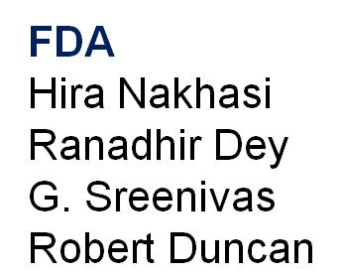
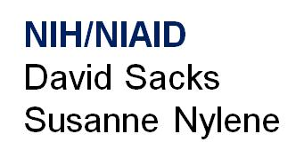

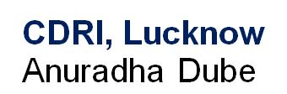

Acknowledgmentss

Slide 35
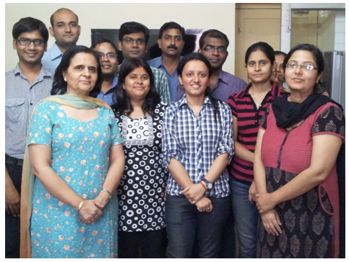

Slide 36
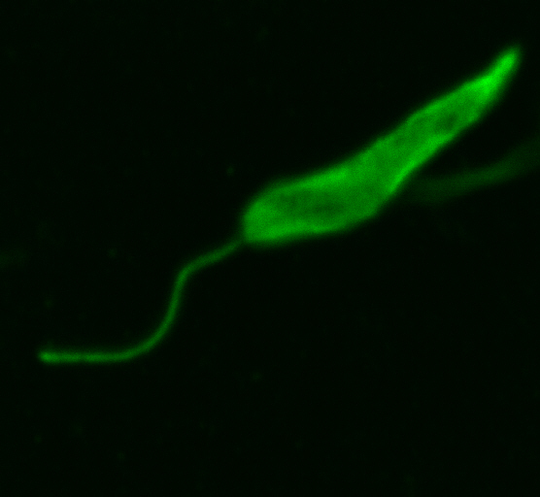
Thank you

