Slide 1
LT Ploypun narindrarangkura, md
Department of military and community medicine
pramongkutklao college of medicine, Thailand
The Pandemic Influenza A Virus in an Outbreak during 2015 in Military Medical School in Bangkok, Thailand

Slide 2
Background
Influenza is a respiratory disease which some subtypes have high virulence.
Military camp is crowded environment.
Prone for an outbreak
Rapid onset
Difficult to control

Slide 3
Background
Phramongkutklao College of Medicine is military medical school in Bangkok.
Students have to stay in the dormitory.
School setting is prone for an outbreak.
In October, we were reported that second year medical cadets were infected with influenza virus then we investigated and controlled the disease.

Slide 4
Objectives
To investigate and characterise an outbreak
To control an outbreak
To treat influenza-like illness cases

Slide 5
Methods
Case report form of respiratory disease was used for all second year medical cadets.
We separated influenza-like illness (ILI) from the others.
Rapid test for influenza A/B was performed in ILI cases.
10 screening positive cases were selected for RT-PCR analysis
Diagnosis and treatment with Oseltamivir were used to control the disease.

Slide 6
Results
Demographic data of second year medical cadets (n=103)
 | Case (n=41) | Non-case (n=62) | p-value
Mean age in year (SD) | 19.6 (0.7) | 19.6 (0.7) | 0.68*
Mean weight in kg (SD) | 59.1 (8.9) | 60.7 (8.2) | 0.35*
Mean height in cm (SD) | 166.5 (8.1) | 168.6 (8.2) | 0.21*
Gender |  |  | 0.84¶
Male | 23 (56.1) | 36 (58.1)
Female | 18 (43.9) | 26 (41.9)
Platoon |  |  | <0.01¶
1 | 12 (30) | 38 (62.3)
2 | 28 (70) | 23 (37.7)
Vaccinated influenza vaccine |  |  | 0.11¶
No | 26 (70.3) | 33 (54.1)
Yes | 11 (29.7) | 28 (45.9)
*t-test ¶Chi-square

Slide 7
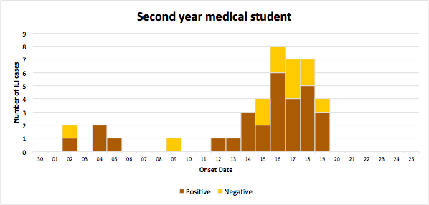
Number of influenza like illness cases in second-year medical cadets, Bangkok, October 2015 (n=41)
Results

Slide 8
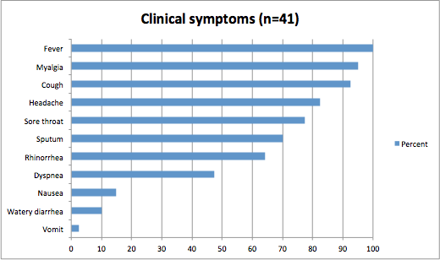
Clinical symptoms of influenza like illness cases in second-year medical cadets, Bangkok, October 2015 (n=41)
Results

Slide 9
Results
Risk factors and risk ratio of influenza outbreak (n=40)*
Behavioral risk factor | ILI cases |  | Risk ratio | 95%CI | p-value
 | Expose | Non-expose
Platoon 2 | 28 (54.9) | 12 (24) | 2.3 | 1.32-3.98 | <0.01
Closed contact person | 35 (40.2) | 4 (33.3) | 1.2 | 0.52-2.80 | 0.76¶
Went outside school 2 wks ago | 28 (33.7) | 11 (64.7) | 0.5 | 0.33-0.83 | 0.02
Contact person outside PCM within 2 wks | 0 | 40 (100)
Smoking | 1 (100) | 39 (38.6) | 2.6 | 2.03-3.31 | 0.39¶
Smoking same cigarette with others | 0 | 40 (100)
Drink water same glass | 17 (30.9) | 22 (47.8) | 0.7 | 0.39-1.10 | 0.08
Activities that prone to contact body fluid from others | 18 (41.9) | 22 (37.9) | 1.1 | 0.68-1.79 | 0.69
Used towel with others | 2 (100) | 38 (38) | 2.6 | 2.05-3.38 | 0.15¶
Used clothes with others | 1 (50) | 39 (39) | 1.3 | 0.31-5.24 | 1.0¶
Contact dead bird | 0 | 40 (100)
Contact bird | 0 | 40 (100)
Vaccinated influenza vaccine | 11 (28.2) | 26 (44.1) | 0.6 | 0.36-1.14 | 0.11
*missing data 1 case ¶Fisher's Exact Test

Slide 10
Results
Risk factor of influenza virus infection was Platoon 2 more than Platoon 1 3.8 times.
 | Platoon 1 |  | Platoon 2
Vaccination | n | % | n | %
No | 26 | 52.0 | 31 | 67.4
Yes | 24 | 48.0 | 15 | 32.6

Slide 11
Results
Multiple logistic regression of behavioral risk factors and adjusted odds ratio in influenza A (n=40)
Risk factor | ILI cases |  | Adjusted odds ratio | 95% CI
 | Expose | Non-expose
Platoon 2 | 28 (54.9) | 12 (24) | 3.8 | 1.54-9.42
Went outside school 2 wks ago | 28 (71.8) | 11 (28.2) | 0.3 | 0.08-0.84
After adjusted by Drink water same glass, Used towel with others and Vaccinated influenza vaccine

Slide 12
Results
Attack rate of influenza like illness cases in second year medical cadets, Bangkok, October 2015 (n=103)
 | Number of cases (% attack rate)
2nd year student (n=103) | 41 (39.8)
- Vaccinated (n=39) | 11 (28.2)
- Non-vaccinated (n=59) | 26 (44.1)
*Unknown vaccine status 5 cases

Slide 13
Results
RT-PCR from sampling cases
All 10 cases were Influenza A/H3.

Slide 14
Conclusion
Second year medical cadets had ILI 41 cases (39.8%) and positive for influenza A/B was 28 (68.3%).
Index case started symptoms on 2 Oct.2015 and positive for influenza A/B.
All 10 cases were Influenza A/H3 by RT-PCR.
Vaccinated students was only 39 (37.9%).
Before pandemic influenza virus, all students were allowed to visit home.

Slide 15
Conclusion
Risk factor of influenza outbreak was Platoon 2 and protective factor was went to outside school 2 weeks ago.
All class of students were treated by Oseltamivir on 19 Oct.2015
After that no new cases were detected.
No report of infection in other grades.

Slide 16
Recommendation
Early detection is the best way to control the infection.
Vaccination policy
Should be vaccinate influenza vaccine to person who have to go military training and healthcare workers.

Slide 17
Thank you

