Slide 1
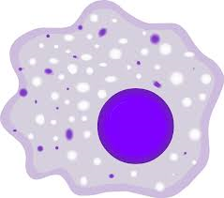
Myeloid-Specific Deletion of SIRT1 Impairs Obesity Associated Endothelial Dysfunction and Atherosclerosis
Ping GU, MD PhD
July 11, 2016
Brisbane
Notes:
Good morning, everyone. I am honored to have the opportunity to share our research with you here. Today I am going to talk about sirt1 in macrophage and obesity related endothelial dysfunction and atherosclerosis.

Slide 2

Distribution of major causes
of death
Cardiovascular diseases 31%
Other NCDS 31%
Injuries 9%
Communicable, maternal, perinatal and nutritional conditions 27%
NCDS：Noncommunicable diseases
World Health Organization 2011
Notes:
It is well known that cardiovascular disease (CVD) currently accounts for over 30% of all deaths in the world. remaining the leading global cause of
Death. IT is worth noting that cardiovascular diseases was two times as many deaths as was caused by cancer.

Slide 3
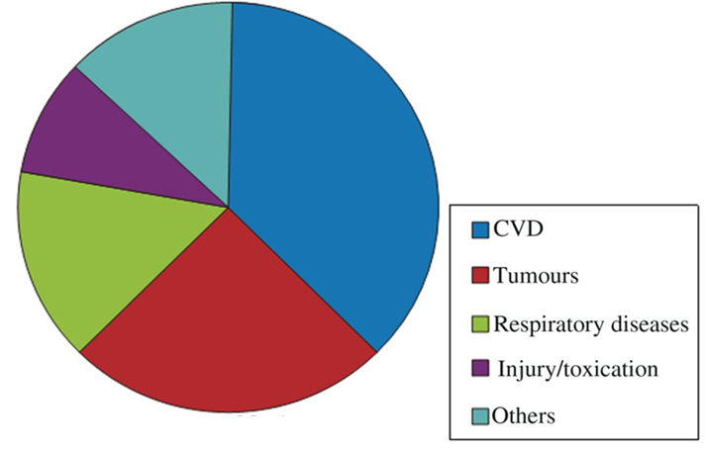
Major causes of death in Chinese population(%)
12.6
230 million patients
with CVD
44.8
8.7
11.5
22.4
Report on Cardiovascular Disease in China, 2011
Notes:
Similarly, cardiovascular relevant morbidity and mortality in Chinese population also rose quickly. It is estimated in the “Report on Cardiovascular Disease in China, 2011” that there are about 230 million patients with CVD. And it also remains the most important disease affecting the health of the Chinese population. A Data published in Eur Heart journal indicates that CVDs accounts for 44.8% death in total. So How to find the mechanism of cardiovascular diseases is very important for preventing and treatment of cardiovascular disease

Slide 4
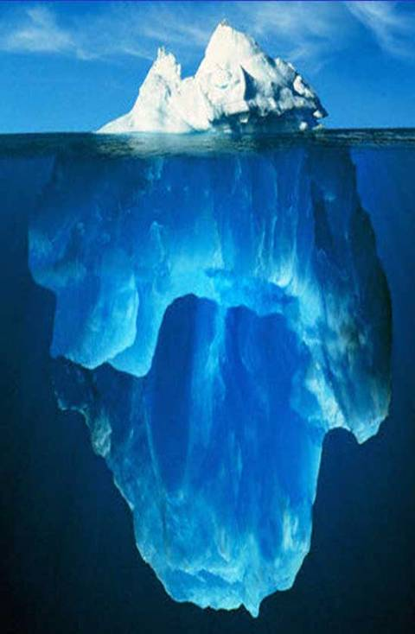
Global Burden Hidden of ardiovascular Diseases
Public health burden hidden and underestimated
Heart attacks and strokes are
only tip of the iceberg
Obesity
Physical activity
Unhealthy diet
Tobacco use
Raised blood pressure
Raised blood sugar
Raised blood lipids
2 Billion
Notes:
Actually, heart attacks and strokes are the only tip of the iceberg. Many risk burdens have not been recognized. For example, obesity, diabetes, hypertension and so on.

Slide 5
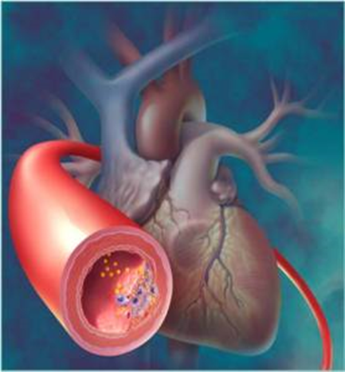
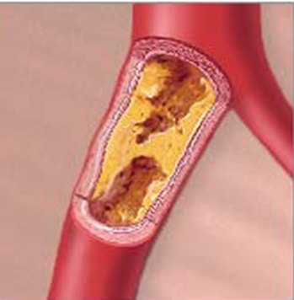
Atherosclerosis and CVDs
Atherosclerosis: the major cause of cardiovascular disease
Notes:
Cardiovascular diseases (CVDs) are disorders of the heart and blood vessels and include coronary heart disease, cerebrovascular disease, rheumatic heart disease and other conditions. The main underlying cause of CVD is a process known as atherosclerosis. Atherosclerosis refers to the process in which deposits of fatty substances, cellular waste, calcium, cholesterol and other substances build up and harden in the endothelium (inner lining) of an artery. The plaques can reduce blood flow through the vessel and have the potential to rupture and send blood clots throughout the body. So how to explore the mechanism and find treatment of atherosclerosis is important to prevent the cardiovascular disease

Slide 6
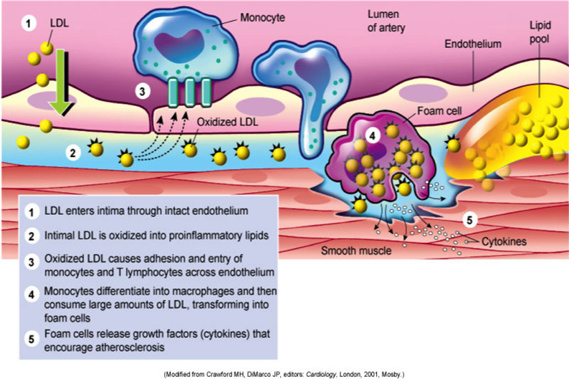
Atherosclerosis pathophysiology
Notes:
The pathophysiologic process of atherosclerosis is complex and somewhat controversial。The earliest changes that precede the formation of lesions of atherosclerosis take place in the endothelium. These changes include vascular permeability and adhesion of leukocyte, including monocyte and lymphocytes, and plateles. The second step is Accumulation of Lipoproteins in vessel wall -usually LDL and its oxidized forms.iii. Oxidized LDL cause adhesion and entry of Monocyte and T lymphocytes across endothelium. Following that, monocytes differentiate into macrophage and then consume large amount of LDL, transforming into foam cells. Foam cell release growth factors and cytokines which result in smooth muscle cell migration into intima, proliferation of smooth muscle cell and deposition of extracellular matrix and encourage atherosclerosis. However the exact mechanism has not been explored.
Chronic endothelial injury* resulting in endothelial dysfunction

Slide 7
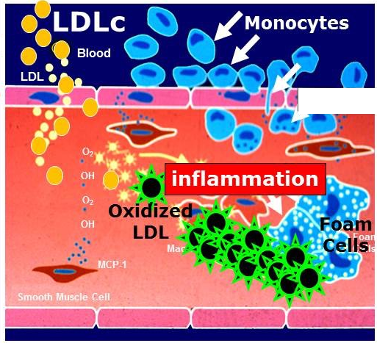
A Healthy Endothelium is the First Defense
against atherosclerosis
Blood
Endothelium
VCAM-1
Endothelial dysfunction
Artery
Wall
Notes:
There is one important connection that I want you to be aware of, and that is about endothelial function and its role in vascular health. The endothelium is the inner lining of the arterial wall that comes in direct contact with the blood. A healthy endothelial protects against atherosclerosis. Their most obvious function is to provide a semi-permeable barrier that regulates the exchange of fluid, nutrients, gases, and waste between the blood and tissues. Endothelial cells also regulate constriction and relaxation of vessels by releasing vasodilatory molecules (e.g., nitric oxide (NO) and prostacyclin (PGI₂) and vasoconstrictive molecules (endothelin and angiotensin-II). When perturbation occurs, The endothelial cells begin to produce cell surface adhesion molecules such as VCAM-1, causing monocytes and T-lymphocytes to adhere to the endothelium and then migrate beneath it by squeezing between the endothelial cells.The endothelial cells also change shape, and the tight junctions between endothelial cells loosen, increasing the permeability to fluid, lipids, and leukocytes. Lipoprotein particles, and especially low-density lipoprotein (LDL), enter the arterial wall and undergo oxidation. These results trigger and maintain an inflammatory response. So how to explore the mechanism of endothelial dysfunction is very important for prevention and treatment of CVDs

Slide 8
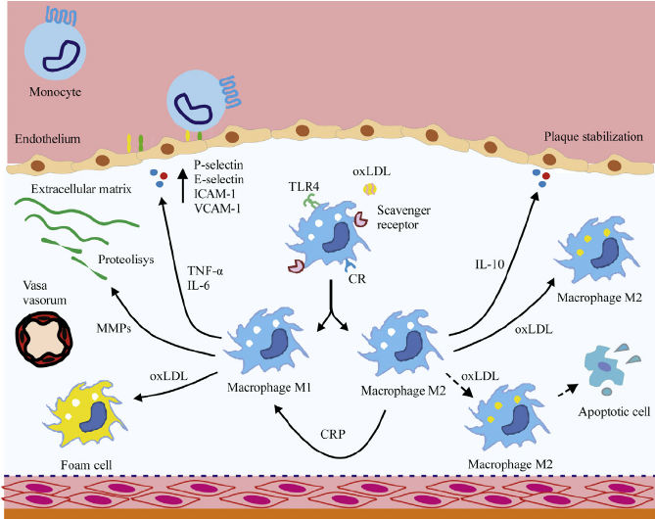
Macrophages play a central role in atherogenesis
Chavez-Sanchez et al. Innate Immune System Cells in Atherosclerosis. Archives of Medical Research 45 (2014) 1-14
Notes:
As we all know, monocytes are a heterogeneous population in mice and are recruited to lesions, where they differentiate into M1 or M2 macrophages. M1 macrophages are found in advanced lesions where they accumulate a large amount of lipids, which promotes their differentiation into foam cells. Furthermore, M1 macrophages secrete TNF- a , IL-6 and metalloproteinases, which exacerbate and destabilize lesion development. M2 macrophages predominate in the early stages of atherosclerosis and are characterized by IL-10 secretion and smaller amounts of accumulated lipids; these events are atheroprotective and can reduce plaque development. M2 macrophages undergo apoptotic death in the presence of oxLDL, and C-reactive protein (CRP) stimulation induces a phenotypical and functional change of M2 macrophages to M1 macrophages, a change that involves lesion development. However, their functions in atherosclerotic plaques are unknown.

Slide 9
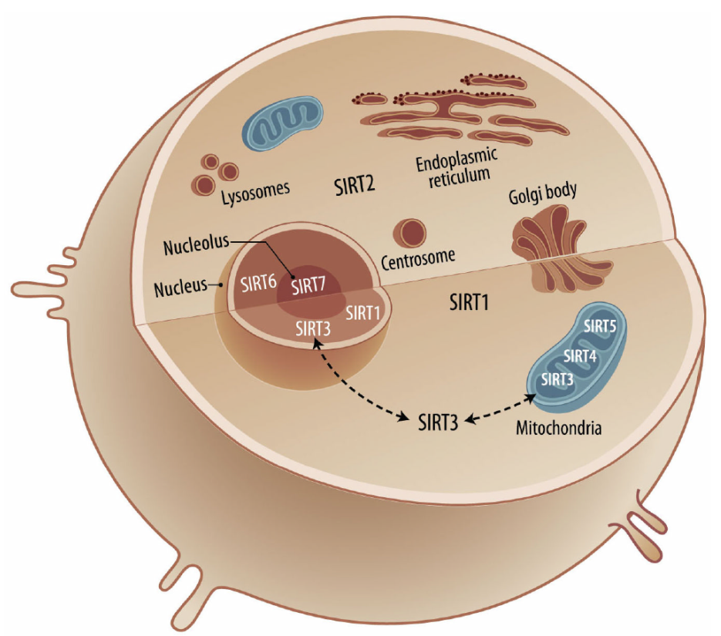
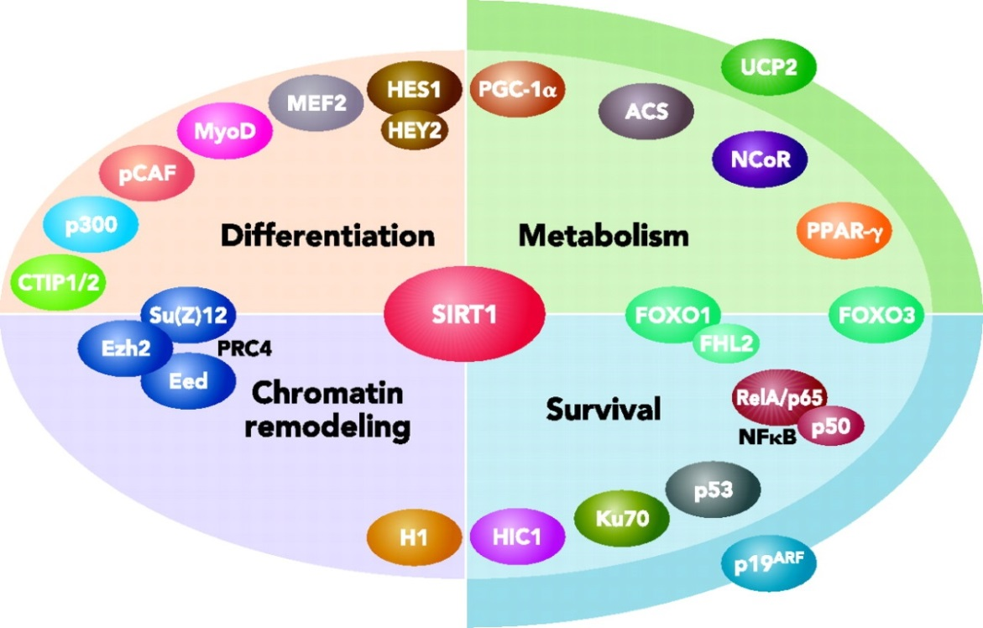
SIRT1:A novel therapeutic target for aging associated diseases
Sirtuin Protein Family
Effect of SIRT1
Anastasiou et al. SIRT1: Linking Adaptive Cellular Responses to Aging-Associated Changes in Organismal Physiology. Physiology2006;21:404-10
Alhazzazi et al. SIRT3 and Cancer: Tumor Promoter or Suppressor? Biochim Biophys Acta. 2011 August ; 1816(1): 80–88
Notes:
Sirtuins (SIRT1–7) are the mammalian homologues of the silent information regulator 2 (Sir2) first discovered in Saccharomyces cerevisiae as an NAD⁺-dependent histone deacetylase (HDAC). Sirtuin biology is complex, and are widely expressed in normal tissues.
SIRT1, the best characterized among them, is a nuclear deacetylase whose substrates include proteins primarily, not only involved in transcriptional regulation, but also influenc diverse aspects of organismal physiology such as differentiation, cell survival, and metabolism. These findings suggest that SIRT1 might be a new therapeutic target for the prevention of disease related to aging, such as diabetes, obesity and cardiovascular diseases.

Slide 10
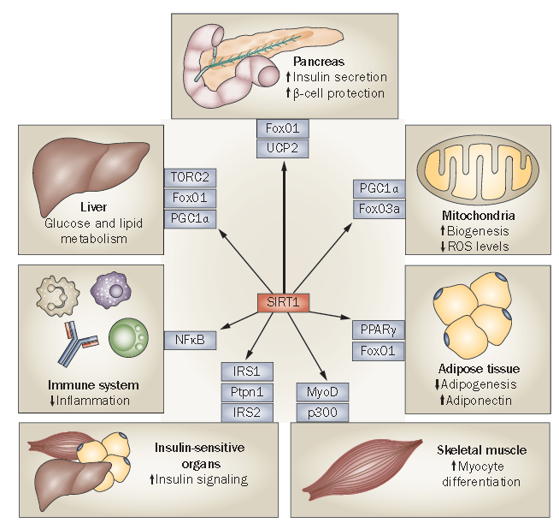
SIRT1 controls metabolism by distinct mechanisms in different tissues
Liang et al. 2009 Nat rev endoc 5, 267
Notes:
SIRT1 is an important regulator in many tissues including liver, pancreas, adipose tissue and muscles, and so on. It controls metabolism by deferent mechanisms.

Slide 11
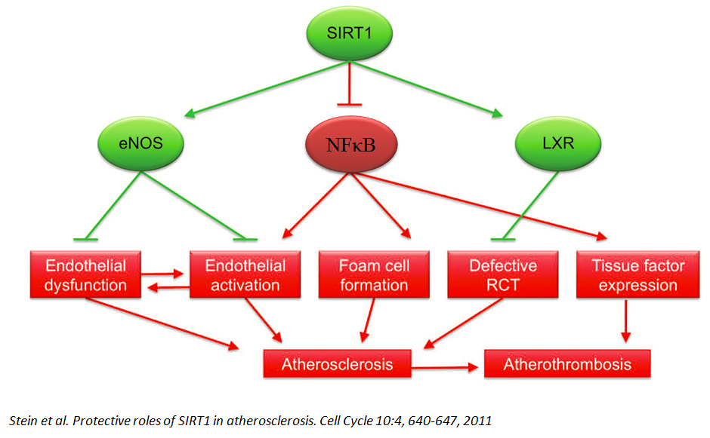
Beneficial effects of SIRT1 on atherosclerosis and thrombosis
Stein et al. Protective roles of SIRT1 in atherosclerosis. Cell Cycle 10:4, 640-647, 2011
Notes:
Recently, it is reported that activation of Sirt1 can prevent atherosclerosis and atherothrombosis. These effects are probably mediated via activation of eNOS in endothelial cells and LXR in macrophages as well as via suppression of NFκB signaling activation in various plaque cells, including endothelial cells, macrophages and smooth muscle cells.

Slide 12
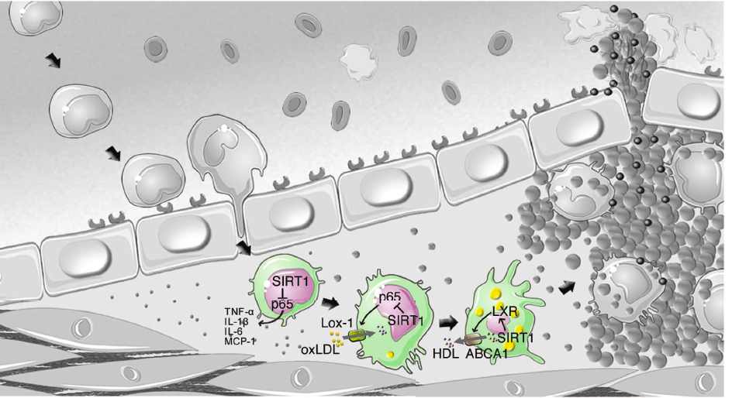
SIRT1 in Macrophage
Cholesterol Uptake and Foam Cell Formation
Stein et al. Protective roles of SIRT1 in atherosclerosis. Cell Cycle 10:4, 640-647, 2011
Notes:
Now It is well known that macrophage SirT1 reduces inflammation, diminishes cholesterol uptake and promotes reverse cholesterol transport. Plaque macrophages induced atherosclerotic disease progression by triggering an inflammatory environment, mediating macrophage foam cell formation and
necrotic core expansion. On one hand, SirT1 suppresses NFκB signaling activation, thereby reducing the expression of inflammatory molecules such as TNF-α, IL-1β, IL-6 and MCP-1. On the other hand, SirT1 diminishes the expression of Lox-1, a receptor for oxLDL that promotes macrophage foam cell formation. Furthermore, SirT1 also stimulates LXR-mediated ABCA1 expression and hence promotes reverse cholesterol transport that protects the cell from excessive cholesterol accumulation. These findings indicate a close link between the activity of SIRT1 in macrophages and atherosclerosis

Slide 13
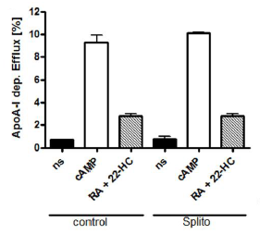
SIRT1 does not affect cholesterol efflux in macrophages
Stein et al. SIRT1 decreases Lox-1-mediated foam cell formation in atherogenesis. European Heart Journal (2010) 31, 2301–2309
Notes:
Most study focus on the of roles of sirt1 in macrophage foam cell formation. However, a controversial study published in Europe Heart Journal showed that SIRT1 do not affect cholesterol efflux in macrophage. In this research, splitomicin, one kind of SIRT1 inhibitor could not increase ApoA-1 dependent cholesterol efflux in macrophage cell line RAW 264.7.

Slide 14
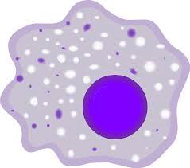
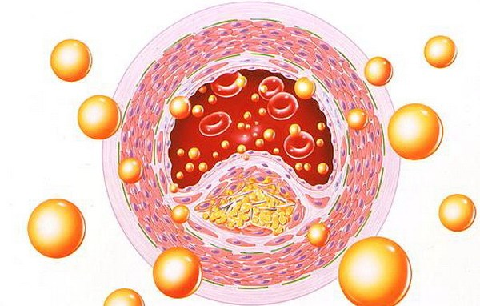
Macrophage
Atherosclerosis
SIRT1
Other possible Mechanism?
Via modulating endothelial function???
Via modulating macrophage polarization???
Notes:
So our question is any other mechanism involved in atherosclerosis?

Slide 15
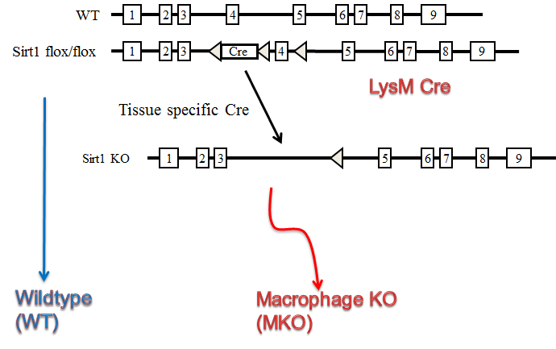
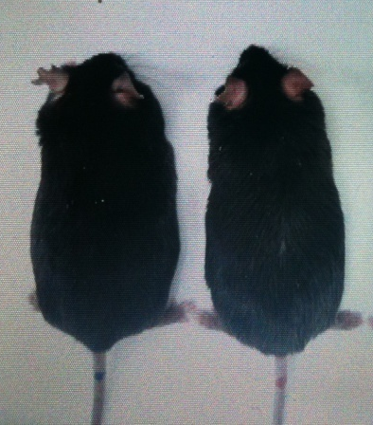
Generation of macrophage specific Sirt1 KO mice
WT MKO
Notes:
In order to explore the possible mechanism, we generated macrophage specific sirt1 KO mice (MKO). There is no different of body weight betweeen MKO and WT mice..
15

Slide 16
Q1. whether deletion of SIRT1 in macrophage affects endothelial
function ?
Notes:
Firstly, we want to investigate whether deletion of SIRT1 in macrophage affects endothelial function

Slide 17

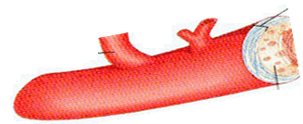
Methods
High Fat /Standard Chow Diet
MKO
16 weeks
Aortic Artery
WT
Notes:
Six weeks old macrophage specific-SIRT1 KO mice and its WT control were fed with SCD or HFHC diet for 16 weeks. Aortas were isolated from mice and perivascular adipose tissue was removed.

Slide 18
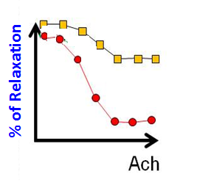
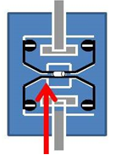

Wire myograph
Bad relaxation
Good relaxation
Notes:
In order to evaluate the endothelial function, we use wire myograph analysis. This is a typical result of myograph. This red curve means the endothelial dependent relaxation is better ,while this yellow curve represents the impaired endothelial function.

Slide 19
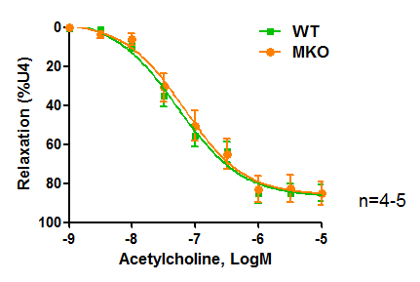
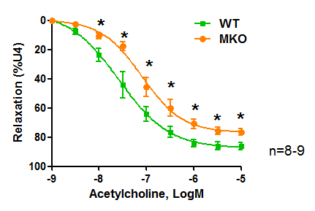
Compared with aorta from wild type mice, the relaxation of aorta from knock out mice was significantly reduced in obesity.
Lean
Obesity
Notes:
We first studied the Ach-induced endothelial relaxation in Lean mice. And found that the aorta from WT and KO mice exhibited similar vasorelaxation activity to Ach. However, in the presence of obesity, the relaxation of aorta from MKO mice was significantly reduced ,compared with aorta from wild type mice.

Slide 20
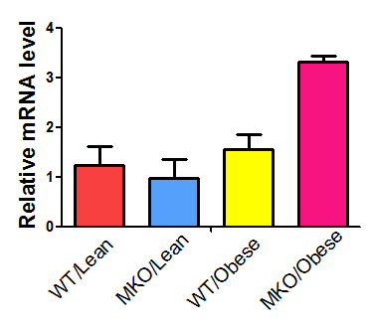
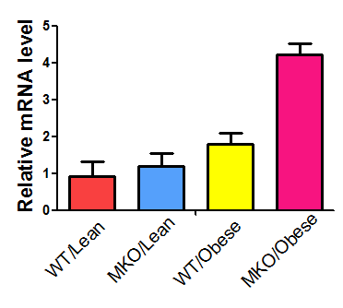
Compared with aorta from wild type mice, The mRNA levels of E-Selectin and ICAM were increased from knock out mice.
E-selectin
ICAM-1
*
*
Notes:
Following that, we sought to investigate whether endothelial activation was changed between wt and ko mice and our results demonstrated that compared with aorta from obest WT mice, mRNA levels of E-selectin and ICAM by q-PCR were increased in aorta from knock out mice, indicating that Macrophage SIRT1 reduces endothelial activation.

Slide 21
Q2. whether deletion of SIRT1 in macrophage affects atherosclerosis?
Notes:
The follow question is whether deletion of SIRT1 in macrophage affects atherosclerosis

Slide 22
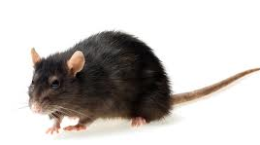
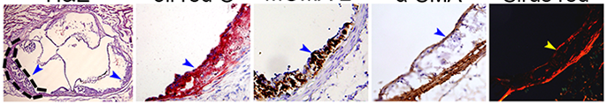
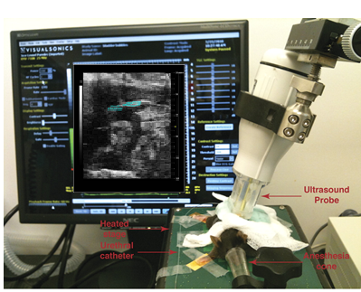
x
Sirt1 MKO
ApoE(-/-)
In Vitro
Sirt1^{fl/fl} apoE^{-/-}
lyzM Cre-
HE
Oil Red O
MOMA
α-SMA
8-10 wks
In Vivo
HFHC
Ultrasound
Sirt1^{fl/fl} apoE^{-/-}
lyzM Cre+(DKO)
Notes:
To this aim, we changed the macrophage-specific SIRT1 knockout mice to the apoE knockout back groud(DKO mice), with the macrohage-cre negative mice as the control. The mice were fed with HFHC for 8 weeks before the development of atherosclerosis was examined. The aorta was subjected to HE, Oil red O, MOMOA and a-SMA .and We also used ultrasound to examine the plaque in vivo.

Slide 23
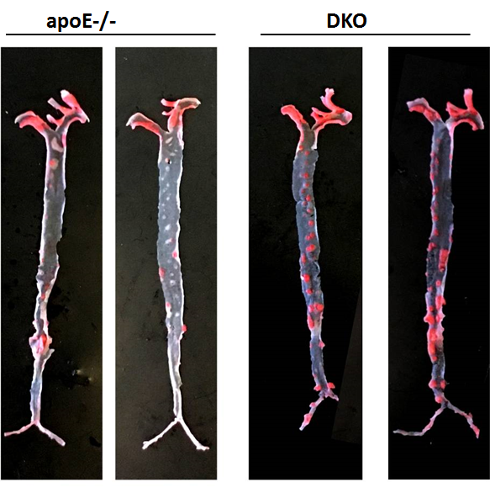
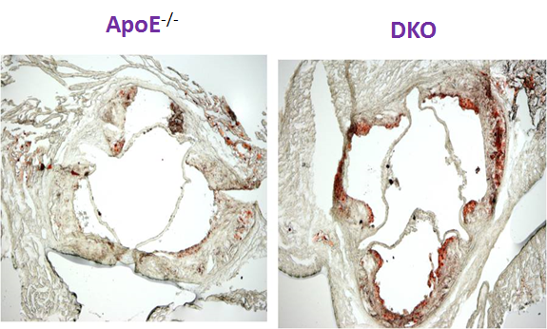
Deletion of SIRT1 in macrophage are more susceptible for high fat high cholesterol induced atherogenesis in apoE deficient mice
Oil Red O
Notes:
In our study, compared with apoE-/- mice, DKO mice showed more severe lipid accumulation (especially in the descending aorta region) by oil red o.

Slide 24
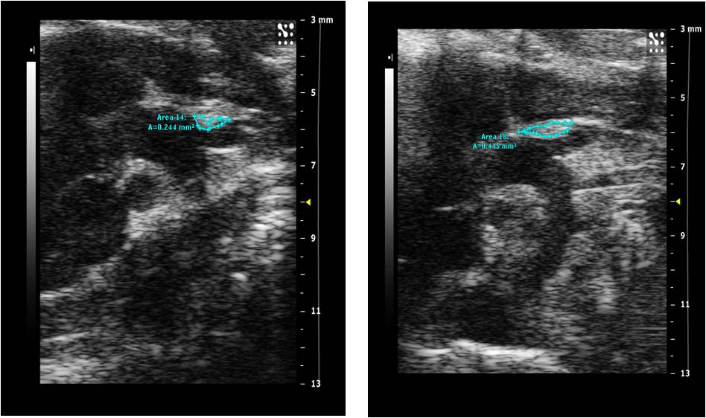
DKO mice showed more severe plaque by ultrasound imaging in aortic arch region
ApoE^{-/-}
DKO
**
Ultrasound
**p<0.01, N=3.
Notes:
And the ultrasound imaging also indicated that DKO mice showed more severe plaque in aortic arch region.

Slide 25
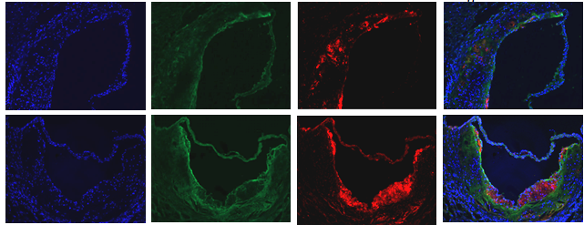
Deletion of SIRT1 in macrophage showed stronger signals for MOMA-2 and α-SMA
DAPI α-SMA MOMA-2 merge
ApoE^{-/-}
DKO
Immunofluorescence staining
Notes:
Immunofluorescence staining results demonstrated that deletion of SIRT1 in macrophage showed stronger signals for α-SMA
and MOMA-2, indicating an acceleration in evolution of lesions toward a more advanced phenotype

Slide 26
Summary Ⅰ
According to our experiments, deletion of SIRT1 in macrophage induced endothelial dysfunction and atherogenesis.
Q3. How SIRT1 in macrophage affects endothelial function and atherosclerosis?
Notes:
According to our experiments, deletion of SIRT1 in macrophage induced endothelial dysfunction and atherogenesis. Now the key question is how of SIRT1 in macrophage affects endothelial function and atherosclerosis?

Slide 27
M1 and M2 Macrophage
M1
M2
Notes:
"Macrophages function as control switches of the immune system, providing a balance between pro- and anti-inflammatory responses. To accomplish this, they develop into different subsets: classically (M1) or alternatively (M2) activated macrophages. Whereas M1 macrophages display a cytotoxic, proinflammatory phenotype, M2 macrophages suppress immune and inflammatory responses and participate in wound repair and angiogenesis. When properly controlled, M1 macrophages effectively destroy invading pathogens, tumor cells, and foreign materials. However, when M1 activation becomes excessive or uncontrolled, these cells release copious amounts of cytotoxic mediators that contribute to disease pathogenesis. The activity of M1 macrophages is countered by alternatively activated M2 macrophages, which release anti-inflammatory cytokines, growth factors, and mediators involved in extracellular matrix turnover and tissue repair. It is the balance in the production of mediators by these two macrophage subpopulations. Interestingly, macrophages are remarkably plastic and can switch from one phenotype to another depending on the environmental cues encountered. Classically activated (M1) macrophages are typically induced by TH1 cytokines, such as IFNγ and tumour necrosis factor (TNF) ,while M2a macrophages are induced by the TH2 cytokines IL4 and IL13.

Slide 28
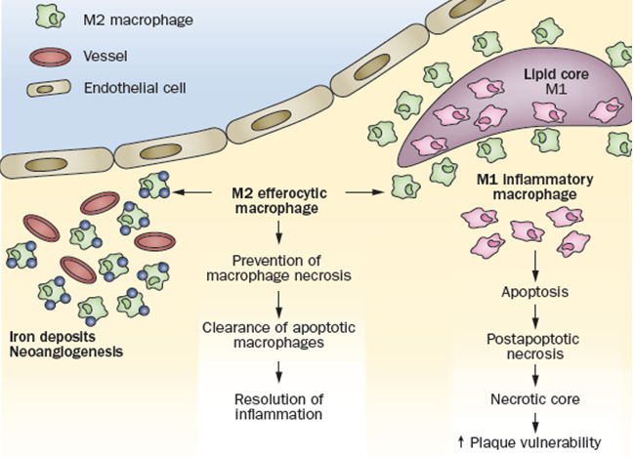
Potential role of M2 macrophages in atherosclerotic plaques
Chinetti-Gbaguidi et al. Macrophage subsets in atherosclerosis. Nat. Rev. Cardiol. 12, 10–17 (2015)
Notes:
Let us look at the M2 macrophage function in atherosclerosis. M2 macrophages localized in areas of neovascularization or outside the lipid core can phagocytose apoptotic M1 macrophages, contributing to the resolution of inflammation. If efferocytosis is insufficient, dead M1 macrophages accumulate and undergo postapoptotic necrosis, leading to the formation of a necrotic core, which contributes to plaque instability and rupture. So Modulation of macrophage phenotypes might be a novel strategy for the pharmacological treatment of atherosclerosis.

Slide 29
Q4. whether SIRT1 Influences the macrophage M1–M2 Polarization Balance ?
Notes:
SO our question is whether SIRT1 Influences the macrophage M1–M2 Polarization Balance

Slide 30
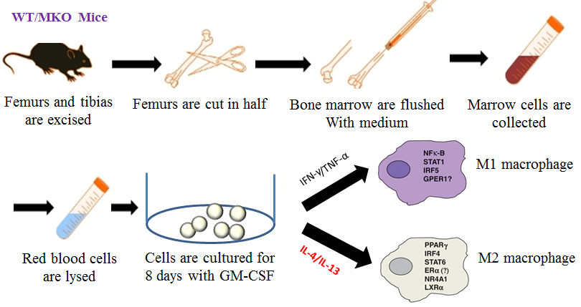
Methods
BMM cultures and Differentiation
Notes:
In order to answer this question, we isolated bone marrow from the femurs and tibias of WT and macrophage SIRT1 KO mice. Marrow cells are collected and cultured for 8 day with Granulocyte-macrophage colony-stimulating factor (GM-CSF). In order to promote differentiation into M1 or M2 , cells were treated with IFNγ plus TNF-αor IL-4.

Slide 31
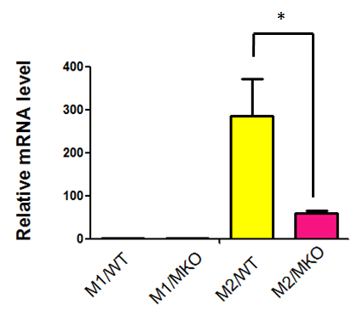
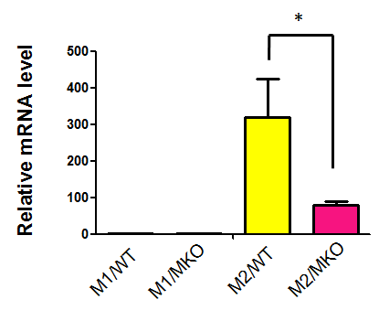
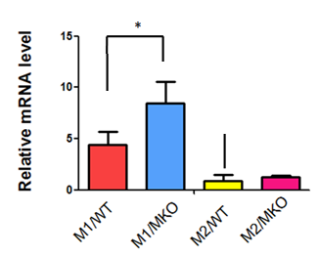
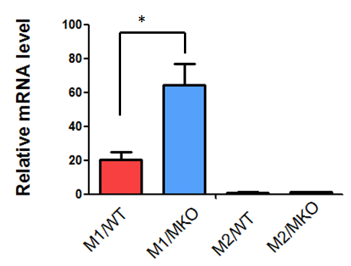
Deletion of SIRT1 in macrophage impaired macrophage polarization
M2 markers
Arg-1
Mgl2
M1 markers
iNOS
MCP-1
Notes:
Although the general properties of macrophages are conserved between species, their cell surface markers are not same. M2 phenotype is defined by expression of arginase I and mgl2 and M1 macrophage cell markers are Inos,MCP-1 and so on. Our results showed that compared with wild type mice, the mRNA levels of Arg-1 and Mgl2 in M2 were significantly reduced in MKO mice, while iNOS and MCP-1 mRNA levels were increased in M1, indicating that deletion of sirt1 in macrophage polarization.

Slide 32
Q5. Whether SIRT1 affects endothelial function by regulation of macrophage polarization?
Notes:
We have investigated that endothelial function was impaired in macrophage specific SIRT knock out mice in vivo. The following question is whether SIRT1 affects endothelial function by macrophage polarization directly?

Slide 33
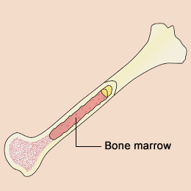
Methods
Porcine Aortic Endothelial Cells
(PAECs)
Bone Marrow
BMMs
M2 Macrophage
WT
IL-4
Conditioned Medium
Recipient
MKO
Donor
Notes:
According to the above mentioned protocol, macrophages were incubated with IL-4 in order to obtain M2 polarized macrophages. After that ,the conditioned medium from wt and knock out mice was collected and incubated with primary porcine aortic endothelial cells (PAECs) from hearts of pigs.

Slide 34
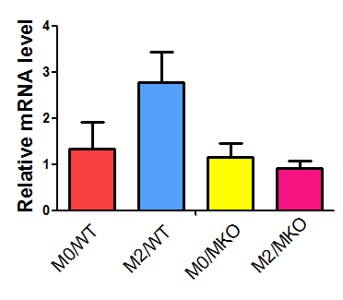
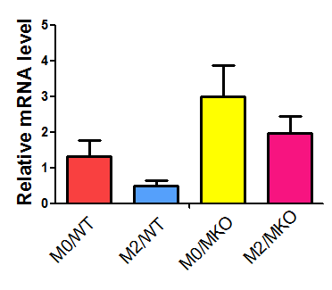
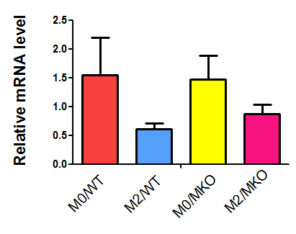
M2 macrophage improved endothelial function
eNOS
E-selectin
ICAM-1
*
*
*
Notes:
Following that, we determined mRNA expression of eNOS, E-selectin and ICAM-1 in PACEs and the results showed that The mRNA levels of eNOS was increased and the levels of E-selectin and ICAM were decrease in PAECs cultured with M2 macrophage conditioned medium from WT mice, not mSIRT1 KO mice .

Slide 35
Summary Ⅱ
SIRT1 plays a pivotal role in controlling macrophage polarization.
SIRT1 in macrophage protects endothelial function by regulation balance of M1 and M2 macrophage.
Future Research
How SIRT1 modulates the macrophage polarization?
Notes:
OK, SO summary that SIRT1 plays a pivotal role in controlling macrophage polarization and protects endothelial function by regulation balance of M1 and M2 macrophage. In the future study ,we will focus on exploring the possible mechanism by which sirt1 regulates the balance of macrophage m1-m1 polarization.

Slide 36

Acknowledgement
University of Hong Kong Jin Ling Hospital
Prof. Aimin XU Prof. Jiaqing SHAO
Hannah HUI, PhD Bin LU, MD, PhD
Zhe HUANG, PhD Jian MA
Jin LI, PhD Cuihua YANG
Kelsey ZHONG, PhD
Notes:
Finally, I would like to thank professor Aimin Xu from the university of hongkong for the guidance and support to my project. Thank for Hannah, Zhe, Jin and Kelsey for the collaboration and discussion with me on this project. Moreover, I would like to thank professor Jiaqing Shao and his team in Jinling Hospital for daily help on work. Thank for your attention.

