Slide 1





Exploiting the cold environments: psychrophilic bacteria as a promising source of novel bioactive compounds
Pietro Tedesco
IBP-CNR
5th World Congress on Biotechnology
Valencia 25/27-06-2014

Slide 2
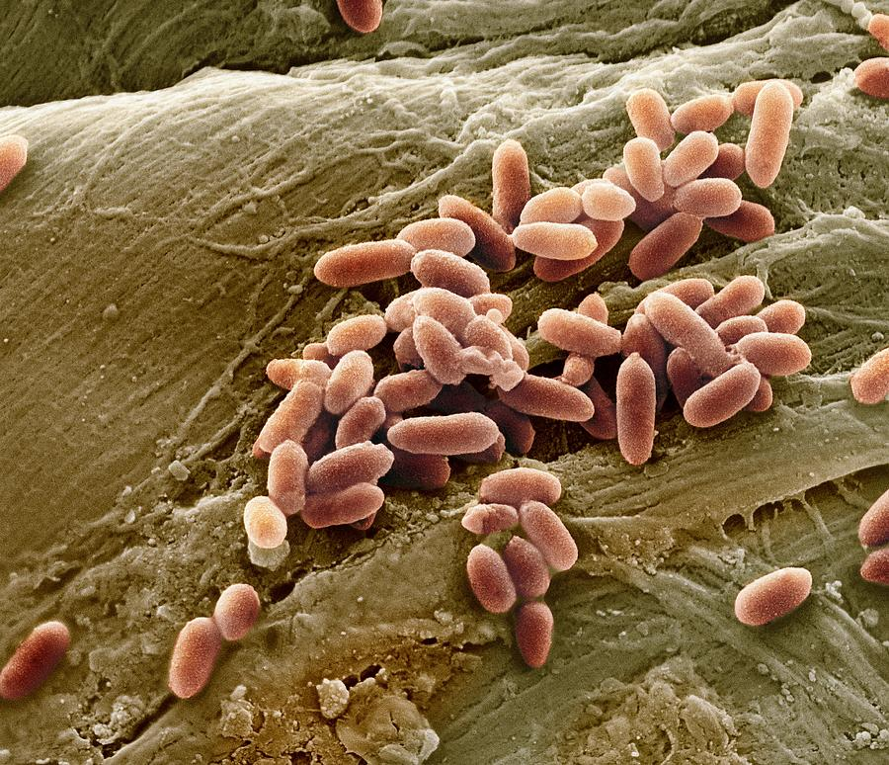
Multidrug resistance bacteria (MDR)
These bacteria are a worldwide concern and a major challenge for modern medicine.
They belong to an elite class of microorganisms: the so-called “superbugs”, the causative agents of recalcitrant infections immune to the effects of the most common antimicrobials.
Notes:
These bacteria are a worldwide concern and a major challenge for modern medicine. They belong to an elite class of microorganisms: the so-called “superbugs”, the causative agents of recalcitrant infections immune to the effects of the most common antimicrobials.

Slide 3
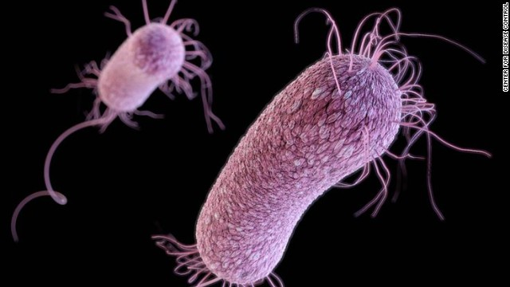
The effect on MDR bacteria on public health
Annual Cost / Per Patient
$3-4 Billion / $14,000 USD
( Infections / Deaths ) per Year USA
90,000 – 100,000 / ~10,000
Methicillin-resistant Staphylococcus aureus (MRSA) is the most prevalent antibiotic resistant bacterial worldwide infection
Emerging MDR strains
Drug-resistant Streptococcus pneumoniae
Multidrug-resistant Burkhokderia cenocepacia
Quinolone-resistant Neisseriaa gonorrheae
Penicillin-resistant Neisseria meningitidis
Notes:
Now, let’s see the effect of this MDRB on public health. Here we can see that the annual cost for patients is around 3-4 Billion dollars- and the number of infections is around 100,000 thousands per year with 10000 deaths per year in the only US, and Europe has very similar numbers by now.
The MRSA is the most prevalent antibiotic resistant bacterial infection in the world, but there are several emerging MDR
Drug-resistant Streptococcus pneumoniae
Multidrug-resistant Staphylococcus aureus
Multidrug-resistant Burkhokderia cenocepacia
Quinolone-resistant Neisseriaa gonorrheae
Penicillin-resistant Neisseria meningitidis

Slide 4
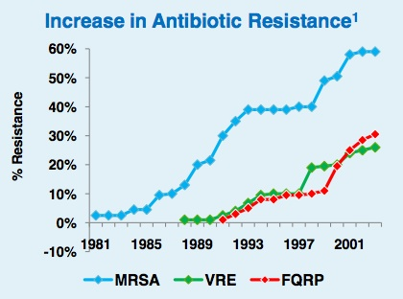
The antibiotic crisis
There is a pressing need to discover novel antibiotics
Notes:
The problem of MDR bacteria is enhanced because of the antibiotic crisis. In the left graph it is shown that in the last 30 years we observed a very high increase in the antibiotic resistance, in this case as a number of new resistant strains detected. (MRSA is methicilline resistent SA, VRE stands for Vancomicin resistant Enterococcus, FQRP is the Fluoroquinolone reistant PA. In the right graph we can observe as in opposite way the number of novel antibiotic released in the last 30 years has dramatically decreased. SO, to fight these MDR there is a serious need to discover novel antibiotics classes or novel therapeutic targets.

Slide 5
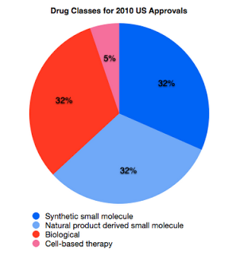
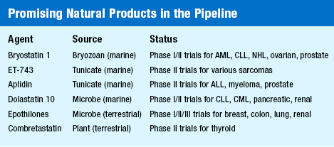
Natural Products
Natural products and their analogs continue to play a prominent role in medicine, accounting for two-thirds of new antibacterial therapies approved from 1980 to 2010
Discovery of novel natural products
BIOPROSPECTING FROM EXTREME ENVIRONMENTS
Notes:
A solution to this problem can arrive from Natural Products. In fact, Natural products and their analogs continue to play a prominent role in medicine, accounting for two-thirds of new antibacterial therapies approved from 1980 to 2010 as well as several antibacterials currently in clinical trials, that we can see in this table: promising natural products in clinical trial.
SO, research efforts are focused on the discovery of novel natural products, and one of the most promising way i represented by BIOPROSPECTING FROM EXTREME ENVIRONMENTS

Slide 6
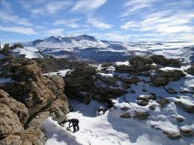
Extreme and unexplored environments may hide of new classes of natural products
Psychrophilic bacteria
These bacteria live in extreme conditions: low temperature, shortage of food
They adopt peculiar survival strategies in order to thrive and face adverse environmental conditions.
These bacteria may produce interesting
compounds with antimicrobial activity
Notes:
In fact, Exploring extreme and unexplored environments may lead to the discovery of new class of natural products. In this ambit the Psychrophilic bacteria represent are a very good source of unexplored biodiversity. Also These bacteria live in extreme conditions: low temperature, shortage of food and They adopt peculiar survival strategies in order to thrive and face adverse environmental conditions achieving competitive advantages. So These bacteria may produce interesting compounds with antimicrobial activity

Slide 7
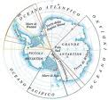
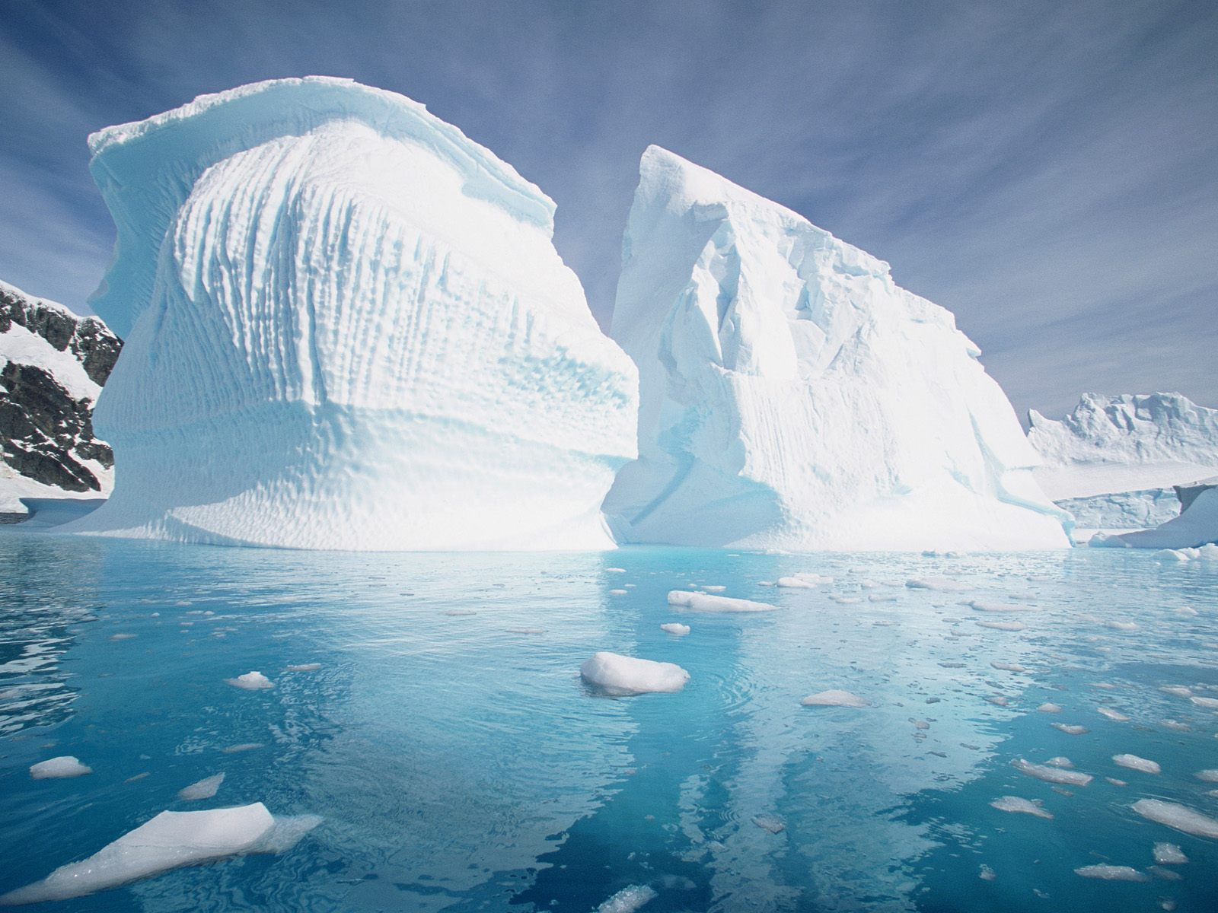
Aim of the work
Discovery of novel bioactive compounds from psychrophilic bacteria

Slide 8

Increasing Value and Flow in
the Marine Biodiscovery Pipeline
“To improve the quality, volume and value of active agents discovered in the marine environment and increase the speed at which they can be delivered to the marketplace, by addressing bottlenecks and restrictions and adding technical booster-pumps”
KBBE.2012.3.2-01: Innovative marine biodiscovery pipelines for novel industrial products.
Grant agreement for: Collaborative project no: 3121184, 2012-2016
Notes:
This work is part of the european Project Pharmase “Increasing Value and Flow in
the Marine Biodiscovery Pipeline”. This project aims to discover and identify novel antimicrobial compounds form marine sources

Slide 9
Development of a biodiscovery pipeline
1.Collection of environmental samples
2.Isolation of bacteria
3.Cell-based bioassays
4.Preparation of crude extracts
5. Extract based bioassay
6.Identification of active compounds

Slide 10

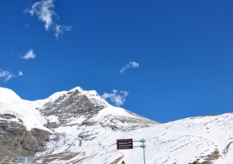
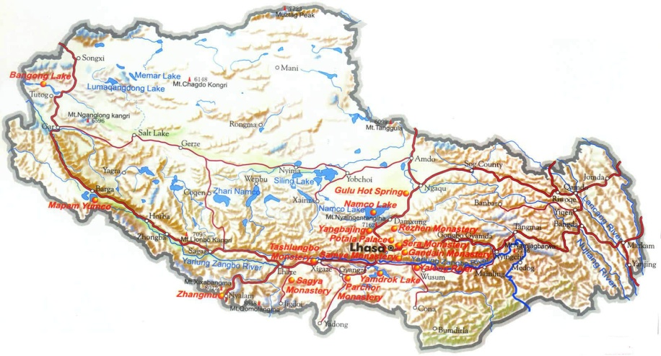
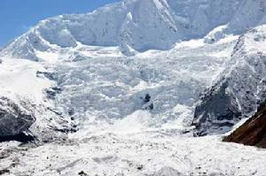
1.Collection of environmental samples
Isolation of bacteria
Cell-based bioassays
Preparation of crude extracts
Extract based bioassay
Identification of active compounds
Karuola glacier
1
2
4300 m
5300 m
Midui glacier
Glacier samples in Tibet
Antarctic sub-sea sediments
Samples collected by Dr Lei Zhai
Mario Zucchelli Station, Baia Terranova Ross sea, Antarctica
CNR-IMCAS Cooperation agreement 2011-2013
Dr. Zhu Cheng- Dr. de Pascale
Notes:
So, we recently decided to improve aour biodiversity and we obteined different samples from extreme environmets. We got Antarctic sub-sea sediments, and this samples were kindly collected by Dr. Ennio Cocca, and we also obteined soil sample from tibetan glaciers during a collaboration with the chinase academy of science.

Slide 11
1.Collection of environmental samples
2.Isolation of bacteria
Cell-based bioassays
Preparation of crude extracts
Extract based bioassay
Identification of active compounds
PYG medium (g/L)
Polypeptone 5.0
Tryptone 5.0
Yeast extract 10.0
Glucose 10.0
Salt solution 40 ml
salt solution, pH 7.2,contained: 0.2 g/L CaCl₂, 0.4 g/L MgSO₄.7H₂O, 1.0 g/L K₂HPO₄, 1.0 g/L KH₂PO4, 10.0 g/L NaHCO₃ and 2.0 g/L NaCl.
15 days at 4°C
We obtained
24 isolates from Antarctic sub-seasediments
11 isolates from Tibetan glaciers
Notes:
We used this sample for the isolation of psychrophilic bacteria. This is the recipe of the PYG, the medium we used. Soil was mixed with a saline solution, the mixture was centifuged and the supernatant was plated after serial dilutions. After 15 days of incubation at 4°C we obteined 11 isolated f1 isolates from Tibetan glaciers and 24 isolates from Anctartic sub-sediments

Slide 12
1. Tibetan Isolates
2
1
Notes:
Now I will present the results I have obteined with the tibetan Isolates

Slide 13
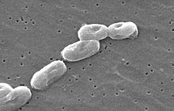
1.Collection of environmental samples
2.Isolation of bacteria
3.Cell-based bioassays
Preparation of crude extracts
Extract based bioassay
Identification of active compounds
Negative control
To identify strains producing bioactive compounds
Low inhibitory activity
Tester strain
Target strains
High inhibitory activity
Methods to determine antagonist interaction against different bacterial isolates
Burkholderia cepacia complex
Many Bcc strains are MDR opportunistic human pathogens and represent a serious concern for Cystic Fibrosis (CF) patients and immune-compromised individuals

Slide 14
Several Tibetan strains were able to inhibit
the growth of some Bcc strains
+ growth
- no growth
Species | Strain | MD1 | MD2 | MD3 | MD4 | MD5 | KRL1 | KRL2 | KRL3 | KRL4 | KRL5 | KRL6
B. ambifaria | LMG 19182 | + | - | - | + | + | + | + | - | - | + | -
B. anthina | LMG 20980 | - | + | + | + | +/- | +/- | +/- | +/- | + | + | +
B. arboris | LMG 24066 | + | + | - | + | + | + | + | - | - | + | +
B. cenocepacia | LMG 16656 | - | - | - | - | + | - | + | - | - | + | -
B. cepacia | LMG 1222 | + | - | - | - | - | - | - | - | - | - | -
B. contaminas | LMG 23361 | + | - | + | - | + | + | + | - | - | + | -
B. diffusa | LMG 24065 | + | + | - | - | +/- | - | + | - | + | + | +
B. dolosa | LMG 18943 | - | + | + | - | + | - | - | - | + | + | +
B. lata | LMG 22485 | + | - | - | + | + | - | + | - | - | + | +
B. latens | LMG 24064 | - | + | - | + | + | + | + | + | - | - | -
B. metallica | LMG 24068 | - | - | - | + | + | - | + | - | - | + | -
B. multivorans | LMG 13010 | - | + | - | + | +/- | +/- | +/- | + | + | + | +
B. pseudomultivorans | LMG 26883 | + | + | - | + | + | - | + | - | - | + | +
We decided to increase the panel of target pathogens
Notes:
We observed that Several Tibetan strains were able to inhibit the growth of some Bcc strains as we can see in the pictures.
Then, we decided to increase the panel of target pathogens,

Slide 15
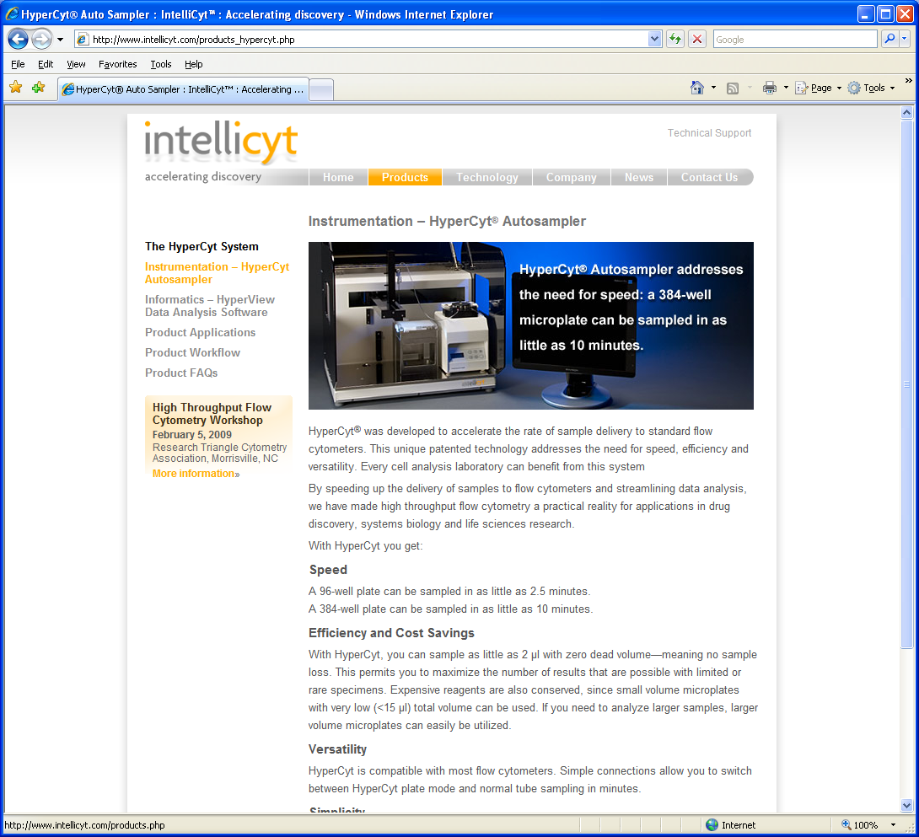
Collaboration with Prof George Tegos of the UNM
HTS instrumentation
Bioinformatic facilities
CDC-certified laboratory to conduct research on Category A select agents such as Francisella tularensis, Burkholderia pseuodomallei and Bacillus anthracis
Notes:
so we started a collaboration with the professor Geroge Tegos from the center for molecular discovery, a research center in US, specialized in drug discovery with HTS instrumentation, bioinformatic facilities and CDC-certified laboratory to conduct research on Category A select agents such as Fransisella tularensis, Burkholderia pseuodomallei and Bacillus anthracis

Slide 16
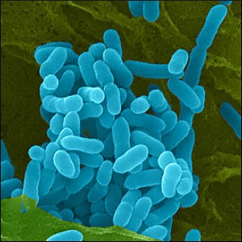
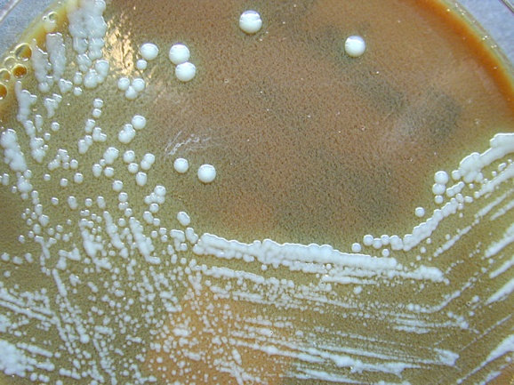
Target 2
Burkholderia pseudomallei (Bp)
Bp is the etiologic agent of meloidosis, particularly relevant in Thailand and northern Australia.
Target 3
Francisella tularensis (Ft)
Ft is the causative agent of tularemia, and can infect humans and animals. It is endemic in North America
These two bacteria have been recognized as
probable biological weapon by US Army
Notes:
We decided to test our bacteria against two new targets. BP is the etiologic agent of meloidosis, particularly relevant in Thailand and northern Australia. FT is the causative agent of tularemia, and can infect humans and animals. It is endemic in North America. These two bacteria have been recognized as probable biological weapon from US army

Slide 17
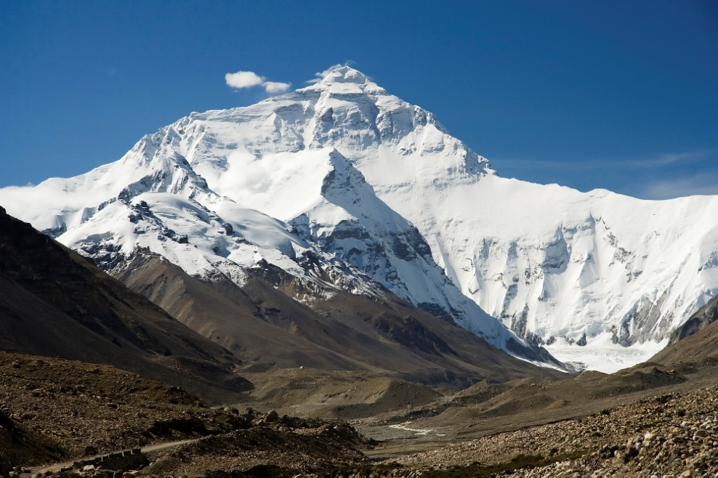


We performed 16S analysis on
the most promising strains
Pseudomonas sp. MD1
Pseudomonas sp. MD2
Pseudomonas sp. MD3
Pseudomonas sp. MD4
Pseudomonas sp. KRL1
Pseudomonas sp. KRL3
Exiguobacterium sp. KRL4
We selected Tibetan strains to perform new antimicrobial screenings
Notes:
We selected tibetan strains to perfom new antimicrobial screening. The bacteria are listed here. From 16S analysis we had 6 bacteria belonging to genus Pseudomonas and 1 bacteria belonging to genus Exiquobacterium. These bacteria have been shipped to US and I went there to perform this work

Slide 18
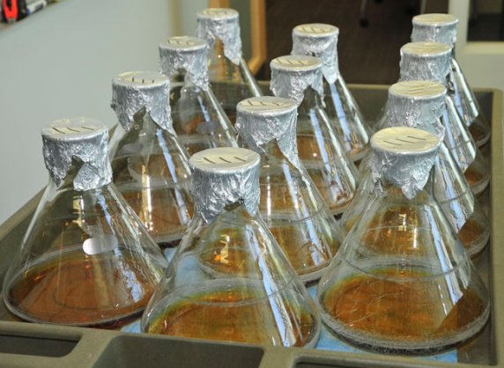
1.Collection of environmental samples
2.Isolation of bacteria
3.Cell-based bioassays
4.Preparation of crude extracts
Extract based bioassay
Identification of active compounds
In collaboration with Prof. Chad E. Melancon III,
Department of Chemistry, University of New Mexico
7 psychrophilic strains
Bacteria growth in 2 different media
at 2 different temperatures
3 different extraction procedures
Library of 84 extracts for antimicrobial screening
Notes:
Per quanto riguarda il drug discovery il primo obiettivo ha riguardato lo screening per composti bioattivi contro patogeni umani. Il primo step di questo lavoro è stata la generezione di una library di estratti da testare. Abbiamo quindi scelto da esperimenti preliminari 7 ceppi psicrofili, che sono stati cresciuti in 2 differenti terreni a 2 diverse temperature. Sono state effettuati 3 differenti estrazioni organiche utilizzando solventi e apposite resine. Abbiamo ottenuto in totale 42 estratti per gli screening.

Slide 19
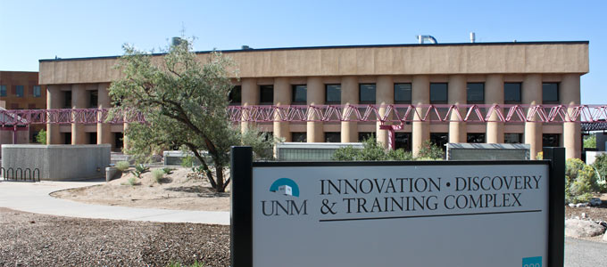
1.Collection of environmental samples
2.Isolation of bacteria
3.Cell-based bioassays
4.Preparation of crude extracts
5.Extract-based bioassays
Identification of active compounds
Screening for
1-Antibiotic extracts
2-Efflux pumps inhibitors (EPIs)
B. Pseudomallei
B. cenocepacia
F. tularensis
B. pseudomallei
B. cenocepacia
Notes:
These screening, performed as I told at the center for molecular discovery were directed to identify extract for direct antibiotic activity against (BP,FT,BC) and for 2-Efflux pumps inhibitors (EPIs) of BP and BC

Slide 20

EPI are inhibitors of the Multidrug efflux systems
Multidrug Efflux Systems (MES)
OprM
H⁺
H⁺
H⁺
MexA
NorM
NorA
MdfA
MexB
LmrA
H⁺
ATP
H⁺
H⁺
H⁺
ADP+Pi
Multidrug and Toxic
compounds Efflux (MATE)
Major Facilitators (MFS)
Small Multidrug Resistance (SMR)
Resistance Nodulation Division (RND)
ATP Binding Cassette Transporters (ABC)
The MES is the principal mechanism of antibiotic resistance of MDR pathogens
Notes:
EPI are inhibitors of the Multidrug efflux systems, that we can see I the picture and The MES is the principal system of antibiotic resistance of MDR pathogens

Slide 21
1- Antibiotic activity screening: LIQUID MIC ASSAY
Extracts at
max concentration
Cells only
Media only
Serial 2-fold diluition
Notes:
The assay we did for the antibiotic screening was the liquid MIC assay. This assay is made in 96 or 384 well plates. Those plates contained compounds at different concentration, we perfomed a serial 2-fold dilution. The plate were also organizaed with the appropriate controls, as we can see in this lanes.

Slide 22
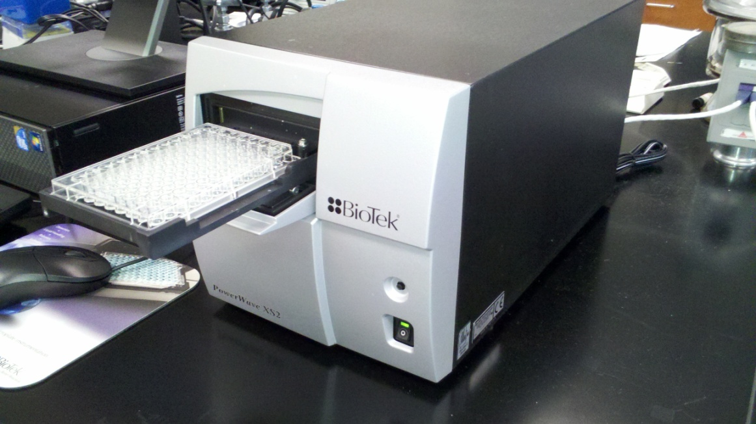
1- Antibiotic activity screening LIQUID MIC ASSAY
40.000 CFU added
to each well and then
plate incubated at 37°C
for 48 h
Cells growth measured with a plate reader monitoring the absorbance at 600 nm
We defined an antibiotic extract as an extract able to completely inhibit the growth of the target strains after 48h at 37°C
Notes:
After the plate preparation 40.000 CFU addedto each well and thenplate incubated at 37°C for 48 h. Cells growth measured with a plate reader monitoring the absorbance at 600 nm. We define an antibiotic extract as an extract able to completely inhibit the growth of the target strains at 37°C

Slide 23
2- EPIs SCREENING POTENTIATOR ASSAY
Enhancement of the effect of an antibiotic
Extracts at
max concentration
Serial 2-fold dilution
Antibiotic at sub-inhibitory
concentration added in each well
Cells only
Media only
Notes:
For the EPI’s screening, we performed a Potentiator assay, to observe Enhancement of the effect of an antibiotic., the plate is prepared like liquid MIC assay, but For this assayAntibiotic at sub-inhibitory concentration is added to each well

Slide 24
1- EPIs screening POTENTIATE ASSAY
40.000 CFU added
to each well and then
plate incubated at 37°C
for 48 h
Cells growth measured with a plate reader monitoring the absorbance at 600 nm
We define an EPI extract as an extract able to completely inhibit the growth of the target strains after 48h at 37°C in the presence of a sub-inhibitory antibiotic concentration
Notes:
Then, again 40.000 CFU addedto each well and thenplate incubated at 37°C for 48 h. Cells growth measured with a plate reader monitoring the absorbance at 600 nm. We define an EPI extract as an extract able to completely inhibit the growth of the target strains at 37°C in the presence of a sub-inhibitory antibiotic concentration

Slide 25
Antibiotic activity - Ft
 | #1 | #2 | #3 | #4 | #5 | #6 | #7 | #8 | #9 | #10 | #11 | #12 | #13 | #14 | #15 | #16 | #17 | #18 | #19 | #20 | #21 | DMSO
EXT 200 ug/mL | 0,31 | 0,31 | 0,28 | 0,22 | 0,23 | 0,23 | 0,17 | 0,24 | 0,24 | 0,2 | 0,23 | 0,22 | 0,2 | 0,23 | 0,22 | 0,14 | 0,23 | 0,24 | -0 | 0,26 | 0,25 | 0,447
EXT 100 ug/mL | 0,31 | 0,26 | 0,2 | 0,17 | 0,18 | 0,17 | 0,12 | 0,18 | 0,17 | 0,16 | 0,18 | 0,17 | 0,16 | 0,18 | 0,17 | 0,15 | 0,17 | 0,16 | 0,001 | 0,19 | 0,19 | 0,288
EXT 50 ug/mL | 0,35 | 0,21 | 0,21 | 0,16 | 0,16 | 0,15 | 0,13 | 0,14 | 0,14 | 0,12 | 0,15 | 0,14 | 0,12 | 0,14 | 0,14 | 0,11 | 0,13 | 0,13 | 0,038 | 0,14 | 0,17 | 0,282
EXT 25 ug/mL | 0,33 | 0,2 | 0,14 | 0,11 | 0,11 | 0,1 | 0,08 | 0,1 | 0,1 | 0,1 | 0,14 | 0,1 | 0,1 | 0,11 | 0,11 | 0,11 | 0,12 | 0,13 | 0,094 | 0,15 | 0,21 | 0,316
EXT 12,5ug/mL | 0,42 | 0,26 | 0,24 | 0,21 | 0,2 | 0,19 | 0,16 | 0,17 | 0,16 | 0,14 | 0,13 | 0,14 | 0,11 | 0,13 | 0,12 | 0,11 | 0,11 | 0,13 | 0,103 | 0,14 | 0,17 | 0,287
EXT 6,25 ug/mL | 0,33 | 0,22 | 0,15 | 0,13 | 0,11 | 0,11 | 0,1 | 0,11 | 0,11 | 0,11 | 0,1 | 0,1 | 0,1 | 0,11 | 0,11 | 0,11 | 0,12 | 0,12 | 0,121 | 0,13 | 0,17 | 0,292
EXT 3,125 ug/mL | 0,36 | 0,24 | 0,19 | 0,14 | 0,14 | 0,13 | 0,12 | 0,13 | 0,13 | 0,13 | 0,12 | 0,12 | 0,11 | 0,13 | 0,11 | 0,13 | 0,13 | 0,13 | 0,13 | 0,14 | 0,19 | 0,309
Cells only | 0,39 | 0,31 | 0,22 | 0,21 | 0,18 | 0,18 | 0,17 | 0,17 | 0,16 | 0,16 | 0,16 | 0,16 | 0,16 | 0,16 | 0,16 | 0,15 | 0,18 | 0,17 | 0,192 | 0,22 | 0,25 | 0,34
Media only | 0 | 0,01 | 0,01 | 0 | 0 | 0,01 | 0,01 | 0 | 0,01 | 0 | 0,01 | 0,01 | 0 | 0,01 | 0,01 | 0,01 | 0,01 | 0,01 | 0,006 | 0 | 0,01 | 0,006
Extract #19 is the ethyl acetate extraction of the Isolate MD3
Notes:
At the end of our screening we found one extract with direct antibiotic activity against the bacteria Francisella tularensis. Here, the results of the MIC are shown. Into each well we can see the value of the OD at 600 nm after 2 days at 37 °C. We can clearly observe that the extract 19 has a clear antibiotic activity against Francisella tularensis. Extract #19 is the ethyl acetate extraction of the Isolate MD3

Slide 26
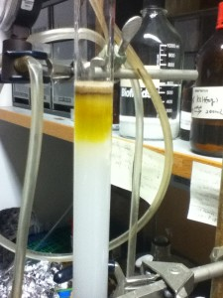
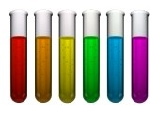
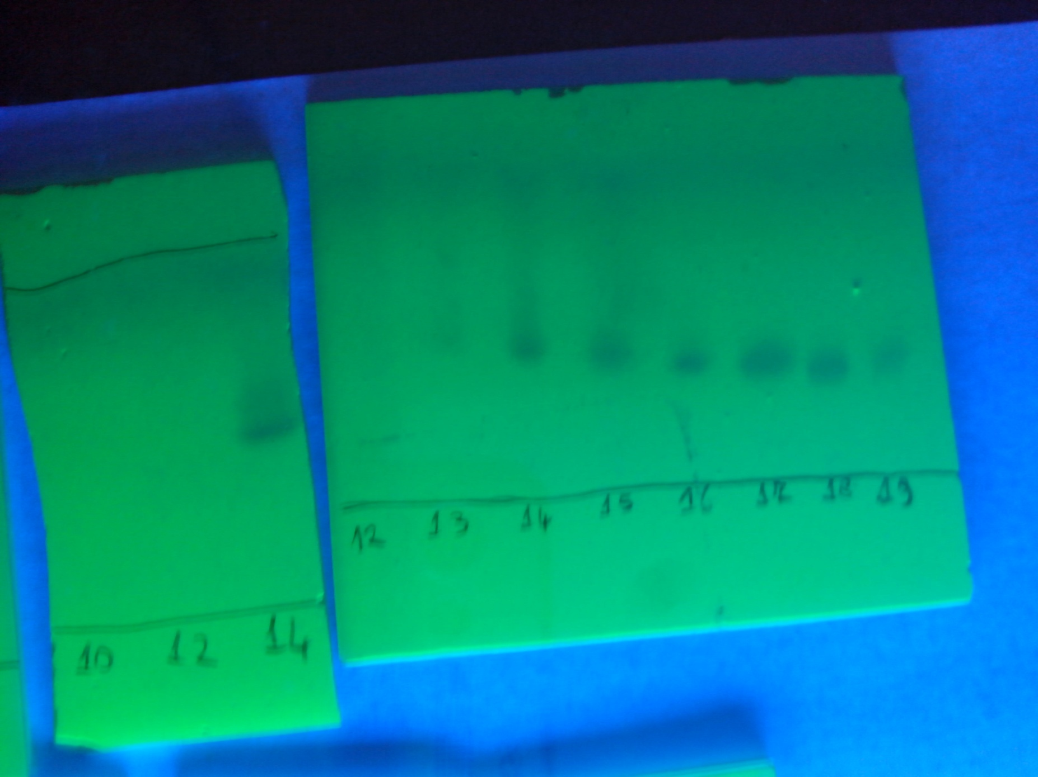
Fractionation with Silica Gel Flash column chromatography
Chloroform-methanol system
CHCl3
100%
MetOH
4%
MetOH
8%
MetOH
12%
MetOH
16%
MetOH
20%
MetOH
30%
MetOH
50%
MetOH
100%
Fractions collected and analyzed performing TLC with
UV-light detection
Notes:
The positive extract was subjected to a Fractionation with Silica Gel Flash column chromatography. Chloroform-methanol system.
Fraction collected and analyzed with UV-light detection

Slide 27
Fraction | Tubes collected | Methanol % v/v | Yield (mg)
1 | Ethyl -acetate extract | 0% | 3
2 | Methanol wash | 100% | 1.6
3 | Flow-through + fractions 1-10 | 0 %-2% | 1.6
4 | Fractions 11-13 | 3% | 5.5
5 | Fraction 14 | 4% | 12.1
6 | Fraction 15 | 5% | 8.0
7 | Fraction 16 | 5% | 4.0
8 | Fractions 17-22 | 5%-7% | 12.2
9 | Fractions 23-30 | 7%-11% | 4.6
10 | Fractions 31-38 | 11%-14% | 3.0
11 | Fractions 39-43 | 14%-16% | 1.2
12 | Fractions 44-50 | 17%-19% | 1.7
13 | Fractions 51-58 | 20%-25% | 2.3
Notes:
We collected several fractions that are listed here. We used methanol as eluent.

Slide 28
Fractions assayed for direct activity
 | 100 ug/mL | 50 ug/mL | 25 ug/mL | 12,5 ug/mL | 6, 25 ug/mL | 3,12 ug/mL | Cells only | Media
#1 | 0,166 | 0,1745 | 0,1675 | 0,161 | 0,155 | 0,179 | 0,2315 | 0,004
#2 | 0,0215 | 0,1095 | 0,127 | 0,1095 | 0,1135 | 0,143 | 0,238 | 0,0095
#3 | -0,009 | 0,011 | 0,092 | 0,1645 | 0,159 | 0,1575 | 0,241 | -0,0015
#4 | -0,046 | -0,0225 | 0,026 | 0,152 | 0,2255 | 0,2015 | 0,309 | 0,0005
#5 | -0,019 | 0,001 | 0,1395 | 0,2135 | 0,2365 | 0,2425 | 0,31375 | -0,00225
#6 | -0,013 | -0,008 | 0,091 | 0,122 | 0,142 | 0,1645 | 0,3373 | -0,0044
#7 | -0,006 | 0,072 | 0,0975 | 0,101 | 0,1105 | 0,14 | 0,36085 | -0,00655
#8 | 0,0685 | 0,11 | 0,1185 | 0,1275 | 0,1325 | 0,152 | 0,3844 | -0,00655
#9 | 0,0495 | 0,1445 | 0,1815 | 0,215 | 0,222 | 0,2405
#10 | 0,093 | 0,1905 | 0,2335 | 0,2795 | 0,255 | 0,3125
#11 | 0,0645 | 0,1155 | 0,146 | 0,1565 | 0,1755 | 0,194
#12 | 0,012 | 0,0925 | 0,116 | 0,1145 | 0,144 | 0,192
#13 | 0,0725 | 0,129 | 0,1285 | 0,1405 | 0,1575 | 0,1955
DMSO | 0,1825 | 0,213 | 0,226 | 0,2195 | 0,2515 | 0,2185
Notes:
Then, the fractions were assayed for direct activity, and as we can see from the table we identify a peak of activtiy.

Slide 29

1.Collection of environmental samples
2.Isolation of bacteria
3.Cell-based bioassays
4.Preparation of crude extracts
5. Extract based bioassay
6-Identification of active compounds
Tromso
Aberdeen
NUI Galway
Prof. Deniz Tasdemir
Copenaghen
Leuven
Naples
Medina

Slide 30
2. Antarctic Isolates
Notes:
Now I will about the very recent work on the antarctic bacteria

Slide 31
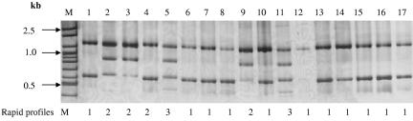
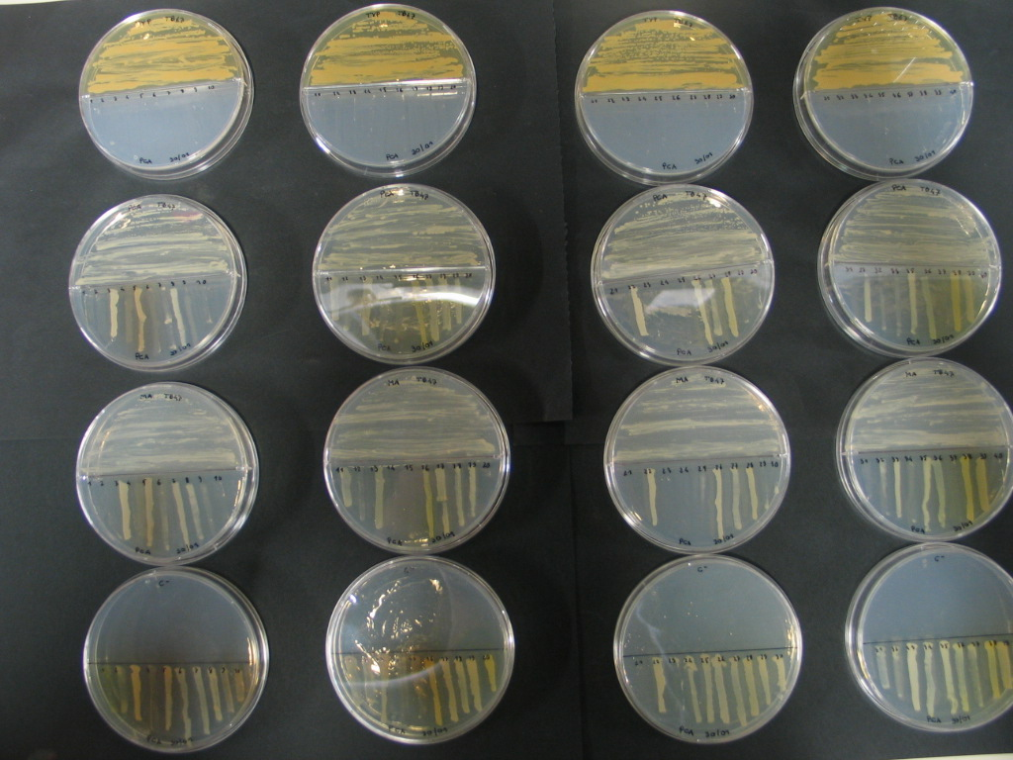
In collaboration with Prof. Renato Fani from Florence University
24 Antarctic isolates
Tassonomic and genomic
analysis on the 24 isolates
1.Collection of environmental samples
2.Isolation of bacteria
3.Cell-based bioassays
Preparation of crude extracts
Extract-based bioassays
Identification of active compounds
Cross-streaking targeting
Bcc strains
Notes:
This work is In collaboration with Prof. Renato Fani from Florence University. We perfomed tassonomic and genomic analys on these isolate to identify the genus, then Cross-streaking experiments Targeting Bcc strains

Slide 32
Cross- streaking results
+ grown
no grown
+/- partially grown
 |  | Pseudomonas | Pseudoalteromonas |  | Psychrobacter |  |  |  |  |  | Arthrobacter
Species | Strain | BTN1 | BTN2 | BTN15 | BTN3 | BTN19 | BTN20 | BTN21 | BTN24 | BTN23 | BTN4
B. ambifaria | LMG 19182 | - | - | - | - | - | - | - | - | - | -
B. anthina | LMG 20980 | - | - | - | - | - | - | - | - | - | -
B. arboris | LMG 24066 | + | + | + | + | + | + | + | + | + | +
B. cenocepacia | LMG 16656 | - | - | - | - | - | - | - | - | - | -
B. cepacia | LMG 1222 | - | - | - | - | - | - | - | - | - | -
B. contaminas | LMG 23361 | - | - | - | - | - | - | - | - | - | -
B. diffusa | LMG 24065 | - | - | - | - | - | - | - | - | - | -
B. dolosa | LMG 18943 | - | - | - | - | - | - | - | - | - | -
B. lata | LMG 22485 | - | - | - | - | - | - | - | - | - | -
B. latens | LMG 24064 | - | - | - | - | - | - | - | - | - | -
B. metallica | LMG 24068 | - | - | + | - | - | +/- | +/- | +/- | +/- | -
B. multivorans | LMG 13010 | - | - | +/- | - | - | - | - | - | - | -
B. pseudomultivorans | LMG 26883 | - | - | +/- | - | - | - | - | - | - | -
B. pyrrocinia | LMG 14191 | - | - | + | - | - | - | - | +/- | +/- | -
B. seminalis | LMG 24067 | - | - | - | - | - | - | - | - | - | -
B. stabilis | LMG 14294 | - | - | - | - | - | - | - | - | - | -
B. uborrensis | LMG 20358 | - | - | +/- | - | - | - | - | - | - | -
B. vietnamensis | LMG10929 | - | - | - | - | - | - | - | - | - | -
Notes:
We can see here the complete table of the results of cross streaking. As we can see in the legends “minus” stand for inhibition of growth, and we can see, that all the tested isolated are very active towards the pathogens panel, except for B. arboris 24066

Slide 33
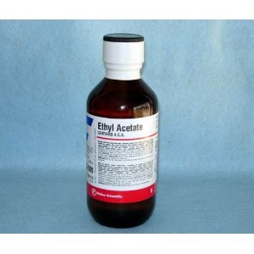
1.Collection of environmental samples
2.Isolation of bacteria
3.Cell-based bioassays
4.Preparation of crude extracts
Extract-based bioassays
Identification of active compounds
-Diaion HP20
-Amberlite XAD16
-Ethyl-acetate
1.Collection of environmental samples
2.Isolation of bacteria
3.Cell-based bioassays
4.Preparation of crude extracts
5.Extract-based bioassays
Identification of active compounds
Liquid MIC Assay
-B. cenocepacia
-F. tularensis
-P. aeruginosa
Notes:
So we star preparing extracts using ethyl-acetate and amberlite XAD-16 and From preliminary experiment
we observed better results using ethyl-acetate, so we are now using only ethyl acetate for this extractions. Then we performed liquid MIC assay targeting Bcc.

Slide 34
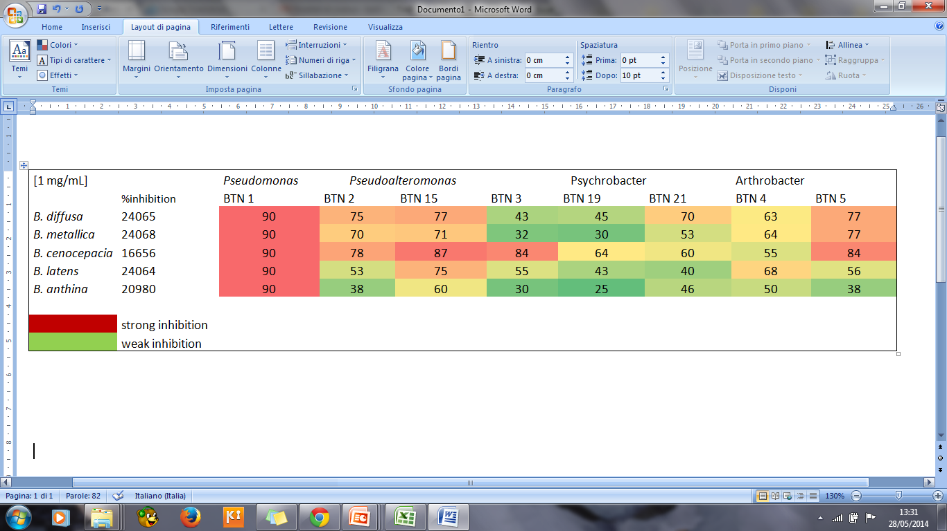
Liquid MIC Results
% of inhibition of Bcc strains with extracts at 1 mg/mL of concentration
Fractionation of BNT1, BTN15, BTN5 extracts with SPE
Notes:
Here we can see the results. In the table are reported the % of inhibition for the extract at 1 mg/mL of concentration in the assay againt the Bcc strains. We can observe that several antarctic strains are able to inhibit the growth of all the Burkholderia tested. In particular the strain BTN1 schow the best inhibition activity.

Slide 35
1.Collection of environmental samples
2.Isolation of bacteria
3.Cell-based bioassays
4.Preparation of crude extracts
5. Extract based bioassay
6-Identification of active compounds
Tromso
Prof. Marcel Jaspars
Aberdeen
Copenaghen
Leuven
Naples
Medina

Slide 36
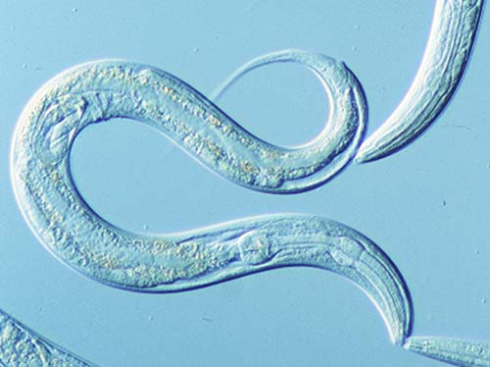
Future Perspective
-In vivo proof of efficacy of the bioactive compounds using the nematode C. elegans as model system
In vivo proof of efficacy is a valuable procedure to establish the effectiveness of a drug in real infection system
Preliminary studies of the pathogen-nematode interaction Poster #44

Slide 37
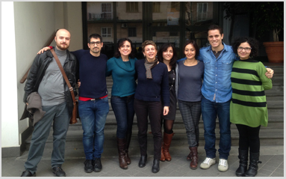
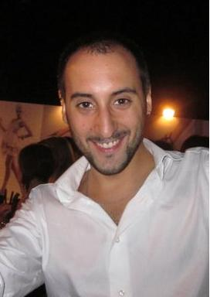
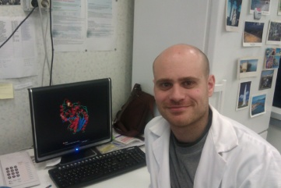




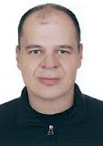

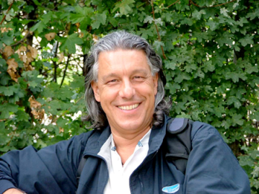
Funding
FP7-KBBE-2012-6-singlestage PharmaSea: Incresing Value and Flow in the Marine Biodiscovery Pipeline
FFC 2011-2013: New drugs for Burkholderia cepacia from Antarctic bacteria
PNRA 2014-2016: New drugs for cystic fibrosis opportunist pathogens
“PROGETTO CREME CAMPANIA RESEARCH IN EXPERIMENTAL MEDICINE” POR CAMPANIA FSE 2007/2013”
Donatella de Pascale
Concetta De Santi
Fortunato Palma Esposito
Rosalba Barone
Marco Visone
Luca Ambrosino
Federica Galati
Roselinda AbateMarco
Alessia Di Scala
Valerio Orlandini
Mena Sannino
Collaborations
Prof. Renato Fani
Prof. George Tegos

Slide 38
Thank you for your kind attention

Slide 39
In vivo validation of novel antimicrobic compounds
Infect C. elegans with Bcc strains
24-36 h of incubation
Transfer15 infected worms in wells of a 96-multiwell plate
containing test compounds
Incubation
Up to 5 days
Count of survival worms in each well
Selection of compounds that prolong worms survival
Notes:
This just a little scheme of the in vivo validation protocols. First Infect C. elegans with pathogens (Bcc) Tranfer 10-15 infected worms in each well of a 96-multiwell platecontaining test compounds and Count of survival worms in each well.
We will select compounds that prolong worms survival

