Slide 1
Immune Modulation in Children in
South Africa: a Practical Approach
Pieter Rousseau Fourie
28 September 2015

Slide 2
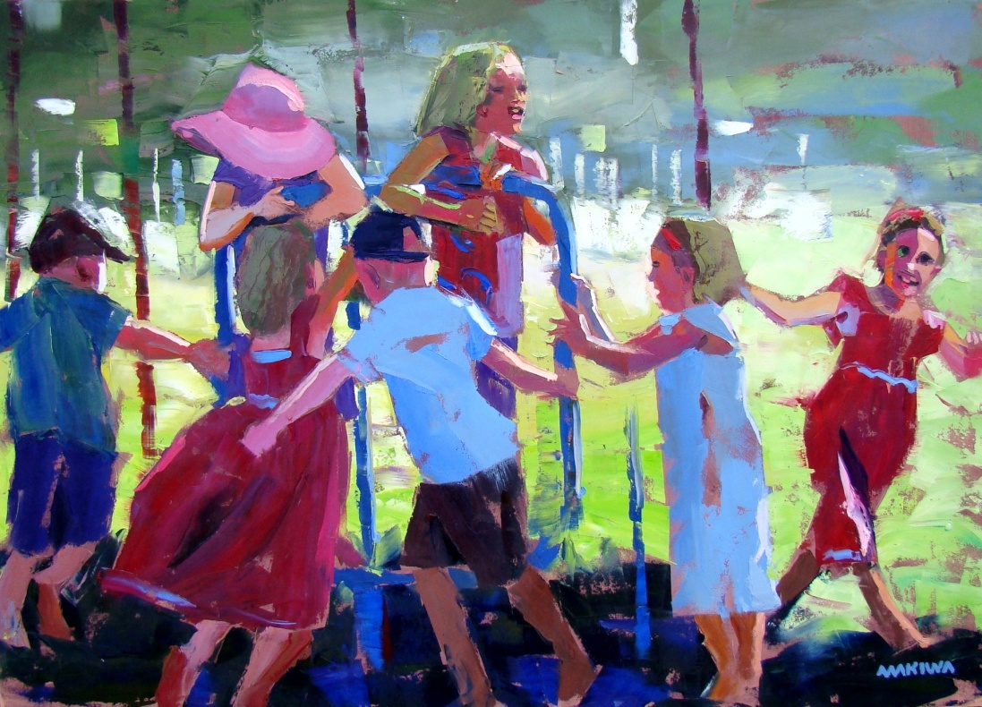
Topics
Background
Problem Statement
Case Studies 1,2 & 3
Underlying Immune Derangement
Immune Modulation: Present
Hygiene Hypothesis: A New Perspective
New Horizons
Epilogue

Slide 3
Background
9 Billion People by 2050
Urbanization, Overcrowding, Pollution, Day Care Centers: Shift towards Th2
Westernized Lifestyle and Diet: Preservatives and Colourants
Over- and Misuse of Antibiotics: Suppression of Th1
South Africa: 49 Million; Developing Country with a very Diverse Population
Affluent, mostly White Middle Class with Access to Private Health Care
Poor, mostly Black, Living in Over Crowded Conditions and Exposed to Pathogens
TB & HIV: Low CD4 and CD8 Levels
Primary Immune Deficiency: Low Percentage
Weather and Diverse Ecosystems: Highly Allergenic Environment.

Slide 4
Problem Statement
A Number of Clinical Entities where the Immune System is Compromised
Criteria According to the Definition of Primary Immune Deficiencies do not Hold
Therapeutic Modalities such as IVIG, Prophylactic Antibiotics and Nutraceuticals " Immune Boosters" not Approved or Ineffective
Leads to Repeat Prescription of Antibiotics or Hospitalizations
Burden on the State and Private Health Care
Emotional, Physical and Economical Impact

Slide 5
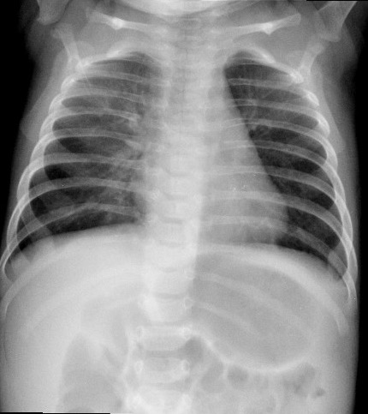
Case 1
3 Months Baby Girl
Tachypnoea, Distressed
Failure to Thrive
Xray: Bilateral Bronchial Infiltrates
P. Jiroveci: Positive
HIV: Negative
TB: Negative

Slide 6
Case 1; Continue
Immunophenotyping Normal ( Including Naive and Memory Cells as well as Beta/Gamma Delta T Cell Receptors were Normal )
IgA: 0.10 (0.08-0.6 g/L)
IgG: 2.08 (2.40-8.8 g/L)
IgM: 0.39 (0.2-1.00 g/L)
IgG1: 1.16 (1.51-7.92 g/L)
Sulfamethoxazole & Trimethoprim
IVIG @ 0.6g/kg Every 4 Weeks

Slide 7
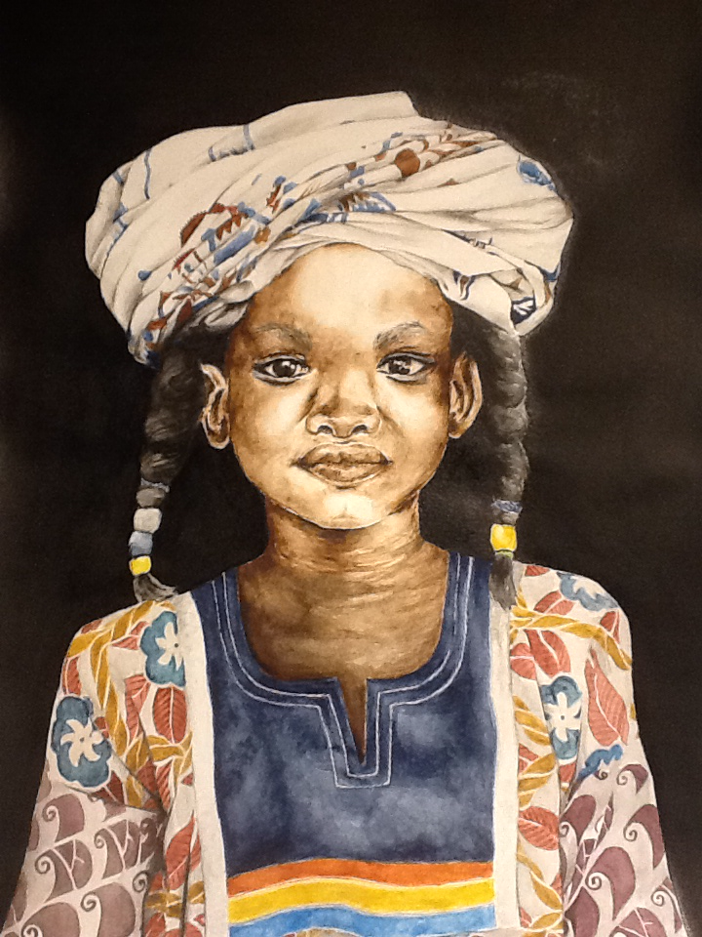
Case 2
4 Year Old Girl
One week old: Severely Distressed, Cyanotic
Total Anomalous Pulmonary Venous Drainage
Surgically Corrected
No Dysmorphism
Longstanding History of Recurrent Upper
and Lower Respiratory Tract Infection.
Multiple Hospitalizations

Slide 8
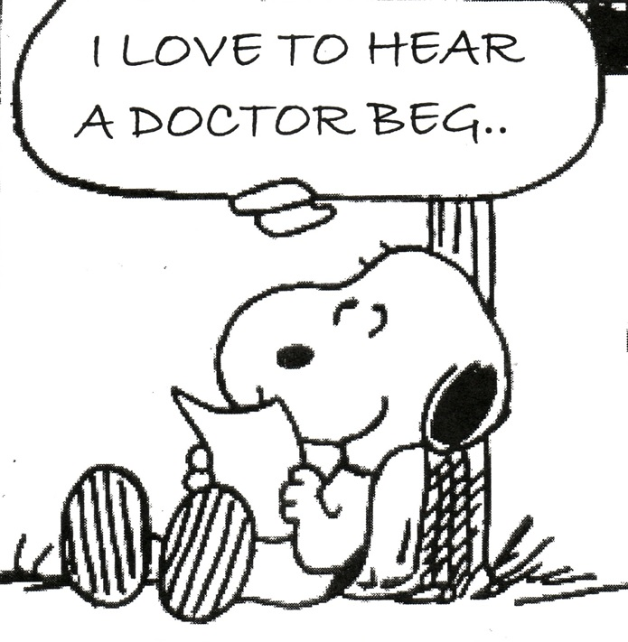
Case 2: Continue
IgA Low
CD4: 248/ccm & CD8: 425/ccm
HIV & TB: Negative
Ca++ Normal
Di George phenotype: Negative
IgG against Haemophilus Low
Medical Aid Refused IVIG
Prophylactic Clathromycin @ Half Therapeutic Dose.

Slide 9
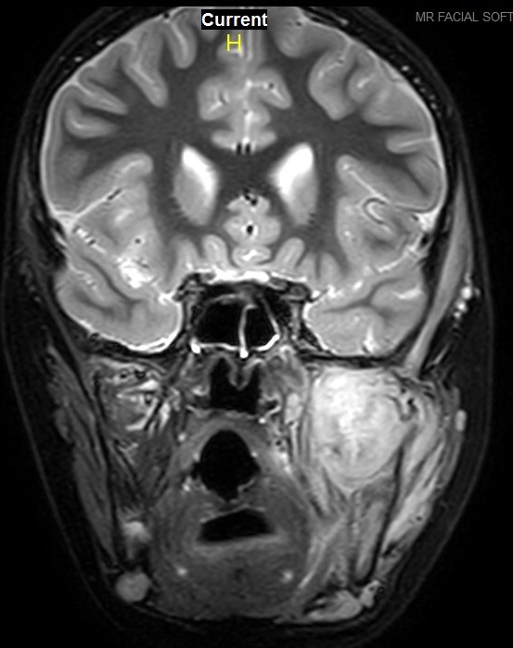
Case 3
9 Year Old Boy
Slow Onset of Trismus
Local Swelling over L Mandible
Rabdomyosarcoma
Chemotherapy & Radiation
After Six Months of Regression
Sudden Expansion

Slide 10
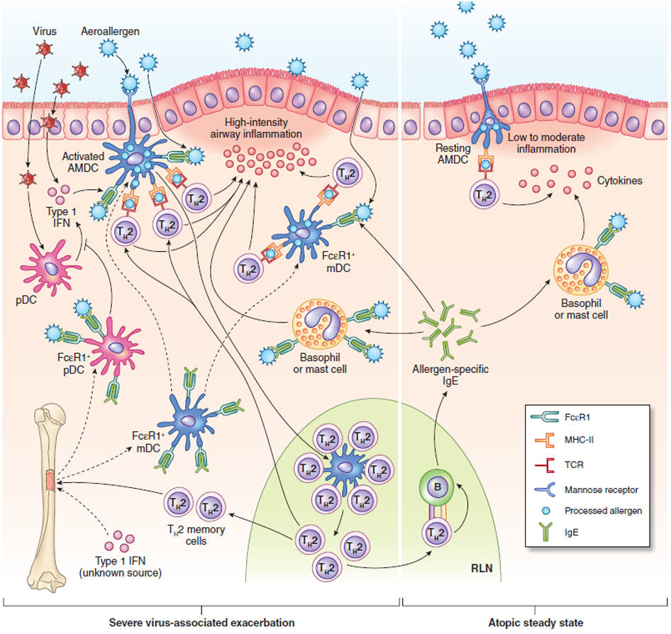
Case 3: Continue
IgG: 6.98 (7-16 g/L)
IgA: 0.41 (0.6-3.00 g/ L)
Complement C3 2.13 (0.55-1.2 g/L))
Complement C4 0.51 (0.20-0.50 g/L)
Total T-cell count 66 (1400-2000/cmm)
CD4+ cell count 24 (700-1100/ccm)
CD8+ cell count 35 (600-800/ccm)
Total B cells 1 (279-860 cells/ul)
NK cells 19 (100-480 cells/ul)
CD4/CD45 Naive 2 (320-1000 cells/ul)
CD4/CD45 Memory 16 (230-630 cells/ul)
CD8/CD45 Naive 20 (310-900 cells/ul)
CD8/CD45 Memory 9 (70-390 cells/ul)
Immunoglobulin Replacement Therapy

Slide 11
Case 3: Underlying Immune Derangement
Escaping Immunosurveillance through TGFbeta Increase Leading to an Increase in Chemokine (C-C) Motif Ligand 2 (CCL2). The Latter recruits Myeloid Derived Suppressor Cells, Reduces Tcell Activation, Blocks Tcells and Suppresses the Tumor Micro-Environment (TME)
Activated Stat3 inhibits the Expression of Mediators necessary for Immune Activation Against Tumor Cells. Stat3 Promotes the Products of Immune Suppressive Factor, Alternating Gene Expression and Restraining Anti- Tumor Immune Responses
Xie, Oncoimmunology 3; June 2014
Pang et al, Cancer Discovery 2013; 3:936-51

Slide 12
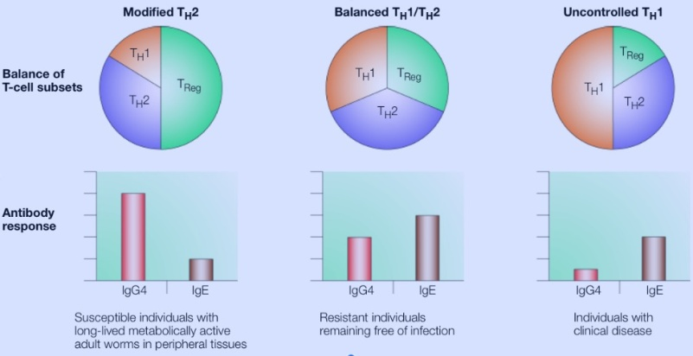
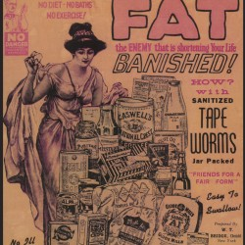
Immune Modulation: Parasites
Associated Molecule Patterns Stimulates T-Lymphocytes
and the Release of IFN-gamma
Treg Inhibition of CD8 T cell Responses during Malaria Infection
Immunology of Human Infections by Schistosoma Mansomi
Urban & Roberts: J. Exp. Med. Vol. 197. 2003
Nature Reviews, Immunology, Vol. 3, 2003

Slide 13
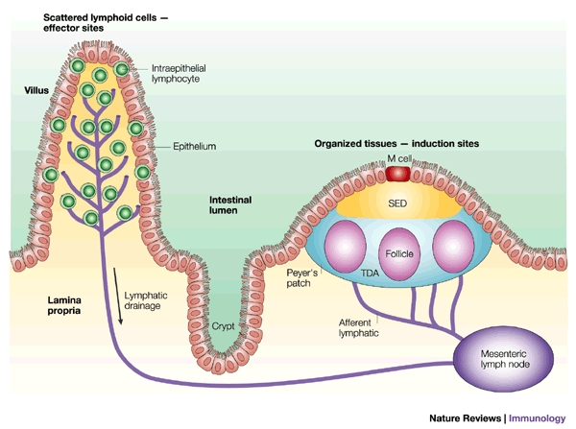
Immune Modulation: Gut Commensal Bacteria
3 Trillion bacteria
Stimulates Gut Associative Lymphoid Tissue (GALT)
Several Cytokines: TLR2&4
Enhances Nitric Oxide Production
Increases Phagocytocis
by Peripheral Blood Macrophages
Probiotics

Slide 14
Immune Modulation: Plant Phytochemicals
Curcumin :
Radiation Therapy
Cinnamaldehyde :
( alpha-beta-unsaturated carbonyl group )
- Interferes with TLR4
- Inhibition NOD2
- Increased Proliferation of Splenic Lymphocytes
- Activation of Macrophages & Increased Nitric Oxide Production
- Increase IL-1beta, IL-6, IL-15 & IFN-gamma

Slide 15
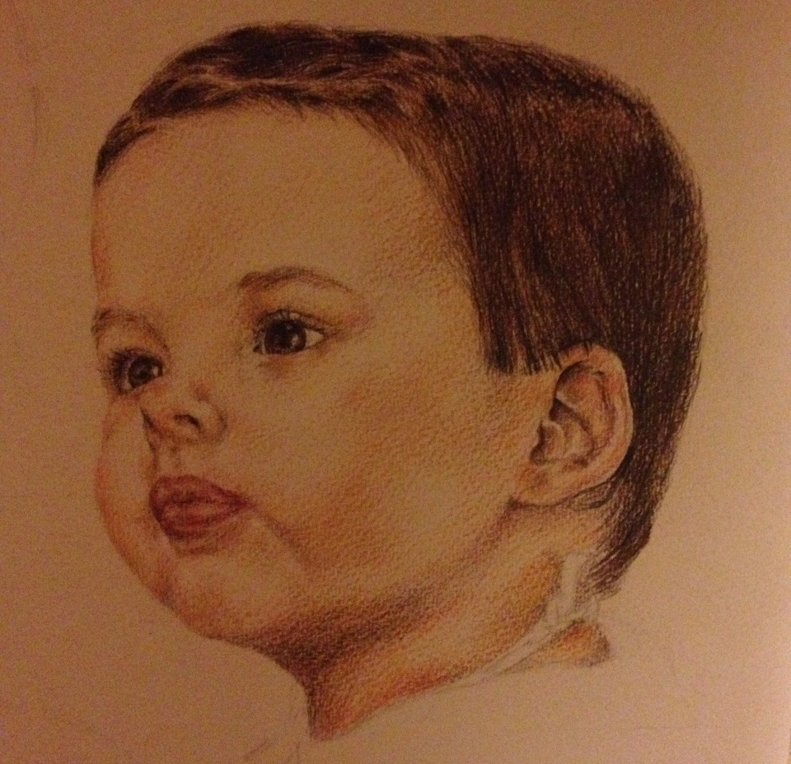
Immune Modulation: Intravenous Immunoglobulins
Primary Immune Deficiencies
Intravenous Immunoglobulins ( IVIG )
Subcutaneous route (SCIG)
Expensive
Dosage: 0.5 to 2g/kg every 4 weeks
Side effects: Nausea, Fever, Headaches and Rarely Anaphylaxis

Slide 16
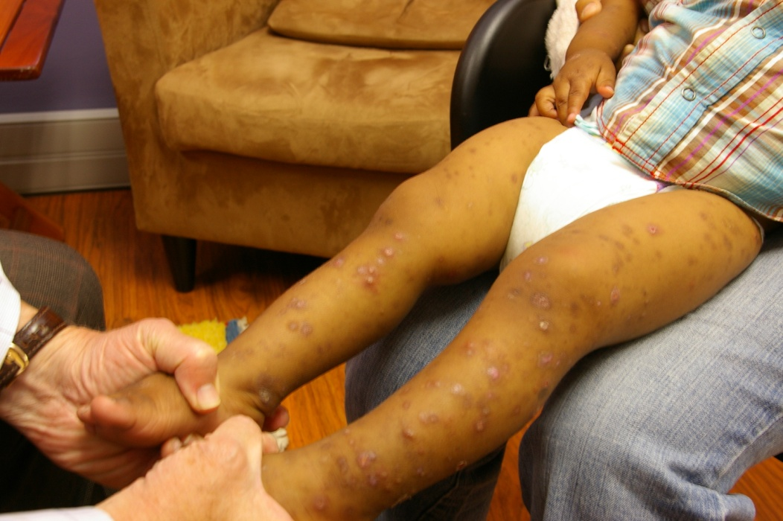
Immune Modulation: Prophylaxis
Immune modulation ( Th2 to Th1 shift )
Half Therapeutic Dosage
Safe
Anti-septic properties
Anti-inflammatory
Inhibits the Biofilm

Slide 17
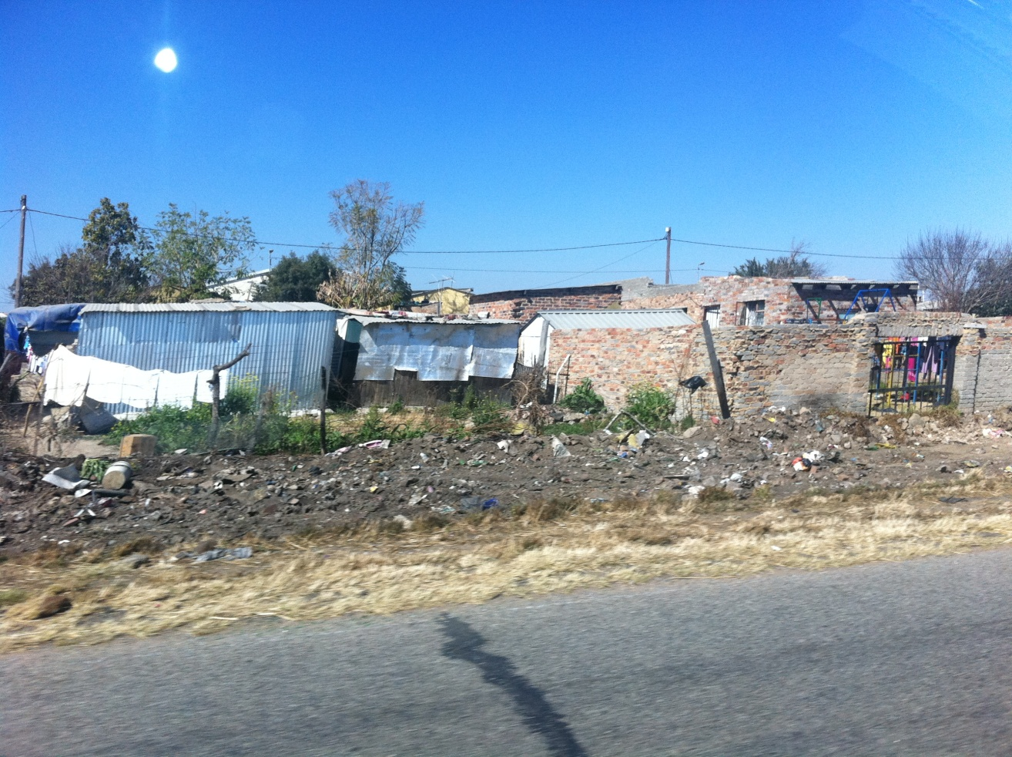
Hygiene Hypothesis: A New Perspective
South African children from poor communities
Immune system
Hygiene Theory
Largest study to date
Very different results
Lawrie et al, SA Med. J. 2015, 105

Slide 18
Hygiene Hypothesis: Holding Out!
The ratio of naïve-to-memory CD4 and CD8 T-cells reaches a 1:1 ratio shortly after the first decade of life in healthy South African children. This is far earlier than in studies from resource-rich countries, where it occurs only during the third or fourth decade of life. We also found increased proportions of natural killer cells and activated T-cells compared to studies from the US and Europe. The dramatic decline in naïve-memory ratio of both T-helper and cytotoxic T-cells and increased activation markers indicate that South African children are exposed to a wider range of environmental pathogens in early life. The marked differences observed in these and other parameters are important in understanding the developing paediatric immune system within an African, poorly resourced context.
Unpublished: Payne H and Nieuwoudt M et al 2015

Slide 19
New Horizons: Immune Cell Potentiating Factor (ICPF)
Peptides, less than 8KDa long
Biologic Response Modifier. IL-6 released early. Leads to increased IL-2 expression ( growth factor/activator for T-, NK- and B-cells ) and IFN-gamma
Effective Innate Immune Response: Up-regulation of Cytotoxic & Phagocytic Immune Cells, Macrophage Activation, Natural-killer Cell Activation, T-cell Activation & Acute-phase Protein Production
Sub-cutaneous
Safe

Slide 20
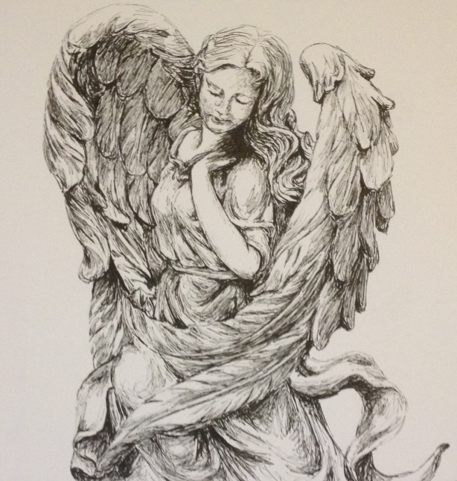
Epilogue: Immune Modulation
Interferon alpha2b
Large Gap in our understanding
Revisit Hygiene Hypothesis
Alternatives to IVIG/SCIG
Immune Cell Potentiating Factor
Thank You

