Slide 1




4th International Conference on
Advanced Steel Structures
November 09-10, 2017 Singapore
Theme: Exploring Innovative Steel Structural Designs for advanced constructions
Structure dependent selection criterion of natural accelerogram sets for non linear time history analysis
by
Ph.D Piero Colajanni
Department of Civil, Environmental, Aerospace, Materials Engineering
University of Palermo, ITALY
Notes:
Thank you mister chairman, good afternoon ladies and gentleman; the paper that I present, titled

Slide 2
Subject:
Modelling of seismic input in Non Linear Response History Analyses (NRHA) by Natural Accelerograms (NA)
Motivation:
The procedures for selection of natural accelerograms in literature supply input samples with very scattered intensity, that produce very scattered response of the analyzed system, that are much larger or smaller than the effects assessed for the seismic level to be represented.
Objective:
Proposal of selection criterion of natural accelerograms that, fulfilling in a generalized sense, the requirement of seismic codes, provide accelerograms each of them able to produce on the structure to be analyzed, response consistent with the intensity level of the target response spectrum
Notes:
is devoted to the formulation of a new procedure that aims at reducing the large scatter in the intensity of the records the are supplied by many f the actual selection criteria, that induces response of the analyzed system, that are much larger or smaller than the effects assessed for the seismic level to be represented.

Slide 3
Selection criteria for natural accelerograms:
Seismological IM parameters :
  Magnitude (M) [Shome et al., 1998; Shome e Cornell, 1998, Iervolino e Cornell, 2004]
  Epicentral distance (R) [Bazzurro e Cornell, 1999; Baker e Cornell, 2005]
  Soil profile (S) [Bommer e Scott, 2000; Bommer e Avecedo, 2004]
  Input duration (Dur) [Iervolino et al., 2006; Hancock e Bommer; 2006]
  Seismogenetic features (rupture mechanism, source environment, fault type, path and wavelength, etc.) [Katsanos et al., 2010]
Seismic Hazard :
  Deterministic (DSHA) by (M,R) [Barani e Spallarossa, 2007]
  Probabilistic (PSHA) by (M,R,ε) [McGuire, 1995; Bazzurro e Cornell, 1999; Baker e Cornell, 2006]
Intensity Measures Parameters (IM)
  Peak Ground Acc./Vel./Displ. (PGA, PGV, PGD)
  Spectral acceleration Se(T₁)
  Arias index I_{A} , Cosenza & Manfredi index I_{D}, Housner index I_{H}, Effective peak ground Acceleration EPA
Notes:
in which the hazard id disaggregated for magnitudo, distance andt deviation epsilon, that is a measure of the deviation of the elastic respone spectrum of the accelerogram fron that predicted by the ground-motion prediction equation.

Slide 4
Intensity Measures Parameters (IM)
Peak:
  Peak Gound Acceleration/Velocity/Displacement (PGA, PGV, PGD) [Elenas, 1997; Amiri e Dana, 2005; Akkar e Bommer, 2007]
  Integrals:
  Arias index I_{A} and Cosenza & Manfredi index I_{D} [Arias,1970; Cosenza e Manfredi, 1997]
  Spectral:
  Spectral Acceleration Se(T₁) [Cordova, et al. 2001; Lin, 2012; Cantagallo, 2012]
  Spectral and Integrals: :
  EffectivePeak Gound Acceleration/Velocity (EPA, EPV)
  [Elenas, 2000; Amiri e Dana 2005]
  Housner index I_{H} [Housner, 1952 ]
Notes:
Denoted with the acronym PGA, PGS, and PGD respectively

Slide 5
Eurocode 8: Time-history representation of the seismic action
3.2.3.1.3 Recorded or simulated accelerograms
the accelerograms must be adequately qualified with regard to the seismo-genetic features of the sources, and to the soil conditions appropriate to the site.
when a spatial model is required, the seismic action shall consists of 3 (or 2) simultaneously acting accelerograms
they have to be selected so that:
  the mean of the zero period spectral response acceleration values should not be smaller than the target spectra values
  in the range of periods between 0,2 T₁ and 2 T₁ (T₁ fundamental period of the structure in the direction where the accelerogram will be applied) no value of the mean 5% damping elastic spectrum of the selected accelerograms should be less than 90% of the corresponding value of the 5% target damping elastic response spectrum
If the response is obtained by at least 7 non linear time history analyses, the average of the response quantities should be used as design values.

Slide 6
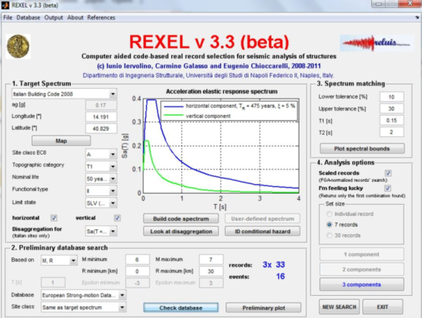
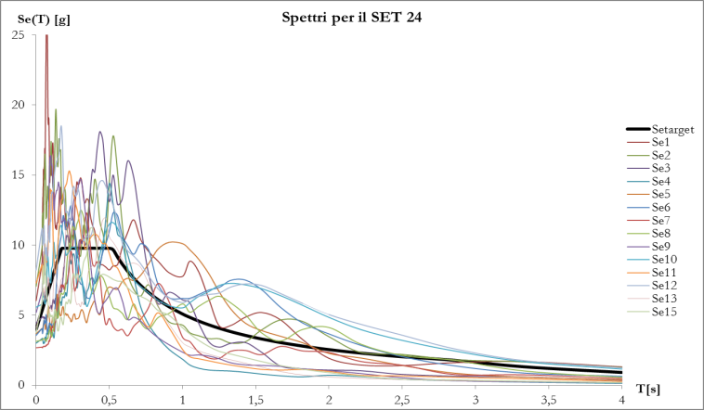
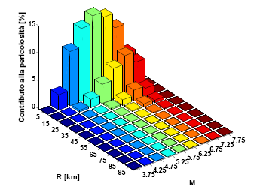
Record selection criterium based on earthquake magnitude (M), epicentral distance (R) and spectral matching [Iervolino, Galasso, Cosenza, 2010. “REXEL: computer aided record selection for code-based seismic structural analysis.” Bulletin of Earthquake Engineering, 8, 339–362]
Set selection criterium (7x2 registazioni)- Spectral matching
the average spectrum is often obtained by accelerogram samples with very different intensity, that induce very different response when structures are excited in non linear field
Notes:
In many of the selection criteria in literature, in order to adequately represent the seismo-genetic features of the sources, and the soil conditions appropriate to the site, a first selection of the accelerograms is performed on the basis of the soil of the recording station, the value of magnitude and epicentral distance; then among the sets of 7 couple of records, those that are characterized by the best spectral matching are selected; parameters utilized are the standard deviation of the average, along the period of interest, of the mean spectrum of the set respect to the target spectrum, or/and the correspond values for each records of the set.

Slide 7
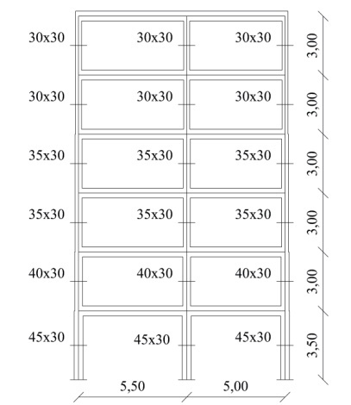
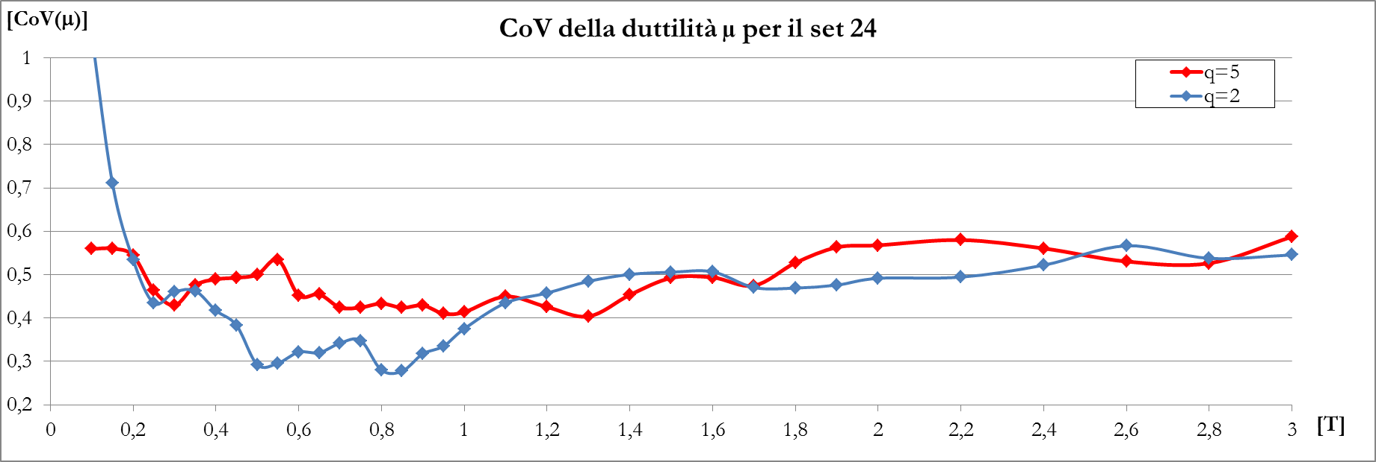
Response scattering- 6storey regular r.c. frame
Response assessment obtained as a mathematical averaging of very scattered responses that are not able to represent the structure response under seismic action with intensity comparable to that of the target response spectrum.
Namely, by averaging response that for:
  Small input intensity –> are elastic ( μ<1)
  Large input intensity –> are beyond the capacity(μ>4); very sensitive to the conventional modelling of the “plastic hinge” behaviour beyond the ultimate state
Response spectra
6 story r.c. regular frame response to accelerograms of the chosen set (a_{g}=3,99 m/sec²)
µ < 1 values
Ductility demand CoV (set 24)
µ > 4 values
I_{P&A}> 1 values
6 story r.c. regular frame response to accelerograms of the chosen set (ag=7,98 m/sec²)
Notes:
In order to stress the effect of the scattering of the input intensity on the assessment of the response of a 6 story regular r.c. frame, in table the peak values of three response parameters, namely the displacement ductility demand mu, the energy ductility demand and the value of the Park and Ang damage index for the 7 couples of accelerograms selected according to the aforementioned criterium are reported for two different values of the input intensity. In the last two columns the mean values and the CoV of the respone parameters, the latter defined as the ratio of standard deviation over the mean value, are reported.
The Cov of ductility demand ranges between 0.46 to 0.56. Larger values of the other two response parameters are also found.

Slide 8
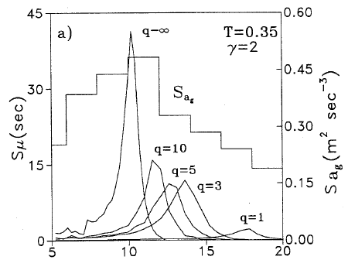
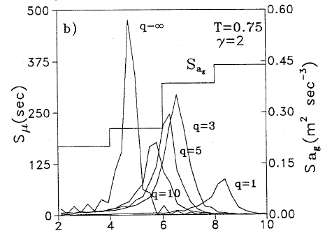
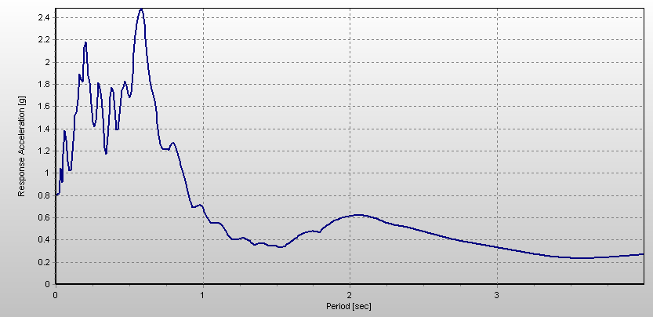
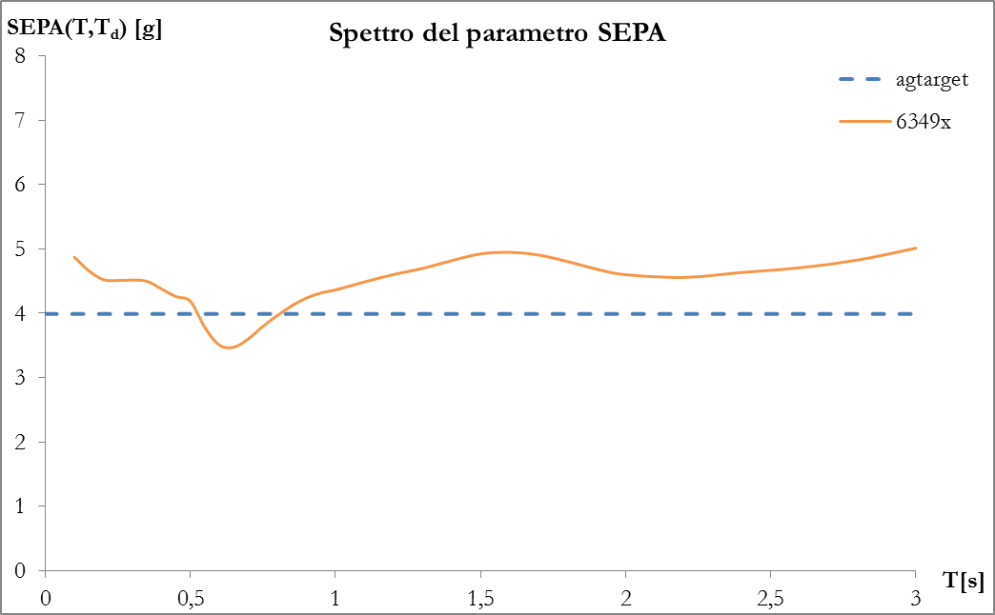
Response of Hysteretic system
[Colajanni 1998. “Braced Frames with Hysteretic Dissipative Devices: Seismic Response and Design Criteria. Journal of Earthquake Engineering, Vol. 3, No. 1 33-57.
Structure Effective Peak Acceleration (SEPA)
Response of bilinear hysteretic system in the frequency domain
Energy content (power Spectral density) of input e response to spectrum-compatible accelerograms
T_{d} fundamental period of damaged structure
ω (rad/sec)
ω (rad/sec)
Notes:
a generalization of the effective peak acceleration is proposed, adapting the averaging of the spectral acceleration values on the evolution of dynamic characteristic of the structure that is expected. In fact, is is well known that when the structure undergoes plastic deformation, the stiffness is reduced and the istanteneous period of vibration is increased. Thus, the expected response depends on the spectral acceleration in a period field that ranges from the elastic one to the period of the damaged structure.

Slide 9
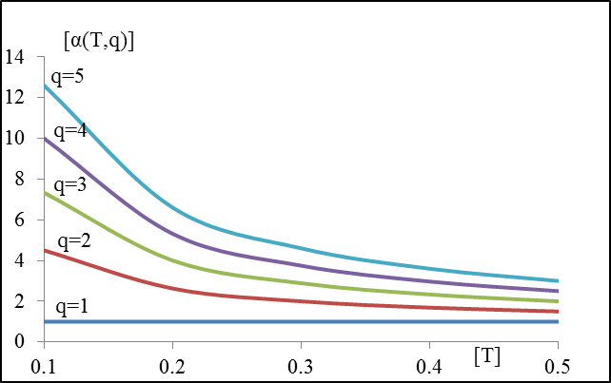
Assessment of fundamental period of damaged structure
Elongation of the fundamental period due to damage depends on the amplitude of the plastic deformation, ruled by:
  ratio between the input intensity and structure strength (behavior factor q)
  period of vibration of the structure T
In order to take into account of the different expected damage for short and medium-long period structures related to the input intensity, consistent with the different value of the expected displacement for non linear structure with period shorter than that of maximum energy content of the input T₁<T_{C} and longer T₁≥T_{C}
k=3 T_{c}=0.5 sec
For T<T_{c}
For T≥T_{c}

Slide 10
Intensity Measure vs. Engineering Demand Parameters (IM-EDP) Correlation Coefficients (CC) for SDOF
Intensity Measures Parameters (IMP)
a) peak and integrals:
  Peak Ground Acceleration/Velocity (PGA, PGV)
  Arias index I_{A}
b) spectral and integrals:
  Spectral Acceleration Se(T₁)
  Housner Index I_{H}
  Effective Peak Ground Acceleration (EPA)
  Structure Effective Peak Ground Acceleration (EPA)
Engineering Demand Parameters (EDP)
  Displacement Ductility Demand μ
  Dissipated Energy E_{H}
  Park & Ang damage Index I_{PA}

Slide 11
Intensity Measure vs. Engineering Demand Parameters (IM-EDP) Correlation Coefficients (CC) for SDOF
Numerical analyses with accelerograms selected by Rexel 3.3 having (5.8<M<7.5; 0<R<30 km) for matching a type B elastic response spectrum having:
  a_{g}=3.99 m/sec²
  S_{e} (T_{b}=0.15<T<T_{c}=0.5)=9.97 m/sec²
  T_{d}=2.5 sec
The program provided more than 100 set of seven pairs of records (x and y directions), formed by 60 different records

Slide 12
Intensity Measure vs. Displacement Ductility Demand Correlation Coefficients (ρ) for SDOF
Displacement ductility demand- input IM correlation coefficients
Weakly non linear system (q=2)
  (T<T_{c}=0.5sec) the parameters PGA, PGV, Se(T) and SEPA are the more correlated
  (T> T_{c}=0.5sec) PGA, PGV, Se(T), I_{H} and SEPA are the more correlated (role of α).
Displacement ductility demand- input IM correlation coefficients
Strongly non linear system (q=5)
  (T<T_{c}=0.5sec) the parameters PGV, Se(T), I_{H} and SEPA are the more correlated
  (T> T_{c}=0.5sec) PGV, Se(T), I_{H} and SEPA are the more correlated (role of α).
Notes:
Spectra of correlation coefficients for intensity measure parameters were evaluated for two different values of the beaviour factor, namely q=2 and q=5.

Slide 13
Intensity Measure vs. Park & Ang Index Correlation Coefficients (ρ) for SDOF
Park & Ang index -input IM correlation coefficients for
Weakly non linear system (q=2)
  (T<T_{c}=0.5sec) the parameters PGV , Se(T), I_{H,} and SEPA are the more correlated
  (T> T_{c}=0.5sec) PGV, Se(T), I_{H} and SEPA are the more correlated (role of α).
Park & Ang index -input IM correlation coefficients for
Strongly non linear system (q=5)
  (T<T_{c}=0.5sec) the parameters PGV, Se(T), I_{H} , SEPA and I_{A} are the more correlated
  (T> T_{c}=0.5sec) PGV, Se(T), I_{H} and SEPA are the more correlated (role of α).
Notes:
On the basis of these results, and aiming at investigating if the SEPA and PGV are still the IM parameters more correlated with the response of MDOF structures

Slide 14
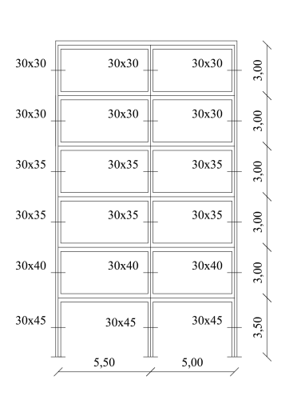
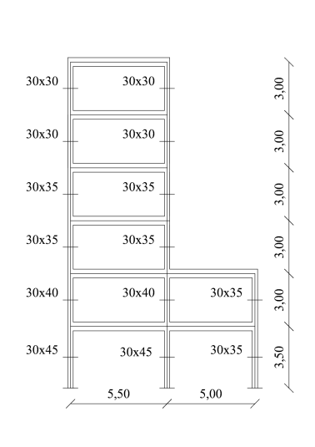
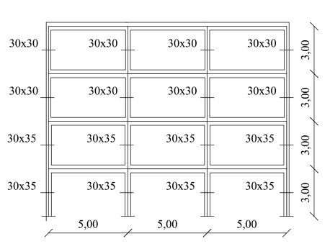
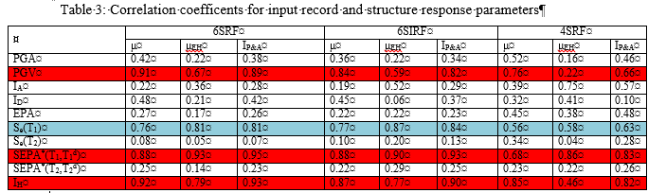
Intensity Measure vs. Engineering Demand Parameters (IM-EDP) Correlation Coefficients (CC) for MDOF
6SRF
6SIRF
4SRF
Weakly non linear system (q=2)
  The higher correlation coefficients are obtained for all the three structures and all the three global engineering demand parameters μ_{roof}, E_{H} and I_{P&A} for PGV, Se(T₁), I_{H} , SEPA
Notes:
the responses of three multistory frames, namely e 6 storey regular frame, … were investigates. Initially, weakly non linear systems ,charachterised by behavior factor q=2 are …in Table 3…

Slide 15
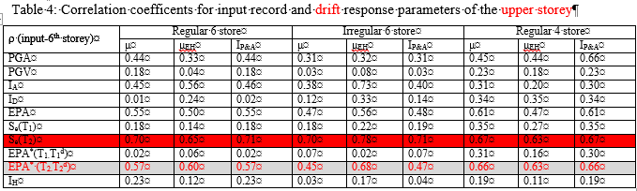
Intensity Measure vs. Engineering Demand Parameters (IM-EDP) Correlation Coefficients (CC) for MDOF
  It is noteworthy that the global response parameters do not give information about the demand distribution along the structure height, and the possible dependence of local demand by the response of the higher mode. Therefore, the correlation among the input Intensity Measure (IM) and the response parameters of the upper floor were evaluated; a dependence from input spectral characteristic corresponding to the second period of vibration T₂ are expected.
6SRF
6SIRF
4SRF
  It can be recognized that the elastic response spectrum at the second period of vibration T₂ are the parameters with highest correlation with the response.

Slide 16
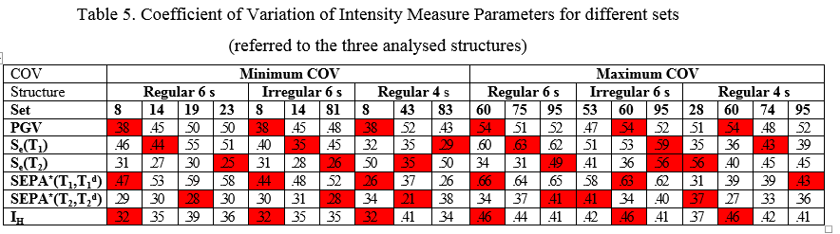
Scattering of the response
6SRF
6SIRF
4SRF
In order to stress the relation of the scattering of the response with the scattering of the Intensity Measure parameters of the input, for each IM Parameter and for each structure (since some input IMP is structure dependent ) the sets affected by the minimum and the maximum CoV of the IMP were identified
Notes:
The set of records identified by the number 8 was the one that showed the larger values of the COV for all the three parameters PGV, SEPA, and Housner index, while the set number 60 was characterize by the larger values of the COV of the three parameters. Lastly, set 24 was provided by the election criterion of Jervolino.
In the following the response of the structures to there three et of records will be analysed.

Slide 17
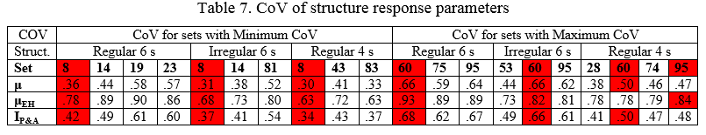
Scattering of the response
6SRF
6SIRF
Once the sets characterized by the minimum and maximum CoV were identified, the corresponding values of the CoV Engineering Demand Parameters were evaluated
4SRF
The results showed that in all the cases (with only one exception) the set characterized by the smallest value of the CoV of the SEPA and PGV produces the smallest value of the Engineering Demand Parameters.
Notes:
…..thus they are the most suitable for record selection finalized to reduce the scattering of the response of each sample

Slide 18
Record selection procedure on the basis of the minimum CoV of SEPA+ α PGV
Evaluation of the behavior factor q by push-over analysis
Selection of n records satisfying the relation
Step 1: in the database, all the accelerograms for which S_{e}[T₁]/(S_{e,target}[T₁]/q)<γ=1) are abandoned (If the number of remaning records are less than 20, γ is reduced with step 0.05 until the number of selected records are non smaller than n=20.
Selection of n records satisfying the relation
Step 2: among the n≥20 selected records, the n=20 records that in both the directions have the SEPA [and the S_{e}(T₂)] parameters closer to the SEPA [and the S_{e}(T₂)] target value (i.e. SEPA=a_{g,target}) are selected, in order to chose accelerograms that produce effects on the structure consistent with target response spectrum.
Notes:
The proposed selection procedure is based on the minimization of a performance parameter, obtained as linear combination of SEPA and PGS. In order to evaluate the SEPA the value of the behaviour factor have to be known; for new structure q value are chosen in the design phase, while for existing trucutre q value can be evaluated by pushover analysis; then in the records set, al the records for which the value of spectral acceleration at the fundamental period is smaller than the target spectrum divided by the behaviour factor are abandoned since an elastic response of the structure is expected.

Slide 19
Record selection procedure on the basis of the minimum CoV of SEPA+ α PGV
Selection of n records satisfying the relation
Step 3: for all the possible combinations of the chosen n=20 records in set of 7 records (77520 combinations), the mean values of the SEPA [and of S_{e}(T₂)] parameters in the x and y direction (E[SEPA(X)] and E[SEPA(Y)]) are evaluated. Among these combinations, only those for which the mean values of the SEPA parameters is within a prefixed confidence interval with the target value are selected (±10%) in order to ensure the required compatibility with the target spectrum
possible combination of 7 records

Slide 20
Step 4: Taking into account that the parameters SEPA and PGV are chosen as the most effective for input selection, the set characterized by the smallest value of the linear combination of the combined (SRSS for x and y direction) Coefficient of Variation (COV) of the SEPA and PGV parameters is chosen, i.e. the set with the smallest value of
possible combination of 7 records
Selection of the set of records
Taking into account that the parameter PGV is less correlated for weakly non linear systems (q=2) and strongly correlated for short period (T<T_{C}) structures with strong non linear behavior (q=5), structures for which the parameter SEPA is not so strongly correlated with the response as much as for other structures, α =0.1 q is advised in order to enlarge the role of PGV for strongly non liner systems
Selected set of records

Slide 21
Efficiency of selection criterion for non linear SDOF structures :
Mean value of Ductility demand μ for
The mean value of the ductility demand for q=2 and q=5 obtained modeling the seismic input by the selected set of accelerograms (EPA+ α PGV) is compared against curves obtained by a selection criterion (Iervolino et al. 2009) based on spectral matching.
The figure prove that the proposed procedure provide a set of accelerograms that induces in the structure a mean value of the ductility demand similar to that of a set chosen according the requirement of the codes, i.e. the proposed procedure provides accelerograms that are “compatible” (by the value of the SEPA parameters) with the target response spectrum.

Slide 22
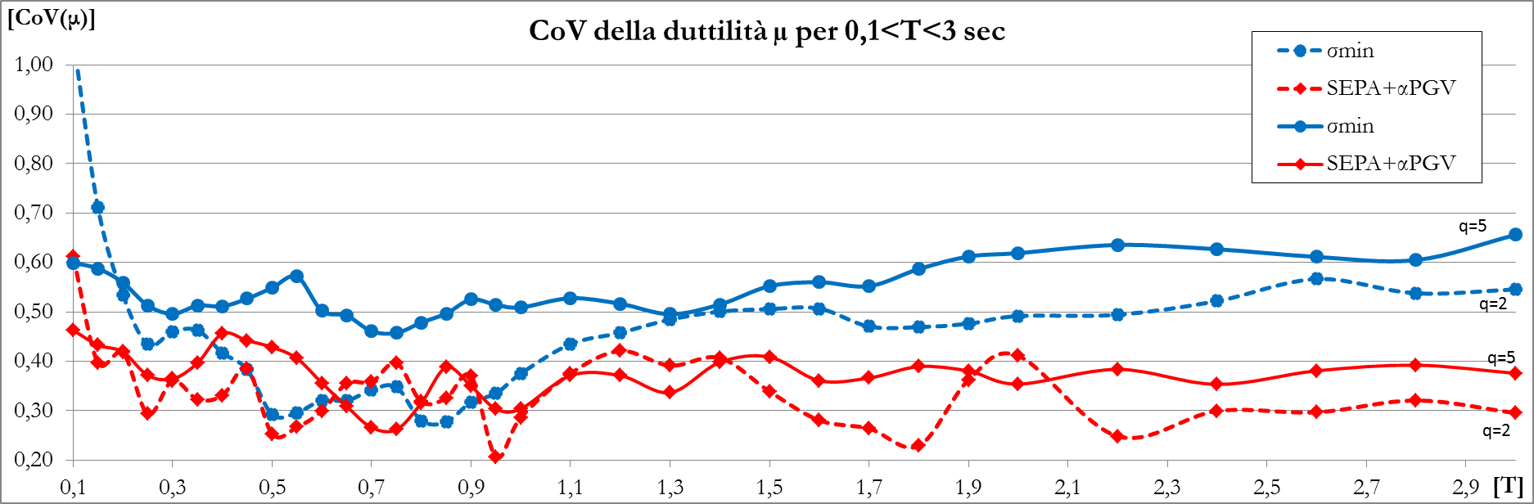
Efficiency of selection criterion for non linear SDOF structures :
CoV of ductility demand for T<3
The spectra of the COV of ductility demand obtained by SRSS combination of the values in x and y direction) for the two values of the behavior factor q=2, and q=5, for the set of accelerograms selected by the proposed criterion are compared with those pertaining to the (Iervolino et al. 2009) selection criterion.
The curves prove that the COV of ductility demand obtained with the proposed procedure is 30-40% smaller than that obtained by the selection criterion in (Iervolino, 2009), except for system with very weak non linear behavior (q=2) and 0.4 sec≤T≤0.9 sec, where the curves are very close each other.

Slide 23
Efficiency of selection criterion for non linear SDOF structures :
CoV of dissipated energy for T<3
A similar reduction of the CoV of the dissipated energy is obtained.

Slide 24
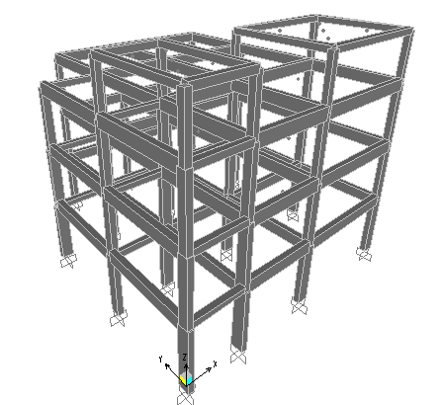
Efficiency of selection criterion for spatial MDOF structures :
T_{1X}=0.71; T_{1Y}=0.55;
T_{2X}=0,35; T_{2Y}=0.32;
q_{X}=1.59; q_{Y}=1.75
  Adapting the procedure to spatial frames, the proposed criterion allows one to reduce the CoV of the response parameters
Notes:
The efficiency of the selection criterion for MDOF structures is proved analizing the response of a 4 storey spatial r.c. frame, comparing the response for set of records n°24, and a new set of record obtained adapting

Slide 25
CONCLUSIONS
  The spectra of correlations among several Intensity Measure Parameters (IMP)s and cinematic, and energetic response parameters, and damage indexes, were evaluated for hysteretic SDOF system.
  In this context a new IMP, namely the Structure Effective Peak Acceleration (SEPA), is defined.
  The numerical analyses showed that the SEPA and PGV parameters are the most correlated with the structure response. The conclusion were confirmed by analyses performed on three RCMRF.
  Then, a procedure for selection of 7 couple of records (x and y directions), compatible in general sense with the target spectrum, and characterized by the minimum scattering among the structure responses to each accelerograms, has been proposed.
  The procedure is computational efficient, since in the selection process, the number of records to be considered is progressively reduced, using for the grouping into 7 records, only those that are effective for the purpose to be obtained.
  The procedure has been applied for record selection used for non linear response history analyses of SDOF e MDOF structures, proving the ability of being consistent with the chosen response spectrum and reducing the scattering of the response of each accelerogram.

Slide 26

…Thank you for your kind attention

